Slide 1

Intellera
A Hardware Based Acceleration of Matrix MAC Processor
Team Members:
2020414 Mr. Saad Khan
2020217 Ms. Mahnoor Maleeka
2020487 Mr. Zaeem Shakir
Supervisor
Dr. Fahad Bin Muslim Co-supervisor
Dr. Taj Muhammad
Faculty of Computer Sciences and Engineering Ghulam Ishaq Khan Institute of Engineering Sciences and Technology, Pakistan
Notes:
1

Slide 2
Evaluation Criteria of title defense
Rubrics | PLO1 | PLO2 | PLO8 | PLO12 | Marks
Problem statement clearly defined |  | ✓ |  |  | 5
Motivation/Justification/Ethical Impact |  |  | ✓ |  | 5
Literature Review |  |  |  | ✓ | 5
In-depth engineering/computing knowledge required | ✓ |  |  |  | 5
Involve at least one of the following attributes: wide-ranging/conﬂicting technical issues, no obvious solution, infrequently encountered issues, diverse groups of stakeholders, or component parts/sub-problems. |  |  |  |  | 5

Slide 3
Problem Statement: Hardware-Based Acceleration of Matrix MAC Operations in RISC-V Processor
The increasing demand for efficient matrix manipulation in scientific computing, machine learning, and signal processing necessitates innovative solutions to enhance performance and reduce execution time.
Matrix MAC operations, being computationally intensive, often pose bottlenecks on traditional processors.
This project aims to address the need for a hardware-based acceleration solution by designing a specialized hardware accelerator and a RISC-V based processor with a custom instruction set architecture (ISA) tailored for matrix MAC operations.
By leveraging parallel processing, optimized algorithms, and hardware acceleration, the proposed solution aims to overcome the limitations of traditional processors and significantly improve performance and power efficiency.
The project involves comprehensive research, algorithm analysis, hardware design, and FPGA implementation.

Slide 4
Identified Problem Area
Problems:
ML & DL algorithms require numerous operations, with matrix multiplication (MAT-MUL) being a common and computationally intensive primitive.
Processors are not optimized for matrix multiplication, resulting in slow performance.
ML hardware, such as GPUs and TPUs, are power-hungry and expensive.
Conventional Solution:
Tesla's full-self driving chip, Google's TPU, and Nvidia's NVDLA, utilize hardware accelerators to speed up ML/DL operations, particularly matrix multiplication.
ML/DL models are constantly evolving, requiring programmable hardware for flexibility and adaptability.

Slide 5
Proposed Solution:
Creation of a RISC-V based processor which has Matrix multiplication capabilities and isn’t power hungry.
Our aim is to design and implement a RISC-V based processor on an FPGA with hardware accelerators for efficient matrix manipulation.
A custom instruction set architecture (ISA) optimized for matrix operations such as multiplication and addition.
Additionally, pipelining techniques will be employed to improve processor performance and speed.

Slide 6
Project Overview
Problems: As previously discussed in the Presentation.
Conventional processors are not optimized for machine learning and lack hardware support for efficient matrix MAC operations.
Type of project: Research + Hardware + Software
Goal: A RISC-V processor with Matrix MAC Capabilities.
Notes:
A problem statement is a concise description of an issue to be addressed or a condition to be improved upon. It identifies the gap between the current state and desired state of a process or product. Focusing on the facts, the problem statement should be designed to address the Five Ws.

Slide 7
Motivation/Justification/Ethical Impact/Socio-economic Impact
Total marks 5 This slide must be present in your presentation During presentation you will read this slide

Slide 8
Justification:
Increasing demand for ML & DL.
Matrix multiplication is a fundamental operation in many ML/DL algorithms.
Conventional processors are not specifically designed for matrix MAC operations.
Hardware accelerators demonstrate the benefits of specialized hardware for matrix operations.
Motivation :
Explore hardware and software co-design techniques.
Understand the relationship between architecture and algorithm performance.
Enable faster and more energy-efficient ML/DL inference.
Make a significant impact in the field of machine learning and deep learning.

Slide 9
Socio-Economic & Ethical Impact:
Enhanced ML/DL performance enables breakthroughs in healthcare, finance, and autonomous systems.
Faster and accurate ML/DL models improve decision-making in disease diagnosis, fraud detection, and risk assessment.
Project contributes to job creation and skill development in ML/DL acceleration.
On-device processing addresses privacy concerns and reduces data transmission risks.
Optimized ML/DL reduces energy consumption and environmental footprint.

Slide 10
Short Literature Review
Total marks 5 This slide must be present in your presentation During presentation you will read this slide

Slide 11
Literature Review:
Existing systems employ specialized co-processors, FPGA-based accelerators, and custom instruction set architectures.
Systems like the Matrix Processor Unit (MPU) utilize custom instruction sets for improved performance.
FPGA-based accelerators, such as the Xilinx Virtex-7 FPGA-based matrix multiplier, achieve high throughput and low latency.
These approaches aim to enhance execution speed and power efficiency of matrix operations, including matrix MAC.
Papers:
Yunji Chen, Tianshi Chen, Zhiwei Xu, Ninghui Sun, and Olivier Temam. 2016. DianNao family: energy-efficient hardware accelerators for machine learning. Commun. ACM 59, 11 (November 2016), 105–112. https://doi.org/10.1145/2996864
A. Shawahna, S. M. Sait and A. El-Maleh, "FPGA-Based Accelerators of Deep Learning Networks for Learning and Classification: A Review," in IEEE Access, vol. 7, pp. 7823-7859, 2019, doi: 10.1109/ACCESS.2018.2890150.
M. Ali and D. Göhringer, "Application Specific Instruction-Set Processors for Machine Learning Applications," 2022 International Conference on Field-Programmable Technology (ICFPT), Hong Kong, 2022, pp. 1-4, doi: 10.1109/ICFPT56656.2022.9974187.
Arrow: A RISC-V Vector Accelerator for Machine Learning Inference. https://arxiv.org/abs/2107.07169

Slide 12
Novelty in your project
Design of a RISC-V based processor with custom instruction set architecture optimized for matrix MAC computations.
Incorporation of dedicated hardware accelerators.
Overcoming limitations of traditional processors.
Superior performance and power efficiency compared to existing systems.
Comparison Table: Existing Systems vs. Proposed System
System | Approach | Advantages | Limitations
Matrix Processor Unit | Custom instruction set | Improved performance, parallelism | Limited scalability, architecture-specific
FPGA-based Accelerators | FPGA-based implementation | High throughput, low latency | Design complexity, resource utilization
Proposed System | RISC-V based processor | Custom ISA, optimized for matrix MAC | Requires FPGA implementation, evaluation

Slide 13
Dataset Description
ONLY FOR ML/AI/Computer Vision/Research Projects

Slide 14
Dataset(s) Description
At present, our project does not require a specific dataset as its primary focus is on making ML and DL algorithms faster.
We are primarily focused on optimizing the underlying hardware and designing efficient matrix MAC operations.
Our project is aimed at making ML and DL algorithms faster.
After result analysis of our project, we will use and incorporate a real NN architecture such as mobile net in our project.
We will discuss datasets later-on that aligns with our project.

Slide 15
In-depth Engineering/ Computing Knowledge
Total marks 5 This slide must be present in your presentation During presentation you will read this slide

Slide 16
In-depth Engineering/Computing Knowledge
In-depth engineering and computing knowledge is crucial for project success.
Custom instruction set architecture (ISA) optimization for matrix MAC operations.
Development of a RISC-V based processor with a 32-bit instruction set architecture.
Implementation of the design on an FPGA.
Designing dedicated hardware accelerators.
Feasibility analysis for System-on-Chip (SoC) development.
Expertise in computer architecture, microarchitecture, digital logic design, HDLs, FPGA implementation, algorithm optimization, and system-level integration is required.
Ensuring project success and creating an efficient hardware-based accelerator for matrix MAC operations.

Slide 17
Involve at least one of the following attributes: Wide-ranging/conﬂicting technical issues, no obvious solution, infrequently encountered issues, diverse groups of stakeholders, or component parts/sub-problems.
Total marks 5 This slide must be present in your presentation During presentation you will read this slide

Slide 18
Attributes:
wide-ranging/conﬂicting technical issues:
The project may face diverse technical challenges such as optimizing the custom instruction set for matrix MAC, parallelization, data dependencies, power-performance trade-offs.
no obvious solution:
Some technical challenges may lack straightforward solutions, requiring iterative design, performance analysis, and experimentation for effective resolution.
infrequently encountered issues:
Unexpected hardware limitations, FPGA constraints, software compatibility, and component interactions may pose infrequent technical challenges, requiring thorough debugging and troubleshooting.
diverse groups of stakeholders:
Engaging and managing stakeholders including supervisors, faculty, experts, and potential users is crucial for gathering feedback and aligning project goals.
component parts/sub-problems:
The project can be divided into component parts such as custom ISA design, RISC-V processor development, hardware accelerators, integration, FPGA implementation, and performance evaluation, requiring systematic approach, teamwork, and project management.

Slide 19
Deliverables, Timeline & Justification of Workload Distribution
Include a set of concrete (and not abstract) deliverables along with a Gantt chart.
Also, clearly justify the workload distribution among the group members.

Slide 21
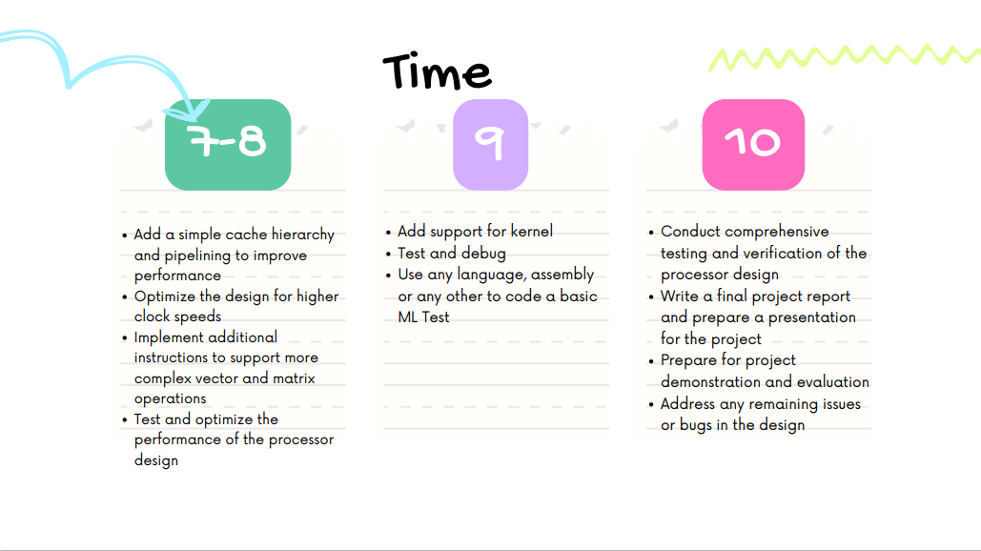

Slide 22
GANTT CHART
Deliverables | 2023 - 2024
 | J | F | M | A | M | J | J | A | S | O | N | D | J | F | M | A | M | J | J | A | S | O | N | D
Project Proposal
Design Specification
Verilog/VHDL Code
Simulation Results
FPGA Implementation:
Performance Analysis
Final Report:
Presentation:
1/3
2/3
3/3
1: Verilog code completion and testing.
2: FPGA implementation.
3: Performance analysis on FPGA.

Slide 23
Work Distribution
Saad:
Verilog code
FPGA implementations
ISA designing
Open Lane
Mahnoor:
Verilog code
FPGA implementations
ISA designing
Documentation
Zaeem:
Verilog code
FPGA implementations
ISA designing
Pipelining

