Slide 1
Project proposals

Slide 2
Project proposals
Project includes:
Reading
Implementation
Evaluation
Short presentation
Submission of results

Slide 3
EduSAT
A SAT solver that is easy to understand and extend
~800 LOC
Supports
Incremental SAT via assumptions
Various decision heuristics

Slide 4
Your project with EduSAT
Optimize as much as you can …
In the next few slides we will see various suggestions

Slide 5
Change decision heuristic
Measure the activity of variables in learning new clauses relative to others, when the variable is assigned*
* Based on: Learning Rate Based Branching Heuristic for SAT Solvers (SAT 2016)

Slide 6
Add LBD information about clauses
LBD (“Glue”) -- the # of decision levels in the clause*.
Use it to improve
Decision strategy
Deletion strategy
clause shrinking
* Predicting Learnt Clauses Quality in Modern SAT Solvers, Gilles Audemard, Laurent Simon, IJCAI09

Slide 7
Add deletion strategy
Deletion of low-activity conflict clauses.
Requires:
Compute activity of clauses based on various measures.
Based on activity of variables in the clause
Based on LBD: the # of decision levels in the conflict clause.
Activate deletion periodically.
Notes:
May base on deletion strategy in other solvers.

Slide 8

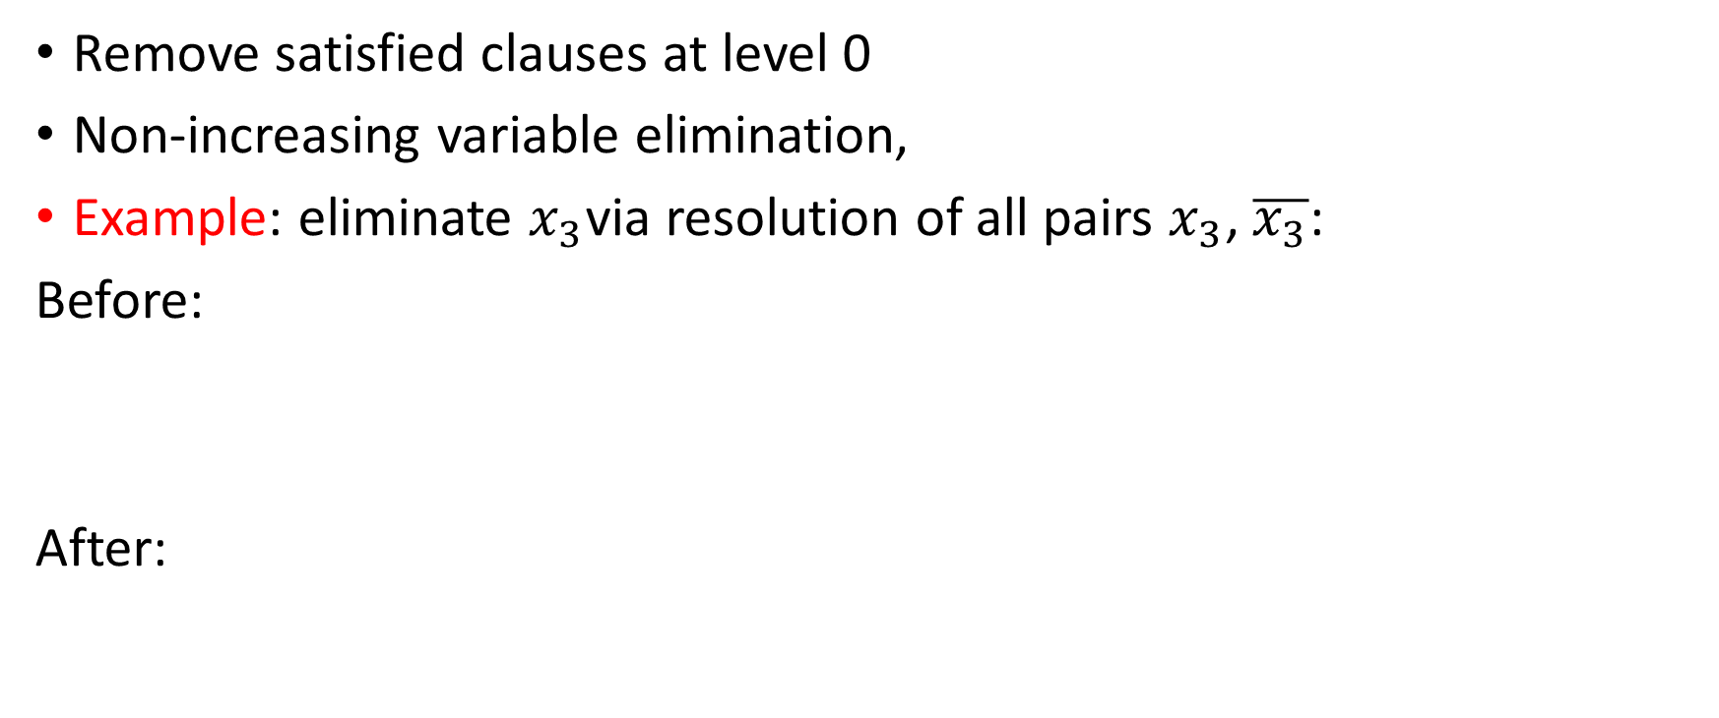

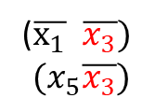
Add preprocessing
Remove satisfied clauses at level 0
Non-increasing variable elimination,
Example: eliminate $x_{3}$via resolution of all pairs $x_{3}$, $\overline{x_{3}}$:
Before:
After:
($x_{1}x_{2}x_{3})$
$$(x_{4}x_{3})$$
($\overline{x_{1}} \overline{x_{3}})$
$$(x_{5}\overline{x_{3}})$$
($x_{1}\overline{x_{1}})$
$$\left(x_{1}x_{2}x_{5}\right)$$
$$\left(\overline{x_{1}}x_{4}\right)$$
$$(x_{4}x_{5})$$
One less variable
One less clause

Slide 9
BCP order
Smart heuristics for BCP order:
e.g., Variables with higher activity score
BFS / DFS among variables
According to the LBD information:
if the learned clause is ‘bad’, re-run BCP with a different order.
Perhaps: process according to the highest decision level within the clause.

Slide 10

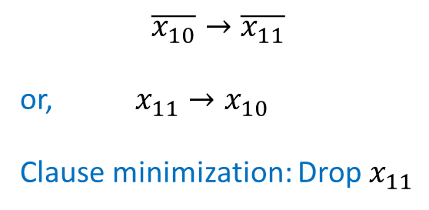
Minimization of conflict clauses
$reason\left(x_{3}\right)=ω_{4}$, $reason\left(x_{6}\right)=ω_{5}, …$
Local / General implication graph
x₁₀=0@3
x₂=1@6
ω₄
x₅=1@6
Learnt Conflict clause: (x₁₀ Ç :x₄ Ç x₁₁)
ω₁
ω₄
Decision
ω₃
ω₆
x₁=1@6
x₄=1@6
ω₆
κ
conflict
ω₃
ω₂
ω₅
ω₂
ω₅
x₆=1@6
x₃=1@6
$$\overline{x_{10}}→\overline{x_{11}}$$
or, $x_{11}→x_{10}$
Clause minimization: Drop $x_{11}$
x₉=0@1
x₁₁=0@3
Notes:
Redundant – does not change the satisfiability

Slide 11




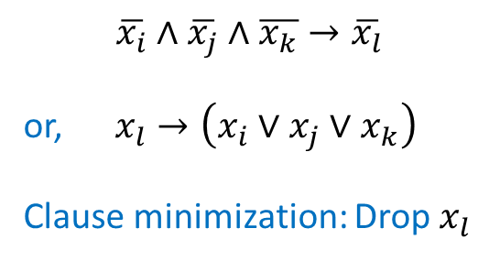

Learnt Conflict Clauses, and minimization
More generally: if we have a c.c. $c=(x_{0}∨⋯∨x_{n})$, and
... all reverse paths on the implication graph hit $c$ literals...
x₁₀=0@3
ω₄
x₅=1@6
ω₄
ω₆
x₄=1@6
ω₆
κ
conflict
ω₅
ω₅
x₆=1@6
$$x_{i}∈c$$
$$\overline{x_{i}}∧\overline{x_{j}}∧\overline{x_{k}}→\overline{x_{l}}$$
or, $x_{l}→\left(x_{i}∨x_{j}∨x_{k}\right)$
Clause minimization: Drop $x_{l}$
$x_{l}$=0@3
$$x_{j}∈c$$
$$x_{k}∈c$$
Notes:
Redundant – does not change the satisfiability

Slide 12
Other ideas …

Slide 13
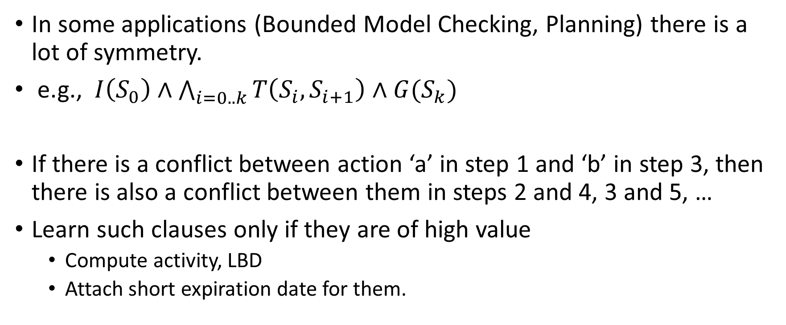
Learn more…
In some applications (Bounded Model Checking, Planning) there is a lot of symmetry.
e.g., $I\left(S_{0}\right)∧\bigwedge_{i=0..k}{T\left(S_{i},S_{i+1}\right)}∧G(S_{k})$
If there is a conflict between action ‘a’ in step 1 and ‘b’ in step 3, then there is also a conflict between them in steps 2 and 4, 3 and 5, …
Learn such clauses only if they are of high value
Compute activity, LBD
Attach short expiration date for them.
* Accelerating Bounded Model Checking of Safety Formulas. /Formal Methods in System Design, Vol. 24(1), Vol. 24(1), Jan 2004

Slide 14
Extend to support pseudo-Boolean constraints
Direct treatment of cardinality constraints.

Slide 15
Test the value of incrementality
Incremental solvers benefit from
Sharing conflict clauses
Sharing heuristic information
Depending on the increment, the heuristic information can perhaps be harmful. Can we find a test for when to activate it ?
Steps:
Take benchmarks from the incremental SAT competition
Also, fabricate incremental instances with varying levels of change.
Add control to reset each heuristic info. Check effect.
Measure change between instances, per variable.
What happens if we reset the heuristic info of those variables that changed.

