Slide 1
From photos to dense, accurate point clouds
Progress on the first half of the pipeline
8 photos
dense, accurate points (now)
lightweight mesh (later)
Fahad Qaseem Khawar · Prof. Zhong’s lab · meeting on Monday, Nov 16, 2026
Notes:
Thank you for the feedback on Nov 9. Today is about the first half of the pipeline: getting dense, accurate points from photos. I will show what limits quality, what I changed, answers to the four questions you asked, and four decisions I need from you. The lightweight mesh part comes later.

Slide 2
Two components; I am on the first half now
THE PIPELINE
NOW: dense, accurate points
LATER: lightweight mesh
8 photos
VGGT
TSDF fusion
Dense points
MeshFlow or HD-PEA
Lightweight mesh
renders with known true shape
depth map and camera for each view
8 depth maps averaged into one surface
the output of this stage
mesher, swappable
vs LATO and MeshCraft
Every part can be swapped: a better point source or a different mesher plugs in without rebuilding the rest.
Agreed on Nov 9: dense, accurate, high-fidelity points first. Lightweight output comes later from the mesher.
Notes:
Two components. First: photos to a dense point cloud, using VGGT and TSDF fusion. Second: a mesher, MeshFlow now and HD-PEA later, that turns the points into a lightweight mesh. As we agreed on Nov 9, I am focusing on the first half: dense, accurate, high-fidelity points. The final comparison is image to lightweight mesh, against LATO and MeshCraft.

Slide 3
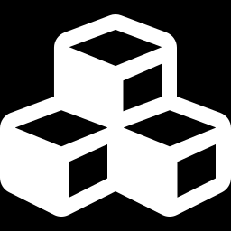
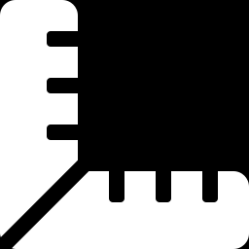

How I test it
SETUP
Known true shapes
MeshFlow’s scoring
Runs on a laptop
19 Thingi10K shapes rendered from 8 views (two rings, 518 px, textured)
7 development shapes and 12 held-out test shapes, never used for tuning
Chamfer and Hausdorff, ×100, 5,000 samples, shapes scaled to [−0.5, 0.5]
Plus F1 at 0.01 and 0.02, and normal consistency, as you asked
MacBook M4 Pro, 24 GB
Per object: VGGT about 25 s, TSDF about 20 s, MeshFlow about 50 s
Notes:
I render Thingi10K shapes myself, so the true shape is always known. 12 test shapes were picked automatically and never looked at before the runs, so the numbers are not tuned to them. Scoring follows the MeshFlow paper: Chamfer and Hausdorff at 5,000 samples, plus F1 and normal consistency. Everything runs on my laptop for now.

Slide 4
Three ways to turn VGGT’s output into points
POINT SOURCES
1
Filter each view
Threw away half the good surface
Keep a point only if 2 other views agree
before
VGGT output
2
TSDF fusion
One clean, closed surface
8 depth maps and cameras
Average all 8 depth maps in a 3D grid
new default
3
Gaussian centres
Accurate but rough, 3× vertices
Fit 3D blobs to the photos, keep their centres
tested
Each source goes into the same MeshFlow, so only the points change
Notes:
VGGT gives a depth map and a camera for each of the 8 photos. There are three ways to turn that into one point cloud. One: drop every point that two other views do not confirm; this was my first version and it threw away about half the good surface. Two: TSDF fusion, which averages all eight depth maps inside a 3D grid so their errors cancel; this is the new default. Three: Gaussian splatting, as you suggested; I fit blobs to the photos and use their centres.

Slide 5
The biggest loss is surface VGGT never recovers
WHAT LIMITS QUALITY
Mesh accuracy, F1@0.02 (higher is better)
0.98
48%
−0.10
0.88
−0.24
of the error gap: surface VGGT never recovers
0.63
0.63
0.00
−0.16
0.47
4%
comes from VGGT’s noise, almost nothing
Perfect points
Only what 8 cameras see
VGGT’s coverage
+ VGGT’s noise
Real VGGT cloud
So the fix had to recover more surface, not remove more noise
Notes:
To find the weak link, I started from perfect points and added one real problem at a time, scoring MeshFlow each time. Keeping only what the 8 cameras can see costs a little. Keeping only the patches where VGGT actually has points is the biggest drop: about half of the error gap. Adding VGGT's noise costs almost nothing. Numbers are means over the 7 development shapes. This pointed to TSDF fusion.

Slide 6
MeshFlow tolerates noise, not missing surface
STRESS TEST OF MESHFLOW
low / mid / high = noise 0.5 / 1 / 2% of size · outliers 1 / 5 / 10% · missing 10 / 25 / 50%. MeshFlow on damaged perfect points, 7 shapes.
Noise mostly adds vertices (MeshFlow reads bumps as detail); missing surface costs accuracy
Notes:
I damaged perfect points in three ways and ran MeshFlow each time. Noise barely changes accuracy, but the vertex count climbs from about 260 to 1,700, because MeshFlow treats bumps as real detail. Outliers hurt both. Missing surface steadily lowers accuracy. Our real VGGT clouds score F1 0.47 with about 1,700 vertices, so they behave like missing surface plus noise.

Slide 7
TSDF fusion: average the views so their errors cancel
THE FIX
Chamfer error
9.58 → 6.24
−35%
F1@0.02
3 of the 8 depth guesses, each a little off
one averaged surface
0.44 → 0.60
+0.16
Each block in a 3D grid keeps a running vote: in front of the surface or behind it. The surface is where the votes switch. A standard method from 1996, about 20 s per object.
Vertices
1,440 → 933
−35%
Better on all 12 held-out test shapes; now the default point source
Notes:
Every camera's depth guess is a little off. TSDF fusion keeps a 3D grid of small blocks; each view votes on whether a block is in front of or behind the surface, and the votes are averaged, so the errors cancel. Marching cubes then finds where the votes switch, and I sample points from that surface. On the 12 test shapes: a third less error, a third fewer vertices, better on every shape. Numbers are for the final MeshFlow mesh.

Slide 8
TSDF gives the best point cloud we have
POINTS FIRST: SCORED AGAINST THE TRUE SHAPE
Point source (12 test shapes) | Chamfer ↓ | F1@0.01 ↑ | F1@0.02 ↑ | Normals ↑ | Coverage | Points
Filtered VGGT points (before) | 8.37 | 0.38 | 0.56 | 0.81 | 43% | 186k
TSDF fusion (default) | 5.61 | 0.47 | 0.71 | 0.81 | 76% | 200k
Gaussian centres | 5.74 | 0.26 | 0.61 | 0.77 | 50% | 11.5k
Gaussian kernel samples | 5.80 | 0.39 | 0.68 | 0.76 | 80% | 200k
TSDF nearly doubles coverage (43% to 76%) and is the most accurate on Chamfer and F1
Gaussian kernels reach the most surface (80%) but are less precise, with rougher normals
Coverage = share of the true surface with a point within 1% of the object size
From now on the point cloud is the main result; MeshFlow meshes are a secondary check
Notes:
As you asked on Nov 9, I now score the point cloud itself against the true shape, with MeshFlow's protocol. On the 12 test shapes, TSDF is the best: Chamfer 5.61, F1 at 0.01 of 0.47, and it covers 76% of the surface instead of 43%. Gaussian kernel samples cover the most surface, 80%, but are less precise.

Slide 9
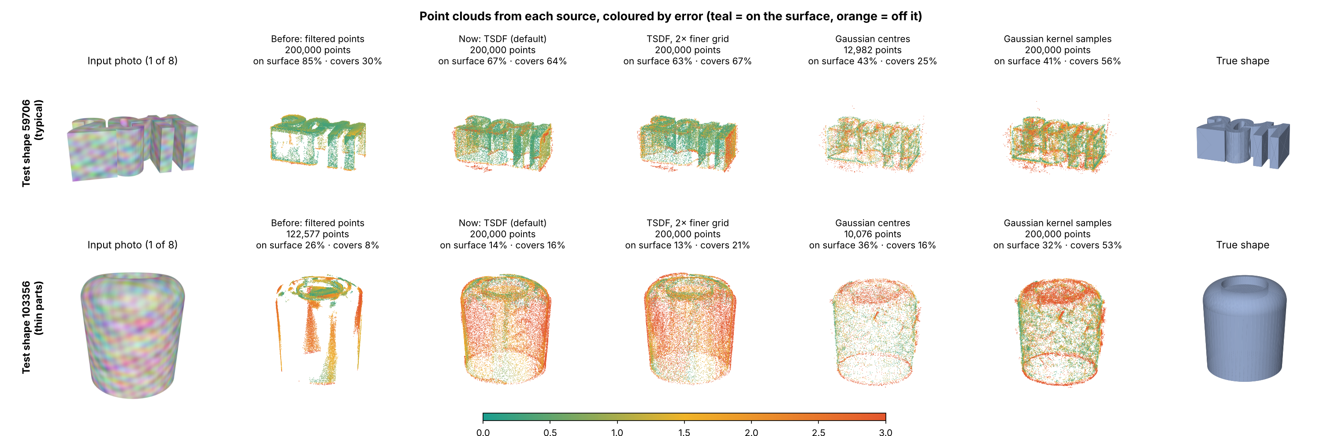
What the point clouds look like
POINT CLOUDS, COLOURED BY ERROR
Teal = on the true surface, orange = 3% of the object’s size away. “On surface” and “covers” use a 1% distance, computed for this picture only.
TSDF fills the object; on thin walls it drifts off, and Gaussian kernel samples stay closer
Notes:
Each point is coloured by its distance to the true surface. Top, a typical test shape: the old filtered points are accurate but leave big holes; TSDF fills the object. Bottom, a shape with thin walls: TSDF builds a full shell but it sits two to three percent off the wall, because its averaging band is thicker than the wall. Gaussian kernel samples cover the most and stay closer. This is why combining TSDF and kernels is my next step.

Slide 10
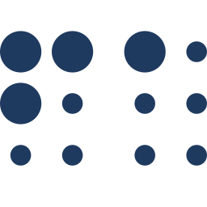
Finer TSDF voxels do not help with 8 views
DENSITY SWEEP
1M points instead of 200k: +0.3 s and the same accuracy; only a denser cloud (all-points recall 0.47 to 0.49).
The limit is VGGT’s depth maps, not the fusion grid; the default stays at voxel 0.005
Notes:
I tried finer TSDF grids. Twice as fine: accuracy about the same, but normals get worse, because the finer grid turns VGGT's depth noise into surface roughness instead of averaging it. Four times as fine: worse on everything, 27 seconds and almost 13 GB. Sampling 1 million points instead of 200,000 costs nothing but only makes the cloud denser, not more accurate. So better depth maps, for example 16 views on the lab GPU, are the real lever.

Slide 11
Sampling across each Gaussian beats its centre
GAUSSIAN KERNEL SAMPLING
12 of 12
test shapes better than centres (F1@0.01 0.26 to 0.39)
80%
coverage, the most surface of any source
Centre only: one point per Gaussian
Kernel sampling: points spread by its shape and opacity
Trails TSDF on average, but wins on thin parts:
Shape (F1@0.01) | TSDF | Kernels
thingi_103356 | 0.14 | 0.37
thingi_77949 | 0.18 | 0.28
thingi_593381 | 0.24 | 0.33
Your Nov 9 suggestion: use the whole Gaussian, not just its centre.
Next: TSDF everywhere, plus Gaussian kernels where TSDF loses thin parts
Notes:
Instead of one point per Gaussian, I sample 200,000 points spread by each Gaussian's shape, weighted by opacity, as you suggested. It beats the centres on every test shape and covers the most surface. On average it is still less precise than TSDF, but on thin or detailed shapes it wins clearly, because TSDF's averaging band is wider than those thin parts. So the two complement each other; combining them is my next step.

Slide 12
After MeshFlow, TSDF still wins
SECONDARY CHECK: AFTER MESHFLOW
Point source (12 test shapes) | Chamfer ↓ | F1@0.02 ↑ | Normals ↑ | Vertices
Filtered VGGT points (before) | 9.58 | 0.44 | 0.81 | 1,440
TSDF fusion (new default) | 6.24 | 0.60 | 0.82 | 933
Gaussian centres | 6.44 | 0.58 | 0.74 | 2,920
Perfect points (ceiling) | 2.93 | 0.98 | 0.94 | 265
TSDF: a third less error and a third fewer vertices than before
Gaussian centres: about as accurate, but rougher normals and 3× the vertices
Caveat: the Gaussians were started from the TSDF points, so not a fully independent test
Notes:
Same 12 test shapes, same MeshFlow, only the point source changes. TSDF wins. Gaussian centres are about as accurate but make rougher surfaces and three times more vertices. Honest caveat: I started the Gaussians from the TSDF points, so it is not fully independent. This week I am also sampling many points across each Gaussian, not just its centre, as you suggested.

Slide 13
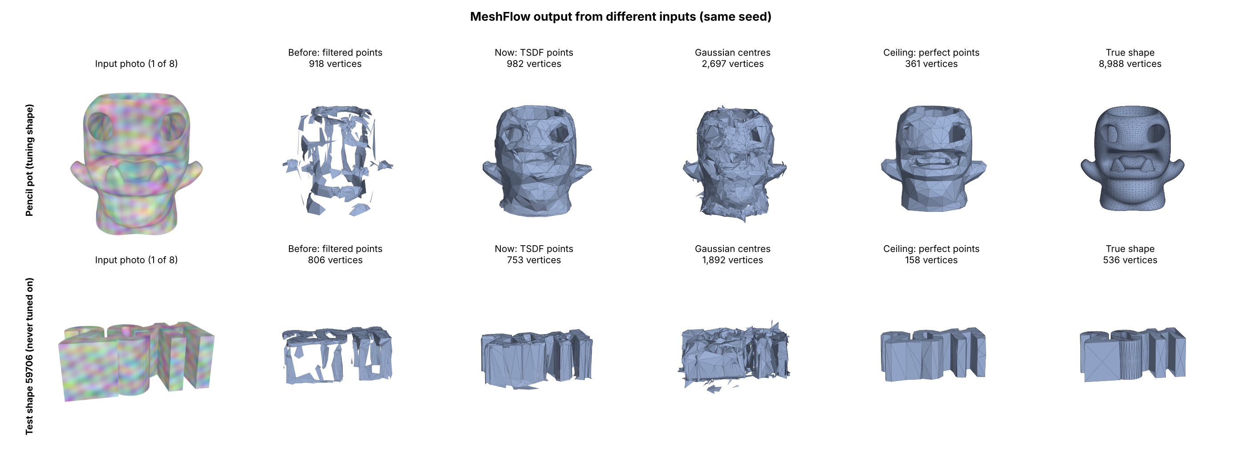
What the meshes look like
OUTPUTS
Every mesh is made by MeshFlow from a point cloud; the vertex drop is generation, not QEM
Notes:
Top: pencilpot, the tuning shape. Bottom: a held-out test shape. Filtered points tear the mesh. TSDF gives a whole object. Gaussian centres are rougher and heavier. Perfect points show what MeshFlow can do: 361 vertices for an object whose original has about 9,000. That reduction is MeshFlow generating a new artist-style mesh, not a simplification step like QEM.

Slide 14
MeshFlow reads only 4,096 points on a 32³ grid
WHAT I FOUND IN MESHFLOW’S CODE
random pick
snap to grid
Our cloud: up to 200,000 points
4,096 points
32 × 32 × 32 grid
Can it read more? Not without retraining: the network has exactly 4,096 input slots, and the 32³ grid is built into its trained weights.
For the mesher, accuracy and coverage matter more than density; a dense cloud still matters as this stage’s own output and for HD-PEA
Notes:
I checked MeshFlow's code. Whatever cloud you give it, it randomly keeps 4,096 points and snaps them to a 32 by 32 by 32 grid before generating the mesh. This is fixed by training: the network has exactly 4,096 input slots and the grid is in its weights, so I cannot raise it without retraining. So extra density does not reach the mesher; wrong or missing surface does. That is why I now score the point cloud directly as the main result, and why dense points still matter for HD-PEA later.

Slide 15
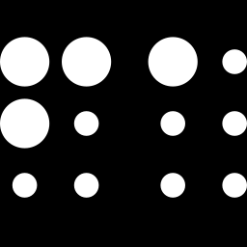


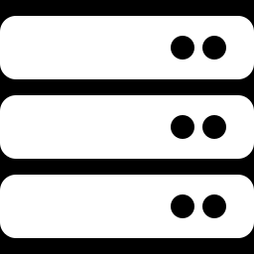
Not without retraining, so make the 4,096 count
CAN MESHFLOW READ MORE POINTS?
Pick an evenly spread 4,096
tested
Make those points accurate
in progress
Hand MeshFlow exactly 4,096 points spread out (farthest-point sampling) instead of a random pick, so thin parts are not skipped
TSDF, plus Gaussian kernels on thin parts: cleaner points matter more than more points
Dense cloud into HD-PEA
later
Retrain MeshFlow for more points
future idea
HD-PEA takes points and normals directly, so the full dense cloud pays off there
A larger input on the lab GPU would be a real mesh-side contribution
The network has exactly 4,096 input slots and the 32³ grid is built into its trained weights
Notes:
You may ask why not just feed MeshFlow more points. I checked the code: the network has exactly 4,096 input slots, one per point, fixed when it was trained, and the 32 cubed grid is part of its trained weights. Its num_verts option only nudges how many vertices the output mesh gets. So instead: hand it an evenly spread 4,096 so nothing is skipped, keep making the points accurate, use the full dense cloud in HD-PEA, and later, retraining MeshFlow for more points on the lab GPU could be a mesh-side contribution.

Slide 16
Even spreading gives the same accuracy, 4× the vertices
TESTED: AN EVENLY SPREAD 4,096
Input (12 test shapes) | Chamfer ↓ | F1@0.02 ↑ | Normals ↑ | Vertices
TSDF, random 4,096 (now) | 6.24 | 0.60 | 0.82 | 933
TSDF, evenly spread 4,096 | 6.31 | 0.60 | 0.83 | 3,862
TSDF + kernels, random 4,096 | 7.17 | 0.52 | 0.72 | 1,837
TSDF + kernels, spread 4,096 | 6.49 | 0.57 | 0.65 | 3,707
4×
the vertices for the same accuracy: MeshFlow keeps almost one vertex per input point when they are evenly spread
Accuracy is unchanged (within the seed-to-seed spread); MeshFlow likely expects random surface samples, as in its own code
The TSDF + kernel union is worse either way: about half its spread points sit off the surface, so it needs cleaning first
Keep MeshFlow’s own random pick; the next lever is cleaner points, not how they are picked
Notes:
I tested handing MeshFlow exactly 4,096 evenly spread points. It covers more of the grid, but the mesh is no more accurate, and the vertex count jumps from about 930 to about 3,860, almost one vertex per input point. MeshFlow's own code only feeds it random surface samples, which is probably what it was trained on, so evenly spread input looks unusual to it. Combining TSDF with Gaussian kernels is worse either way, because many kernel samples sit off the surface. So I keep the random pick, and the next step is cleaning the kernel points before combining.

Slide 17
Answers to your questions from Nov 9
FOLLOW-UP
1
How is the mesh downsized? QEM?
No simplification step. MeshFlow generates a new mesh, guided by the points, in the artist style it learned.
2
Marching cubes for mesh extraction?
Every mesh comes from MeshFlow. Marching cubes runs only inside TSDF, to build the surface I sample points from.
3
Why are the Gaussian-centre meshes bumpy?
From 8 views, splatting fits appearance, so many centres sit slightly off the surface; MeshFlow reads that as detail.
4
Why the ceiling column?
MeshFlow on perfect points: it shows the mesher is fine, so the gap is in the points.
Notes:
These are the four things I promised to check. Mesh extraction is consistent across the pipeline: it is always MeshFlow from a point cloud. The bumpiness is the splats sitting off the surface, not a missing extraction step.

Slide 18
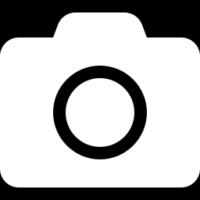

Next steps on the points side
NEXT
Clean TSDF plus Gaussian kernels
next
Kernel samples only where the TSDF surface is missing, with stray samples removed
16 views on the lab GPU
needs GPU
Better depth maps are now the main lever; the laptop fits 8 views
ShapeNet and Toys4K
requesting access
Render scripts are ready; both datasets need an access request
Dense output
your call
1M points cost nothing extra if you want a denser cloud
Notes:
The cheap points-side fixes are done: TSDF won, a finer grid does not help, kernels help on thin parts. Next is combining TSDF with kernels, then better depth maps from 16 views on the GPU. ShapeNet and Toys4K scripts are ready but both datasets need access, which I am requesting.

Slide 19
Five decisions I need from you
1
Dataset: ShapeNet, or Toys4K (MeshFlow’s own test set)?
2
Final baselines: LATO (March 2026) or LATO.2 (July 2026), plus MeshCraft?
3
Dense output: Switch the default to 1M points? Cheap, but denser rather than more accurate.
4
Camera focal length: Is using the known focal length acceptable? Phones record it.
5
Lab GPU: Access for 16-view runs; the laptop fits 8 views.
Notes:
Ask in this order. The dataset choice decides next week's work; the baseline choice decides the final comparison; the dense-output question is quick. Then focal length and the GPU.

