Slide 1
C++
Fahad Waheed
20I-0651

Slide 2
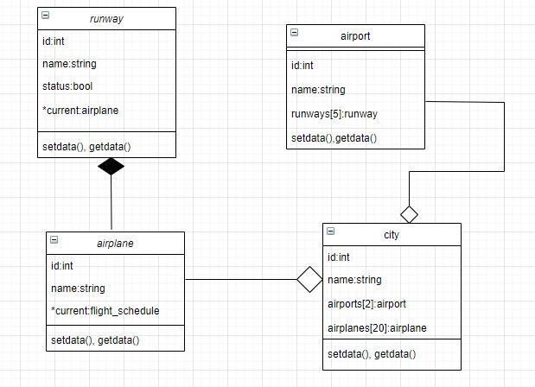
History
Look in the slide notes below for topics to consider talking about
airplane class is a composited of runway class, airplane is also aggregated of city class, and airport is aggregated of city class.
Notes:
Consider talking about:
Etymology
Standardization

Slide 3
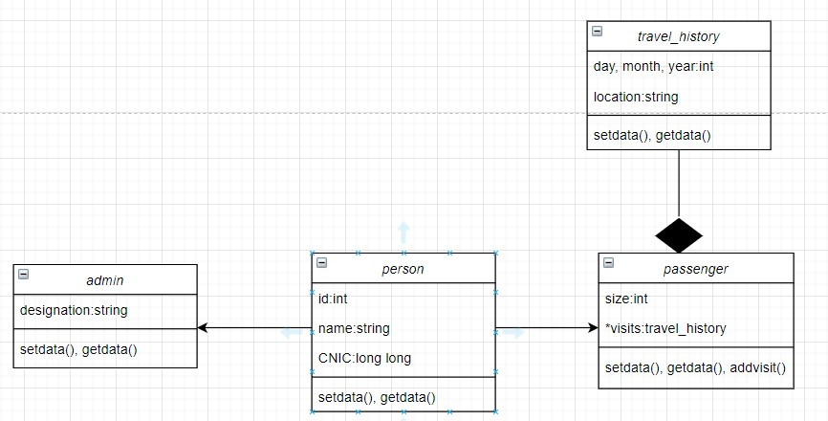
Language
Look in the slide notes below for topics to consider talking about
Person class is associated with admin and passenger class, and travel history is composited with passenger class
Notes:
Consider talking about:
Object storage
Templates
Objects
Operators and operator overloading
Polymorphism
Lambda expressions
Exception handling

Slide 4
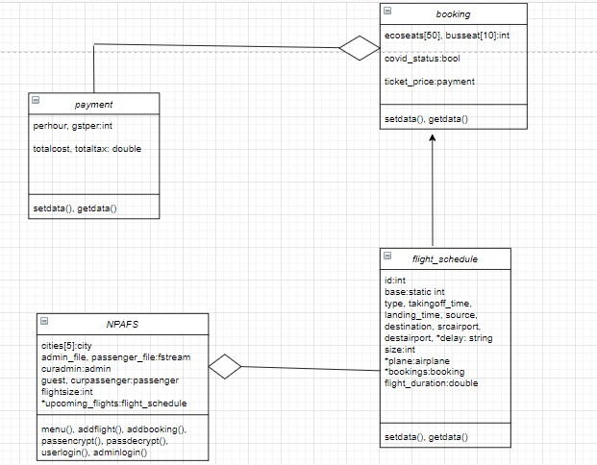
Compatibility
Look in the slide notes below for topics to consider talking about
Payment class is aggregated with booking class, booking class is associated with flight schedule class, and city, admin, passenger, flight_schedule is aggregated with NPAFS.
Notes:
Consider talking about:
With C

