Slide 1
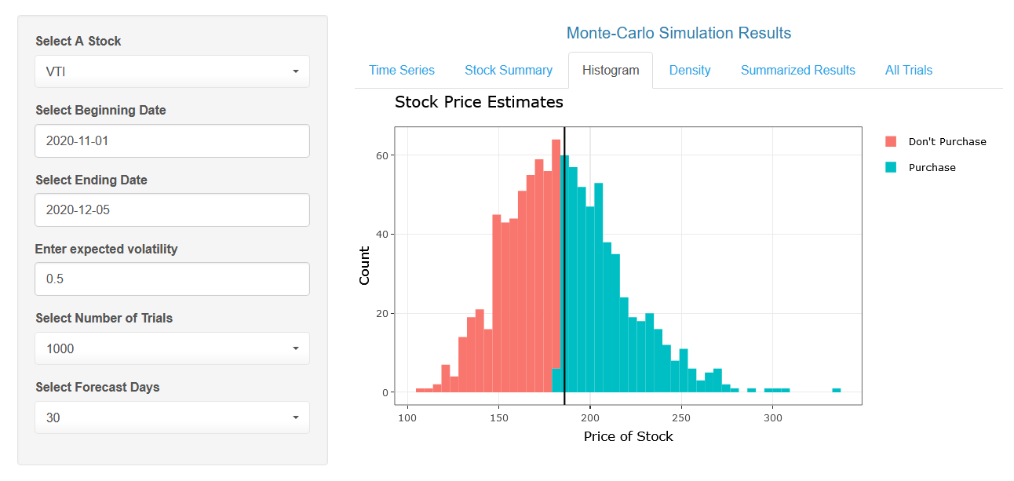
Stock price prediction APP
w/ Monte-carlo simulation

Slide 2
Situation Can a monte-carlo simulation model be useful for the purpose of investing in stocks?
Stocks in the S&P500 appear to display a high degree of randomness / stochasticity
A thoughtful investor might be interested in understanding the probability of a positive ROI
Simulation has applications in many areas including in the area of Finance for Stock price forecasting
This exercise shows an interactive software application that performs Monte-Carlo simulations based on a Stock’s historical performance
To judge the usefulness of the application, following questions appear relevant:
Can Monte-Carlo simulation be used to forecast a certain stock or bond?
Is the model reliable from an accuracy perspective?
Can we utilize such a simulation to inform us whether to buy shares of a company or not?

Slide 3
Input & Outputs
The model includes the following inputs that are dependent on the selected stock and date range. The user’s judgement is relevant when considering these inputs.
1) Mean Value of the Stock
2) Volatility (0.0 – 1.0)
The model generates a histogram, a data table and a statistical summary of the simulation results as far as the forecasted stock price is concerned

Slide 4
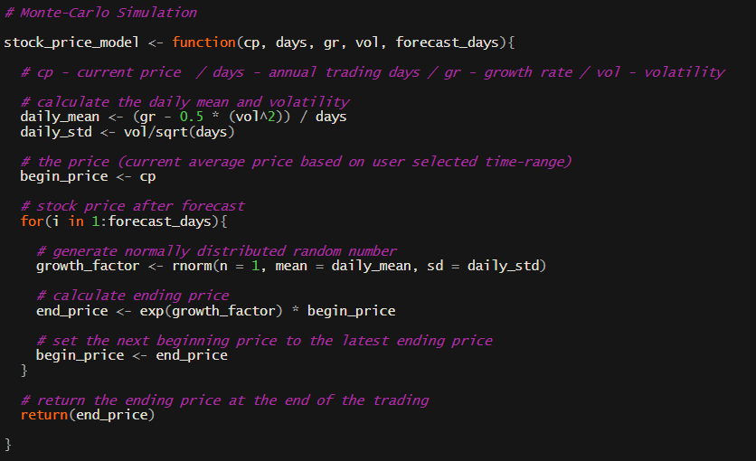
Structure / Logic of the application
The core function that drives the simulation considers the following aspects of a given stock:
Current Price (cp) – Mean value of a stock based on the date range selected
Trading Days (days) – 252 Days
Growth Rate (gr) – % Return based on the date range selected
Volatility (vol) – 50% (Default), however the user can enter another value
Forecast Days (forecast_days) – 30 days (Default), however a user can select another value
The growth rate is based on a lognormal distribution which considers the daily mean and daily volatility
This functionality is repeated multiple times to generate the selected number of trials
A snapshot of the function that is replicated multiple times to generate stock price simulation

Slide 5
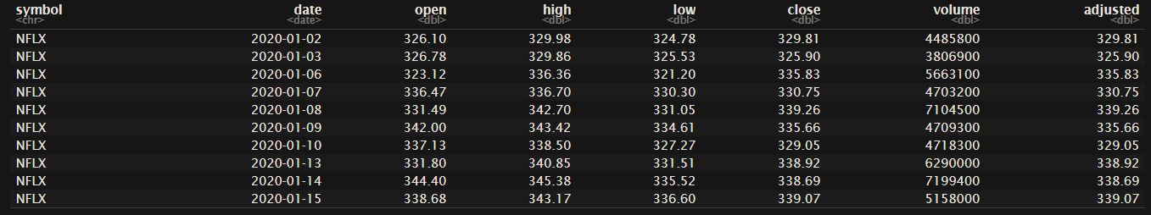
Data Source
Historical and Current Stock Price data is required to perform this analysis
There are various R Packages and API’s that provide financial data that is sourced from Yahoo, IEX, Quandl, Google Finance, etcetera
For this application, Quantmod Package in R was used to access daily stock prices for the selected stock
The data appears in a tidy format for all the trading days based on user’s selection
Adjusted stock price is used for calculation the average return and volatility of a stock

Slide 6

Access the app from the link below And Follow along:
https://fahadtaimur.shinyapps.io/MonteCarloSimulator/

Slide 7
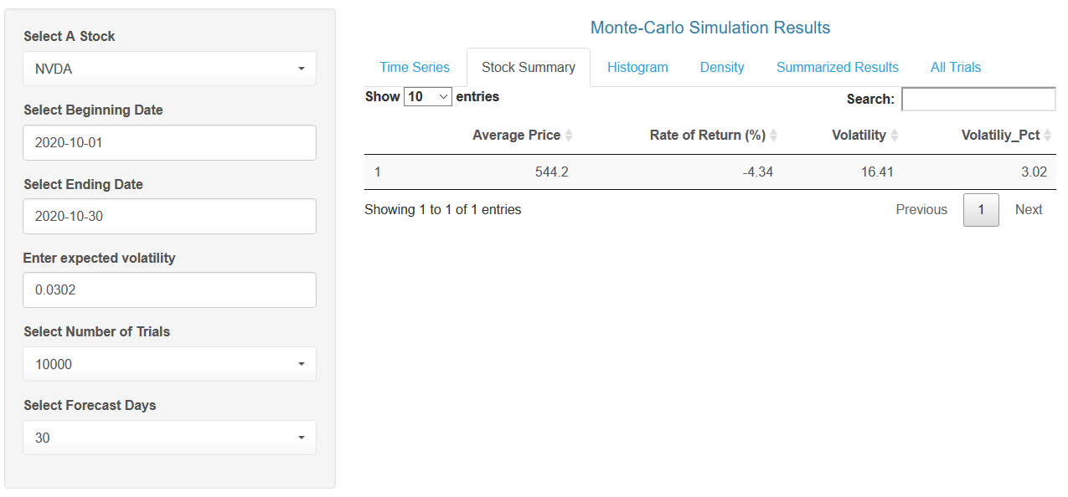
Follow along Example
Let’s say that on November 1st, 2020, you had to predict whether NVDA might be a profitable investment by December 1st, 2020. On October 30th, NVDA was trading at ~ $501 / share. You decide to use the entire month of October in your simulation model and you select the model parameters as shown on the left panel
The relevant assumption here is that the past performance is indicative of future performance
Results are shown on the next few slides
Stock Summary tab shows the Avg. Price, Rate of Return and Volatility % based on the Stock Ticker (NVDA) and the Beginning and Ending Days
The volatility on a percent basis was 3.02% or 0.0302 which is entered as input for simulation purposes. The user is free to enter a higher or lower volatility if they are so inclined

Slide 8
Key outputs
The outputs from the model can be used to answer the following questions:
Can Monte-Carlo simulation be used to forecast a certain stock or bond?
Can we utilize such a simulation to inform us whether to buy shares of a company or not?
Is the model reliable from an accuracy perspective?

Slide 9
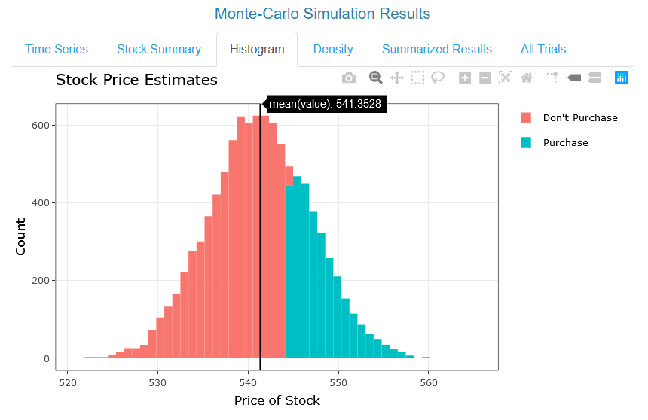
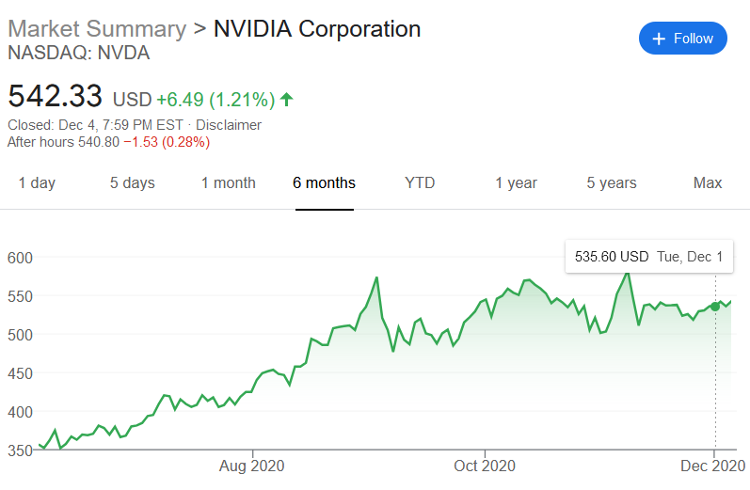
Can simulation be used for forecasting purposes? - mean predicted price vs. actual
The 30-day forecast for NVDA based on the inputs from the previous slide yields a mean stock price of ~ $541/ share. If you purchased NVDA on November 1st based on this model, you’d expect to incur a ~ $40 positive ROI per share by December 1st.
The stock price of NVDA was ~$535 / share on December 1st, 2020. Therefore, the actual gain was ~ $35 per share had you invested.

Slide 10
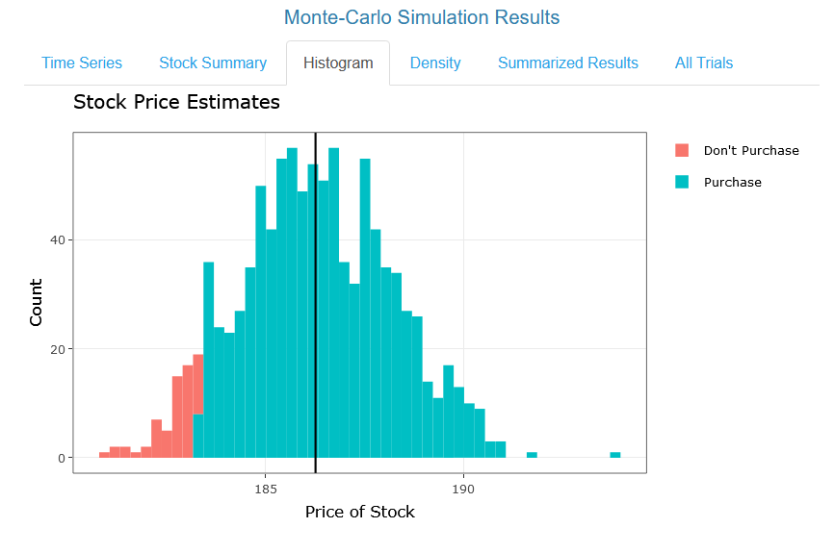
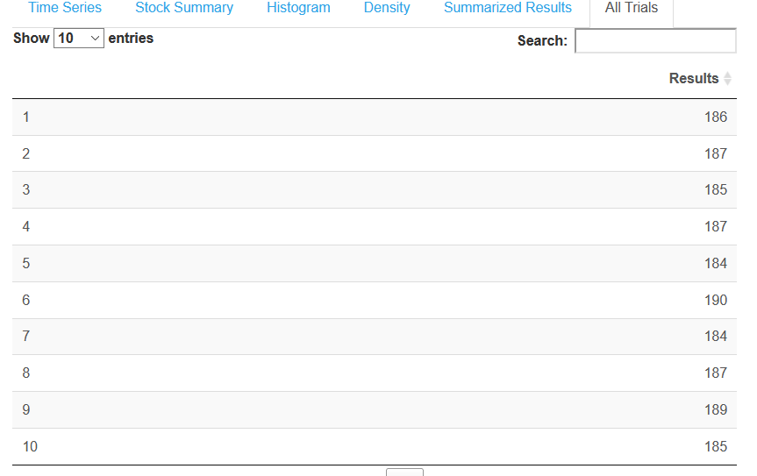
Can the simulation inform us whether to buy or not?
The histogram bar color is based on whether the trials yield a stock price greater than the average price of stock for the selected time-window.
The summarized results for all the trials can be generated as shown below:
The results from the individual trials can also be used to compute the probability of positive ROI.

Slide 11
Accuracy of monte-carlo stock simulations
The model was utilized for several other stocks based on the methodology shown in the previous slides. On a percent basis, the error varies from 0.3% - 6.8% for this small sample of stocks. The reality is that a much larger sample of the S&P500 should be tested and the application might cease to be useful when the market is highly volatile. For these selected stocks, investment based on the Monte-Carlo model would have resulted in a positive ROI even when the simulation over or underestimated the price.
Ticker | Price on October 30th, 2020 | Actual Price (Dec 1st, 2020) | Simulation Avg. Price (Dec 1st, 2020) | % Abs Error vs. Actual
WMT | 138.8 | 152.6 | 142.4 | 6.7%
AAPL | 108.7 | 122.7 | 116.4 | 5.1%
NVDA | 501.2 | 535.6 | 541.4 | 1.1%
SPY | 326.4 | 365.5 | 340.7 | 6.8%
BND | 87.3 | 87.9 | 87.6 | 0.3%

Slide 12
Future improvements
Monte-Carlo simulation appears to be a useful tool for the purposes of investing in stocks
It is not recommended to use it as the only source for guidance, however, it can be a useful tool in an investor’s arsenal
The application could potentially be improved with the use of AI to provide a user more guidance for selecting the appropriate date range and volatility inputs
The daily simulation results could be integrated as an indicator in an ML model that also takes other features into account such as seasonality

Slide 13
Source code:
https://github.com/fahadtaimur/Monte_Carlo_Simulation

