Slide 1
Bellman Ford Algorithm Implementation and analysis using Tkinker aND NETWORKX
GROUP MEMBERS:
Fahad Yousuf
Abdul Rafay
Huzaifa Asad
Muhammad Ali

Slide 2
Introduction
Welcome!
Today, we explore an engaging application designed for graph visualization and the Bellman-Ford algorithm.
This interactive tool leverages Tkinter for its user interface and NetworkX for effective graph manipulation.

Slide 3
Problem Statement
Our task was to create an interactive application that empowers users to visualize, manipulate, and analyze shortest path between source and destination node using the Bellman Ford Algorithm.
The application features a user-friendly interface for graph creation, real-life problem-solving, and the execution of the Bellman-Ford algorithm.

Slide 4
Application Overview
Key Components:
Tkinter Canvas for dynamic graph representation.
ttk widgets for an intuitive user interface.
Notable Features:
Generate predefined graphs.
Run the Bellman-Ford algorithm.
Solve real-life problems using graph optimization.

Slide 5
Bellman-Ford Algorithm (Methodology)
Understanding Bellman-Ford:
It is the algorithm for finding shortest paths in graphs.
It is critically useful for detecting negative weight cycles.

Slide 6
PSUEDOCODE
function BellmanFord(Graph graph, Vertex source):
// Initialization
for each vertex v in graph:
distance[v] = INFINITY
predecessor[v] = NULL
distance[source] = 0 // Relaxation for i from 1 to |V| - 1: for each edge (u, v) in graph:
if distance[u] + weight(u, v) < distance[v]: distance[v] = distance[u] + weight(u, v)
predecessor[v] = u // Check for negative cycles
for each edge (u, v) in graph:
if distance[u] + weight(u, v) < distance[v]: //Negative Cycle
return (distance, predecessor

Slide 7
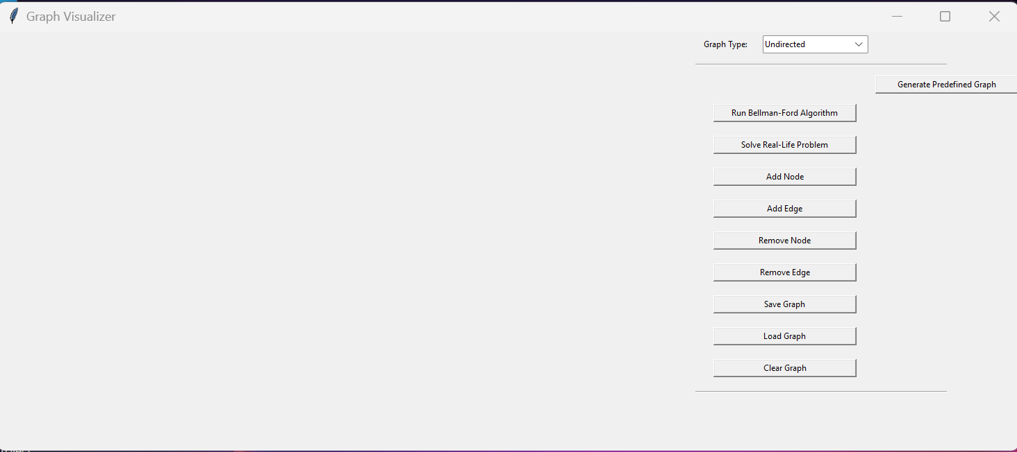
SCREENSHOTS
.

Slide 8
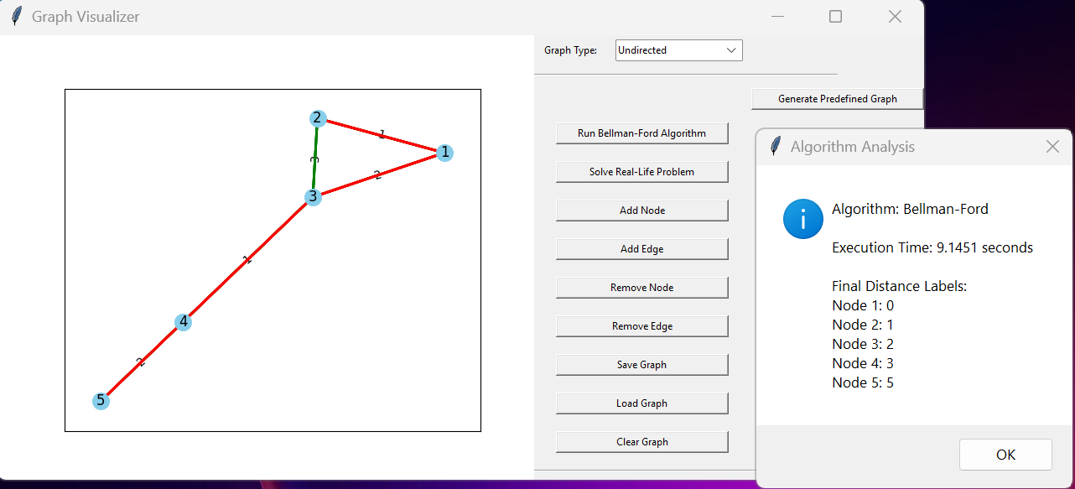
SCREENSHOTS
.

Slide 9
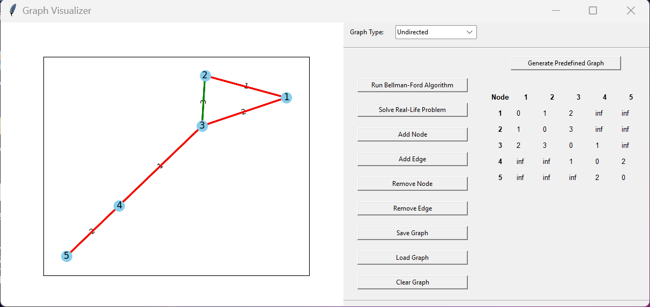
SCREENSHOTS
.

Slide 10
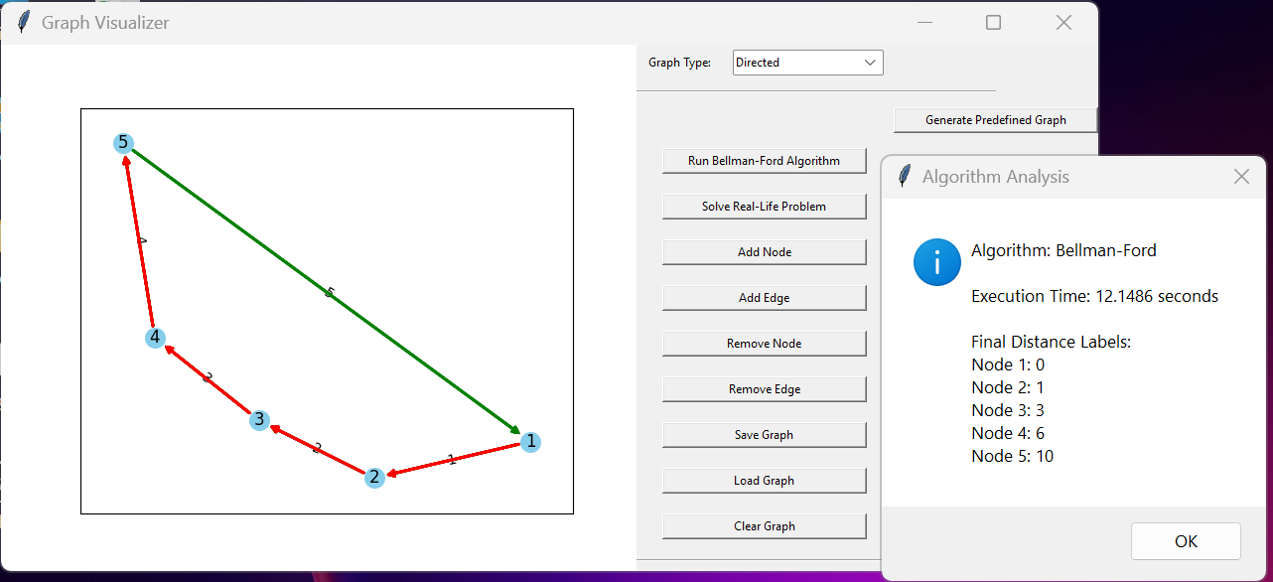
SCREENSHOTS
.

Slide 11
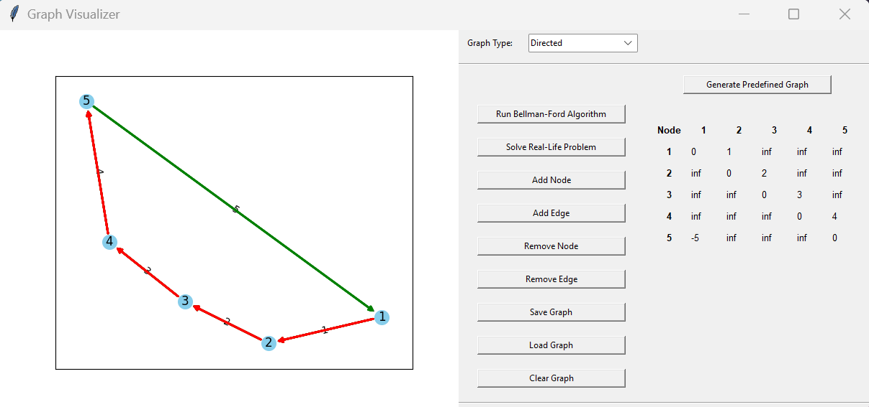
SCREENSHOTS
.

Slide 12
SUMMARY
The presented Python application is a Graph Visualizer that combines Tkinter for the user interface and NetworkX for graph manipulation. Key features include the ability to generate predefined graphs, run the Bellman-Ford algorithm for finding shortest paths, and solve real-life problems using graph optimization. The interactive UI allows users to manipulate the graph by adding/removing nodes and edges, visualize the Bellman-Ford algorithm in real-time, and save/load graphs. Overall, this tool offers a visually appealing and educational platform for exploring graph algorithms.

Slide 13
THANK YOU

