Slide 1
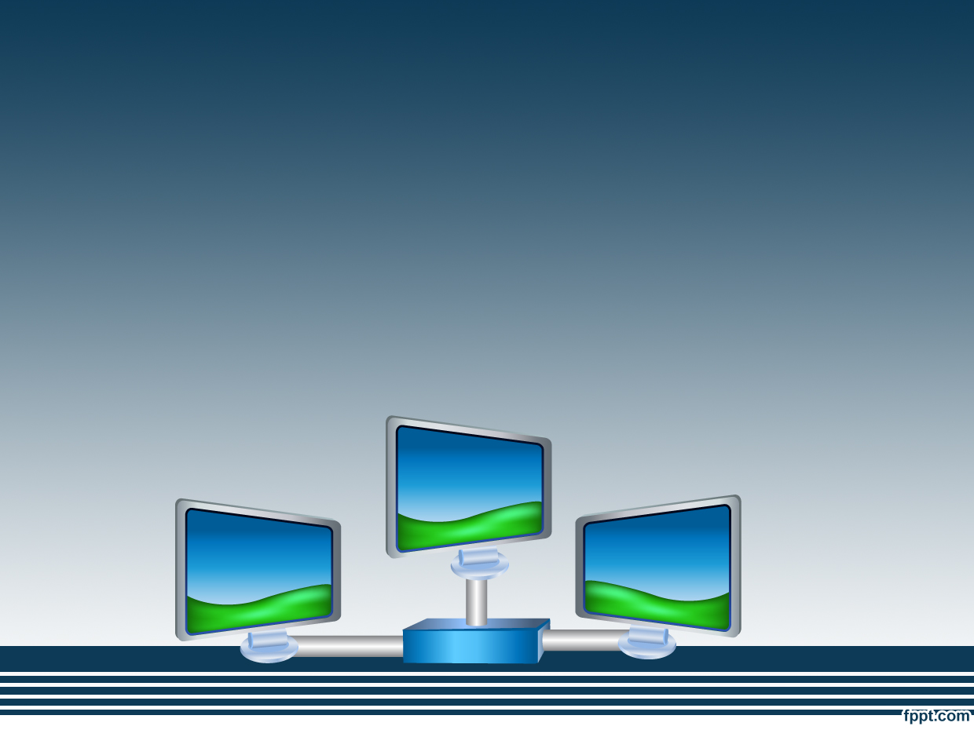
ZEST-WARE Welcomes You
Restaurant Automation
14:332:452
Group 8:
Shehpar Sohail • Fahd Humayun
Nathan Morgenstern • Raphaelle Marcial
• Ama Freeman •Alexander Dewey
• Dwayne Anthony

Slide 2
Who is ZEST-WARE for?
ZEST-WARE is meant to be used by privately-owned restaurants
It’s main features will be used by:
  Customers
  Manager
  Waiters
  Busboy
  Chef

Slide 3
Purpose of ZEST-WARE
It is designed to improve the collaboration of the employees and increase customer satisfaction
Its aim is to make time consuming and everyday tasks around the restaurant faster.
It is used to increase efficiency and overall income to the restaurant

Slide 4
ZEST-WARE eliminates out-of-date restaurant services and makes employees’ jobs easier
  Examples:
    Hosts do not have to physically update seating diagrams to view status of tables (completed through Customer Welcome Screen)
    Waiters do not have to continuously check the kitchen to see if meals are ready
    Waiters do not have to note down orders using the “pen and paper” method (completed through Customer Table Screen)
    Customers do not have to wait for waiter to place order or make a payment
    Manager does not have to go through tedious process of bookkeeping
    Manager does not have to keep track of which employees are working
    Employees do not have to punch cards (completed through punching into system with pin)

Slide 5
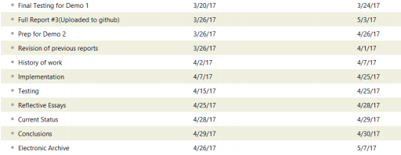
Plan for rest of semester:
Plans for final demo:
We plan to make our software better by:
  Adding more detailed items on the menu
  Adding the changing menu option that will allow the menu to be updated at any time
  Adding the financial records feature-to keep track of finances along with periodic reports of net revenue
  Adding the control music option that changes the mood in the restaurant

