Slide 1

Pemrograman Fungsional
Currying, Partial Evaluation and Composition
Ade Azurat
Senin, 28 September 2020
Mayoritas Slide bersumber dari: Paul Huldak, Haskell School of Expression

Slide 2
Diskusi Pekan 02: Too much Abstraction (Dwi, Supri)
multiply x y | isZero x || isZero y = 0 | isOne x = y | isOne y = x | greaterThanOne x && greaterThanOne y = x + multiply x (y-1)
isZero n = equals n 0 isOne n = equals n 1
sum a b = a + b
substract a b = a - b
times a 0 = 0
times a b = sum a a + (times a (substract b 1))

Slide 3
Diskusi Pekan 02: Data Abstraction (Rafif, Dwi)
data Time = Hour Integer | Minute Integer | Second Integer
data RGB = RGBInt Integer Integer Integer | RGBFloat Float Float Float | HexCode String | Red | Green | Blue | Cyan | Magenta | Yellow | White | Black
toFloat (RGBInt r g b) = RGBFloat (r/255) (g/255) (b/255) toInt Red = RGBInt 255 0 0 toFloat Red = RGBFloat 1.0 0 0

Slide 4
Diskusi Pekan 02: Monad? Abstraction? (Wulan)
do user <- getUser "pemfung" birthdate <- getBirthDate user getAge birthdate
Maybe Monad
case getUser "pemfung" of Nothing -> Nothing Just user -> case getBirthDate user of Nothing -> Nothing Just birthdate -> getAge birthdate

Slide 5
Diskusi Pekan 02: Computation by Calculation (Achir)
... kebenaran dari pemrograman fungsional dapat langsung dibuktikan terletak di paradigma bahasa pemrogramannya. Karena semuanya fungsi, maka fungsi-fungsi tersebut bisa otomatis di-unfold kemudian hasil akhirnya dapat terlihat sehingga dapat ditentukan kebenarannya.
Sedangkan untuk bahasa pemrograman yang imperatif, ini tidak dapat dilakukan secara alami di bahasa pemrogramannya. Kita perlu menerjemahkan kode imperatif tersebut ke bentuk yang lebih matematis, mungkin di kertas, lalu kemudian terjemahan matematisnya yang dibuktikan kebenarannya.

Slide 6
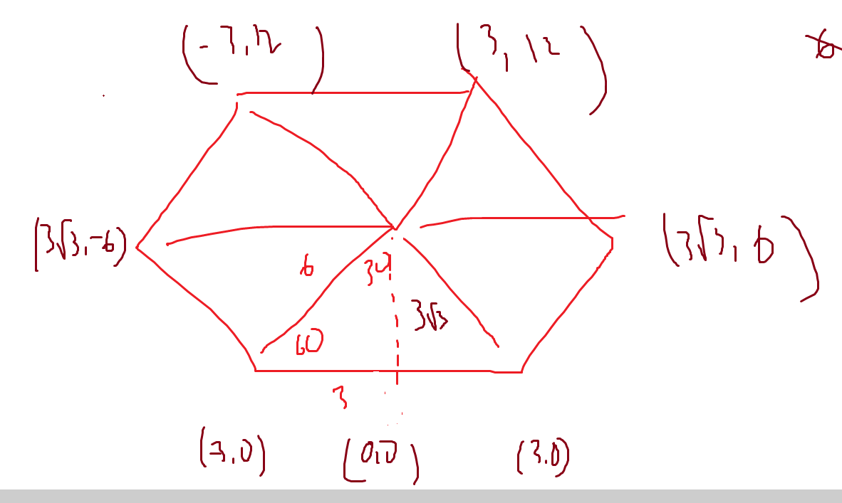
Diskusi Pekan 02: Algorithm design (Febri, Aji)
https://maxow.github.io/posts/computational-geometry-set-operations-on-polytopes.html
https://www.mathopenref.com/coordpolygonarea.html

Slide 7
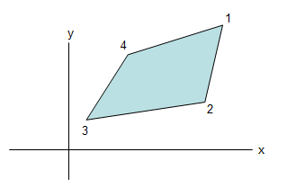

Diskusi Pekan 02: Algorithm Design (Bagas, Jo, Achir)
Apakah permasalahan sudah dimodelkan dengan benar?
Bila sudah bagaimana design algoritma, seberapa berbeda implementasi dengan model nya?
https://www.mathopenref.com/coordpolygonarea.html
https://rosettacode.org/wiki/Shoelace_formula_for_polygonal_area#Haskell

Slide 8
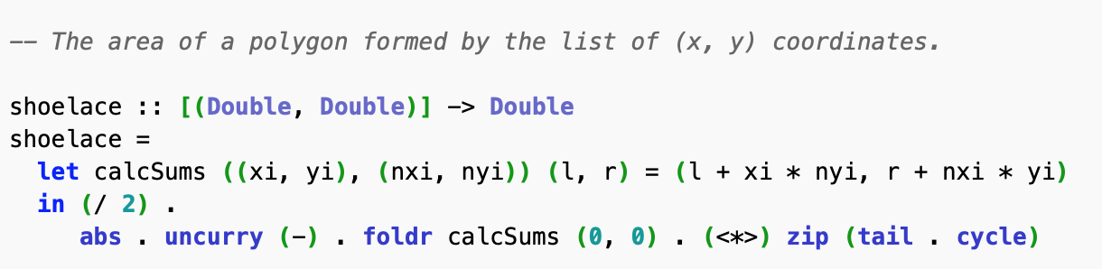
Diskusi Pekan 02: Algorithm Design (Bagas, Jo, Achir)

Slide 9
Agenda dan Learning Objective
Agenda
Currying
Partial Evaluation
Function Composition
Learning Objective
Peserta memahami terminology Currying, Partial Evaluation and Function Composition dalam pemrograman fungsional Haskell
Peserta dapat membuat program yang menerapkan Partial Evaluation dan Currying
Peserta dapat mengubah uncurrying menjadi currying.
Peserta dapat menyusun program lebih modular dengan function composition memanfaatkan partial evaluation dan currying.

Slide 10
Currying
Recall the function: simple n a b = n * (a+b)
Note that:
simple n a b is really
(((simple n) a) b) in fully parenthesized notation
simple :: Float -> Float -> Float -> Float
simple n :: Float -> Float -> Float
(simple n) a :: Float -> Float
((simple n) a) b :: Float
Therefore:
multSumByFive a b = simple 5 a b is the same as
multSumByFive = simple 5

Slide 11
Use of Currying
listSum, listProd :: [Integer] -> Integer
listSum xs = foldr (+) 0 xs
listProd xs = foldr (*) 1 xs
listSum = foldr (+) 0
listProd = foldr (*) 1
and, or :: [Bool] -> Bool
and xs = foldr (&&) True xs
or xs = foldr (||) False xs
and = foldr (&&) True
or = foldr (||) False

Slide 12
Be Careful Though ...
Consider:
f x = g (x+2) y x
This is not equal to:
f = g (x+2) y
because to do so might change the value of x.
In general:
f x = e x
is equal to
f = e
only if x does not appear free in e.

Slide 13
Simplify Definitions
Recall:
reverse xs = foldl revOp [] xs
where revOp acc x = x : acc
In the prelude we have: flip f x y = f y x.
(what is its type?) Thus:
revOp acc x = flip (:) acc x
or even better:
revOp = flip (:)
And thus:
reverse xs = foldl (flip (:)) [] xs
or even better:
reverse = foldl (flip (:)) []

Slide 14
Anonymous Functions
So far, all of our functions have been defined using an equation, such as the function succ defined by: succ x = x+1
This raises the question: Is it possible to define a value that behaves just like succ, but has no name? Much in the same way that 3.14159 is a value that behaves like pi?
The answer is yes, and it is written \x -> x+1. Indeed, we could rewrite the previous definition of succ as: succ = \x -> x+1.

Slide 15
Sections
Sections are like currying for infix operators. For example: (+5) = \x -> x + 5 (4-) = \y -> 4 – y So in fact succ is just (+1) !
Note that sections are consistent with the fact that (+), for example, is equivalent to \x -> \y -> x+y.
Although convenient, however, sections are less expressive than anonymous functions. For example, it’s hard to represent \x -> (x+1)/2 as a section.
You can also pattern match using an anonymous function, as in \(x:xs) -> x, which is the head function.

Slide 16
Function Composition
Very often we would like to combine the effects of one function with that of another. Function composition accomplishes this for us, and is simply defined as the infix operator (.): (f . g) x = f (g x)
So f.g is the same as \x -> f (g x).
Function composition can be used to simplify previous definitions: totalSquareArea sides = sumList (map squareArea sides) = (sumList . map squareArea) sides Combining this with currying simplification yields: totalSquareArea = sumList . map squareArea

Slide 17
Selamat Belajar dan Berlatih!
Silahkan baca Bab 6 buku Haskell School of Expression
atau Bab 10 buku Haskell The Craft of Functional Programming
atau Bab 6 Learn You a Haskell for Great Good! (http://learnyouahaskell.com)

