Slide 1
MOVIBAZAR

Slide 2
ONLINE MOVIE TICKET BOOKING SYSTEM
Presented By:
FAHAD C JAMAL
MCK22MCA-2016
MCET
Guided By:
SANOOJA BEEGAM
ASSISTANT PROFESSOR
MCET

Slide 3
ABSTRACT
The online movie ticket booking system revolutionizes traditional ticketing methods by providing users with a streamlined and user-friendly platform.
Movie enthusiasts can effortlessly browse movies, select showtimes, and secure their tickets in a few clicks.
Real-time updates on seat availability enhance decision-making, ensuring users can choose their desired seats promptly.
Enhances user experiences through secure transactions.

Slide 4
MODULES
ADMIN: Manages movie listings, theatre information, and user accounts.
USER: Allows users to create accounts, log in, and manage their profiles.
MOVIE: Provides information about movies, including showtimes, trailers, and details.
THEATRE: Add movies, showtimes, screens.
BOOKING: Enable users to select number of seats, choose showtimes, and purchase tickets.
PAYMENT: Handles secure online transactions for ticket purchases.

Slide 5
SYSTEM REQUIREMENTS
SOFTWARE
Operating system :- Windows 8 or above
Front-end :- HTML, CSS
Back-end :- PHP, MySQL, Javascript
HARDWARE
Processor :- Intel core i3
Hard Disk :- 256 GB
RAM :- 4GB or above

Slide 6
LITERATURE REVIEW
Sl.No | Paper Title | Author | Year of publishing | Advantage | Limitations
1. | A Comparative analysis of Online Movie Ticket Booking Systems | Jane Doe | 2018 | Enhanced user convenience | Potential Security risks in transactions
2. | The Evolution of Movie Ticketing: A review of Digital Platforms | John Smith | 2020 | Improved accessibility for Diverse Audiences | Dependency on internet connectivity
3. | User Experience in Online Movie Ticket Booking: A Literature Review | Emily Johnson | 2019 | Streamlined reservation process | Concerns about data privacy
4. | Technological Trends in Cinema Ticketing Systems | Michael Brown | 2021 | Integration of Mobile Ticketing Solutions | Resistance to adoption among older audiences

Slide 7
DATA FLOW DIAGRAMS

Slide 8
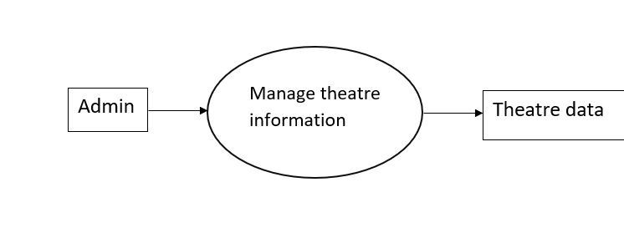
DFD LEVEL 0: Admin module

Slide 9
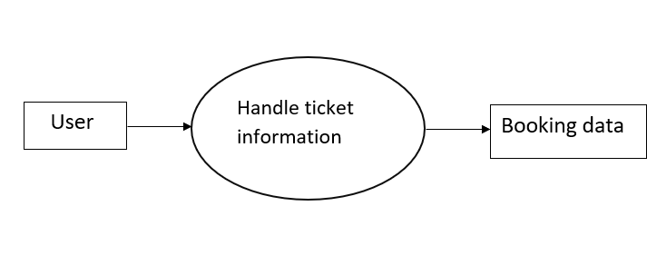
DFD LEVEL 0: User module

Slide 10
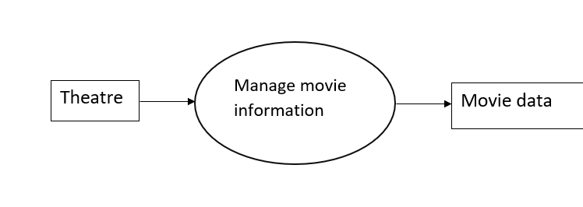
DFD LEVEL 0:- Theatre module

Slide 11
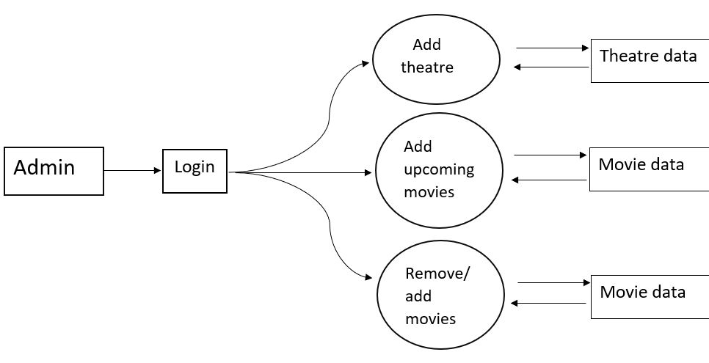
DFD LEVEL 1:- Admin module

Slide 12
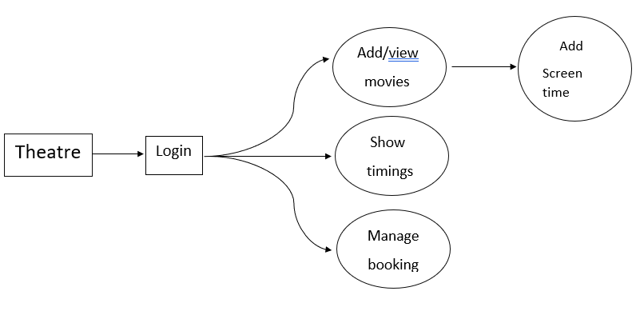
DFD LEVEL 1:- Theatre module

Slide 13
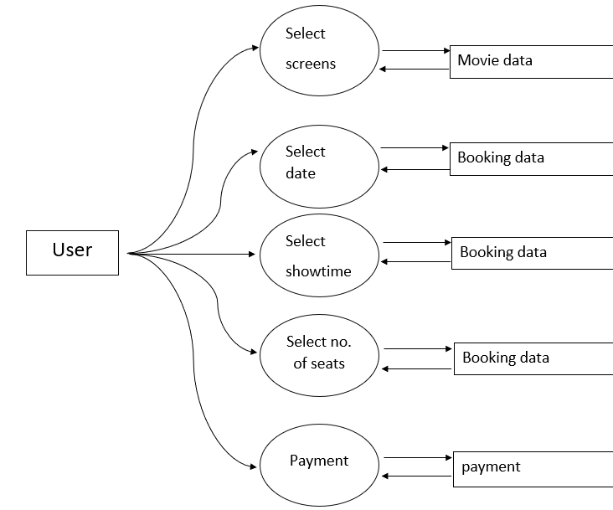
DFD LEVEL 2:- Admin module

Slide 14
DATABASE TABLES

Slide 16
SCREENSHOTS

Slide 17
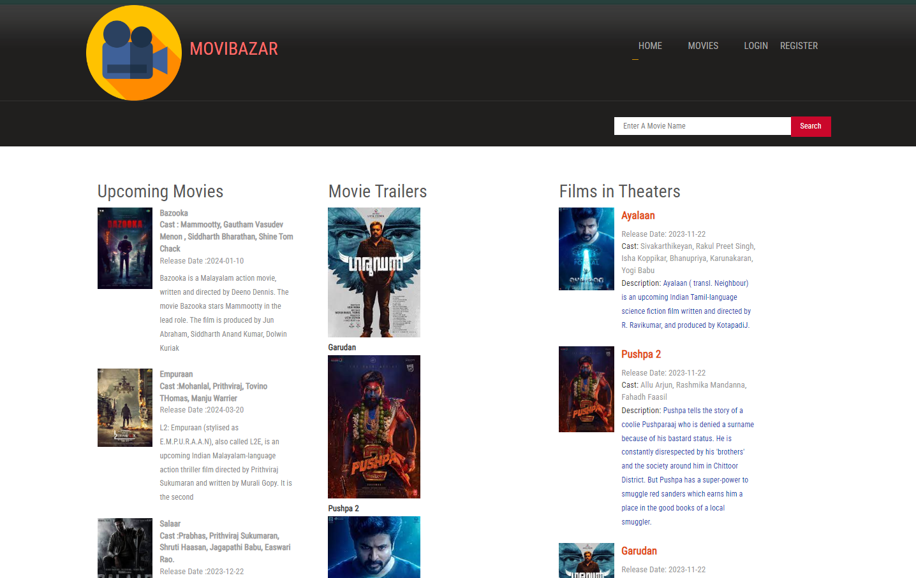
HOME PAGE:

Slide 18
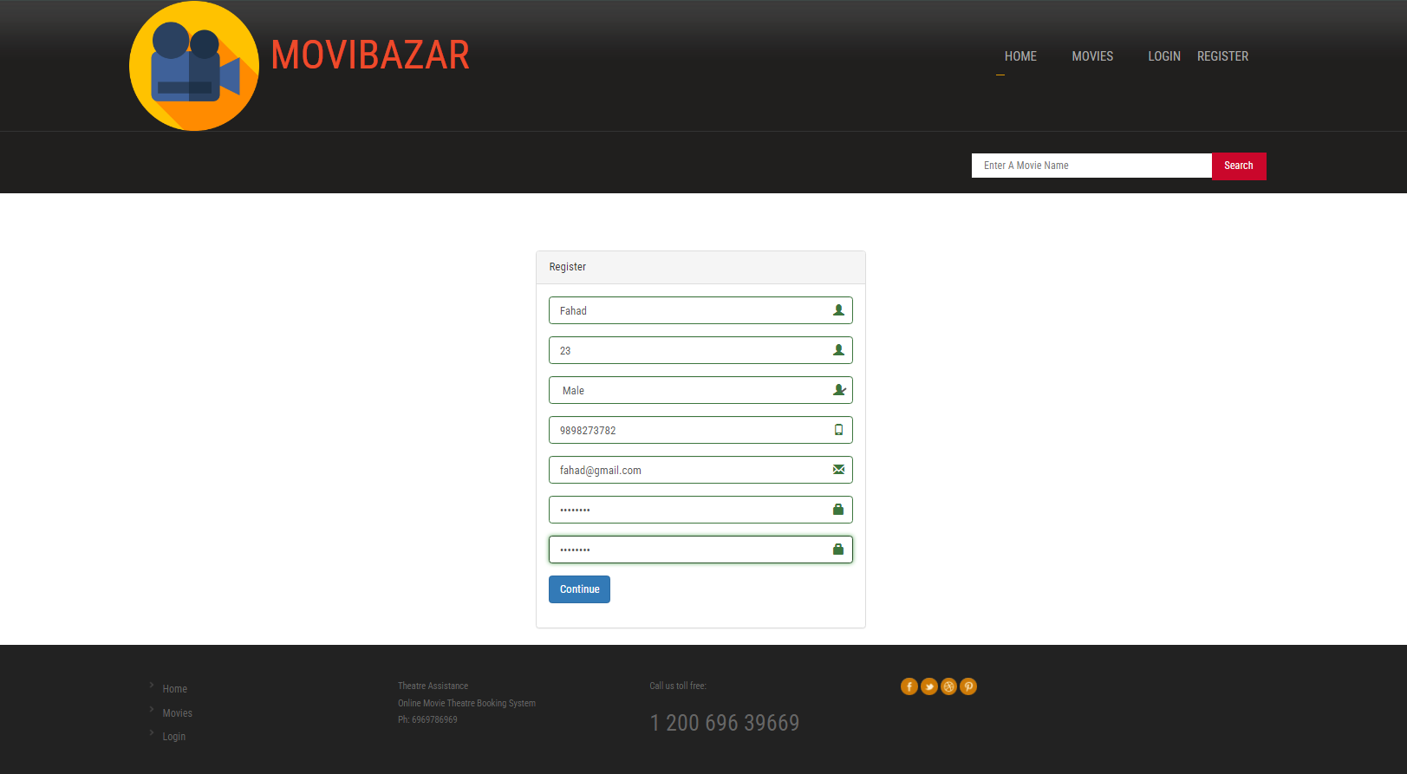
USER REGISTRATION:

Slide 19
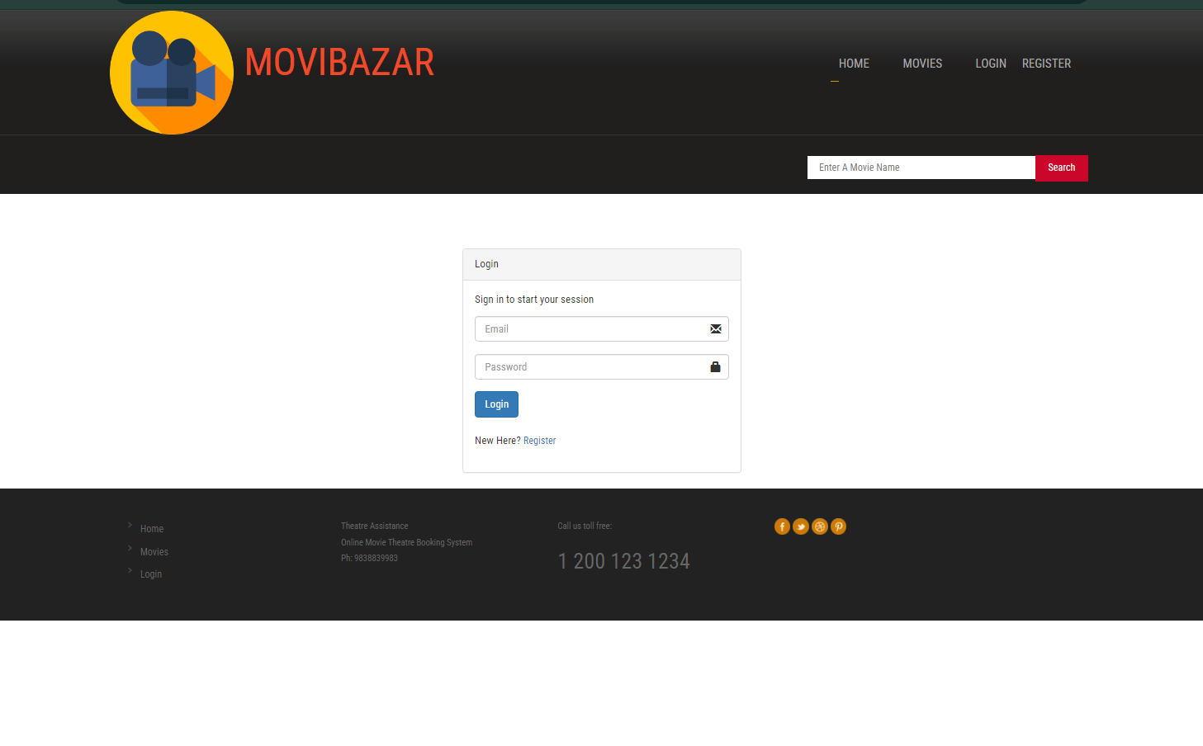
USER LOGIN:

Slide 20
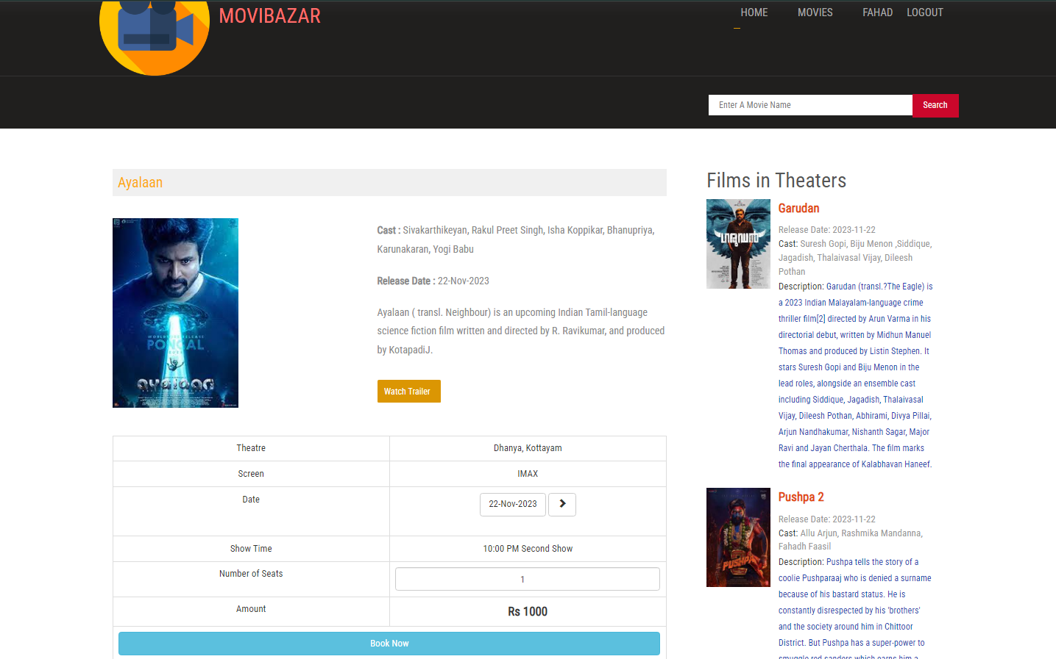
MOVIE SELECTION:

Slide 21
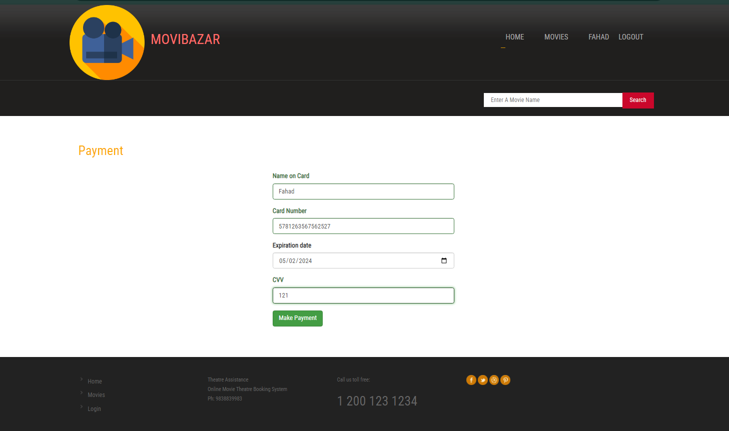
PAYMENT:

Slide 22
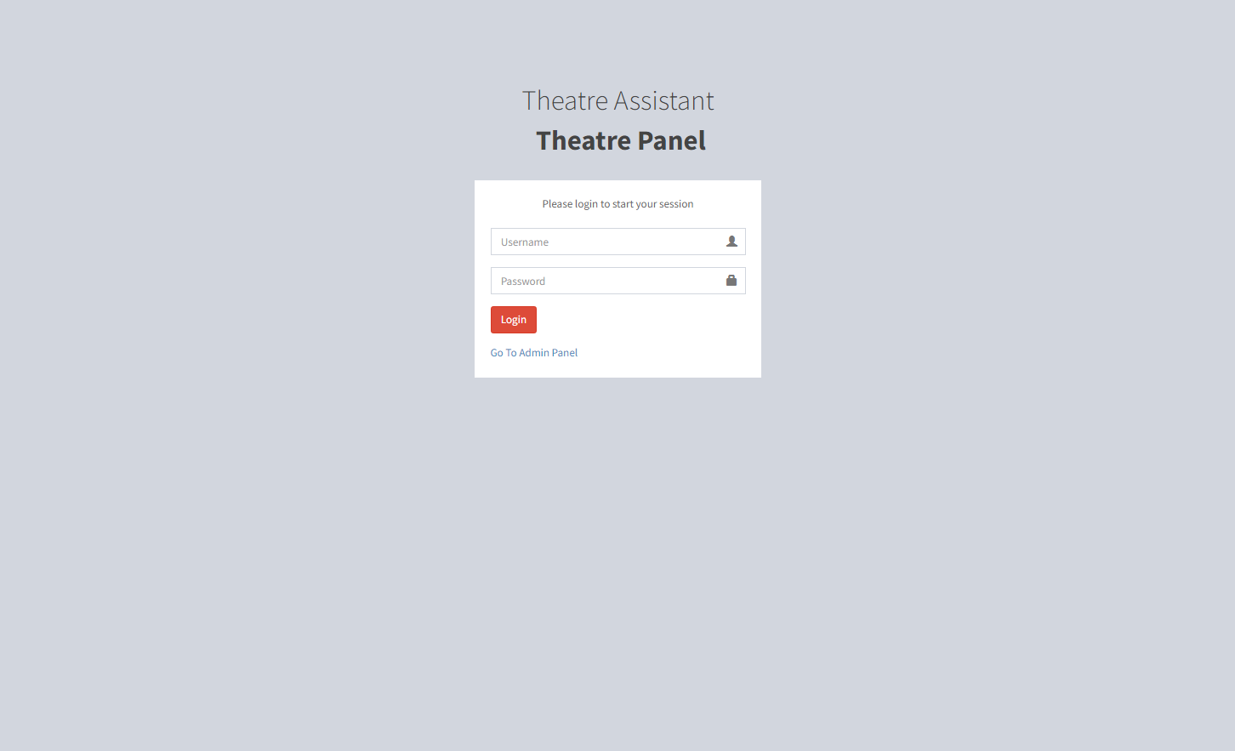
THEATRE LOGIN:

Slide 23
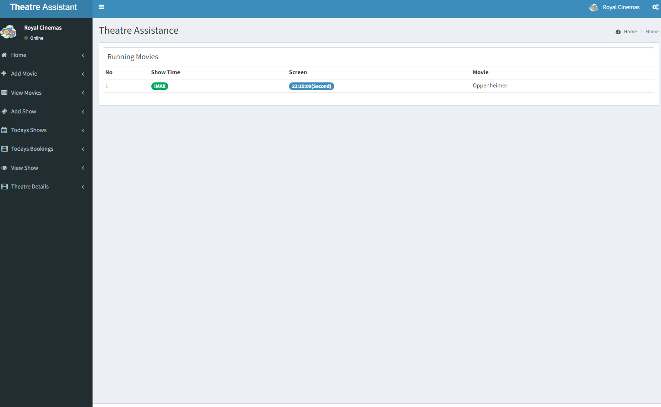
MOVIES RUNNING:

Slide 24
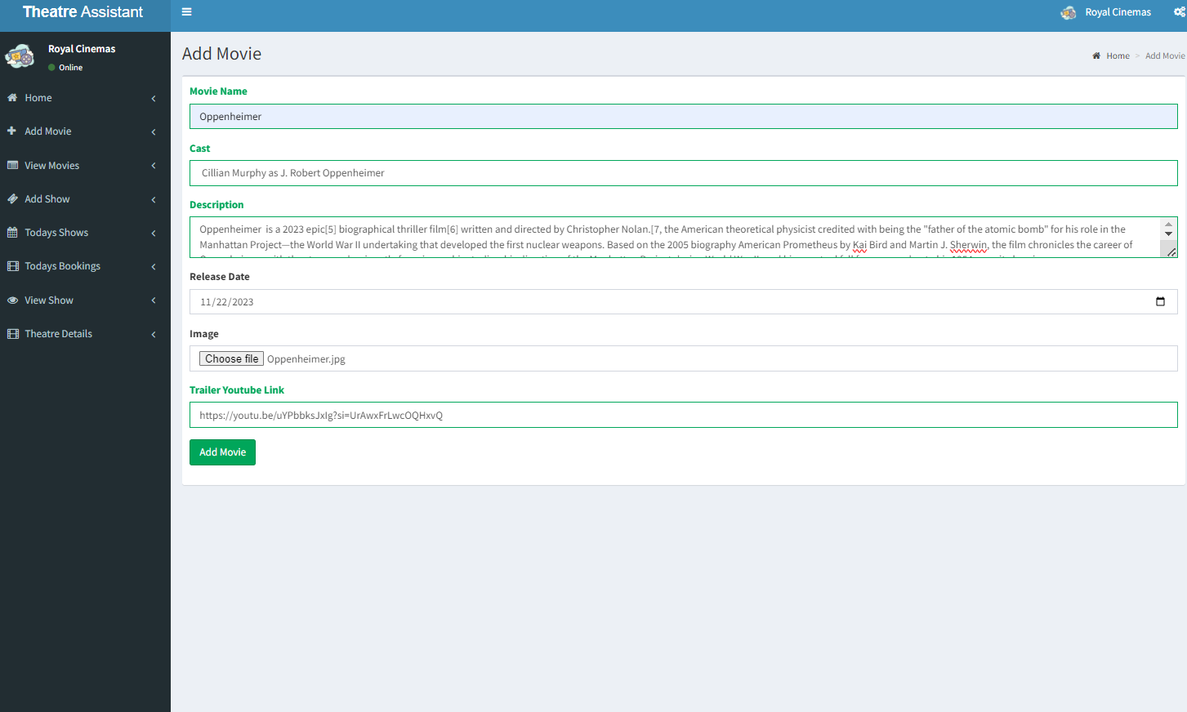
ADD MOVIE:

Slide 25

MOVIES LIST:

Slide 26
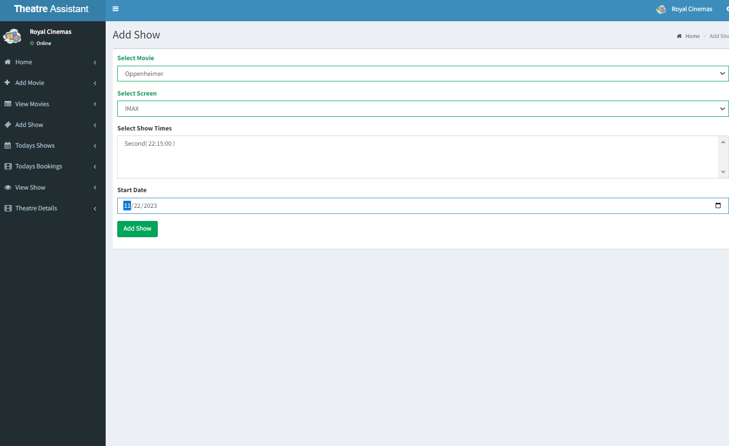
ADD SHOW:

Slide 27
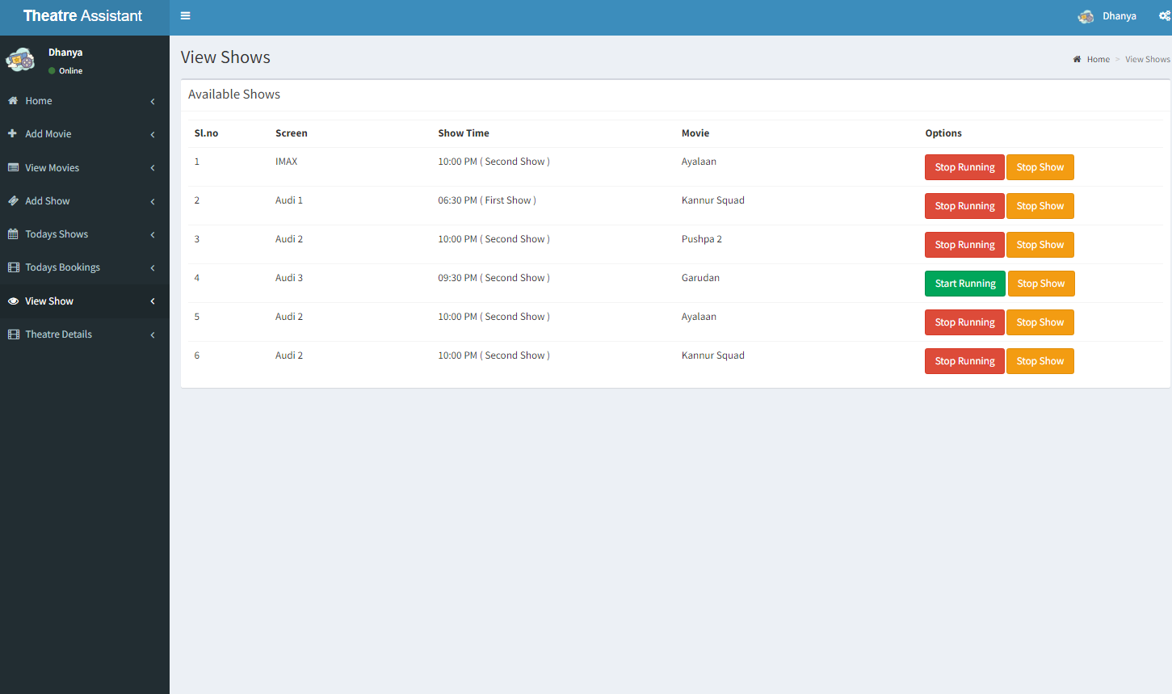
VIEW SHOWS:

Slide 28
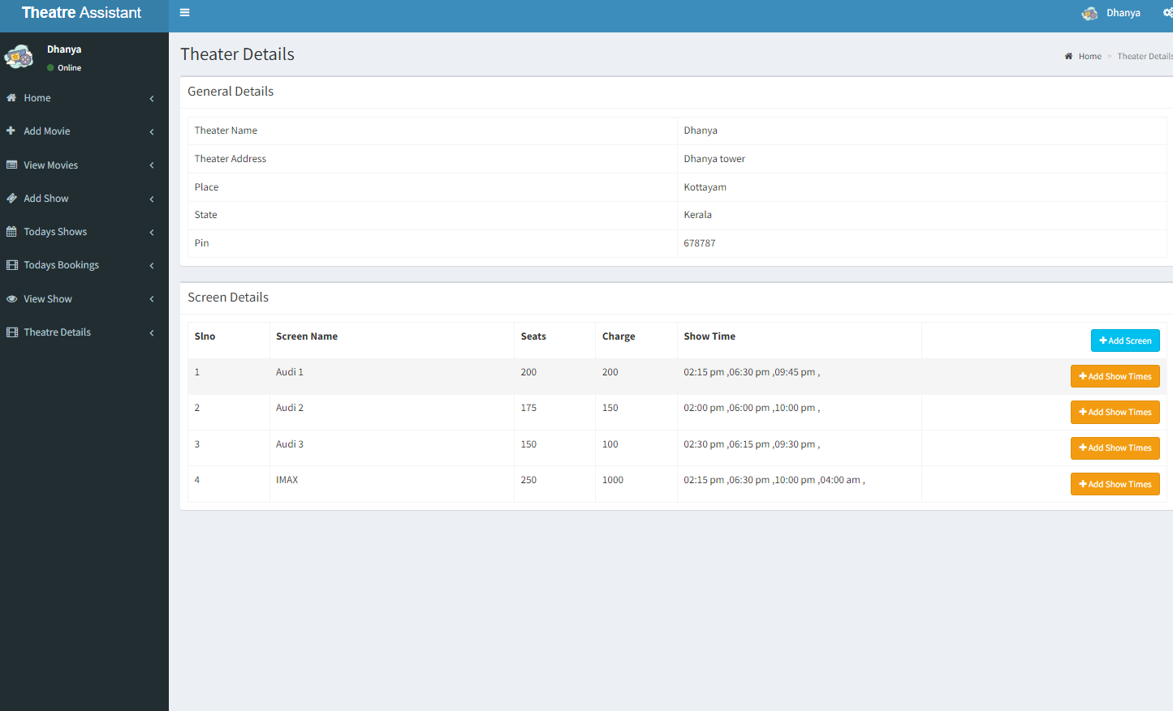
SCREEN DETAILS:

Slide 29

ADMIN PANEL:

Slide 30
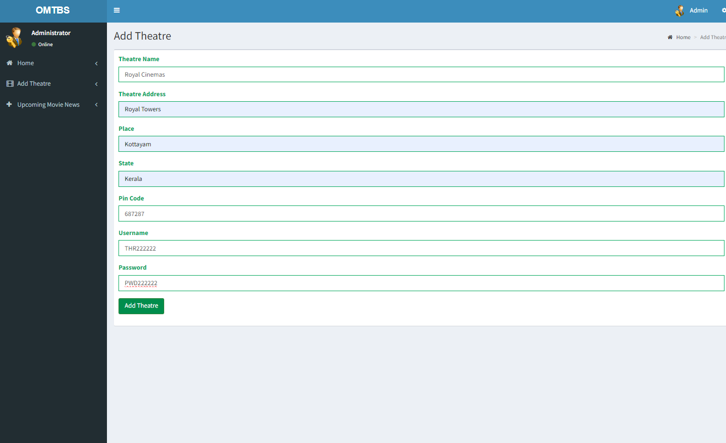
ADD THEATRE:

Slide 31
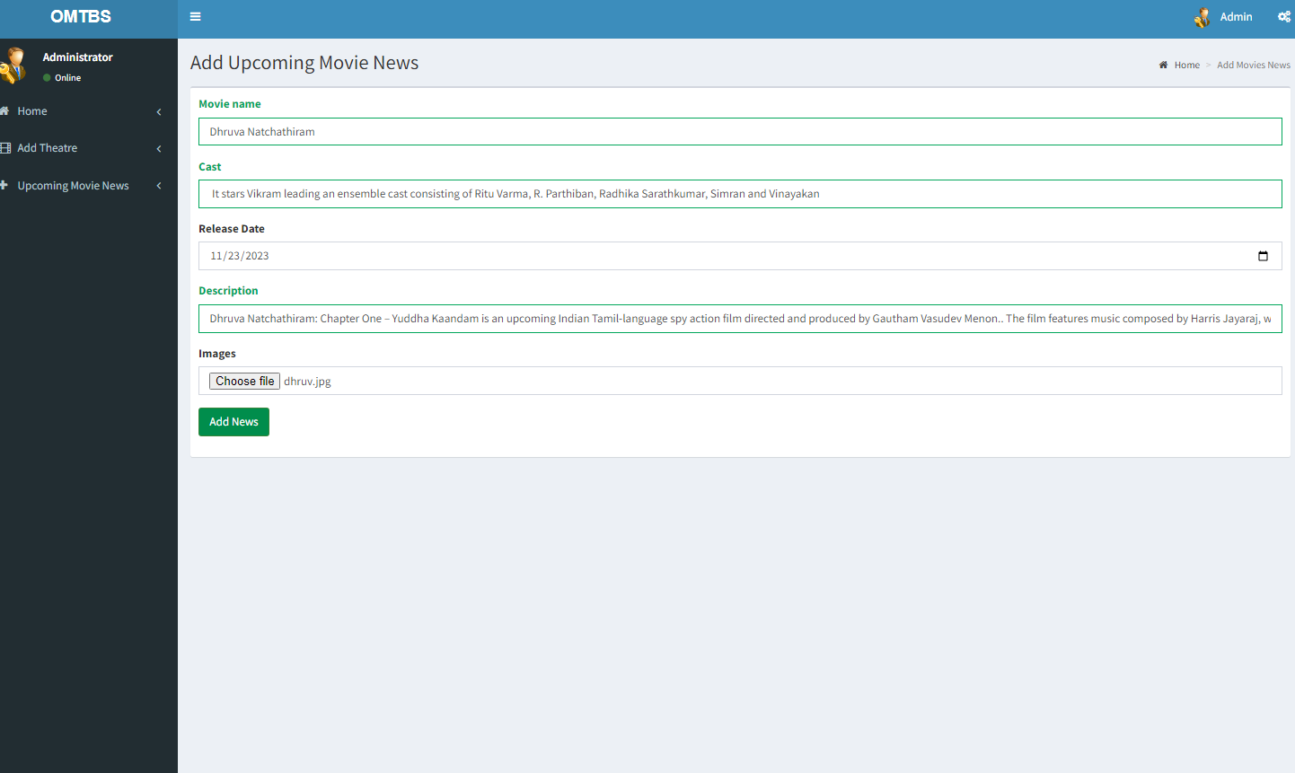
ADD UPCOMING MOVIES:

Slide 32
FUTURE SCOPE
The future scope for the Online Movie Ticket Booking System could involve incorporating advanced technologies to further enhance user engagement and convenience.
Implementing features like virtual reality (VR) for immersive movie previews, personalized recommendations based on user preferences, and integrating with emerging payment methods or digital wallets can keep the platform ahead of the curve.
Additionally, exploring partnerships with cinemas to provide exclusive deals, loyalty programs, or integrating social features for group bookings and movie discussions could further enrich the user experience and strengthen the system's market presence.
Continuously adapting to technological advancements and user trends will be key to ensuring the long-term success and relevance of the project.

Slide 33
CONCLUSION
The Online Movie Ticket Booking System is a user-friendly and efficient platform that streamlines the movie ticket booking process. It enhances the overall movie-going experience by providing a convenient and accessible way for users to browse movie options, select showtimes, and purchase tickets online. The system facilitates easy navigation, secure transactions, and timely confirmation, ultimately contributing to a seamless and enjoyable
movie-watching experience for users.

Slide 34
THANK YOU

