Slide 1

AirGuard: Smart Air Quality Monitoring for Urban Sustainability
An evidence-based solution for real-time air quality awareness, health protection, and data-driven urban policy.

Slide 2

The Urban Air Quality Crisis
7 Million
90% of Cities
Premature deaths annually attributed to air pollution — WHO
Major urban centres exceed safe PM2.5 and PM10 levels
Fragmented Data
Monitoring systems are expensive, siloed, and inaccessible to citizens

Slide 3


Why This Matters for Cities
Health Impact
Respiratory diseases, cardiovascular problems, and measurably reduced life expectancy across urban populations.
Economic Cost
Surging healthcare expenses, lost workforce productivity, and long-term environmental degradation.
Equity Gap
Low-income communities remain systematically excluded from real-time pollution data and health guidance.

Slide 4

The Sustainability Challenge
Health Guidance
Affordable Sensors
Planner Data
Bridging the gap between raw environmental data and meaningful, accessible action requires tools designed for people — not just institutions.

Slide 5
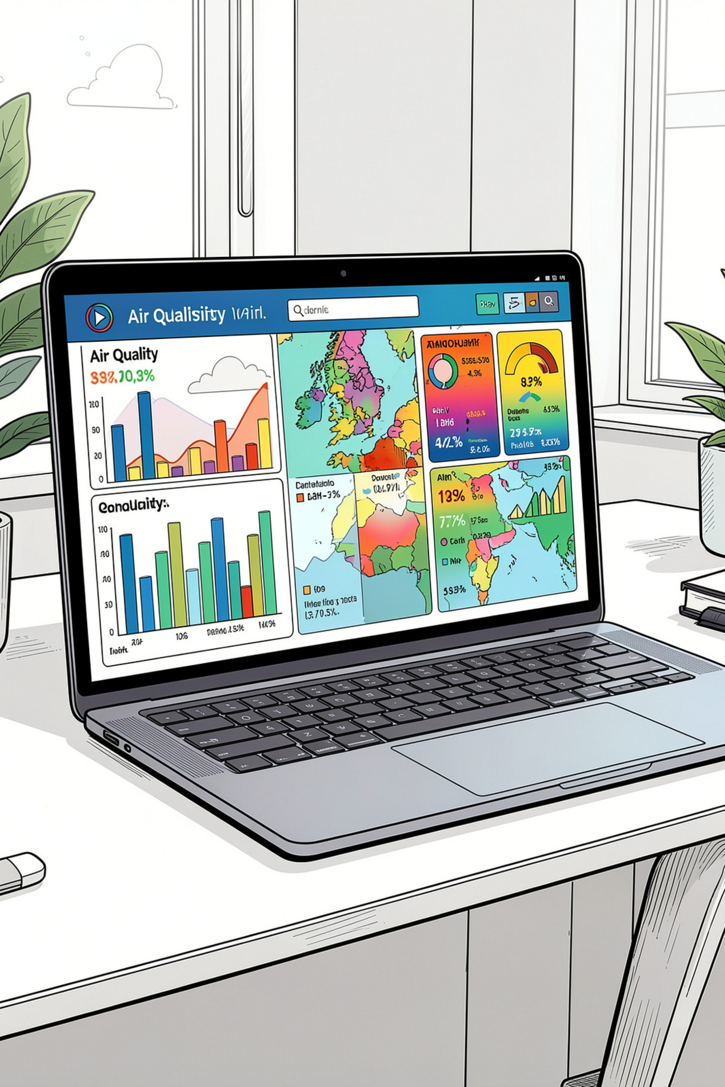



Introducing AirGuard: The Solution
Real-Time AQI Monitoring
Location-based search delivers live air quality index readings for any city, instantly.
Multi-Pollutant Tracking
Individual measurements for PM2.5, PM10, CO, and NO₂ — the key urban pollutants.
Intelligent Alerts
Customisable health advisories and warnings tailored for vulnerable population groups.

Slide 6
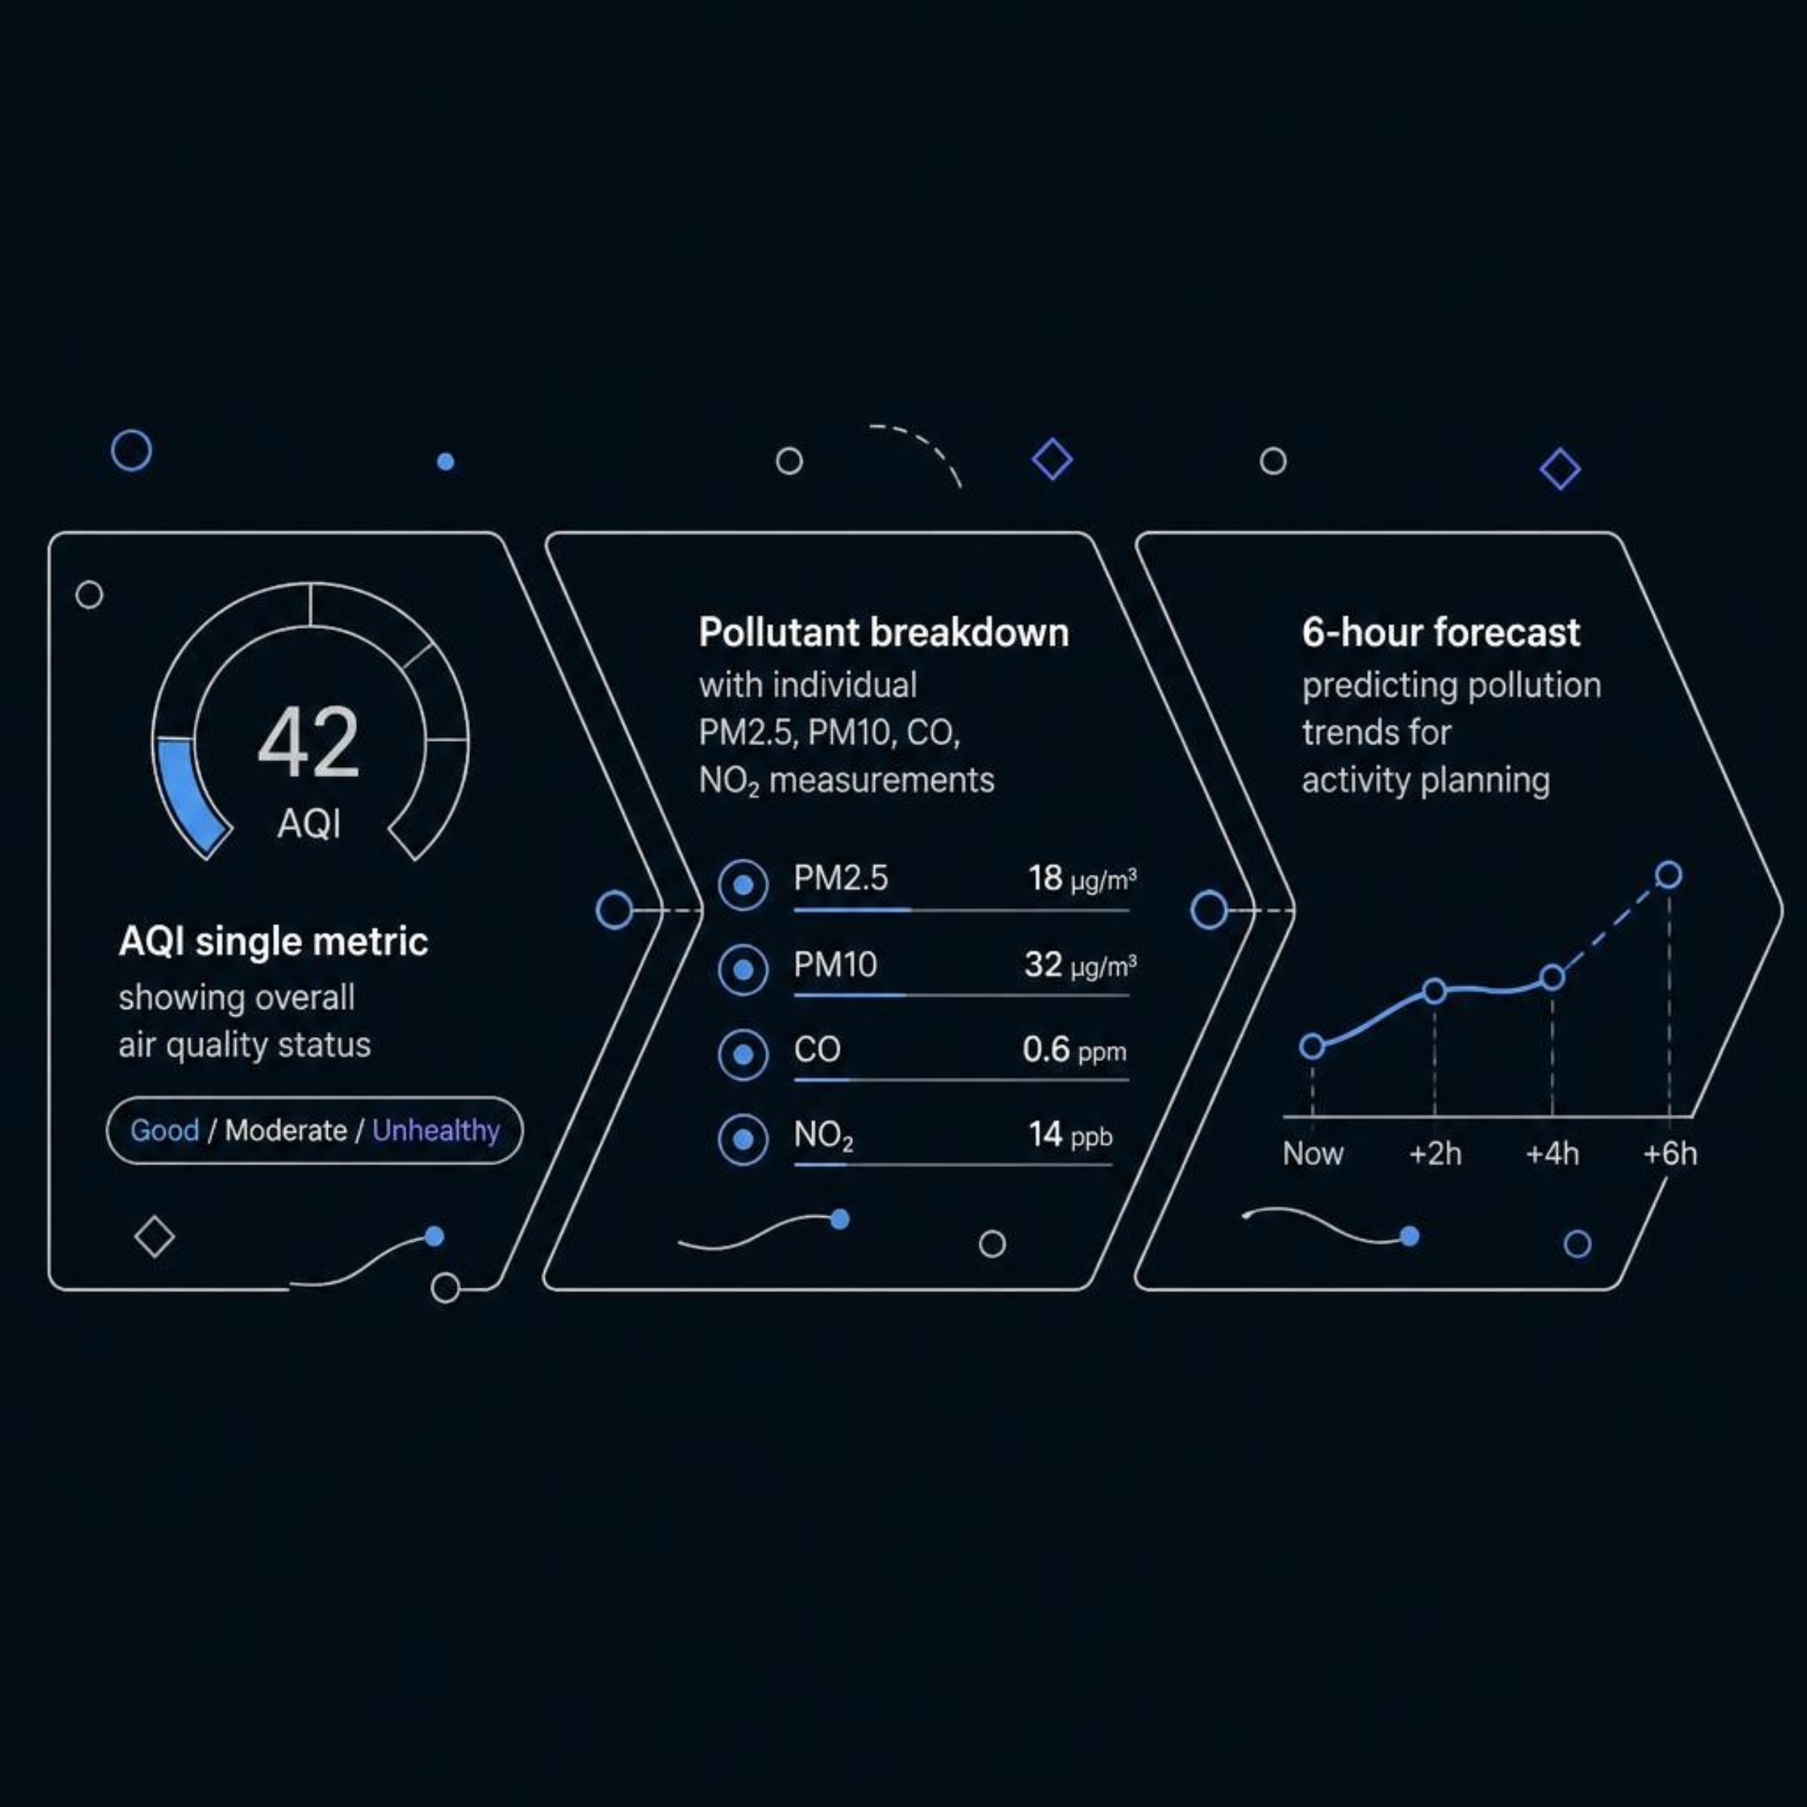
Key Features: Dashboard Overview
Built for Citizens, Not Specialists
AirGuard translates complex environmental data into clear, actionable information. The Air Quality Index condenses multi-pollutant readings into one intuitive score. Individual pollutant breakdowns provide scientific depth for researchers and planners. The 6-hour forecast empowers users to make proactive decisions — from choosing outdoor exercise times to planning school trips.

Slide 7

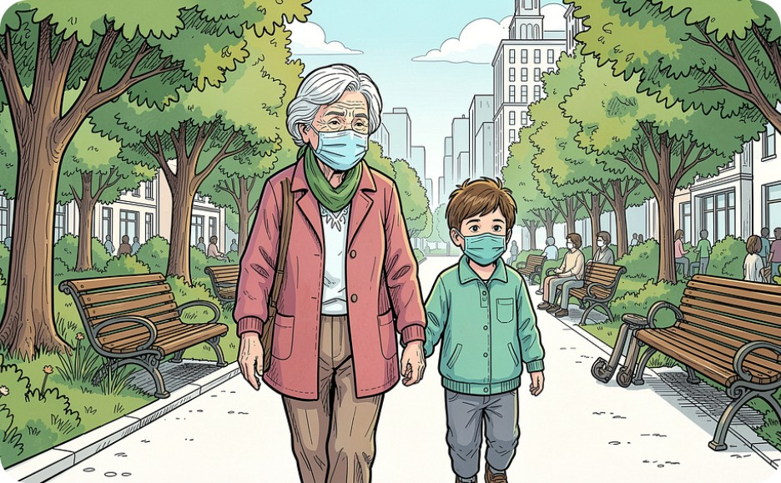

Sustainability Impact: How AirGuard Helps
Citizen Awareness
Health Protection
Data-Driven Policy
Real-time local air quality data empowers everyday decisions about outdoor exposure and commuting.
Personalised alerts reduce exposure to dangerous pollution events, especially for vulnerable groups.
Trend data enables cities to identify pollution hotspots and implement targeted emission reduction strategies.

Slide 8

Health Advisory System
AQI Health Categories
AQI Range | Category | Advisory
0–50 | Good | No action needed
51–100 | Moderate | Sensitive groups cautious
101–150 | Unhealthy (Sensitive) | Limit prolonged outdoor exertion
151–200 | Unhealthy | Masks recommended
200+ | Hazardous | Stay indoors
AirGuard's advisory engine activates automatically when AQI reaches unhealthy thresholds, ensuring no user is caught off guard by a sudden pollution spike.
Automatic warnings triggered when AQI exceeds safe levels
Tailored guidance for children, the elderly, and respiratory patients
Practical recommendations: mask usage, outdoor activity limits, and protective measures
Vulnerable populations receive specific, condition-appropriate advice — not generic public health messaging.

Slide 9




Customisable Alert Thresholds
User-Defined Levels
Set personal alert thresholds at AQI 100, 150, 200, or 300 — calibrated to individual health sensitivity.
Browser Notifications
Instant push alerts trigger the moment thresholds are exceeded, requiring no manual monitoring.
Proactive Behaviour Change
Timely alerts enable users to modify outdoor plans before exposure occurs — not after.

Slide 10



Next Steps: Scaling AirGuard
Phase 1: Real Data Integration
Connect live APIs from national and regional environmental agencies to replace prototype mock data.
Phase 2: Multi-City Expansion
Deploy across multiple urban centres with predictive ML models for longer-range pollution forecasting.
Phase 3: Mobile + Community
Launch a mobile application with crowdsourced community reporting to extend sensor coverage and civic engagement.
AirGuard — from prototype to platform, one city at a time.

