Slide 1
Air ticket reservation system
Developed by: Faheem Ajmal, Muhammad Tayyab and Fahad Khalid

Slide 2
Project Profile
Project Title: Online Air Ticket Reservation System.
Project Description: Passenger can make his/her Reservation Easily.
Front End Tool: JSP, HTML, CSS, JavaScript and BootStrap
Back End Tool: Microsoft SQL Server 2005.
Operating System: Windows 10 education
Project Duration: Approx 20 days.
Submitted To: Sir Burhan Khalid

Slide 3
Introduction
A customer can reserve his/her air ticket using this web site without
any difficulty.
It basically a different form of execution of online transactions in which
the customer can reserve for tickets and can pay online for their
ticket conformation.
A customer can also view his/her conformation after reservation process,
which is for security.
If customer needed to cancel his/her reservation due to any
reason, he/she may easily cancel out reservation
with charges applied.

Slide 4
NEED FOR THE NEW SYSTEM
For provide the better reservation in turn the fast service
to get the reservation over in time to the passenger.
Passenger can get the information without visiting airport far
from home or their offices, like baggage, healthy traveling tips,
before-after and during flying tips.
Millions of rupees each year to staff their toll-free
customer service telephony systems.
Thousands of people calls not only for book flights but for extra
services.

Slide 5
Features
Better user interface for the users.
Security for the reservation of the customers.
User can search for specific flight.
A customer can also view his/her conformation after
reservation process.

Slide 6
Cont…
If customer needed to cancel his/her reservation due to any reason, he/she may easily cancel out reservation with
charges applied for cancellation.
A customer can view the time table for the flights and its time for reservation.
A customer also get information about baggage/luggage,
airport, airbus, and airport tips, about pets and
healthy traveling tips.
We provided the Administrator part separately, which manages flight scheduling and manages
administrator’s account.

Slide 7
Objectives
Better storage capability.
More Efficient operations.
This system saves the time and manpower.
The objective of the project is to provide the passenger the better reservation in turn the fast service to get the
reservation over in time.
To give information about baggage/luggage, airport, airbus, and airport tips, about pets and healthy traveling tips.
Easy and fast retrieval of data.

Slide 8
Modules And Process
Air Ticket Reservation
System
Reservation
Information
Administrator
Ticket
Reservation
View
Cancellation
New Admin
Flight
Schedule
Search
Choose
Flight
Traveler
Detail
Confirmation

Slide 9
Reservation Modules
Ticket Reservation: This module handles air ticket reservation process,
which is user friendly and user can access easily.
Cancellation: This module handles the cancellation process of reservation
of passengers.

Slide 10
Information Modules
This module provides information to passenger like
baggage/luggage, airport tips, about pets and healthy traveling tips.
This Module Also provide facility to see time table for flight

Slide 11
Administrator Modules
Flight schedule : This Module Manage The Schedules Of Flight.
New admin : This Module Handle the Process of creating
new Administrator Account.
Seat cancelation: This Module Handle the Process of canceling
the passenger’s seat.

Slide 12
DATA FLOW DIAGRAM

Slide 13
Context Level Diagram

Slide 14
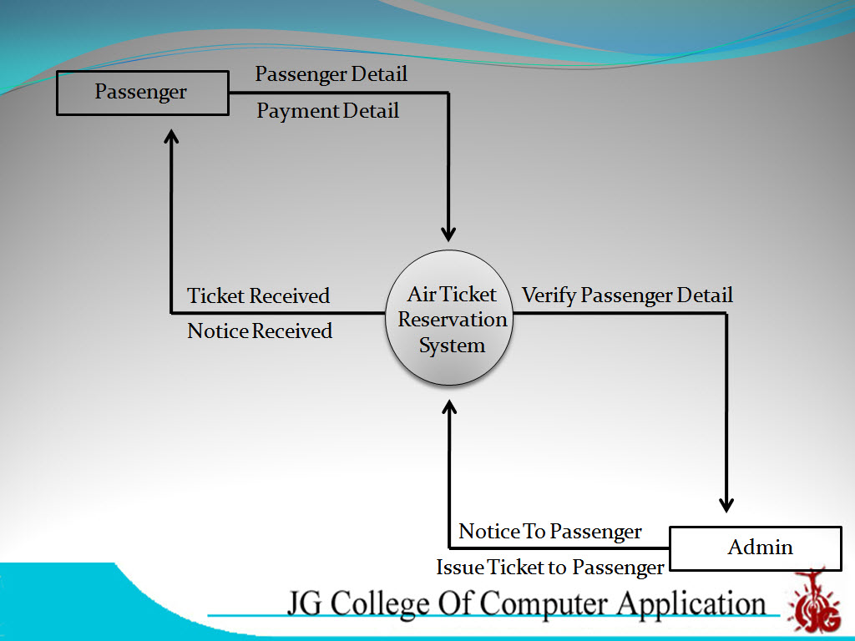

Slide 15
First Level Diagram

Slide 16
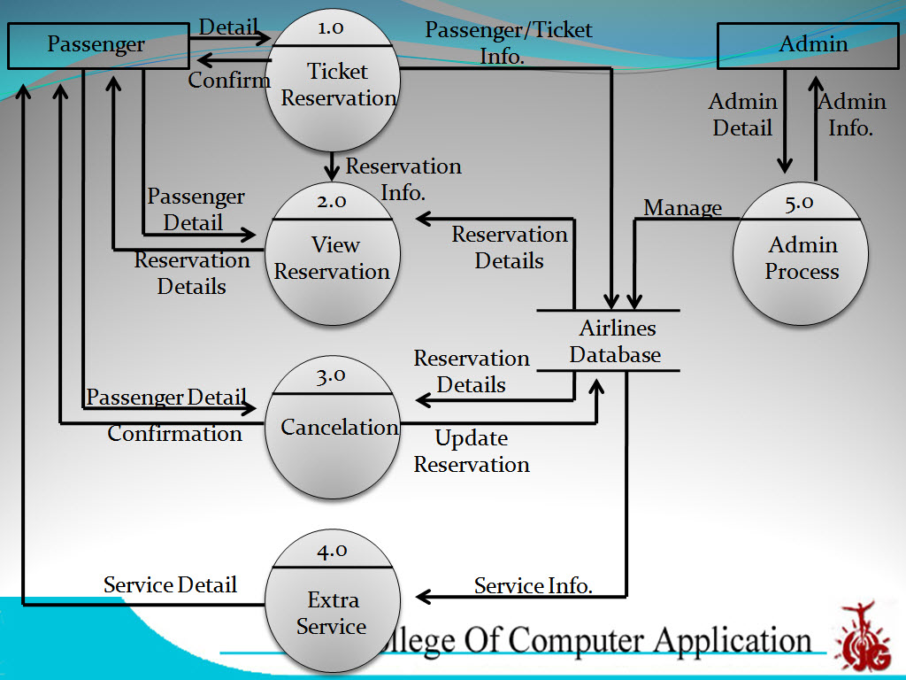

Slide 17
Second Level Diagram
Ticket Reservation Process

Slide 18
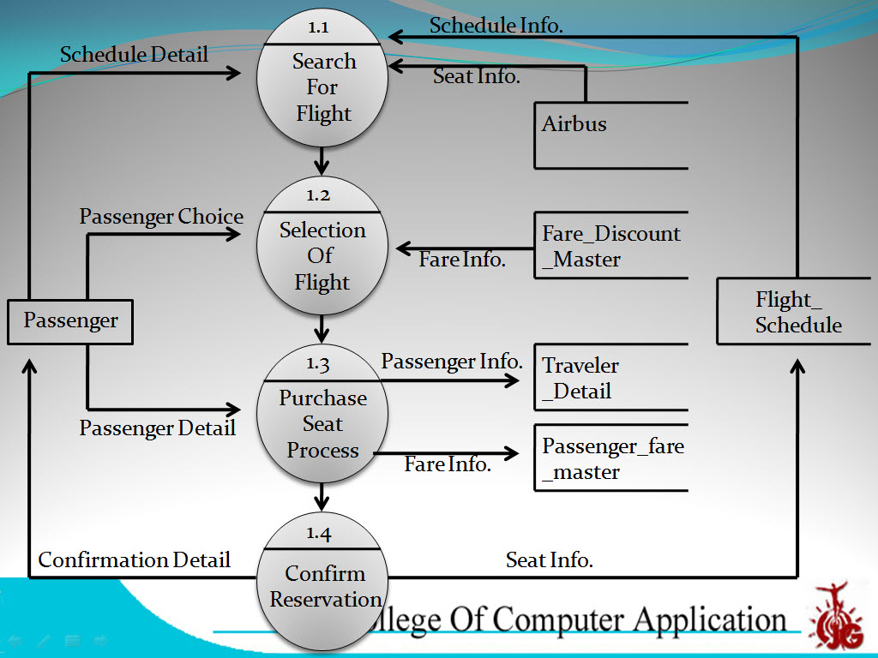

Slide 19
Administrator Process

Slide 20
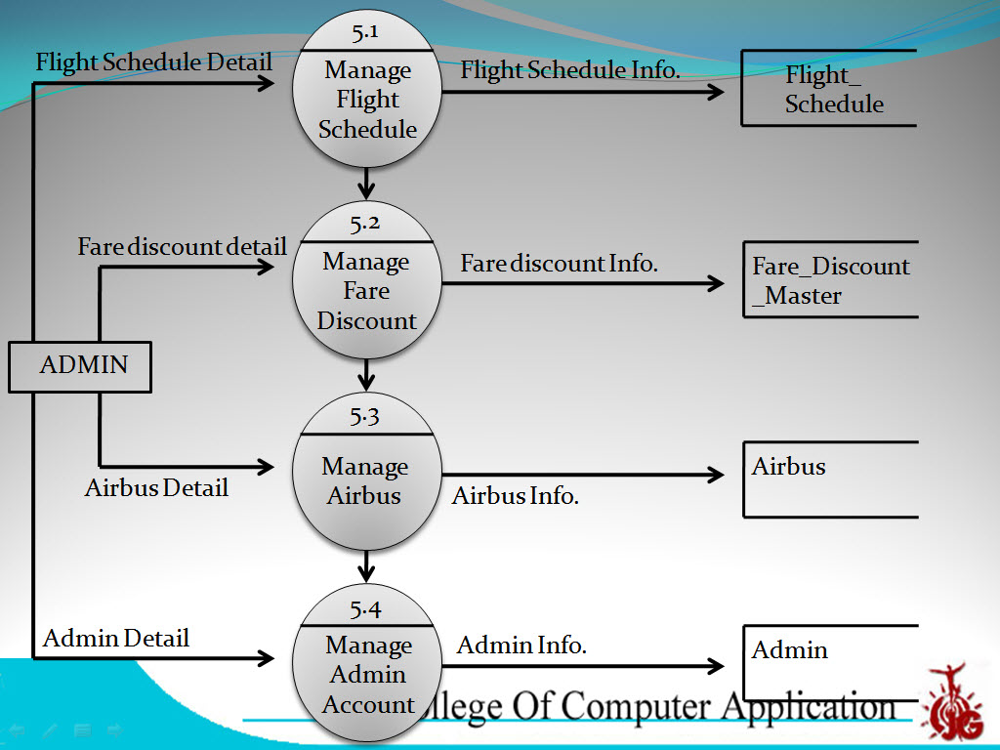

Slide 21
Limitations
This online air ticket reservation website supports only domestic airlines.
you can not make reservation for international airlines.
You can not make reservation for multiple domestic airlines.

Slide 22
Future Enhancement
Automatically e-mail communication to passenger about flight scheduling
and new schemes and discounting.
We provide different types of tour packages in nominal cost.
Sending messages on mobile of delaying or cancellation of flight.

Slide 23
Thank You

