Slide 1

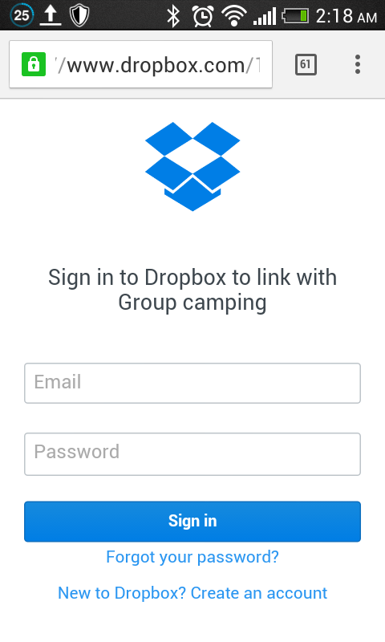
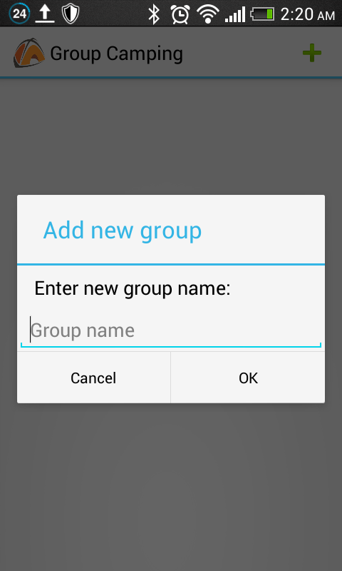
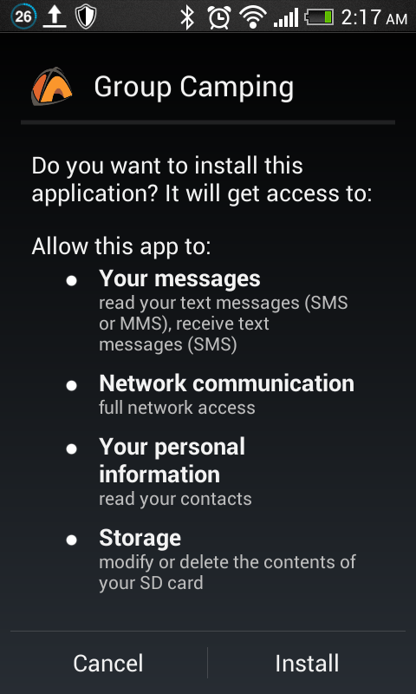
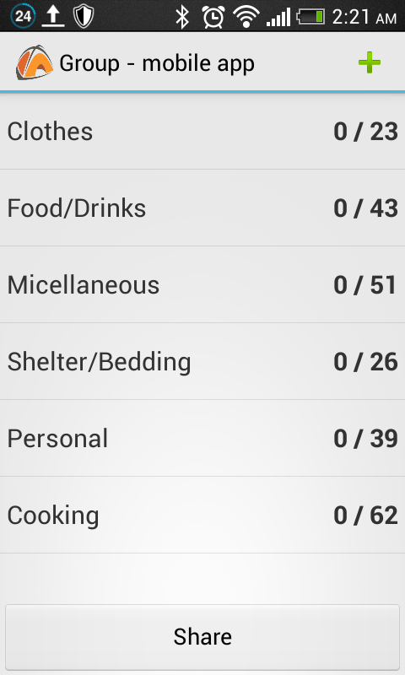
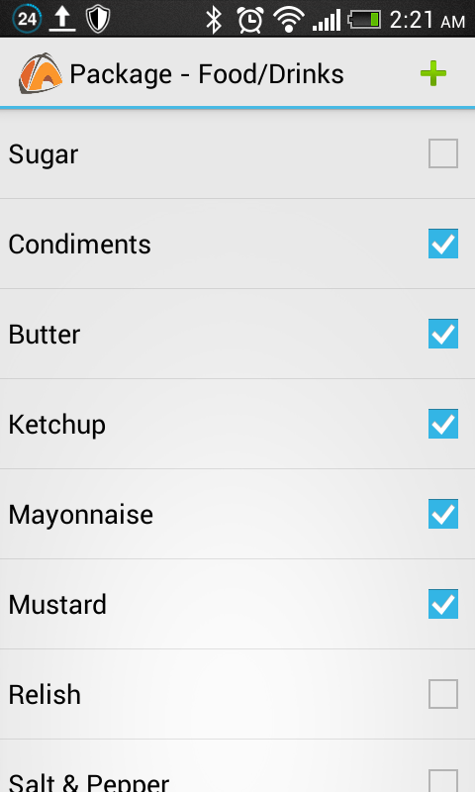
Group Camping
Group Camping
User Registration
Group Creation
Group camping app is the best way to add essential items to the camping list
There is also custom package is available where one can make own list.
Easy to add friends to group and manage it.
Provides support for Multiple Groups.
Best way to keep the track of items and share bills.
Also figure out costs for a group vacation, or just to remember when a friend spots you for lunch.
This is User registration & welcome screenshot. It only appears once (the first time the application is run).It allows the user to register with the group camping server
Group creation and management streamlines the process of creating and organizing groups and also provides support for multiple groups. It allows the user to add group members from contacts list
Camping List
Additional Features
Posting a bill : Stores and monitors the bill amount, the individuals involved.
Group history: Automatically records all transactions and bills posted to each group
Push notifications : Appear after any significant event occurs in a group
Receipt imaging: Records and stores a snapshot of receipts associated with different expenses
E-mail notifications : Extends the standard notifications service built into group camping
Permissions
Package list
Description
The group camping system is composed of two main components: a client-side application which will run on Android handsets, and a server-side application runs on the Dropbox which will support and interact with various client-side features. The system is designed to facilitate custom selection of camping lists and also allows the process of tracking and settling shared expenses during vacation.
Camping list displays a list of packages and items in packages.it allows user to select item from camping list. Even you can create custom package.
Abdul Faheem Mohed
mohammedfaheem@unm.edu

