Slide 1
Performance and Security of HSTS
By,
Faheem Ali - 114362913
Navaneeth Umesh Holla - 114712783
Nilesh Rustagi - 113259870
Notes:
Why we choose this topic?
Companies moving to
Tell security and performance analysis have been confirmed in the study

Slide 2
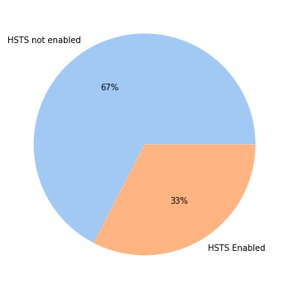
What is HSTS ?
HTTP Strict Transport Security allows a site to request that it should always be contacted over HTTPS connection.
It is a method used by websites to declare that they should only be accessed using a secure connection (HTTPS).
Why HSTS ?
HSTS avoids Man In The Middle attack that use SSL stripping.
Improved security, page load time.
HSTS improves SEO score of the domain.
Notes:
With HSTS policy, the browser will refuse all HTTP connections and prevent users from accepting insecure SSL certificates.

Slide 3
What problem are you solving?
Why it is important?
What is your Approach ? Contribution to the project ?
What is your key finding ?
What is the new learning ?

Slide 4
Methodology
Environment
AWS EC2 instance with Ubuntu OS, RAM 2 GB, Disk 8 GB
Libraries Used: selenium with firefox, safari and chrome web drivers
Page Load, Page Render and Request Response times were calculated for top 500 domains for different browsers.
Page load times were nearly the same for all the browsers, so we took into account the data from Firefox for consistency.
We divided the websites into 5 categories namely Entertainment, Social Media, Education, News, Ecommerce. Websites not falling into any of these categories were categorized as Miscellaneous.
Used Klazify API for obtaining categories.

Slide 5
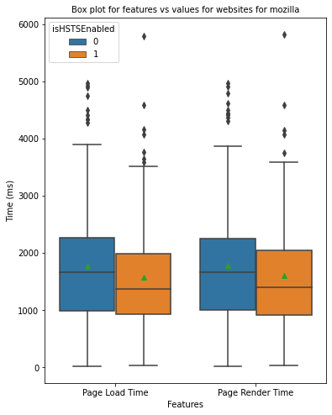
Performance Results
Box plot of page load and page render times indicating the median values along with outliers
From initial analysis, we get a sense of the effect of HSTS enabled websites i.e they have page load times lesser than that of websites with no HSTS

Slide 6
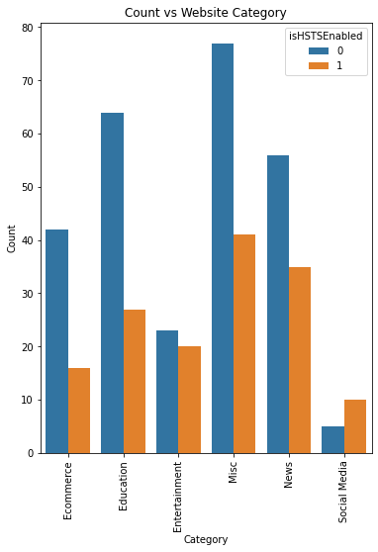
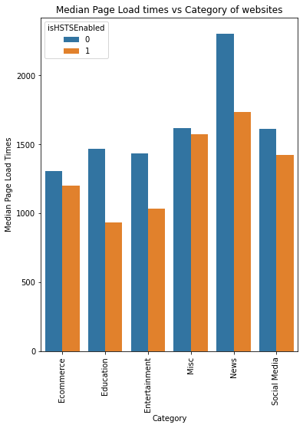
Performance Results

Slide 7
Performance evaluation
Conclusion :
News category websites due to high number of objects to render, took the most time to load
Websites with HSTS, due to elimination of server redirects from HTTP to HTTPS (302 redirect) takes less time to load.

Slide 8
Browser handling preloaded HSTS websites
Since the first connection or a fresh install of the browser is still vulnerable for MiTM attacks, preload list was introduced which enabled the browsers to recognize HSTS enabled websites even for the first connection, making it even more secure.
Google Chrome
Chrome mainstains the HSTS Preload List, each domain has to fill out the form in the https://hstspreload.org/ website to be on the list. Major browsers use the Chromium list.
Mozilla Firefox
An automated job runs everyday to update the preload list in mozilla.
The job makes HTTP requests to each host in the list, if the basic criteria is met then it is considered to be preloaded, like,
Connect successfully to the host and receive the header Strict Transport Security.
Strict Transport Security header with max-age value of at least 18 weeks.
If the host connection is not established, the host is not loaded into the preload list.
To guard against accidentally dropping a host from the list due to network issues or an attacker, if the host is already in the preload list in Firefox, but can not be reached. The automated job keeps that host in the preload list.
Firefox drops a host from the preload list only when the HTTP connection is successful and it doesn’t receive the Strict Transport Security header or when the max-age value is less than 18 weeks, only then firefox takes the host from the preload list.

Slide 9
How secure is HSTS?
Security/ Penetration Testing
Tools used
Burp Suite
Nmap
SQL Map
Syntax of HSTS header
Strict-Transport-Security: max-age=<expire-time>
Strict-Transport-Security: max-age=<expire-time>; includeSubDomains
Strict-Transport-Security: max-age=<expire-time>; preload
If each of the header values are not configured correctly, it will introduce plethora of vulnerabilities.
Correct Configuration
expire-time >= 31536000 (1 Year).
includeSubDomains
Includes all the subdomains of the website.
preload
Trust on first use.

Slide 10
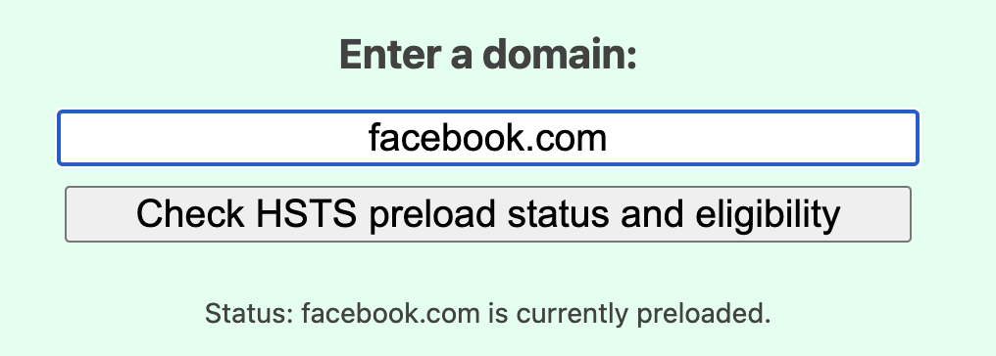
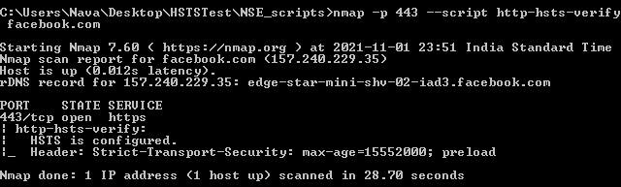
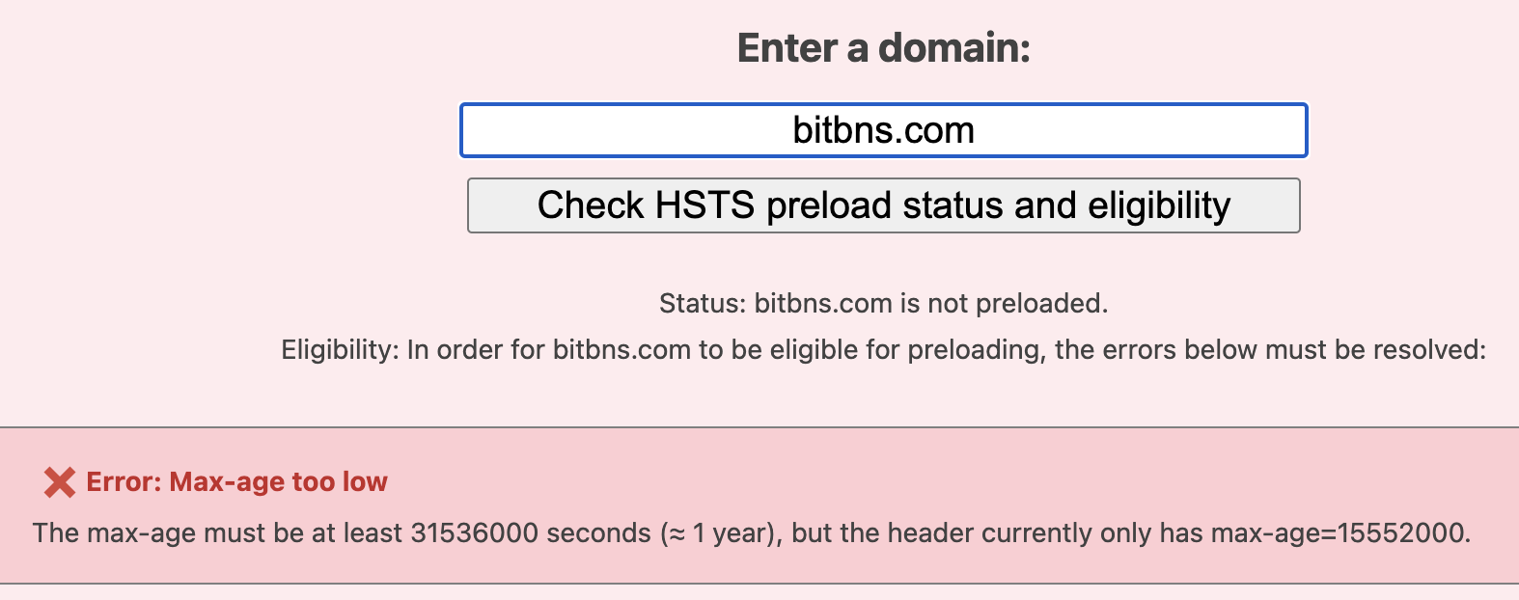
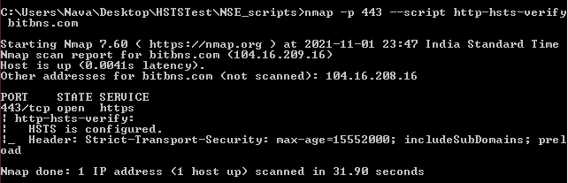
Vulnerable configuration
Expire-time < 31536000
Domain will not be preloaded and still vulnerable for Trust on First use vulnerability.
Not including includeSubDomains
Subdomains will be vulnerable for the MiTM attacks.
Preload
Domain will not be preloaded, vulnerable for MiTM attacks.
Examples

Slide 11
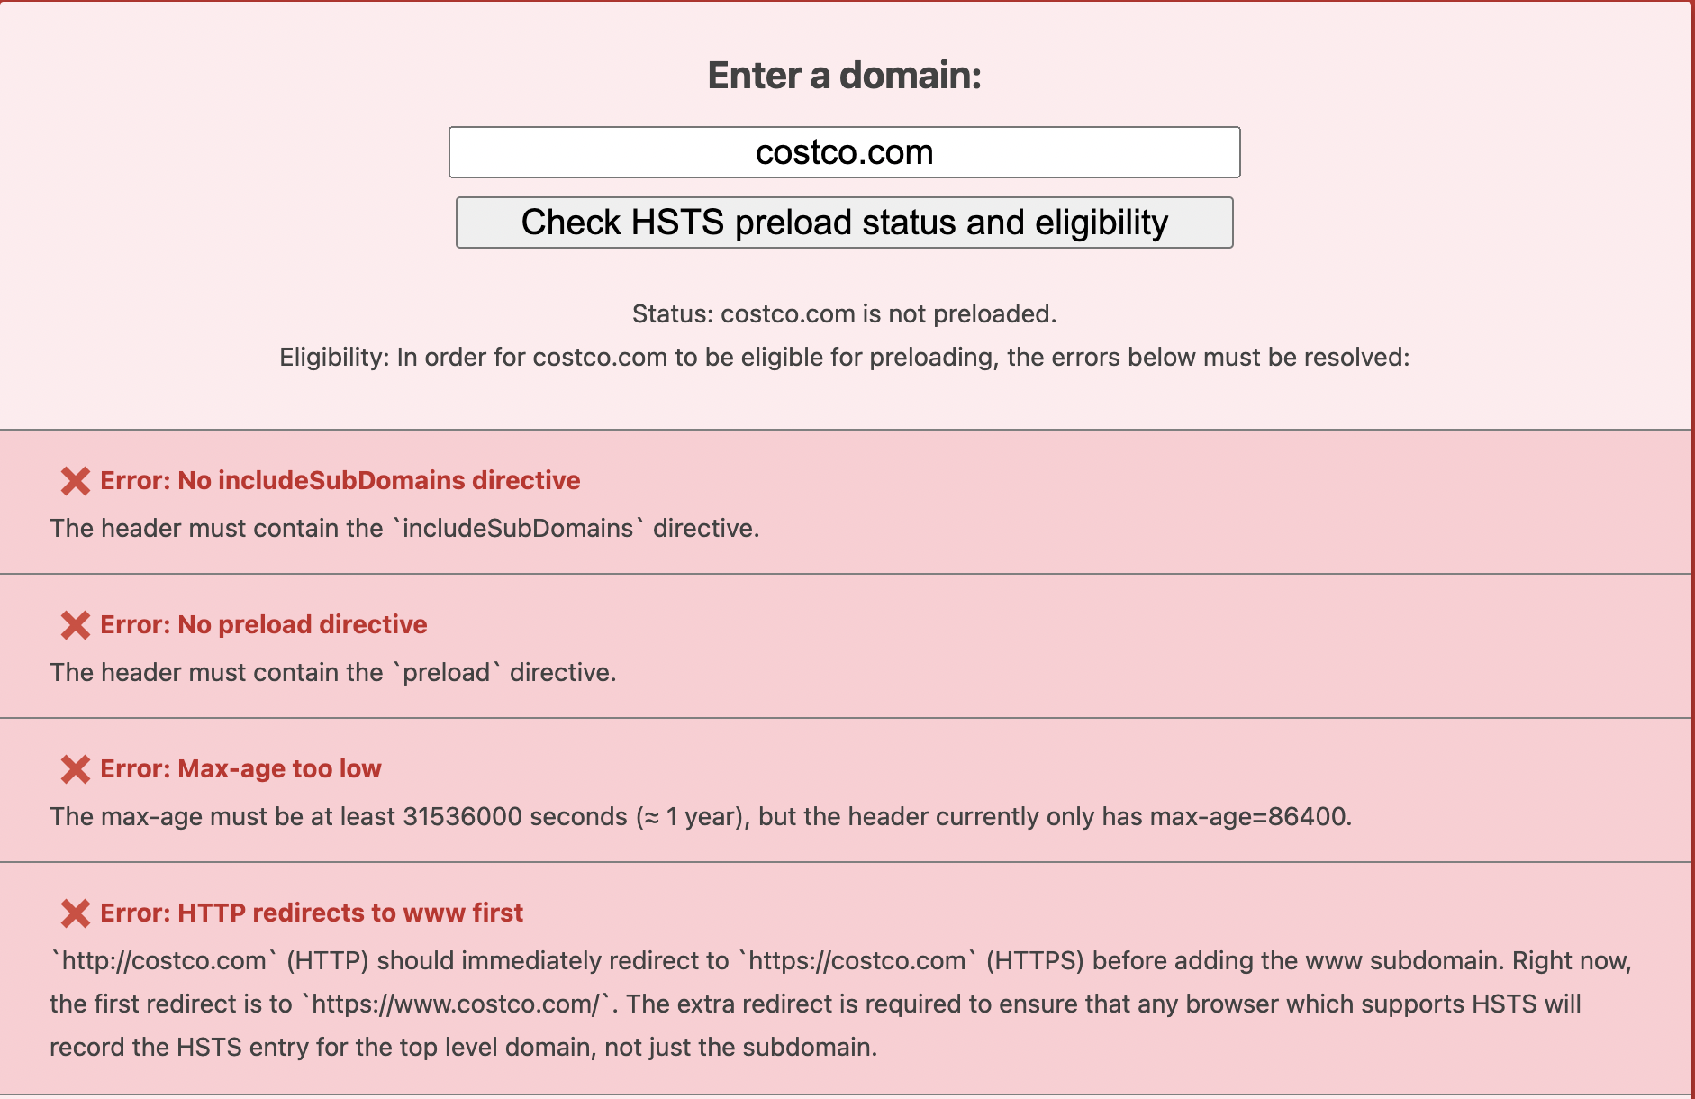
Costco.com has HSTS header enabled, but the configurations are completely wrong and the purpose of HSTS header is not utilized still making the domain vulnerable to MiTM attacks.

Slide 12
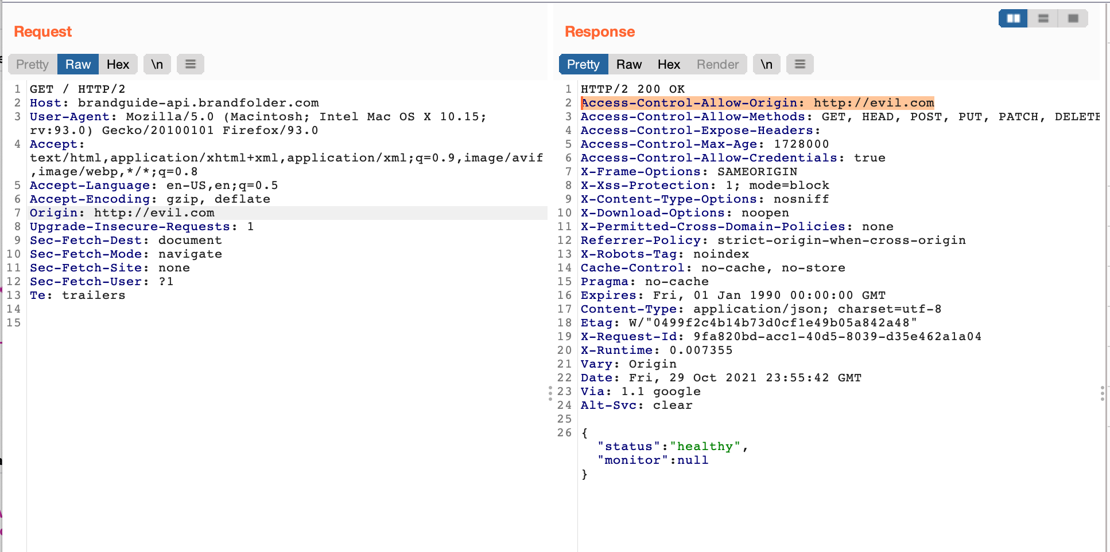
Different vulnerability affecting the performance of HSTS
Cross-Origin Resource Sharing
In the Man In the Middle attack scenario, hacker can exploit the Cross-Origin Resource vulnerability to trick the user to navigate to attacker controlled website, defeating the purpose of HTTP Strict Transport Security. Possibilities of attack scenarios are limitless in this regard, as an attacker controlled website user can be tricked to give in sensitive information like user details, passwords, credit card information and so on.
Exploiting the vulnerability
Injecting the origin with domain http://evil.com to the request header and we can see the same reflecting in the response header with Access-Control with methods to GET, POST, PUT and so on.
In MiTM attack scenario, this technique can be used to get sensitive information from users.

Slide 13
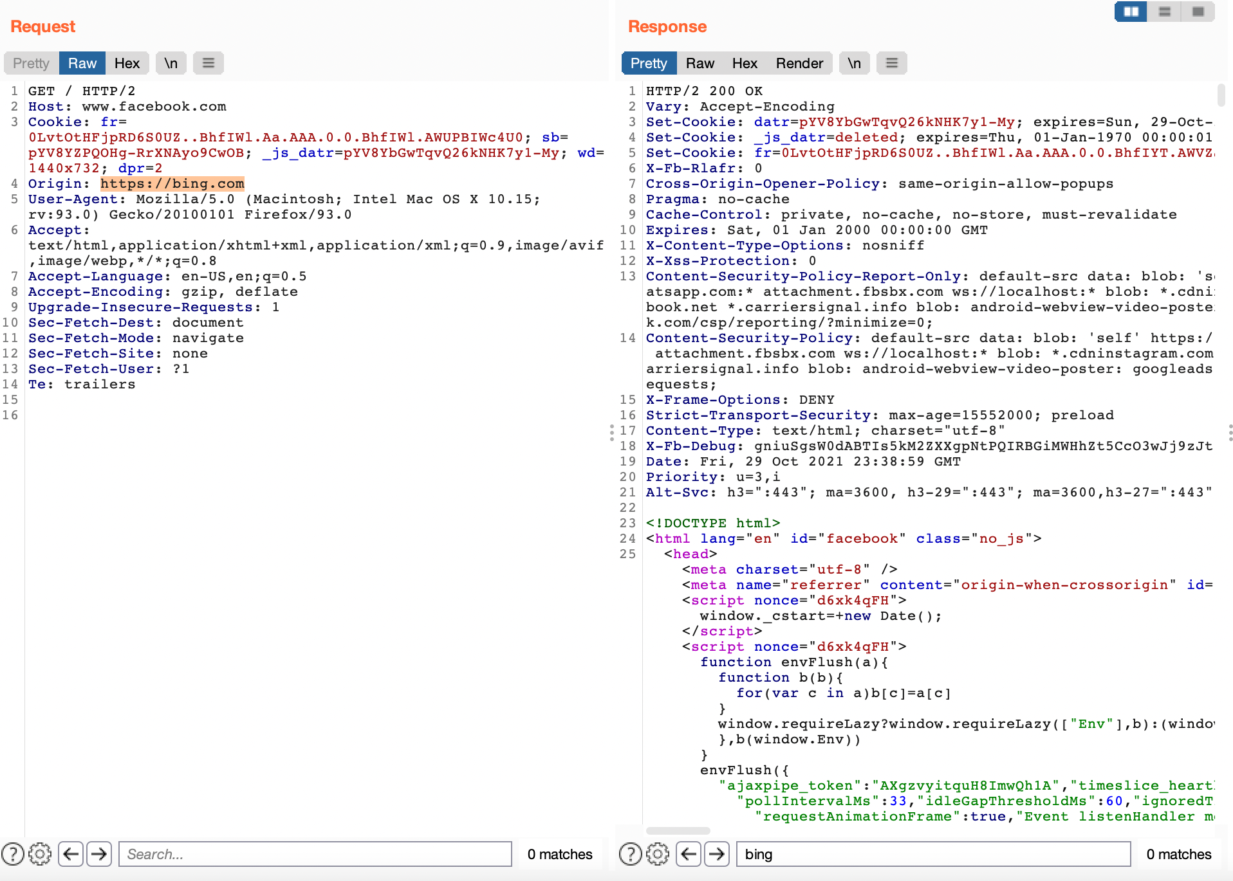
Testing on a secured website for Cross-Origin Resource Sharing Vulnerability
Injecting the origin to bing.com, but the domain facebook.com is secure from Cross-Origin Resource Sharing vulnerability, because of that we are not seeing the update origin in the response header.
Proper Configuration of Cross-Domain requests
Access-Control-Allow-Origin
Allow only trusted sites.
Avoid whitelisting null.
Avoid wildcards.
Authentication and session management for sensitive data.

Slide 14
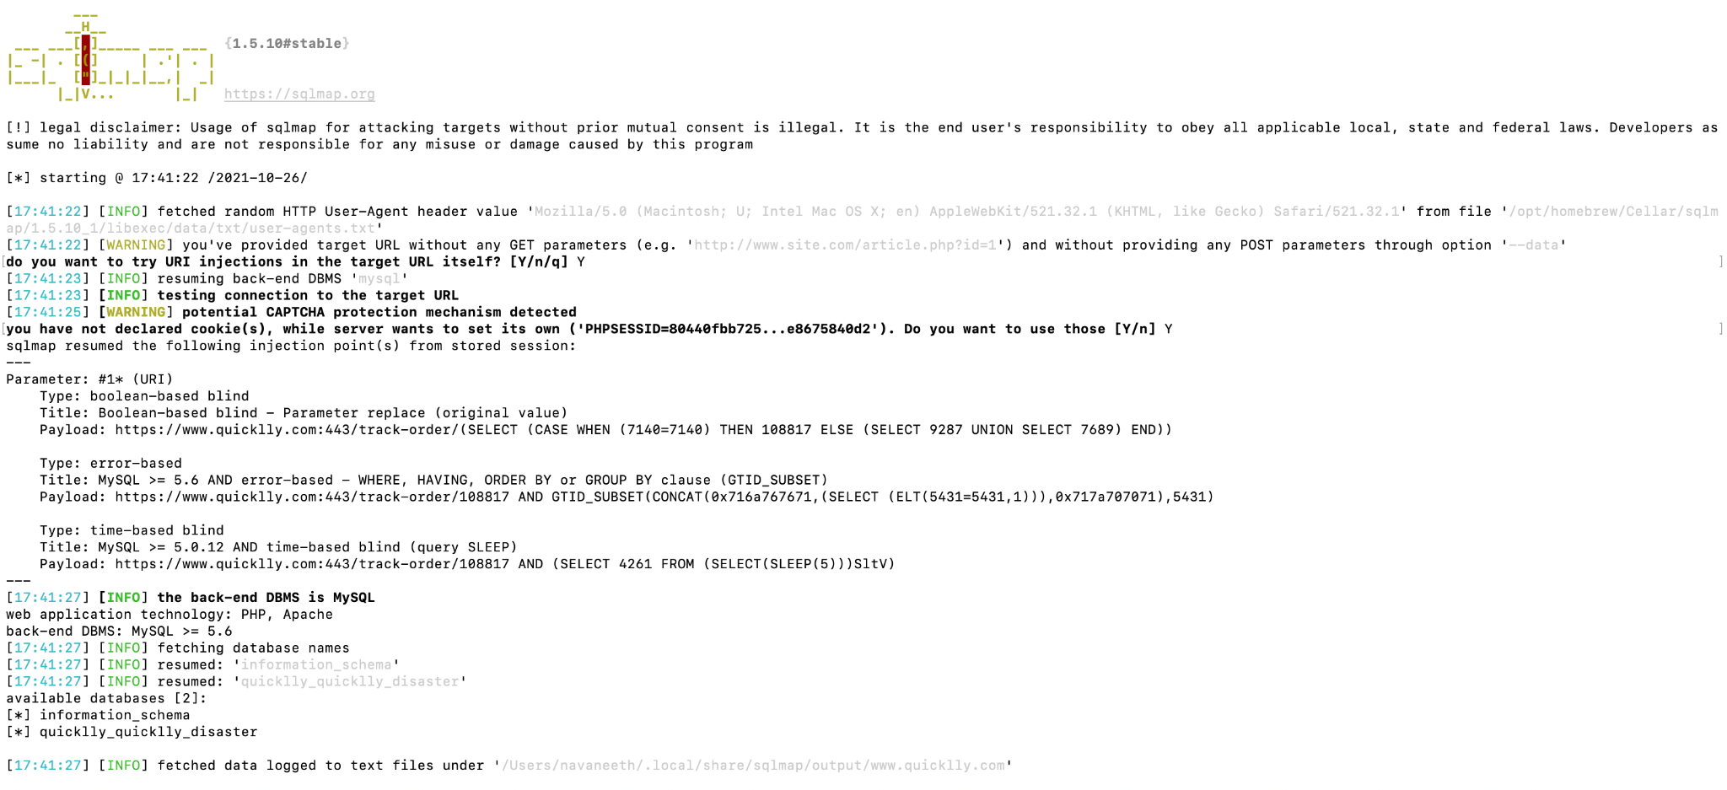
Exploiting SQL Injection vulnerability in HTTP and HTTPS connections
SQL Injection vulnerability is a common attack vector that uses malicious SQL code for backend database manipulation to access information that was not intended to be displayed. This information might include any number of items, including sensitive company data, user details or customer details.
Exploited SQL Injection vulnerability for the domain quicklly.com where the id parameter was vulnerable.
Used SQLMap tool to exploit the vulnerability with HTTP connection.
Retrieved the database dump
Information_schema
Quicklly_quicklly_disaster

Slide 15
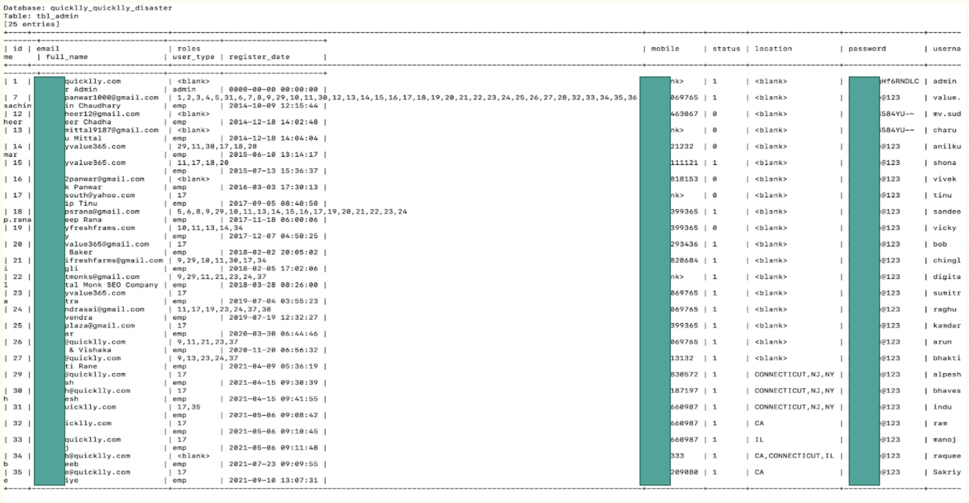
Admin Table dump

Slide 16
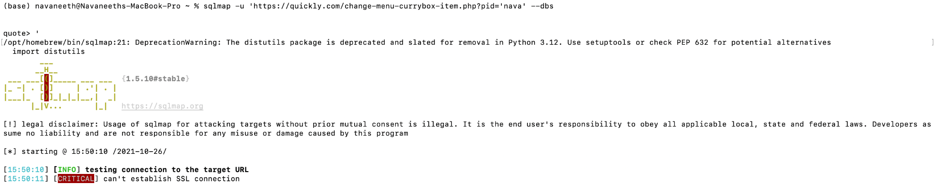
SQL Injection using SQLMap for HTTPS connection
SQL Injection using SQLMap for HTTPS connection failed to establish the connection, this doesn’t mean that SQL Injection is not possible in HTTPS connection, but using third party softwares to inject or exploit the vulnerability can be limited. From the below screenshot we can see that vulnerable parameter was not exploited.

Slide 17
Results of HSTS Security/ Penetration testing
Making security someone else’s problem is out of the equation. Just using the HSTS header doesn’t make the domain secure, it requires the developer to be aware of security policies, proper configurations to be able to use the HSTS header security to maximum extent.
Vulnerability chaining, even if the HSTS header is configured properly hacker can use a different vulnerability in the system to exploit the user and the purpose of the HSTS header is lost. Software developer teams and Security teams should be doing routine checks for vulnerabilities and if found, should be fixed on priority.
From a few of the literature reviews, we found that the most number of vulnerabilities, system down times are caused by the configuration errors, new security measures should be studied and pen tested before deploying the domain to the production environment.
OWASP Top 10 vulnerabilities should be tested thoroughly as multiple chaining vulnerabilities can be used by hackers to exploit users, company and the reputation of the company is at stake, as headlines like system down, domain hacked, user scammed make big headlines, making investors think about their investment and users to think about the safety of their data depending on the type of the website.
Usage of open source tools to test the domains and having knowledge about the same is important to keep the system secure.
No company, no system is bug or vulnerability free. Because of that there should be Public Bug Bounty programs enabled if the data is sensitive so ethical hackers can hack into systems, find vulnerabilities and report it responsibly. Security team can use these reports to make the system secure.

