Slide 1

OS: PROJECT
CONCURRENT MAPREDUCE FRAMEWORK USING OPERATING SYSTEM CONCEPT
Hunain Maqbool
Hammad Ali
Muhammad Faheem
Demo

Slide 2
Introduction
MapReduce helps chunk data processing projects into smaller pieces so they can run faster.
Using one processor to analyze a huge file with terabytes or petabytes of data might, for example, take 10 hours.
A MapReduce job can split that same data file into 10 tasks that run in parallel on 10 processors.
MapReduce facilitates concurrent processing by splitting petabytes of data into smaller chunks, and processing them in parallel on Hadoop commodity servers.
In the end, it aggregates all the data from multiple servers to return a consolidated output back to the application.
One real-life example of MapReduce is analyzing social media data. Imagine you want to analyze millions of tweets to find the most common hashtags.
The “map” step could involve splitting the data into smaller chunks and counting the occurrences of hashtags in each chunk.

Slide 3
FUNCTIONALITY
File ‘nestedwithfilereading.cpp’ contains our complete code which fulfils the goal of the project.
Initially we’ve created three Thread functions.
First Thread Fuctions is named ‘Split’ which is responsible for implementing the functionalities of both splitting and mapping.
It is splitting the given data (arrays) of items into separate threads. For example if the input data is of the following format:
[ {Deer,Bear,River}
{Car,Car,River}
{Deer,Car,Bear} ]
So the split thread aims to break this into three threads and then performs mapping. Which basically tells the occurrence of each unique items inside the thread (i.e {Car,Car,River}.
To handle this type of mapping we have implemented a struct of thread to cater keys and values of the generated dictionary.

Slide 4
Mapping functionality implemented inside the Split thread aims to generate a dictionary having key value pairs in the following format:
[ ‘Deer’:1,’Bear’:1,’River’:1] ,
[’Car’:2,’River’:1],
[”Deer”:1,”Car”:1,”Bear”:1]

Slide 5
Second thread aims to apply the functionality of shuffling, named as ‘Shuffle’. This thread aims to shuffle the key value pairs generated from the above steps.
Our Implementation is bit different from how it was instructed in the manual. As we are implementing the “Reduce” thread (which is the third thread) functionality inside the shuffle function.
So the Shuffle function transforms the key value pair in the following format:
‘Bear’:1
‘Bear’:1
‘Car’:1
‘Car’:1
‘Car’:1
‘Deer’:1
‘Deer’:1
‘River’:1
‘River’:1

Slide 6
Each of the keys having values greater than 1 are replicated into number of times the value they had.
Inside the same thread of Shuffle, after generating the above format output we proceeded with sending the generated arrays into Reduce thread.
Which aims to implement the procedure of getting total values of each unique key
The working flow is similar to what shown below on this page.
These totals will be returned to Shuffle thread, and shuffle thread will be responsible to send these values into the main function.

Slide 7
‘Bear’:1
‘Bear’:1
‘Car’:1
‘Car’:1
‘Car’:1
‘Deer’:1
‘Deer’:1
‘River’:1
‘River’:1
‘Bear’:2
‘Car’:3
‘Deer’:2
‘River’:2
Shuffle
Reduce

Slide 8
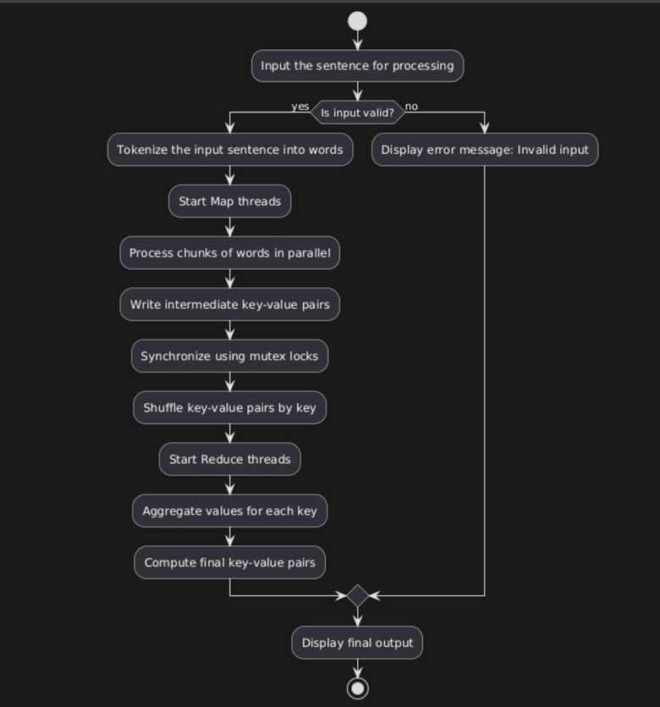
ACTIVITY DIAGRAMS

Slide 9

Diagram: 2
main
Split
Map
Reduce
Shuffle

Slide 10
TEST CASES
The file named 'testcode.cpp' functions the same as our main file, but it is run using a bash script called test_cases.sh.
Designed test case are assembled in the folder named ‘Testcases’. Which includes the text files having different variations of string to observe the algorithm at edge cases
In order to run the test case we need to follow the instructions mentioned in ‘Instructions.txt’

Slide 11
EDGE CASES
Empty File
Single Word
Same word with different characters
Single word repeated over 3000 times
A paragraph on Map reduce

Slide 12
THANK YOU!

