Slide 1


Data Warehousing Lecture I-II
Dr. Javed Ali Baloch

Slide 2
Outline
The need of Data warehousing
Merits of Data Warehousing
Applications of Data Warehousing
Multi-tiered Approach
Decision Support System
OLTP/Application Database vs Data Warehouse
Dimensionality Modeling
Schema Models
Data Mining

Slide 3
The need of Data warehousing
I can’t find the data I need
  data is scattered over the network
  many versions, subtle differences
I can’t get the data I need
  need an expert to get the data
I can’t understand the data I found
  available data poorly documented
I can’t use the data I found
  results are unexpected
  data needs to be transformed from one form to other

Slide 4


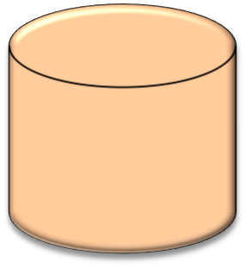



Why Data Warehousing?
Effective distribution
channel?
Identify
lowest/highest margin
customers ?
What product promotions have the biggest
impact on revenue?
Data Warehousing
Identify customers
and what products
are they buying?
Impact of new products/services
have on revenue
and margins?
Which customers
are most likely to go
to the competition ?

Slide 5
Merits of Data Warehousing
Maintains data history
Restructure data so that it makes sense
Integrate data
Sharing data and allowing others to easily access data
Potential high returns on investment
Competitive advantage
Increased productivity of corporate decision makers

Slide 6
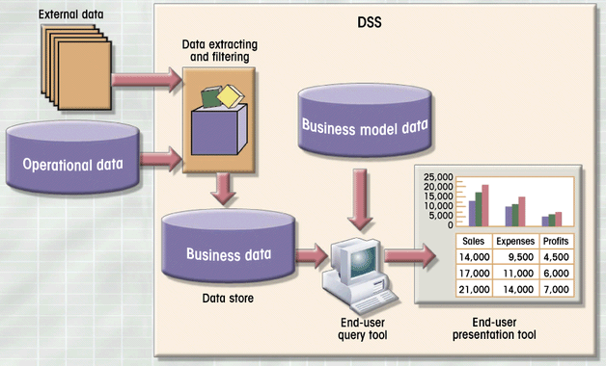
Decision Support System

Slide 7
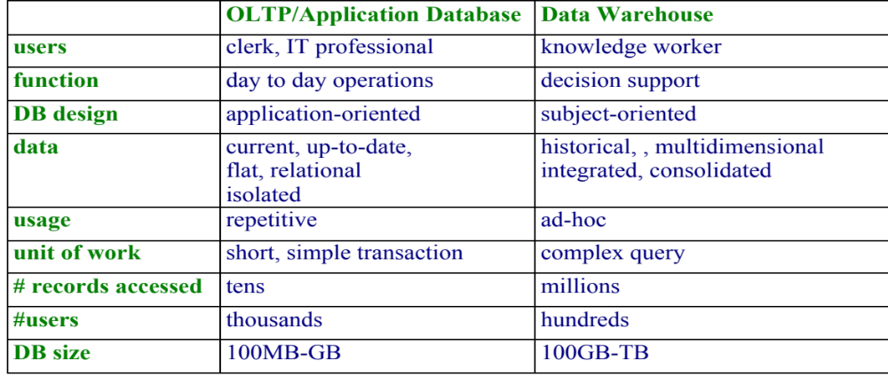
OLTP vs Data Warehouse

Slide 8
Multi-tiered Approach
OLTP Systems and other Data Sources
Extract,
Transform,
Load
Data Warehouse / Data Storage
Business
Intelligence/
Data Mining/
OLAP Engine
Front End Tools
Query, Reports, Analysis

Slide 9
Dimensionality Modelling
The database component of a data warehouse is described using a technique called dimensionality modelling.
DM is a Logical design technique that aims to present the data in a standard, intuitive form that allows for high-performance access.
Every dimensional model (DM) is composed of one table with a composite primary key, called the fact table, and a set of smaller tables called dimension tables.
Forms ‘star-like’ structure, which is called a star schema or star join.

Slide 10
Data warehousing Schemas
Star schema: A fact table in the middle connected to a set of
  dimension tables
Snowflake schema: A refinement of star schema where some
  dimensional hierarchy is normalized into a set of smaller dimension
  tables, forming a shape similar to snowflake
Fact constellations: Multiple fact tables share dimension tables,
  viewed as a collection of stars, therefore called galaxy schema or
  Fact constellation

Slide 11
Data Mining
Data mining is a process of discovering and interpreting patterns in data to solve a business problem.
Data Mining provides the Enterprise with Intelligence
The goal of data mining is to extract knowledge
from a data set in a human-understandable Structure
Data mining, the extraction of hidden predictive information from large databases

Slide 12
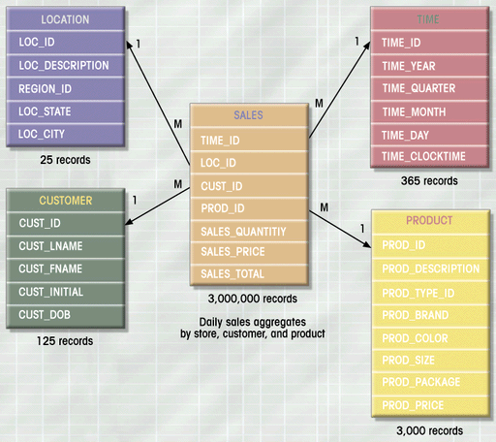
Star Schema

Slide 13
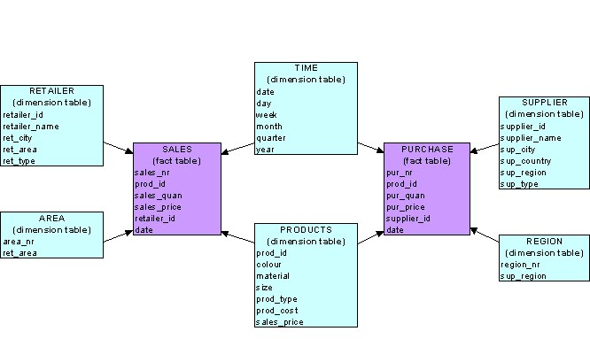
Fact Constellation/Galaxy Schema

Slide 14
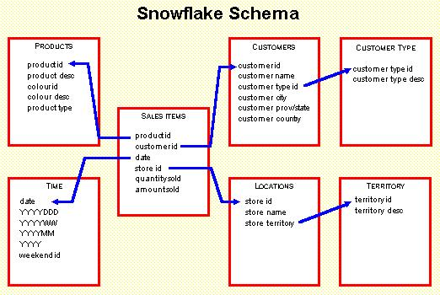
Snowflake Schema

Slide 15
Example of Star Schema
time
time_key
day
day_of_the_week
month
quarter
year
item
item_key
item_name
brand
type
supplier_type
Sales Fact Table
time_key
item_key
branch_key
branch
location
location_key
branch_key
branch_name
branch_type
location_key
street
city
province_or_street
country
units_sold
dollars_sold
avg_sales
Measures

Slide 16
Example of Snowflake Schema
time
item
time_key
day
day_of_the_week
month
quarter
year
item_key
item_name
brand
type
supplier_key
supplier
Sales Fact Table
supplier_key
supplier_type
time_key
item_key
branch_key
branch
location
location_key
location_key
street
city_key
branch_key
branch_name
branch_type
units_sold
city
dollars_sold
city_key
city
province_or_street
country
avg_sales
Measures

Slide 17
Example of Fact Constellation/Galaxy
time
time_key
day
day_of_the_week
month
quarter
year
item
Shipping Fact Table
item_key
item_name
brand
type
supplier_type
Sales Fact Table
time_key
time_key
item_key
shipper_key
item_key
branch_key
from_location
branch
location_key
location
to_location
branch_key
branch_name
branch_type
units_sold
location_key
street
city
province_or_street
country
dollars_cost
dollars_sold
units_shipped
avg_sales
shipper
Measures
shipper_key
shipper_name
location_key
shipper_type

