Slide 1
Process Synchronization

Slide 2
References
Operating System Concepts, 7th and 8th editions, Silberschatz et al. Wiley.
Modern Operating Systems, Andrew S. Tanenbaum, 3rd edition, 2009.

Slide 3
Outline
Background
The Critical-Section Problem
Peterson’s Solution
Synchronization Hardware
Semaphores
Classic Problems of Synchronization
Monitors
Synchronization Examples from operating systems

Slide 4
Objectives
To introduce the critical-section problem, whose solutions can be used to ensure the consistency of shared data
To present both software and hardware solutions of the critical-section problem

Slide 5
Background
Cooperative process and IPC mechanisms
Concurrent access to shared data may result in data inconsistency
Maintaining data consistency requires mechanisms to ensure the orderly execution of cooperating processes
Shared Data
Can be a shared memory
variable, a global variable
in a multi-thread program or
a file; or a kernel variable
Concurrent Threads or Processes

Slide 6
Producer Consumer Problem Revisited
Suppose that we wanted to provide a solution to the consumer-producer problem that fills all the buffers. We can do so by having an integer count that keeps track of the number of full buffers. Initially, count is set to 0. It is incremented by the producer after it produces a new buffer and is decremented by the consumer after it consumes a buffer.
also a shared variable
Producer
count
Consumer
Shared Buffer
at most BUFFER_SIZE items

Slide 7
Producer and Consumer Code
Producer
ConSUMER
while (true) {
/* produce an item and
put in nextProduced */
while (count == BUFFER_SIZE)
; // do nothing
buffer [in] = nextProduced;
in = (in + 1) % BUFFER_SIZE;
count++;
}
while (true) {
while (count == 0)
; // do nothing
nextConsumed = buffer[out];
out = (out + 1) % BUFFER_SIZE;
count--;
/* consume the item
in nextConsumed */
}

Slide 8
A possible Problem: race condition
Assume we had 5 items in the buffer
Then:
  Assume producer has just produced a new item and put it into buffer is about to increment the count.
  Assume the consumer has just retrieved an item from buffer and is about the decrement the count.
Situation: Assume producer and consumer are now about to execute count++ and count– statements.

Slide 9
A possible Problem: race condition
Producer
Consumer
or
Producer
Consumer

Slide 10
Race Condition
count++ could be implemented as
register1 = count
register1 = register1 + 1
count = register1
count-- could be implemented as
register2 = count
register2 = register2 - 1
count = register2

Slide 11
Interleaved Execution sequence
Consider this execution interleaving with “count = 5” initially:
  S0: producer execute register1 = count {register1 = 5}
  S1: producer execute register1 = register1 + 1 {register1 = 6}
  S2: consumer execute register2 = count {register2 = 5}
  S3: consumer execute register2 = register2 - 1 {register2 = 4}
  S4: producer execute count = register1 {count = 6 }
  S5: consumer execute count = register2 {count = 4}

Slide 12
Race Condition
register1
Count
PRODUCER (count++)
5
6
5
6
4
register1 = count
register1 = register1 + 1
count = register1
register1 = count
register1 = register1 + 1
count = register1
register2
5
4
CONSUMER (count--)
register2 = count
register2 = register2 – 1
count = register2
register2 = count
register2 = register2 – 1
count = register2
CPU
6
Main Memory

Slide 13

Race Conditions
Two processes want to access shared memory at the same time.

Slide 14
Programs and critical sections
The part of the program (process) that is accessing and changing shared data is called its critical section
Process 1 Code
Process 2 Code
Process 3 Code
Change X
Change X
Change Y
Change Y
Change Y
Change X
Assuming X and Y are shared data.

Slide 15
Program lifetime and its structure
Considering a process:
  It may be executing critical section code from time to time
  It may be executing non critical section code (remainder section) other times.
Requirement: We should not allow more than one process to be in their critical regions where they are manipulating the same shared data.

Slide 16

Critical Regions (2)
Mutual exclusion using critical regions.

Slide 17
Structuring Programs
The general way to do that is:
do {
entry section
critical section
exit section
remainder
} while (TRUE)
do {
critical section
remainder section
} while (TRUE)
The general structure of a program
Entry section will allow only one process to enter and execute critical section code.

Slide 18
Avoiding Race Condition
Conditions required to avoid race condition:
No two processes may be simultaneously inside their critical regions.
No assumptions may be made about speeds or the number of CPUs.
No process running outside its critical region may block other processes.
No process should have to wait forever to enter its critical region.

Slide 19
Mutual Exclusion with Busy Waiting
Proposals for achieving mutual exclusion:
Disabling interrupts
Lock variables
Strict alternation
Peterson's solution
The TSL instruction

Slide 20
Disabling interrupts
Allow each process to disable all interrupts just after entering its critical region and re-enable them just before leaving it
Unattractive approach because it is unwise to give user processes the power to turn of interrupts.
  Suppose one of them did it and never turned them on again?
What if the computer have multiple cores?
More suitable for kernel of the operating systems

Slide 21
Solution to Critical-section Problem Using Locks
do {
acquire lock
critical section
release lock
remainder section
} while (TRUE);
Only one process can acquire lock. Others has to wait (or busy loop)

Slide 22
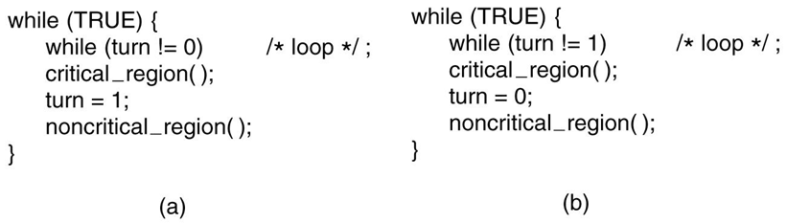
Strict Alternation
A proposed solution to the critical region problem.
(a) Process 0. (b) Process 1. In both cases, be sure to note the semicolons terminating the while statements.

Slide 23
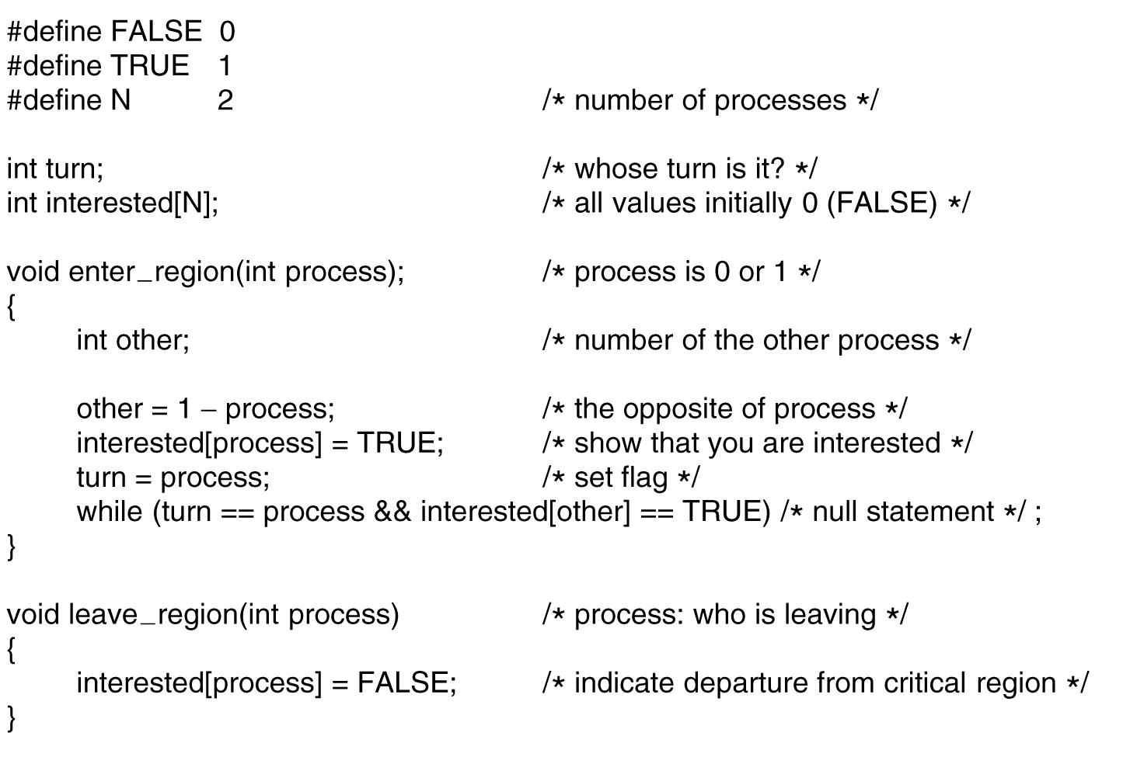
Peterson's Solution
Peterson’s solution for achieving mutual exclusion.1

Slide 24
Atomic Hardware Instructions
Modern machines provide special atomic hardware instructions
    Atomic = non-interruptible
  Either test memory word and set value (TestAndSet)
  Or swap contents of two memory words (Swap)

Slide 25
The TSL Instruction
Many computers have a special command in their architecture called “Test and Set Lock”
  TSL RX, LOCK
  Reads the contents of a memory word lock into register RX and then stores a nonzero value at memory address lock
  Atomic/Indivisible: CPU executing TSL instruction locks the memory bus to prohibit other CPUs from accessing the memory
When lock is 0, any process may set it to 1 using the TSL instruction and then it can enter its critical section
When the process is done with its critical section, it sets the lock back to 0 using a MOV instruction
Problem ☹ - Busy waiting

Slide 26
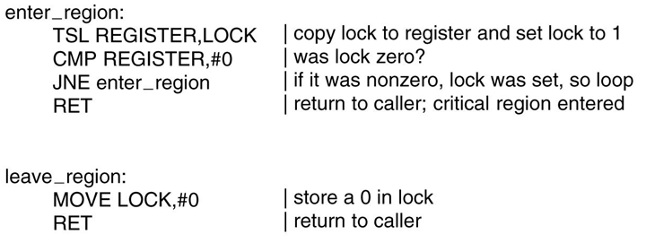
The TSL Instruction
Entering and leaving a critical region using the TSL instruction.

Slide 27
Sleep and Wakeup
Apparently both Peterson’s and TSL are correct but they require busy waiting
Busy waiting results in wastage of CPU time.
In certain cases it can have unexpected effects
  Assume preemptive priority based scheduling
  Consider a system with two processes: H (high priority), L (low priority)
  At a certain moment, L is in its critical section but H becomes ready to run.
  L will be preempted and H will be assigned CPU
  If H now decides to use its critical section it can’t use it as L has not finished with its critical section yet
  RESULT: H loops forever “Priority Inversion Problem”

Slide 28
Sleep and Wakeup
Lets look at the IPC methods that block instead of busy waiting (or wasting CPU time)
Such techniques usually employ some IPC primitives to accomplish this job
What kind of primitives?
  sleep and wakeup system calls
sleep: causes the caller to block/suspended until another process wakes it up
wakeup: wakes up a process that is passed as parameter (the process to be awakened)

Slide 29
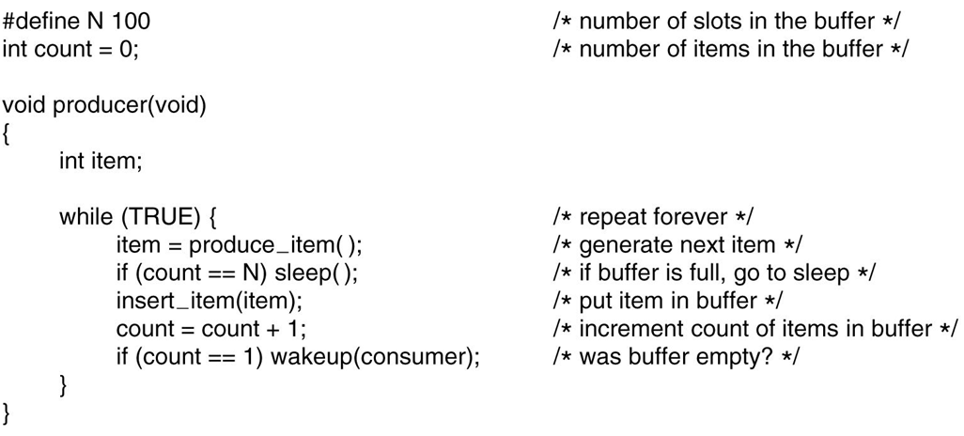
The Producer-Consumer Problem (1)
. . .
The producer-consumer problem with a fatal race condition.

Slide 30
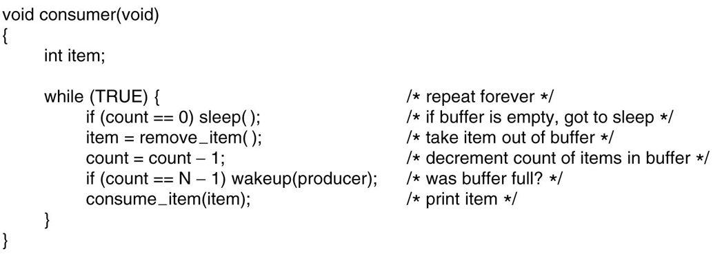
The Producer-Consumer Problem (2)
The producer-consumer problem with a fatal race condition.

Slide 31
Semaphore
Synchronization tool that does not require busy waiting
Semaphore S: integer variable
shared, and can be a kernel variable
Two standard operations modify S: wait() and signal()
    Originally called P() and V()
    Also called down() and up()
  Semaphores can only be accessed via these two indivisible (atomic) operations;
  They can be implemented as system calls by kernel. Kernel makes sure they are indivisible.
Less complicated entry and exit sections when semaphores are used

Slide 32
Semaphore Operations: Meaning
down (S): indivisible (until calling process is blocked)
  if S is positive (S > 0), decrement S and return.
    will not cause the process to block.)
  If S is not positive, then the calling process is put to sleep (blocked), until someone does a up and this process is selected to wakeup.
up (S): indivisible (never blocks the calling process)
  If there is one or more processes sleeping on S, then one process is selected and waken up, and up returns.
  If there is no process sleeping, then S is simply incremented by 1 and up returns.

Slide 33
Semaphore as General Synchronization Tool
Binary semaphore – integer value can range only between 0
and 1; can be simpler to implement
  Also known as mutex locks
  Binary semaphores provides mutual exclusion; can be used for the critical section problem.
Counting semaphore – integer value can range over an unrestricted domain
  Can be used for other synchronization problems; for example for resource allocation.

Slide 34
Usage
Binary semaphores (mutexes) can be used to solve critical section problems.
A semaphore variable (lets say mutex) can be shared by N processes, and initialized to 1.
Each process is structured as follows:
  do {
  down (mutex);
  // Critical Section
  up (mutex);
  // remainder section
  } while (TRUE);

Slide 35
usage: mutual exclusion
Process 0
Process 1
  do {
  down (mutex);
  // Critical Section
  up (mutex);
  // remainder section
  } while (TRUE);
  do {
  down (mutex);
  // Critical Section
  up (mutex);
  // remainder section
  } while (TRUE);
down() {…}
signal() {…}
Kernel
Semaphore mutex; // initialized to 1

Slide 36
usage: resource allocation
Assume we have a resource that has 5 instances. A process that needs that type of resource will need to use one instance. We can allow at most 5 process concurrently using these 5 resource instances. Another process (processes) that want the resource need to block. How can we code those processes?
Solution:
one of the processes creates and initializes a semaphore to 5.
semaphore x = 5; // semaphore to access resource
down (x);
…
….use one instance
of the resource…
…
up (x);
Each process has to be
coded in this manner.

Slide 37
Semaphore Implementation
Must guarantee that no two processes can execute down() and up() on the same semaphore at the same time.
Kernel can guarantee this.
typedef struct {
int value;
struct process *list;
} semaphore;

Slide 38
Semaphore Implementation with no Busy waiting
With each semaphore there is an associated waiting queue.
  The processes waiting for the semaphore are waited here.

Slide 39
Semaphore Implementation with no Busy waiting (Cont.)
Implementation of down:
down(semaphore *S) {
S->value--;
if (S->value < 0) {
add this process to S->list; block the process;
}
}
Implementation of up:
up(semaphore *S) {
S->value++;
if (S->value <= 0) {
remove a process P from S->list; wakeup the process;
}
}

Slide 40
Kernel Implementing wait and signal
The down and up operations must be atomic. The integer value is updated. No two process should update at the same time.
How can the kernel ensure that? It can NOT use semaphores to implement semaphores.

Slide 41
Deadlock and Starvation
Deadlock – two or more processes are waiting indefinitely for an event that can be caused by only one of the waiting processes
Let S and Q be two semaphores initialized to 1
P₀ P₁
wait (S); wait (Q);
wait (Q); wait (S);
. .
. .
. .
signal (S); signal (Q);
signal (Q); signal (S);
Starvation – indefinite blocking. A process may never be removed from the semaphore queue in which it is suspended
Priority Inversion - Scheduling problem when lower-priority process holds a lock needed by higher-priority process

Slide 42
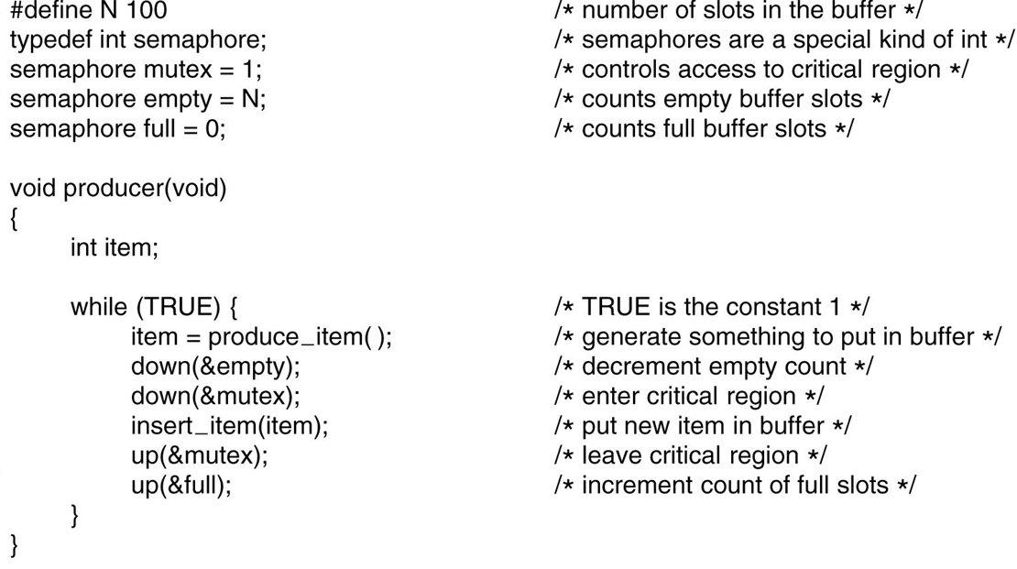
Semaphores (1)
. . .
The producer-consumer problem using semaphores.

Slide 43
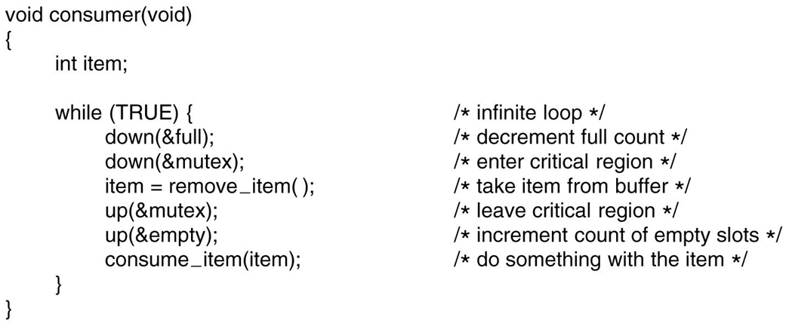
Semaphores (2)
The producer-consumer problem using semaphores.

Slide 44
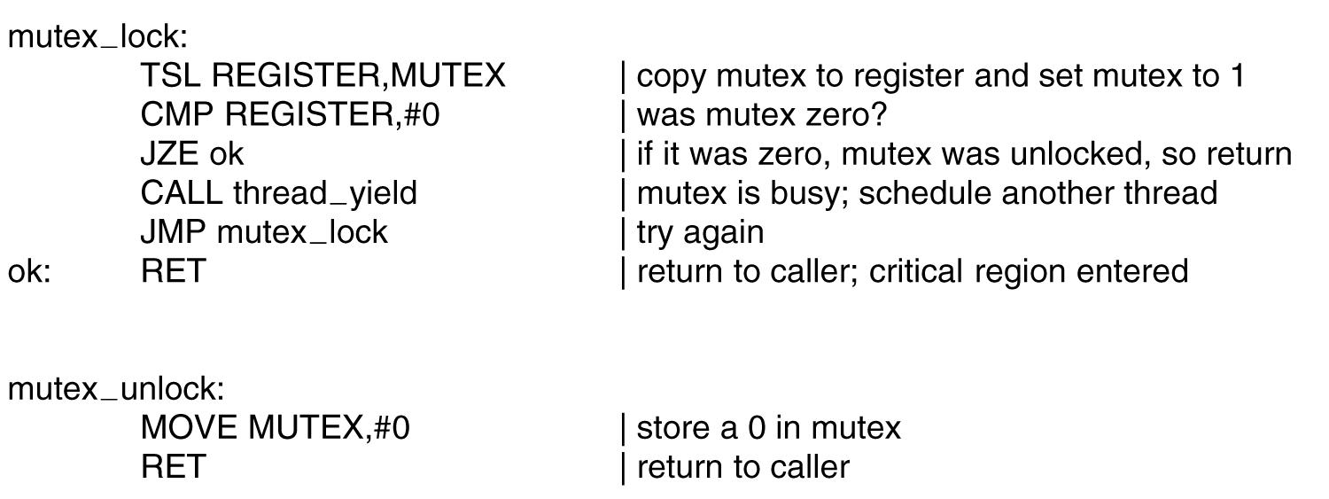
Mutexes
Implementation of mutex lock and mutex unlock.

Slide 45
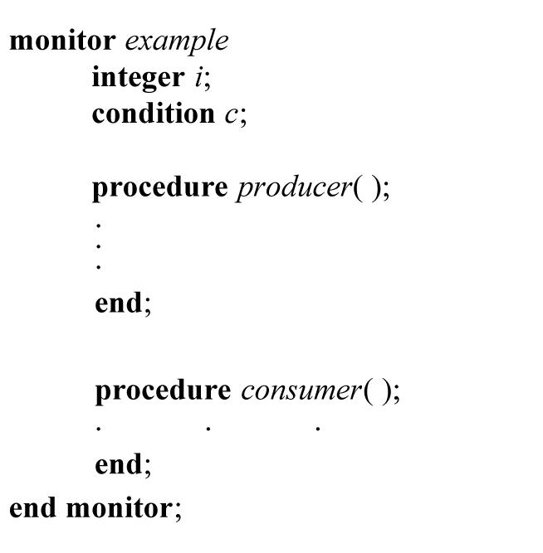
Monitors (1)
A monitor.

Slide 46
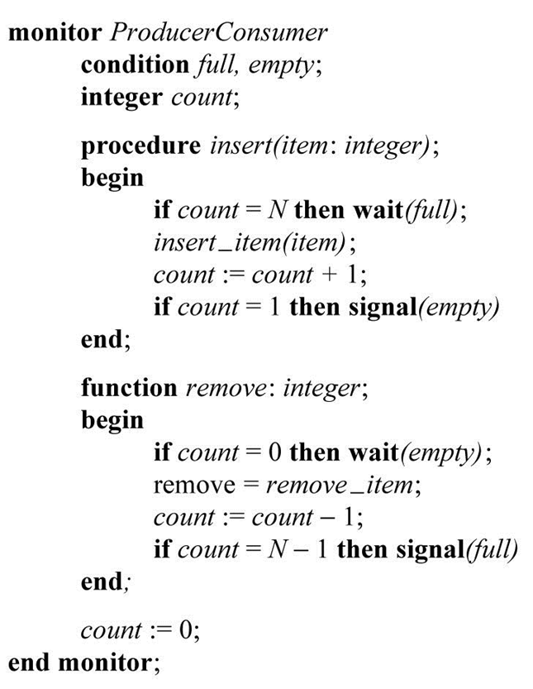
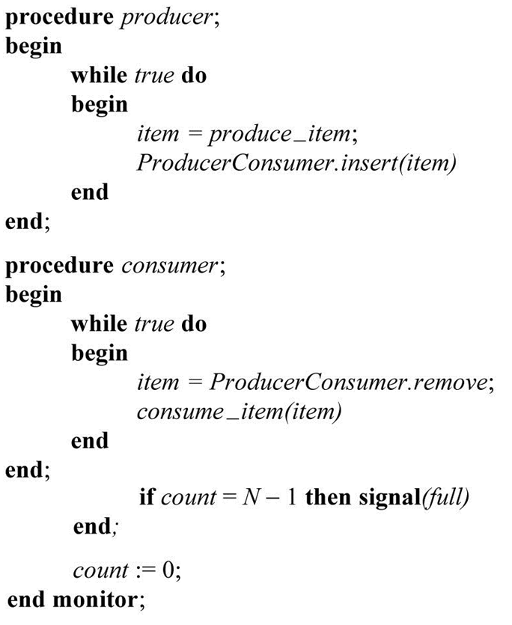
Monitors (2)
An outline of the producer-consumer problem with monitors.

Slide 47
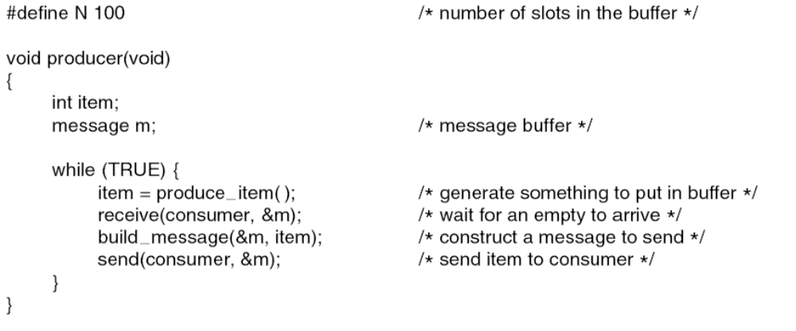
Producer-Consumer Problem
with Message Passing (1)
. . .
The producer-consumer problem with N messages.

Slide 48
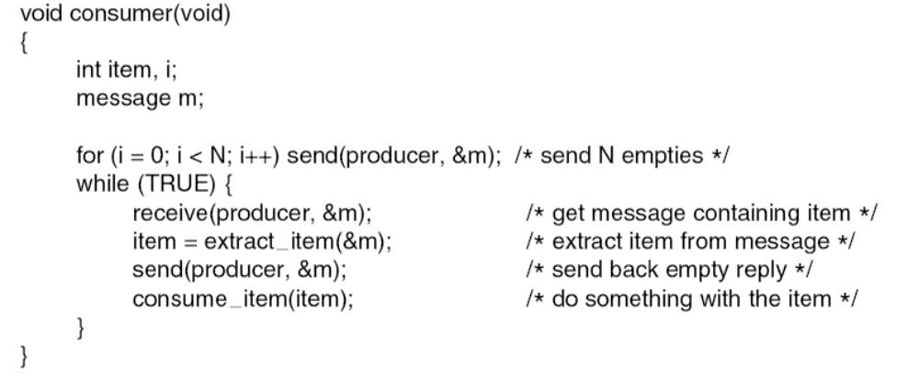
Producer-Consumer Problem
with Message Passing (2)
The producer-consumer problem with N messages.

Slide 49
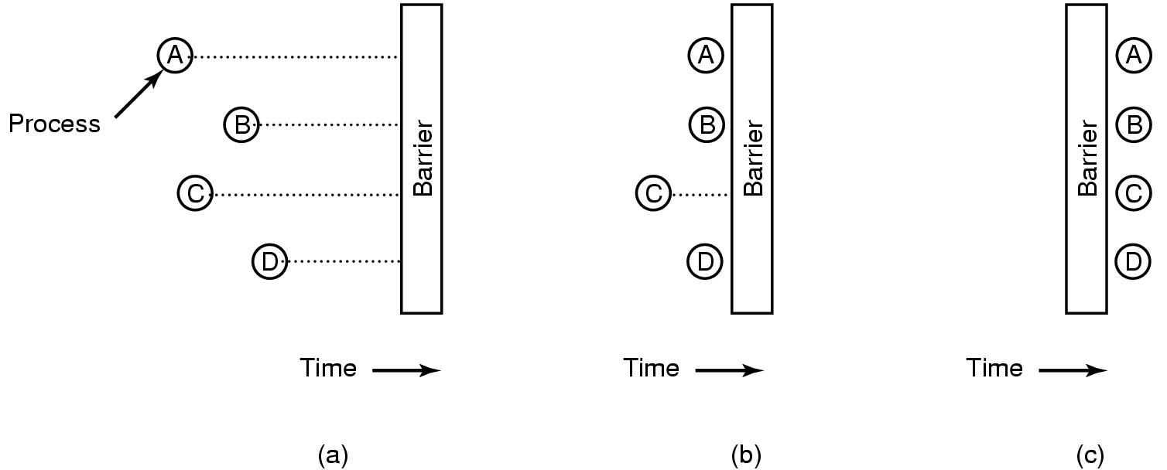
Barriers
Use of a barrier. (a) Processes approaching a barrier. (b) All processes but one blocked at the barrier. (c) When the last process arrives at the barrier, all of them are let through.

Slide 50

Dining Philosophers Problem (1)
Lunch time in the Philosophy Department.

Slide 51
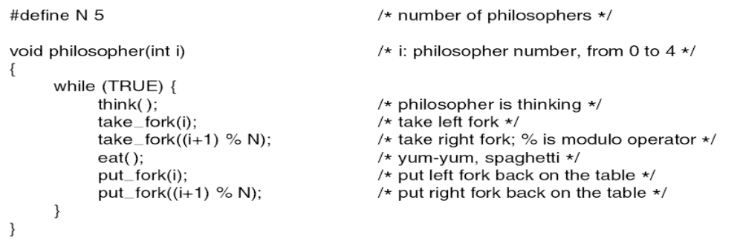
Dining Philosophers Problem (2)
A nonsolution to the dining philosophers problem.

Slide 52
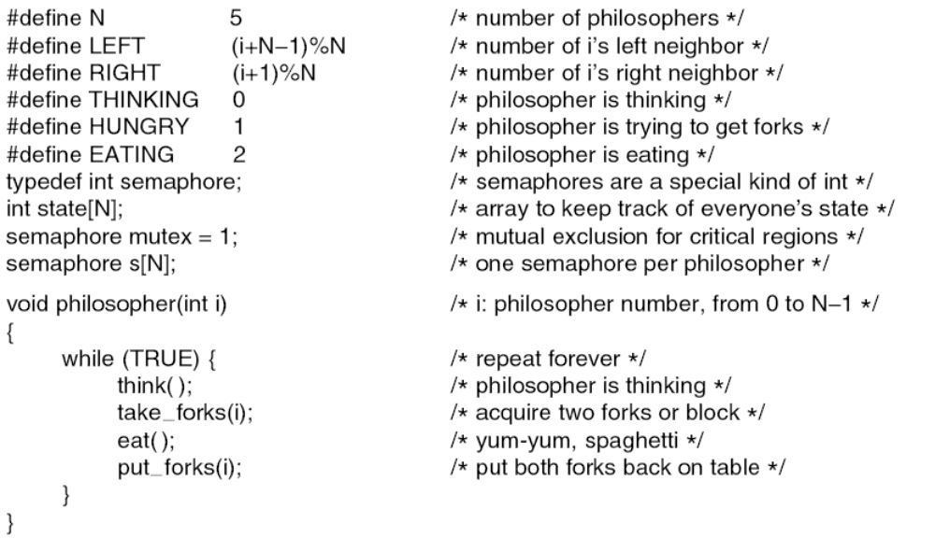
Dining Philosophers Problem (3)
. . .
A solution to the dining philosophers problem.

Slide 53
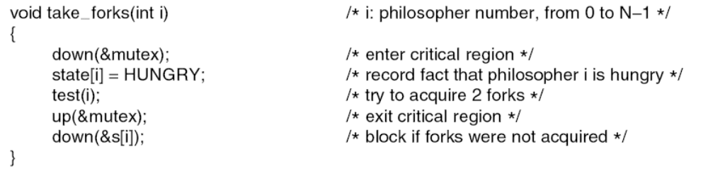
Dining Philosophers Problem (4)
. . .
. . .
A solution to the dining philosophers problem.

Slide 54
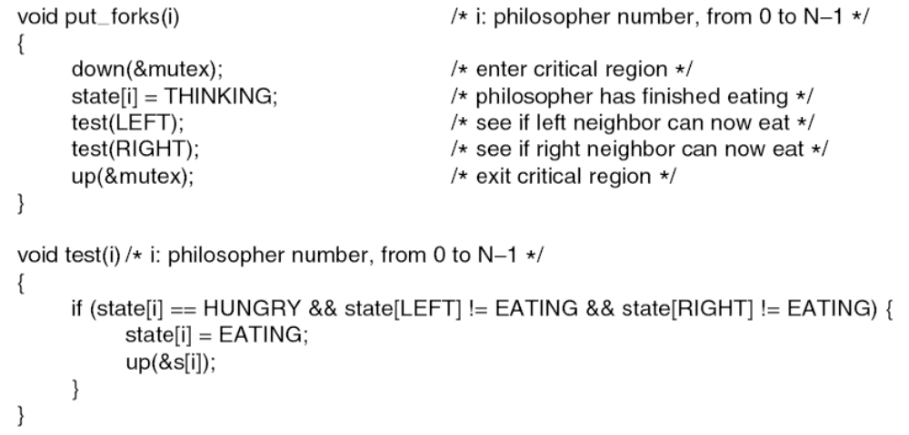
Dining Philosophers Problem (5)
. . .
A solution to the dining philosophers problem.

Slide 55
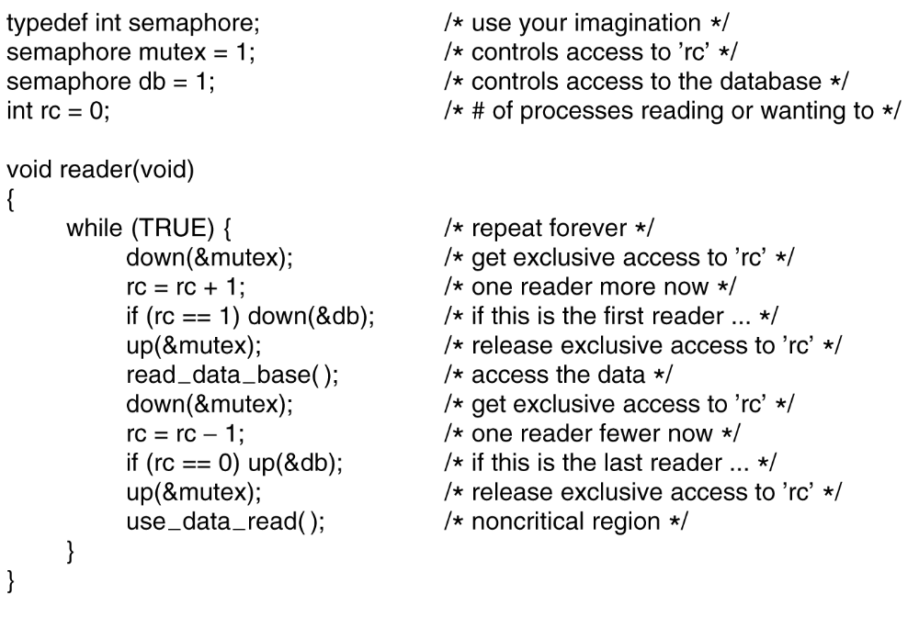
The Readers and Writers Problem (1)
. . .
A solution to the readers and writers problem.

Slide 56
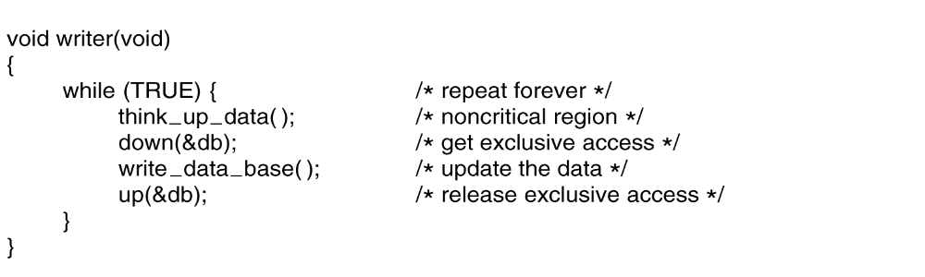
The Readers and Writers Problem (2)
. . .
A solution to the readers and writers problem.

Slide 57
End of lecture

Slide 58
Quiz

Slide 59
1. Briefly define the following terms (in 3 lines):
  Turnaround time
  Response time
  Waiting time
  Preemptive scheduling
  Non-preemptive scheduling
  Starvation
  Convoy Effect
  Race condition
2. Discuss the impact of time quantum on the following
  Priority scheduling
  Round robin scheduling
  Shortest job first scheduling

Slide 60
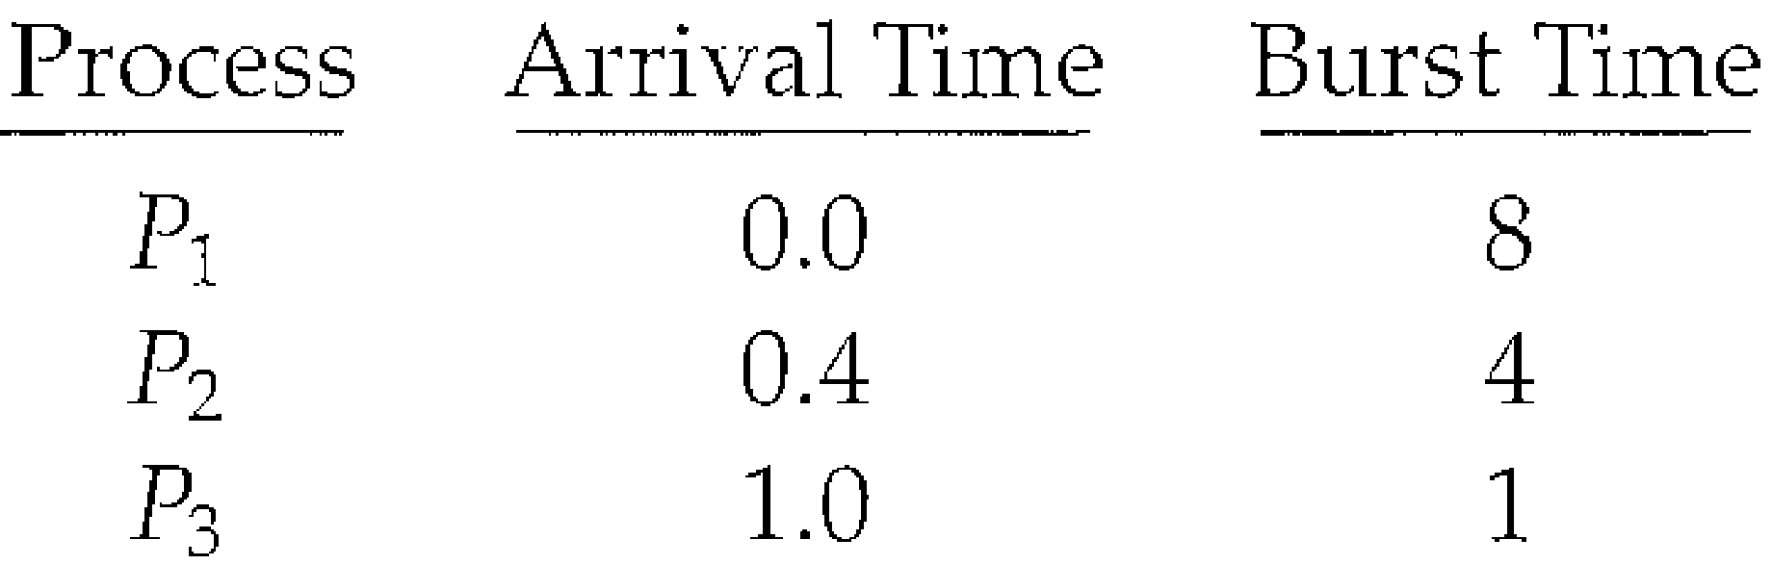
Suppose that the following processes arrive for execution at the times indicated. Each process will run for the amount of time listed. In answering the questions, use non-preemptive scheduling, and base all decisions on the information you have at the time the decision must be made:
What is the average turnaround and average waiting time for these processes with the FCFS scheduling algorithm?
What is the average turnaround and average waiting time for these processes with the SJF scheduling algorithm?
The SJF algorithm is supposed to improve performance, but notice that we chose to run process P₁ at time 0 because we did not know that two shorter processes would arrive soon. Compute what the average turnaround time will be if the CPU is left idle for the first 1 unit and then SJF scheduling is used. Remember that processes P₁ and P₂ are waiting during this idle time, so their waiting time may increase. This algorithm could be known as future-knowledge scheduling.

