Slide 1
Processes

Slide 2
References
Operating System Concepts, 7th and 8th editions, Silberschatz et al. Wiley.
Modern Operating Systems, Andrew S. Tanenbaum, 3rd edition, 2009.

Slide 3
Objectives
To introduce the notion of a process -- a program in execution, which forms the basis of all computation
To describe the various features of processes, including scheduling, creation and termination, and communication
To describe communication in client-server systems

Slide 4
Outline
Process Concept
Process Scheduling
Operations on Processes
Interprocess Communication
Examples of IPC Systems
Communication in Client-Server Systems
Reading Assignment

Slide 5
Process Concept
A process can be thought of as a program in execution
  To accomplish its task a process require:
    CPU time
    Memory
    Files
    I / O devices
Resources are allocated:
  Upon creation
  During execution
Traditionally a process contained a single thread of control

Slide 6
Process Concept
Modem operating systems support processes having multiple threads
Process / Thread management responsabilities:
  Creation and deletion of both user and system processes
  Scheduling of processes
  Provision of mechanisms for synchronization
  Communication
  Deadlock handling

Slide 7
Process Concept
Early computers were batch processing
  Only one program can be executed at a time
  The running program had access to all the system resources
Modern computer systems are multiprogramming
  Multiple programs to be loaded and executed concurrently
  Required more firm control of various running programs
Resulted in the concept of a process
  Unit of work in modern time-sharing systems
Main concern is execution of user programs, but it also needs to take care of system tasks

Slide 8
Process Concept
A system consists of a collection of processes:
  Operating system processes executing system code
  User processes executing user code
Operating system makes the computer more productive by switching CPU among different processes

Slide 9
Process Concept
Terminologies for CPU activities:
  Batch system – jobs
  Time-shared systems – user programs or tasks
The terms job and process are used interchangeably
Process – a program in execution;
  execution must progress in sequential fashion
A process includes:
  text – code – section (program counter – PC)
  stack section (stack pointer)
  data section
  set of open files currently used
  set of I/O devices currently used

Slide 10

Process in Memory (Structure)
Stack segment
(holds the called function parameters,
local variables)
Storage for dynamically allocated
variables
Data segment
(includes global
variables, arrays, etc., you use)
Text segment
(code segment)
(instructions are here)
A process needs this to
be in memory
(address space; memory image)

Slide 11
Process: program in execution
CPU
(Physical)
Main
Memory
(RAM)
registers
PSW
PC
IR
CPU state
of the process
(CPU context)
process address space
(currently used portion of the address space
must be in memory)

Slide 12
Process: program in execution
If we have a single program running in the system, then the task of OS is easy:
  load the program, start it and program runs in CPU
  (from time to time it calls OS to get some service done)
But if we want to start several processes, then the running program in CPU (current process) has to be stopped for a while and other program (process) has to run in CPU.
To do this switch, we have to save the state/context (register values) of the CPU which belongs to the stopped program, so that later the stopped program can be re-started again as if nothing has happened.

Slide 13

CPU Switch from Process to Process

Slide 14
Multiple Processes
one program counter
Process
A
processes
Three program counters
Process
B
C
Process
A
Process
B
Process
C
B
Process
C
A
time
Conceptual model
of three different
processes
what is
happening
physically
one process
executing at
a time

Slide 15
Process State
As a process executes, it changes state
  new: The process is being created
  running: Instructions are being executed
  waiting: The process is waiting for some event to occur
  ready: The process is waiting to be assigned to a processor
  terminated: The process has finished execution
In a single-CPU system, only one process may be in running state; many processes may be in ready and waiting states

Slide 16

Diagram of Process State

Slide 17
Process Control Block
How to represent a process in the memory?
Keep information associated with each process
  Process state (ready, running, waiting, etc)
  Program counter (PC)
  CPU registers
  CPU scheduling information
    Priority of the process, etc.
  Memory-management information
    text/data/stack section pointers, sizes, etc.
    pointer to page table, etc.
  Accounting information
    CPU usage, clock time so far, …
  I/O status information
    List of I/O devices allocated to the process, a list of open files, etc.

Slide 18
Process Control Block (PCB)
Process management
Registers
Program Counter (PC)
Program status word (PSW)
Stack pointer
Process state
Priority
Scheduling parameters
Process ID
Parent Process
Time when process started
CPU time used
Children’s CPU time
Memory management
Pointer to text segment info
Pointer to data segment info
Pointer to stack segment info
File management
Root directory
Working directory
File descriptors
User ID
Group ID
……more
a PCB of a process may contain this information

Slide 19
Maintaining a PCB by OS
Process 1
Process 2
Process 3
Process N
stack
stack
stack
stack
process
address space
data
data
data
data
text
text
text
text
PCB
1
PCB
2
PCB
3
PCB
N
Kernel Memory
Kernel mains a PCB for each process. They can be linked together in various queues.

Slide 20
Process Representation in Linux
In Linux kernel source tree, the file include/linux/sched.h contains
the definition of the structure task_struct, which is the PCB for a process.
struct task_struct {
long state; /* state of the process */
….
pid_t pid; /* identifier of the process */
…
unisgned int time_slice; /* scheduling info */
…
struct files_struct *files; /* info about open files */
….
struct mm_struct *mm; /* info about the address space of this process */
…
}

Slide 21
Threads
So far a process model has implied that a process is program performing a single thread of execution
  Cannot perform more than one task at a time
  User cannot type in characters and run a spell checker simultaneously in a word processor program
Many modern operating systems extend the concept to allow to have multiple threads of execution
  Can perform more than one task at a time

Slide 22
Process Scheduling
Purpose of multiprogramming
  Some processes running at all time to maximize CPU utilization
Purpose of time-sharing
  Switch CPU among competing processes so that user can interact with each loaded program
Process scheduler selects an available process for program execution at the CPU
The selected processes are usually kept in a ready queue

Slide 23
Process Scheduling Queues
Job queue – set of all processes in the system
Ready queue – set of all processes residing in main memory, ready and waiting to execute
Device queues – set of processes waiting for an I/O device
Processes migrate among the various queues

Slide 24

Ready Queue & Various I/O Device Queues

Slide 25
Process Scheduling
A new process is initially put in the ready queue until it is dispatched.
During execution, one of several events could occur:
  The process issues an I/0 request -> goes to I/0 queue.
  The process creates a new subprocess -> enters waiting state.
  The process removed forcibly from the CPU -> interrupt.
In (1) and (2), the process eventually switches from the waiting state to the ready state and is then put back in the ready queue.
A process continues this cycle until it is terminated

Slide 26
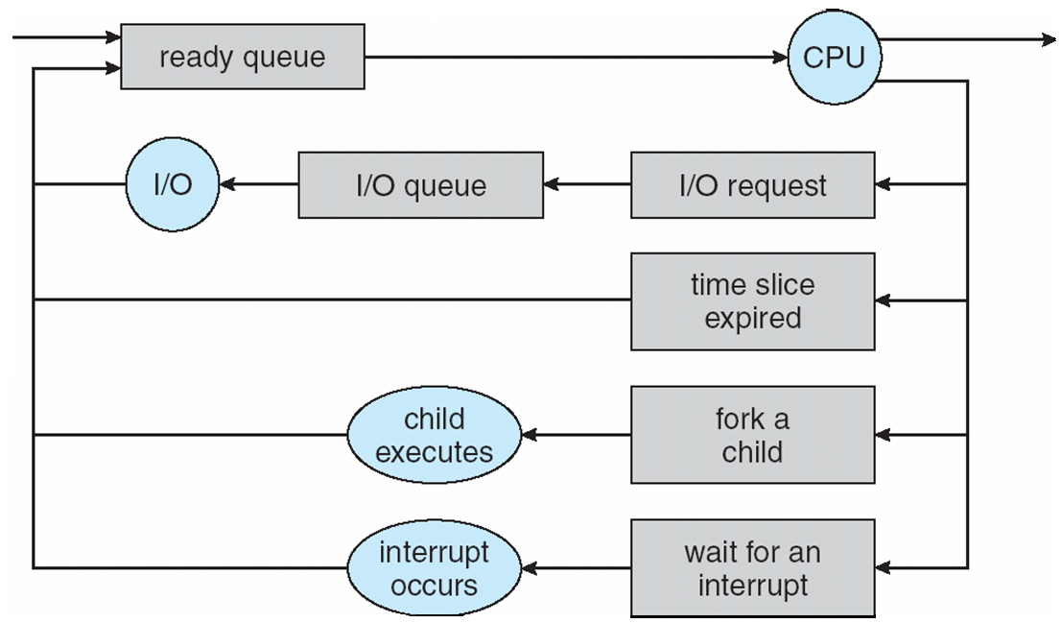
Representation of Process Scheduling
CPU Scheduler
ready queue
I/O queue

Slide 27
Schedulers
Long-term scheduler (or job scheduler) – selects which processes should be brought into the ready queue
Short-term scheduler (or CPU scheduler) – selects which process should be executed next and allocates CPU
Short-term
scheduler
CPU
ready queue
Long-term
scheduler
Main Memory
job queue

Slide 28
Schedulers
Difference – frequency of execution
Short-term scheduler – selects next process to be executed more frequently
  Must be fast
  Process executes for 100 milliseconds
  Short-term scheduler executes for 10 milliseconds
  Overhead is 10/(100+10)=9% of CPU time wasted is scheduling
Long-term scheduler – selects next process to be executed less frequently
  May be slow
  Controls the degree of multiprogramming (# of processes in memory)

Slide 29
Process Behaviour
Processes can be described as either:
  I/O-bound process – spends more time doing I/O than computations, many short CPU bursts
  CPU-bound process – spends more time doing computations; few very long CPU bursts
    CPU burst: the execution of the program in CPU between two I/O requests (i.e. time period during which the process wants to
    continuously run in the CPU without making I/O)
      We may have a short or long CPU burst.

Slide 30

Addition of Medium Term Scheduling
Medium term
scheduler
Medium term
scheduler
Short term
Scheduler
(CPU Scheduler)

Slide 31
Context Switch
When CPU switches to another process, the system must
  save the state of the old process
  load the saved state for the new process
  via a context switch
Context of a process represented in the PCB
Context-switch time is overhead; the system does no useful work while switching
Time dependent on hardware support

Slide 32
CPU Switch from Process to Process

Slide 33
Process Creation
Parent process create children processes, which, in turn create other processes, forming a tree of processes
Generally, process identified and managed via a process identifier (pid)
Resource sharing alternatives:
  Parent and children share all resources
  Children get subset of parent’s resources
  Parent and child share no resources
Execution alternatives:
  Parent and children execute concurrently
  Parent waits until children terminate
Process
Process
Process
Process
Process
Process

Slide 34
Process Creation (Cont)
Child’s address space?
Child has a new address space.
Child’s address space can contain:
  the copy of the parent (at creation)
  has a new program loaded into it
UNIX examples
  fork system call creates new process
  exec system call used after a fork to replace the process’ memory space with a new program
Parent
AS
Child
AS
1)
Parent
AS
Child
AS
2)

Slide 35
C Program Forking Separate Process
int main()
{
pid_t n; // return value of fork; it is process ID
/* fork another process */
n = fork();
if (n < 0) { /* error occurred */
fprintf(stderr, "Fork Failed");
exit(-1);
}
else if (n == 0) { /* child process */
execlp("/bin/ls", "ls", NULL);
}
else { /* parent process */
/* parent will wait for the child
to complete */
wait (NULL);
printf ("Child Complete");
exit(0);
}
}
Parent
n=?
pid=x
before fork() executed
Parent
n=y
Child
n=0
pid=x
pid=y
after fork() executed
Parent
n=y
Child
pid=x
pid=y
after execlp() executed

Slide 36
Execution Trace: fork()
Process-Parent
Process-Child
stack
n
y
stack
n
0
PC
data
data
….
n=fork();
If (n == 0)
..
else if (n>0)
...
….
n=fork();
If (n == 0)
..
else if (n>0)
...
text
text
CPU
PC
PC
x
pid
y
pid
PCB-Parent
PCB-Child
sys_fork()
{….}
RAM
Kernel

Slide 37
Execution Trace: fork() with execlp()
Process-Parent
Process-Child
stack
n
y
stack
n
0
PC
data
data
….
n=fork();
If (n == 0)
…exec()
else if (n>0)
...
….
n=fork();
If (n == 0)
…exec()
else if (n>0)
...
text
text
new code
CPU
PC
PC
x
pid
y
pid
PCB-Parent
PCB-Child
sys_fork()
{….}
sys_execve()
{….}
RAM
Kernel

Slide 38
Family of exec() Functions in Unix
Program A
Program B
…
execlp(…);
…
…
execv(…);
…
Your Programs
…..
user
mode
execl(...)
{…}
execlp(...)
{…}
execle(...)
{…}
execv(...)
{…}
execvp(...)
{…}
execve(...)
{…}
C Library
sys_execve(…)
{
…
}
kernel
mode
Kernel

Slide 39
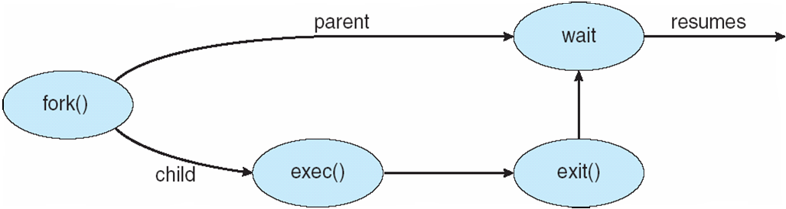
Process Creation

Slide 40
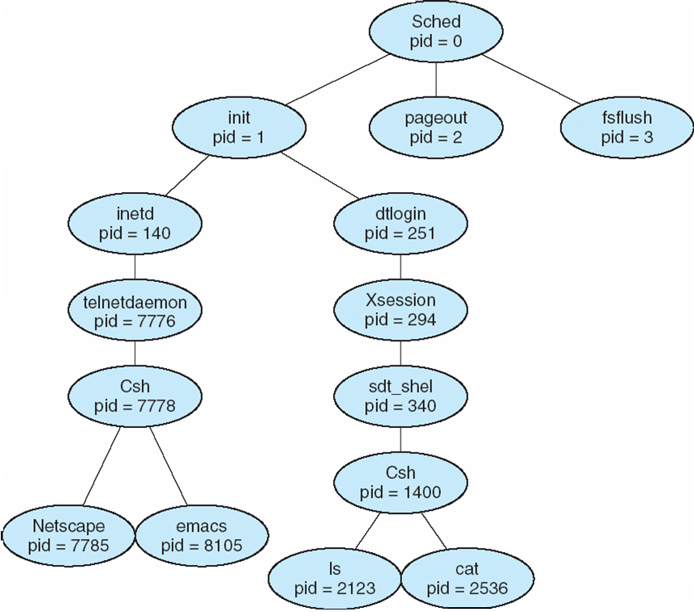
A tree of processes on a typical Solaris

Slide 41
Process Termination
Process executes last statement and asks the operating system to delete it (can use exit system call)
  Output data from child to parent (via wait)
  Process’ resources are deallocated by operating system
Parent may terminate execution of children processes (abort)
  Child has exceeded allocated resources
  Task assigned to child is no longer required
  If parent is exiting
    Some operating systems do not allow child to continue if its parent terminates
      All children terminated - cascading termination

Slide 42
Process Termination
Parent
Child
fork();
….
….
x = wait ();
….
….
….
exit (code);
PCB of parent
PCB of child
sys_wait()
{
…return(..)
}
sys_exit(..)
{
…
}
Kernel

Slide 43
Cooperating Processes
Processes within a system may be independent or cooperating
Independent process cannot affect or be affected by the execution of another process
Cooperating process can affect or be affected by the execution of another process
Reasons for process cooperation
  Information sharing
  Computation speed-up
  Modularity (application will
  be divided into modules/sub-tasks)
  Convenience (may be better to
  work with multiple processes)
Application
Process
Process
Process
cooperating process
The overall application is designed
to consist of cooperating processes

Slide 44
IPC Mechanisms
Cooperating processes require a facility/mechanism for interprocess communication (IPC)
There are two basic mechanism provided by most systems:
1) Shared Memory
2) Message Passing

Slide 45
Shared Memory IPC Mechanism
A region of shared memory is established between (among) two or more processes.
Establishment of that shared region is done via the help of the operating system kernel.
Then, processes can read and write shared memory region (segment) directly as ordinary memory access (like they are accessing memory variables directly without kernel help)
  During this time, kernel is not involved.
  Hence it is fast
Process A
shared region
Process B
Kernel

Slide 46
Shared Memory IPC Mechanism
To illustrate use of the shared memory IPC mechanism, a general model problem, called producer-consumer problem, can be used.
Producer-consumer problem: we have a producer, a consumer, and data is sent from producer to consumer.
  unbounded-buffer places no practical limit on the size of the buffer
  bounded-buffer assumes that there is a fixed buffer size
Producer
Process
Buffer
Consumer
Process
Produced Items
We can solve this problem via shared memory IPC mechanism

Slide 47
Shared Memory IPC Mechanism
Examples
  A compiler may produce assembly code that is consumed by assembler. Assembler may produce object modules that can be consumed by loader
  Client-server paradigm. A web server produces HTML pages or images that are consumed by client web browser.
Producer
Process
Buffer
Consumer
Process
Produced Items
We can solve this problem via shared memory IPC mechanism

Slide 48
Bounded-Buffer – Shared-Memory Solution
Shared data
      #define BUFFER_SIZE 10
      typedef struct {
      . . .
      } item;
      item buffer[BUFFER_SIZE];
      int in = 0; // next free position
      int out = 0; // first full position
Solution is correct, but can only use BUFFER_SIZE-1 elements

Slide 49
Buffer State in Shared Memory
Producer
Consumer
item buffer[BUFFER_SIZE]
int out;
int in;
Shared Memory

Slide 50
Buffer State in Shared Memory
Buffer Full
in
out
((in+1) % BUFFER_SIZE == out) : considered full buffer
Buffer Empty
in
out
In == out : empty buffer

Slide 51
Bounded-Buffer – Producer and Consumer Code
while (true) {
/* Produce an item */
while ( ((in + 1) % BUFFER SIZE) == out)
; /* do nothing -- no free buffers */
buffer[in] = item;
in = (in + 1) % BUFFER SIZE;
}
Producer
Consumer
while (true) {
while (in == out)
; // do nothing -- nothing to consume
// remove an item from the buffer
item = buffer[out];
out = (out + 1) % BUFFER SIZE;
return item;
}
      item buffer[BUFFER_SIZE];
      int in = 0;
      int out = 0;
Shared Memory

Slide 52
Message Passing IPC Mechanism
Another mechanism for processes to communicate and to synchronize their actions
Message system – processes communicate with each other without resorting to shared variables
Useful in distributed environments
Example
  A chat program on WWW designed so that chat participants can communicate with each other by exchanging messages.

Slide 53
Message Passing IPC Mechanism
This IPC facility provides two operations:
  send(message) – message size fixed or variable
  receive(message)
If P and Q wish to communicate, they need to:
  establish a (logical) communication link
  between them
  exchange messages via send/receive
messages
Passed
through
P
Q
Logical
Communication
Link

Slide 54
Message Passing
Process A
M
M
Process B
Kernel
M

Slide 55

Communication Models
message passing approach
shared memory approach

Slide 56
Implementation Questions
How are links established?
Can a link be associated with more than two processes?
How many links can there be between every pair of communicating processes?
What is the capacity of a link?
Is the size of a message that the link can accommodate fixed or variable?
Is a link unidirectional or bi-directional?

Slide 57
Issues to Consider
Naming
  Direct
  Indirect
Synchronization
  Blocking send/receive
  Non-blocking send/receive
Buffering
  Zero capacity
  Bounded capacity
  Unbounded capacity

Slide 58
Direct Communication
Processes must name each other explicitly:
  send (P, message) – send a message to process P
  receive(Q, message) – receive a message from process Q
Properties of communication link
  Links are established automatically (i.e. implicitly by the kernel)
  A link is associated with exactly one pair of communicating processes
  Between each pair there exists exactly one link
  The link may be unidirectional, but is usually bi-directional

Slide 59
Indirect Communication
Messages directed / received from mailboxes (referred as ports)
  Each mailbox has a unique id
  Processes can communicate only if they share a mailbox
Properties of communication link
  Link established only if processes share a common mailbox
  A link may be associated with many processes
  Each pair of processes may share several communication links
  Link may be unidirectional or bi-directional

Slide 60
Indirect Communication
Operations
  create a new mailbox
  send and receive messages through mailbox
  destroy a mailbox
Primitives are defined as:
send(A, message) – send a message to mailbox A
receive(A, message) – receive a message from mailbox A
Process
Process
send()
{..
{
receive()
{…
}
Mailbox
Kernel

Slide 61
Indirect Communication
Mailbox sharing
  P₁, P₂, and P₃ share mailbox A
  P₁, sends; P₂ and P₃ receive
  Who gets the message?
Solutions
  Allow a link to be associated with at most two processes
  Allow only one process at a time to execute a receive operation
  Allow the system to select arbitrarily the receiver. Sender is notified who the receiver was.

Slide 62
Synchronization
Message passing may be either blocking or non-blocking
Blocking is considered synchronous
  Blocking send has the sender block until the message is received
  Blocking receive has the receiver block until a message is available
Non-blocking is considered asynchronous
  Non-blocking send has the sender send the message and continue
  Non-blocking receive has the receiver receive a valid message or null

Slide 63
Buffering
Queue of messages attached to the link; implemented in one of three ways
  Zero capacity – 0 messages
  Sender must wait for receiver (rendezvous)
  Bounded capacity – finite length of n messages
  Sender must wait if link full
  Unbounded capacity – infinite length
  Sender never waits

Slide 64
Quiz
Describe the actions taken by a kernel to context-switch between processes.
Describe the differences among short-term, medium-term, and long-term scheduling.

Slide 65
Examples of IPC Systems –Unix/Linux Shared Memory
There are two different API that provide functions for shared memory in Unix/Linux operating system
  System V API
    System V is one of the earlier Unix versions that introduced shared memory
  POSIX API
    POSIX (Portable Operating System Interface) is the standard API for Unix like systems.

Slide 66
Examples of IPC Systems –
Unix System V Shared Memory
System V Shared Memory
  Process first creates shared memory segment
  segment id = shmget(IPC PRIVATE, size, S IRUSR | S IWUSR);
  Process wanting access to that shared memory must attach to it
  shared memory = (char *) shmat(id, NULL, 0);
  Now the process could write to the shared memory
  sprintf(shared memory, "Writing to shared memory");
  When done a process can detach the shared memory from its address space
  shmdt(shared memory);

Slide 67
Examples of IPC Systems –
Unix POSIX Shared Memory
The following functions are defined to create and manage shared memory in POSIX API
    shm_open():
      create or open a shared memory region/segment (also called shared memory object)
    shm_unlink():
      remove the shared memory object
    ftruncate():
      set the size of shared memory region
    mmap():
      map shared memory into the address space of a process. Process gets a pointer to the shared memory region

Slide 68
Examples of IPC Systems - Mach
Mach communication is message based
  Even system calls are messages
  Each task gets two mailboxes at creation- Kernel and Notify
  Only three system calls needed for message transfer
    msg_send()
    msg_receive()
    msg_rpc()
  Mailboxes needed for commuication, created via port_allocate()

Slide 69
Examples of IPC Systems – Windows XP
Message-passing centric via local procedure call (LPC) facility
  Only works between processes on the same system
  Uses ports (like mailboxes) to establish and maintain communication channels
  Communication works as follows:
    Client opens a handle to subsystem’s connection port object
    The client sends a connection request
    The server creates two private communication ports and returns the handle to one of them to the client
    The client and server use the corresponding port handle to send messages or callbacks and to listen for replies

Slide 70

Local Procedure Calls in Windows XP

Slide 71
Communications in Client-Server Systems
Sockets
Remote Procedure Calls
Remote Method Invocation (Java)

Slide 72
Sockets
A socket is defined as an endpoint for communication
Concatenation of IP address and port
The socket 161.25.19.8:1625 refers to port 1625 on host 161.25.19.8
Communication consists between a pair of sockets

Slide 73

Socket Communication

Slide 74
Remote Procedure Calls
Remote procedure call (RPC) abstracts procedure calls between processes on networked systems
Stubs – client-side proxy for the actual procedure on the server
The client-side stub locates the server and marshalls the parameters
The server-side stub receives this message, unpacks the marshalled parameters, and performs the procedure on the server

Slide 75
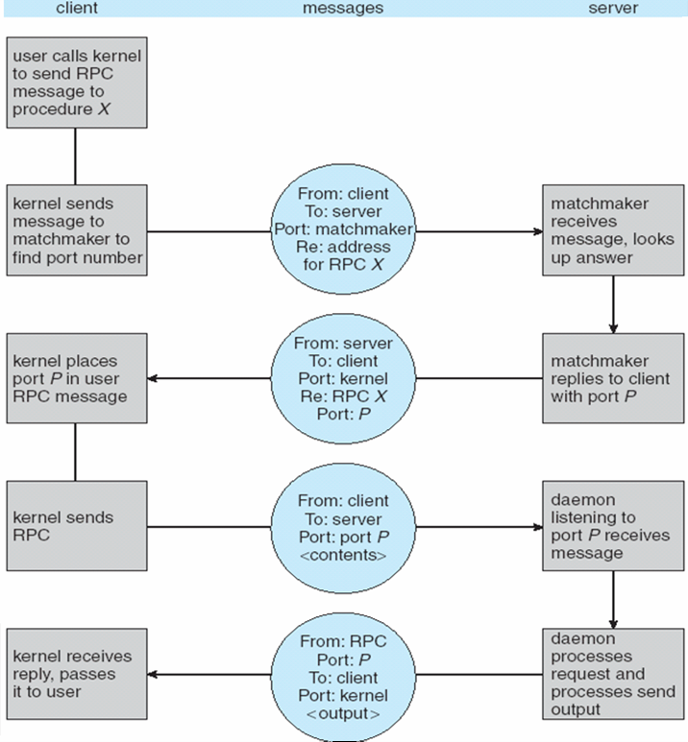
Execution of RPC

Slide 76
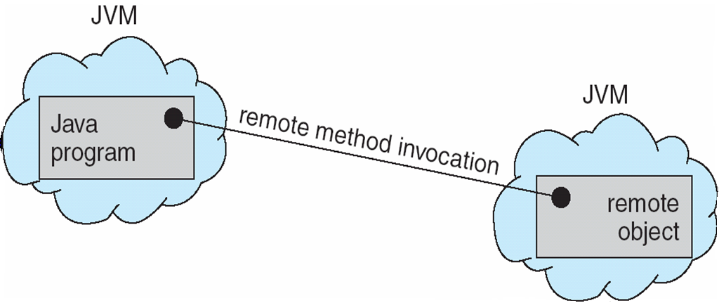
Remote Method Invocation
Remote Method Invocation (RMI) is a Java mechanism similar to RPCs
RMI allows a Java program on one machine to invoke a method on a remote object

Slide 77
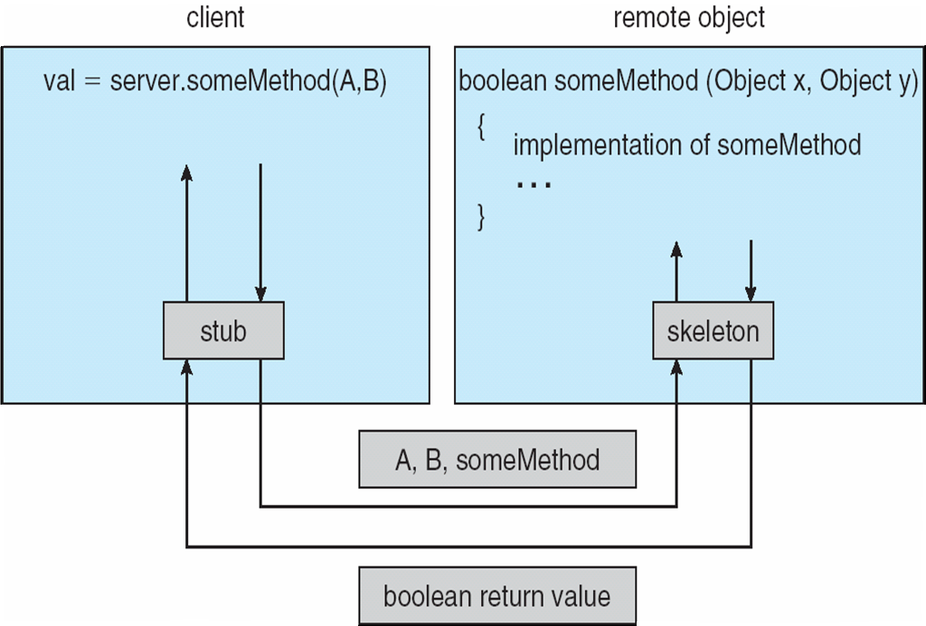
Marshalling Parameters

Slide 78
End of Lecture

