Slide 1
Process Scheduling

Slide 2
References
Operating System Concepts, 7th and 8th editions, Silberschatz et al. Wiley.
Modern Operating Systems, Andrew S. Tanenbaum, 3rd edition, 2009.

Slide 3
Outline
Basic Concepts
Scheduling Criteria
Scheduling Algorithms
Thread Scheduling
Multiple-Processor Scheduling
Operating Systems Examples
Algorithm Evaluation

Slide 4
Objectives
To introduce CPU scheduling, which is the basis for multiprogrammed operating systems
To describe various CPU-scheduling algorithms
To discuss evaluation criteria for selecting a CPU-scheduling algorithm for a particular system

Slide 5
Basic Concepts
In simple batch systems, the CPU sits idle when a process is waiting
Notion of multiprogramming
  Keep more than one process in memory at a time
  A process is executed until it must wait (e.g. for I/O)
  When one processes is waiting, take the CPU from that process and assign it to another processes ready for execution
Objective of multiprogramming
  Maximize the CPU utilization
Uniprocessor systems
  Only one process runs at a time
  Other processes must wait until CPU is free
  When the CPU is free, rescheduled it to another process by a process scheduler

Slide 6

Alternating Sequence of CPU and I/O Bursts
CPU Burst Cycle – a cycle of CPU execution
I/O Burst Cycle – a cycle of I/O wait
During execution a process alternates between CPU burst and I/O burst
  Starts with a CPU burst
  Then alternates between CPU burst and I/O burst
  End with CPU burst
CPU burst distribution

Slide 7

Histogram of CPU-burst Times
A frequency histogram provides information about the frequency of different burst durations (which is similar for most computer systems)
CPU burst distribution
  important in selection
  of an appropriate
  scheduling algorithm

Slide 8
CPU Scheduler
Also referred to as short-term scheduler (or CPU scheduler)
Selects from among the processes in the ready queue and allocate it the CPU
Short-term
scheduler
CPU
ready queue
Long-term
scheduler
Main Memory
job queue

Slide 9

CPU Scheduler
CPU scheduling decisions may take place when a process:
  1. Switches from running to waiting state
  2. Switches from running to ready state
  3. Switches from waiting to ready state
  4. Terminates
Scheduling under 1 and 4 is nonpreemptive
All other scheduling is preemptive

Slide 10
Dispatcher
Dispatcher module gives control of the CPU to the process selected by the short-term scheduler; this involves:
  switching context
  switching to user mode
  jumping to the proper location in the user program to restart that program
Dispatch latency – time it takes for the dispatcher to stop one process and start another running

Slide 11
Scheduling Criteria
CPU utilization – keep the CPU as busy as possible
Throughput – # of processes that complete their execution per time unit
Turnaround time – amount of time to execute a particular process
Waiting time – amount of time a process has been waiting in the ready queue
Response time – amount of time it takes from when a request was submitted until the first response is produced, not output (for time-sharing environment)
ready
running
waiting

Slide 12
Scheduling Algorithm Optimization Criteria
Maximize CPU utilization
Maximize throughput
Minimize turnaround time
Minimize waiting time
Minimize response time

Slide 13
First-Come, First-Served (FCFS) Scheduling
Process Burst Time (ms)
P₁ 24
P₂ 3
P₃ 3
Suppose that the processes arrive in the order: P₁ , P₂ , P₃
The Gantt Chart for the schedule is:
Waiting time for P₁ = 0; P₂ = 24; P₃ = 27
Average waiting time: (0 + 24 + 27)/3 = 17 ms
P₁
P₂
P₃
0
24
27
30

Slide 14
FCFS Scheduling (Cont)
Suppose that the processes arrive in the order
P₂ , P₃ , P₁
The Gantt chart for the schedule is:
Waiting time for P₁ = 6; P₂ = 0; P₃ = 3
Average waiting time: (6 + 0 + 3)/3 = 3 ms
Much better than previous case
Convoy effect: I/O-bound process behind CPU-bound process
Note that the FCFS scheduling algorithm is non-preemptive.
  Not suitable for time-sharing systems
P₂
P₃
P₁
0
3
6
30

Slide 15
Shortest-Job-First (SJF) Scheduling
Associate with each process the length of its next CPU burst.
Use burst length to schedule the process with the shortest time
SJF is optimal – gives minimum average waiting time for a given set of processes
PROBLEM:
What if two processes have same length of next CPU burst?
How to calculate the length of the next CPU request?

Slide 16
Example of SJF
Process Arrival Time Burst Time
P₁ 0.0 6
P₂ 0.0 8
P₃ 0.0 7
P₄ 0.0 3
SJF scheduling chart
Average waiting time = (3 + 16 + 9 + 0) / 4 = 7 ms
P₄
P₁
P₃
P₂
0
3
9
16
24

Slide 17
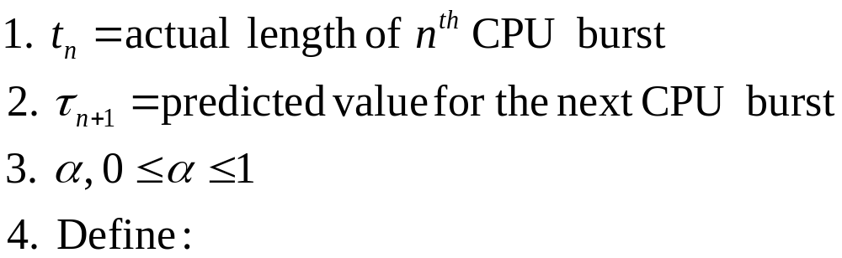

Determining Length of Next CPU Burst
Burst length can never be accurately specified, value may be predicted.
Expectation: Next CPU-burst will be similar in length to previous ones
Next CPU burst can be predicted as an exponential average of the measured lengths of previous CPU bursts.

Slide 18
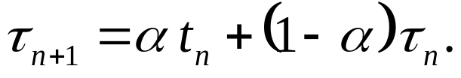
Examples of Exponential Averaging
t_{n} contains our most recent information
τ_{n} stores the past history
α controls relative weight of recent and past history
α=0 => τ_{n+1} = τ_{n}
  Recent history does not count
α =1 => τ_{n+1} = α t_{n}
  Only the actual last CPU burst counts

Slide 19
Shortest Remaining Job First (SRJF)
If we expand the formula, we get:
τ_{n+1} = α t_{n}+(1 - α)α t_{n-1} + …+(1 - α )^{j} α t_{n} _{-j} + …+(1 - α )^{n +1} τ₀
both α and (1 - α) are less than or equal to 1
  each successive term has less weight than its predecessor

Slide 20

Prediction of the Length of the Next CPU Burst

Slide 21
Shortest Remaining Job First (SRJF)
Preemptive version of SJF
While job A is running, a new job B comes whose length is shorter than the remaining time of job A,
  B preempts A and B is started to run.
Also referred to as shortest-remaining-time-first scheduling
Example on the next slide

Slide 22
Shortest Remaining Job First (SRJF)
Process Arrival Time Burst Time
P₁ 0.0 8
P₂ 1.0 4
P₃ 2.0 9
P₄ 3.0 5
SJF scheduling chart
Average waiting time = (9 + 0 + 2 + 15) / 4 = 6.5 ms
P₁
P₂
P₄
P₁
P₃
0
1
5
10
17
26

Slide 23
Priority Scheduling
A priority number (integer) is associated with each process
The CPU is allocated to the process with the highest priority
  Preemptive: A running process is preempted if a high process arrives in the ready queue.
  Non-preemptive: The running process is never preemted.
SJF is a priority scheduling where priority (p) is the inverse of the (predicted) next CPU burst
Priorities are indicated by a fixed range of numbers, e.g. 0 to 7 or 4095
  Highest / lowest priority? (smallest integer ≡ highest priority)
Equal-priority processes are scheduled in FCFS order

Slide 24
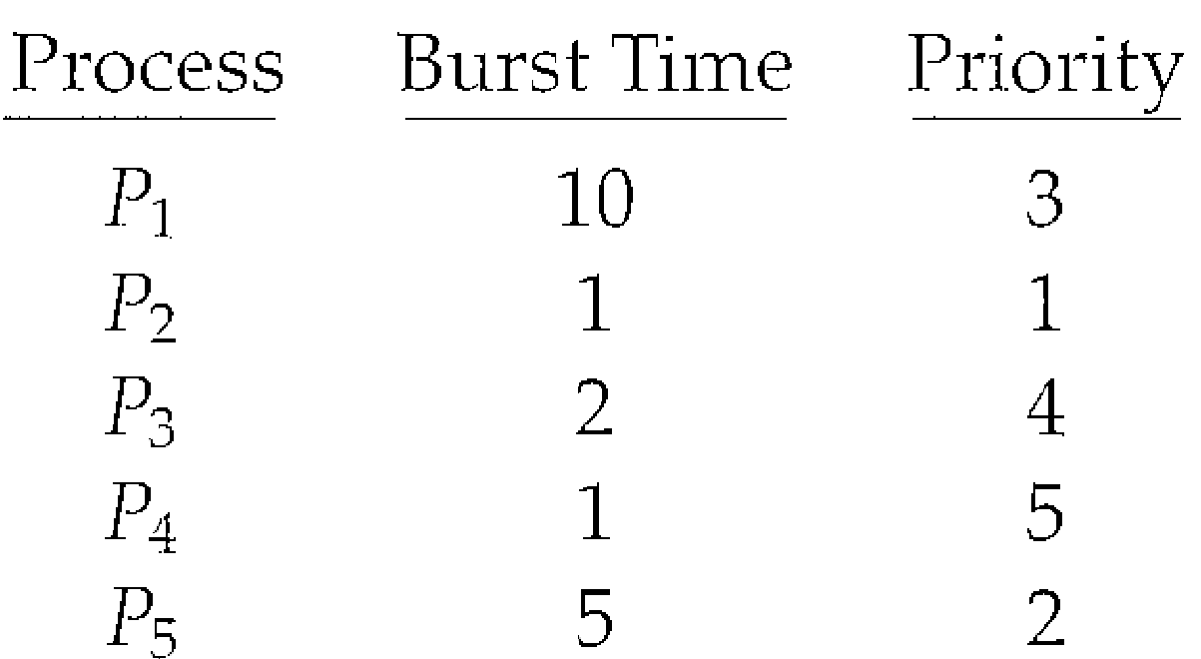
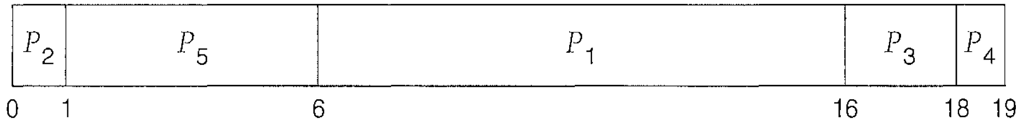
Priority Scheduling
Consider the following set of processes, assumed to have arrived at time 0 in the order P₁, P₂, · · ·, P₅,:
Using priority scheduling, the processes are scheduled according to the Gantt chart: (Average waiting time = 8.2 milliseconds)

Slide 25
Priority Scheduling
Computing priority: Can be defined either internally or externally.
Internally defined priorities use some measurable quantity or quantities to compute the priority of a process
  Example: time limits, memory requirements, the number of open files, and the ratio of average I/0 burst to average CPU burst
External priorities are set by criteria outside the operating system,
  Example: importance of the process, the type and amount of funds being paid for computer use, the department sponsoring the work,
Problem ≡ Starvation – low priority processes may never execute
Solution ≡ Aging – as time progresses increase the priority of the process

Slide 26
Round Robin (RR)
Similar to FCFS scheduling, but preemption is added to enable the system to switch between processes
A small unit of time, called a time quantum or time slice, is defined
The ready queue is treated as a circular queue.
The CPU scheduler goes around the ready queue, allocating the CPU to each process for a time interval of up to 1 time quantum (typically between 10-100 milliseconds)
After this time has elapsed, the process is preempted and added to the end of the ready queue.

Slide 27
Round Robin (RR)
Number processes in the ready queue = n, Time quantum = q,
  Each process gets 1/n of the CPU time in chunks of at most q time units at once.
No process waits more than (n-1)q time units.
Implementing RR scheduling
  Keep the ready queue as a FIFO queue of processes.
  New processes are added to the tail of the ready queue.
  CPU scheduler
    Picks the first process from the ready queue
    Sets a timer to interrupt after 1 time quantum
    Dispatches the process.

Slide 28
Example of RR with Time Quantum = 4
Process Burst Time
P₁ 24
P₂ 3
P₃ 3
The Gantt chart is:
Typically, higher average turnaround than SJF, but better response
P₁
P₂
P₃
P₁
P₁
P₁
P₁
P₁
0
4
7
10
14
18
22
26
30

Slide 29

Time Quantum and Context Switch Time
Performance
  q large ⇒ FIFO
  q extremely small ⇒ processor sharing - creates the appearance that each of n processes has its own processor running at 1/n the speed of the real processor
q small ⇒ q must be large w.r.t. context switch, o.w. overhead is high
A smaller time quantum increases context switches

Slide 30

Turnaround Time Varies With The Time Quantum

Slide 31
Multilevel Queue Schdueling
Processes are easily classified into different groups
  Foreground (interactive)
  Background (batch)
These two types of processes have different response-time requirements and so may be scheduling differently
Partition ready queue into two separate queues: Foreground (interactive) and Background (batch)
Processes are permanently assigned to one queue based on some property of the process
  Memory size
  Process priority
  Process type.

Slide 32
Multilevel Queue Scheduling
Each queue has its own scheduling algorithm
  foreground – RR
  background – FCFS
Scheduling must be done between the queues
  Fixed priority scheduling; (i.e., serve all from foreground then from background). Possibility of starvation.
  Time slice – each queue gets a certain amount of CPU time which it can schedule amongst its processes; i.e. 80% to foreground in RR and 20% to background in FCFS
Advantage of low scheduling overhead, but it is inflexible

Slide 33
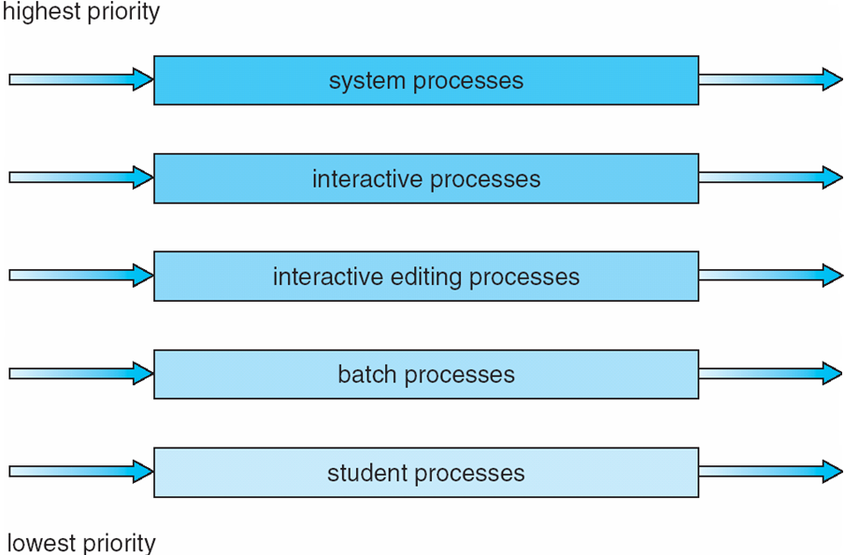
Multilevel Queue Scheduling

Slide 34
Multilevel Feedback Queue
In multilevel queue scheduling, processes are permanently assigned to a queue
  Problem: Starvation
Idea: Allow processes to move between the various queues
How:
  By separating processes according to nature of their CPU bursts
    Move CPU bound processes to a lower-priority queue
    I/O-bound and interactive processes in higher-priority queues
  By implementing process aging

Slide 35
Multilevel Feedback Queue
Generalization of the Idea!
Multilevel-feedback-queue scheduler defined by the following parameters:
  number of queues
  scheduling algorithms for each queue
  method used to determine when to upgrade a process
  method used to determine when to demote a process
  method used to determine which queue a process will enter when that process needs service

Slide 36
Example of Multilevel Feedback Queue
Three queues:
  Q₀ – RR with time quantum 8 milliseconds
  Q₁ – RR time quantum 16 milliseconds
  Q₂ – FCFS
Scheduling
  A new job enters queue Q₀ which is served RR (q=8). When it gains CPU, job receives 8 milliseconds. If it does not finish in 8 milliseconds, job is moved to queue Q₁.
  At Q₁ job is again served RR and receives 16 additional milliseconds. If it still does not complete, it is preempted and moved to queue Q₂.

Slide 37
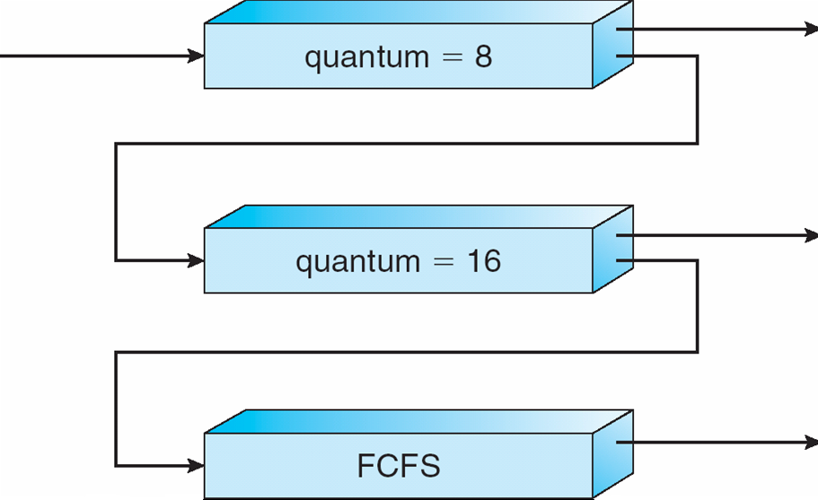
Multilevel Feedback Queues

Slide 38
Thread Scheduling
Distinction between user-level and kernel-level threads
Many-to-one and many-to-many models, thread library schedules user-level threads to run on LWP
  Known as process-contention scope (PCS) since scheduling competition is within the process
Kernel thread scheduled onto available CPU is system-contention scope (SCS) – competition among all threads in system

Slide 39
Pthread Scheduling
API allows specifying either PCS or SCS during thread creation
  PTHREAD SCOPE PROCESS schedules threads using PCS scheduling
  PTHREAD SCOPE SYSTEM schedules threads using SCS scheduling.

Slide 40
Pthread Scheduling API
#include <pthread.h>
#include <stdio.h>
#define NUM THREADS 5
int main(int argc, char *argv[])
{
int i;
pthread t tid[NUM THREADS];
pthread attr t attr;
/* get the default attributes */
pthread attr init(&attr);
/* set the scheduling algorithm to PROCESS or SYSTEM */
pthread attr setscope(&attr, PTHREAD SCOPE SYSTEM);
/* set the scheduling policy - FIFO, RT, or OTHER */
pthread attr setschedpolicy(&attr, SCHED OTHER);
/* create the threads */
for (i = 0; i < NUM THREADS; i++)
pthread create(&tid[i],&attr,runner,NULL);
This means kernel
will create threads and
will do scheduling
Treat it as a
normal process
(not real-time, etc.)

Slide 41
Pthread Scheduling API
/* now join on each thread */
for (i = 0; i < NUM THREADS; i++)
pthread join(tid[i], NULL);
}
/* Each thread will begin control in this function */
void *runner(void *param)
{
printf("I am a thread\n");
pthread exit(0);
}

Slide 42
Multiple-Processor Scheduling
CPU scheduling more complex when multiple CPUs are available
Homogeneous processors within a multiprocessor
Asymmetric multiprocessing – only one processor accesses the system data structures, alleviating the need for data sharing
Symmetric multiprocessing (SMP) – each processor is self-scheduling, all processes in common ready queue, or each has its own private queue of ready processes
Processor affinity – process has affinity for processor on which it is currently running
  soft affinity
  hard affinity

Slide 43
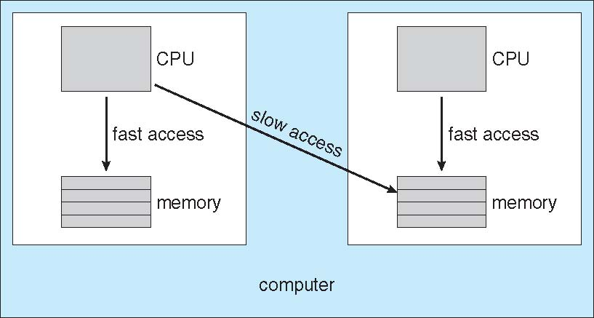
NUMA and CPU Scheduling

Slide 44
Multicore Processors
Recent trend to place multiple processor cores on same physical chip
Faster and consume less power
Multiple threads per core also growing
  Takes advantage of memory stall to make progress on another thread while memory retrieve happens

Slide 45

Multithreaded Multicore System

Slide 46
Operating System Examples
Solaris scheduling
Windows XP scheduling
Linux scheduling

Slide 47
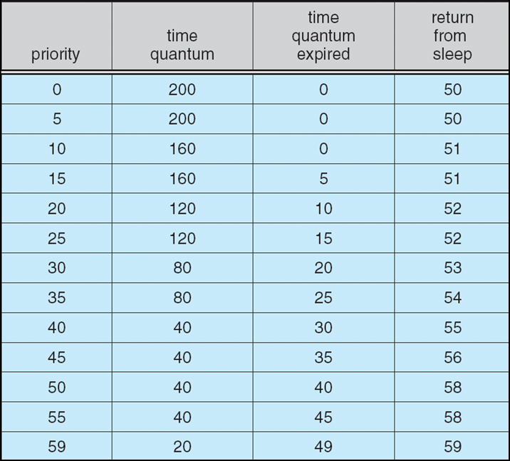
Solaris Dispatch Table

Slide 48
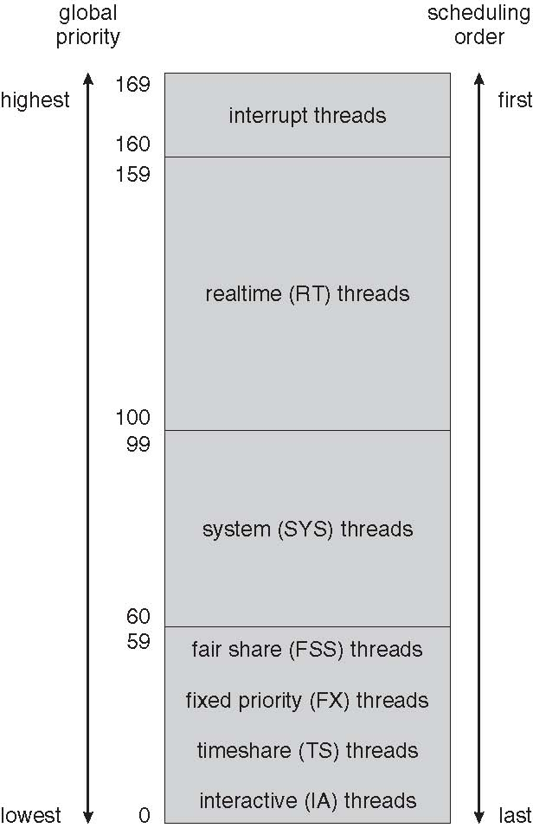
Solaris Scheduling

Slide 49
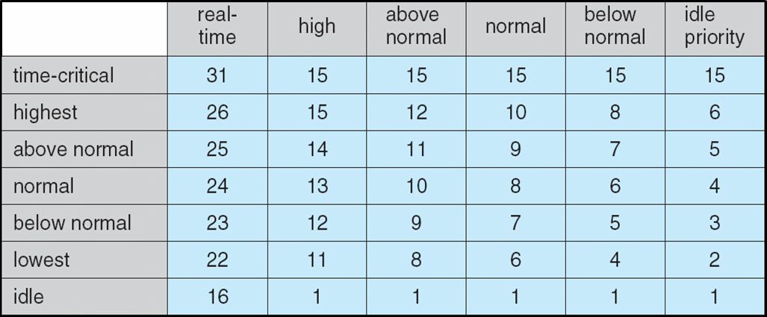
Windows XP Priorities

Slide 50
Linux Scheduling
Constant order O(1) scheduling time
Two priority ranges: time-sharing and real-time
Real-time range from 0 to 99 and nice value from 100 to 140
(figure 5.15)

Slide 51
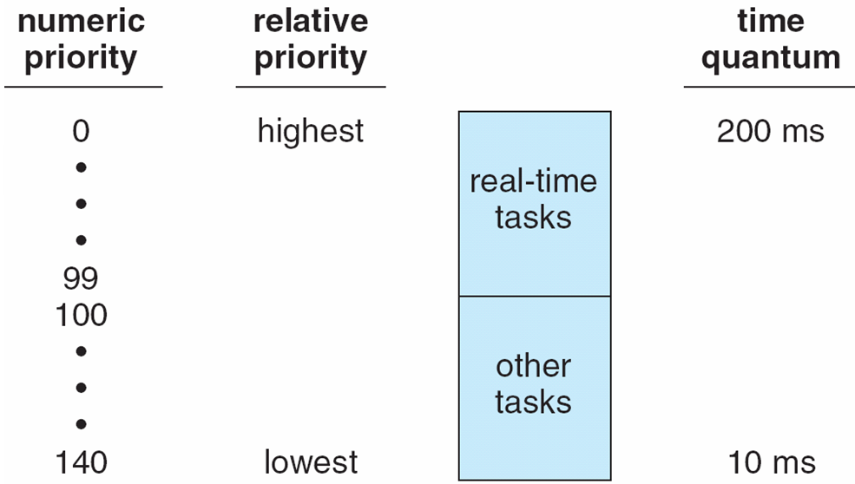
Priorities and Time-slice length

Slide 52
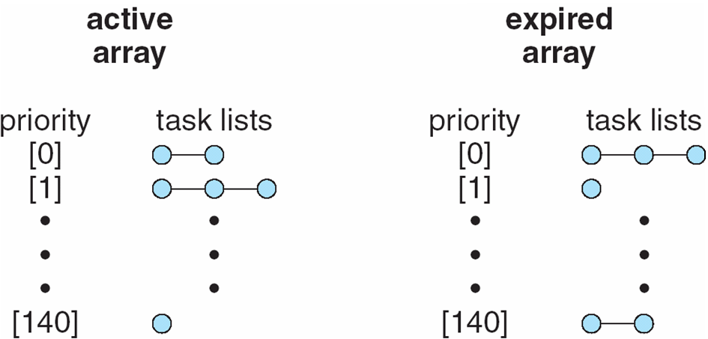
List of Tasks Indexed According to Priorities

Slide 53
Algorithm Evaluation
Deterministic modeling – takes a particular predetermined workload and defines the performance of each algorithm for that workload
Queueing models
Implementation

Slide 54
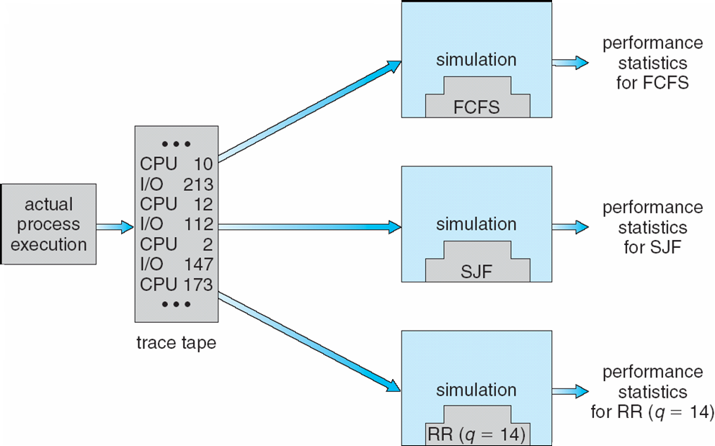
Evaluation of CPU schedulers by Simulation

Slide 55
End of lecture

Slide 56
Quiz
Consider a multiprocessor system and a multithreaded program written using many-to-many threading model. Let the number of user-level threads in the program be more than the number of processors in the system.
Discuss the performance implications of the following scenarios:
The number of kernel threads allocated to the program is less than the number of processors.
The number of kernel threads allocated to the program is equal to the number of processors.
The number of kernel threads allocated to the program is greater than the number of processors but less than the number of user-level threads.
CS342 Operating Systems
İbrahim Körpeoğlu, Bilkent University

Slide 57
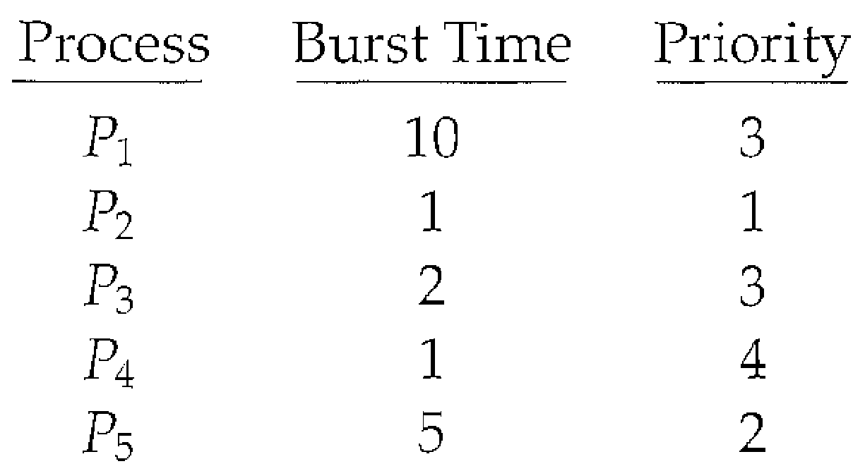
Quiz
Consider the following set of processes, with the length of the CPU burst given in milliseconds:
The processes are have arrived in the
order P₁, P₂, P₃, P₄, P₅ all at time 0.
Draw Gantt charts that illustrate the execution of these processes using FCFS, SJF and non-preemptive priority (a smaller number implies a higher priority) scheduling.
What is the waiting time of each process for each of the scheduling algorithms in part (a)?
Which of the algorithms results in the minimum average waiting time?

Slide 58
Prepare for Quiz

Slide 59
Quiz
Consider the following set of processes, with the length of the CPU burst time given in milliseconds:
Draw four timelines illustrating the execution of these processes using First-Come-First-Served (FCFS), Shortest Job First (SJF), a non-preemptive priority (a smaller priority number implies a higher priority), and Round Robin (with Time Quantum = 10 ms) scheduling
What is the average waiting time of each process for each of the scheduling algorithm in part (a)?
Process | Burst Time | Priority
P₁ | 10 | 3
P₂ | 29 | 1
P₃ | 3 | 2
P₄ | 7 | 4
P₅ | 12 | 2
CS342 Operating Systems
İbrahim Körpeoğlu, Bilkent University

