Slide 1








BAHRIA UNIVERSITY, ISLAMABAD
WEEK 7 + WEEK 6 RECAP
Working with Learning Management Systems
Moodle, Canvas & Google Classroom — plus a full recap of Video Conferencing & Social Media
ICT 201 | Applications of ICT | 3-Hour Session | CLO-2 & CLO-3 | Fall 2026
Moodle
Canvas
Google Classroom
Meet / Teams / Zoom
LinkedIn
Facebook
Instagram

Slide 2
AGENDA — 3-HOUR SESSION, TWO BREAKS
180 MIN
Today’s Roadmap
01
Why LMS? Fundamentals, Components & How It Works
20 min
Purpose, core components, workflow, types of LMS
02
Moodle — Open-Source Learning Platform
20 min
Course page, activities, quizzes, gradebook, benefits
03
Canvas — Cloud-Based Learning Platform
20 min
Dashboard, modules, SpeedGrader, integrations
☕
BREAK 1
15 min
04
Google Classroom — Simple & Free
15 min
Stream, classwork, grading, Google tools
05
LMS Comparison, Benefits to Society & Student Etiquette
20 min
Side-by-side table, scenarios, responsible use
06
Week 6 Recap — Video Conferencing
30 min
Purpose, how it works, Meet vs Teams vs Zoom, netiquette
☕
BREAK 2
10 min
07
Week 6 Recap — Social Media Applications
20 min
LinkedIn, Facebook, Instagram: education, jobs, marketing
08
Hands-On Activity, Key Takeaways & Exit Ticket
10 min
Guided practice and wrap-up
ICT 201 | Week 7 — Learning Management Systems + Week 6 Recap
2

Slide 3
SETTING THE CONTEXT
Why Do We Need a Learning Management System?
“A good LMS keeps the classroom open after the bell rings.”
The Problem
The Solution
Slides sent on WhatsApp, deadlines announced by email, marks written on paper, questions lost in group chats — students and teachers spend more time chasing information than learning.
A Learning Management System (LMS) puts content, assignments, quizzes, grades, and communication in one secure, always-available place, reachable from any device.
TODAY’S PLAN
First half: Learning Management Systems — Moodle, Canvas, and Google Classroom. Second half: because last week’s session went to Evernote/OneNote revision, we complete Week 6 in full — video conferencing (Meet, Teams, Zoom) and social media (LinkedIn, Facebook, Instagram).
ICT 201 | Week 7 — Learning Management Systems + Week 6 Recap
3

Slide 4
PART 1: LEARNING MANAGEMENT SYSTEMS
Moodle, Canvas & Google Classroom
Purpose, working, features, and benefits to society

Slide 5
LMS FUNDAMENTALS
What Is a Learning Management System?
An LMS is a software application — usually web-based — used to plan, deliver, manage, and track learning. It is the digital “campus” where a course lives: its materials, tasks, tests, marks, and conversations.
Purpose
Who Uses It
Where It Is Used
Deliver course content, collect and grade work, communicate with learners, and keep a reliable record of progress — without depending on physical presence or paper.
Teachers create and manage courses. Students learn and submit work. Administrators manage users and security. Some systems also give parents or guardians a progress view.
Universities and schools, corporate training and compliance programs, government and NGO capacity building, and online course providers.
Examples you will meet today: Moodle (open-source) | Canvas (cloud-based) | Google Classroom (free & simple)
ICT 201 | Week 7 — Learning Management Systems + Week 6 Recap
5

Slide 6
LMS FUNDAMENTALS
Core Components of an LMS
1. Course & Content Management
2. Assessment & Assignments
Organize lectures, readings, videos, and links by week or topic so students always know where to find what they need.
Create quizzes with automatic marking, accept assignment uploads, apply rubrics, and run plagiarism checks.
3. Grading & Feedback
4. Communication Tools
A central gradebook stores every mark; teachers add written, audio, or video feedback and release results when ready.
Announcements, discussion forums, private messages, notifications, and links to video meetings keep everyone connected.
5. Tracking & Analytics
6. User Roles & Security
Reports show who has logged in, finished activities, or missed deadlines — helping teachers support struggling students early.
Administrator, teacher, student, and guest roles each get different permissions; secure login protects privacy and grades.
ICT 201 | Week 7 — Learning Management Systems + Week 6 Recap
6

Slide 7
LMS FUNDAMENTALS
How an LMS Works — Step by Step
1
2
3
4
5
6
Set Up
Build the Course
Students Enrol
Learn & Participate
Submit & Grade
Feedback & Insight
The administrator installs or subscribes to the LMS, creates user accounts, and builds empty courses.
The teacher uploads content, sets deadlines, and creates quizzes and assignments.
Students log in (or join with a class code) and see their courses and to-do list.
They read, watch, discuss, and take quizzes at their own pace or by schedule.
Work is uploaded; the teacher marks it using rubrics or automatic scoring.
Students see grades and comments; reports show progress for everyone.
Behind the scenes
Why it works anywhere
Data you can trust
Content and records live on a server (the institution’s or the vendor’s cloud) and are opened through a web browser or mobile app.
Because the LMS runs over the internet, a student only needs a device and a connection — at home, in a hostel, or on a phone.
Every submission is time-stamped and every grade is stored, so deadlines and marks are transparent for both sides.
ICT 201 | Week 7 — Learning Management Systems + Week 6 Recap
7

Slide 8
LMS FUNDAMENTALS
Types of LMS & How They Are Delivered
Open-Source LMS (e.g. Moodle)
Commercial Cloud LMS (e.g. Canvas)
Free software that an institution installs on its own server and can modify. Maximum control and customization, but needs technical staff.
The vendor hosts, secures, and updates the system for a subscription fee. Less maintenance, polished experience, less low-level control.
Lightweight Classroom Tools (e.g. Google Classroom)
Self-Hosted vs Cloud-Hosted
Free, quick-to-start tools tied to an existing account system. Ideal for simple class management, with fewer advanced course-design features.
Self-hosted = you run it (control, responsibility). Cloud-hosted = vendor runs it (convenience, recurring cost). Both are accessed through a browser.
Standards & Integrations
Mobile Access
Common standards such as LTI and SCORM let an LMS connect to video meetings, plagiarism checkers, publishers’ content, and student information systems.
Dedicated apps send deadline reminders and let students read, submit, and discuss from a phone — vital where laptops are scarce.
ICT 201 | Week 7 — Learning Management Systems + Week 6 Recap
8

Slide 9
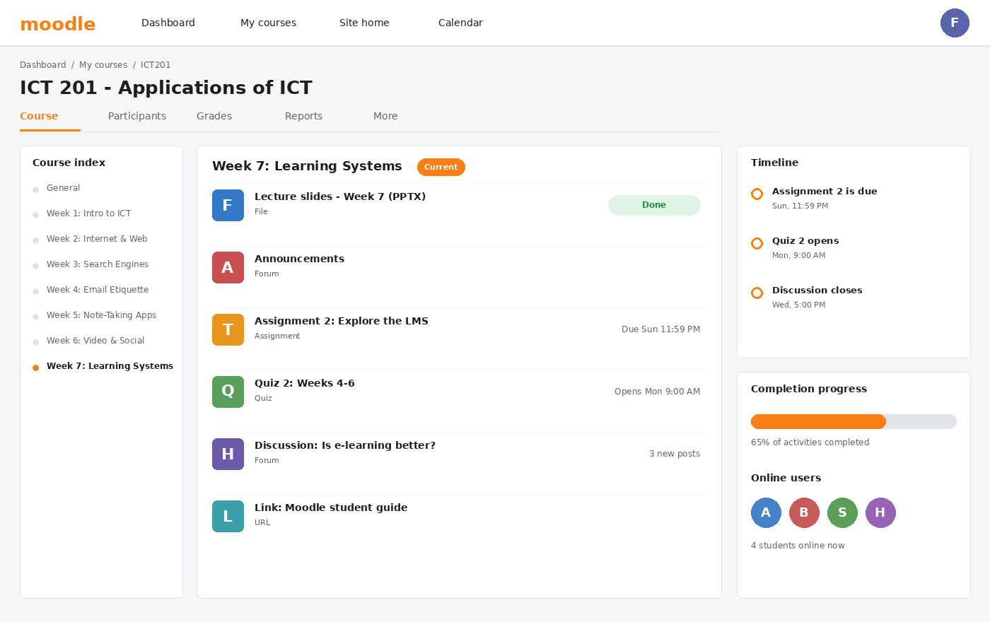
PART 1: LMS — MOODLE
Moodle — The Course Page
WHAT IT IS
An open-source LMS (free to download and customize) used by universities, schools, and training organizations worldwide.
HOW IT WORKS
Teachers add Resources (files, pages, links) and Activities (assignments, quizzes, forums) into weekly sections. Students log in at the institution’s Moodle site and see their courses on a Dashboard.
KEY AREAS SHOWN
• Course index — jump to any week
• Topic section with activity icons
• Timeline — upcoming deadlines
• Completion progress bar
Illustrative interface drawn for teaching — exact layout varies by version and institution.
ICT 201 | Week 7 — Learning Management Systems + Week 6 Recap
9

Slide 10
PART 1: LMS — MOODLE
Moodle — Main Features
Rich Activity Library
Question Bank & Quizzes
Assignment, Quiz, Forum, Workshop (peer assessment), Lesson, Glossary, Wiki, and H5P interactive content — all inside one course.
Many question types, random questions from a bank, timers, automatic marking, and instant feedback to students.
Gradebook & Rubrics
Completion & Restricted Access
Weighted grade categories, scales, and rubrics; results can be exported to a spreadsheet for records.
Lock a topic until earlier tasks are finished or a date arrives, guiding students through the course in order.
Plugins & Customization
Roles, Groups & Badges
Thousands of free plugins and themes; institutions can adapt the system to their branding and workflow.
Fine-grained permissions, group work, and digital badges or certificates that reward achievement.
ICT 201 | Week 7 — Learning Management Systems + Week 6 Recap
10

Slide 11
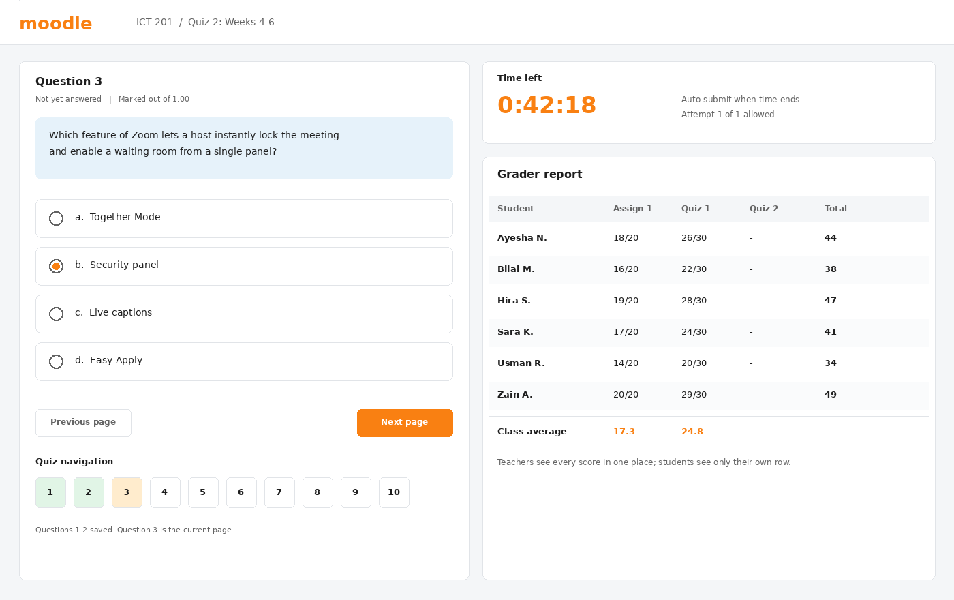
PART 1: LMS — MOODLE
Moodle — Quizzes & Gradebook
TAKING A QUIZ
A countdown timer, a navigation panel, and automatic saving help students work through questions; the quiz can auto-submit when time ends.
GRADER REPORT
Teachers see every student’s marks in one table with class averages; students see only their own row.
WHY IT MATTERS
• Objective quizzes are marked instantly
• Question banks are reused every semester
• Marks are stored safely, not on paper
Illustrative interface drawn for teaching — exact layout varies by version and institution.
ICT 201 | Week 7 — Learning Management Systems + Week 6 Recap
11

Slide 12
PART 1: LMS — MOODLE
Moodle — Benefits, Best Fit & Cautions
Key Benefits
Best Fit
No license fee, a very large global community, support for many languages, and exceptional flexibility through plugins and settings.
Institutions that want full control over data, branding, and features — for example universities with their own IT team and servers.
Things to Consider
Typical Users
Needs a server and technical administration (or paid cloud hosting). Without good setup the interface can feel dense to new users.
Universities, colleges, schools, NGOs, and corporate training teams around the world that value open-source software.
ICT 201 | Week 7 — Learning Management Systems + Week 6 Recap
12

Slide 13
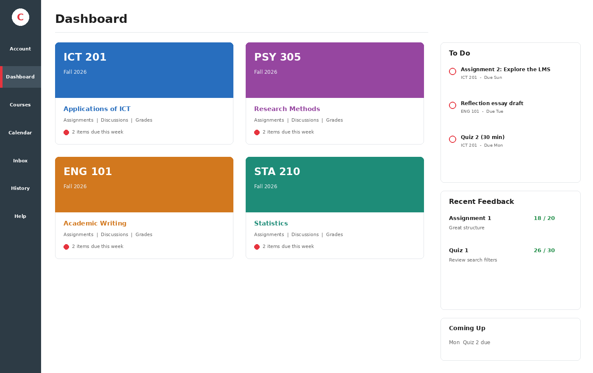
PART 1: LMS — CANVAS
Canvas — Dashboard & Global Navigation
WHAT IT IS
A cloud-based LMS made by Instructure. The vendor hosts and updates it; students simply open their institution’s Canvas web address or mobile app.
DASHBOARD
Colorful course cards open each course. The sidebar lists To Do items, Recent Feedback, and Coming Up deadlines.
GLOBAL NAVIGATION (LEFT BAR)
• Account, Dashboard, Courses
• Calendar and Inbox messaging
• History and Help
Illustrative interface drawn for teaching — exact layout varies by version and institution.
ICT 201 | Week 7 — Learning Management Systems + Week 6 Recap
13

Slide 14
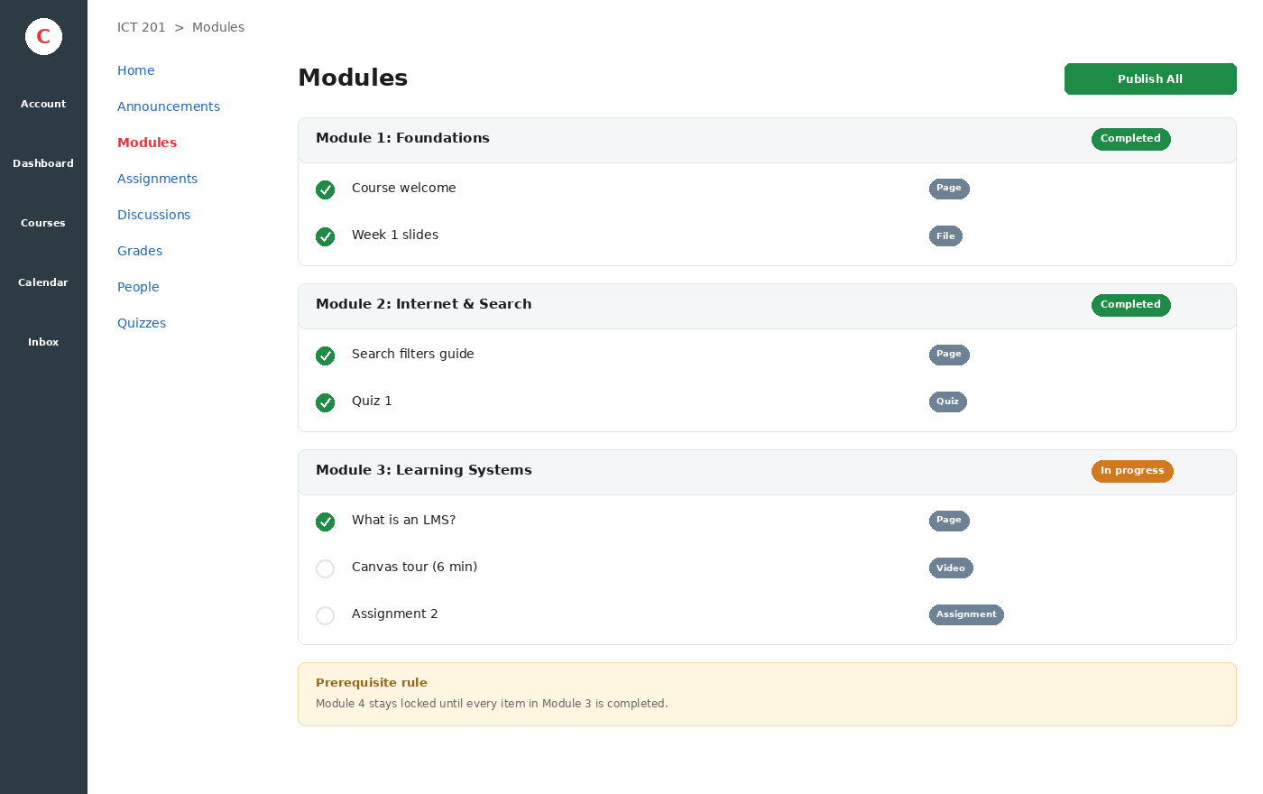
PART 1: LMS — CANVAS
Canvas — Modules & Course Navigation
HOW MODULES WORK
Teachers group content into sequential Modules (by week or unit). Each module holds pages, files, videos, quizzes, and assignments.
REQUIREMENTS & PREREQUISITES
A module can stay locked until the previous one is completed, so students follow a clear learning path.
STUDENT BENEFIT
• Green check marks show progress
• One predictable place for all content
• Course menu: Home, Assignments, Discussions, Grades, People
Illustrative interface drawn for teaching — exact layout varies by version and institution.
ICT 201 | Week 7 — Learning Management Systems + Week 6 Recap
14

Slide 15
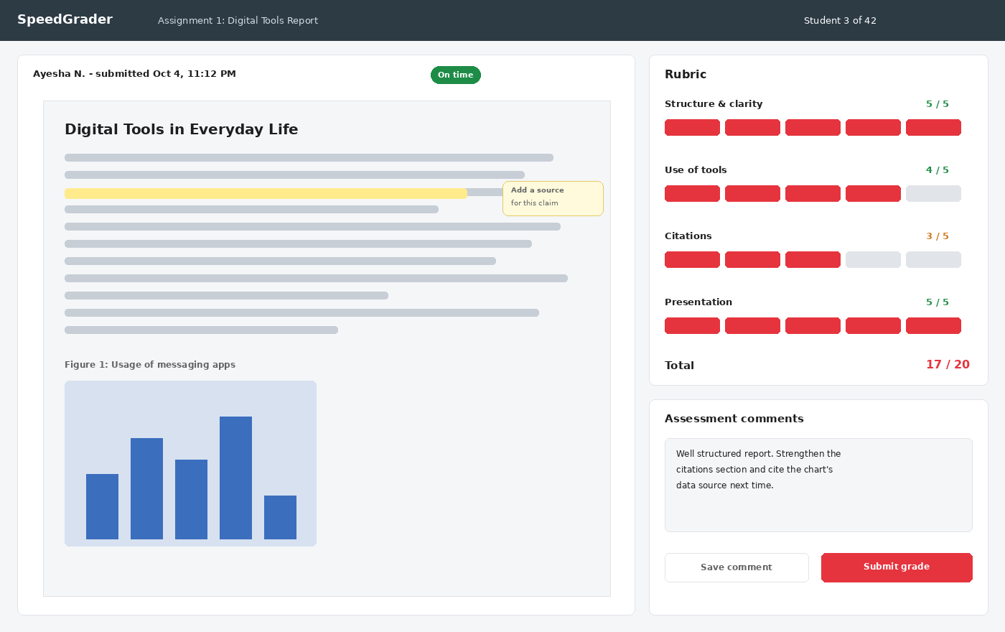
PART 1: LMS — CANVAS
Canvas — SpeedGrader & Rubrics
SPEEDGRADER
Teachers open each submission in the browser, highlight text, add comments, and move quickly from student to student.
RUBRICS
Scores for each criterion add up automatically, which makes marking consistent and transparent.
FEEDBACK
Written, audio, or video comments appear to the student as soon as the grade is submitted, helping them improve the next assignment.
Illustrative interface drawn for teaching — exact layout varies by version and institution.
ICT 201 | Week 7 — Learning Management Systems + Week 6 Recap
15

Slide 16
PART 1: LMS — CANVAS
Canvas — Main Features & Integrations
Modules & Mastery Paths
Calendar & To-Do List
Sequenced content with prerequisites, and paths that adapt to a student’s performance on earlier work.
Every deadline from every course appears in one calendar and a personal to-do list, reducing missed submissions.
Quizzes, Rubrics & Gradebook
Discussions & Groups
Quiz tools, reusable rubrics, and a flexible gradebook with comments and late-work policies.
Threaded class discussions and student groups with their own spaces for projects.
Mobile Apps
Integrations (LTI)
Canvas Student and Canvas Teacher apps allow reading, submitting, grading, and notifications on a phone.
Connects to tools such as video meetings, Google Drive, Microsoft 365, and plagiarism checkers inside the course.
ICT 201 | Week 7 — Learning Management Systems + Week 6 Recap
16

Slide 17
☕
BREAK 1
15 Minutes
Back at it: Google Classroom, LMS comparison, and then the Week 6 recap

Slide 18
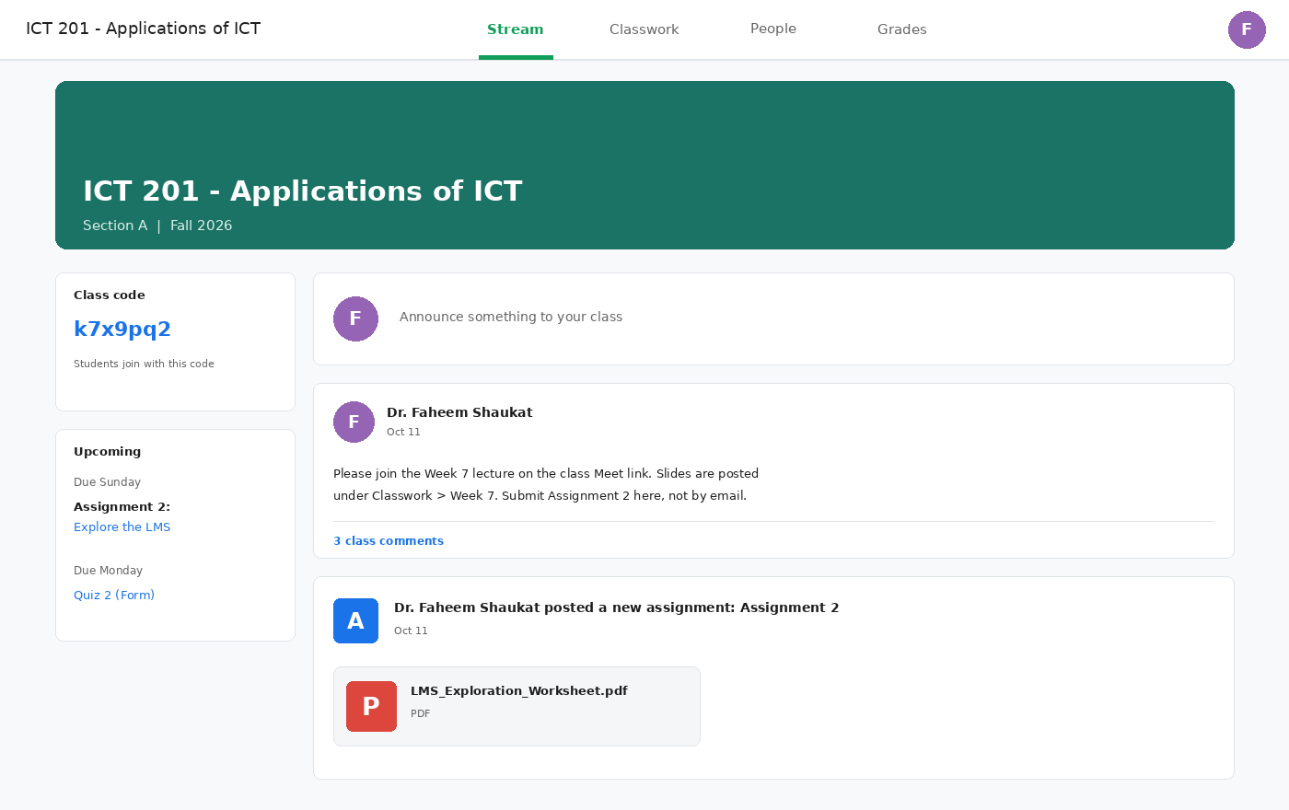
PART 1: LMS — GOOGLE CLASSROOM
Google Classroom — The Stream
WHAT IT IS
A free, simple class-management tool from Google that works with Google accounts. Students join using a class code.
THE STREAM
A feed of announcements, new assignments, and class comments. The Upcoming box shows what is due soon.
WORKS WITH GOOGLE TOOLS
• Docs, Slides, and Forms for work
• Drive for storing files
• Meet for live lessons
• Calendar for deadlines
Illustrative interface drawn for teaching — exact layout varies by version and institution.
ICT 201 | Week 7 — Learning Management Systems + Week 6 Recap
18

Slide 19
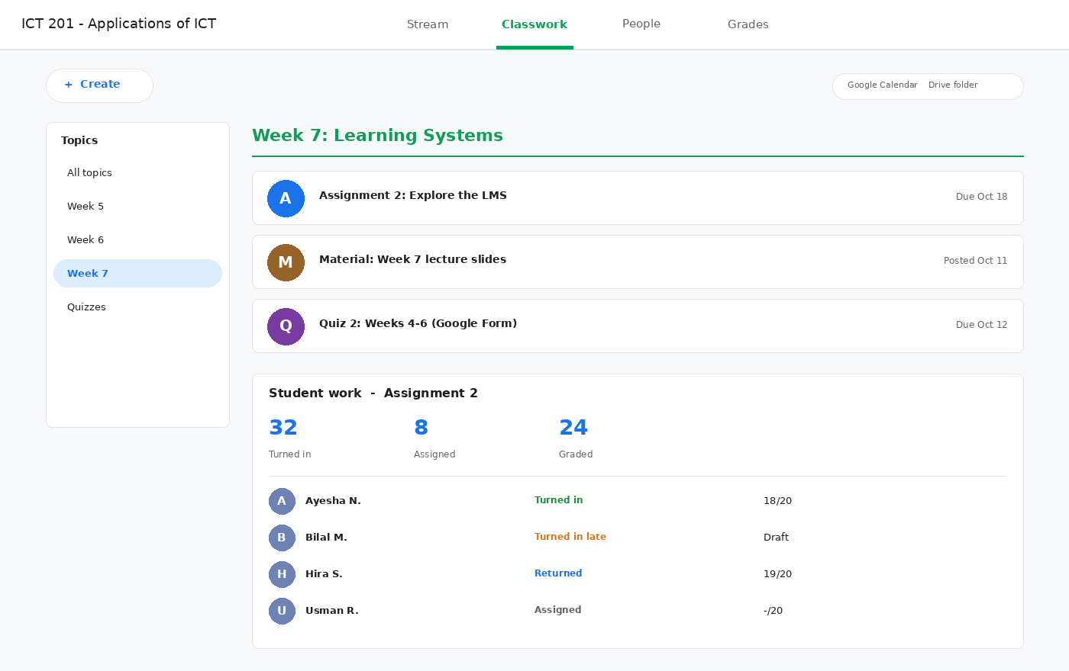
PART 1: LMS — GOOGLE CLASSROOM
Google Classroom — Classwork & Grading
CLASSWORK TAB
Teachers organize work under Topics and post Assignments, Quiz assignments (Google Forms), Questions, and Materials.
STUDENT WORK
Each submission shows a status — Assigned, Turned in, Turned in late, or Returned — with counts for the whole class.
GRADING
• Add points and private comments
• Return work to the student
• Marks flow into the Grades tab
Illustrative interface drawn for teaching — exact layout varies by version and institution.
ICT 201 | Week 7 — Learning Management Systems + Week 6 Recap
19

Slide 20
PART 1: LMS — GOOGLE CLASSROOM
Google Classroom — Facilities & Strengths
Google Meet Integration
Drive & Docs Collaboration
Each class can include a Meet link, so live lessons start from the same place as the assignments.
A personal copy of a Doc is created for each student; the teacher can comment on drafts as students write.
Quizzes with Google Forms
Rubrics & Originality Reports
Auto-graded quizzes, with answers and scores flowing back to the Classroom grade list.
Rubrics help consistent marking; originality (plagiarism) checks are available in certain Google Workspace for Education editions.
Guardian Summaries
Free & Quick to Start
Parents or guardians can receive email summaries of upcoming and missing work when the school enables it.
Free for schools using Google accounts, set up in minutes, and works on phones and tablets — but with fewer advanced course-design tools than Moodle or Canvas.
ICT 201 | Week 7 — Learning Management Systems + Week 6 Recap
20

Slide 21
SIDE-BY-SIDE COMPARISON
Moodle vs Canvas vs Google Classroom
Aspect
Moodle
Canvas
Google Classroom
Cost model
Free open-source software (hosting and support cost extra)
Subscription paid by the institution; vendor-hosted
Free with Google accounts; paid editions add features
Setup & hosting
Needs a server and administrator (or paid cloud host)
Vendor hosts, updates, and secures it
Minutes: create a class, share the code
Ease of use
Moderate — powerful but dense
Easy — clean and consistent
Easiest — very minimal interface
Signature strength
Customization, plugins, and question bank
Modules, SpeedGrader, and integrations
Google Docs, Forms, Meet, and Drive
Assessment & grading
Advanced quizzes, workshops, outcomes
Rubrics, SpeedGrader, quiz tools
Forms quizzes, simple rubrics, grade list
Main limitation
Setup and maintenance effort
Subscription cost; less code-level control
Fewer deep course-design and analytics tools
Best fit
Universities wanting control of data and features
Large institutions wanting a polished experience
Schools and small classes needing a quick start
ICT 201 | Week 7 — Learning Management Systems + Week 6 Recap
21

Slide 22
WHY IT MATTERS BEYOND THE CLASSROOM
Benefits of LMS in Society
Access to Education Anywhere
Lower Cost & Paperless Learning
Learners in remote areas, working students, and people with mobility challenges can study without relocating or commuting.
Digital handouts, online submission, and automatic marking save printing, travel, and teacher time.
Equity & Inclusion
Transparency & Accountability
Self-paced content, captions, mobile access, and screen-reader friendly design give more learners a fair chance to participate.
Deadlines, marks, and feedback are recorded and visible, reducing disputes and helping fair assessment.
Continuity in Crises
Workforce & Lifelong Learning
During COVID-19 closures, LMS platforms and video meetings kept millions of students learning when buildings were shut.
Companies and governments use LMS platforms for training, compliance, certificates, and upskilling throughout a career.
ICT 201 | Week 7 — Learning Management Systems + Week 6 Recap
22

Slide 23
PROFESSIONAL USE & DIGITAL ETIQUETTE
Working Responsibly in an LMS — Student Best Practices
Check It Daily
Submit Early & Confirm
Open the dashboard, to-do list, and announcements every day so a deadline or room change never surprises you.
Do not wait for the last minute; after uploading, check that the submission shows as received or “turned in.”
Communicate Professionally
Protect Academic Integrity
Use clear subject lines, polite wording, and the right channel (forum, message, or email) — the same etiquette from Week 4.
Submit your own work, cite sources, and remember that plagiarism checkers and timestamps are part of the LMS.
Protect Your Account
Use Notifications & Calendar
Use a strong password, never share your login, and sign out on shared computers to protect your grades and privacy.
Turn on mobile notifications and sync deadlines to your phone calendar so reminders find you.
ICT 201 | Week 7 — Learning Management Systems + Week 6 Recap
23

Slide 24
APPLYING WHAT YOU LEARNED
Which LMS Fits Which Situation?
Scenario
Better fit
Why
A school teacher needs to start online classes tomorrow with a free tool
Google Classroom
Free, ready in minutes, works with Meet, Docs, and Forms
A university wants full control of its data and custom features
Moodle
Open-source, self-hosted, and highly customizable with plugins
A large institution wants a polished, low-maintenance experience
Canvas
Vendor-hosted, intuitive, strong integrations and SpeedGrader
A teacher who already uses Gmail, Drive, and Docs every day
Google Classroom
Native integration with the Google tools already in use
A company must track training completion and issue certificates
Moodle or Canvas
Completion tracking, restricted access, and certificates or badges
ICT 201 | Week 7 — Learning Management Systems + Week 6 Recap
24

Slide 25


WEEK 6 RECAP — PART A: VIDEO CONFERENCING
Google Meet, Microsoft Teams & Zoom
Purpose, how they work, key facilities, and how they differ

Slide 26
WEEK 6 RECAP — VIDEO CONFERENCING
What Is Video Conferencing & How Does It Work?
1
2
3
4
5
Capture
Compress
Transmit
Relay
Display
Your camera and microphone record you as digital video and audio.
A codec shrinks the data so it can travel over normal internet connections.
Data is sent as small packets over the internet, often using real-time protocols such as WebRTC.
A meeting server receives each stream and forwards it to every participant.
Each device decodes the data and shows video while playing the audio.
Purpose
What you need
Quality depends on
Real-time, face-to-face communication across distance: classes, meetings, interviews, webinars, and consultations.
A device with a camera and microphone, a stable internet connection, and a free or institutional account.
Bandwidth (speed), latency (delay), and device power — which is why a wired or strong Wi-Fi link gives a better call.
ICT 201 | Week 7 — Learning Management Systems + Week 6 Recap
26

Slide 27
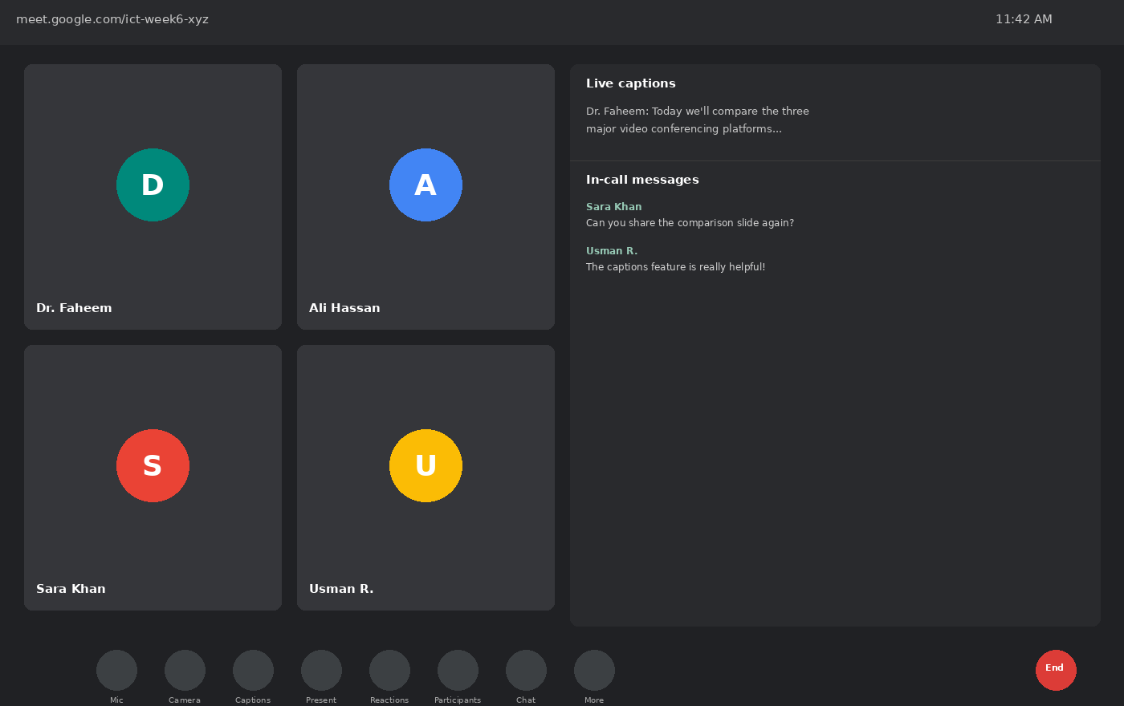
WEEK 6 RECAP — GOOGLE MEET
Google Meet — Inside a Live Meeting
PURPOSE
Quick, lightweight video meetings from the browser, tightly linked to Google Calendar, Gmail, and Workspace files.
HOW IT WORKS
Start from a Calendar invite or a meet.google.com link — no software install is needed on a computer.
ON-SCREEN CONTROLS
• Mic and camera toggles
• Live captions (speech-to-text)
• Present now — share screen or tab
• Reactions and in-call chat
Illustrative interface drawn for teaching — exact layout varies by version and institution.
ICT 201 | Week 7 — Learning Management Systems + Week 6 Recap
27

Slide 28
WEEK 6 RECAP — GOOGLE MEET
Google Meet — Facilities & Positive Uses
Deep Google Workspace Integration
Live Captions & Translation
Joins directly from Calendar, Gmail, and Docs/Sheets/Slides — meeting links generate automatically.
Real-time AI captions support students who are hard of hearing or learning in a second language.
Breakout Rooms
Noise Cancellation & Low-Light Mode
Hosts split large classes into small discussion groups, then bring everyone back together.
AI filters background noise and brightens video in poor lighting — useful for students joining from busy homes.
Browser-Based Access
Positive Use in Education
No installation needed on shared or low-spec computers; works from almost any device.
Common for guest lectures, office hours, and viva or defense sessions; free plans include time limits on group meetings.
ICT 201 | Week 7 — Learning Management Systems + Week 6 Recap
28

Slide 29
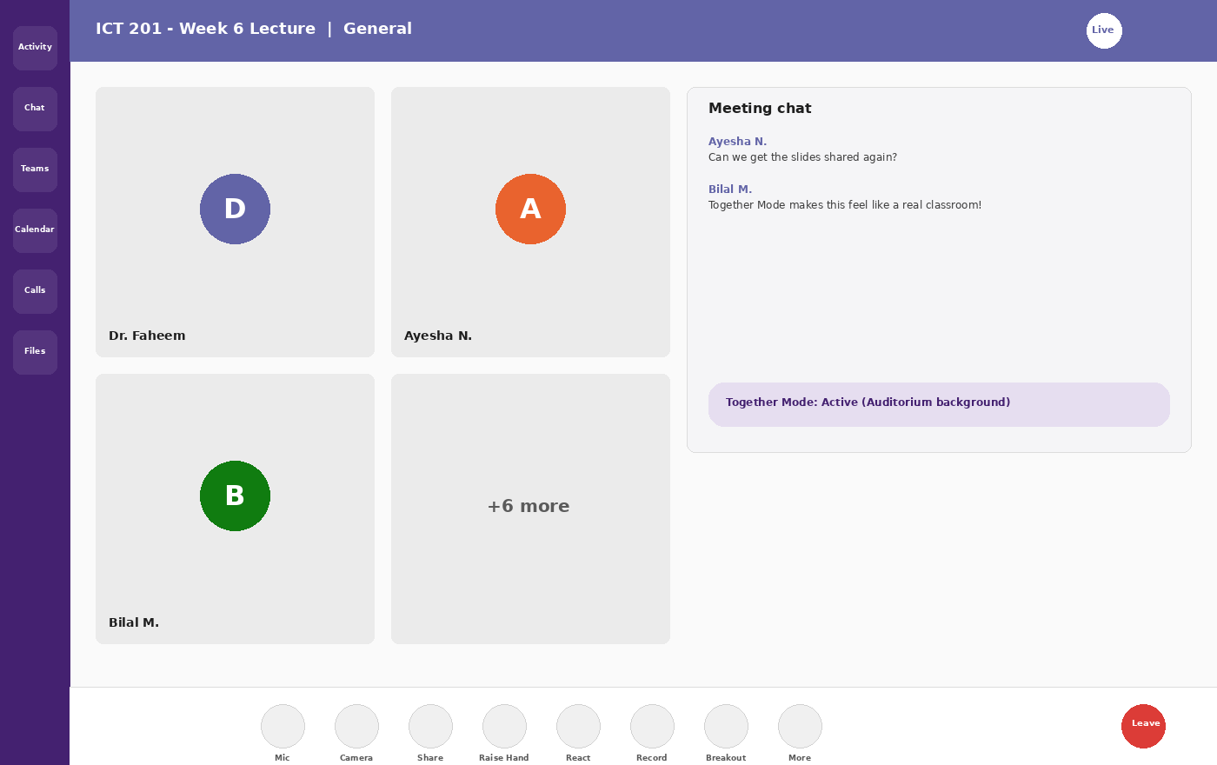
WEEK 6 RECAP — MICROSOFT TEAMS
Microsoft Teams — Inside a Live Meeting
PURPOSE
A complete collaboration hub for institutions and companies: meetings, chat, channels, and shared files in one app.
HOW IT WORKS
Built into Microsoft 365. Meetings are scheduled in Outlook Calendar and opened from the Teams desktop or web app.
LEFT NAVIGATION
• Activity — mentions and notifications
• Chat — one-to-one and group messages
• Teams — channels per class or project
• Calendar, Calls, and Files
Illustrative interface drawn for teaching — exact layout varies by version and institution.
ICT 201 | Week 7 — Learning Management Systems + Week 6 Recap
29

Slide 30
WEEK 6 RECAP — MICROSOFT TEAMS
Microsoft Teams — Facilities & Positive Uses
Together Mode
Channels & Persistent Chat
Places everyone in one shared virtual setting (such as a lecture hall) to reduce “video-grid fatigue.”
Each class or project has channels where recordings, files, and chat history stay organized after the call.
Office App Integration
Recording & Transcripts
Open and co-edit Word, Excel, and PowerPoint files during a meeting — ideal for group assignment reviews.
Meetings can be recorded with searchable transcripts, so absent students can catch up.
Breakout Rooms
Positive Use in Education
Hosts create small-group rooms for case studies and can send announcements to all rooms.
Fits naturally where a university already uses Microsoft 365 accounts for official classes and meetings.
ICT 201 | Week 7 — Learning Management Systems + Week 6 Recap
30

Slide 31
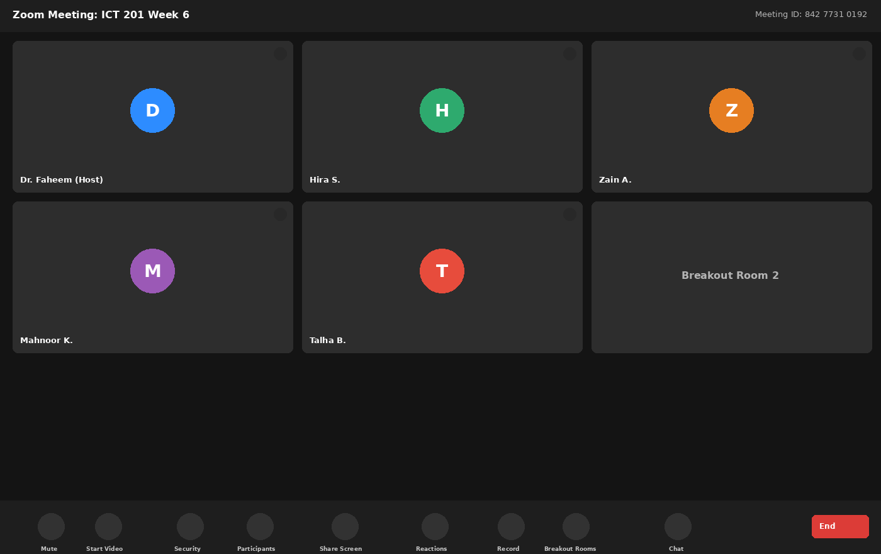
WEEK 6 RECAP — ZOOM
Zoom — Inside a Live Meeting
PURPOSE
Reliable video meetings and large webinars for any organization, whichever email or office system they use.
HOW IT WORKS
Join through the Zoom app (or browser) using a Meeting ID and passcode. Known for stable quality on weaker connections.
ON-SCREEN CONTROLS
• Security — lock meeting, waiting room
• Gallery view of many participants
• Share Screen with annotation
• Breakout Rooms and Record
Illustrative interface drawn for teaching — exact layout varies by version and institution.
ICT 201 | Week 7 — Learning Management Systems + Week 6 Recap
31

Slide 32
WEEK 6 RECAP — ZOOM
Zoom — Facilities & Positive Uses
Dedicated Security Panel
Breakout Rooms
One “Security” button lets a host lock the meeting, enable a waiting room, or limit sharing and chat — a defense against “Zoom-bombing.”
Mature tools to assign participants to many small rooms, broadcast messages, and set timers to return.
Webinar Mode
Virtual Backgrounds & Filters
Supports very large audiences who only watch, with Q&A and polling — used for seminars and public lectures.
Backgrounds and touch-up options help presenters look professional without a studio.
Cloud Recording & Transcripts
Positive Use in Education
Paid plans can store recordings and generate transcripts that become revision material.
Often chosen for guest speakers and for students joining from areas with weaker internet.
ICT 201 | Week 7 — Learning Management Systems + Week 6 Recap
32

Slide 33
WEEK 6 RECAP — COMPARISON
Google Meet vs Microsoft Teams vs Zoom
Facility
Google Meet
Microsoft Teams
Zoom
Access model
Browser-first, Google account
Microsoft 365 account
Dedicated app, Meeting ID
Best integration
Gmail, Calendar, Docs
Outlook, Office apps, Channels
Works with any ecosystem
Signature feature
Live captions & translation
Together Mode & persistent channels
Security panel & Webinars
Breakout rooms
Yes (basic)
Yes (with broadcast message)
Yes (most mature)
Chat & files after the call
Basic in-meeting chat
Channels keep chat and files
In-meeting chat; limited team workspace
Best fit
Quick, lightweight, cross-platform calls
Microsoft-based institutions and teams
Large seminars, weaker connections
ICT 201 | Week 7 — Learning Management Systems + Week 6 Recap
33

Slide 34
WEEK 6 RECAP — VIDEO CONFERENCING
Positive Uses & Video-Meeting Netiquette
Positive Use: Access & Collaboration
Positive Use: Flexible Learning
Remote students attend lectures and consult supervisors; research teams and guest speakers connect across time zones at near-zero cost.
Recordings and transcripts let students revisit lectures; telemedicine and professional consultations also rely on the same technology.
Netiquette: Audio & Video
Netiquette: Participation
Join early to test your microphone and camera; mute when not speaking; use a tidy, neutral background.
Raise your hand or use chat, avoid talking over others, and keep side conversations out of the main chat.
Netiquette: Professionalism
Netiquette: Privacy
Dress and behave as you would in a classroom, and keep your name clearly visible so the host can identify you.
Do not record, screenshot, or share a meeting without permission, and never post meeting links publicly.
ICT 201 | Week 7 — Learning Management Systems + Week 6 Recap
34

Slide 35
☕
BREAK 2
10 Minutes
Back at it: social media applications — then hands-on practice and wrap-up

Slide 36
WEEK 6 RECAP — PART B: SOCIAL MEDIA APPLICATIONS
LinkedIn, Facebook & Instagram
Purpose, how they work, and positive impact on education, jobs, and marketing

Slide 37
WEEK 6 RECAP — SOCIAL MEDIA
What Are Social Media Applications & How Do They Work?
1
2
3
4
5
6
Create a Profile
Connect
Create Content
Feed Algorithm
Engage
Data & Advertising
Sign up and build an identity: name, photo, interests, education, or business details.
Add friends, follow accounts, join groups, or connect with professionals.
Post text, photos, videos, reels, articles, or stories for your audience.
The platform ranks posts and decides what each person sees, based on interests and past activity.
Users like, comment, share, and message — which feeds back into the ranking.
The platform learns audience interests; businesses pay to reach targeted groups.
Purpose
Why they are “free”
Why it matters for ICT
Share information, build communities, and communicate with large audiences — personally, professionally, and commercially.
Most platforms earn money through advertising and data about audience interests, so features are built to keep users engaged.
The same tools that connect classmates and employers can also spread misinformation, so responsible use is a core ICT skill.
ICT 201 | Week 7 — Learning Management Systems + Week 6 Recap
37

Slide 38
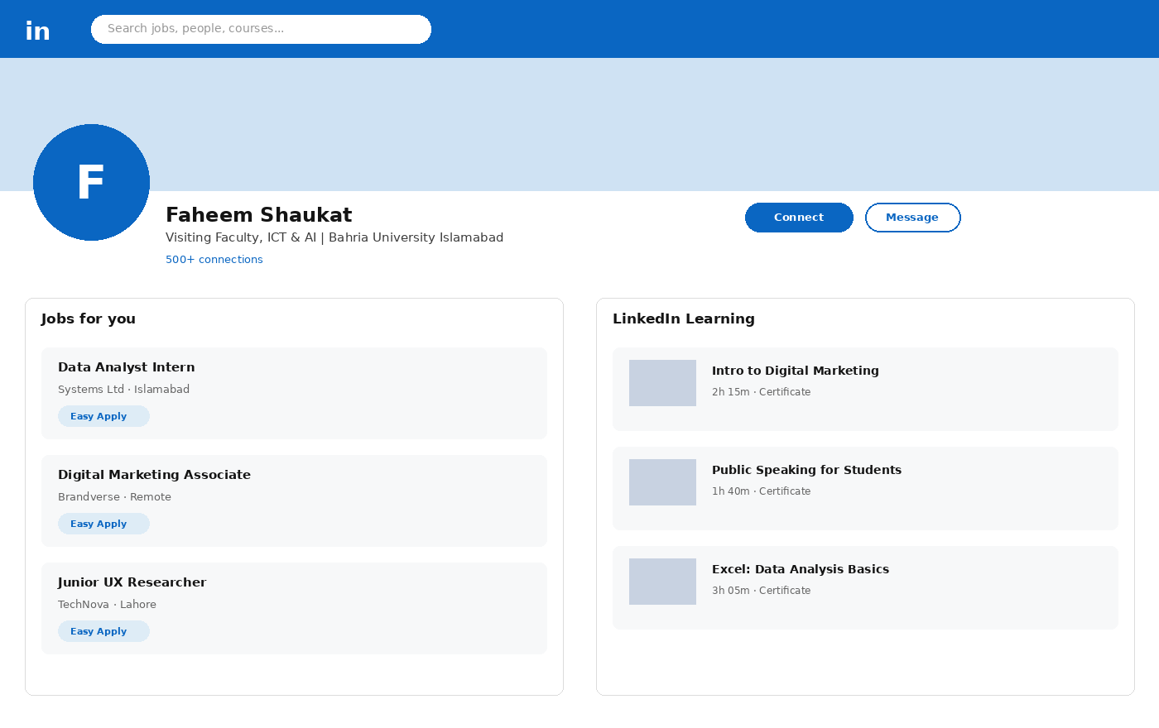
WEEK 6 RECAP — LINKEDIN
LinkedIn — Profile, Jobs & Learning
PURPOSE
A professional networking platform built around a resume-style profile, company pages, and a feed of industry content.
HOW IT WORKS
You build a profile, connect with colleagues and recruiters, follow companies, and apply to jobs with “Easy Apply.”
KEY SECTIONS SHOWN
• Profile — education, experience, skills
• “Jobs for You” — matched openings
• LinkedIn Learning — short courses
• Connect / Message networking
Illustrative interface drawn for teaching — exact layout varies by version and institution.
ICT 201 | Week 7 — Learning Management Systems + Week 6 Recap
38

Slide 39
EDUCATION · PROFESSIONAL/JOBS · MARKETING
LinkedIn — Positive Impact
Education
Professional / Jobs
LinkedIn Learning offers short courses with certificates that can be added to a profile — turning scrolling time into verifiable upskilling.
AI-matched job recommendations and “Easy Apply” connect students with internships and entry-level roles; recommendations act as digital references.
Marketing
Why It Works for Students
Businesses and freelancers publish expert posts and case studies; ads can target by job title and industry, not just age or location.
A well-built profile is a living CV that teachers, peers, and recruiters can all check in one public place.
ICT 201 | Week 7 — Learning Management Systems + Week 6 Recap
39

Slide 40
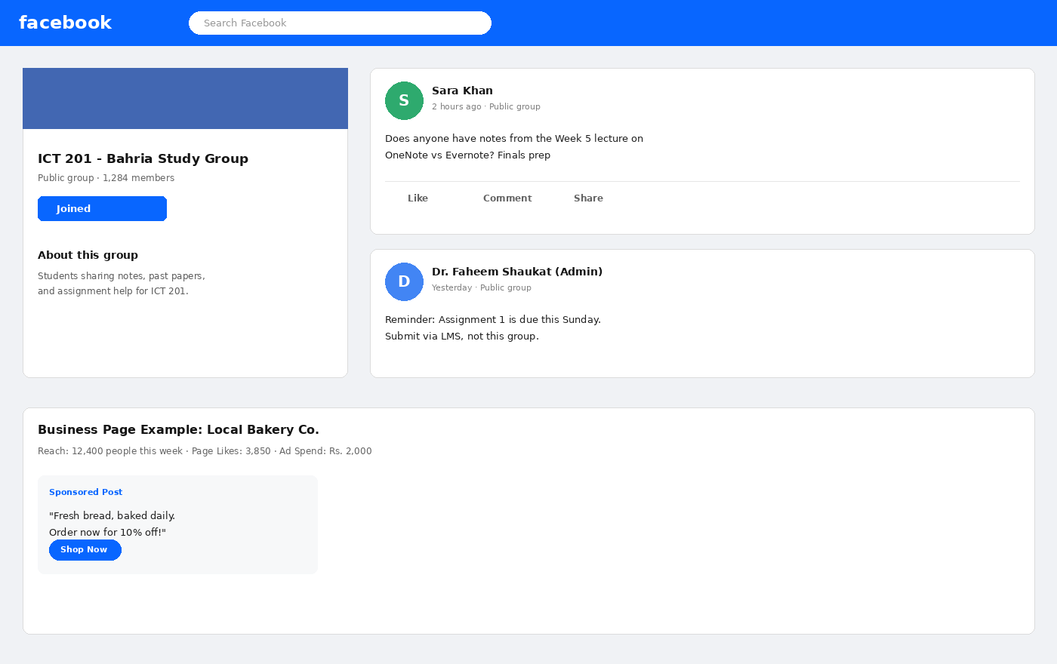
WEEK 6 RECAP — FACEBOOK
Facebook — Groups, Pages & Community
PURPOSE
A community-centered platform built around Groups (shared-interest communities) and Pages (public profiles for businesses and organizations).
HOW IT WORKS
Members join groups, post and comment; page owners publish updates, view insights, and can pay to promote posts.
KEY ELEMENTS SHOWN
• Study group for notes and queries
• Admin posts — official reminders
• Business page — reach, likes, ad spend
• Sponsored post with a call to action
Illustrative interface drawn for teaching — exact layout varies by version and institution.
ICT 201 | Week 7 — Learning Management Systems + Week 6 Recap
40

Slide 41
EDUCATION · PROFESSIONAL/JOBS · MARKETING
Facebook — Positive Impact
Education
Professional / Jobs
Class and university Groups become informal study communities where students share notes, ask questions, and get reminders outside class hours.
Community job-posting groups and Pages connect small businesses with local candidates; alumni groups share internships and openings.
Marketing
Why It Works at Scale
Business Pages give even very small businesses insight into reach, engagement, and ad spend — professional marketing at low cost.
Ads can target by location, age, and interest, making Facebook a cost-effective tool for local and student-run businesses.
ICT 201 | Week 7 — Learning Management Systems + Week 6 Recap
41

Slide 42
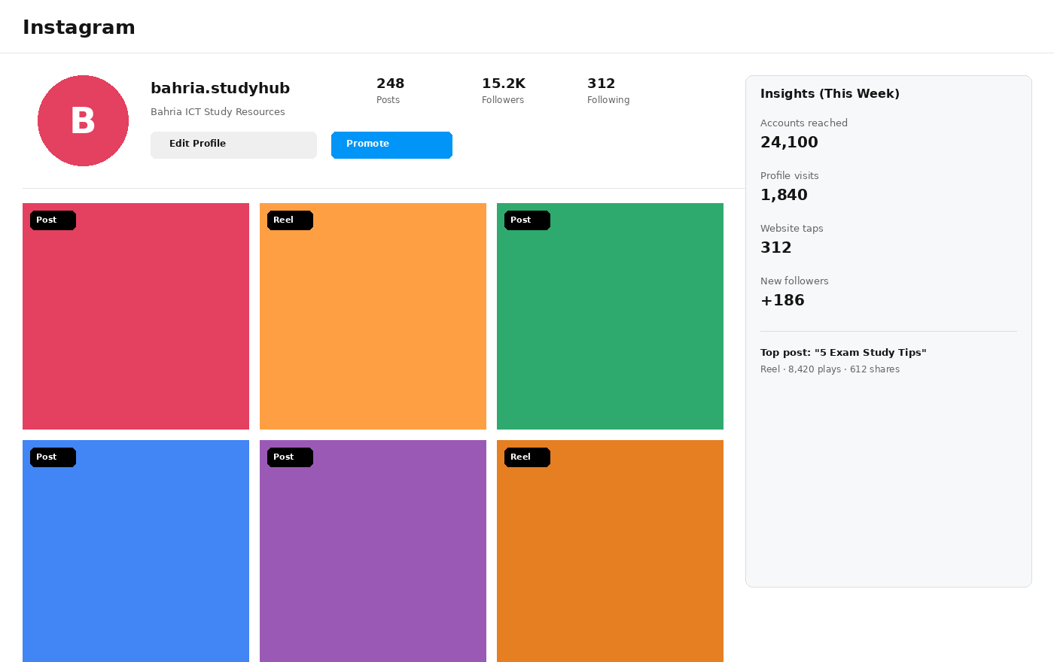
WEEK 6 RECAP — INSTAGRAM
Instagram — Business Profile & Insights
PURPOSE
A visual-first platform built around Posts, Reels (short video), and Stories, with a Business/Creator mode for analytics and promotion.
HOW IT WORKS
Accounts post visual content; the Explore and Reels algorithms can show it to people who do not yet follow the account.
KEY ELEMENTS SHOWN
• Content grid of posts and reels
• Promote button for paid boosting
• Insights — reach, visits, new followers
• Top-post callout
Illustrative interface drawn for teaching — exact layout varies by version and institution.
ICT 201 | Week 7 — Learning Management Systems + Week 6 Recap
42

Slide 43
EDUCATION · PROFESSIONAL/JOBS · MARKETING
Instagram — Positive Impact
Education
Professional / Jobs
Short Reels break complex topics (exam tips, quick tutorials, lab demos) into bite-sized visual lessons that are easy to revise and share.
A tidy, well-tagged portfolio of design, photography, or writing works as a visual CV that many creative-industry recruiters check.
Marketing
Why It Works for Reach
Insights (reach, profile visits, website taps) show a small brand which content drives real traffic and sales.
Explore and Reels can show content to non-followers, giving small accounts a chance to grow without ad spend.
ICT 201 | Week 7 — Learning Management Systems + Week 6 Recap
43

Slide 44
WEEK 6 RECAP — COMPARISON
LinkedIn vs Facebook vs Instagram
Aspect
LinkedIn
Facebook
Instagram
Core format
Professional profile & articles
Groups, Pages & long-form posts
Visual posts, Reels & Stories
Best for education
Verified courses & certificates
Class and study groups
Bite-sized visual tutorials
Best for jobs
Direct job matching & Easy Apply
Community job-posting groups
Visual portfolio & creative CV
Best for marketing
B2B and expert authority
Local business, detailed ad targeting
Visual branding, high reach
Primary audience
Professionals & recruiters
General public, wide age range
Younger, visually driven users
Signature tool
LinkedIn Learning
Groups & Page Insights
Reels & Insights
ICT 201 | Week 7 — Learning Management Systems + Week 6 Recap
44

Slide 45
WEEK 6 RECAP — ETHICS & SAFETY
Using Social Media Responsibly
Your Digital Footprint
Privacy Settings
Posts, comments, and photos can stay online for years and may be checked by universities and employers.
Review who can see your profile, tags, and location; share personal details only with people you trust.
Check Before You Share
Respectful Conduct
Verify news and claims with trusted sources before reposting — misinformation spreads faster than corrections.
Avoid harassment and cyberbullying; disagree politely and report abusive content.
Scams & Phishing
Time & Wellbeing
Be careful with unknown links, fake job offers, and requests for money or passwords — even from “friends.”
Endless scrolling and constant comparison can affect attention and mood; set limits and take regular breaks.
ICT 201 | Week 7 — Learning Management Systems + Week 6 Recap
45

Slide 46
APPLY WHAT YOU LEARNED
10 MIN
Hands-On Activity
TASK 1 — Learning Management Systems
Open the LMS your university provides (or a free Google Classroom class). Find: (1) where deadlines appear, (2) how to submit an assignment, (3) where grades and feedback are shown. Then write ONE benefit and ONE limitation of the system compared with sending files by email.
TASK 2 — Week 6 Recap
A student society plans an online orientation event. Choose ONE video-conferencing tool to host it and ONE social platform to promote it. In three sentences, explain why you chose each and name one netiquette or privacy rule you would announce to participants.
ICT 201 | Week 7 — Learning Management Systems + Week 6 Recap
46

Slide 47
KEY TAKEAWAYS
Week 7 and Week 6 in Six Points
1
An LMS centralizes content, assignments, quizzes, grades, and communication — replacing scattered files, emails, and paper records.
2
Moodle (open-source, highly customizable), Canvas (polished, cloud-hosted), and Google Classroom (free and simple) solve the same problem for different needs.
3
Choose an LMS by cost, control, ease of use, integrations, and the skills of the people who will maintain it.
4
Google Meet, Microsoft Teams, and Zoom each win in a different setting: lightweight browser use, Microsoft-based institutions, and large or low-bandwidth sessions.
5
LinkedIn, Facebook, and Instagram can support education, jobs, and marketing — each with a different strength and audience.
6
Whatever the tool, professional etiquette, academic integrity, privacy, and verification of information are the marks of an ICT-literate person.

Slide 48
BEFORE YOU LEAVE
Exit Ticket
On a slip of paper (or the LMS form), answer briefly:
1
Name TWO components of an LMS and explain what each is used for.
2
A school with no IT staff and no budget wants to start online classes this week. Which LMS would you suggest, and why?
3
Give ONE difference between Zoom and Microsoft Teams, and ONE way LinkedIn helps a student find work.
Next session: see the course outline for Week 8 — details to be shared on the LMS.
ICT 201 | Week 7 — Learning Management Systems + Week 6 Recap
48

