Slide 1

SESSION ROADMAP
BAHRIA UNIVERSITY, ISLAMABAD
0:00
Hook
0:08
PART 1: Search Engines
0:08
Google Tips & Tricks
ICT 201 · CLASS 3 · WEEK 3
0:32
Google New Facilities
0:40
Google Lens
Search Engines &
AI Platform Mastery
0:47
Bing Tips + Copilot
1:03
Perplexity
1:31
Search Engine Landscape
1:38
BREAK (10 min)
1:48
PART 2: AI Platforms
🔍 Google & Bing Mastery
🤖 AI Assistants & Prompting
PART 1: Google, Bing & Search Facilities
PART 2: ChatGPT, Claude, Gemini & Grok
1:58
Prompt Engineering
2:08
AI Search vs Traditional
2:13
ChatGPT · Claude · Gemini · Grok
2:38
Prompting Workshop
2:53
Takeaways + Exit
3-Hour Deep Dive · 1 Break (10 min)
Notes:
Full 3-hour session: Part 1 covers classic + modern search engines, Part 2 covers AI platforms individually with their own prompting styles.

Slide 2
PART 1
Search Engines
Tips, Tricks, New Facilities & Comparison
Notes:
Clear divider — signals the start of Part 1.

Slide 3
⏱ 0:00–0:08
OPENING HOOK
🔍
How good are your Google skills — really?
Challenge: Find the exact PDF syllabus for "ICT 201" from a Pakistani university website — in under 30 seconds.
⏱️
💡
🎯
Try it now
There's a faster way
Today's goal
Most people type plain keywords and scroll for minutes
Search operators can get you there in one search
Master the tools professionals use to find anything instantly
Notes:
Let a few students actually try this live on their phones. Most will fail to find it fast — perfect motivation for the lesson.

Slide 4
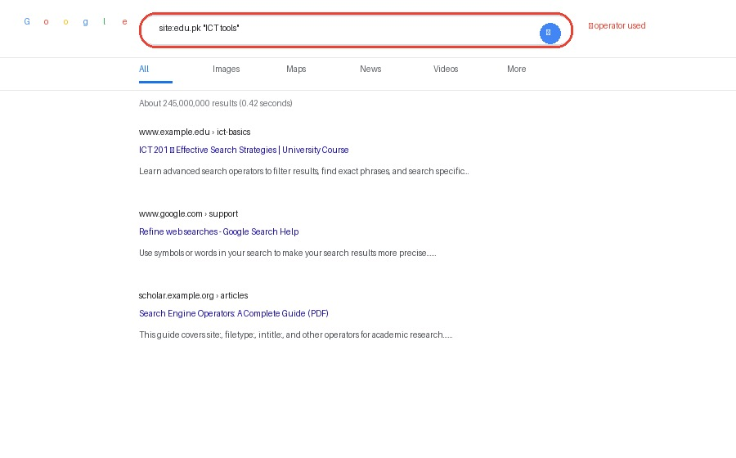
⏱ 0:08–0:16
GOOGLE — TIPS & TRICKS (1 OF 3)
🔎 Google Search Operators
"exact phrase"
Finds pages with the exact wording
site:domain.com
Search within ONE website only
-word
Excludes a word from results
filetype:pdf
Only shows PDF documents
🖼 Mockup: using site: + "exact phrase" together
Notes:
Demo live on the projector — type each operator into Google and show real results changing.

Slide 5
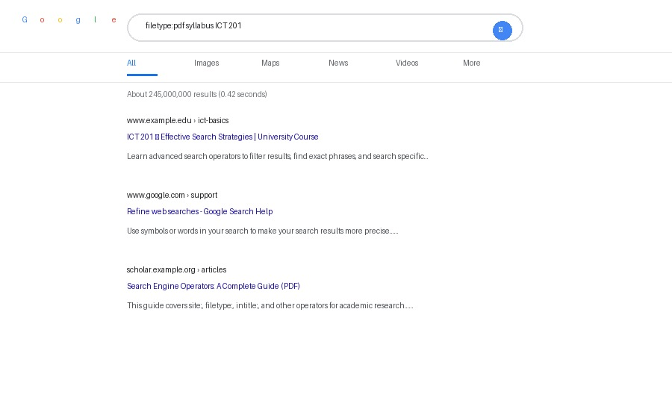
⏱ 0:16–0:24
GOOGLE SEARCH — TIPS & TRICKS (2 OF 3)
🔎 More Powerful Operators
filetype:pdf
Only shows PDF documents
define:word
Instant dictionary definition
2020..2024
Searches within a number/date range
related:site.com
Finds sites similar to one you like
🖼 Mockup: filetype:pdf narrows results to PDF documents only
Notes:
Try filetype:pdf "past papers" ICT 201 live — students love seeing instant PDF results.

Slide 6
⏱ 0:24–0:32
GOOGLE SEARCH — TIPS & TRICKS (3 OF 3)
✨ Hidden Google Features
📷
Reverse Image Search
🧮
Built-in Calculator
Upload or drag a photo to find its source or similar images
Type any math expression directly into the search bar
✈️
Flight & Time Tools
🎓
Google Scholar
"flights to Dubai" or "time in London" show instant widgets
scholar.google.com — search only academic papers & citations
🌦️
Quick Answers
⏲️
Search by Time
Weather, unit conversions, and currency — right in the results
Tools → Any time → Past 24 hours for the freshest results
Notes:
Google Scholar is especially valuable — mention it will help with future research assignments.

Slide 7
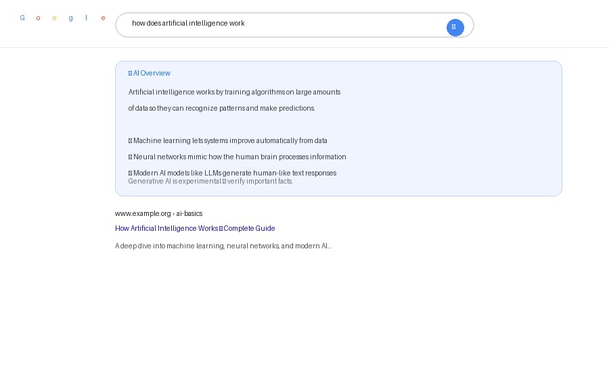
⏱ 0:32–0:40
GOOGLE — NEWEST FACILITIES
🆕 What Google Added Recently
AI Overviews
AI-written summary answers your question before you click anything
Google Lens
Search using your camera — point at any object, text, or homework problem
Circle to Search
On Android: circle anything on your screen to search it instantly
SGE (Search Generative Experience)
Follow-up questions within the search results itself, like a chat
🖼 AI Overview — an AI-generated summary above regular results
Notes:
Google is racing to add AI features to stay competitive with ChatGPT/Perplexity.

Slide 8

⏱ 0:40–0:47
MODERN SEARCH — AI IS CHANGING HOW WE SEARCH
📸 Google Lens: Search With Your Camera
Identify objects
Point at a plant, product, or landmark to identify it instantly
Translate text
Point at a sign or menu in another language for instant translation
Solve homework
Point at a math problem to get step-by-step solutions
Shop visually
Point at clothes/furniture to find where to buy them online
🖼 Mockup: pointing your camera at an object to search it instantly
Notes:
Most students have Google Lens on their phone already (in the Google app) without realizing it.

Slide 9
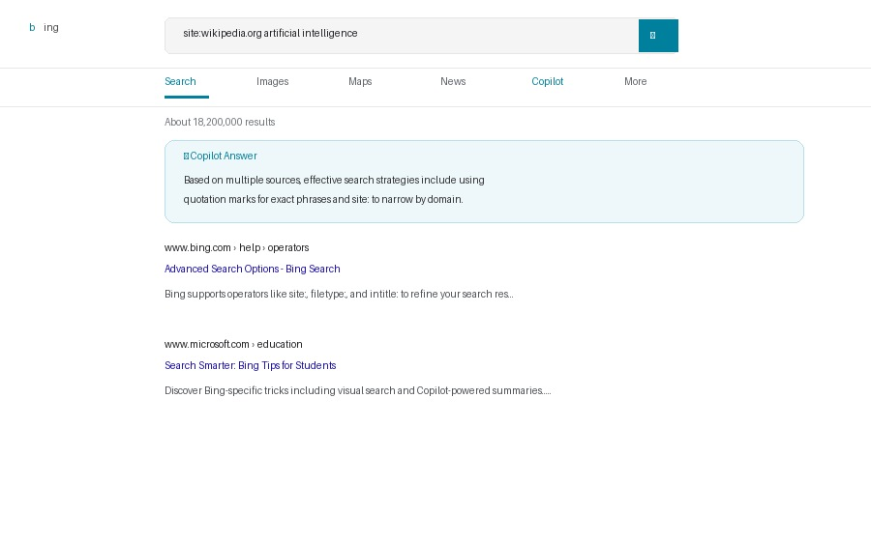
⏱ 0:47–0:55
BING — TIPS & TRICKS
🅱️ Bing: Google's Biggest Rival
Same operators as Google
site:, filetype:, "exact phrase" all work identically
Visual Search
Search using an image instead of typing — great for shopping
Rewards Program
Microsoft Rewards gives points for searching, redeemable for gift cards
Deep Search
Bing rewrites your query using AI to find more relevant hidden results
🖼 Bing results with Copilot AI answer box built in
Notes:
Ask: who has used Bing before? Usually very few.

Slide 10
⏱ 0:55–1:03
BING — NEWEST FACILITIES
🆕 Copilot: Bing's Biggest Upgrade
💬
Chat Mode
🎨
Image Creator
Have a full back-and-forth conversation right inside Bing
Generate AI images directly from a text description, free
📝
Compose Feature
🔗
Cited Answers
Draft emails, posts, or essays in a chosen tone and length
Copilot shows numbered links to sources, unlike plain AI chat
Notes:
Copilot cited answers are a great bridge into why Perplexity/AI platforms matter next.

Slide 11
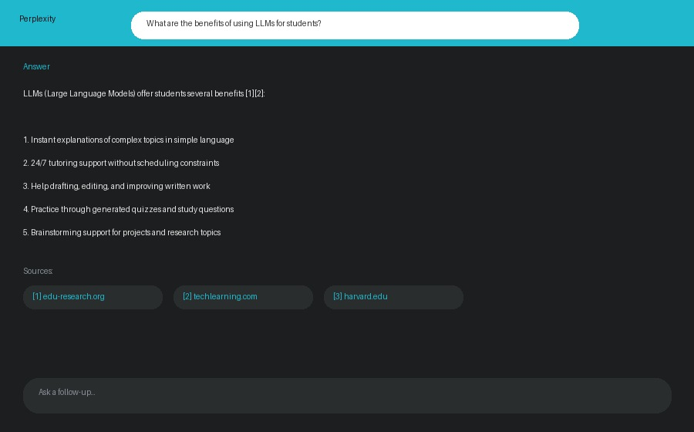
⏱ 1:03–1:11
MODERN SEARCH — AI IS CHANGING HOW WE SEARCH
🌐 Perplexity: Built for the AI Era
It IS a search engine
Unlike ChatGPT, it searches the live web for every answer
Shows its sources
Every claim is numbered and linked back to a real website
Best for research
Great for assignments — you can verify and cite the sources shown
Free to use
Works in browser or app — no account needed for basic use
🖼 Mockup: Perplexity answers in full sentences WITH numbered source citations
Notes:
Perplexity is genuinely one of the best tools for student research — real sources, not hallucinated ones.

Slide 12
⏱ 1:11–1:19
COMPARING SEARCH ENGINES BY TASK
⚖️ Which Engine Wins for Which Job?
Task
Google
Bing
DuckDuckGo
Perplexity
General web search
🏆 Best
Good
Good
Decent
Academic research
🏆 Scholar
Decent
Basic
🏆 Cited sources
AI answers & citations
AI Overview
🏆 Copilot built-in
Limited
🏆 Best citations
Avoiding hallucination
Medium risk
Medium risk
No AI answers
🏆 Lowest risk
Privacy protection
Tracks you
Tracks you
🏆 No tracking
Some tracking
Image / visual search
🏆 Lens, largest index
Very good
Basic
Basic
Shopping comparison
Good
🏆 Strong integration
Basic
Basic
Notes:
Emphasize: no single "best" engine — the right choice depends on your task.

Slide 13
⏱ 12 Minutes
HANDS-ON ACTIVITY
The Search Speed Challenge
Complete each task as fast as you can, and note which engine you used:
1
Search "best laptop 2026" on Google and Bing — which AI summary is better?
4
Find 3 "neural network diagram" images via reverse image search
2
Find Bahria University’s founding year using site:bahria.edu.pk
5
Ask Bing Copilot for a short poem about technology/Phycology
3
Compute 15% of 4,850 with Google’s built-in calculator
6
Use Google Scholar to find one academic paper on any topic
🏆 First 3 students to finish all 6 tasks get bonus points!
Notes:
Walk around checking progress. Reinforces both classic operators and new AI facilities.

Slide 14
⏱ 1:31–1:38
THE SEARCH ENGINE LANDSCAPE
🌐 Popular Search Engines Today
Google
Bing
Yahoo
Market share: ~90%
Market share: ~4%
Market share: ~1.5%
Global default — largest index, most features
Microsoft-powered, built-in Copilot AI
Runs on Bing's index under the hood
DuckDuckGo
Baidu
Yandex
Market share: ~0.8%
Market share: ~0.5%
Market share: ~0.4%
Privacy-first — does not track your searches
Dominant search engine in China
Most popular in Russia and Central Asia
Notes:
Market share numbers are approximate global averages — mention they shift over time.

Slide 15
☕
BREAK
10 Minutes
Returning at 1:48 (elapsed time)
Stand up · Stretch · Hydrate
Coming up next PART 2: ChatGPT, Claude, Gemini & Grok — one at a time
Notes:
One break today at the halfway point.

Slide 16
PART 2
AI Platforms
Search Capabilities, Comparison & Platform-Specific Prompting
Notes:
Clear divider — signals the shift into Part 2, the AI-focused half.

Slide 17
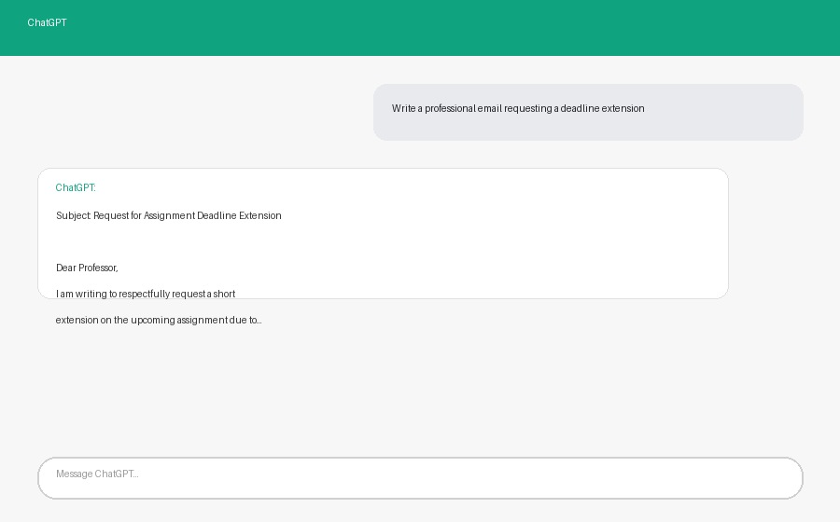
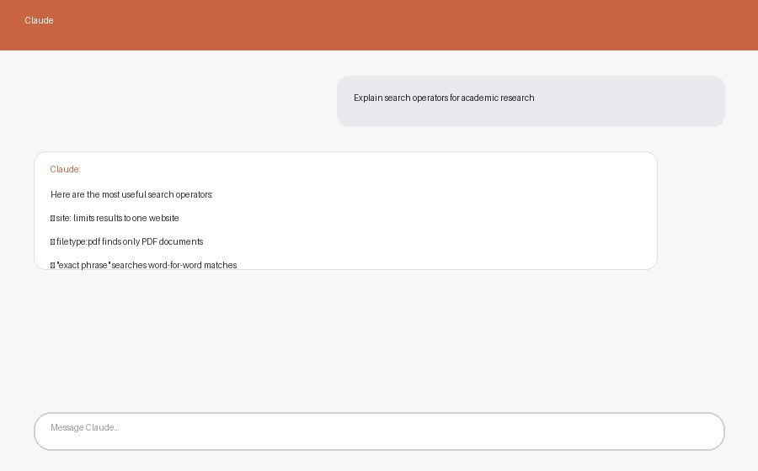
⏱ 1:48–1:53
BEYOND SEARCH — AI ASSISTANTS
🤖 Meet the AI Chat Assistants
ChatGPT — OpenAI
Claude — Anthropic
💡 Both are "large language models" trained on massive amounts of text to understand and generate human-like responses.
Notes:
This is the exact tool being used to build these slides — a fun meta moment to share with students.

Slide 18
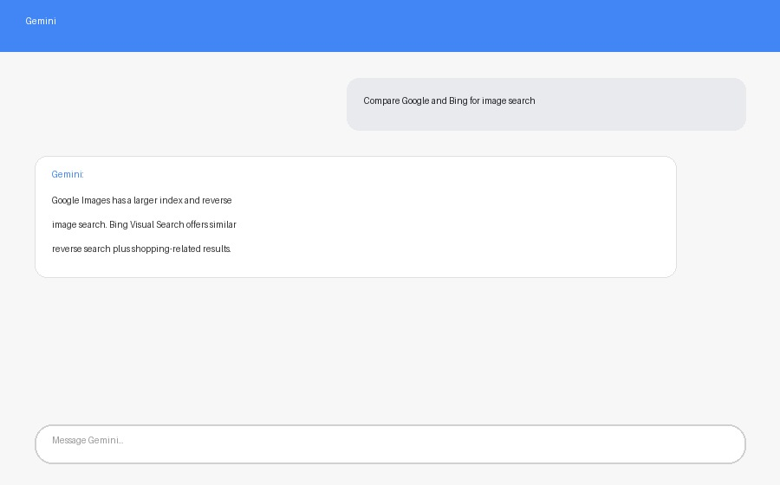
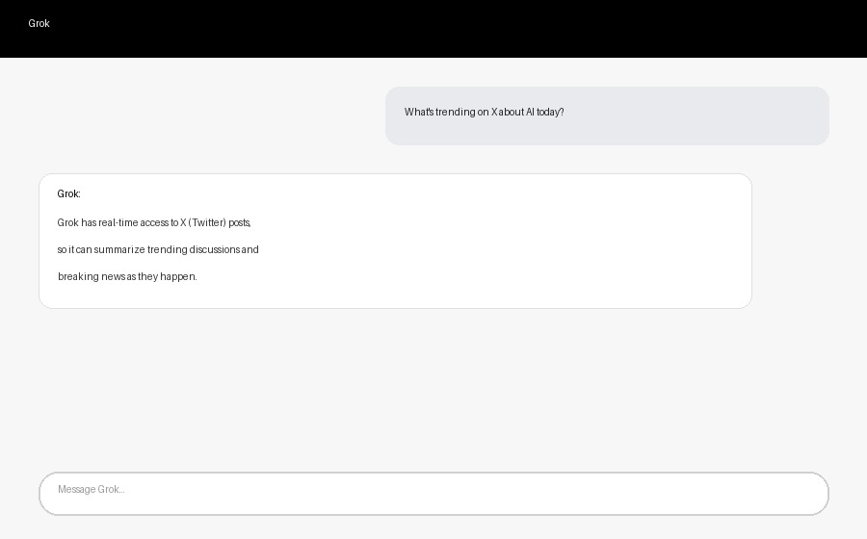
⏱ 1:53–1:58
BEYOND SEARCH — AI ASSISTANTS
🤖 Gemini, Grok & More
Gemini — Google
Grok — xAI (Elon Musk)
🌍 Others worth knowing: Microsoft Copilot (built into Bing & Office), Meta AI (in WhatsApp/Instagram), DeepSeek, and Perplexity (an AI-powered search engine).
Notes:
Grok has real-time access to X (Twitter) — a key differentiator worth mentioning.

Slide 19
⏱ 1:58–2:03
PROMPT ENGINEERING — PART 1 OF 2
✍️ What is Prompt Engineering?
Prompt Engineering = the skill of writing clear instructions to get the BEST possible response from an AI assistant.
🎯
Be Specific
👤
Give a Role
"Write a 200-word email" beats "write an email"
"Act as a professor grading this essay..." improves tone/quality
📋
Provide Context
🔄
Iterate
Share background info the AI needs to answer well
Refine your prompt based on the first response you get
Notes:
This is a genuinely valuable career skill now — worth emphasizing its growing importance.

Slide 20
⏱ 2:03–2:08
PROMPT ENGINEERING — PART 2 OF 2
✍️ Weak Prompt vs Strong Prompt
❌ WEAK
✅ STRONG
"help me study"
"Act as a tutor. Quiz me with 5 multiple-choice questions on Chapter 2: Hardware, and explain each answer."
❌ WEAK
✅ STRONG
"write an email"
"Write a formal 100-word email to my professor requesting a 3-day extension on my ICT assignment due to illness."
Notes:
Have students rewrite one weak prompt of their own into a strong one — quick pair exercise if time allows.

Slide 21
⏱ 2:08–2:13
AI PLATFORMS VS TRADITIONAL SEARCH
🆚 How AI Search Really Compares
🔍 TRADITIONAL SEARCH
🤖 AI PLATFORM SEARCH
✅ Shows many independent sources
✅ Synthesizes info into ONE answer
✅ You control which link to trust
✅ Conversational follow-up questions
✅ Great for live prices/news
✅ Explains reasoning, not just facts
❌ You do the reading & synthesis
❌ Can hallucinate false information
❌ Takes longer to compare info
❌ Not all platforms cite sources
Notes:
Key message: complementary tools. Now we go platform-by-platform to see HOW each one searches differently.

Slide 22
⏱ 2:13–2:17
💬 ChatGPT: Style & Tips
ChatGPT — OpenAI
🔎 Search Capability
Has a built-in "Search the web" mode — browses live and shows clickable citations when enabled.
✍️ Its Prompting Style
Best with conversational, multi-turn prompts. Supports "Custom Instructions" so it remembers your preferences across chats.
💡 Tip: ask it to "browse the web" for anything time-sensitive.
Good vs Traditional Search: excellent for versatile tasks (code, essays, ideas) — but weaker than Google for very recent breaking news unless browsing is manually enabled.
Notes:
Emphasize: ChatGPT is the most "general purpose" of the four — good at almost everything, master of none specific search niche.

Slide 23
⏱ 2:17–2:21
📄 Claude: Style & Tips
Claude — Anthropic
🔎 Search Capability
Can search the web when needed, but truly excels at analyzing LONG documents — paste in a 50-page PDF and ask questions.
✍️ Its Prompting Style
Responds well to clearly STRUCTURED prompts — using labeled sections or tags helps it follow complex, multi-part instructions precisely.
💡 Tip: paste your document/notes for deep analysis.
Good vs Traditional Search: unmatched for research synthesis and careful writing — but less suited than Google for quick live facts like prices or scores.
Notes:
Great for students: paste your whole assignment/notes and ask Claude to check, summarize, or explain them.

Slide 24
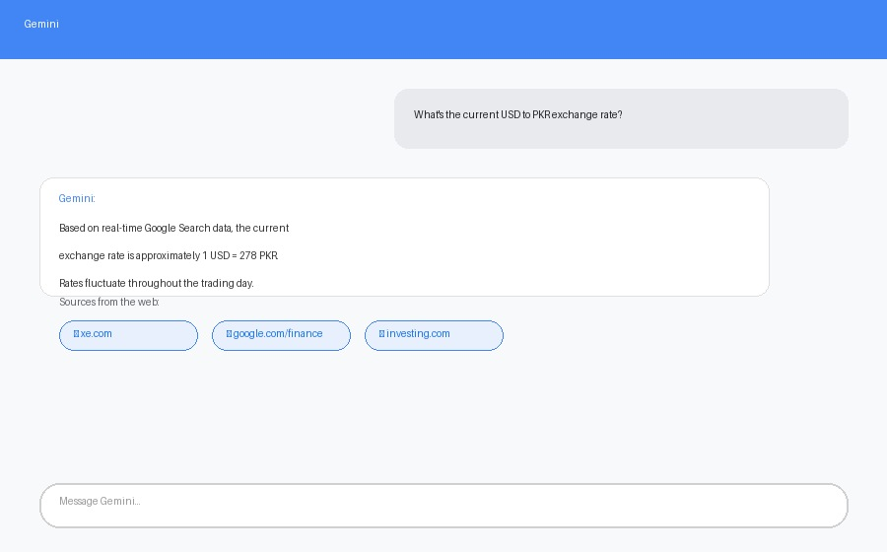
⏱ 2:21–2:25
🌐 Gemini: Style & Tips
Gemini — Google
🔎 Search Capability
Directly connected to live Google Search ("grounding") — shows real source chips, great for current/factual info.
✍️ Its Prompting Style
Multimodal by design — upload an image, PDF, or even video and ask questions about it directly.
💡 Tip: say "search the web for..." for grounded results.
🖼 "Grounding": Gemini shows real, clickable web sources
Good vs Traditional Search: best AI option for factual/current questions since it IS built on Google Search — closest AI replacement for a quick Google search.
Notes:
Also mention deep Google Workspace integration — summarizing Gmail/Docs directly.

Slide 25
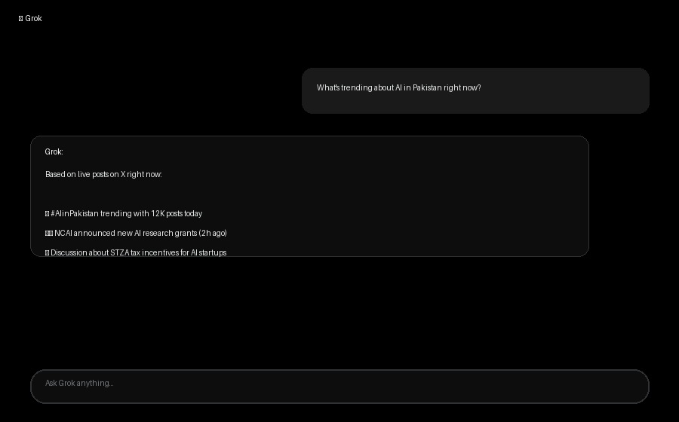
⏱ 2:25–2:29
𝕏 Grok: Style & Tips
Grok — xAI
🔎 Search Capability
Unique real-time access to X (Twitter) posts — knows about trending topics and breaking news as they happen.
✍️ Its Prompting Style
Casual, direct prompts work well. Less filtered tone than others, so it can be blunter with opinions and humor.
💡 Tip: ask "what's trending right now?" for live results.
🖼 Grok reading live X (Twitter) posts to answer in real time
Good vs Traditional Search: best AI option for social trends/current public discussion — but not designed for academic or formal research citations.
Notes:
Grok is the "social pulse" AI — great for what people are saying right now, less great for deep research.

Slide 26
⏱ 2:29–2:34
SIDE-BY-SIDE: ALL 4 AI PLATFORMS
📊 Which AI Wins for Which Job?
Best For
ChatGPT
Claude
Gemini
Grok
Live web citations
✓ (browse mode)
✓ (limited)
🏆 Always
✓ (X only)
Long document analysis
Good
🏆 Best
Good
Basic
Real-time trends
No
No
Some
🏆 Best
Multimodal (image/video)
Yes
Yes (images)
🏆 Best
Yes
Coding help
🏆 Excellent
Excellent
Good
Good
Casual/witty tone
Adjustable
Professional
Adjustable
🏆 Built-in
Notes:
Reinforce: no single "best" AI — pick based on the specific task at hand.

Slide 27
⏱ 2:34–2:38
TIPS THAT WORK ACROSS ALL PLATFORMS
💡 5 Tips for Better AI Search Results
1
Ask it to cite sources
"...and show me your sources" reduces made-up facts
2
Specify recency
"as of 2026" or "check the latest" nudges it to search fresh info
3
Give context/role
"As a psychology student..." tailors depth and vocabulary
4
Ask to compare, not just answer
"Compare 3 viewpoints on..." avoids one-sided answers
5
Always verify critical facts
Cross-check anything important with Google or Perplexity
Notes:
These 5 tips apply no matter which of the 4 platforms a student prefers.

Slide 28
⏱ 15 Minutes
PROMPTING WORKSHOP
Same Question, Four Platforms
If you have access, ask this exact question on 2 different AI platforms and compare:
"What are the most in-demand tech skills for 2026, and cite your sources"
☐ Did it cite real sources?
☐ Was the answer current/up-to-date?
☐ Which platform's style did you prefer?
🏆 Share your comparison with the class for bonus points!
Notes:
If internet/AI access is available, let students actually run this on two platforms live.

Slide 29
⏱ 2:53–2:58
TODAY'S KEY TAKEAWAYS
🎯 8 Big Ideas From Today
1
Google & Bing keep evolving
2
Compare by facility, not brand
AI Overviews, Lens, Copilot — search is not static
Pick the tool with the specific feature you need
3
ChatGPT = versatile generalist
4
Claude = document & writing expert
Great all-rounder, browse mode for live info
Best for long text analysis and structured prompts
5
Gemini = closest to real Google Search
6
Grok = real-time social pulse
Grounded in live web results with real citations
Unmatched for live X/Twitter trends and news
7
5 universal tips work everywhere
8
Use search AND AI together
Ask for sources, recency, context, comparison, verify
They are complementary, not competing tools
Notes:
Quick recap tying together both parts of the session.

Slide 30
⏱ 2:58–3:00
EXIT TICKET — BEFORE YOU LEAVE
Answer These 3 Questions
01
Name ONE new facility you learned about today (Google or Bing).
e.g. AI Overviews, Google Lens, Copilot Image Creator
02
Which AI platform (ChatGPT/Claude/Gemini/Grok) fits your needs best, and why?
Reference its specific search style or strength.
03
What is ONE question you still have about search engines or AI platforms?
I will answer it at the start of next class.
📅 Next Class (Week 4): Gmail, Outlook, Yahoo Mail & Professional Email Etiquette
Notes:
Collect answers verbally or via Mentimeter.

