Slide 1

BAHRIA UNIVERSITY, ISLAMABAD
WEEK 4 — ICT 201 APPLICATIONS of ICT
Formal Communication Tools
& Digital Etiquette
Email Composition • Gmail Features & Settings • Security • Outlook & Alternatives
1-Hour Session | Fall 2026
This session covers the communication-tools topic originally scheduled for Week 3

Slide 2
AGENDA — 60 MINUTES
60 MIN TOTAL
Today’s Roadmap
01
Why Formal Communication Matters
8 min
ICT etiquette in academic & professional life
02
Anatomy of a Professional Email
10 min
Structure, tone, subject lines, Do’s & Don’ts
03
Gmail — Composition & Productivity Tools
12 min
Smart Compose, Smart Reply, templates, scheduling
04
Gmail — Organization Facilities
8 min
Labels, filters, tabs, search operators
05
Gmail — Settings, Deep Dive
8 min
Every major settings panel explained
06
Gmail — Security Facilities
8 min
2-Step Verification, phishing protection, app passwords
07
Outlook, Yahoo & Other Services
4 min
Feature & security comparison
08
Quick Activity + Key Takeaways
2 min
Hands-on check + wrap-up
ICT 201 | Week 4 (Makeup) — Formal Communication Tools & Etiquette
2

Slide 3
SETTING THE CONTEXT
Why Formal Communication Matters
Recall from Week 3: search engines and AI help you FIND information. Today’s topic is about how you PROFESSIONALLY COMMUNICATE that information to others — a core ICT skill for academic and professional life.
Academic Life
Professional Life
Digital Identity
Emailing instructors, submitting assignments, requesting extensions, group project coordination.
Job applications, client communication, meeting requests, official correspondence.
Your email tone & etiquette shape how others perceive your professionalism — permanently and in writing.
THE GOLDEN RULE
A formal email is a permanent, searchable, forwardable record of how you communicate. Unlike a spoken conversation, it cannot be un-said — which is exactly why structure, tone, and etiquette matter so much more here than in casual chat or texting.
ICT 201 | Week 4 (Makeup) — Formal Communication Tools & Etiquette
3

Slide 4
STRUCTURE & COMPONENTS
Anatomy of a Professional Email
Subject Line
Subject: ICT 201 — Request for Assignment Extension
1
Specific and clear — e.g. "ICT 201 — Request for Assignment Extension" not "Question"
Dear Dr. Shaukat,
I hope you are doing well. I am writing to request a short extension for Assignment 1, due to a medical appointment scheduled on the submission date.
I have attached a medical slip for your reference and will submit the assignment within 24 hours of the original deadline.
Thank you for your understanding.
Kind regards,
Ali Hassan
Roll No: 02-134231-XXX
BS Psychology, Section A
ICT 201
2
Greeting
"Dear Dr. Shaukat," or "Respected Sir/Madam," — never "Hey" or no greeting at all
3
Opening Line
State your purpose in the first sentence — don’t bury the request
4
Body
Short paragraphs, one idea per paragraph, polite and direct tone
5
Closing
"Kind regards," / "Best regards," / "Sincerely,"
6
Signature
Full name, roll number, course, section — so the reader can identify you instantly
ICT 201 | Week 4 (Makeup) — Formal Communication Tools & Etiquette
4

Slide 5
COMMON MISTAKES TO AVOID
Email Etiquette — Do’s and Don’ts
DO
DON’T
✓
Use a specific, informative subject line
✗
Use texting language ("u", "pls", emojis) in formal mail
✓
Address the recipient formally and correctly
✗
Leave the subject line blank or vague ("Hi", "Query")
✓
Proofread before sending (spelling, tone, attachments)
✗
Use "Reply All" unless everyone truly needs the reply
✓
Use CC to keep relevant people informed
✗
Send without checking the correct recipient/attachment
✓
Reply within a reasonable time (24-48 hrs academic norm)
✗
Write in ALL CAPS (reads as shouting)
✓
Keep the message concise and purposeful
✗
Send follow-ups within minutes — allow reasonable time
✓
Use a professional email signature
✗
Forget a closing line or your name/identification
ICT 201 | Week 4 (Makeup) — Formal Communication Tools & Etiquette
5

Slide 6

PART 1: GMAIL
Composition, Organization, Settings & Security
The most widely used email platform — explored feature by feature

Slide 7
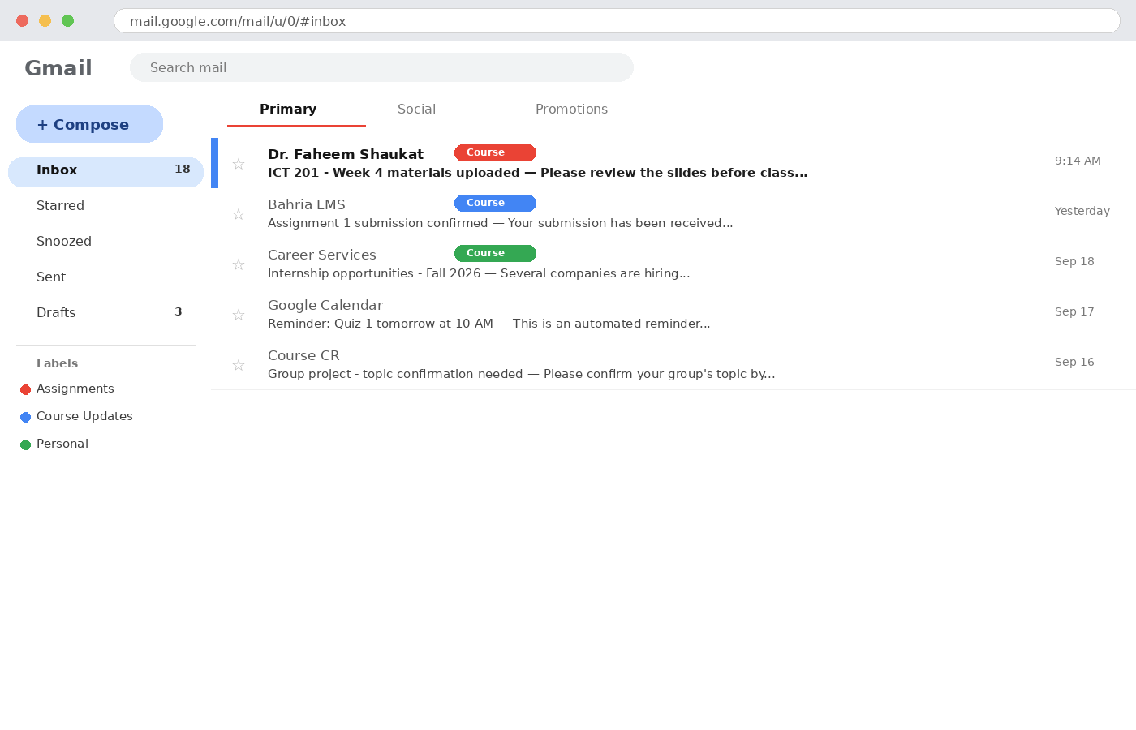
PART 1: GMAIL
Gmail Interface — Inbox Overview
KEY ZONES
Compose button
Starts a new email draft
Navigation pane
Inbox, Starred, Snoozed, Sent, Drafts
Labels
Custom color-coded organization tags
Category tabs
Primary / Social / Promotions auto-sort
Message list
Sender, subject, snippet preview, timestamp
ICT 201 | Week 4 (Makeup) — Formal Communication Tools & Etiquette
7

Slide 8
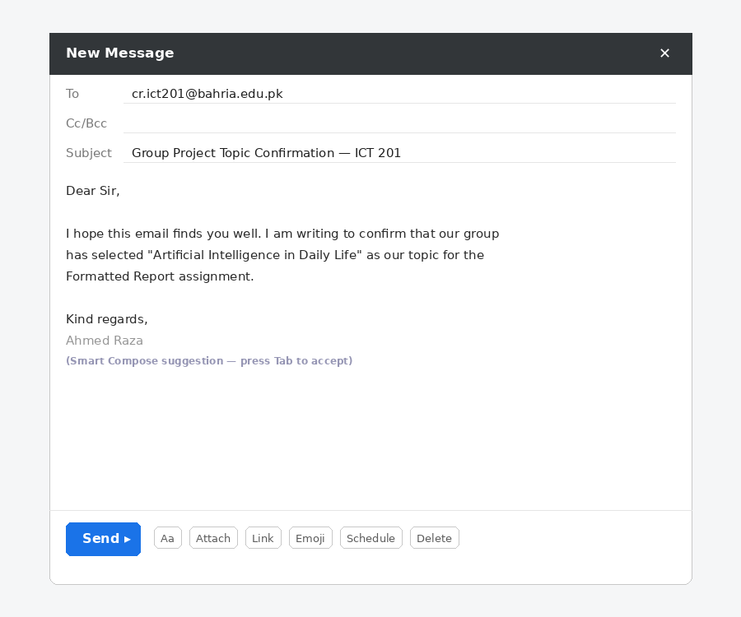
PART 1: GMAIL
Gmail Composition Tools
Smart Compose
Smart Reply
Predicts and suggests the rest of your sentence as you type — press Tab to accept.
Offers short one-click reply suggestions based on the message content.
Formatting toolbar
Attach & Insert
Bold, italics, bullet lists, text color, and font size for rich text emails.
Attach files directly or insert Google Drive links without leaving Gmail.
Schedule Send
Confidential Mode
Compose now, but choose a future date/time for the email to be sent.
Set an expiry date and disable forward/copy/print for sensitive emails.
ICT 201 | Week 4 (Makeup) — Formal Communication Tools & Etiquette
8

Slide 9
PART 1: GMAIL
Gmail Organization Facilities
Labels
Filters
Custom, color-coded tags applied to emails — one email can have multiple labels (unlike folders).
Automatic rules: "If sender = X, then apply label / archive / forward" — set once, runs forever.
Category Tabs
Stars & Importance markers
Primary, Social, Promotions, Updates — auto-sorts incoming mail by type.
Flag priority emails; Gmail also auto-marks likely-important messages.
Search operators in Gmail
Multiple Inboxes / Snooze
from:, has:attachment, is:unread, older_than: — same logic as Week 3’s search operators!
Split inbox into sections, or temporarily hide an email until a chosen time.
ICT 201 | Week 4 (Makeup) — Formal Communication Tools & Etiquette
9

Slide 10
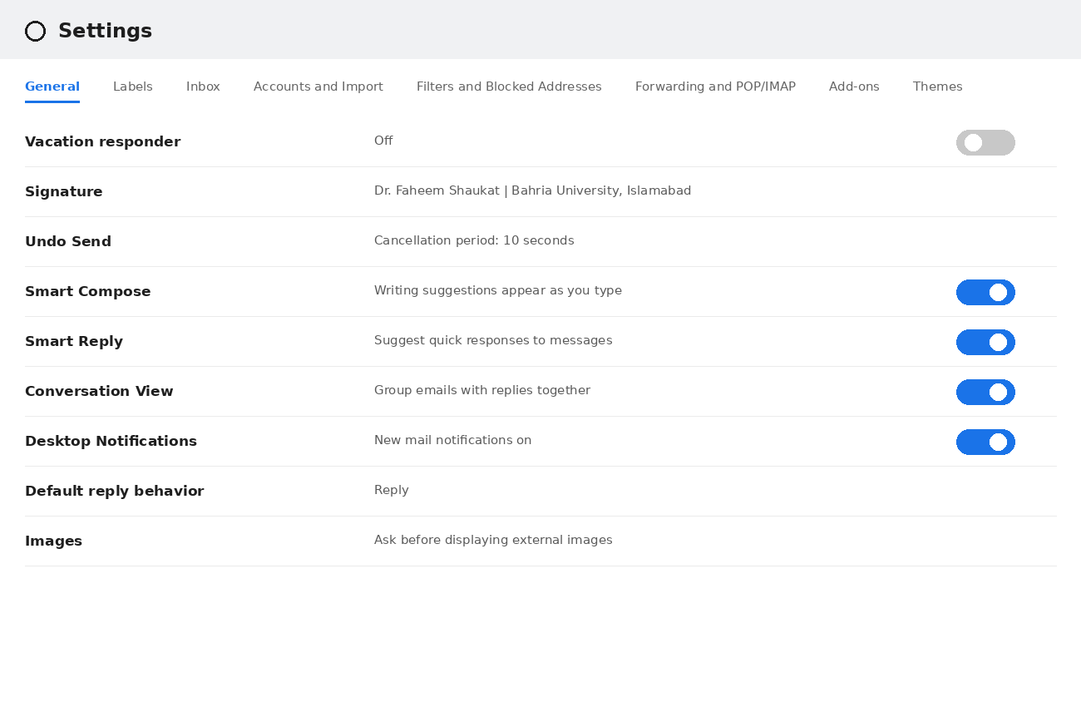
PART 1: GMAIL
Gmail Settings — Deep Dive
SETTINGS TABS EXPLAINED
General
Signature, Smart features, vacation responder, undo send
Labels
Create, show/hide, and color-code labels
Inbox
Choose inbox type: Default, Important first, Unread first
Accounts & Import
Add other email accounts, change password
Filters & Blocked
Manage automation rules and blocked senders
Forwarding & POP/IMAP
Auto-forward mail; connect to Outlook/other apps
ICT 201 | Week 4 (Makeup) — Formal Communication Tools & Etiquette
10

Slide 11
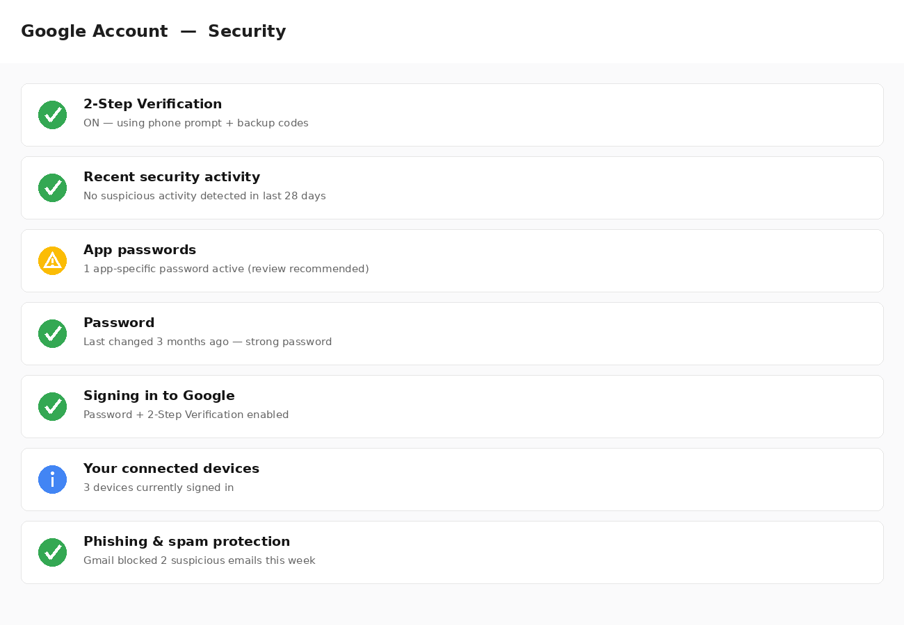
PART 1: GMAIL — STAY PROTECTED
Gmail Security Facilities
SECURITY FEATURES
2-Step Verification
Requires a phone prompt/code in addition to your password when signing in.
Phishing & Spam detection
Automatically flags suspicious senders and fake login-request emails.
App Passwords
Special passwords for older apps that don’t support 2-Step Verification.
Security Checkup
A guided review of your account’s overall security health.
Confidential Mode
Prevents forwarding, copying, downloading, or printing of sensitive emails.
Encryption in transit (TLS)
Gmail automatically encrypts messages between mail servers.
ICT 201 | Week 4 (Makeup) — Formal Communication Tools & Etiquette
11

Slide 12
PART 1: GMAIL — STAY PROTECTED
Recognizing Phishing & Spam Emails
WARNING SIGNS
WHAT GMAIL DOES FOR YOU
⚠
Urgent language ("Act now!", "Your account will be suspended")
✓
Automatically filters most spam/phishing into the Spam folder
⚠
Sender address looks slightly wrong (paypa1.com, not paypal.com)
✓
Shows a red warning banner on suspicious/unverified senders
⚠
Requests for passwords, OTPs, or banking details via email
✓
Scans attachments and links for known malware before delivery
⚠
Unexpected attachments or links from unknown senders
✓
Blocks external images by default to prevent tracking pixels
⚠
Generic greeting ("Dear User") instead of your actual name
✓
Lets you report Phishing directly from the message menu
⚠
Poor grammar/spelling in an otherwise "official" email
✓
Warns you before you reply to an email flagged as risky
ICT 201 | Week 4 (Makeup) — Formal Communication Tools & Etiquette
12

Slide 13



PART 1: GMAIL — BEYOND THE INBOX
Gmail Integration with Google Workspace
Google Calendar
Google Meet
Google Drive
Meeting invites in emails become calendar events with one click.
Start a video call directly from an email thread or the Gmail sidebar.
Attach large files as Drive links instead of email attachments.
WHY THIS MATTERS (ICT CONCEPT)
This is a real example of ICT platform INTEGRATION — separate tools (email, calendar, video conferencing, cloud storage) working together as one connected ecosystem, instead of isolated apps. This is the same principle you’ll see across almost every modern ICT platform.
ICT 201 | Week 4 (Makeup) — Formal Communication Tools & Etiquette
13

Slide 14



PART 2: BEYOND GMAIL
Outlook, Yahoo Mail & Other Services
Microsoft Outlook
Yahoo Mail
Apple Mail (iCloud)
Deep integration with Microsoft 365 (Word, Excel, Teams). Preferred in corporate environments.
One of the earliest webmail services; generous free storage; less used professionally today.
Built into Apple devices; simple interface; tightly integrated with iOS/macOS ecosystem.
OUTLOOK’S DISTINCTIVE FEATURES
• Focused Inbox (separates important mail automatically) • Rules (same concept as Gmail Filters)
• Categories & color tags (like Gmail Labels) • Built-in Calendar & Teams meeting scheduling • Out-of-Office / Automatic Replies
ICT 201 | Week 4 (Makeup) — Formal Communication Tools & Etiquette
14

Slide 15
PART 2: FEATURE & SECURITY COMPARISON
Email Platform Comparison
Facility
Gmail
Outlook
Yahoo Mail
Smart writing suggestions
Smart Compose
Editor suggestions
Basic spell-check
Automation rules
Filters
Rules
Filters (limited)
Organization tags
Labels (multi-tag)
Categories
Folders only
2-Step Verification
Yes
Yes (MS Authenticator)
Yes
Confidential/expiring mail
Confidential Mode
Encrypt/Do Not Forward
Not available
Native office suite link
Google Docs/Sheets/Slides
Word/Excel/PowerPoint
None built-in
Free storage
15 GB (shared with Drive)
15 GB (Outlook.com)
1 TB
ICT 201 | Week 4 (Makeup) — Formal Communication Tools & Etiquette
15

Slide 16
APPLY WHAT YOU LEARNED
5 MIN
Quick In-Class Activity
TASK 1 — Compose
Open your own Gmail account and draft (do NOT send) a formal email to a course instructor requesting a one-day extension on an assignment. Use a proper subject line, greeting, structured body, and signature.
TASK 2 — Explore
In your Gmail Settings, locate and take a screenshot of:
1.
Your current Signature setting
2.
Whether Smart Compose is turned ON or OFF
3.
Whether 2-Step Verification is enabled on your Google Account
ICT 201 | Week 4 (Makeup) — Formal Communication Tools & Etiquette
16

Slide 17
KEY TAKEAWAYS
Week 4 (Makeup) in Five Points
1
A professional email has a clear structure: subject, greeting, purpose, body, closing, signature.
2
Gmail’s composition tools (Smart Compose, Smart Reply, Scheduling) exist to save time without sacrificing professionalism.
3
Labels, Filters, and Tabs are Gmail’s organization system — conceptually similar to Outlook’s Categories and Rules.
4
Security facilities like 2-Step Verification and phishing detection are essential ICT skills, not optional extras.
5
Different email platforms (Gmail, Outlook, Yahoo) share the same core concepts but differ in ecosystem integration.

Slide 18
BEFORE YOU LEAVE
Exit Ticket
On a slip of paper (or the LMS form), answer briefly:
1
Name ONE Gmail feature you did not know about before today’s session.
2
Explain, in one sentence, why "Reply All" should be used carefully.
3
What is ONE thing you would check in your own email account’s security settings after today?
Next session: Google Workspace, Cloud Storage & the MS Office Suite
ICT 201 | Week 4 (Makeup) — Formal Communication Tools & Etiquette
18

