Slide 1







BAHRIA UNIVERSITY, ISLAMABAD
WEEK 6
Video Conferencing & Social Media Applications
Google Meet, Microsoft Teams & Zoom — LinkedIn, Facebook & Instagram
ICT 201 | Applications of ICT | 3-Hour Session | CLO-2 | Fall 2026
Google Meet
MS Teams
Zoom
LinkedIn
Facebook
Instagram

Slide 2
AGENDA — 3-HOUR SESSION, TWO BREAKS
180 MIN
Today’s Roadmap
01
Why Video Conferencing & Social Media Matter
10 min
Setting the context for today’s session
02
Google Meet — Interface & Facilities
20 min
How it works, key features, positive uses
03
Microsoft Teams — Interface & Facilities
20 min
How it works, key features, positive uses
04
Zoom — Interface & Facilities
20 min
How it works, key features, positive uses
05
Meet vs Teams vs Zoom — Comparison
15 min
Differences & positive uses of video conferencing
☕
BREAK 1
15 min
06
LinkedIn — Education, Jobs & Marketing Impact
25 min
Interface tour + three-lens impact analysis
07
Facebook — Education, Jobs & Marketing Impact
20 min
Groups, pages & community interface tour
☕
BREAK 2
10 min
08
Instagram — Education, Jobs & Marketing Impact
15 min
Business profile & content interface tour
09
Social Media Comparison + Hands-On + Takeaways
20 min
Comparison table, guided practice, wrap-up
ICT 201 | Week 6 — Video Conferencing & Social Media Applications
2

Slide 3
SETTING THE CONTEXT
Why This Matters
“Distance no longer decides who you can learn from, work with, or sell to.”
Video Conferencing
Social Media Applications
Tools like Google Meet, Microsoft Teams, and Zoom let classes, meetings, interviews, and consultations happen face-to-face from anywhere — reshaping education and the modern workplace.
Platforms like LinkedIn, Facebook, and Instagram have moved far beyond casual sharing — they are now serious tools for learning, career-building, and marketing.
TODAY’S FOCUS
We will look closely at what each video-conferencing platform actually provides, how they work, and how they differ — then explore LinkedIn, Facebook, and Instagram’s positive impact through three lenses: education, professional/jobs, and marketing.
ICT 201 | Week 6 — Video Conferencing & Social Media Applications
3

Slide 4
PART 1: VIDEO CONFERENCING
Google Meet, Microsoft Teams & Zoom
What each platform provides, how it works, and how they differ

Slide 5
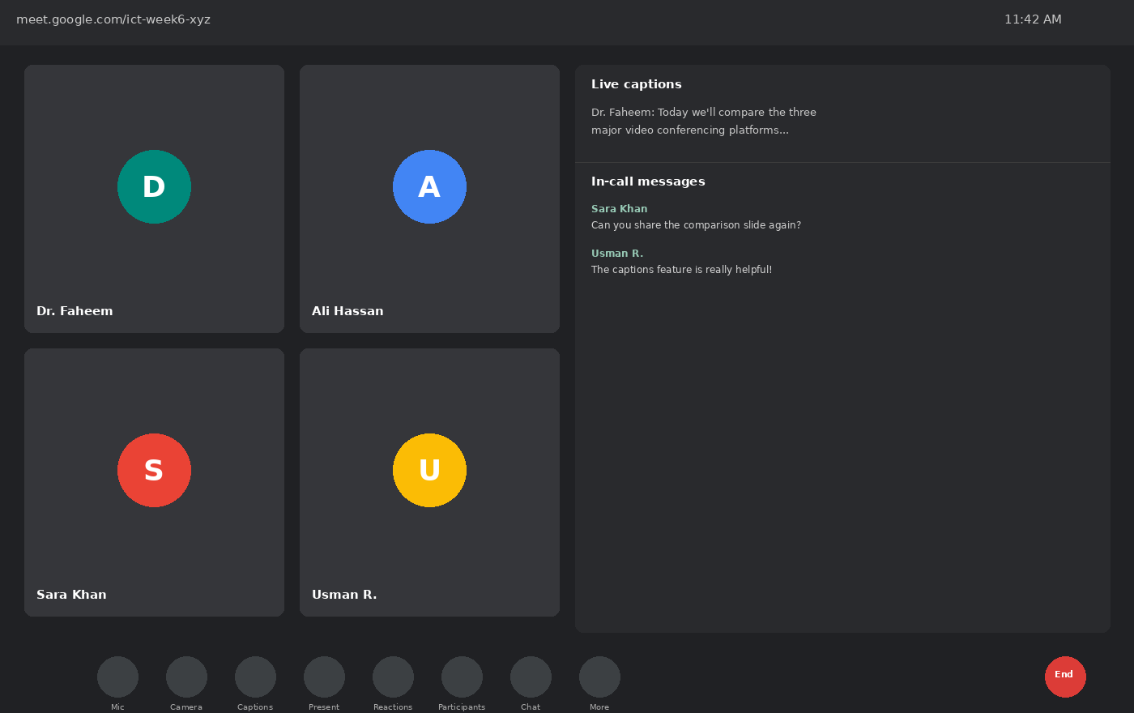
VIDEO CONFERENCING — PLATFORM 1
Google Meet — Inside a Live Meeting
HOW IT WORKS
Runs entirely in the browser — no software install needed. Meetings start from a Google Calendar invite, Gmail, or a generated meet.google.com link.
ON-SCREEN CONTROLS
• Mic & Camera toggle with one click
• Live Captions — real-time speech-to-text
• Present Now — share screen, window, or tab
• Reactions — quick emoji feedback mid-call
• In-call messages — text chat alongside video
ICT 201 | Week 6 — Video Conferencing & Social Media Applications
5

Slide 6
VIDEO CONFERENCING — PLATFORM 1 (CONTINUED)
Google Meet — Facilities & Positive Uses
Deep Google Workspace Integration
Live Captions & Translation
Joins directly from Calendar, Gmail, and Docs/Sheets/Slides — meeting links generate automatically, with no separate app required.
Real-time, AI-generated captions support students who are hard of hearing or non-native speakers of the lecture language.
Breakout Rooms
Noise Cancellation & Low-Light Mode
Hosts split large classes into smaller discussion groups for group work, then bring everyone back together instantly.
Built-in AI filters background noise and automatically brightens video in poor lighting — useful for students joining from busy homes.
Browser-Based Access
Positive Use in Education
No installation needed on shared or low-spec computers — ideal for students or guest lecturers joining from any device.
Free tier supports classes up to 100 participants for 60 minutes — widely used for guest lectures, office hours, and viva/defense sessions.
ICT 201 | Week 6 — Video Conferencing & Social Media Applications
6

Slide 7
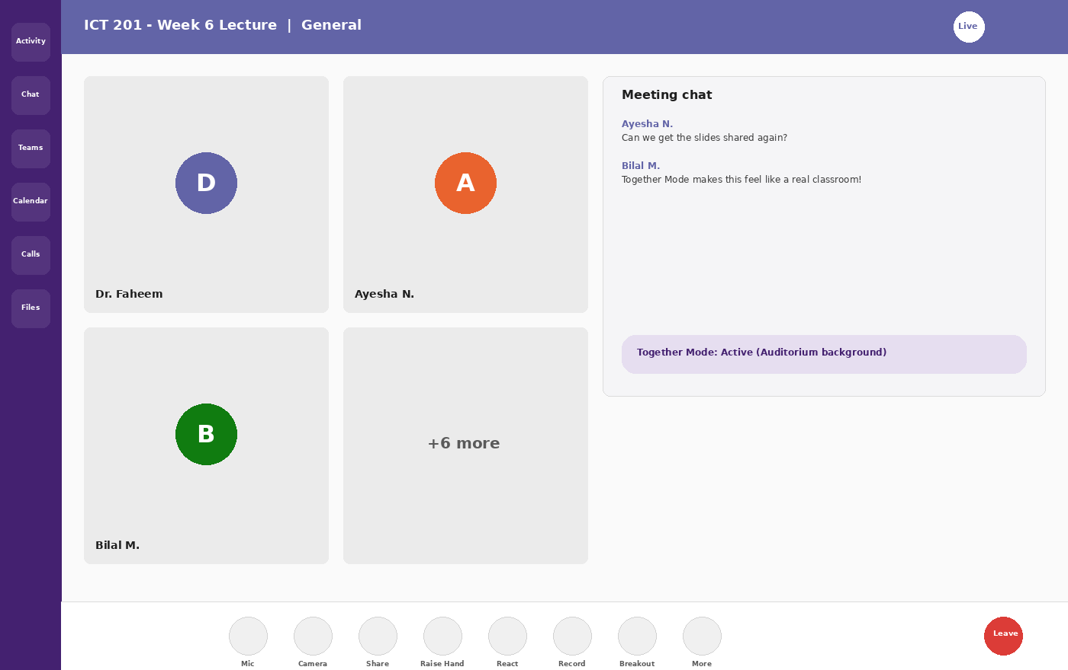
VIDEO CONFERENCING — PLATFORM 2
Microsoft Teams — Inside a Live Meeting
HOW IT WORKS
Built into Microsoft 365 — meetings are scheduled via Outlook Calendar and opened from the Teams desktop or web app, alongside Chat, Teams channels, and Files.
LEFT NAVIGATION
• Activity — @mentions & notifications feed
• Chat — 1:1 and group messaging
• Teams — channels organized by class/department
• Calendar — schedule & join meetings
• Calls & Files — voice calling and shared storage
ICT 201 | Week 6 — Video Conferencing & Social Media Applications
7

Slide 8
VIDEO CONFERENCING — PLATFORM 2 (CONTINUED)
Microsoft Teams — Facilities & Positive Uses
Together Mode
Channels & Persistent Chat
An AI-powered view places all participants in one shared virtual background (like a lecture hall), reducing "video-grid fatigue" in long classes.
Each class or project gets its own Team with channels — meeting recordings, files, and chat history stay organized and searchable long after the call ends.
Office App Integration
Meeting Recording & Transcripts
Open and co-edit Word, Excel, and PowerPoint files live inside a meeting — ideal for group assignment reviews without switching apps.
Automatic recording with searchable transcripts lets absent students catch up, and lets instructors reuse lectures as study material.
Breakout Rooms
Positive Use in Education
Hosts create and manage small-group rooms for case studies or project work, with the ability to broadcast announcements to all rooms at once.
Deep integration with institutional Microsoft 365 accounts (common at universities) makes Teams a natural fit for official class delivery and admin meetings.
ICT 201 | Week 6 — Video Conferencing & Social Media Applications
8

Slide 9
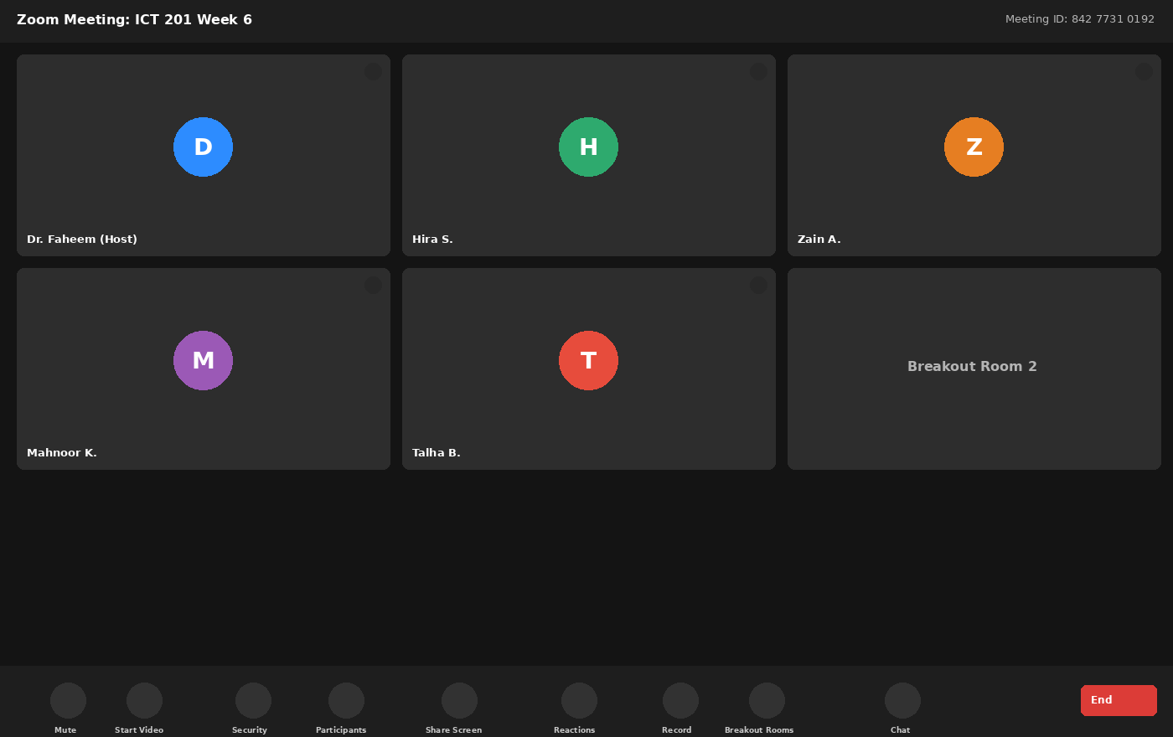
VIDEO CONFERENCING — PLATFORM 3
Zoom — Inside a Live Meeting
HOW IT WORKS
A dedicated desktop/mobile app (or browser) joined via a Meeting ID and passcode. Known for stable video quality even on lower-bandwidth connections.
ON-SCREEN CONTROLS
• Security — lock meeting, waiting room, lock chat
• Gallery view — up to 49 tiles per screen
• Share Screen — with optional annotation
• Breakout Rooms — dedicated one-click panel
• Record — local or cloud, with auto-transcript
ICT 201 | Week 6 — Video Conferencing & Social Media Applications
9

Slide 10
VIDEO CONFERENCING — PLATFORM 3 (CONTINUED)
Zoom — Facilities & Positive Uses
Dedicated Security Panel
Breakout Rooms
A single "Security" button lets a host instantly lock the meeting, enable a Waiting Room, or restrict screen sharing and chat — a strong defense against "Zoom-bombing."
Among the most mature breakout room tools available — hosts pre-assign or auto-split up to 50 rooms, broadcast messages, and set self-return timers.
Webinar Mode
Virtual Backgrounds & Filters
A separate large-scale mode supports up to thousands of view-only attendees with Q&A and polling — used for guest seminars and public lectures.
Low-bandwidth-friendly virtual backgrounds and touch-up filters help presenters look professional without needing a studio setup.
Cloud Recording & Auto-Transcription
Positive Use in Education
Paid tiers auto-generate searchable transcripts and highlight reels, useful for creating revision material from recorded lectures.
Long-standing reliability on weak internet connections makes Zoom a common choice for guest speakers and students joining from remote areas.
ICT 201 | Week 6 — Video Conferencing & Social Media Applications
10

Slide 11
SIDE-BY-SIDE COMPARISON
Google Meet vs Microsoft Teams vs Zoom
Facility
Google Meet
Microsoft Teams
Zoom
Access model
Browser-first, Google account
Microsoft 365 account
Dedicated app, Meeting ID
Best integration
Gmail, Calendar, Docs
Outlook, Office apps, Channels
Standalone — works with any ecosystem
Free tier limit
100 participants / 60 min
100 participants / 60 min
100 participants / 40 min
Signature feature
Live Captions & translation
Together Mode & persistent channels
Dedicated Security panel & Webinars
Breakout rooms
Yes (basic)
Yes (advanced, broadcast msg)
Yes (most mature, up to 50 rooms)
Best fit
Quick, lightweight, cross-platform calls
Microsoft-based institutions & teams
Large seminars, weak-connection users
ICT 201 | Week 6 — Video Conferencing & Social Media Applications
11

Slide 12
BRINGING IT TOGETHER
Positive Uses of Video Conferencing
Access to Education
Global Collaboration
Students in remote areas attend lectures, defend theses, and consult supervisors without travel — directly supporting distance learning discussed in Week 2.
Research teams, guest speakers, and international conferences connect instantly across time zones and borders at near-zero cost.
Flexible, Recorded Learning
Reduced Cost & Carbon Footprint
Recorded sessions and transcripts let students revisit lectures, aiding exam preparation and students who missed a live class.
Eliminates travel costs and commute time for routine meetings, interviews, and consultations — a measurable business and environmental benefit.
Telehealth & Professional Services
Inclusive Participation
The same technology underlies telemedicine consultations discussed earlier — doctors, lawyers, and advisors now serve remote clients directly.
Captions, chat, and screen-reader-friendly interfaces let students with hearing or mobility challenges participate fully in real time.
ICT 201 | Week 6 — Video Conferencing & Social Media Applications
12

Slide 13
☕
BREAK 1
15 Minutes
Back at it: LinkedIn, Facebook & Instagram — education, jobs & marketing

Slide 14
PART 2: SOCIAL MEDIA APPLICATIONS
LinkedIn, Facebook & Instagram
Positive impact through three lenses: education, jobs, and marketing

Slide 15
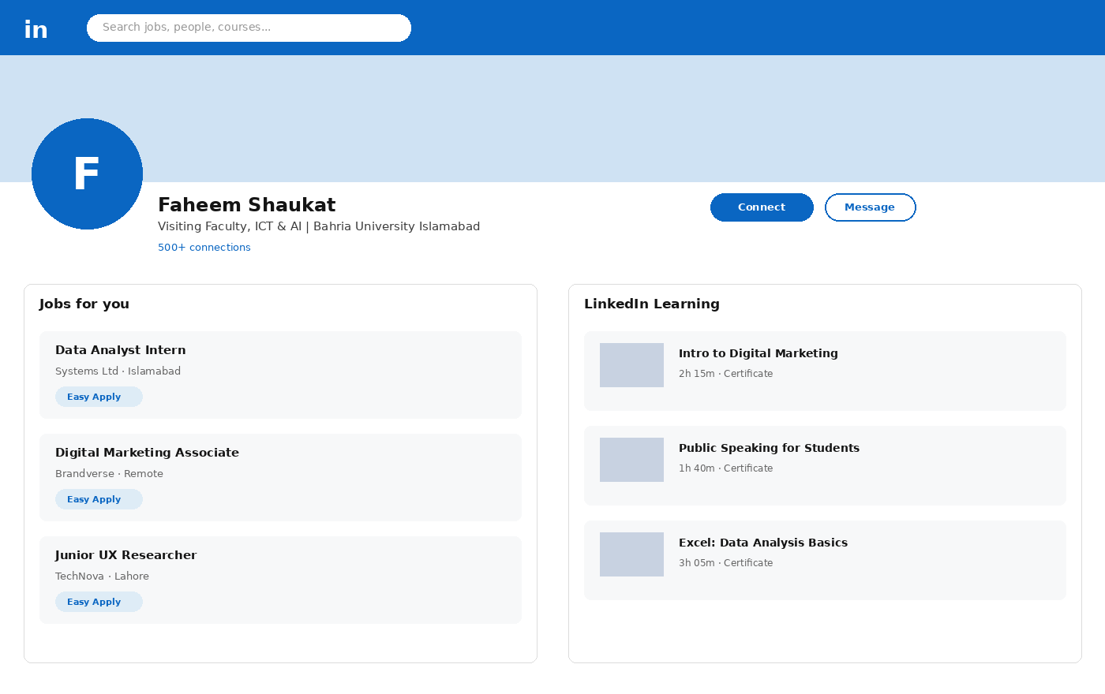
SOCIAL MEDIA — PLATFORM 1
LinkedIn — Profile, Jobs & Learning
WHAT IT IS
A professional networking platform built around a resume-style profile, a company/recruiter ecosystem, and a feed of industry content.
KEY SECTIONS
• Profile — education, experience, skills, endorsements
• "Jobs for You" — AI-matched openings with Easy Apply
• LinkedIn Learning — short skill-building video courses
• Connect / Message — direct professional networking
ICT 201 | Week 6 — Video Conferencing & Social Media Applications
15

Slide 16
EDUCATION · PROFESSIONAL/JOBS · MARKETING
LinkedIn — Positive Impact
Education
Professional / Jobs
LinkedIn Learning offers thousands of short courses with certificates students can add directly to their profile — turning passive scrolling into verifiable upskilling.
"Easy Apply" and AI-matched job recommendations connect students directly with internships and entry-level roles; endorsements and recommendations act as a digital reference.
Marketing
Why It Works for Students
Businesses and freelancers publish thought-leadership posts and case studies to reach decision-makers directly — LinkedIn Ads target by job title and industry, not just demographics.
A well-built LinkedIn profile functions as a living CV: instructors, peers, and recruiters can all verify skills, projects, and coursework in one public place.
ICT 201 | Week 6 — Video Conferencing & Social Media Applications
16

Slide 17
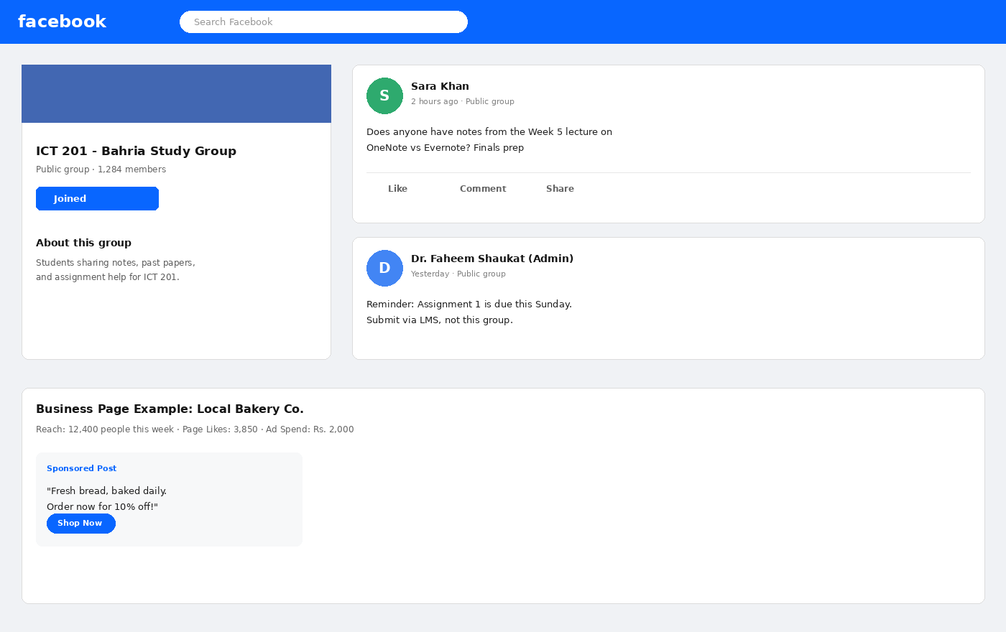
SOCIAL MEDIA — PLATFORM 2
Facebook — Groups, Pages & Community
WHAT IT IS
A community-centered platform built around Groups (shared-interest communities) and Pages (public profiles for businesses and organizations).
KEY ELEMENTS SHOWN
• Study Group — class-wide note & query sharing
• Admin posts — official reminders reach all members
• Business Page — Reach, Page Likes, Ad Spend metrics
• Sponsored Post — paid promotion with a direct CTA
ICT 201 | Week 6 — Video Conferencing & Social Media Applications
17

Slide 18
EDUCATION · PROFESSIONAL/JOBS · MARKETING
Facebook — Positive Impact
Education
Professional / Jobs
Class and university Groups become informal study communities — students share notes, past papers, and ask questions outside class hours, as seen in the Study Group mockup.
Facebook Jobs and community job-posting groups connect small businesses with local candidates; Pages let alumni networks share internships and openings directly.
Marketing
Why It Works at Scale
Business Pages give even very small businesses (like the "Local Bakery Co." example) access to detailed Reach, engagement, and Ad Spend analytics — professional-grade marketing at low cost.
With billions of active users, Facebook Ads can target by precise location, age, and interest — making it one of the most cost-effective tools for local and student-run businesses.
ICT 201 | Week 6 — Video Conferencing & Social Media Applications
18

Slide 19
☕
BREAK 2
10 Minutes
Back at it: Instagram, the final comparison, and hands-on practice

Slide 20
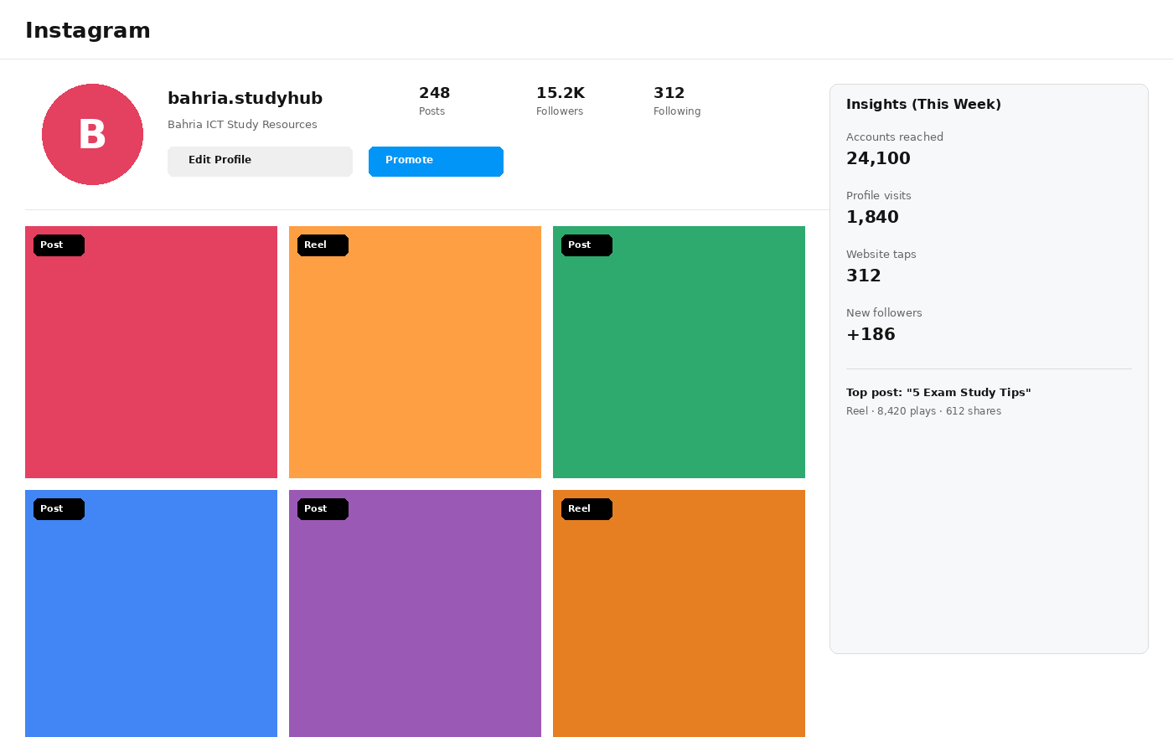
SOCIAL MEDIA — PLATFORM 3
Instagram — Business Profile & Insights
WHAT IT IS
A visual-first platform built around Posts, Reels (short video), and Stories, with a dedicated Business/Creator mode offering analytics and promotion tools.
KEY ELEMENTS SHOWN
• Content grid — mix of Posts and Reels
• Promote button — one-tap paid boosting
• Insights panel — reach, visits, new followers
• Top post callout — identifies best-performing content
ICT 201 | Week 6 — Video Conferencing & Social Media Applications
20

Slide 21
EDUCATION · PROFESSIONAL/JOBS · MARKETING
Instagram — Positive Impact
Education
Professional / Jobs
Short-form Reels break complex topics (exam tips, quick tutorials, lab demos) into bite-sized, highly shareable visual lessons — ideal for revision content.
A polished, well-tagged portfolio of work (design, photography, writing samples) acts as an informal visual CV that many creative-industry recruiters now check directly.
Marketing
Why It Works for Reach
Instagram Insights (reach, profile visits, website taps) let even a small student-run brand measure exactly what content drives real traffic and sales — the same metrics large companies pay agencies for.
The Explore and Reels algorithms can surface content to non-followers instantly — giving new or small accounts a real chance to go viral without any ad spend.
ICT 201 | Week 6 — Video Conferencing & Social Media Applications
21

Slide 22
SIDE-BY-SIDE COMPARISON
LinkedIn vs Facebook vs Instagram
Facility
LinkedIn
Facebook
Instagram
Core format
Professional profile & articles
Groups, Pages & long-form posts
Visual posts, Reels & Stories
Best for education
Verified courses & certificates
Class/study Groups & discussion
Bite-sized visual tutorials
Best for jobs
Direct job matching & Easy Apply
Community job-posting groups
Visual portfolio & creative CV
Best for marketing
B2B, thought leadership
Local business, detailed ad targeting
Visual brand building, high reach
Primary audience
Professionals & recruiters
General public, broad age range
Younger, visually-driven audience
Signature tool
LinkedIn Learning
Groups + Business Page Insights
Reels + Insights
ICT 201 | Week 6 — Video Conferencing & Social Media Applications
22

Slide 23
APPLY WHAT YOU LEARNED
10 MIN
Hands-On Activity
TASK 1 — Video Conferencing
In groups of 3, open any one of Google Meet, Microsoft Teams, or Zoom. Start a test meeting, turn on captions (or the closest equivalent), share your screen for 30 seconds, and list one facility your platform has that the other two groups’ platforms do not.
TASK 2 — Social Media for Education, Jobs & Marketing
Pick ONE of LinkedIn, Facebook, or Instagram. Write a one-paragraph plan for how a student-run small business (e.g. a bakery, tutoring service, or handmade crafts page) could use that platform for: (1) reaching students for education/awareness, (2) finding part-time help, and (3) marketing to new customers.
ICT 201 | Week 6 — Video Conferencing & Social Media Applications
23

Slide 24
KEY TAKEAWAYS
Week 6 in Six Points
1
Google Meet, Microsoft Teams, and Zoom all solve the same problem — remote face-to-face communication — but each wins in a different context: Meet for lightweight browser access, Teams for Microsoft-based institutions, Zoom for large or low-bandwidth sessions.
2
Video conferencing removes distance as a barrier to education, healthcare (telemedicine), and global professional collaboration.
3
LinkedIn is the strongest platform for verified learning (LinkedIn Learning) and direct job-matching (Easy Apply).
4
Facebook Groups and Pages combine informal peer-learning communities with surprisingly detailed, low-cost marketing analytics.
5
Instagram’s Reels and visual portfolio format make it uniquely strong for bite-sized education content and creative-industry job visibility.
6
Across all six platforms, the real value lies in features, not fame — knowing the right facility for the right task is the mark of an ICT-literate professional.

Slide 25
BEFORE YOU LEAVE
Exit Ticket
On a slip of paper (or the LMS form), answer briefly:
1
Name ONE facility that makes Zoom different from Google Meet or Microsoft Teams.
2
Pick one of LinkedIn, Facebook, or Instagram and describe one way it could help you find a part-time job or internship.
3
In one sentence, explain the difference between how Facebook and Instagram support marketing for a small business.
Next session: Week 6 outline continues — stay tuned on the LMS for the next topic.
ICT 201 | Week 6 — Video Conferencing & Social Media Applications
25

