Slide 1

SESSION ROADMAP
BAHRIA UNIVERSITY, ISLAMABAD
—
Introduction
—
Course Info
—
Policy & Grading
ICT 201 · CLASS 1 · WEEK 1
Welcome to
the Digital World
0:00
Hook — Devices
0:15
What is ICT?
0:45
Hardware
1:20
Software
Applications of Information
and Communication Technologies
1:45
BREAK
1:55
Networks
2:20
Cloud Storage
2:40
Activity
Instructor: Dr. Faheem Shaukat
2:55
Exit Ticket
Notes:
Welcome students to Bahria University. Introduce the course and yourself briefly before diving into details on next slide.

Slide 2
ABOUT YOUR INSTRUCTOR
Meet Your Instructor
🏫
Role at Bahria University
FS
Visiting Faculty — Dept. of Software Engineering
📧
Best way to reach me
Email is the most reliable way to contact me for questions or clarifications
🕐
Availability
Dr. Faheem Shaukat
As a visiting faculty member, I do not hold regular office hours — but I am happy to discuss during class breaks
Visiting Faculty
📧 faheemshaukat3@gmail.com
💬
Open door policy
Any confusion about content, deadlines, or grading — please reach out. No question is too small
Notes:
Introduce yourself warmly. Emphasize that email is best contact method since you are visiting faculty without fixed office hours. Encourage students to ask questions during breaks.

Slide 3
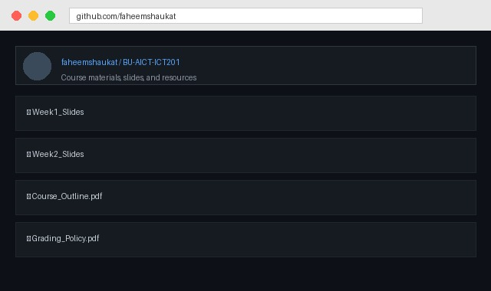
COURSE INFORMATION
Everything You Need to Know
📌 Pre-requisite
🆘 Need Help or Clarification?
None (N/A) — assumes no prior ICT background. Everyone starts equal.
Email me anytime: faheemshaukat3@gmail.com
I am visiting faculty, so I do not have fixed office hours. During class breaks is a great time to discuss questions in person.
📚 Recommended Textbooks
• Discovering Computers — Vermaat, Shaffer & Freund
• GO! with Microsoft Office — Gaskin, Vargas, McLellan
• Exploring Microsoft Office — Grauer & Poatsy
Any point of clearance — reach out, don't hesitate!
• Computing Essentials — Morley & Parker
• Technology in Action — Evans, Martin & Poatsy
📂 Where to Find Course Content
✅ LMS (official platform)
✅ github.com/faheemshaukat
Check both regularly for updates!
Notes:
Emphasize: no prerequisite means everyone starts fresh. Point out GitHub repo and LMS as the two places to always check for materials. Mention email as primary contact given no office hours.

Slide 4
COURSE POLICY
Attendance & Grading Weightage
⚠️
75% Attendance is MANDATORY
Falling below 75% may result in you being barred from sitting the final exam — per university policy.
Assessment Weightage
Quizzes
15%
Assignments
20%
Mid-Term Exam
25%
Final-Term Exam
40%
Total: 15% Quizzes + 15% Assignments + 30% Mid-Term + 40% Final-Term = 100%
Notes:
Stress the 75% attendance rule firmly — this is university policy, not optional. Walk through the weightage bar chart. Final exam carries the most weight, so remind students to prepare consistently throughout, not just at the end.

Slide 5
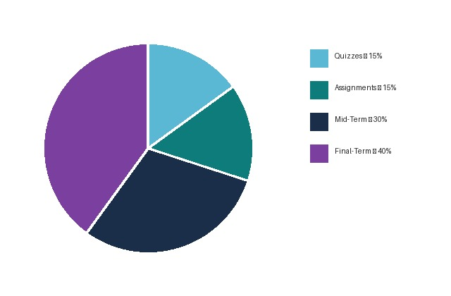
GRADING SCHEME
How Your Final Grade is Calculated
Grade
GP
LL %
UL %
A
4.00
≥ 85
-
A-
3.67
≥ 80
< 85
B+
3.33
≥ 75
< 80
B
3.00
≥ 71
< 75
B-
2.67
≥ 68
< 71
C+
2.33
≥ 64
< 68
C
2.00
≥ 60
< 64
C-
1.67
≥ 57
< 60
D+
1.33
≥ 53
< 57
D
1.00
≥ 50
< 53
F
0.00
-
< 50
W
Withdrawn
💡 Official Bahria University grading system — LL = Lower Limit, UL = Upper Limit of marks range.
Notes:
Walk through the pie chart first — visual breakdown of where marks come from. Then the grade table — explain that this is indicative and relative grading may adjust based on class performance, which is standard university practice.

Slide 6
⏱ 0:10–0:25
OPENING HOOK
🤔
Before we start — answer honestly:
"How many devices did you touch
before coming to class today?"
1️⃣
2️⃣
3️⃣
Count
Share
Discuss
Think from the moment your alarm went off this morning
Tell your neighbour your number
Why do we depend on so many devices without thinking?
📊 Mentimeter Poll
Notes:
Average person touches 8-12 devices before 9am. Write numbers on board.

Slide 7
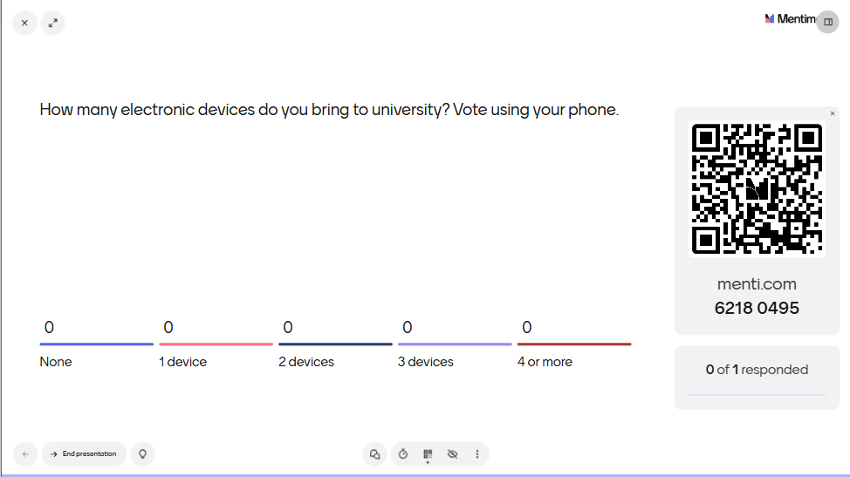

Slide 8
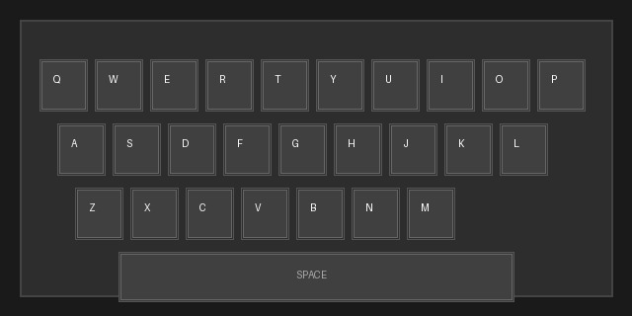
⏱ 0:25–0:35
WHAT IS ICT? — PART 1 OF 2
The Definition
ICT = Any technology that helps people COLLECT, STORE, PROCESS, or SHARE information — and COMMUNICATE with each other.
🖼 Real ICT Device: Keyboard (Input)
💾 INFORMATION
📡 COMMUNICATION
⚙️ TECHNOLOGY
Data that has meaning
Sending & receiving data
Tools that make it possible
e.g. Patient records, class notes, survey results
e.g. Email, video call, social media
e.g. Phones, laptops, internet, apps
Notes:
Show the keyboard image — real INPUT device. Ask: "Is a book ICT?" No. "Is WhatsApp?" Yes.

Slide 9
⏱ 0:35–0:45
WHAT IS ICT? — PART 2 OF 2
Why ICT Matters — Especially for YOU
🧠 Psychology Research
💬 Client Communication
Google Scholar · SPSS · Survey tools
Zoom therapy · Email · Telecounseling
📊 Data & Analysis
📚 Continuous Learning
Excel · Google Forms · Statistical apps
Coursera · YouTube · Digital journals
🏥 Healthcare Integration
🤝 Collaboration
Hospital software · Telemedicine · EHR
Google Docs · Teams · Shared drives
Notes:
Ask: "Which of these 6 will YOU use most in your psychology career?"

Slide 10
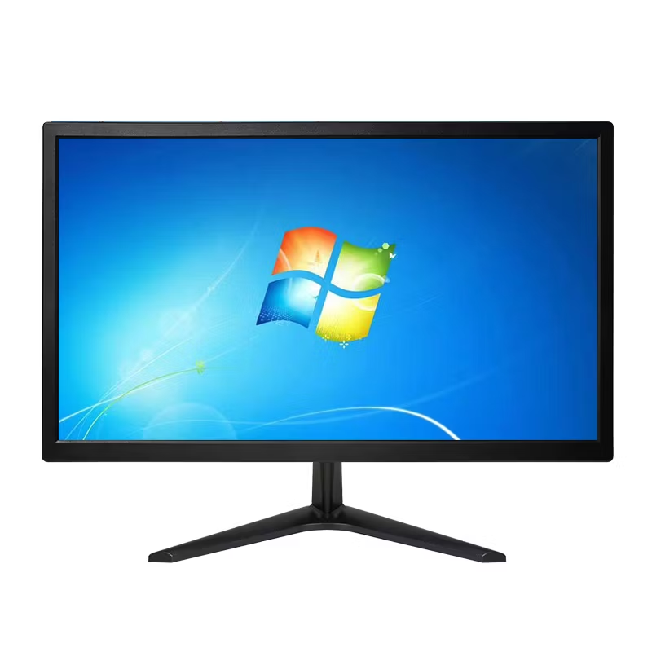
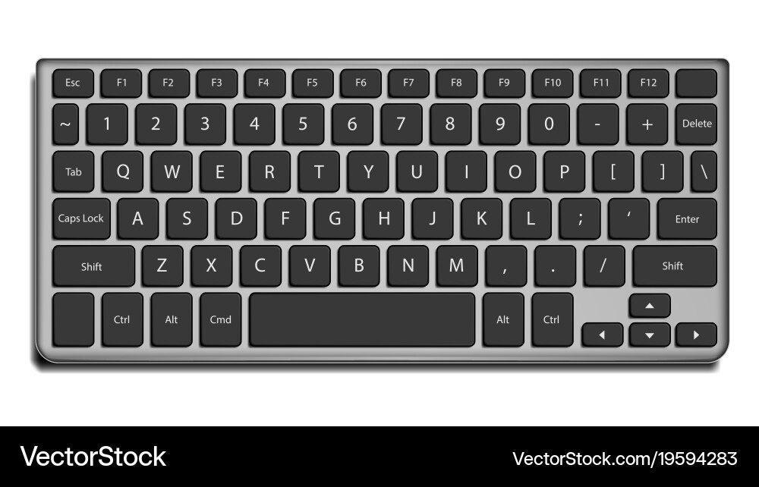
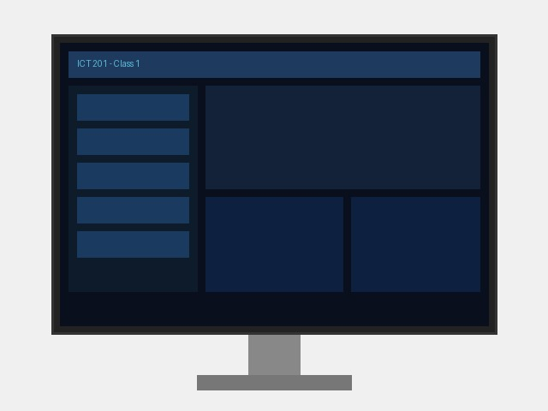
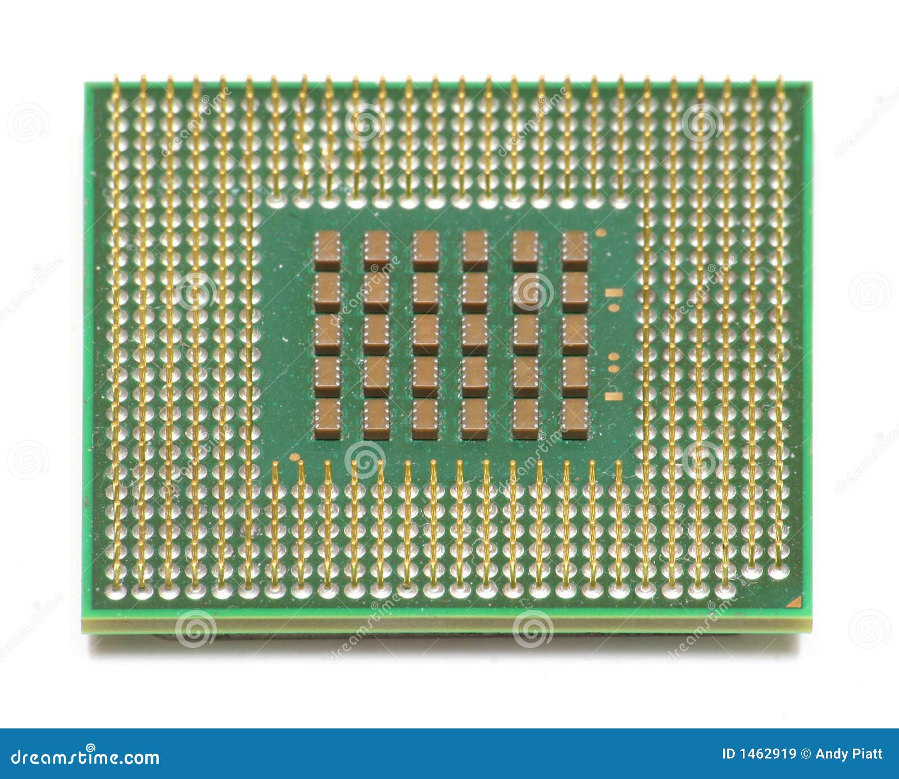
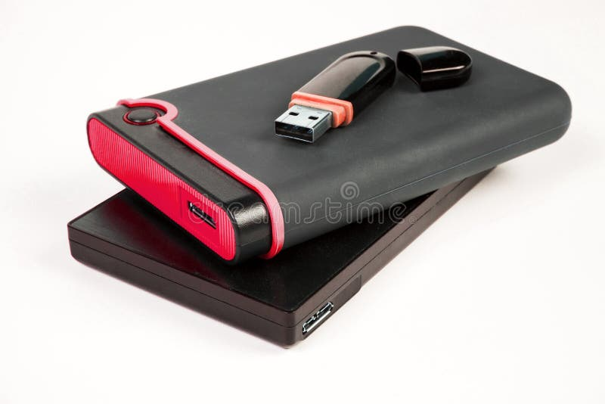

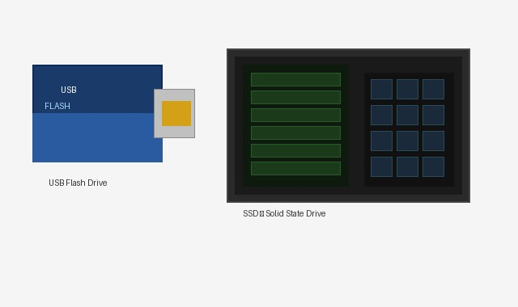
⏱ 0:45–0:55
HARDWARE — PART 1 OF 3
The 4 Categories of Hardware
Quick Reference
INPUT
Keyboard · Mouse · Camera · Mic
OUTPUT
📷 Input: Keyboard
📷 Output: Monitor
Monitor · Printer · Speaker
PROCESSING
CPU · GPU · RAM
STORAGE
SSD · HDD · USB · SD Card
📷 Processing: CPU Chip
📷 Storage: USB & SSD
Notes:
Point to each image. Students can SEE real devices.

Slide 11
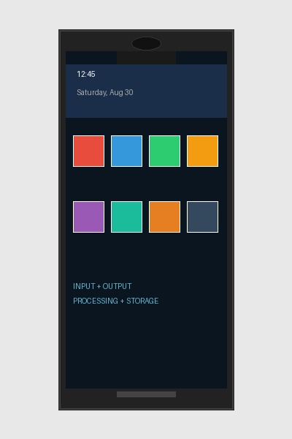
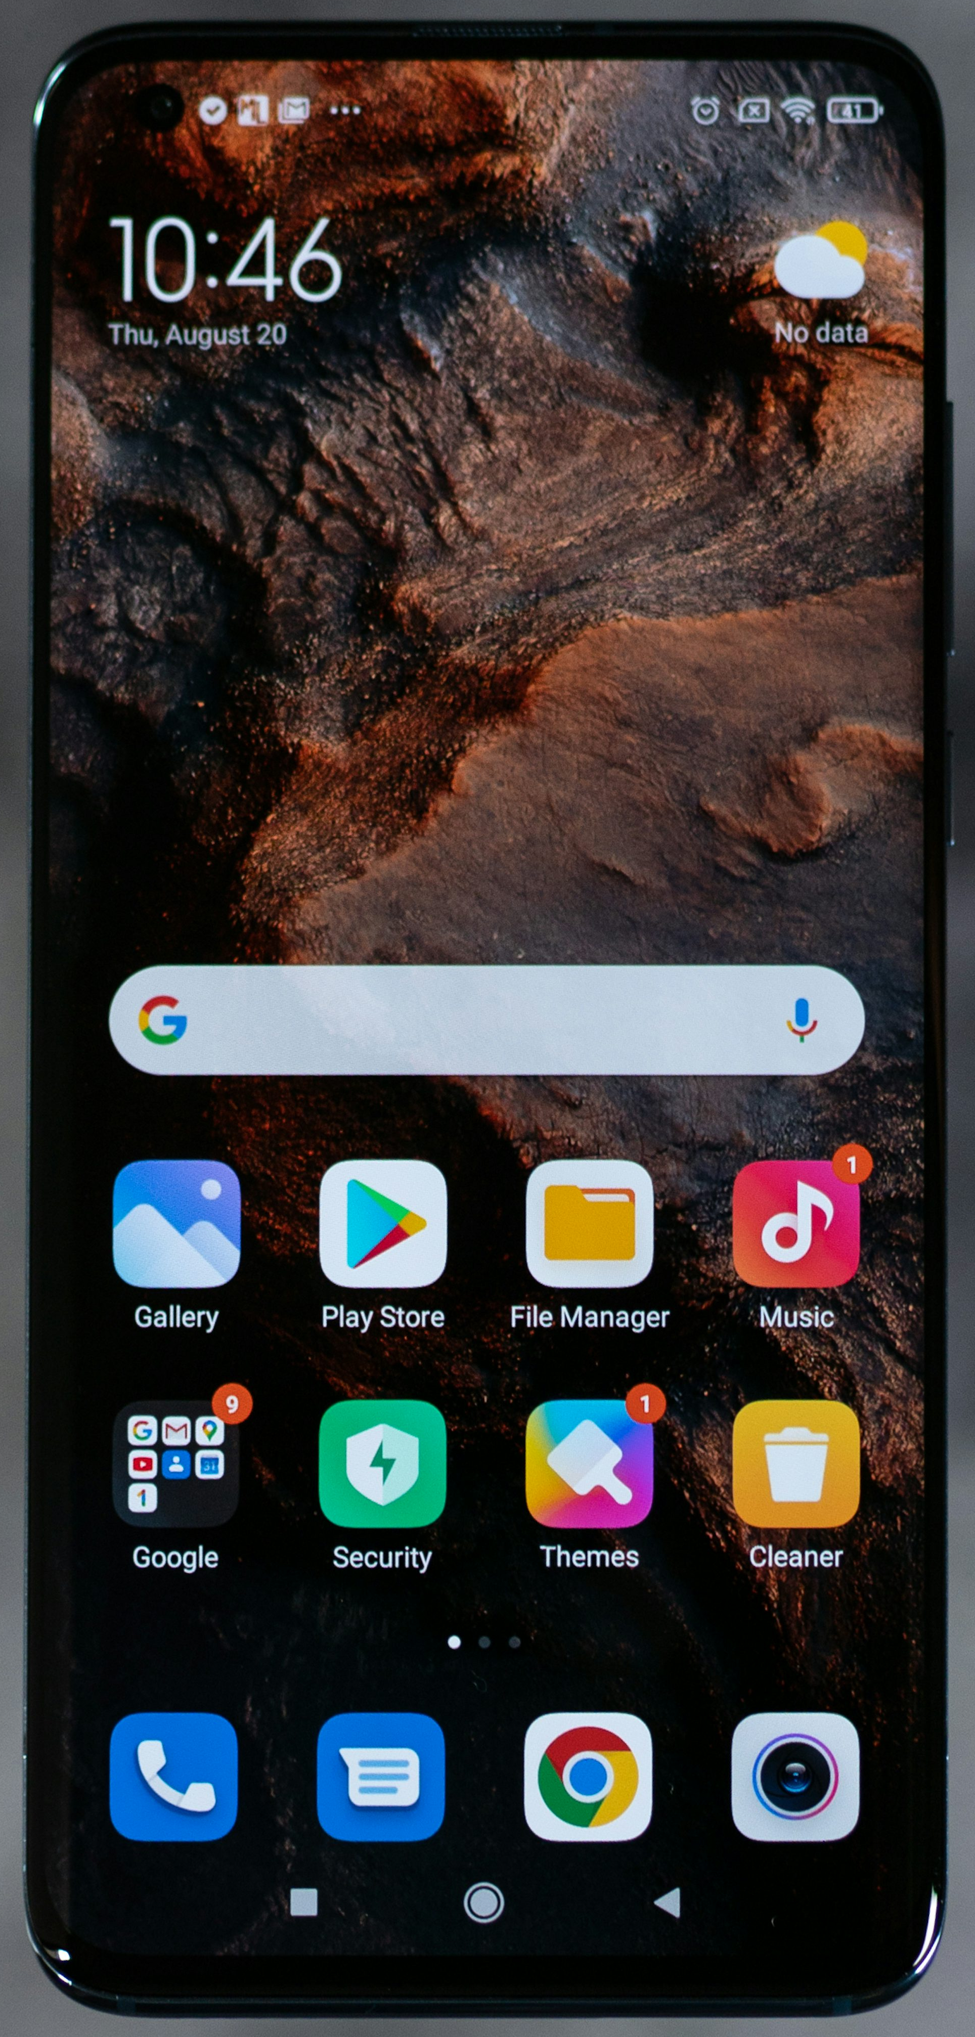
⏱ 0:55–1:05
HARDWARE — PART 2 OF 3
Your Smartphone = ALL 4 Categories
INPUT
OUTPUT
• Touchscreen
• Screen/Display
• Camera (front & back)
• Speaker & earpiece
• Microphone
• Vibration motor
• Fingerprint sensor
• Flash/torch
PROCESSING
STORAGE
• Processor (Snapdragon/Apple A)
• Internal 64GB–1TB
• RAM 4–16 GB
• microSD slot
• GPU for graphics
• Cloud auto-backup
📷 A modern smartphone
Notes:
Students already own a complete computer. Every hardware category fits in their pocket.

Slide 12
⏱ 1:05–1:15
HARDWARE — PART 3 OF 3 | QUICK CHECK
Look around this classroom right now.
Can you identify one device for each category?
INPUT DEVICE
Name one: ____________________
Look at what students are touching
OUTPUT DEVICE
Name one: ____________________
What shows or plays information?
PROCESSING UNIT
Name one: ____________________
Usually hidden inside a device
STORAGE DEVICE
Name one: ____________________
Check your bag or pockets
Notes:
3 minutes to think, then call on 4 students.

Slide 13
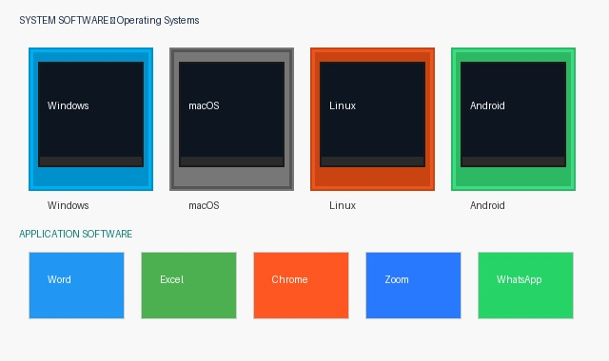

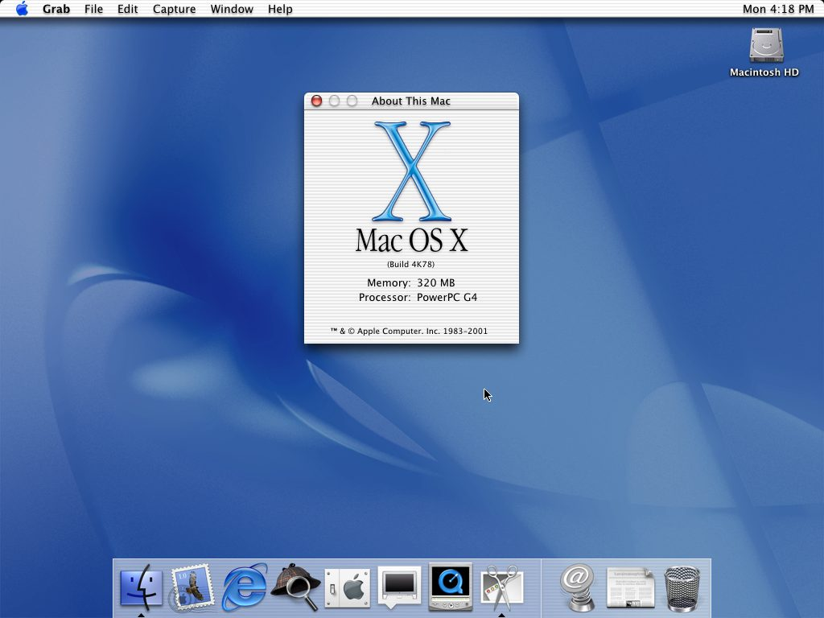



⏱ 1:15–1:25
SOFTWARE — PART 1 OF 2
Software: The Invisible Layer
🔑 Hardware is the body. Software is the mind. Without software, hardware is just an expensive box.
SYSTEM SOFTWARE
Runs the machine
🪟 Windows / macOS / Linux
📱 Android / iOS
🔧 Device Drivers
🛡️ Antivirus
APPLICATION SOFTWARE
Word · Excel · Chrome · Zoom · WhatsApp
📷 System & Application Software Examples
Notes:
Image shows real OS logos. System software = nervous system. Application software = hands.

Slide 14
⏱ 1:25–1:35
SOFTWARE — PART 2 OF 2 | CLASSIFY IT!
System or Application?
Call out your answer before I reveal it!
Windows 11
System
Microsoft Word
Application
→ Operating system — manages all hardware & software
→ You open it to do a specific task
Android 14
System
Google Chrome
Application
→ Runs the phone — you cannot delete it
→ A browser you install to access the web
Device Driver
System
Zoom
Application
→ Helps OS communicate with hardware
→ Communication app you choose to install
Notes:
Reveal one by one. Students call out System/Application.

Slide 15
☕
10-Minute Break
Returning at 1:45
Stand up · Stretch · Hydrate · Step outside
Coming up after break:
Networks → Cloud vs Local Storage → Group Activity → Exit Ticket
Notes:
Enforce the break!

Slide 16
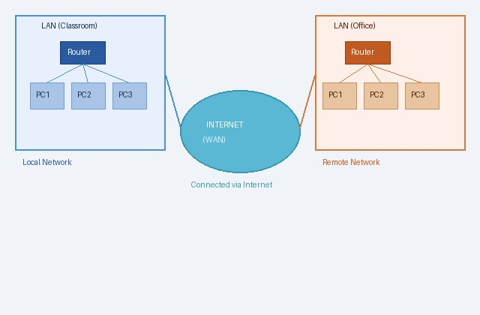
⏱ 1:45–1:58
NETWORKS & INTERNET — PART 1 OF 2
How Devices Talk to Each Other
🏠 LAN
Local Area Network
📍 One building/home
🏙️ MAN
Metropolitan Area Network
📍 City or campus
🌍 WAN
Wide Area Network
📍 Countries/continents
📷 LAN connected to the Internet (WAN)
Analogy: LAN = your street · WAN = the entire motorway system
Notes:
Point to the image. The road analogy lands well in Pakistani cities.

Slide 17
⏱ 1:58–2:10
NETWORKS & INTERNET — PART 2 OF 2
Internet vs Intranet vs Extranet
🌐 Internet
🔒 Intranet
🔗 Extranet
Massive global PUBLIC network — open to everyone with a connection.
PRIVATE internal network — only for people inside an organization.
Controlled network shared with selected OUTSIDERS.
👤 Who: Anyone
👤 Who: Staff/Students only
👤 Who: Invited external parties
Examples:
Examples:
Examples:
• Browsing Google
• University portal
• Supplier portal
• YouTube streaming
• Hospital system
• Bank partner access
• WhatsApp messages
• Company HR
• B2B platforms
Notes:
University portal login = Intranet. External journal link = Internet.

Slide 18
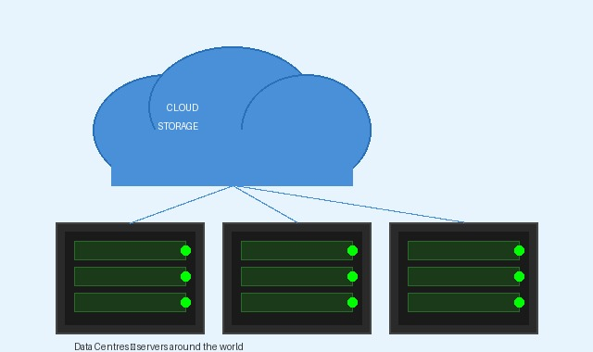
⏱ 2:10–2:20
CLOUD VS LOCAL STORAGE — PART 1 OF 2
What is Cloud Storage?
☁️ Cloud = storing YOUR files on SOMEONE ELSE'S computers, accessed via the Internet.
1
2
3
4
You save a file
Auto upload
Stored on servers
Access anywhere
On phone, laptop, or tablet
Sent via internet to a data centre
Thousands of drives in a warehouse
Any device downloads it instantly
📷 Data centres — the "cloud" is real servers in warehouses
Notes:
Point to the image — this is what the cloud actually looks like.

Slide 19
⏱ 2:20–2:32
CLOUD VS LOCAL STORAGE — PART 2 OF 2
Cloud vs Local: Side by Side
☁️ CLOUD STORAGE
💾 LOCAL STORAGE
Google Drive · OneDrive · Dropbox · iCloud
USB Drive · HDD · SSD · Memory Card
✅ Access from any device, anywhere
✅ Works without internet
✅ Easy sharing and collaboration
✅ Full control over your data
✅ Auto backup — no data loss risk
✅ Fast access — no upload wait
✅ Free tier (15 GB Google Drive)
✅ One-time cost, no subscription
❌ Needs internet connection
❌ Lost if device breaks/stolen
❌ Privacy depends on provider
❌ Hard to share with others
❌ Paid plans for large storage
❌ Limited physical capacity
Notes:
Best answer for thesis storage: BOTH.

Slide 20
⏱ 2:32–2:40
CLOUD STORAGE — KNOW YOUR TOOLS
3 Platforms You Will Use This Semester
🔵 Google Drive
🟦 Microsoft OneDrive
🔷 Dropbox
Best for collaboration
Best for Office
Simplest file sharing
Free: 15 GB free
Free: 5 GB free
Free: 2 GB free
• Real-time co-editing
• Syncs with Word/Excel/PowerPoint
• Drag and drop interface
• Integrated Docs/Sheets/Slides
• Integrated with Teams
• Works on all devices & OS
• Great on Android phones
• Often free via university
• Great for large file sharing
Best for: Group assignments & shared notes
Best for: Formal reports & academic docs
Best for: Sharing media & research data
Notes:
Show of hands: who uses Google Drive? OneDrive? Dropbox?

Slide 21
⏱ 10 Minutes
GROUP ACTIVITY
Classify Your
Digital Life
With your neighbour — complete this table:
ICT Component
Used Today
Category
Cloud or Local?
Smartphone
Laptop
USB Drive
Google Drive
🏆 First pair to fill ALL 4 rows correctly shares with the class!
Notes:
7 minutes to fill, 3 minutes for sharing.

Slide 22
⏱ 2:50–2:55
ACTIVITY DEBRIEF — SAMPLE ANSWERS
Here's How It Should Look
Component
Used For
ICT Category
Cloud or Local
Smartphone
Alarm, WhatsApp, camera
Input+Output+Processing+Storage
Both — local + iCloud/Google Photos
Laptop
Email, browsing, assignments
Input+Output+Processing+Storage
Both — local drive + OneDrive
USB Drive
Transferred assignment file
Storage only
Local only
Google Drive
Saved and shared notes
Cloud Storage
Cloud only
Notes:
Smartphone row is the aha moment.

Slide 23
⏱ 2:55–3:00
TODAY'S KEY TAKEAWAYS
6 Things You Now Know
1
ICT definition
2
4 Hardware types
Any tech that helps collect, store, process, share info and communicate
Input · Output · Processing · Storage — your phone has ALL four
3
2 Software types
4
3 Network types
System software runs the machine · Application software does your work
LAN (building) · MAN (city) · WAN (global) — Internet is biggest WAN
5
Internet vs Intranet
6
Cloud vs Local
Internet = public global · Intranet = private organizational
Cloud = accessible anywhere, needs internet · Local = offline, risk of loss
Notes:
Quick recap.

Slide 24
⏱ 3:00–3:10
EXIT TICKET — BEFORE YOU LEAVE
Answer These 3 Questions
01
Name ONE ICT tool from today you will use before next class.
Be specific — which app, device, or platform?
02
What is ONE thing that surprised you or you did not know before?
Think about hardware, software, networks, or cloud.
03
What is ONE question you still have about ICT?
I will answer it at the start of next class.
📅 Next Class (Week 2): ICT in Society — Education · Healthcare · Business · Governance · Emerging Technologies
Notes:
Call on 3 students per question.

