Slide 1












BAHRIA UNIVERSITY, ISLAMABAD
Department of AI & Computer Technologies
WEEK 8 + WEEK 4 CATCH-UP
Online Learning, Virtual Classrooms & Cloud Tools
Coursera, edX, Udemy, Khan Academy — interactive multimedia — Google Workspace and cloud storage
ICT 201 | Applications of ICT | 3-Hour Session | CLO-2 & CLO-3 | Fall 2026
Coursera
edX
Udemy
Khan Academy
Virtual classroom
Docs
Sheets
Slides
Drive
Dropbox
OneDrive

Slide 2
AGENDA — 3-HOUR SESSION, TWO BREAKS
180 MIN
Today’s Roadmap
01
Online Education: Landscape & How Courses Work
15 min
Why online learning, course types, how a course runs
02
Coursera & edX — University-Led Platforms
20 min
Interface tour, features, tracks, certificates
03
Udemy, Khan Academy & Other Sources
25 min
Comparison table, choosing a credible course
☕
BREAK 1
15 min
04
Interactive Multimedia in Learning
20 min
What it is, types, tools, benefits and cautions
05
Virtual Classrooms
20 min
How they work, features, tools, best practices
06
Week 4 Catch-Up: Google Workspace
20 min
Docs, Sheets, and Slides — features and collaboration
☕
BREAK 2
10 min
07
Week 4 Catch-Up: Cloud Storage
25 min
Google Drive, Dropbox, OneDrive, sharing, security
08
Hands-On Activity, Key Takeaways & Exit Ticket
10 min
Guided practice and wrap-up
ICT 201 | Week 8 — Online Courses, Virtual Classrooms & Cloud Tools
2

Slide 3
SETTING THE CONTEXT
Learning Does Not Stop at the Classroom Door
“Today a student can learn from the best universities in the world — without leaving home.”
Learning Beyond Our Course
Learning Together, Online
Free and low-cost platforms offer thousands of courses, from programming to psychology. Knowing where to find them — and which ones to trust — is now an essential digital skill.
Interactive multimedia and virtual classrooms make remote learning active instead of passive, while cloud tools let teams write, store, and share work from anywhere.
TODAY’S PLAN
Part 1: sources of online courses (Coursera, edX, Udemy, Khan Academy). Part 2: interactive multimedia and virtual classrooms. Part 3: the Week 4 topic we skipped earlier — Google Workspace (Docs, Sheets, Slides) and cloud storage (Google Drive, Dropbox, OneDrive).
ICT 201 | Week 8 — Online Courses, Virtual Classrooms & Cloud Tools
3

Slide 4
PART 1: SOURCES OF ONLINE EDUCATION COURSES
Coursera, edX, Udemy, Khan Academy & More
Where to learn, how courses work, and how to choose wisely

Slide 5
ONLINE EDUCATION
The Landscape of Online Courses
MOOCs
Self-Paced Courses
Massive Open Online Courses: large, usually free-to-start courses from universities and organizations, open to anyone with internet.
Pre-recorded lessons you can start any time and finish on your own schedule — ideal for working students.
Instructor-Led & Cohort Courses
Certificates & Micro-Credentials
Fixed start dates, live sessions or deadlines, and a group of classmates moving together.
Shorter, skills-focused programs that end in a certificate — useful for a CV, but quality and recognition vary.
Online Degrees
Open Educational Resources
Full bachelor’s or master’s programs delivered online by accredited universities, usually at higher cost and commitment.
Freely shared lecture notes, videos, and textbooks (for example, open university course materials) that anyone may reuse.
ICT 201 | Week 8 — Online Courses, Virtual Classrooms & Cloud Tools
5

Slide 6
ONLINE EDUCATION
How an Online Course Works
1
2
3
4
5
6
Find
Enrol
Learn
Practice
Assess
Credential
Search a platform by topic, level, or provider and read the syllabus.
Create an account and join free, audit, or pay for full access.
Watch short videos, read materials, and join discussion forums.
Complete quizzes, exercises, and projects with feedback.
Pass graded work or exams to show you met the learning goals.
Receive a certificate you can add to your CV or profile.
Cost
Time
Outcome
Many courses are free to learn from; certificates, graded work, or extra features usually cost money.
Courses are broken into weekly modules of a few hours — realistic to fit around university.
Real value comes from skills you can show: projects, portfolios, and knowledge you can apply.
ICT 201 | Week 8 — Online Courses, Virtual Classrooms & Cloud Tools
6

Slide 7
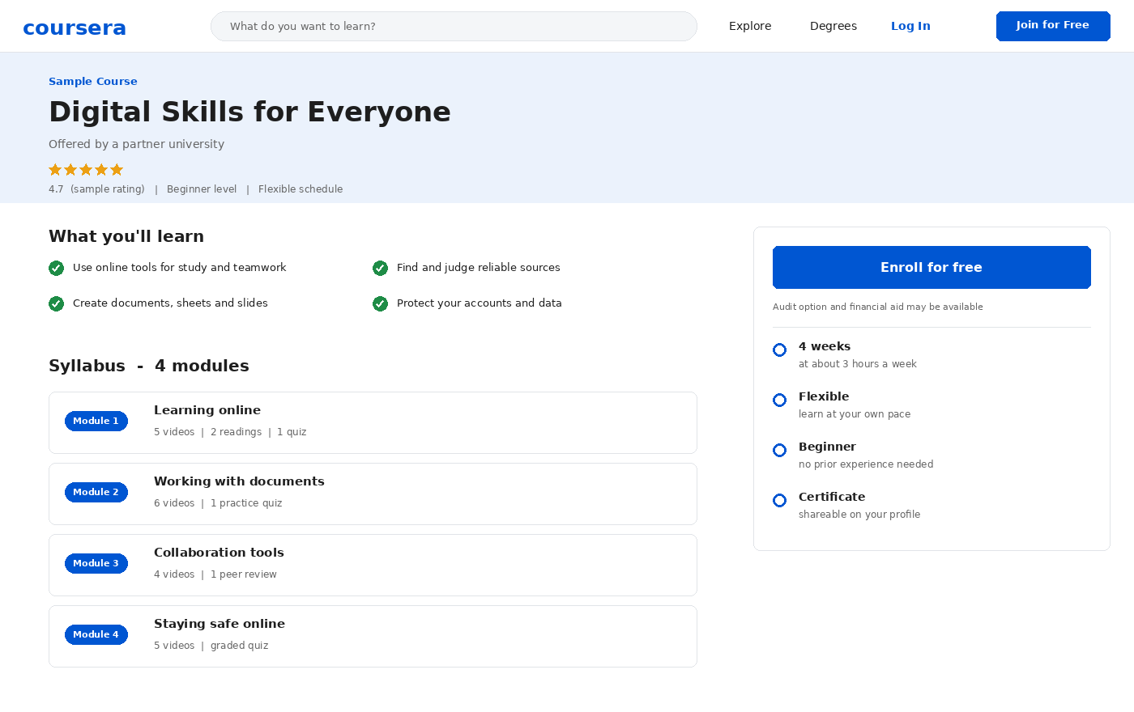
PART 1: ONLINE COURSES — COURSERA
Coursera — Course Page & Syllabus
WHAT IT IS
An online learning platform that offers courses, certificates, and degrees created with universities and companies.
HOW IT WORKS
You open a course page, read what you will learn and the syllabus, then enroll. Each module has videos, readings, and quizzes.
KEY AREAS SHOWN
• Course title, level, and ratings
• What you will learn
• Module-by-module syllabus
• Enroll card with time and certificate
Illustrative interface drawn for teaching — exact layout varies by version and institution.
ICT 201 | Week 8 — Online Courses, Virtual Classrooms & Cloud Tools
7

Slide 8
PART 1: ONLINE COURSES — COURSERA
Coursera — Features & Learning Paths
Courses & Specializations
Professional Certificates
Single courses, or a series of connected courses (a Specialization) that build one skill step by step.
Job-focused programs, some created with major companies, that end in a shareable credential.
Degrees
Audit & Financial Aid
Online bachelor’s and master’s programs offered through partner universities.
Many courses can be explored for free in audit mode; graded work may need payment, and financial aid exists for eligible learners.
Graded Work & Peer Review
Shareable Certificates
Quizzes, assignments, and peer-reviewed projects give feedback and prove progress.
Completed courses give certificates that can be added to LinkedIn and your CV.
ICT 201 | Week 8 — Online Courses, Virtual Classrooms & Cloud Tools
8

Slide 9
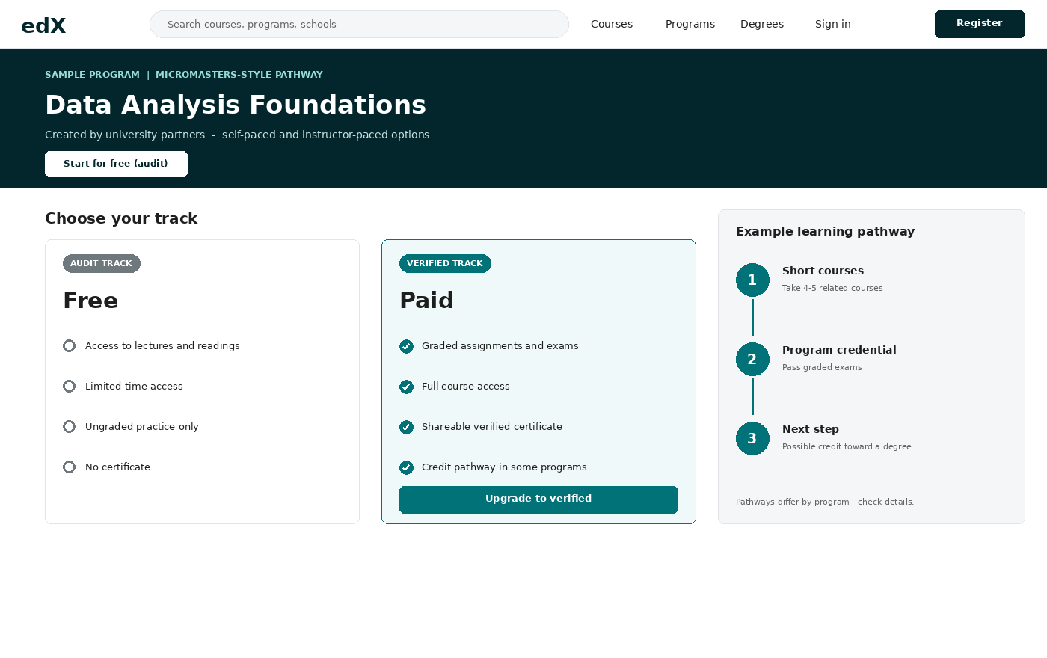
PART 1: ONLINE COURSES — EDX
edX — Tracks & Learning Pathway
WHAT IT IS
An online learning platform founded by Harvard and MIT, offering courses from many universities and institutions.
AUDIT VS VERIFIED
You can often start in an audit (free, limited-time) track, or choose the verified (paid) track for graded work and a certificate.
PATHWAYS
• Short courses grouped into programs
• Program credentials for career goals
• Some programs link to degree credit
Illustrative interface drawn for teaching — exact layout varies by version and institution.
ICT 201 | Week 8 — Online Courses, Virtual Classrooms & Cloud Tools
9

Slide 10
PART 1: ONLINE COURSES — EDX
edX — Features & What Makes It Different
University-Backed Content
Audit Track
Courses are created by universities and institutions, so syllabi often follow real campus courses.
Free access to lectures and readings for a limited time, with no graded work or certificate.
Verified Track
Program Credentials
Paid option that unlocks graded assignments, full access, and a verified certificate.
Groups of related courses that form a recognized program, sometimes counted toward further study.
Boot Camps & Degrees
Open edX Platform
Intensive skills programs and degree options are offered alongside regular courses.
The software behind edX is open source, so many universities run their own course sites on it.
ICT 201 | Week 8 — Online Courses, Virtual Classrooms & Cloud Tools
10

Slide 11
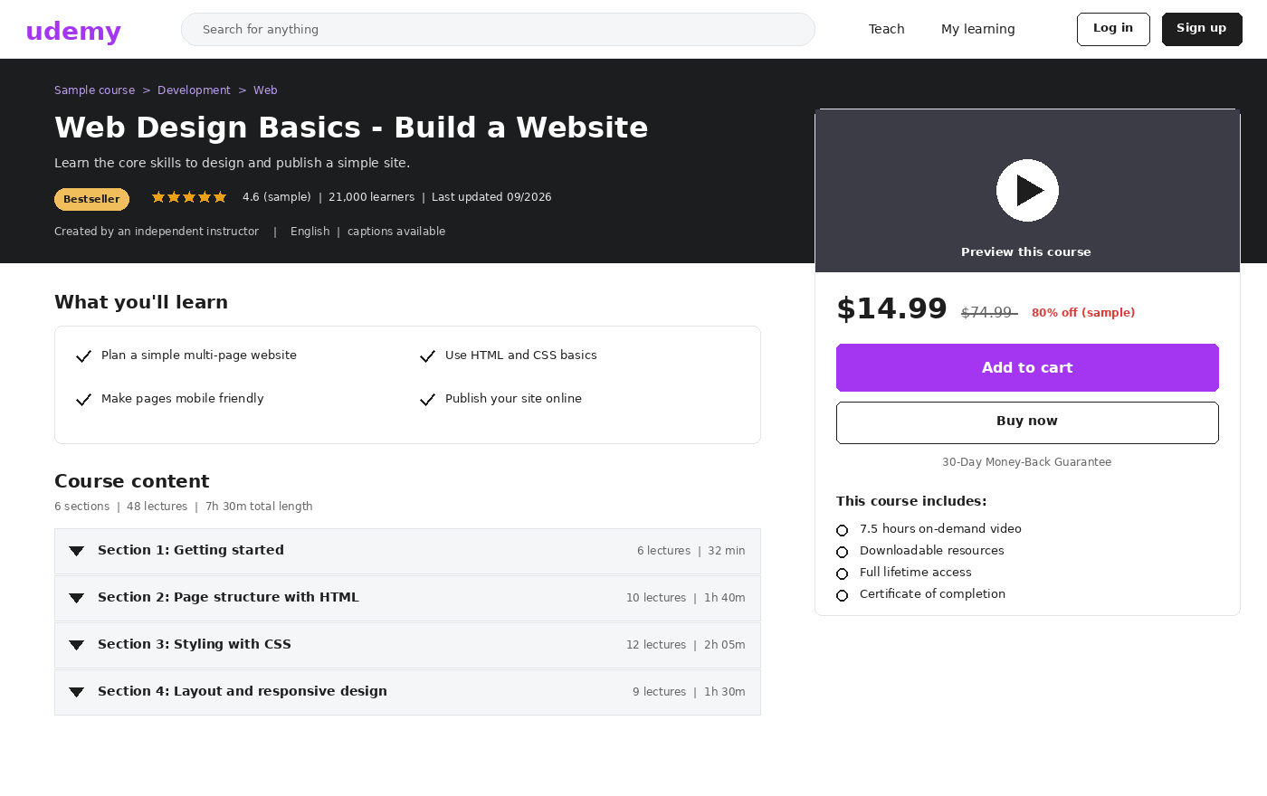
PART 1: ONLINE COURSES — UDEMY
Udemy — Course Landing Page
WHAT IT IS
A marketplace where independent instructors create and sell courses on a very wide range of practical skills.
HOW IT WORKS
You buy a course once and get on-demand access to its videos and downloads, learning at your own pace.
WHAT TO CHECK ON THE PAGE
• Rating and number of learners
• Last updated date
• Preview video and syllabus
• Price and refund policy
Illustrative interface drawn for teaching — exact layout varies by version and institution.
ICT 201 | Week 8 — Online Courses, Virtual Classrooms & Cloud Tools
11

Slide 12
PART 1: ONLINE COURSES — UDEMY
Udemy — Features, Strengths & Cautions
Marketplace Model
Buy Once, Learn at Your Pace
Anyone can publish a course, so topics range from coding and design to photography and business.
Most purchases give long-term access to the course content and later updates.
Frequent Discounts
Practical, Skills-First Courses
Prices change often, so waiting for a sale is common — but compare value, not just price.
Courses are usually short, project-based, and focused on doing — good for hands-on skills.
Quality Varies
Certificates of Completion
Because there is no single editor, always read reviews, the syllabus, and the update date before buying.
You receive a certificate of completion, which shows effort but is not a formal degree or accreditation.
ICT 201 | Week 8 — Online Courses, Virtual Classrooms & Cloud Tools
12

Slide 13
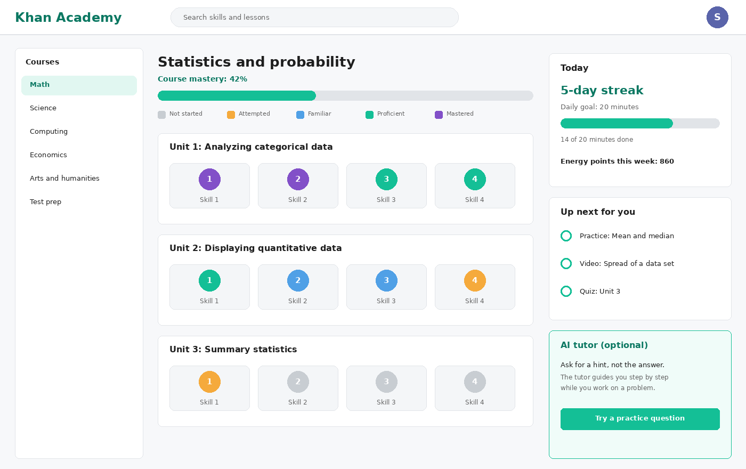
PART 1: ONLINE COURSES — KHAN ACADEMY
Khan Academy — Mastery Dashboard
WHAT IT IS
A non-profit learning platform with free lessons and practice, mainly for school-level and early college subjects.
HOW IT WORKS
Short videos and articles teach a skill, then practice questions check it. Progress is shown as mastery levels.
KEY AREAS SHOWN
• Course mastery bar
• Units with skills and levels
• Daily goal and streak
• Recommended next practice
Illustrative interface drawn for teaching — exact layout varies by version and institution.
ICT 201 | Week 8 — Online Courses, Virtual Classrooms & Cloud Tools
13

Slide 14
PART 1: ONLINE COURSES — KHAN ACADEMY
Khan Academy — Features & Strengths
Completely Free
Mastery Learning
Run by a non-profit organization, so lessons and practice are free for every learner.
Practice continues until a skill is mastered, so gaps are fixed before moving on.
Wide Subject Range
Instant Feedback
Math, science, computing, economics, arts and humanities, and test-preparation material.
Hints and step-by-step solutions appear as you practice, helping you learn from mistakes.
Teacher & Parent Tools
Optional AI Tutor
Teachers can assign work and see class progress; parents can follow a child’s learning.
An AI tutor can guide learners with hints instead of just giving answers (some features may be paid or limited).
ICT 201 | Week 8 — Online Courses, Virtual Classrooms & Cloud Tools
14

Slide 15
PART 1: ONLINE COURSES — MORE PLACES TO LEARN
Other Sources of Online Courses
FutureLearn & Udacity
LinkedIn Learning & Skillshare
FutureLearn offers university-linked courses with a social learning style; Udacity focuses on technology skills and project-based programs.
Short professional and creative skill videos; LinkedIn Learning links directly to your professional profile.
Alison & freeCodeCamp
Open University Materials
Free-to-learn sites: Alison covers many job skills, and freeCodeCamp teaches programming through projects.
Many universities publish lecture notes, videos, and assignments online for anyone to study.
Company Learning Hubs
Local & Distance Universities
Technology companies run free learning portals for their own tools and certifications.
Distance-learning institutions, such as the Virtual University of Pakistan, deliver full programs online.
ICT 201 | Week 8 — Online Courses, Virtual Classrooms & Cloud Tools
15

Slide 16
SIDE-BY-SIDE COMPARISON
Coursera vs edX vs Udemy vs Khan Academy
Aspect
Coursera
edX
Udemy
Khan Academy
Main model
Partner universities and companies
University and institution courses
Marketplace of independent instructors
Non-profit free learning
Typical cost
Free to audit many; paid for certificates
Free audit; paid verified track
Pay per course (often discounted)
Free
Credentials
Certificates and degrees
Verified certificates, programs, degrees
Certificate of completion
No formal certificate
Content style
Structured weekly modules and graded work
University-style courses and programs
Practical, short, skills-first videos
Short lessons plus mastery practice
Strength
Career and degree pathways
Academic depth and open-source roots
Huge variety of practical skills
Free, clear foundations
Watch out for
Some graded features need payment
Free access may be time-limited
Quality varies by instructor
Mostly school and early-college level
Best for
Career change or credential
University-level learning
Quick hands-on skills
Strengthening basics
ICT 201 | Week 8 — Online Courses, Virtual Classrooms & Cloud Tools
16

Slide 17
EVALUATING ONLINE COURSES
How to Choose a Credible Online Course
Check the Provider
Read the Syllabus
Prefer recognized universities, established organizations, or clearly credited experts over unknown sources.
Make sure topics, level, and weekly workload match your goal and available time.
Look at Reviews & Updates
Understand the Real Cost
Recent ratings and a recent “last updated” date suggest the material is current and useful.
Check what is free, what needs payment, and whether certificates add real value for your goal.
Value Skills over Certificates
Beware of Scams
Employers care about projects and demonstrated ability; a certificate alone rarely proves skill.
Avoid “guaranteed job” promises, fake accreditation, and sites asking for unusual personal or payment details.
ICT 201 | Week 8 — Online Courses, Virtual Classrooms & Cloud Tools
17

Slide 18
APPLYING WHAT YOU LEARNED
Which Source Fits Which Learner?
Learner situation
Suggested source
Why
A student wants to strengthen weak statistics basics, for free
Khan Academy
Free mastery-based practice with instant feedback
A graduate wants a job-focused certificate from a recognized provider
Coursera
Professional certificates and partner-backed programs
A learner wants university-style content and to audit before paying
edX
Audit track and academic-style courses
A freelancer needs a practical web design skill quickly
Udemy
Project-based, short, practical courses
A student wants a full degree while living far from campus
Distance university or online degree
Accredited programs delivered entirely online
ICT 201 | Week 8 — Online Courses, Virtual Classrooms & Cloud Tools
18

Slide 19
☕
BREAK 1
15 Minutes
Back at it: interactive multimedia and virtual classrooms

Slide 20
PART 2: INTERACTIVE MULTIMEDIA & VIRTUAL CLASSROOMS
Learning That Responds to You
Rich media, active practice, and live online teaching

Slide 21
INTERACTIVE MULTIMEDIA
What Is Interactive Multimedia?
1
2
3
4
5
Text & Graphics
Audio
Video
Animation & Simulation
Interaction
Words, images, charts, and infographics that explain ideas visually.
Narration, podcasts, and sound that help learners listen and review.
Recorded or live demonstrations, lectures, and short explainers.
Moving diagrams and models that learners can explore and change.
Quizzes, drag-and-drop, games, and feedback that need a response.
Definition
Why it works
What you need
Interactive multimedia combines several media types and lets the learner act — click, answer, drag, or experiment — instead of only watching.
Using words with visuals, adding practice, and giving instant feedback helps attention, understanding, and memory.
A device and internet connection, plus tools that support interaction — often just a browser.
ICT 201 | Week 8 — Online Courses, Virtual Classrooms & Cloud Tools
21

Slide 22
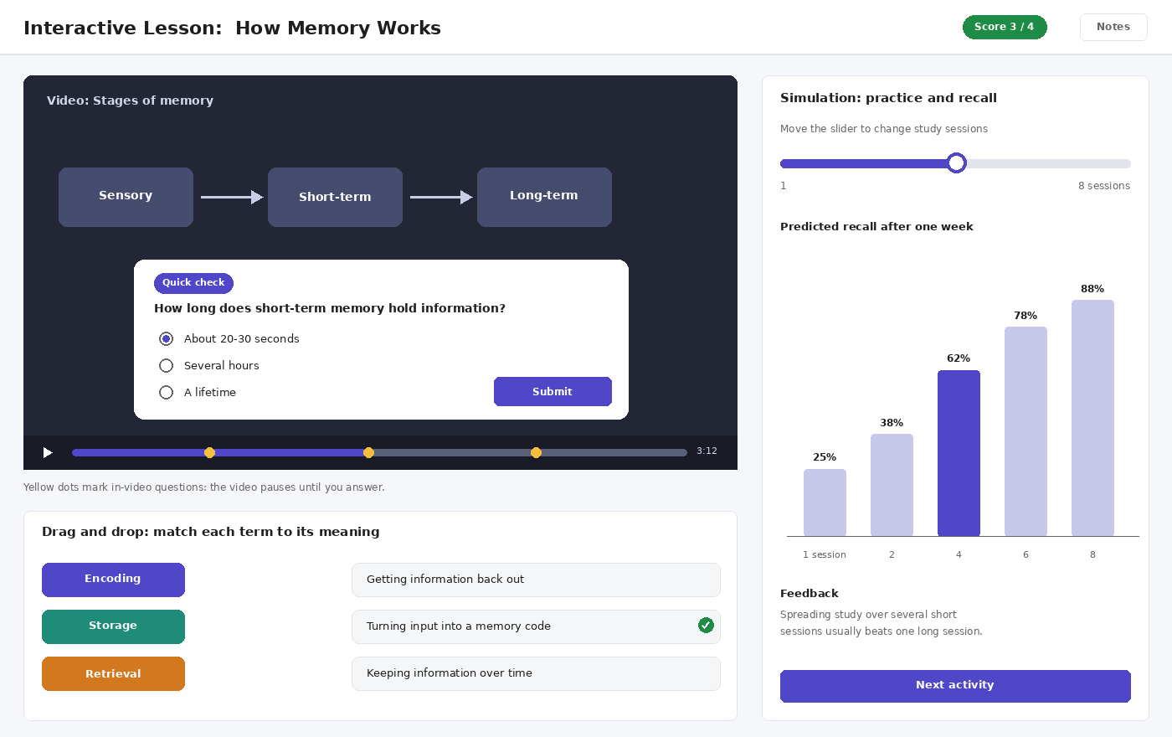
INTERACTIVE MULTIMEDIA
An Interactive Lesson in Action
IN-VIDEO QUESTIONS
The video pauses at marked points so learners answer a quick check before continuing.
DRAG AND DROP
Learners match terms to meanings, turning passive reading into active practice with instant correction.
SIMULATION
A slider changes a variable (study sessions) and the chart updates, so learners see cause and effect by experimenting.
Illustrative interface drawn for teaching — exact layout varies by version and institution.
ICT 201 | Week 8 — Online Courses, Virtual Classrooms & Cloud Tools
22

Slide 23
INTERACTIVE MULTIMEDIA
Types & Tools of Interactive Learning
Interactive Video
Quizzes & Live Polls
Videos with built-in questions and notes. Examples of tools: Edpuzzle and H5P.
Instant checks of understanding during class. Examples: Kahoot, Quizizz, Mentimeter.
Simulations & Virtual Labs
Gamification
Models learners can change and observe — such as science simulations or online experiments.
Points, badges, streaks, and levels that motivate steady practice, as seen in Khan Academy.
Infographics & Digital Storytelling
AR / VR Learning
Visual summaries and story-based lessons created with design tools such as Canva or Genially.
Augmented and virtual reality can place learners inside 3D models, field trips, or training scenarios.
ICT 201 | Week 8 — Online Courses, Virtual Classrooms & Cloud Tools
23

Slide 24
INTERACTIVE MULTIMEDIA
Benefits, Cautions & Examples for Psychology
Benefits
Cautions
Higher engagement, learning at your own pace, instant feedback, and multiple ways to understand the same idea.
Too many effects can overload learners; poor design, slow internet, or missing captions can exclude some students.
Design Principle
Examples for Psychology
Keep it simple: relevant visuals, clear narration, short segments, and activities that match the learning goal.
Interactive 3D brain models, online reaction-time experiments, simulated case interviews, and memory or attention demonstrations.
ICT 201 | Week 8 — Online Courses, Virtual Classrooms & Cloud Tools
24

Slide 25
VIRTUAL CLASSROOMS
What Is a Virtual Classroom & How Does It Work?
1
2
3
4
5
Schedule & Invite
Join
Teach Live
Interact
Record & Follow Up
The teacher sets a time and shares the join link, often through the LMS.
Students open the link in a browser or app and check audio and video.
The teacher presents slides, uses a whiteboard, or shares a screen.
Students use chat, polls, raise hand, and breakout rooms to take part.
The session is recorded, and notes and tasks are shared afterwards.
Definition
Synchronous vs asynchronous
Often linked to an LMS
A virtual classroom is an online space where teacher and students meet live, with tools that copy the teaching and discussion of a physical room.
Live sessions are synchronous; recorded lessons and forums are asynchronous. Good courses combine both.
The class schedule, recordings, and assignments typically live in the LMS, with live sessions launched from it.
ICT 201 | Week 8 — Online Courses, Virtual Classrooms & Cloud Tools
25

Slide 26
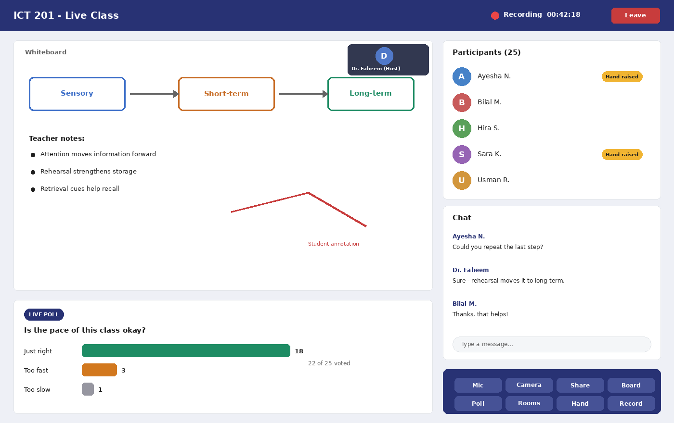
VIRTUAL CLASSROOMS
Inside a Virtual Classroom
TEACHING SPACE
A shared whiteboard, slides, or screen share; the teacher’s video appears in a small tile.
INTERACTION TOOLS
• Live poll with instant results
• Participant list with raised hands
• Chat for questions
• Breakout rooms for group work
CONTROLS
Mic, camera, share, whiteboard, poll, rooms, hand-raise, and record buttons sit in a toolbar, as in the Zoom and Teams recap.
Illustrative interface drawn for teaching — exact layout varies by version and institution.
ICT 201 | Week 8 — Online Courses, Virtual Classrooms & Cloud Tools
26

Slide 27
VIRTUAL CLASSROOMS
Key Features of Virtual Classrooms
Live Audio & Video
Whiteboard & Screen Sharing
Real-time lectures and discussion with the teacher and classmates.
Draw, annotate, and show slides, documents, or software demonstrations.
Polls & Quizzes
Breakout Rooms
Instant questions give the teacher a quick view of who understands.
Split the class into small groups for discussion and project work, then reunite.
Recording & Attendance
Chat, Hand Raise & Files
Sessions can be recorded for revision, and attendance can be tracked automatically.
Ask questions without interrupting, signal you want to speak, and share files with the class.
ICT 201 | Week 8 — Online Courses, Virtual Classrooms & Cloud Tools
27

Slide 28
VIRTUAL CLASSROOMS
Virtual Classroom Tools
Tool
Type
Notable strength
Zoom, Google Meet, Microsoft Teams
General video meeting tools
Familiar, easy to join, and widely used for classes (see Week 6)
BigBlueButton
Open-source virtual classroom built for teaching
Whiteboard, polls, and breakout rooms; often connects to Moodle
Adobe Connect
Commercial virtual classroom and webinar tool
Customizable rooms and strong training and webinar features
Blackboard Collaborate
Virtual classroom linked to Blackboard LMS
Built-in whiteboard, polls, and recording within the LMS
Immersive VR classrooms
Virtual reality learning spaces
Students meet as avatars inside 3D spaces — still emerging
ICT 201 | Week 8 — Online Courses, Virtual Classrooms & Cloud Tools
28

Slide 29
VIRTUAL CLASSROOMS
Physical vs Virtual Classroom
Aspect
Physical classroom
Virtual classroom
Location & access
Everyone travels to one room
Join from anywhere with internet
Interaction
Natural face-to-face and body language
Chat, polls, and video; less body language
Resources
Whiteboard, printed handouts
Screen sharing, files, recordings, online tools
Record of class
Notes only, unless the teacher records
Recording and chat history easy to keep
Main challenges
Travel, fixed room capacity
Internet problems, distractions, screen fatigue
Best used for
Hands-on labs and social learning
Flexible, remote, and recorded teaching
ICT 201 | Week 8 — Online Courses, Virtual Classrooms & Cloud Tools
29

Slide 30
VIRTUAL CLASSROOMS
Benefits, Challenges & Best Practices
Benefits
Challenges
Flexible access, lower travel cost, recordings for revision, and the ability to bring in experts from anywhere.
Unequal internet and device access (the digital divide), distractions at home, and “screen fatigue” from long sessions.
Best Practices: Teachers
Best Practices: Students
Keep sessions interactive, change activity every few minutes, share notes, and record for absent students.
Join early, mute when not speaking, use chat and raise hand, and keep a quiet, distraction-free space.
Netiquette
Support Equity
Be respectful, keep your name visible, and never record or share a session without permission.
Offer low-bandwidth options, recordings, and clear materials so students with weaker connections are not left behind.
ICT 201 | Week 8 — Online Courses, Virtual Classrooms & Cloud Tools
30

Slide 31
PART 3 — WEEK 4 CATCH-UP: GOOGLE WORKSPACE
Google Docs, Sheets & Slides
Write, calculate, and present — together, in the cloud

Slide 32
WEEK 4 CATCH-UP — GOOGLE WORKSPACE
What Is Google Workspace?
The Idea
Docs, Sheets, Slides
A set of online productivity apps that run in a browser; files are saved automatically in the cloud and can be shared instantly.
Word processing, spreadsheets, and presentations — the online counterparts of Word, Excel, and PowerPoint.
Connected Services
Real-Time Collaboration
Works with Gmail, Drive, Calendar, Meet, and Forms so mail, files, meetings, and surveys fit together.
Several people edit the same file at once, see each other’s cursors, and discuss through comments.
Free and Paid Options
Compatible with Microsoft Office
A free Google account includes the apps with shared storage; Workspace plans add business and education features.
Files can be downloaded as Word, Excel, PowerPoint, or PDF, and Office files can be opened and edited.
ICT 201 | Week 8 — Online Courses, Virtual Classrooms & Cloud Tools
32

Slide 33
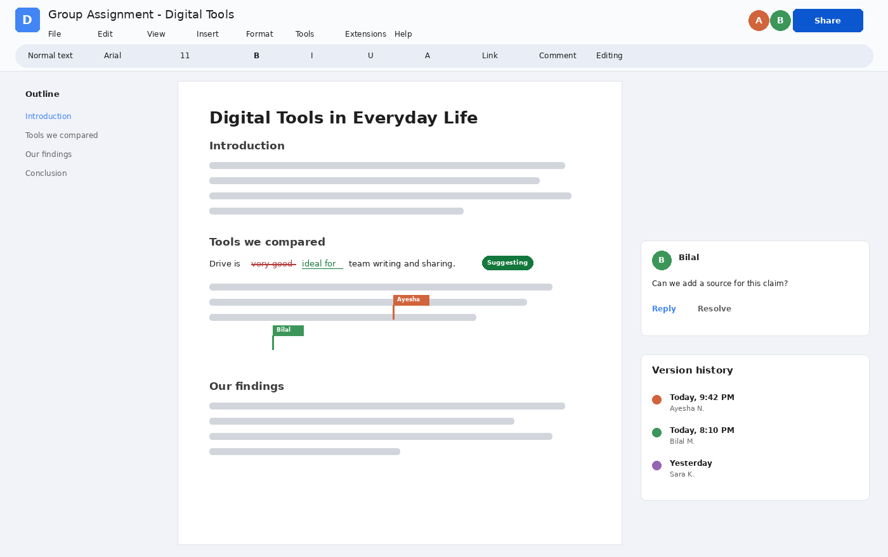
WEEK 4 CATCH-UP — GOOGLE DOCS
Google Docs — Writing Together
WHAT IT IS
An online word processor for reports, assignments, letters, and notes, with changes saved automatically.
COLLABORATION SHOWN
• Collaborator cursors with names
• Suggesting mode (edits to approve)
• Comments with replies
• Version history by person and time
SHARING
The Share button gives people Viewer, Commenter, or Editor access.
Illustrative interface drawn for teaching — exact layout varies by version and institution.
ICT 201 | Week 8 — Online Courses, Virtual Classrooms & Cloud Tools
33

Slide 34
WEEK 4 CATCH-UP — GOOGLE DOCS
Google Docs — Main Features
Formatting & Styles
Suggesting Mode
Headings, fonts, lists, tables, images, and a clickable outline that is built from your headings.
Proposed edits appear as suggestions that the owner can accept or reject — ideal for feedback and proofreading.
Comments & Mentions
Version History
Leave comments on any text and mention a person to notify them and assign follow-up.
See who changed what and when, and restore an earlier version if something goes wrong.
Voice Typing & Add-ons
Offline, Export & Print
Dictate text, check spelling and grammar, and add extra tools such as citation helpers.
Work offline when enabled, then export to Word or PDF for submission or printing.
ICT 201 | Week 8 — Online Courses, Virtual Classrooms & Cloud Tools
34

Slide 35
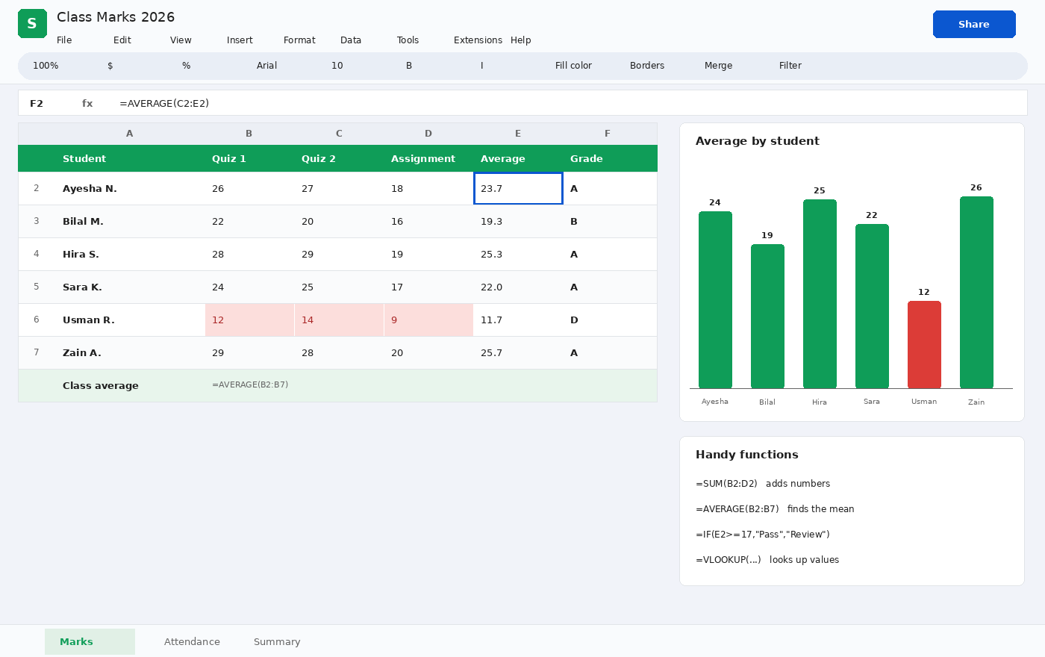
WEEK 4 CATCH-UP — GOOGLE SHEETS
Google Sheets — Calculations & Charts
WHAT IT IS
An online spreadsheet for lists, marks, budgets, and data analysis, with formulas and charts.
SHOWN HERE
• Formula bar with =AVERAGE
• Highlighted low scores (conditional formatting)
• A chart built from the data
• Handy functions panel
WHY USEFUL
Change a number and every formula and chart updates instantly.
Illustrative interface drawn for teaching — exact layout varies by version and institution.
ICT 201 | Week 8 — Online Courses, Virtual Classrooms & Cloud Tools
35

Slide 36
WEEK 4 CATCH-UP — GOOGLE SHEETS
Google Sheets — Main Features
Formulas & Functions
Charts & Pivot Tables
Use SUM, AVERAGE, IF, and lookup functions to calculate totals, grades, and comparisons automatically.
Turn rows of data into bar, line, or pie charts, and summarize large tables with pivot tables.
Conditional Formatting
Data Validation & Filters
Color cells automatically by rule — for example, highlight scores below a pass mark.
Limit entries to valid values, and sort or filter to focus on the rows you need.
Google Forms Link
Collaboration & Sharing
Survey responses from Google Forms flow straight into a sheet for analysis — useful for research projects.
Multiple people can edit at once, with comments and protected ranges to guard important cells.
ICT 201 | Week 8 — Online Courses, Virtual Classrooms & Cloud Tools
36

Slide 37
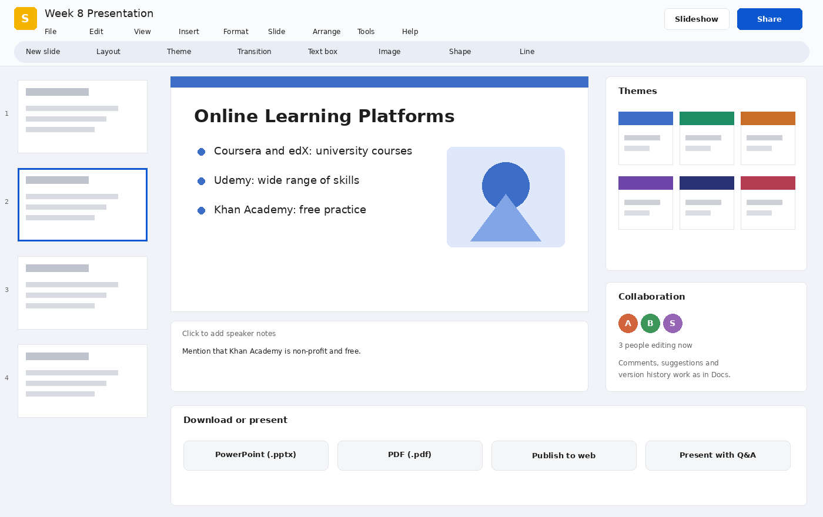
WEEK 4 CATCH-UP — GOOGLE SLIDES
Google Slides — Building Presentations
WHAT IT IS
An online presentation tool for lectures, project talks, and pitches, built and edited together in the cloud.
SHOWN HERE
• Slide filmstrip on the left
• Main slide canvas with text and image
• Speaker notes under the slide
• Themes and collaborator list
SHARING A PRESENTATION
Present from the browser, publish to the web, or download as PowerPoint or PDF.
Illustrative interface drawn for teaching — exact layout varies by version and institution.
ICT 201 | Week 8 — Online Courses, Virtual Classrooms & Cloud Tools
37

Slide 38
WEEK 4 CATCH-UP — GOOGLE SLIDES
Google Slides — Main Features
Themes & Layouts
Media & Shapes
Ready-made themes and layouts keep fonts, colors, and spacing consistent across the deck.
Insert images, videos, shapes, charts, and diagrams, and link charts from Sheets.
Animations & Transitions
Speaker Notes & Presenter View
Add simple motion to slides and objects to guide the audience’s attention.
Keep notes visible only to you while the audience sees the slides.
Q&A and Audience Tools
Download & Compatibility
Let the audience submit questions during a presentation, or share a view-only link.
Export to PowerPoint (.pptx) or PDF so the file opens anywhere.
ICT 201 | Week 8 — Online Courses, Virtual Classrooms & Cloud Tools
38

Slide 39
☕
BREAK 2
10 Minutes
Back at it: cloud storage — Google Drive, Dropbox and OneDrive

Slide 40
PART 3 — WEEK 4 CATCH-UP: CLOUD STORAGE
Google Drive, Dropbox & Microsoft OneDrive
Store, sync, and share files from anywhere

Slide 41
CLOUD STORAGE
What Is Cloud Storage & How Does It Work?
1
2
3
4
5
6
Save a File
Upload
Stored Securely
Synced
Shared
Versions Kept
You save or drag a file into your cloud folder on a device.
The file is sent over the internet to the provider.
Copies are kept on servers in data centers.
Other devices signed into your account receive the file.
You send a link or invite people with chosen permissions.
Earlier versions and deleted files can often be recovered.
Benefits
Risks
Free vs paid
Access files from any device, automatic backup, easy sharing, and fewer lost USB drives.
Needs internet, depends on the provider, and can be exposed if an account is hacked or shared carelessly.
Providers give limited free space and sell more storage and features through paid plans.
ICT 201 | Week 8 — Online Courses, Virtual Classrooms & Cloud Tools
41

Slide 42
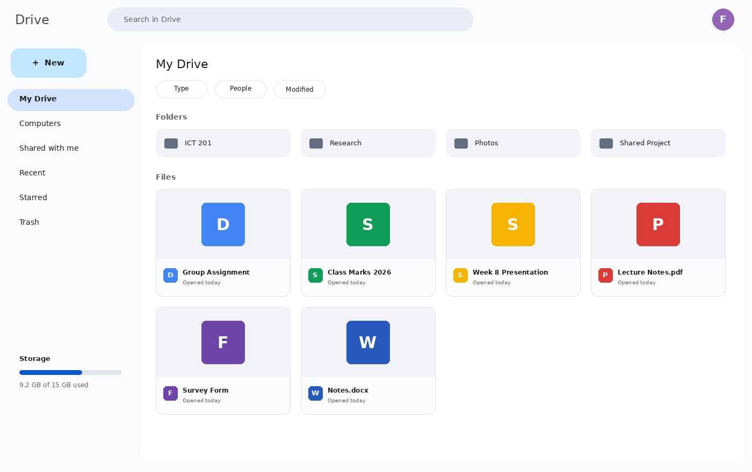
CLOUD STORAGE — GOOGLE DRIVE
Google Drive — My Drive
WHAT IT IS
Google’s cloud storage, built into Gmail, Docs, Sheets, and Slides. A free account includes 15 GB shared across Google services.
SHOWN HERE
• New button for upload or create
• My Drive, Shared with me, Recent
• Folders and files with type icons
• Storage meter
WHY USEFUL
Docs, Sheets, and Slides you create are saved straight into Drive — no uploading needed.
Illustrative interface drawn for teaching — exact layout varies by version and institution.
ICT 201 | Week 8 — Online Courses, Virtual Classrooms & Cloud Tools
42

Slide 43
CLOUD STORAGE — GOOGLE DRIVE
Google Drive — Features & Strengths
Deep Docs Integration
Powerful Search
Create and edit Docs, Sheets, and Slides directly, and open Office files in the same place.
Search by name, content inside files, file type, owner, or date to find things fast.
Sharing Controls
Version History
Share with specific people or by link, with Viewer, Commenter, or Editor roles.
View and restore earlier versions of files, especially useful for shared documents.
Drive for Desktop & Offline
Shared Drives (Workspace)
Sync selected folders to your computer and mark files for offline use.
Team-owned spaces for institutions, where files stay even if a member leaves (available on Workspace plans).
ICT 201 | Week 8 — Online Courses, Virtual Classrooms & Cloud Tools
43

Slide 44
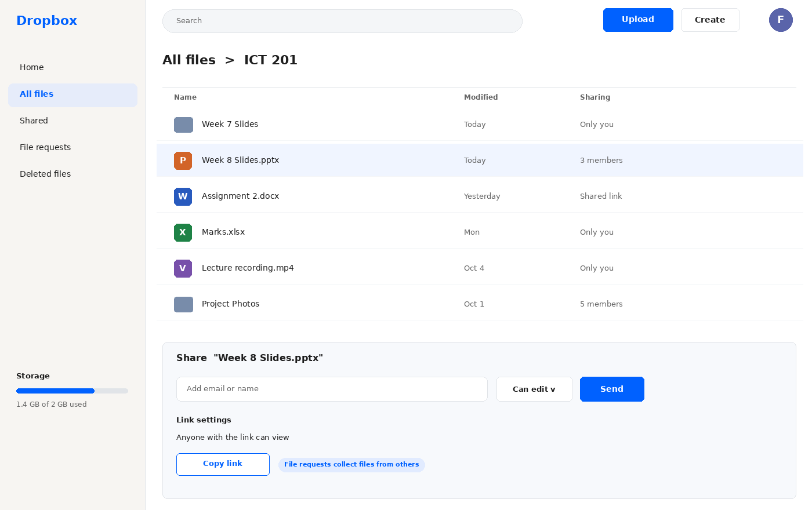
CLOUD STORAGE — DROPBOX
Dropbox — Files & Sharing
WHAT IT IS
A pioneer of cloud file sync, known for simple folders that stay identical on all your devices. The free plan is small (about 2 GB).
SHOWN HERE
• All files list with sharing status
• Upload and Create buttons
• Share panel with permissions
• Link settings and file requests
WHY USEFUL
Works with any computer or ecosystem and connects to many third-party apps.
Illustrative interface drawn for teaching — exact layout varies by version and institution.
ICT 201 | Week 8 — Online Courses, Virtual Classrooms & Cloud Tools
44

Slide 45
CLOUD STORAGE — DROPBOX
Dropbox — Features & Strengths
Reliable Sync
Simple, Platform-Independent
Changes made on one device appear quickly on the others, and files sync in the background.
Works well on Windows, macOS, mobile, and the web without tying you to one ecosystem.
File Requests
Link Sharing & Permissions
Ask anyone to send you files directly into a folder, even if they do not have a Dropbox account.
Share files and folders by link or invitation with view or edit rights.
Recovery & Version History
App Integrations
Deleted files and earlier versions can be recovered for a limited time, depending on the plan.
Connects with many tools, such as video meetings, messaging, and Microsoft or Google apps.
ICT 201 | Week 8 — Online Courses, Virtual Classrooms & Cloud Tools
45

Slide 46
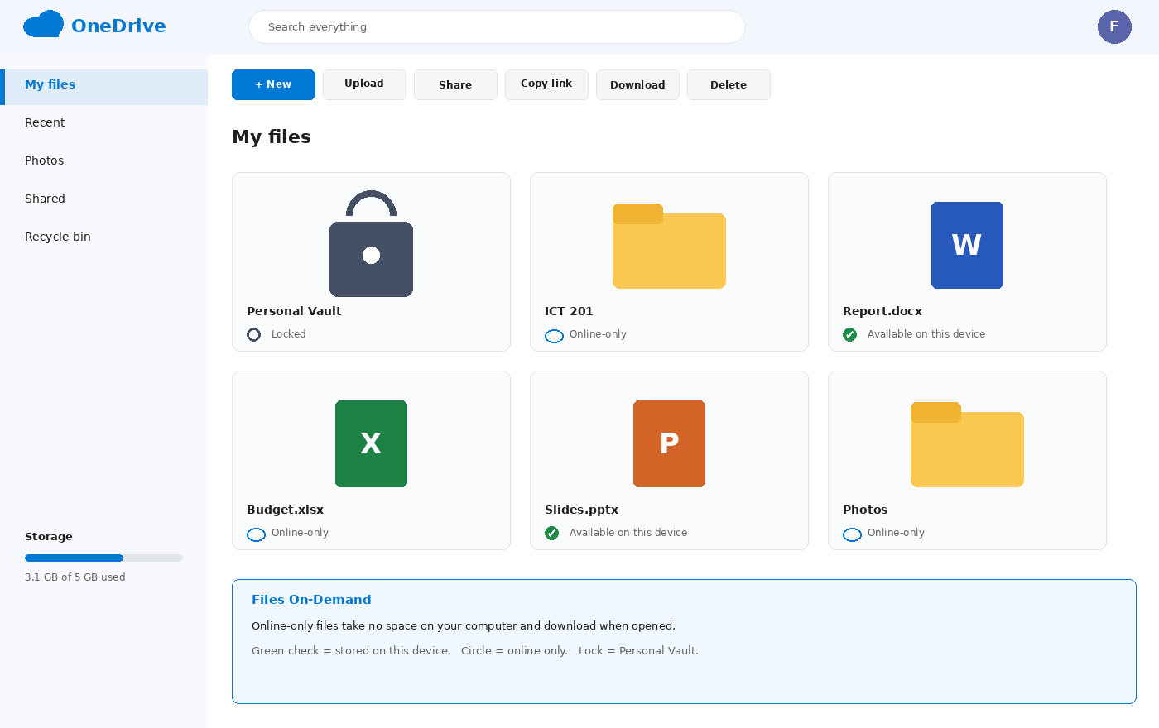
CLOUD STORAGE — ONEDRIVE
Microsoft OneDrive — Files On-Demand
WHAT IT IS
Microsoft’s cloud storage, built into Windows and Microsoft 365. A free personal account starts at about 5 GB.
SHOWN HERE
• My files, Recent, Shared
• Online-only vs on-device files
• Personal Vault (extra protection)
• Toolbar for share and copy link
WHY USEFUL
Word, Excel, and PowerPoint files open and can be co-edited online, and your folders can back up automatically.
Illustrative interface drawn for teaching — exact layout varies by version and institution.
ICT 201 | Week 8 — Online Courses, Virtual Classrooms & Cloud Tools
46

Slide 47
CLOUD STORAGE — ONEDRIVE
OneDrive — Features & Strengths
Microsoft Office Integration
Built into Windows
Open, edit, and co-author Word, Excel, and PowerPoint files in the browser or desktop apps.
Appears in File Explorer and can back up the Desktop, Documents, and Pictures folders automatically.
Files On-Demand
Personal Vault
See all your files without using disk space; online-only files download when you open them.
An extra-protected area that needs additional identity verification to open, for sensitive documents.
Sharing & Link Settings
Recycle Bin & Restore
Share by link or invitation; some link controls, such as expiry or passwords, depend on the plan.
Recover deleted files and restore earlier states, helping recover from mistakes or malware.
ICT 201 | Week 8 — Online Courses, Virtual Classrooms & Cloud Tools
47

Slide 48
CLOUD STORAGE — COMPARISON
Google Drive vs Dropbox vs OneDrive
Aspect
Google Drive
Dropbox
OneDrive
Free storage (typical)
15 GB shared with Gmail and Photos
About 2 GB
About 5 GB
Best integration
Docs, Sheets, Slides, Gmail, Meet
Third-party apps, any ecosystem
Windows and Microsoft 365 apps
Signature feature
Search and real-time Google editing
Simple, reliable sync and file requests
Files On-Demand and Personal Vault
Collaboration
Strongest live co-editing in browser
Sharing with comments; relies on other apps
Co-authoring in Office apps
Works best for
Students and teams using Google tools
Cross-platform users and sharing with outsiders
Windows and Microsoft 365 users
Watch out for
Storage shared across services
Small free space
Best features need Microsoft 365
ICT 201 | Week 8 — Online Courses, Virtual Classrooms & Cloud Tools
48

Slide 49
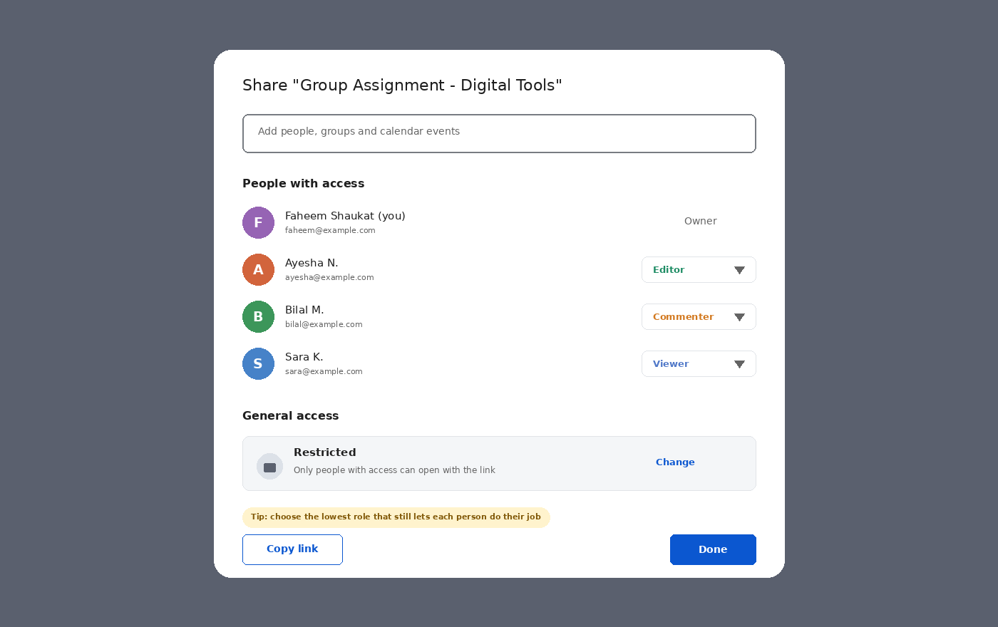
CLOUD STORAGE — SHARING & PERMISSIONS
Sharing Files Safely — Permissions Explained
PEOPLE WITH ACCESS
• Owner — full control
• Editor — can change the file
• Commenter — can only comment
• Viewer — can only read
GENERAL ACCESS
Restricted means only invited people can open the link; “anyone with the link” is convenient but less private.
RULE OF THUMB
Give the lowest role that still lets each person do their job, and review sharing from time to time.
Illustrative interface drawn for teaching — exact layout varies by version and institution.
ICT 201 | Week 8 — Online Courses, Virtual Classrooms & Cloud Tools
49

Slide 50
CLOUD STORAGE — USING IT WISELY
Cloud Best Practices & Security
Use Strong Passwords & 2-Step Verification
Share with Least Privilege
Protect your account with a strong, unique password and a second verification step, because it guards all your files.
Prefer named people over public links, and choose Viewer or Commenter unless editing is needed.
Name & Organize Files
Keep a Backup (3-2-1 idea)
Use clear folder structures and file names with dates or versions so teammates can find things.
Keep more than one copy of important work — for example, cloud plus a second copy elsewhere.
Protect Sensitive Data
Review Access Regularly
Avoid storing passwords or confidential records unprotected; use features like Personal Vault where available.
Remove old collaborators, expire or delete old links, and check which apps have access to your files.
ICT 201 | Week 8 — Online Courses, Virtual Classrooms & Cloud Tools
50

Slide 51
APPLY WHAT YOU LEARNED
10 MIN
Hands-On Activity
TASK 1 — Online Courses
Pick a topic you want to learn. Find one course on TWO different platforms (for example Coursera and Khan Academy) and compare cost, time needed, and certificate. Decide which you would choose and why.
TASK 2 — Interactive Multimedia & Virtual Classrooms
Choose one topic from this semester. In three bullet points, describe one interactive element (poll, quiz, simulation, or video question) you would add to teach it, and one virtual classroom tool you would use.
TASK 3 — Workspace & Cloud (Week 4 catch-up)
In a group of three, create one Google Doc in Drive, share it with the other two as Editors, add one comment and one suggested edit, then change one person to Viewer and check the version history.
ICT 201 | Week 8 — Online Courses, Virtual Classrooms & Cloud Tools
51

Slide 52
KEY TAKEAWAYS
Week 8 and Week 4 Catch-Up in Six Points
1
Coursera and edX bring university-style courses; Udemy is a marketplace of practical skills; Khan Academy offers free mastery-based foundations.
2
Choose courses by provider credibility, syllabus, reviews, recent updates, and real cost — skills and projects matter more than certificates alone.
3
Interactive multimedia turns passive viewing into active learning through in-video questions, simulations, quizzes, and instant feedback.
4
Virtual classrooms combine live video, whiteboards, polls, and breakout rooms; they work best with interaction, recordings, and inclusive practices.
5
Google Docs, Sheets, and Slides let teams write, calculate, and present together in real time, with comments, suggestions, and version history.
6
Google Drive, Dropbox, and OneDrive store and sync files — choose by ecosystem, and protect data with strong passwords, 2-step verification, and careful sharing.

Slide 53
BEFORE YOU LEAVE
Exit Ticket
On a slip of paper (or the LMS form), answer briefly:
1
Name ONE difference between Coursera and Khan Academy, and ONE thing you would check before paying for a Udemy course.
2
Give ONE example of interactive multimedia and explain why it can help learning more than a plain video.
3
Explain the difference between Viewer, Commenter, and Editor access, and say which you would give a classmate who only needs to read your file.
Next session: see the course outline for Week 9 — details to be shared on the LMS.
ICT 201 | Week 8 — Online Courses, Virtual Classrooms & Cloud Tools
53

