Slide 1



BAHRIA UNIVERSITY, ISLAMABAD
WEEK 5
Digital Note-Taking & Organization
Evernote & Microsoft OneNote — A Complete Feature Tutorial
ICT 201 | Applications of ICT | 3-Hour Session | CLO-2 | Fall 2026
Evernote
Microsoft OneNote

Slide 2
AGENDA — 3-HOUR SESSION, TWO BREAKS
180 MIN
Today’s Roadmap
01
Why Digital Note-Taking Matters
10 min
The problem with scattered notes across devices
02
Evernote — Setup, Interface & Notebooks
20 min
Account setup, dashboard tour, notebook management
03
Evernote — Formatting, Lists & Code Blocks
20 min
Text styling, headers, special formatting
04
Evernote — Sketches, Audio, Clipper & Tables
25 min
Visual notes, web clipper, table creation
☕
BREAK 1
15 min
05
Evernote — Organization, Sharing & Security
25 min
Tags, search, sharing, encryption, backup/export
06
OneNote — Introduction & Structure
20 min
The centralization principle, Notebook→Section→Page
07
OneNote — Formatting, Media & Collaboration
25 min
Tags, AI Dictate, rich media, sharing & permissions
☕
BREAK 2
10 min
08
Evernote vs OneNote — Comparison
10 min
Side-by-side feature comparison
09
Hands-On Activity + Key Takeaways
10 min
Guided practice + wrap-up
ICT 201 | Week 5 — Evernote & Microsoft OneNote
2

Slide 3
SETTING THE CONTEXT
The Problem with Scattered Notes
“Your mind is for having ideas, not to remember them.”
The Problem
The Solution
Notes scattered across physical notebooks, PCs, and phones lead to lost information, missed tasks, and reduced performance — academically and professionally.
Digital note-taking apps centralize note creation in a single workspace, accessible across desktop, web, and mobile — always synced, always searchable.
TWO LEADING SOLUTIONS
Today we explore Evernote and Microsoft OneNote — two of the most widely used digital note-taking and organization platforms, each with a distinct approach but the same underlying goal: never lose an idea again.
ICT 201 | Week 5 — Evernote & Microsoft OneNote
3

Slide 4
PART 1: EVERNOTE
Setup, Formatting, Media, Organization & Sharing
A complete feature tutorial with step-by-step guidance

Slide 5
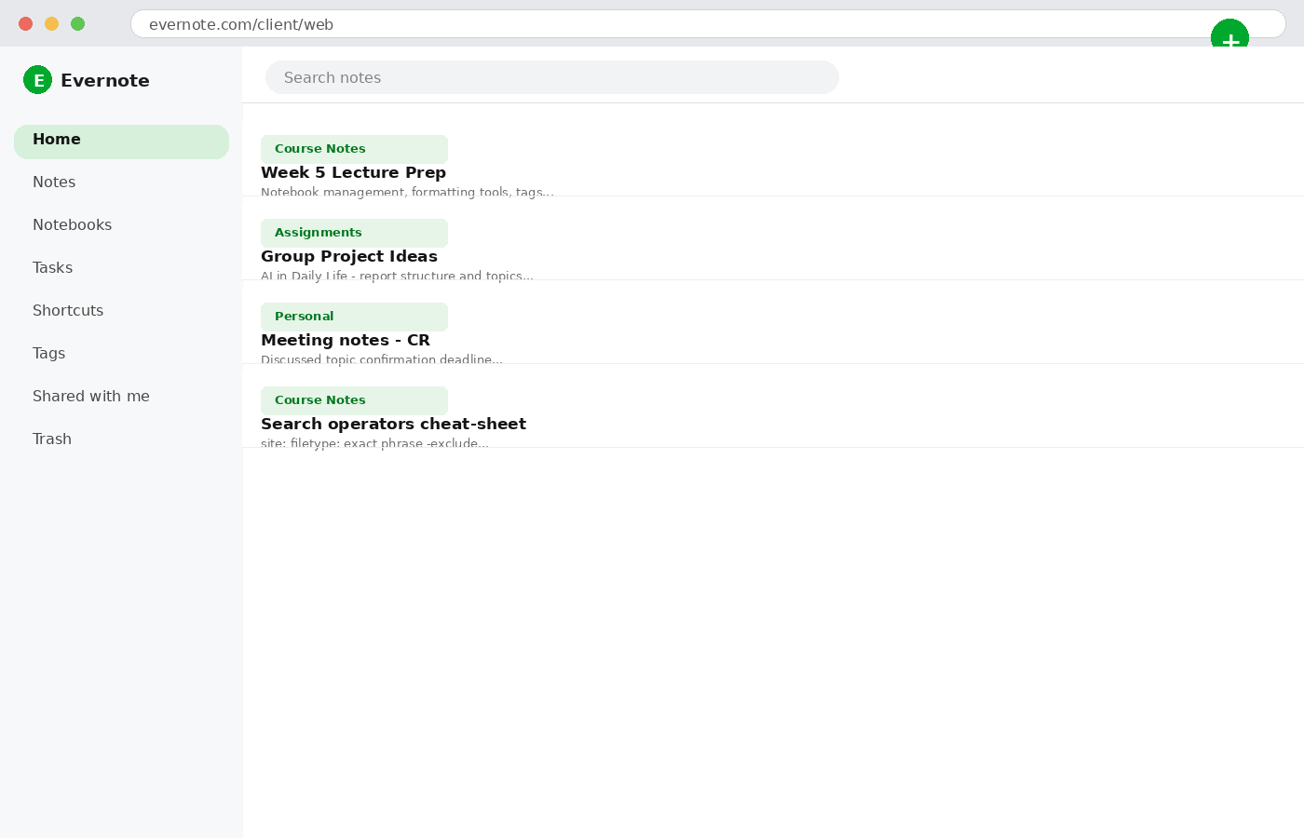
PART 1: EVERNOTE — TUTORIAL STEP 1
Getting Started: Setup & Interface
SETUP STEPS
1. Download
Get the desktop setup file directly from evernote.com for Windows or macOS.
2. Create Account
Sign up or log in using email, Google account, or Apple ID.
3. Sync Access
Same account works across web and desktop versions instantly.
KEY ZONES ON DASHBOARD
Search bar • Home • Notes • Notebooks • Tasks • Shortcuts • Tags • Shared • Trash
ICT 201 | Week 5 — Evernote & Microsoft OneNote
5

Slide 6
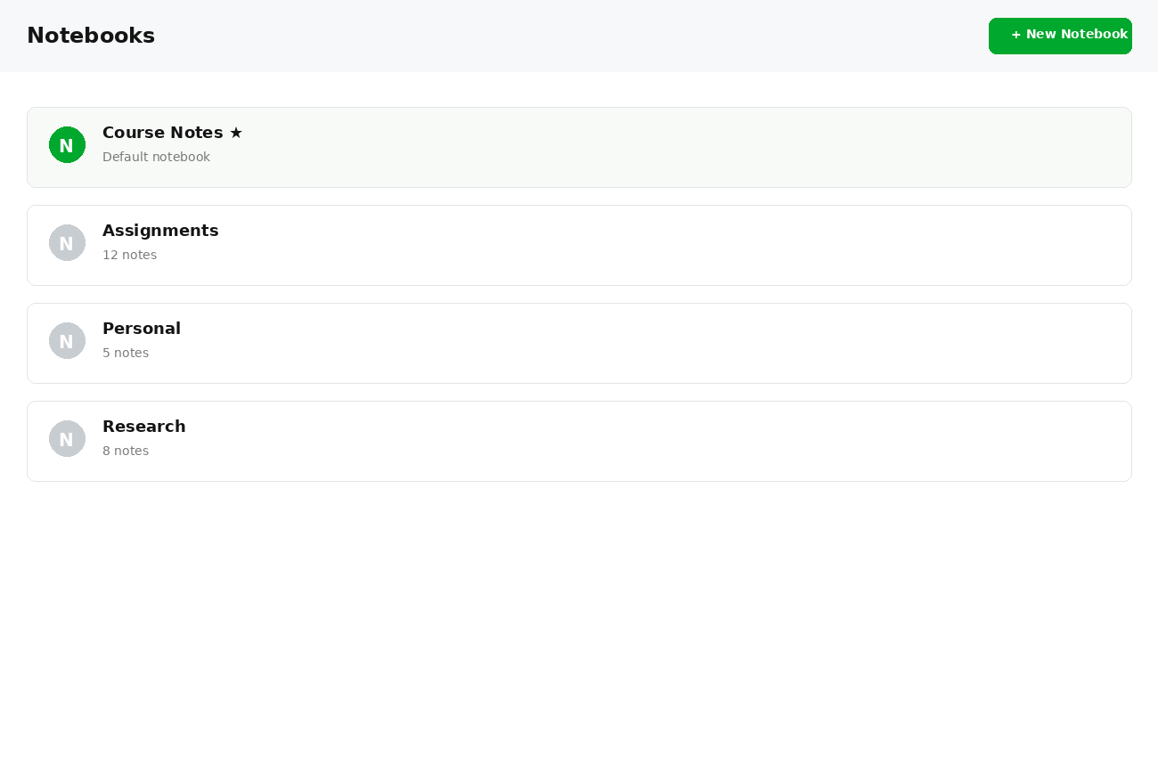
PART 1: EVERNOTE — TUTORIAL STEP 2
Creating Notes & Managing Notebooks
HOW IT WORKS
Create a note
Use the Home dashboard or the green "+" button for instant note creation.
Group into notebooks
Organize related notes together under a custom notebook.
Default notebook (★)
One notebook is marked with a star — new notes auto-save here unless you choose otherwise.
Rename anytime
Custom notebooks can be renamed whenever your organization needs change.
Delete notebooks
Deleting a notebook moves all its notes to Trash — not permanently gone.
ICT 201 | Week 5 — Evernote & Microsoft OneNote
6

Slide 7
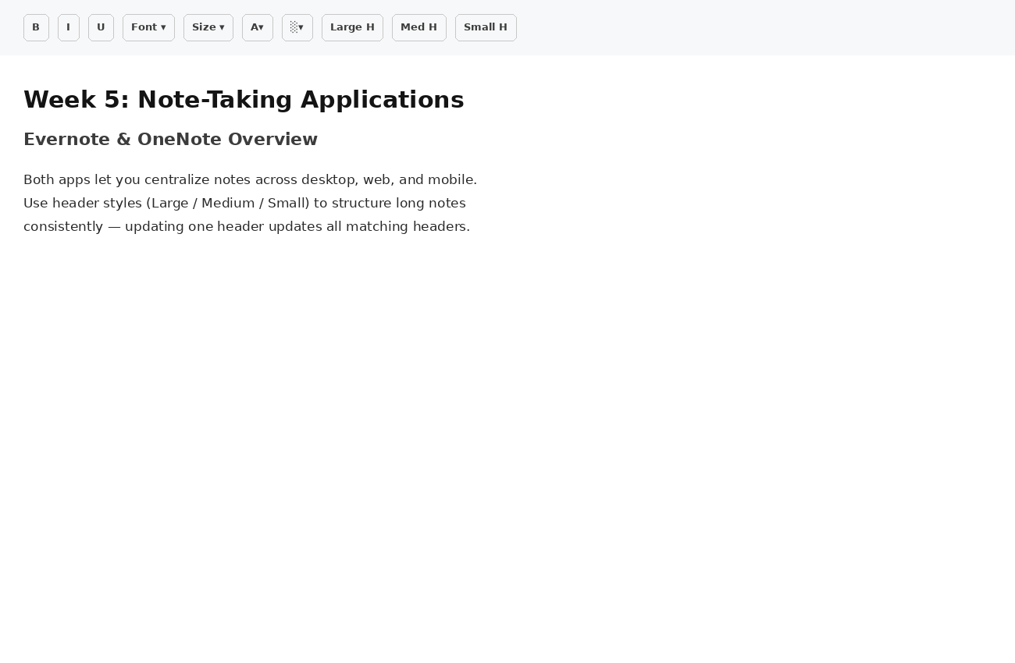
PART 1: EVERNOTE — TUTORIAL STEP 3
Text Formatting & Header Hierarchy
STANDARD STYLING
Font family, size, Bold, Italic, Underline, text color, and background highlight color — all customizable per selection.
HEADER HIERARCHY
Apply Large, Medium, or Small header styles to structure long notes. Updating one header style automatically updates ALL matching headers across the note — with an option to reset to default.
WHY THIS MATTERS
Consistent header styles turn a wall of text into a scannable, navigable document — the same principle used in this very lecture deck.
ICT 201 | Week 5 — Evernote & Microsoft OneNote
7

Slide 8
PART 1: EVERNOTE — TUTORIAL STEP 4
Advanced Formatting, Lists & Alignment
Special Formatting
Code Blocks
Strikethrough, superscript, and subscript (great for equations) — or simplify/remove all formatting to convert back to plain text.
Insert dedicated code blocks for programming snippets (e.g. HTML) that disable spellcheck/formatting while preserving indentation.
List Types
Multi-Level Sub-Lists
Create bulleted lists, numbered lists, or interactive checklists for tasks.
Press Tab within a bulleted list to nest it as a sub-list — multiple levels deep.
Alignment
Indentation
Align text Left, Center, or Right to match your note’s visual style.
Adjust paragraph indentation levels for clearer visual grouping.
ICT 201 | Week 5 — Evernote & Microsoft OneNote
8

Slide 9
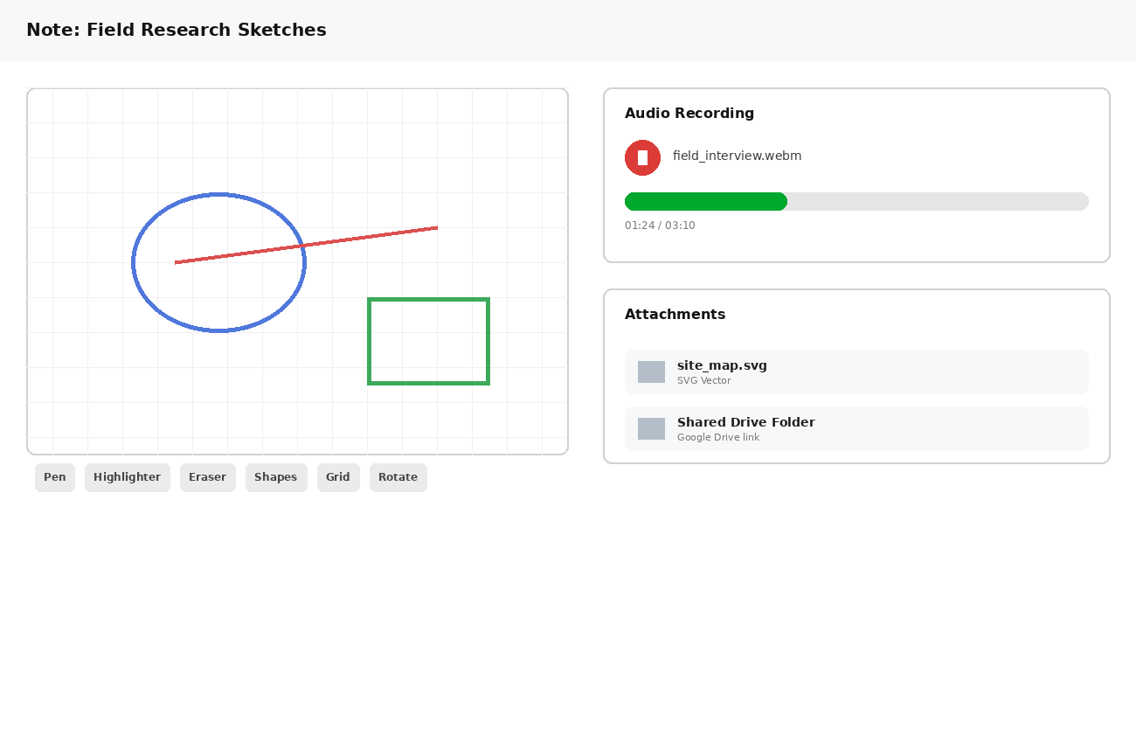
PART 1: EVERNOTE — TUTORIAL STEP 5
Visual Sketches, Audio & Attachments
WHAT YOU CAN DO
Sketch
Pen, highlighter, eraser, shape snapping, grids, and canvas rotation.
Record audio
Live audio saved as .webm with full playback controls.
Attach files
Embed SVGs and other files directly into the note.
Google Drive links
Insert live Drive file links without leaving Evernote.
ICT 201 | Week 5 — Evernote & Microsoft OneNote
9

Slide 10
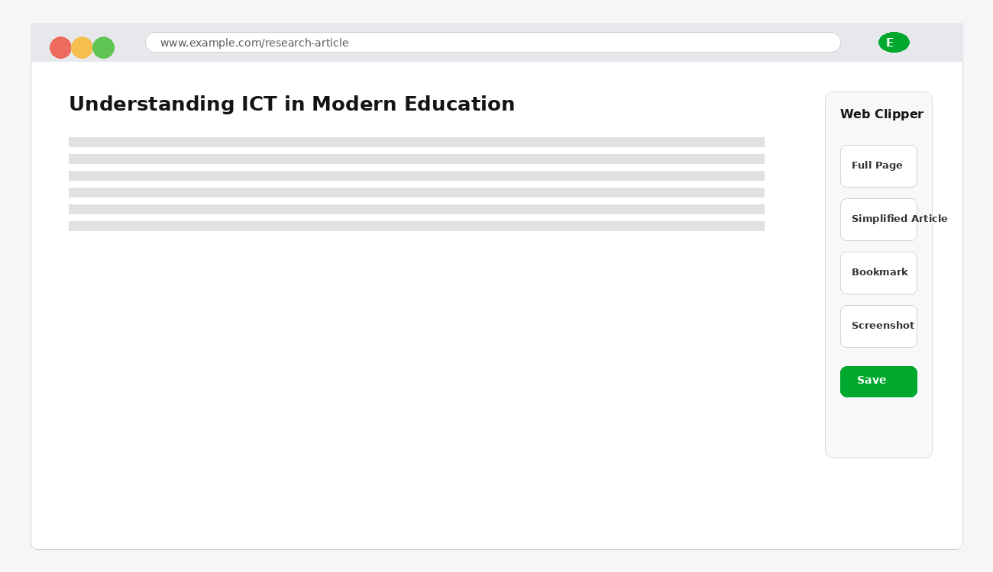
PART 1: EVERNOTE — TUTORIAL STEP 6
Web Clipper Integration
INSTALLATION
Install the Evernote Web Clipper browser extension on Chrome or Chromium-based browsers.
CLIPPING MODES
• Full Page:
Captures the entire webpage as-is.
• Simplified Article:
Clean, distraction-free reading view.
• Bookmark:
Saves just the link and preview.
• Screenshot:
Full-page visual capture.
ICT 201 | Week 5 — Evernote & Microsoft OneNote
10

Slide 11
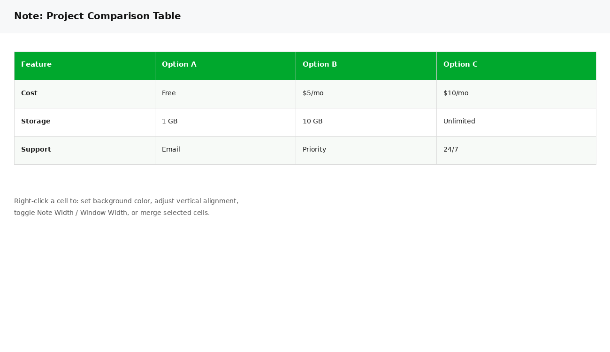
PART 1: EVERNOTE — TUTORIAL STEP 7
Table Creation & Cell Properties
TABLE BASICS
Insert tables, drag borders to resize cells, and insert or delete rows/columns as needed.
CELL CUSTOMIZATION
✓ Set individual cell background colors
✓ Adjust vertical alignment (Top, Center, Bottom)
✓ Toggle table width: Note Width vs. Window Width
✓ Merge or unmerge selected cells
ICT 201 | Week 5 — Evernote & Microsoft OneNote
11

Slide 12
☕
BREAK 1
15 Minutes
Back at it: Evernote organization, sharing & security — then OneNote

Slide 13
PART 1: EVERNOTE — TUTORIAL STEP 8
Structuring & Organizing Notes
Section Dividers
Duplicate Notes
Insert horizontal divider lines to split a single note into distinct visual sections — great for long lecture notes.
Duplicate a note within the same notebook to create a working copy without affecting the original.
Copy Across Notebooks
Move Between Stacks
Copy a note into a different notebook while keeping the original in place.
Reorganize notes by moving them between notebook stacks as your structure evolves.
Merge Notes
Result: Cleaner Notebooks
Select multiple notes and merge them into a single consolidated note with automatic subheaders.
These tools let you restructure without starting over — organization evolves as your content grows.
ICT 201 | Week 5 — Evernote & Microsoft OneNote
13

Slide 14
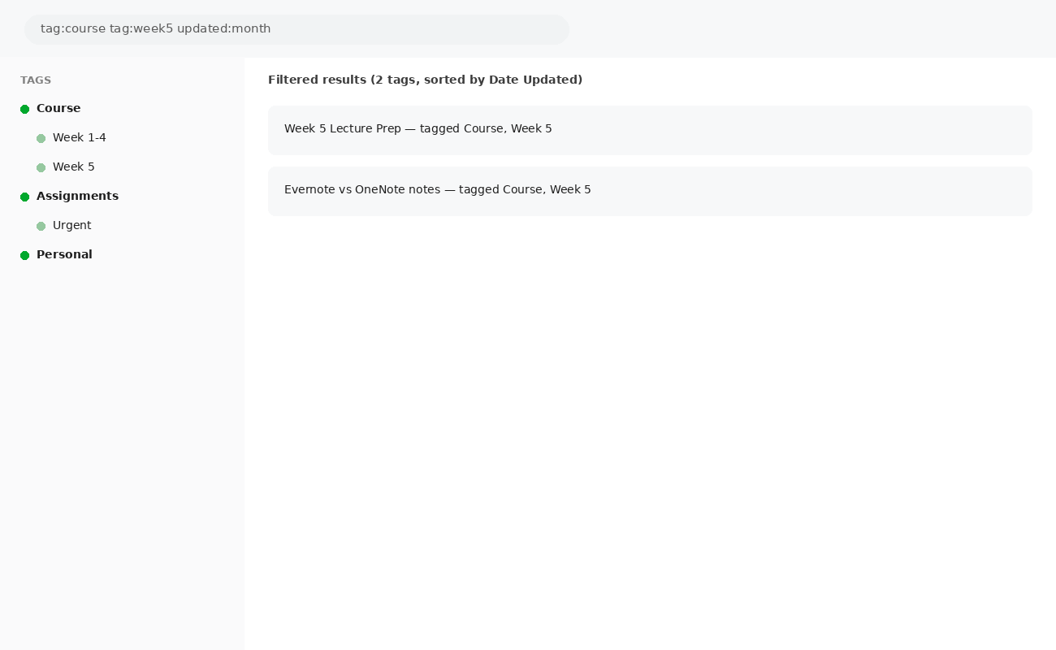
PART 1: EVERNOTE — TUTORIAL STEP 9
Tags, Filters & Content Search
TAG HIERARCHY
Create, edit, rename, and nest sub-tags under primary tags to categorize content in a structured hierarchy.
FILTER & SEARCH
• Filter notes using single or multiple tags
• Sort by date updated, date created, or title
• Run global keyword searches across all notes
• Search within a specific note using Ctrl+F
ICT 201 | Week 5 — Evernote & Microsoft OneNote
14

Slide 15
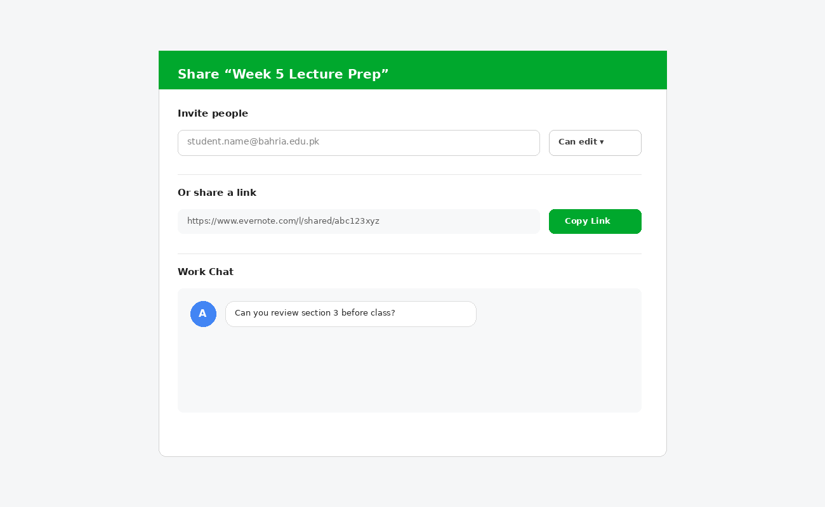
PART 1: EVERNOTE — TUTORIAL STEP 10
Note Sharing & Collaboration
SHARING OPTIONS
Shareable links
Generate public, view-only links for anyone to see.
Email invitations
Invite specific people with permissions: Can view or Can edit.
Co-editing
Multiple users collaborate on the same note, with single-user editing locks while changes sync.
Work Chat
Communicate directly with collaborators inside Evernote — no need to switch apps.
ICT 201 | Week 5 — Evernote & Microsoft OneNote
15

Slide 16
PART 1: EVERNOTE — TUTORIAL STEP 11
Encryption, Metadata & Productivity Tools
Text Encryption
Note Metadata
Protect confidential text selections with custom passphrases; content can be temporarily revealed or permanently decrypted.
View/modify title, creation date, author name, and related web URLs for any note.
Internal Links
Scratch Pad
Generate internal App/Web links to cross-reference other notes.
Use the homepage Scratch Pad for quick temporary notes — convert to a permanent note with one click.
Task Checklists
Shortcuts Sidebar
Create dedicated task checklists to track to-dos alongside your notes.
Pin frequently used notes or tags to the Shortcuts sidebar for instant access.
ICT 201 | Week 5 — Evernote & Microsoft OneNote
16

Slide 17
PART 1: EVERNOTE — TUTORIAL STEP 12 (FINAL)
Preferences, Trash & Backup Export
Light/Dark Mode
Auto-Import Folders
Toggle appearance mode and set startup preferences to match your workflow.
Connect local folders so files placed there are automatically imported as notes.
Trash Management
Export as .enex/PDF/HTML
Review deleted notes and permanently empty the Trash when ready.
Backup and export entire notebooks in Evernote’s native format, PDF, or HTML.
Import Options
Why It Matters
Import plain text files or .enex backups directly into desktop Evernote.
These tools ensure your notes are portable, backed up, and never locked into one platform.
ICT 201 | Week 5 — Evernote & Microsoft OneNote
17

Slide 18
PART 2: MICROSOFT ONENOTE
Structure, Formatting, Media & Collaboration
Microsoft’s digital notebook for capturing and organizing ideas

Slide 19
PART 2: ONENOTE — TUTORIAL STEP 1
Introduction: Solving Scattered Information
“Your mind is for having ideas, not to remember them.”
The Problem
The Solution
Unorganized notes across physical notebooks, PCs, and mobile devices lead to lost information, missed tasks, and reduced professional performance.
Microsoft OneNote centralizes note creation in a single digital workspace, accessible across desktop, web, and mobile devices.
SAME GOAL, DIFFERENT ECOSYSTEM
While Evernote is platform-independent, OneNote is deeply tied to the Microsoft 365 ecosystem — useful to know when recommending a tool for a specific workplace or institution.
ICT 201 | Week 5 — Evernote & Microsoft OneNote
19

Slide 20
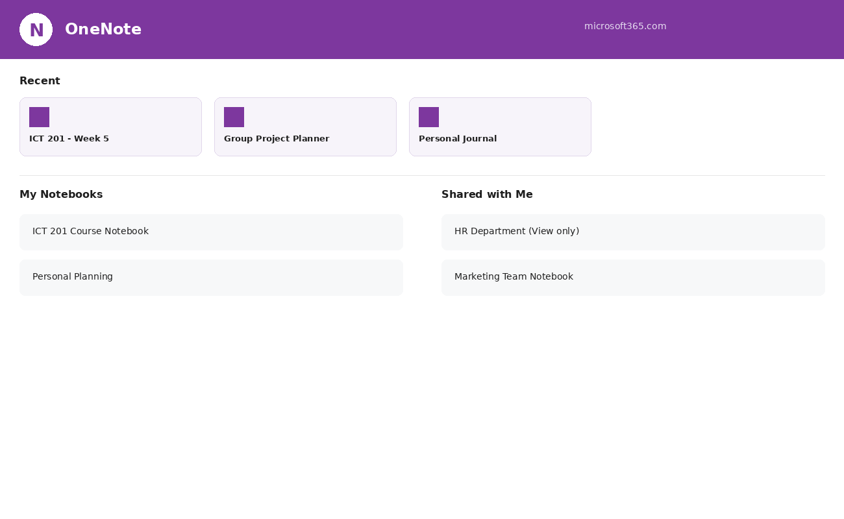
PART 2: ONENOTE — TUTORIAL STEP 2
OneNote Dashboard & File Navigation
ACCESSING ONENOTE
Log into microsoft.com and select OneNote from the Microsoft 365 App Launcher.
Recent & Pinned
Access recently created files or pin important notebooks to keep them always accessible.
My Notebooks
Your personal notebooks, private by default.
Shared with Me
Notebooks shared by internal colleagues or external members, kept visually separate.
ICT 201 | Week 5 — Evernote & Microsoft OneNote
20

Slide 21
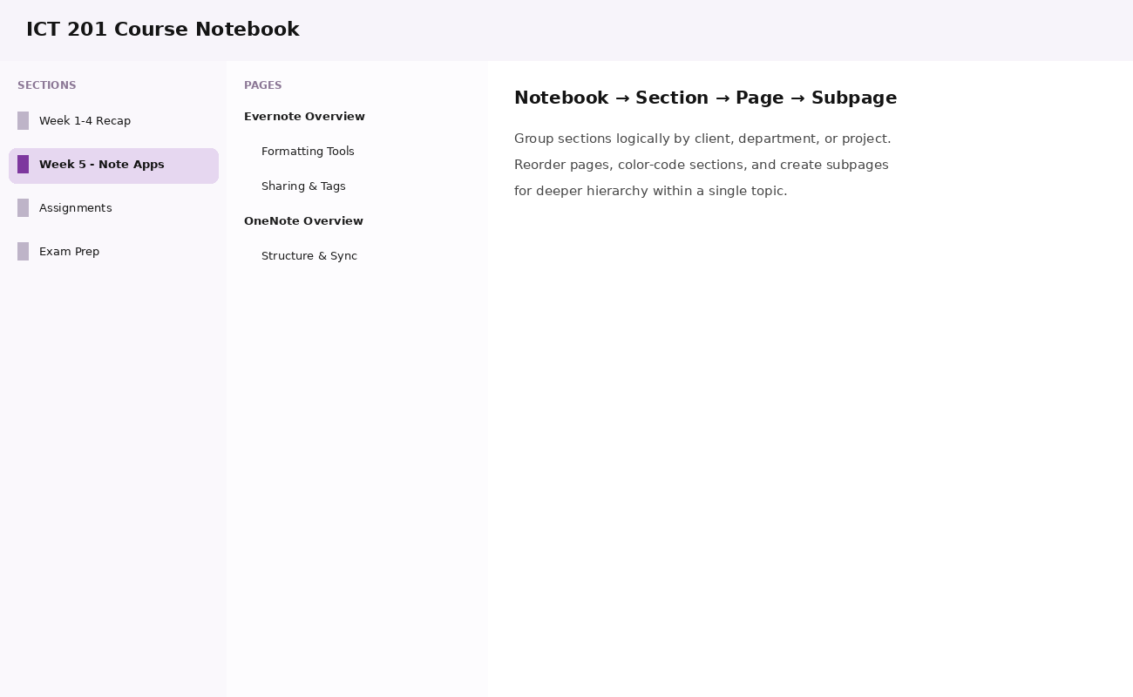
PART 2: ONENOTE — TUTORIAL STEP 3
Structure & Organization: Notebooks, Sections, Pages
THE HIERARCHY
Notebook → Sections → Pages → Subpages
Section Grouping
Group information logically by client, department (e.g. Sales, Marketing), or specific project.
Page Customization
Reorder pages, customize section colors, create subpages.
Version History
View past edits via Show Versions — nothing is ever truly lost.
ICT 201 | Week 5 — Evernote & Microsoft OneNote
21

Slide 22
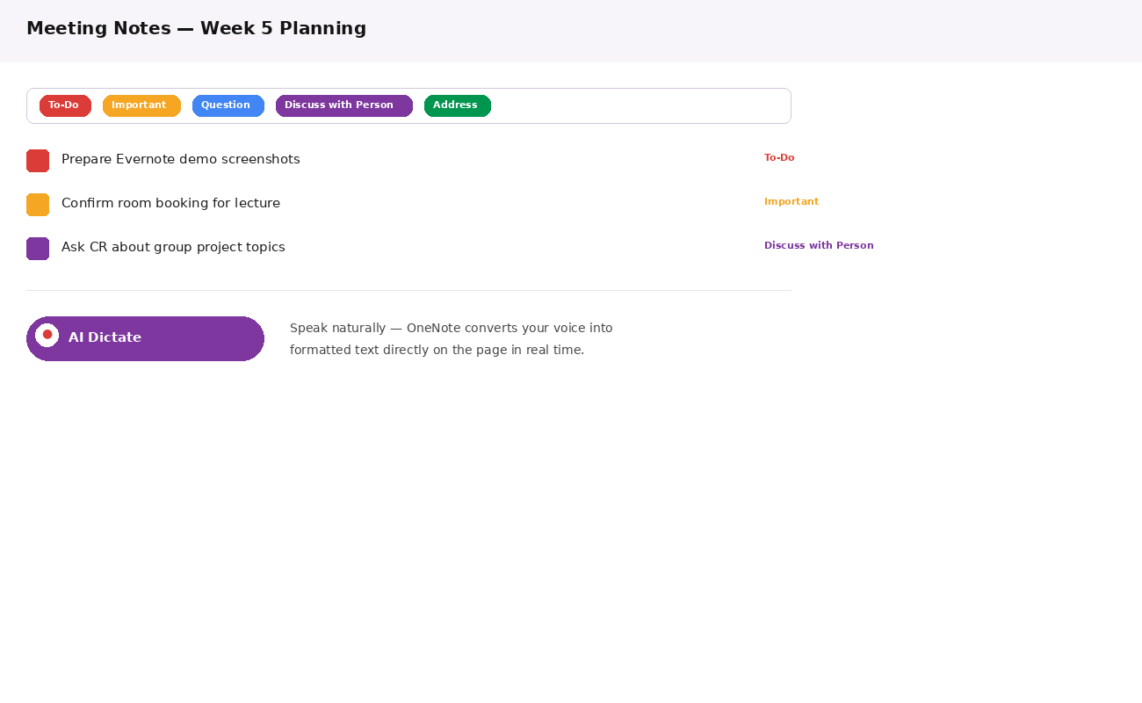
PART 2: ONENOTE — TUTORIAL STEP 4
Formatting Tools, Tags & AI Voice Dictation
CATEGORIZATION WITH TAGS
Highlight important points using tags like To-Do, Address, Critical, Question, or "Discuss with Person."
STANDARDIZED TAGGING
Establishing organization-wide tagging standards improves clarity in team communication.
AI DICTATE
Automatically convert spoken voice into text within notes using AI-powered dictation.
TEXT MAINTENANCE
Built-in spelling check and auto-correct ensure note accuracy.
ICT 201 | Week 5 — Evernote & Microsoft OneNote
22

Slide 23
PART 2: ONENOTE — TUTORIAL STEP 5
Rich Media & Information Insertion
Tables
File Attachments
Insert tables for meeting notes or product details — same concept as Evernote, different engine.
Attach external files that appear as downloadable link icons directly on the page.
Images & Web Links
Audio Recording
Embed images directly on pages or add clickable web links for reference.
Record and attach audio files to explain notes in your own voice.
Math & Symbols
Calendar & Add-ins
Insert math calculations, symbols, and emojis directly into notes.
Insert Office Add-ins, stickers, and direct Microsoft Calendar meeting details.
ICT 201 | Week 5 — Evernote & Microsoft OneNote
23

Slide 24
PART 2: ONENOTE — TUTORIAL STEP 6
Freehand Drawing, View Modes & Version Tracking
Draw Tools
Immersive Reader
Sketch diagrams, handwritten calculations, or project designs directly on the page.
Have text read aloud — useful for reviewing long notes hands-free.
Zoom & Page Colors
Rulers & Gridlines
Adjust zoom levels and change page background colors to reduce eye strain.
Enable physical file-like rulers/gridlines for precise diagram alignment.
Show Author
Version History
Identify who created specific content on a shared page.
Review or revert to earlier page versions — nothing is permanently lost.
ICT 201 | Week 5 — Evernote & Microsoft OneNote
24

Slide 25
☕
BREAK 2
10 Minutes
Back at it: OneNote sharing & permissions — then the final comparison

Slide 26
PART 2: ONENOTE — TUTORIAL STEP 7
Sharing Capabilities & Collaboration
Targeted Sharing
Share Entire Notebook
Share notebooks with individual employees, entire departments (e.g. HR), or external freelancers via email.
Grant full co-authoring access — live updates by any contributor are visible to everyone.
Copy Link
Copy Notebook
Share a standalone copy of the notebook so future additions to your master notebook remain private.
Duplicate the notebook entirely for someone to build on independently.
ICT 201 | Week 5 — Evernote & Microsoft OneNote
26

Slide 27
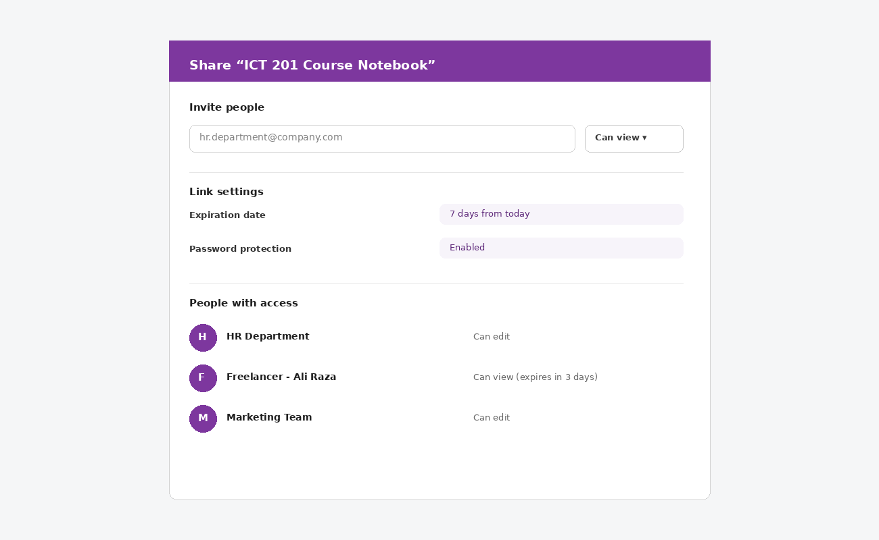
PART 2: ONENOTE — TUTORIAL STEP 8 (FINAL)
Permissions & Access Control
PERMISSION LEVELS
View or Edit rights
Assign either permission level when sending a sharing invitation.
Security features
Set expiration dates and password protection on shared notebook links.
Manage access
Track sharing history, modify permissions on the fly, or revoke access when a project ends (e.g. for external freelancers).
ICT 201 | Week 5 — Evernote & Microsoft OneNote
27

Slide 28
SIDE-BY-SIDE COMPARISON
Evernote vs. OneNote — Feature Comparison
Facility
Evernote
OneNote
Organization model
Notebooks + Tags (flat/multi-tag)
Notebook → Section → Page (hierarchy)
Ecosystem
Platform-independent
Deep Microsoft 365 integration
Web capture
Web Clipper browser extension
Web clipping via browser extension
Voice input
Audio recording only
AI Dictate (voice-to-text)
Drawing/Sketching
Built-in sketch canvas
Full freehand Draw tools
Security
Text encryption (passphrase)
Password-protected shared links
Best fit
Personal & cross-platform users
Microsoft 365 organizations & teams
ICT 201 | Week 5 — Evernote & Microsoft OneNote
28

Slide 29
APPLY WHAT YOU LEARNED
10 MIN
Hands-On Activity
TASK 1 — Evernote
Create a free Evernote account. Make one note titled "ICT 201 Week 5," apply a Large header, add a bulleted list of 3 note-taking apps you’ve used before, and tag the note "Week5."
TASK 2 — OneNote
In OneNote, create a new Section called "Week 5" inside your personal notebook, add a Page titled "Comparison Notes," and use the To-Do tag on at least 2 lines summarizing what you learned today.
ICT 201 | Week 5 — Evernote & Microsoft OneNote
29

Slide 30
KEY TAKEAWAYS
Week 5 in Six Points
1
Digital note-taking centralizes information across devices — solving the "scattered notes" problem for good.
2
Evernote organizes with Notebooks + multi-tag Labels; OneNote organizes with a strict Notebook → Section → Page hierarchy.
3
Both apps support rich media: sketches, audio, tables, and file attachments — notes aren’t just text anymore.
4
OneNote’s AI Dictate and deep Microsoft 365 integration make it a natural fit inside Microsoft-based organizations.
5
Evernote’s Web Clipper and cross-platform flexibility make it a strong personal, platform-independent choice.
6
Both offer granular sharing controls (view/edit permissions, expiration, password protection) — essential ICT etiquette for collaboration.

Slide 31
BEFORE YOU LEAVE
Exit Ticket
On a slip of paper (or the LMS form), answer briefly:
1
Name ONE feature Evernote has that OneNote does not (or vice versa).
2
Explain, in one sentence, why organizing notes with tags differs from organizing with a strict folder hierarchy.
3
Which app would you personally choose for your own studies — Evernote or OneNote — and why?
Next session: Video Conferencing (Meet, Teams, Zoom) & Social Media Applications
ICT 201 | Week 5 — Evernote & Microsoft OneNote
31

