Slide 1

⏱ 2:30 PM
BAHRIA UNIVERSITY
GEO 321 / GEL 321
Computing with MATLAB
Week 4 & 5 — Output Formatting, 2-D Plotting & Logical Constructs
CLO-2: Control structures & logical/relational operators • CLO-3: 2-D/3-D plotting & visualization
Dr. Faheem Shaukat
Visiting Faculty Member — Department of Software Engineering
From Decisions to Pictures
Format output like an engineer, plot like a geophysicist, filter like a scientist

Slide 2
SESSION ROADMAP
⏱ 2:30–3:30 PM
Today's 1-Hour Plan — Fast, Full Coverage
2:33 – 2:46
Part A: Output formatting — format, disp, fprintf, sprintf
13 min
2:46 – 3:08
Part B: 2-D plotting — plot, styling, annotations, hold on, log scale, specialized plots, subplot
22 min
3:08 – 3:23
Part C: Logical constructs — relational/logical ops, masking, find/any/all/isempty
15 min
3:23 – 3:29
Part D: Geophysics applications — seismic, gravity, well-log, outlier cleanup
6 min
3:29 – 3:30
Capstone lab + wrap-up
1 min
This session absorbs the postponed Week 4 topic (formatting & plotting) together with Week 5's planned topic (logical constructs) — the pace is brisk, so the full code on every slide is also your take-home reference.
Bahria University • GEO 321 / GEL 321 • Computing with MATLAB
Week 4 & 5 | 2
Notes:
Fast-paced single session covering: output formatting (format/disp/fprintf/sprintf), full 2-D plotting toolkit (styling, annotations, overlays, log scales, specialized plot types, subplots), logical constructs (relational/logical operators, masking, helper functions), and geophysics applications tying it all together.

Slide 3
PART A — OUTPUT FORMATTING
⏱ 2:33 PM
The format Command: Controlling Display Precision
No semicolon at line end -> MATLAB prints the result to the Command Window
format changes only the DISPLAY — not the stored 64-bit precision
Stays in effect for the rest of the session, until changed again
Command
Effect
pi displayed as
format short
Default — 4 decimal places
3.1416
format long
Fixed-point, 15 decimals
3.141592653589793
format short e
Scientific notation
3.1416e+00
format rat
Rational fraction approx.
355/113
format +
Sign only (+, -, or blank)
+
Bahria University • GEO 321 / GEL 321 • Computing with MATLAB
Week 4 & 5 | 3
Notes:
Omitting the semicolon prints the result. format controls only how numbers are SHOWN in the Command Window, never their actual stored precision. format short (the default) shows 4 decimals; format long shows 15; format short e uses scientific notation; format rat approximates as a fraction; format + shows only the sign, useful for scanning large matrices for sign patterns.

Slide 4
PART A — OUTPUT FORMATTING
⏱ 2:37 PM
disp, fprintf & sprintf — Three Ways to Show Text
disp(x) — prints a variable/string cleanly, no name, no '='
fprintf(...) — writes FORMATTED text + numbers to the screen
sprintf(...) — SAME formatting rules as fprintf, but SAVES the result into a string variable instead of printing it
Specifier
Meaning
%f
Floating-point decimal
%d or %i
Integer value
%e
Exponential notation
%g
Compact: shorter of %f / %e
\n
Newline (next line)
Bahria University • GEO 321 / GEL 321 • Computing with MATLAB
Week 4 & 5 | 4
Notes:
disp() is the simplest display — just the value, no variable-name header. fprintf() embeds numbers inside a formatted text string using conversion specifiers like %f (decimal), %d (integer), %e (exponential), %g (compact). sprintf() uses identical specifiers but returns the formatted text as a string variable instead of printing it — useful for building labels or filenames.

Slide 5
PART A — OUTPUT FORMATTING
⏱ 2:41 PM
fprintf Width & Precision Modifiers
%.2f — restrict to 2 decimal places
%+.2f — force a leading + sign on positives
%12.2f — total field width 12, right-aligned with spaces
%012.2f — same width, but pad with ZEROS instead of spaces
a = pi * 50; % a = 157.0796...
fprintf('Default: %f\n', a);
% 157.079633
fprintf('2 dp: %.2f\n', a);
% 157.08
fprintf('Signed: %+.2f\n', a);
% +157.08
fprintf('Width 12: %12.2f\n', a);
% ' 157.08' (6 leading spaces)
fprintf('Zero-pad: %012.2f\n', a);
% '000000157.08'
Bahria University • GEO 321 / GEL 321 • Computing with MATLAB
Week 4 & 5 | 5
Notes:
Width/precision modifiers give publication-quality formatted output. %.2f rounds to 2 decimals. A leading + forces the sign to show on positive numbers. The number before the decimal in %12.2f sets the TOTAL field width (12 characters), right-padding with spaces to align columns in a report; a leading 0 (%012.2f) pads with zeros instead of spaces. These are verified outputs — run them yourself to confirm.

Slide 6
PART B — 2-D PLOTTING
⏱ 2:46 PM
plot(x, y): The Core 2-D Plotting Command
plot(x, y) needs two vectors of the EXACT SAME length
Use a fine step (0:0.1:10) or linspace(a,b,n) for a smooth curve
CRITICAL: use element-wise operators .^ .* ./ when computing y from x — plain ^ * / will error or multiply matrices instead
x = 0:0.1:10; % fine step -> smooth curve
y = x.^2 - 10.*x + 15; % DOT operators required!
plot(x, y);
% Without dots: x^2 tries MATRIX power
% on a 1x101 vector -> ERROR
Bahria University • GEO 321 / GEL 321 • Computing with MATLAB
Week 4 & 5 | 6
Notes:
plot(x,y) is the workhorse 2-D plotting command; x and y must have identical length. A fine colon step or linspace gives a smooth-looking curve. The single most common beginner error: writing x^2 instead of x.^2 when x is a vector — without the dot, MATLAB attempts true matrix exponentiation (which requires a square matrix) and throws a dimension error, instead of squaring each element.

Slide 7
PART B — 2-D PLOTTING
⏱ 2:50 PM
Line Specifiers: Color + Marker + Style in One String
plot(x, y, 'line_specifier') — third argument, single-quoted string
Combine a color + a marker + a line style in any order
Example: 'r--*' = red, dashed line, asterisk markers
Color
Marker
Line Style
'r' red
'o' circle
'-' solid
'g' green
'*' asterisk
'--' dashed
'b' blue
'+' plus
':' dotted
'k' black
's' square
'-.' dash-dot
'y' yellow
'^' triangle
Bahria University • GEO 321 / GEL 321 • Computing with MATLAB
Week 4 & 5 | 7
Notes:
The LineSpec string packs color, marker shape, and line style into one compact argument, in any order. 'r--*' plots in red with a dashed line and an asterisk at every data point. This table is worth memorizing — it is used constantly from here on to make multi-curve geophysics plots visually distinguishable.

Slide 8
PART B — 2-D PLOTTING
⏱ 2:54 PM
Annotations: title, xlabel, ylabel, grid
An unlabeled plot is an INCOMPLETE answer — always annotate
title('text'), xlabel('text'), ylabel('text') — always include units
grid on / grid off — toggles background gridlines
Best-practice script header: clc; clear; close all;
clc; clear; close all; % clean start, every script
x = 0:0.1:6; y = sin(x);
plot(x, y, 'b-');
title('Sine Wave Signal');
xlabel('Time (s)'); ylabel('Amplitude');
grid on;
Bahria University • GEO 321 / GEL 321 • Computing with MATLAB
Week 4 & 5 | 8
Notes:
Every figure needs a title and labeled axes WITH UNITS — this is non-negotiable in scientific reporting. grid on adds gridlines that make reading values off the plot much easier. Starting every script with clc; clear; close all; clears the Command Window, wipes old variables, and closes stray figure windows, so each run starts clean.

Slide 9
PART B — 2-D PLOTTING
⏱ 2:58 PM
Overlaying Curves: hold on and legend Placement
hold on — keeps the current plot while new plot() calls add on top
plot(x,y1,x,y2) — plots multiple series in ONE call (auto-colored)
legend('S1','S2') — labels each curve
legend(...,'Location','northwest') or 'northoutside' + 'Orientation','horizontal' — controls placement
x = 0:0.1:2*pi;
plot(x, sin(x)); hold on;
plot(x, cos(x));
legend('Sin','Cos','Location','northwest');
hold off;
% Outside, horizontal legend:
legend('Sin','Cos','Location','northoutside', ...
'Orientation','horizontal');
Bahria University • GEO 321 / GEL 321 • Computing with MATLAB
Week 4 & 5 | 9
Notes:
Without hold on, each new plot() call ERASES the previous curve — the most common plotting mistake. hold on fixes this. Alternatively, plot(x,y1,x,y2) draws both in one call with automatic distinct colors. legend() must list labels in plotting order, and its 'Location'/'Orientation' name-value pairs give full control over where the legend sits.

Slide 10
PART B — 2-D PLOTTING
⏱ 3:01 PM
Logarithmic Axis Scaling
plot(x,y) — linear scale on both axes
semilogx(x,y) — log scale on X, linear on Y
semilogy(x,y) — linear on X, log scale on Y
loglog(x,y) — log scale on BOTH axes
Geophysics use: frequency spectra, resistivity sounding curves — data spanning many orders of magnitude
freq = logspace(0, 4, 50); % 1 Hz to 10,000 Hz
amp = 1 ./ (1 + (freq/500).^2);
loglog(freq, amp);
xlabel('Frequency (Hz)');
ylabel('Amplitude');
title('Frequency Spectrum'); grid on;
Bahria University • GEO 321 / GEL 321 • Computing with MATLAB
Week 4 & 5 | 10
Notes:
Linear axes compress small values near the origin when data spans several orders of magnitude — e.g. a frequency spectrum from 1 Hz to 10,000 Hz. semilogx/semilogy put ONE axis on a log scale; loglog puts BOTH on a log scale. This is standard for frequency spectra and electrical resistivity sounding curves in geophysics.

Slide 11
PART B — 2-D PLOTTING
⏱ 3:04 PM
Specialized 2-D Plots
Function
Draws
Typical Use
stem(x,y)
Discrete vertical lines + markers
Digitally sampled signals
stairs(x,y)
Step-shaped (blocky) lines
Stratigraphic / interval data
bar(x,y) / barh(x,y)
Vertical / horizontal bar chart
Category comparisons
pie(x)
Percentage-share pie chart
Composition breakdowns
polar(theta,rho)
Radial distance vs. angle (radians)
Directional/azimuthal data
Bahria University • GEO 321 / GEL 321 • Computing with MATLAB
Week 4 & 5 | 11
Notes:
MATLAB has over 20 specialized 2-D plot types. stem() suits discretely sampled digital signals. stairs() draws blocky step profiles, ideal for stratigraphic or interval logs. bar()/barh() build category comparisons. pie() shows percentage composition. polar() plots radial distance against an angle in radians — useful for azimuthal survey data.

Slide 12
PART B — 2-D PLOTTING
⏱ 3:06 PM
subplot() and Axis Control
subplot(rows, cols, index) — several small plots in one figure window
xlim([a b]) / ylim([a b]) — control the visible axis range
axis equal — equal scaling on both axes (important for maps)
text(x, y, 'label') — annotate a specific point on the plot
subplot(2,1,1);
plot(t, seismic1); title('Trace 1'); grid on;
subplot(2,1,2);
plot(t, seismic2); title('Trace 2'); grid on;
xlabel('Time (s)');
xlim([0 1]); % zoom into first second
Bahria University • GEO 321 / GEL 321 • Computing with MATLAB
Week 4 & 5 | 12
Notes:
subplot(rows, cols, index) arranges several related plots in one figure window, read left-to-right then top-to-bottom — useful for comparing multiple seismic traces or well logs side by side. xlim/ylim zoom into a specific range without altering the underlying data.

Slide 13
PART C — LOGICAL CONSTRUCTS
⏱ 3:08 PM
Relational Operators: Yes/No Questions on Data
Comparisons return a LOGICAL array (1s and 0s), never numeric
Common pitfall: = is ASSIGNMENT; == is EQUALITY TESTING — never confuse them
Op
Meaning
A=[1 10;5 12]
<
less than
A<10 -> [1 0;1 0]
<=
less or equal
A<=10 -> [1 1;1 0]
>
greater than
A>5 -> [0 1;0 1]
>=
greater or equal
A>=5 -> [0 1;1 1]
==
equal to
A==10 -> [0 1;0 0]
~=
not equal to
A~=10 -> [1 0;1 1]
Bahria University • GEO 321 / GEL 321 • Computing with MATLAB
Week 4 & 5 | 13
Notes:
Every relational operator, applied to a vector or matrix, checks each element independently and returns a logical array the same size — this is verified directly above for A=[1 10;5 12]. The classic beginner mix-up: single = assigns a value (x=5), double == tests equality (x==5) — using the wrong one is a very common bug.

Slide 14
PART C — LOGICAL CONSTRUCTS
⏱ 3:12 PM
Logical Operators: Combining Conditions
& (AND) — true only if BOTH conditions are true
| (OR) — true if AT LEAST ONE condition is true
~ (NOT) — flips true<->false
Use & | ~ on ARRAYS; use && || only for SCALAR if-conditions (short-circuit)
A
B
A & B
A | B
~A
1
1
1
1
0
1
0
0
1
0
0
1
0
1
1
0
0
0
0
1
Bahria University • GEO 321 / GEL 321 • Computing with MATLAB
Week 4 & 5 | 14
Notes:
The standard truth table for AND, OR and NOT. & and | work element-by-element on arrays of any size and are what you use for data filtering. && and || only accept a single scalar logical value and are reserved for if-condition short-circuit evaluation — e.g. if a>0 && b>0, where the second test is skipped once the first fails.

Slide 15
PART C — LOGICAL CONSTRUCTS
⏱ 3:16 PM
Logical Indexing & Data Masking
1. Build a logical MASK with relational/logical operators
2. Pass the mask inside indexing parentheses: data(mask)
3. MATLAB extracts/modifies only the elements where mask = 1
4. ~mask inverts it — perfect for replacing bad values with NaN
raw = [980.1 980.3 -999.0 980.2 9999.0 980.4];
valid_mask = (raw >= 970) & (raw <= 990);
clean = raw(valid_mask);
% [980.1 980.3 980.2 980.4]
raw(~valid_mask) = NaN;
% replaces -999.0 and 9999.0 with NaN
Bahria University • GEO 321 / GEL 321 • Computing with MATLAB
Week 4 & 5 | 15
Notes:
Logical indexing avoids loops entirely: build a mask once with relational/logical operators, then use it to extract (data(mask)) or modify (data(~mask)=NaN) in one line. This exact raw-gravity example — a sensor error code -999 and an overflow 9999 — is a realistic field-data cleaning scenario.

Slide 16
PART C — LOGICAL CONSTRUCTS
⏱ 3:19 PM
Helper Functions: find, any, all, isempty
find(cond) — returns the INDEX positions where cond is true
any(v) — true if AT LEAST ONE element is true/nonzero
all(v) — true only if EVERY element is true/nonzero
isempty(x) — true if x is empty ([]), false otherwise
A = [4 11 53];
find(A > 20) % [3] <- index, not value
any(A > 50) % 1 (true)
all(A > 0) % 1 (true, all positive)
all(A > 10) % 0 (false, 4 is not > 10)
B = [];
isempty(B) % 1 (true)
Bahria University • GEO 321 / GEL 321 • Computing with MATLAB
Week 4 & 5 | 16
Notes:
find() returns WHERE a condition holds (the index positions), not the values. any()/all() summarize a condition across a whole vector — useful as a quick pass/fail check before deeper analysis. isempty() checks whether a variable holds no data at all ([]), often used to guard against processing an empty dataset.

Slide 17
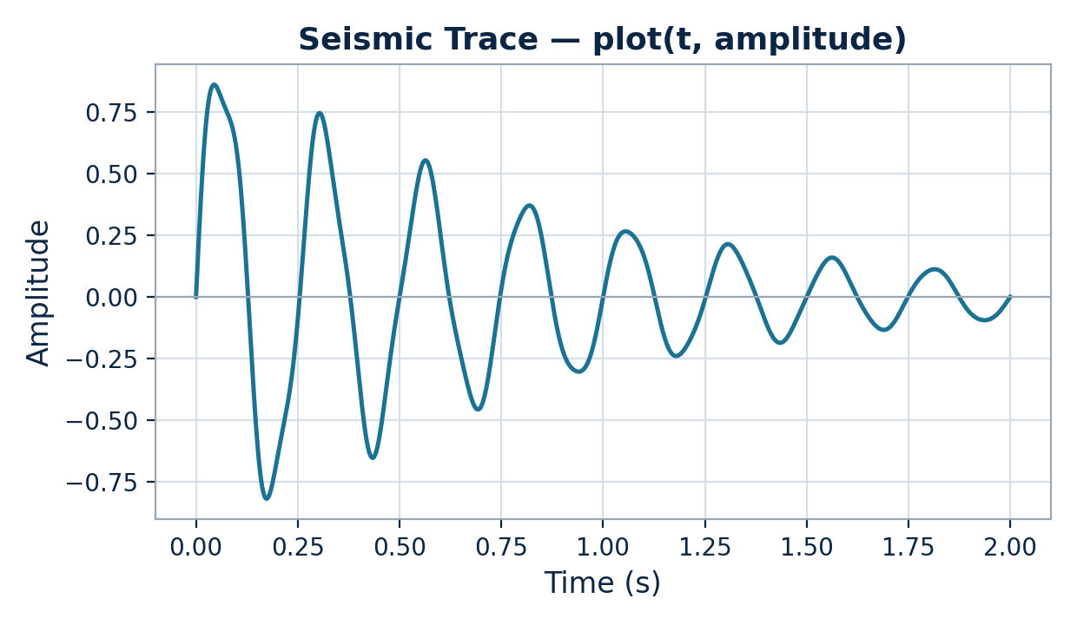
APPLICATION
⏱ 3:23 PM
Seismic Waveform
Time on the x-axis, amplitude on the y-axis
The canonical plot(x,y) example from the textbook's plotting chapter
t=linspace(0,2,800); amp=exp(-1.2*t).*sin(2*pi*4*t)+...; plot(t,amp);
Bahria University • GEO 321 / GEL 321 • Computing with MATLAB
Week 4 & 5 | 17
Notes:
Seismic trace: time on x, amplitude on y, a damped oscillation mimicking a real seismic arrival dying out — the canonical plot(x,y) use case.

Slide 18
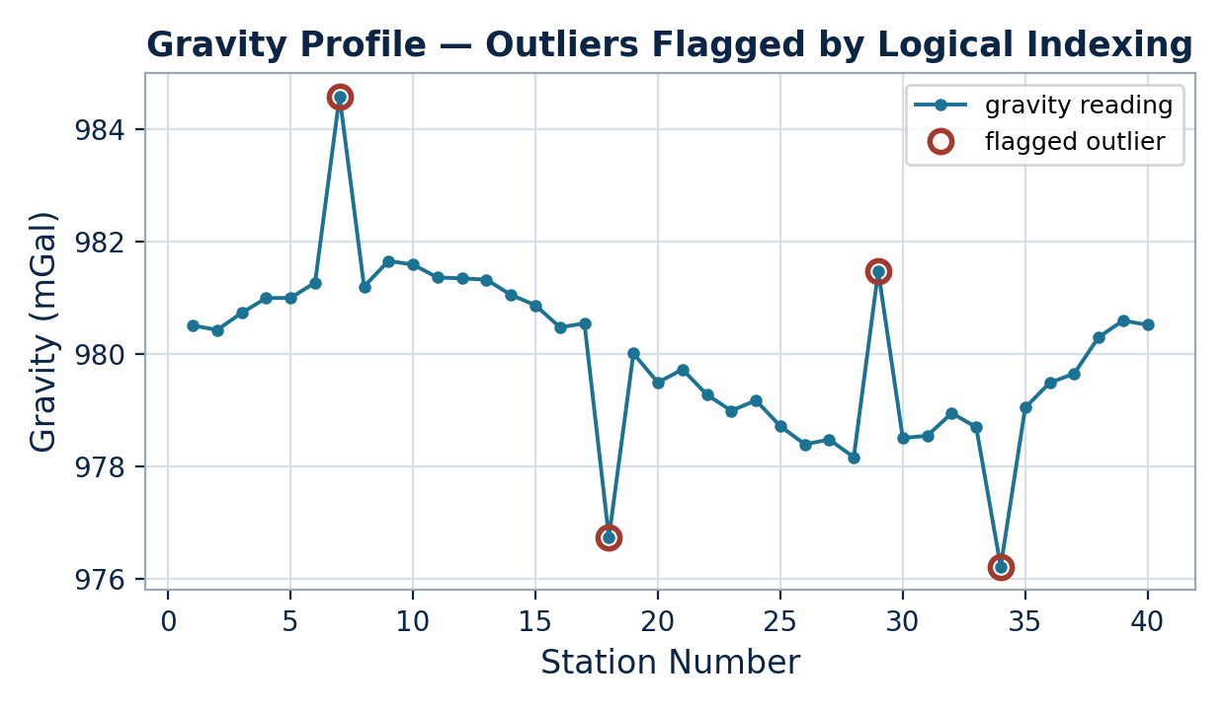
APPLICATION
⏱ 3:24 PM
Gravity Profile — Flagging Combined with Plotting
mu=mean(grav); sigma=std(grav);
flag = abs(grav-mu) > 2*sigma;
plot(grav,'o-'); hold on;
plot(find(flag), grav(flag), ...
'ro','MarkerSize',8);
legend('readings','flagged');
Part C's masking + Part B's hold on/legend, in one figure
Bahria University • GEO 321 / GEL 321 • Computing with MATLAB
Week 4 & 5 | 18
Notes:
This is where everything meets: Part C's logical mask identifies outliers, find() reports their positions, and Part B's hold on + distinct marker + legend displays them clearly on the same figure as the raw data.

Slide 19
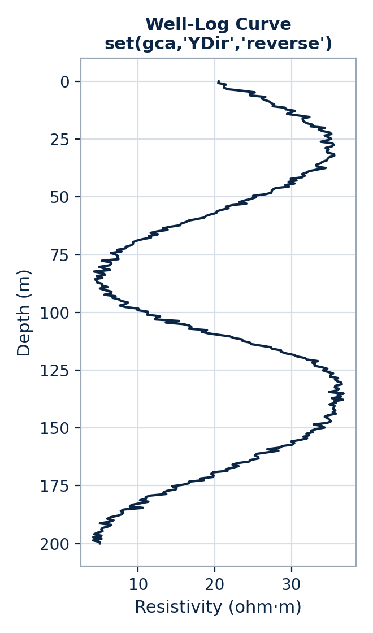
APPLICATION
⏱ 3:25 PM
Well-Log Curve — Depth Increases Downward
Geophysics convention: depth on the Y-axis, increasing DOWNWARD
set(gca,'YDir','reverse') flips the default direction
plot(resistivity, depth);
set(gca,'YDir','reverse');
xlabel('Resistivity (ohm\cdotm)');
ylabel('Depth (m)');
title('Well-Log Curve'); grid on;
Depth runs top-to-bottom, as read against the borehole
Bahria University • GEO 321 / GEL 321 • Computing with MATLAB
Week 4 & 5 | 19
Notes:
Well logs break the usual convention: depth on the y-axis but increasing DOWNWARD, matching how a geologist reads a log against the borehole. set(gca,'YDir','reverse') is the one line that flips MATLAB's default.

Slide 20
APPLICATION
⏱ 3:27 PM
Cleaning a Noisy Velocity Log
Field instruments record spikes from poor coupling / power surges
find() locates bad readings; NaN marks them; mean(...,'omitnan') skips them
velocity = [1800 2200 -999 2500 9999 2800];
bad = find(velocity < 1000 | velocity > 5000);
fprintf('Bad readings at: %s\n', num2str(bad));
% Bad readings at: 3 5
velocity(bad) = NaN;
mean_vel = mean(velocity, 'omitnan');
% mean_vel = 2325.0 m/s (valid readings only)
Bahria University • GEO 321 / GEL 321 • Computing with MATLAB
Week 4 & 5 | 20
Notes:
A realistic end-to-end cleanup: a physically implausible range (<1000 or >5000 m/s) flags the -999 error code and the 9999 overflow at positions 3 and 5, fprintf reports it as a summary line, NaN marks them, and mean(...,'omitnan') computes the correct average of 2325 m/s from the 4 valid readings only.

Slide 21
HANDS-ON CAPSTONE LAB
⏱ 3:28 PM
Lab: Clean, Report & Plot a Resistivity Log
(a) Mask valid readings (0 <= R <= 100); extract clean_R & clean_d
(b) fprintf a one-line summary: how many bad readings found
(c) Plot clean_R vs. clean_d, invert the y-axis, label & grid
d = 1000:100:1800;
R = [12 15 -999 22 18 9999 25 30 -500];
mask = (R >= 0) & (R <= 100);
clean_R = R(mask); clean_d = d(mask);
fprintf('%d bad readings removed\n', sum(~mask));
plot(clean_R, clean_d,'g-o');
set(gca,'YDir','reverse'); grid on;
xlabel('Resistivity'); ylabel('Depth (m)');
Bahria University • GEO 321 / GEL 321 • Computing with MATLAB
Week 4 & 5 | 21
Notes:
The capstone chains every idea from today: a logical mask (Part C) isolates valid readings, fprintf (Part A) reports a formatted summary, and the plotting toolkit (Part B) — inverted y-axis, labels, grid — displays the cleaned log exactly as a geophysicist would expect to see it.

Slide 22
WRAP-UP
⏱ 3:29 PM
Week 4 & 5 Summary & Deliverables
format/disp/fprintf/sprintf control how numbers & text are displayed
✓
plot() + LineSpec + hold on/legend + log scales + specialized plots + subplot
✓
Relational ops return logical arrays; & | ~ (array) vs && || (scalar, if-only)
✓
Logical indexing + find/any/all/isempty = loop-free data cleaning
✓
Submit week4_plotting_lab.m & week5_logical_cleaning_lab.m — next: if/elseif/switch
✓
Bahria University • GEO 321 / GEL 321 • Computing with MATLAB
Week 4 & 5 | 22
Notes:
Summary: output formatting (format/disp/fprintf/sprintf), the full 2-D plotting toolkit, relational/logical operators with the array-vs-scalar distinction, and loop-free data cleaning via logical indexing and find/any/all/isempty. Submit both lab scripts. Next week: flow control with if/elseif/else/switch for rock lithology classification.

