Slide 1

Chapter 13
Wired LANs: Ethernet
13.<number>
Copyright © The McGraw-Hill Companies, Inc. Permission required for reproduction or display.

Slide 2
13-1 IEEE STANDARDS
In 1985, the Computer Society of the IEEE started a project, called Project 802, to set standards to enable intercommunication among equipment from a variety of manufacturers. Project 802 is a way of specifying functions of the physical layer and the data link layer of major LAN protocols.
Topics discussed in this section:
Data Link Layer
Physical Layer
13.<number>

Slide 3

Figure 13.1 IEEE standard for LANs
13.<number>

Slide 4

Figure 13.2 HDLC frame compared with LLC and MAC frames
13.<number>

Slide 5
13-2 STANDARD ETHERNET
The original Ethernet was created in 1976 at Xerox’s Palo Alto Research Center (PARC). Since then, it has gone through four generations. We briefly discuss the Standard (or traditional) Ethernet in this section.
Topics discussed in this section:
MAC Sublayer
Physical Layer
13.<number>

Slide 6

Figure 13.3 Ethernet evolution through four generations
13.<number>

Slide 7

Figure 13.4 802.3 MAC frame
13.<number>

Slide 8

Figure 13.5 Minimum and maximum lengths
13.<number>

Slide 9

Note
Frame length:
Minimum: 64 bytes (512 bits)
Maximum: 1518 bytes (12,144 bits)
13.<number>

Slide 10

Figure 13.6 Example of an Ethernet address in hexadecimal notation
13.<number>

Slide 11

Figure 13.7 Unicast and multicast addresses
13.<number>

Slide 12
Note
The least significant bit of the first byte
defines the type of address.
If the bit is 0, the address is unicast;
otherwise, it is multicast.
13.<number>

Slide 13
Note
The broadcast destination address is a special case of the multicast address in which all bits are 1s.
13.<number>

Slide 14
Example 13.1
Define the type of the following destination addresses:
a. 4A:30:10:21:10:1A b. 47:20:1B:2E:08:EE
c. FF:FF:FF:FF:FF:FF
Solution
To find the type of the address, we need to look at the second hexadecimal digit from the left. If it is even, the address is unicast. If it is odd, the address is multicast. If all digits are F’s, the address is broadcast. Therefore, we have the following:
a. This is a unicast address because A in binary is 1010.
b. This is a multicast address because 7 in binary is 0111.
c. This is a broadcast address because all digits are F’s.
13.<number>

Slide 15
Example 13.2
Show how the address 47:20:1B:2E:08:EE is sent out on line.
Solution
The address is sent left-to-right, byte by byte; for each byte, it is sent right-to-left, bit by bit, as shown below:
13.<number>

Slide 16

Figure 13.8 Categories of Standard Ethernet
13.<number>

Slide 17

Figure 13.9 Encoding in a Standard Ethernet implementation
13.<number>

Slide 18

Figure 13.10 10Base5 implementation
13.<number>

Slide 19

Figure 13.11 10Base2 implementation
13.<number>

Slide 20

Figure 13.12 10Base-T implementation
13.<number>

Slide 21

Figure 13.13 10Base-F implementation
13.<number>

Slide 22
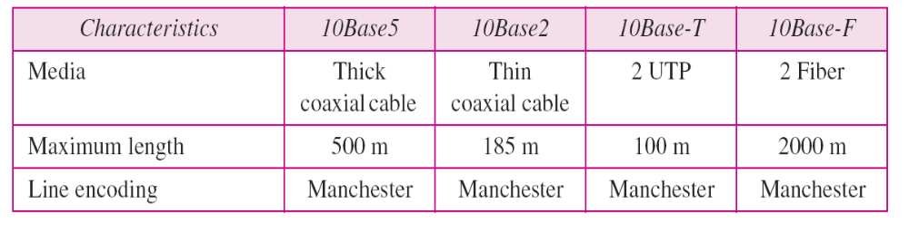
Table 13.1 Summary of Standard Ethernet implementations
13.<number>

Slide 23
13-3 CHANGES IN THE STANDARD
The 10-Mbps Standard Ethernet has gone through several changes before moving to the higher data rates. These changes actually opened the road to the evolution of the Ethernet to become compatible with other high-data-rate LANs.
Topics discussed in this section:
Bridged Ethernet
Switched Ethernet
Full-Duplex Ethernet
13.<number>

Slide 24

Figure 13.14 Sharing bandwidth
13.<number>

Slide 25

Figure 13.15 A network with and without a bridge
13.<number>

Slide 26

Figure 13.16 Collision domains in an unbridged network and a bridged network
13.<number>

Slide 27

Figure 13.17 Switched Ethernet
13.<number>

Slide 28

Figure 13.18 Full-duplex switched Ethernet
13.<number>

Slide 29
13-4 FAST ETHERNET
Fast Ethernet was designed to compete with LAN protocols such as FDDI or Fiber Channel. IEEE created Fast Ethernet under the name 802.3u. Fast Ethernet is backward-compatible with Standard Ethernet, but it can transmit data 10 times faster at a rate of 100 Mbps.
Topics discussed in this section:
MAC Sublayer
Physical Layer
13.<number>

Slide 30

Figure 13.19 Fast Ethernet topology
13.<number>

Slide 31

Figure 13.20 Fast Ethernet implementations
13.<number>

Slide 32

Figure 13.21 Encoding for Fast Ethernet implementation
13.<number>

Slide 33
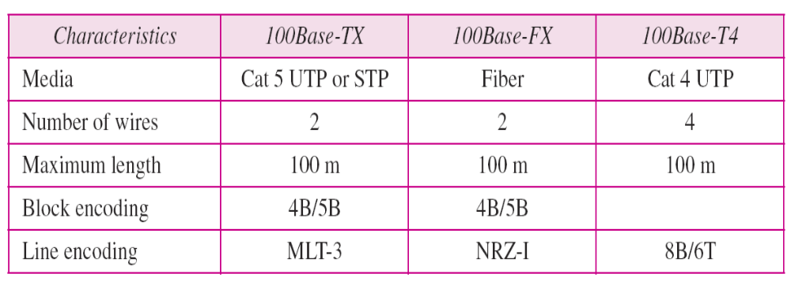
Table 13.2 Summary of Fast Ethernet implementations
13.<number>

Slide 34
13-5 GIGABIT ETHERNET
The need for an even higher data rate resulted in the design of the Gigabit Ethernet protocol (1000 Mbps). The IEEE committee calls the standard 802.3z.
Topics discussed in this section:
MAC Sublayer
Physical Layer
Ten-Gigabit Ethernet
13.<number>

Slide 35
Note
In the full-duplex mode of Gigabit Ethernet, there is no collision;
the maximum length of the cable is determined by the signal attenuation
in the cable.
13.<number>

Slide 36

Figure 13.22 Topologies of Gigabit Ethernet
13.<number>

Slide 37

Figure 13.23 Gigabit Ethernet implementations
13.<number>

Slide 38

Figure 13.24 Encoding in Gigabit Ethernet implementations
13.<number>

Slide 39

Table 13.3 Summary of Gigabit Ethernet implementations
13.<number>

Slide 40

Table 13.4 Summary of Ten-Gigabit Ethernet implementations
13.<number>

