Slide 1

Chapter 14
Wireless LANs
14.<number>
Copyright © The McGraw-Hill Companies, Inc. Permission required for reproduction or display.

Slide 2
14-1 IEEE 802.11
IEEE has defined the specifications for a wireless LAN, called IEEE 802.11, which covers the physical and data link layers.
Topics discussed in this section:
Architecture
MAC Sublayer
Physical Layer
14.<number>

Slide 3

Note
A BSS without an AP is called an ad hoc network;
a BSS with an AP is called an infrastructure network.
14.<number>

Slide 4
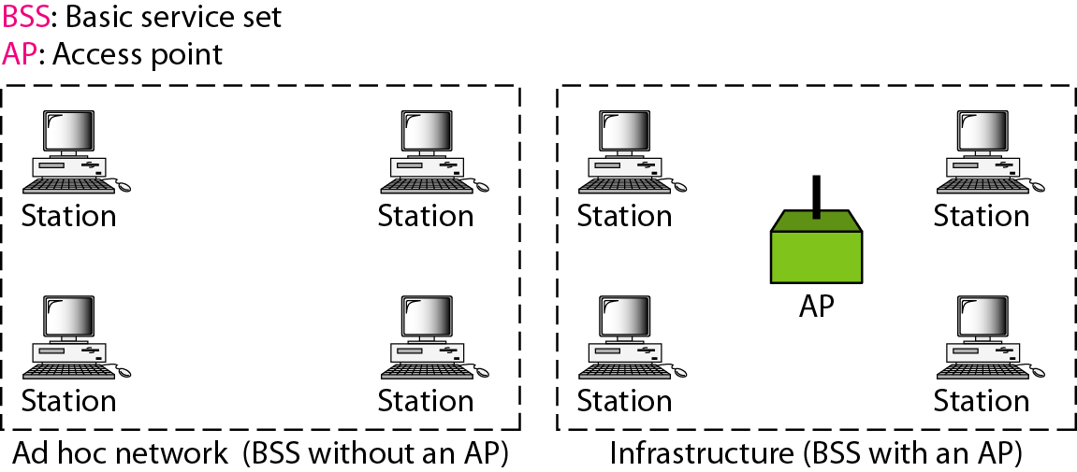
Figure 14.1 Basic service sets (BSSs)
14.<number>

Slide 5
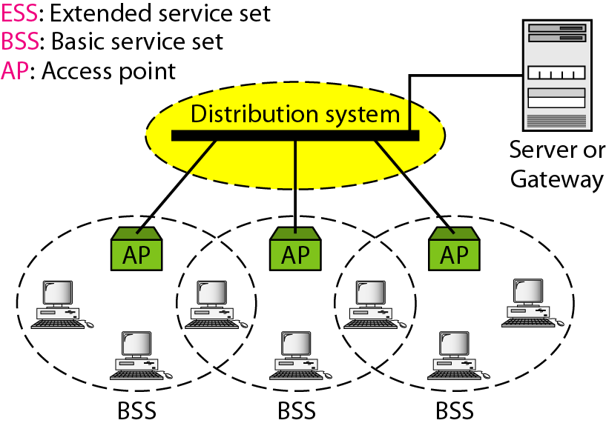
Figure 14.2 Extended service sets (ESSs)
14.<number>

Slide 6
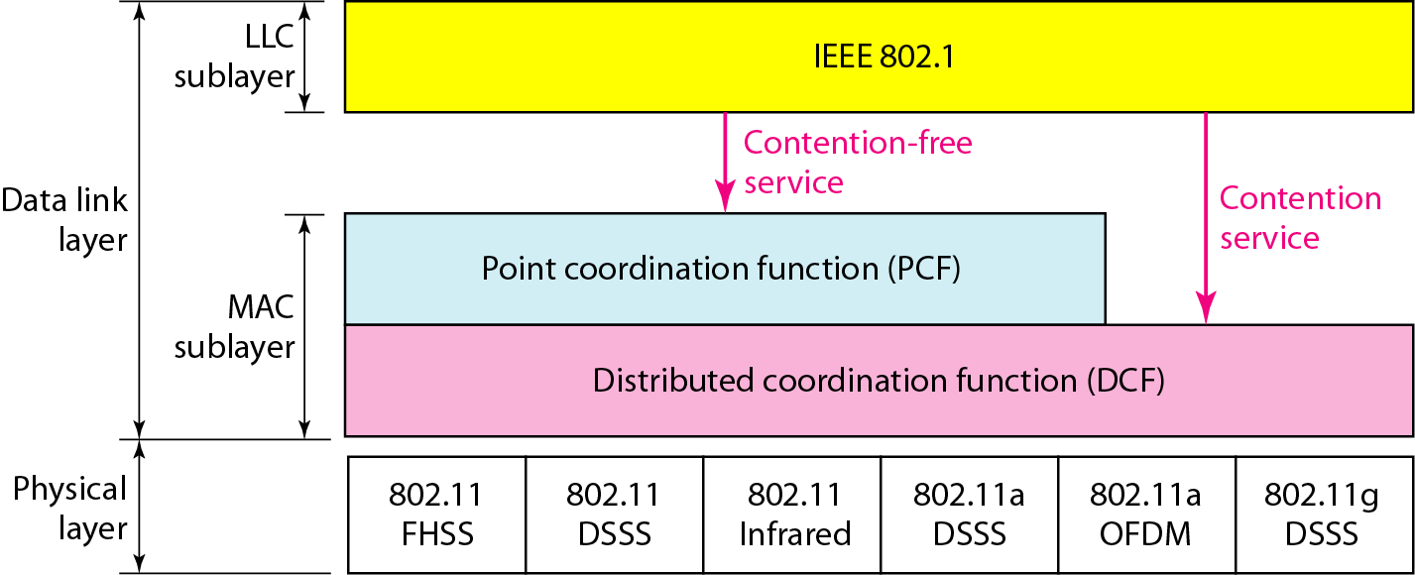
Figure 14.3 MAC layers in IEEE 802.11 standard
14.<number>

Slide 7

Figure 14.4 CSMA/CA flowchart
14.<number>

Slide 8
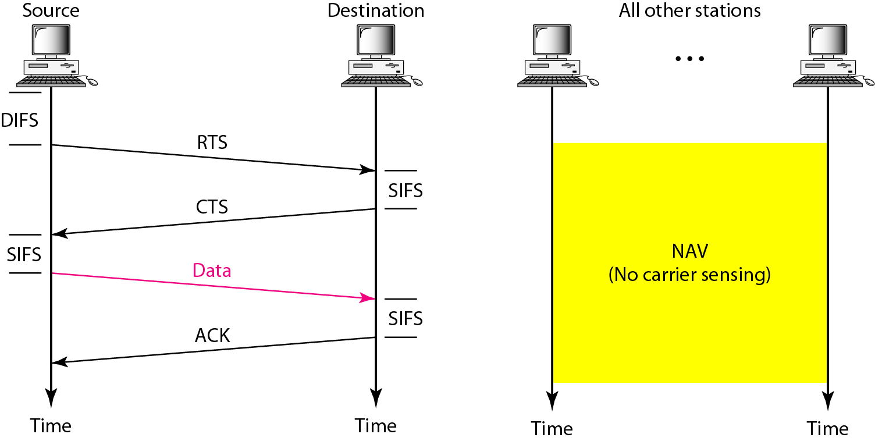
Figure 14.5 CSMA/CA and NAV
14.<number>

Slide 9
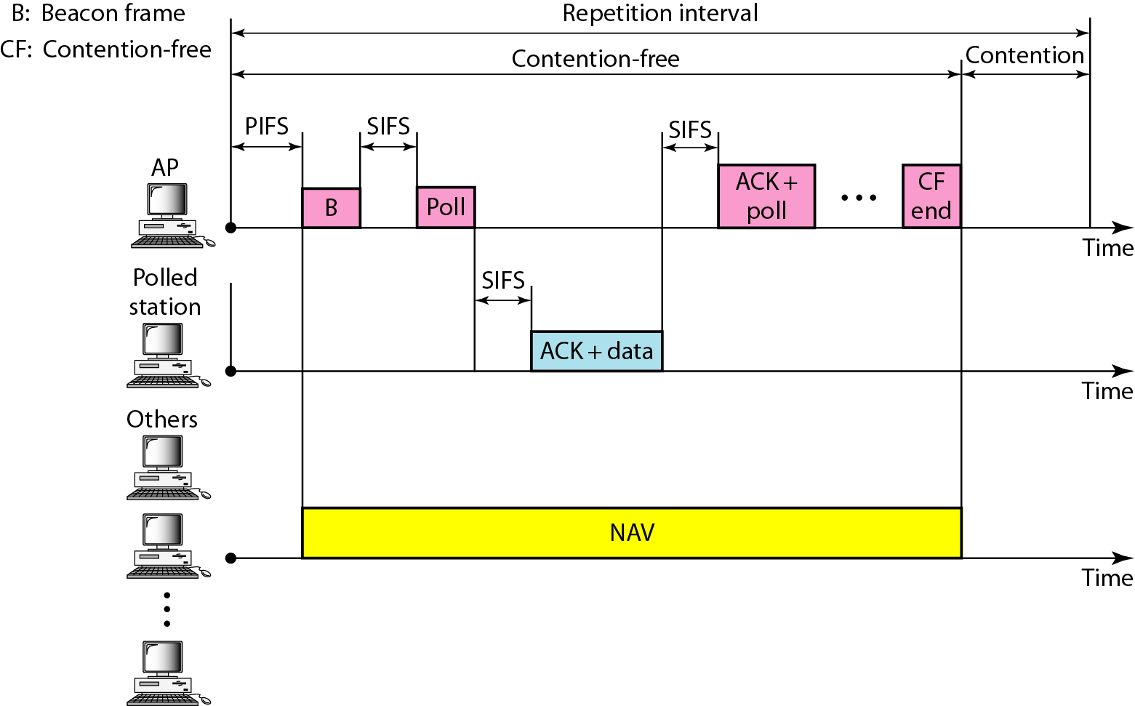
Figure 14.6 Example of repetition interval
14.<number>

Slide 10

Figure 14.7 Frame format
14.<number>

Slide 11
802.11 Frame format
Frame control (FC) has control information.
D. Defines duration of transmission to set the value of NAV.
Addresses. There are four address fields, each 6 bytes long. The meaning of each address field depends on the value of the To DS and From DS subfields.
Sequence control (SC). This field, often called the SC field, defines a 16-bit value. The first four bits define the fragment number; the last 12 bits define the sequence number, which is the same in all fragments.
Frame body. This field, which can be between 0 and 2312 bytes, contains information based on the type and the subtype defined in the FC field.
FCS. The FCS field is Frame Check Sequence, 4 bytes long and contains a CRC-32 error-detection sequence.
14.<number>

Slide 12
FC:Frame control
Defines the type of frame and some control information.
Protocol version, which allows two versions of the protocol to operate at the same time in the same cell.
Type (data, control, or management) and Subtype fields (e.g., RTS or CTS).
To DS and From DS bits indicate the frame is going to or coming from the inter-cell distribution system.
The MFlag bit means that more fragments will follow.
The Retry bit marks a retransmission of a frame.
The Power management bit is used by the base station to put the receiver into sleep state or take it out of sleep state.
The More data indicates that the sender has additional frames for the receiver.
The W bit specifies that the frame body has been encrypted using the WEP (Wired Equivalent Privacy) algorithm.
Finally, the O bit tells the receiver that a sequence of frames with this bit on must be processed strictly in order.
14.<number>

Slide 13
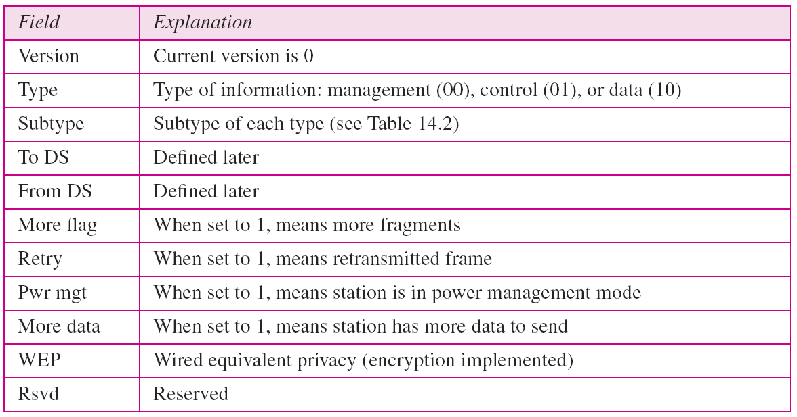
Table 14.1 Subfields in FC field
14.<number>

Slide 14
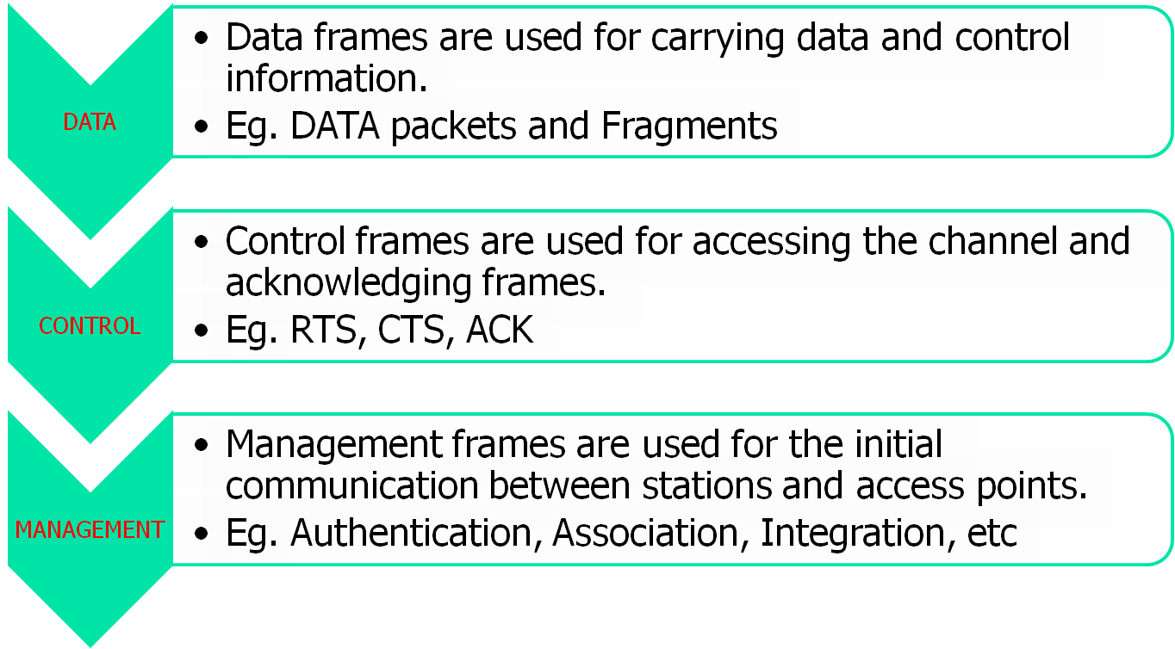
Frame Types
14.<number>

Slide 15
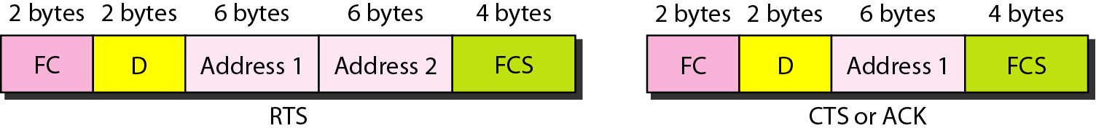
Figure 14.8 Control frames
14.<number>

Slide 16
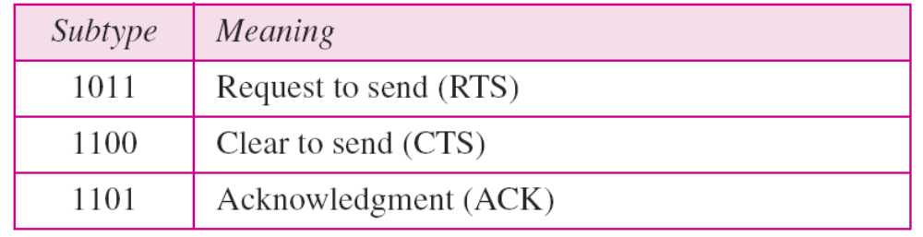
Table 14.2 Values of subfields in control frames
14.<number>

Slide 17
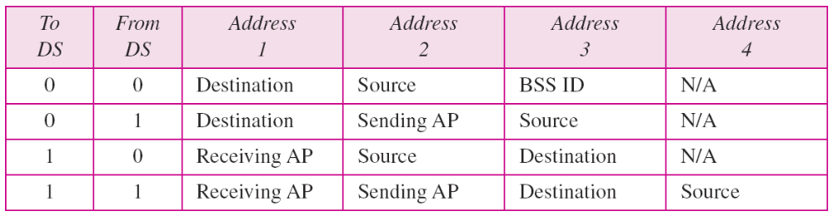
Table 14.3 Addresses
14.<number>

Slide 18
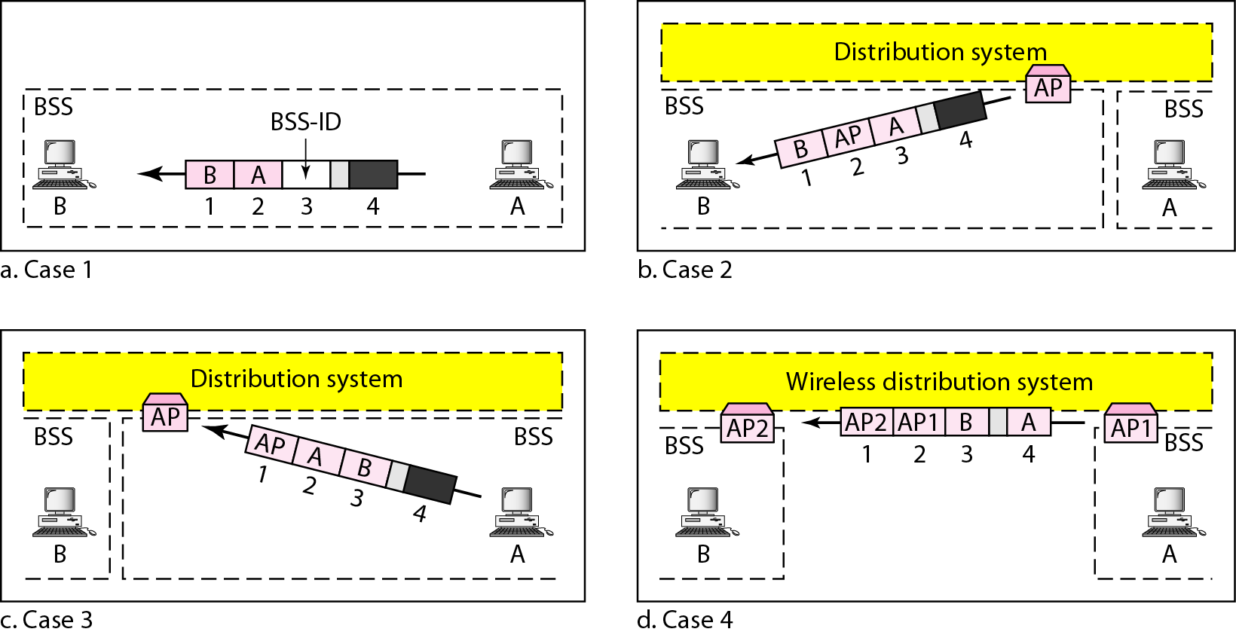
Figure 14.9 Addressing mechanisms
14.<number>

Slide 19
HIDDEN STATION & EXPOSED STATION PROBLEM
HIDDEN STATION PROBLEM:
A wants to send to B.
C is a station within range of A.
D is a station within range of B but not within range of A.
A want to communicate with B. Sends RTS.
B responds with CTS.
A start ACK timer and sends data.
B receives and send ACK.
OK if ACK received by A, but what if not?
Problem: If A's ACK timer expires before the ACK gets back to it, the whole protocol is going to run again.
EXPOSED STATION PROBLEM:
What about C and D?
C is within range of A, so can sense RTS.
D is within range of B, so can not here RTS but can CTS.
C with RTS can estimate how long the sequence will take, including the final ACK, so it asserts a kind of virtual channel busy for itself, indicated by NAV (Network Allocation Vector).
Similarly for D hearing CTS indicate NAV for itself.
Note: NAV signals are not transmitted; they are just internal reminders to keep quiet for a certain period of time.
SOLUTION? CSMA/CA, RTS AND CTS HANDSHAKING.
14.<number>

Slide 20
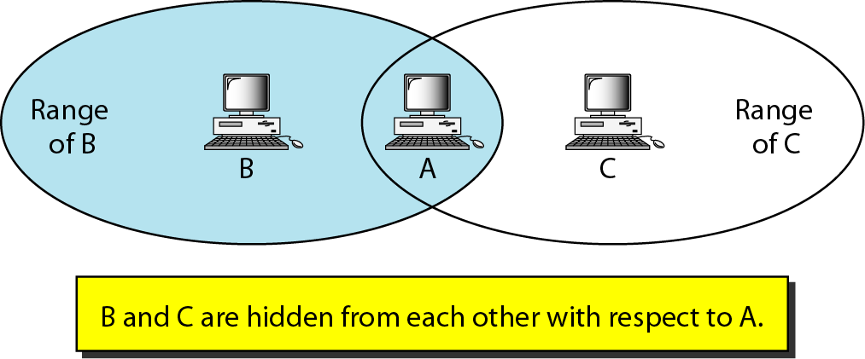
Figure 14.10 Hidden station problem
14.<number>

Slide 21
Note
The CTS frame in CSMA/CA handshake can prevent collision from
a hidden station.
14.<number>

Slide 22
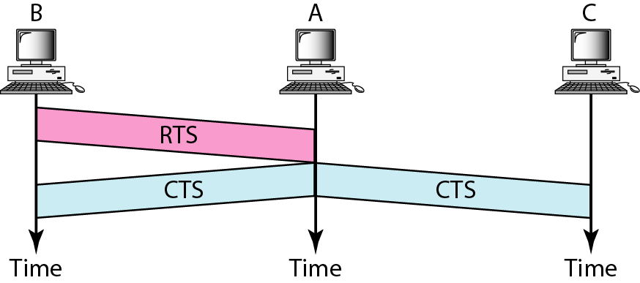
Figure 14.11 Use of handshaking to prevent hidden station problem
14.<number>

Slide 23
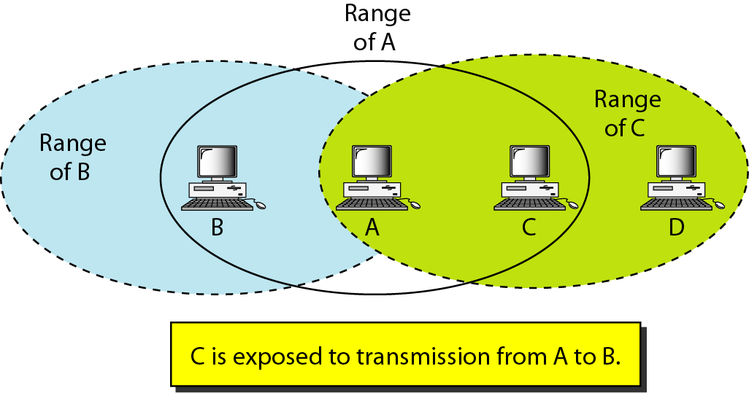
Figure 14.12 Exposed station problem
14.<number>

Slide 24
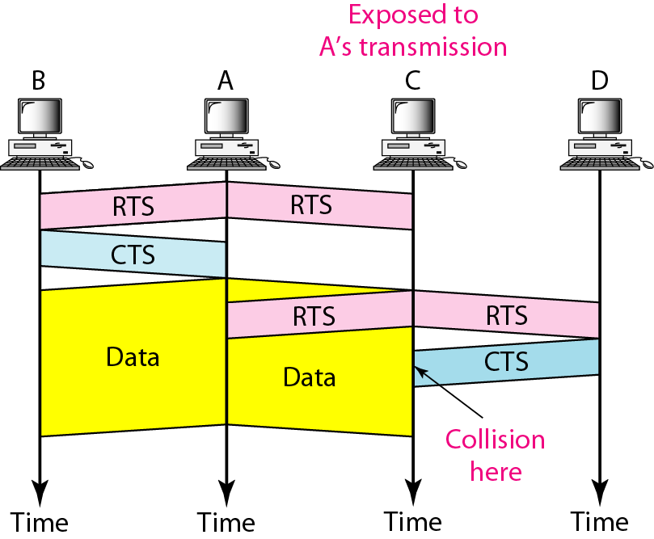
Figure 14.13 Use of handshaking in exposed station problem
14.<number>

Slide 25
The 802.11 Physical Layer
1. Infrared –
  1 Mbps and
  2 Mbps
2.FHSS (Frequency Hopping Spread Spectrum)
3. DSSS (Direct Sequence Spread Spectrum) delivers 1 or 2 Mbps in the 2.4 GHz band.
4. OFDM (Orthogonal Frequency Division Multiplexing) to deliver up to 54 Mbps in the 5 GHz band. 802.11a uses.
5. HR-DSSS (High Rate Direct Sequence Spread Spectrum) to achieve 11 Mbps in the 2.4 GHz band. 802.11b uses.
6. OFDM (Orthogonal Frequency Division Multiplexing) to achieve 54 Mbps in the 2.4 GHz band. 802.11g uses.

Slide 26
Infrared method:
  Technology same as television remote controls.
Short-range radio, using techniques called
  FHSS and DSSS.
  Both use the spectrum that does not require licensing (the 2.4-GHz ISM band).
  Eg: Radio-controlled garage door openers, Cordless telephones and Microwave ovens.
  All of these techniques operate at 1 or 2 Mbps and at low enough power that they do not conflict too much.
In 1999, two new techniques were introduced to achieve higher bandwidth.
These are called OFDM and HR-DSSS.
  They operate at up to 54 Mbps and 11 Mbps, respectively.
In 2001, a second OFDM modulation was introduced, but in a different frequency band from the first one.
Now we will examine each of them briefly.

Slide 27
Standard | Modulation | Spectrum | Max physical Rate | Working distance
802.11 | WDM, FHSS DSSS | 2.4 GHz | 2 Mbps | ≈100 m
802.11a | OFDM | 5 GHz | 54 Mbps | ≈ 50 m
802.11b | HR-DSSS | 2.4 GHz | 11 Mbps | ≈ 200 m
802.11g | OFDM | 2.4 GHz | 54 Mbps | ≈ 200 m

Slide 28
FHSS
Frequency Hopping Spread Spectrum.
Uses 79 channels, each 1 MHz wide, starting in the 2.4 GHz band.
A psudo-random number generator is used to produce the sequence of frequencies hopped to.
Due to this, stations remain synchronized to same frequency.
The amount of time spent at each frequency, dwell time, is adjustable but must be less than 400 msec.
Advantage:
  FHSS' randomization provides a fair way to allocate spectrum in the unregulated ISM band.
  It provides security since an intruder who does not know the hopping sequence or dwell time cannot eavesdrop on transmissions.
  Over longer distances, multipath fading can be an issue, and FHSS offers good resistance to it.
  Relatively insensitive to radio interference, which makes it popular for building-to-building links.
Disadvantage: its low bandwidth.

Slide 29
DSSS
Direct Sequence Spread Spectrum.
restricted to 1 or 2 Mbps.
Similarities to the CDMA system.
But differs in other ways.
  Each bit is transmitted as 11bit chips (8 bit in CDMA), using what is called a Barker sequence.
  It uses phase shift modulation (FDM in CDMA), at 1 Mbaud, transmitting 1 bit per baud when operating at 1 Mbps and 2 bits per baud when operating at 2 Mbps.
For years, the FCC required all wireless communications equipment operating in the ISM bands to use spread spectrum.
But in May 2002, that rule was dropped as new technologies emerged.

Slide 30
OFDM
Orthogonal Frequency Division Multiplexing.
802.11 a use it.
Deliver up to 54 Mbps in the wider 5-GHz ISM band.
2 Control, 48 for data and 4 for synchronization (2+48+4=54).
Unlike ADSL. (8:1, 32:n-32 upstream: downstream).
Considered a form of spread spectrum, but different from both CDMA and FHSS.
A complex encoding system is used, based on phase-shift modulation for speeds up to 18 Mbps and on QAM above that.
At 54 Mbps, 216 data bits are encoded into 288-bit symbols.
Advantage:
  better immunity to narrowband interference and
  May be using non-contiguous bands.
  compatibility with the European HiperLAN/2 system (Doufexi et al., 2002).
  The technique has a good spectrum efficiency in terms of bits/Hz and good immunity to multipath fading.

Slide 31
HR-DSSS
High Rate Direct Sequence Spread Spectrum.
Spread spectrum technique.
Uses 11 million chips/sec to achieve 11 Mbps in the 2.4-GHz band.
Used by 802.11b but is not a follow-up to 802.11a.
Data rates supported by 802.11b are 1, 2, 5.5, and 11 Mbps.
The two slow rates run at 1 Mbaud, with 1 and 2 bits per baud, respectively, using phase shift modulation (for compatibility with DSSS).
The two faster rates run at 1.375 Mbaud, with 4 and 8 bits per baud, respectively, using Walsh/Hadamard codes.
The data rate may be dynamically adapted during operation to achieve the optimum speed possible under current conditions of load and noise.
In practice, the operating speed of 802.11b is nearly always 11 Mbps.
Imp note: Although 802.11b is slower than 802.11a, its range is about 7 times greater, which is more important in many situations.

Slide 32
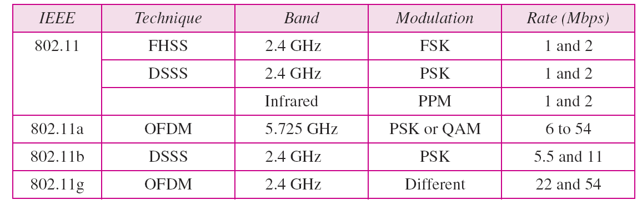
Table 14.4 Physical layers
14.<number>

Slide 33
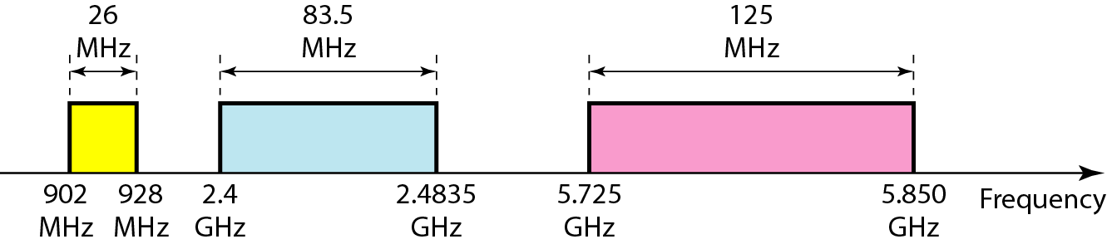
Figure 14.14 Industrial, scientific, and medical (ISM) band
14.<number>

Slide 34
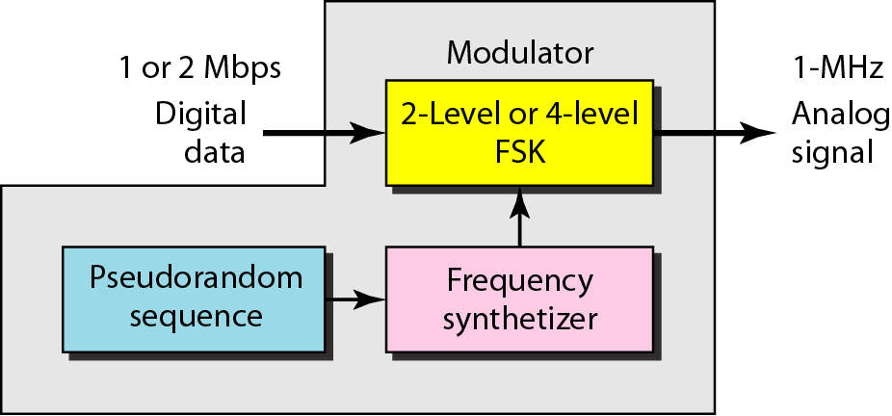
Figure 14.15 Physical layer of IEEE 802.11 FHSS
14.<number>

Slide 35
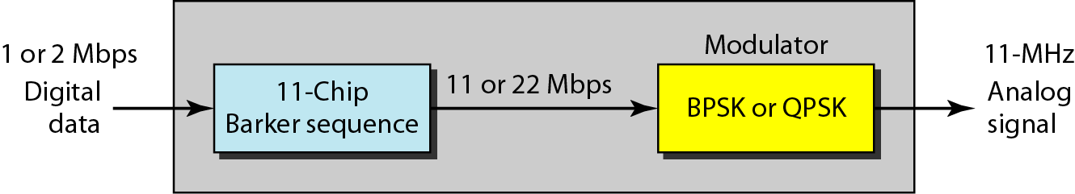
Figure 14.16 Physical layer of IEEE 802.11 DSSS
14.<number>

Slide 36
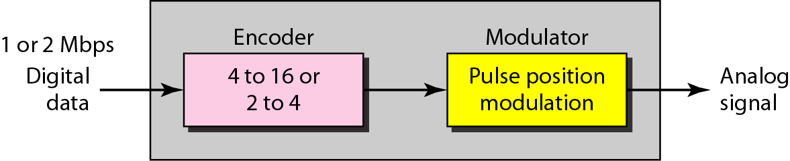
Figure 14.17 Physical layer of IEEE 802.11 infrared
14.<number>

Slide 37
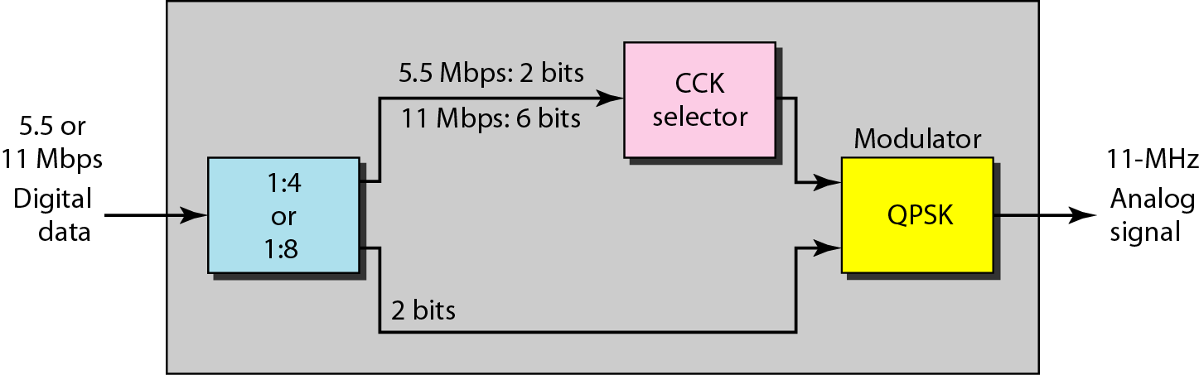
Figure 14.18 Physical layer of IEEE 802.11b
14.<number>

Slide 38
14-2 BLUETOOTH
Bluetooth is a wireless LAN technology designed to connect devices of different functions such as telephones, notebooks, computers, cameras, printers, coffee makers, and so on. A Bluetooth LAN is an ad hoc network, which means that the network is formed spontaneously.
Topics discussed in this section:
Architecture
Bluetooth Layers
Baseband Layer
L2CAP
14.<number>

Slide 39
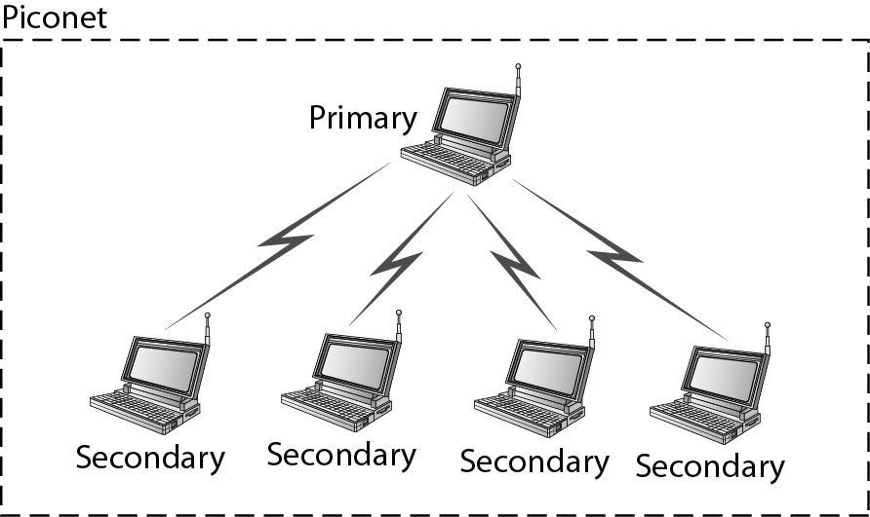
Figure 14.19 Piconet
14.<number>

Slide 40
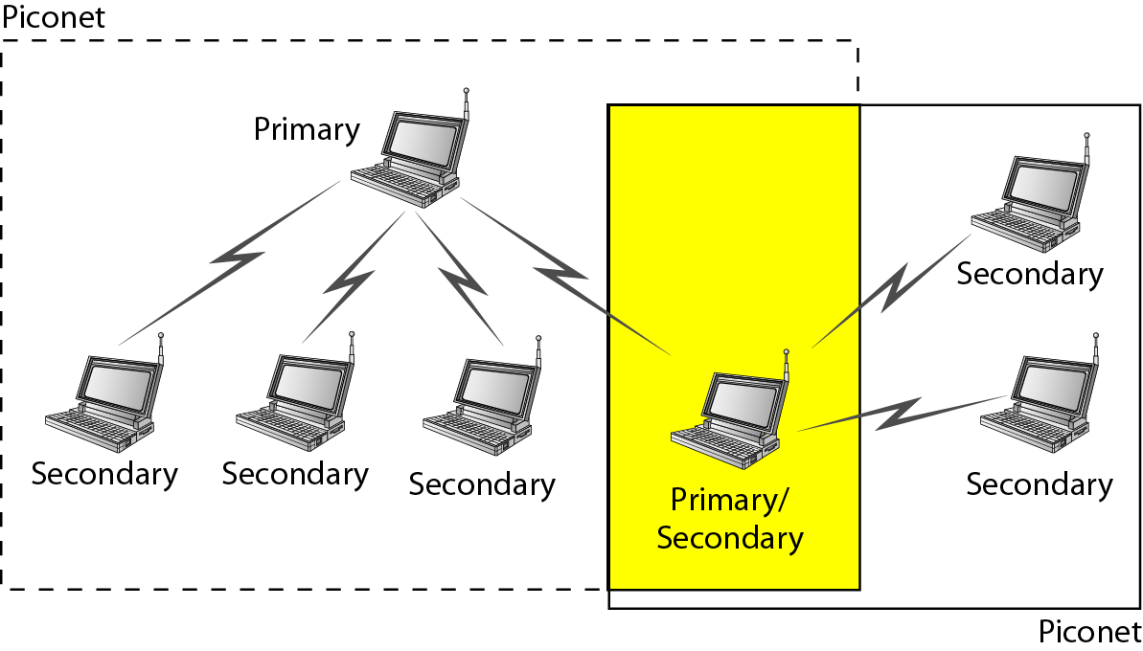
Figure 14.20 Scatternet
14.<number>

Slide 41
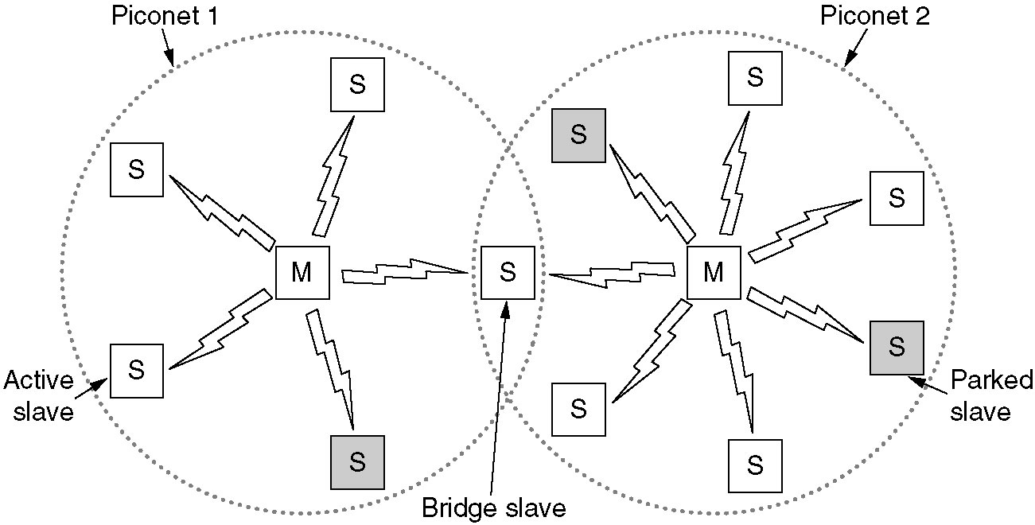
Bluetooth Architecture: Scatternet
Two piconets can be connected to form a scatternet.

Slide 42
Continue….
The basic unit of a Bluetooth system is a piconet, which consists of a master node and up to seven active slave nodes within a distance of 10 meters.
Multiple piconets can exist in the same (large) room and can even be connected via a bridge node, as shown in figure.
An interconnected collection of piconets is called a scatter net.
There can be up to 255 parked nodes in the net.
Parked means?
In parked state, device cannot do anything except respond to an activation or beacon signal from the master.
Y implemented master/slave design? Purpose is to implement complete Bluetooth chips for under 5$. Costly master and cheap slaves.
Slaves are fairly dumb, basically just doing whatever the master tells them to do.
At its heart, a piconet is a centralized TDM system, with the master controlling the clock and determining which device gets to communicate in which time slot.
All communication is between the master and a slave; direct slave-slave communication is not possible.
14.<number>

Slide 43
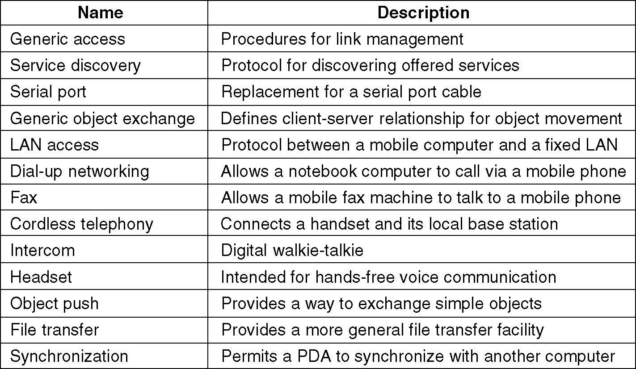
Bluetooth Applications
The Bluetooth profiles.

Slide 44
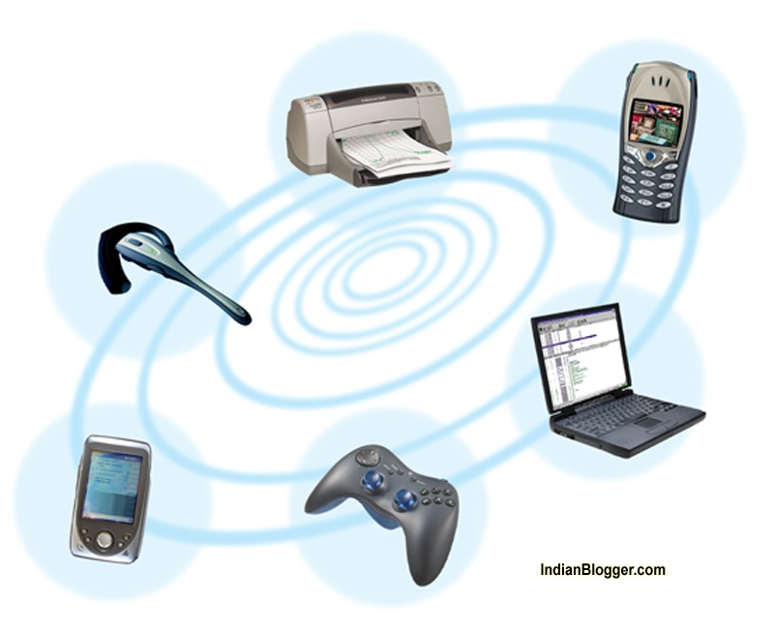

Slide 45
The 13 applications, which are called profiles, are listed in figure.
All Bluetooth devices are expected to implement given first two profiles. The remaining ones are optional.
Generic:
  generic access profile: Its main job, provide a way to establish and maintain secure links (channels) between the master and the slaves.
  service discovery profile: is used by devices to discover what services other devices have to offer.
Building Block Profiles:
  serial port profile: is a transport protocol, It emulates a serial line and is especially useful for legacy applications that expect a serial line.
  generic object exchange profile : defines a client-server relationship for moving data around, building block for other profiles.
Networking:
  LAN access profile allows a Bluetooth device to connect to a fixed network. This profile is a direct competitor to 802.11.
  The dial-up networking profile was the original motivation for the whole project. It allows a notebook computer to connect to a mobile phone containing a built-in modem without wires.
  The fax profile is similar to dial-up networking, except that it allows wireless fax machines to send and receive faxes using mobile phones without a wire between the two.
Telephony:
  Cordless telephony profile provides a way to connect the handset of a cordless telephone to the base station.
  The intercom profile allows two telephones to connect as walkie-talkies.
  Finally, the headset profile provides hands-free voice communication between the headset and its base station, for example, for hands-free telephony while driving a car.
Object Exchange:
  These could be business cards, pictures, or data files.
  E.g Object Push....
  And File transfer.
  The synchronization profile, in particular, is intended for loading data into a PDA or notebook computer when it leaves home and collecting data from it when it returns.
Notes:
Prof. Bhargavi H Goswami, Email:bhargavigoswami@gmail.com, Mob: +91 7383816996

Slide 46
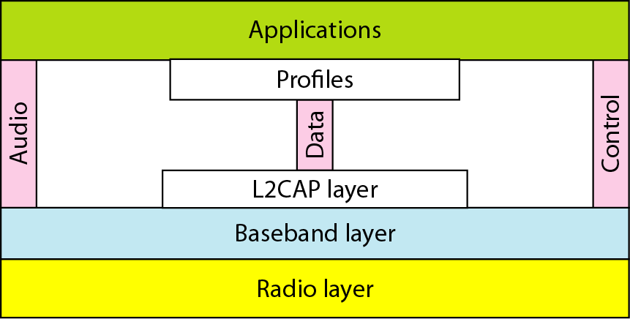
Figure 14.21 Bluetooth layers
14.<number>

Slide 47
Conti….
The Bluetooth Protocol Stack does not follow OSI model and revised by IEEE to fix 802.11.
The Physical Radio layer corresponds to the ISO(International Standardization Organization) physical layer and deals with radio transmission and modulation.
The Baseband layer corresponds to MAC sublayer and some physical layer and handles how the master control time slots.
The link manager handles establishment of logic channel (power management, authentication, QoS).
The logical link control adaptation protocol (L2CAP) shields the upper layer from lower layer
Audio and Control protocols deal with audio and control.
LLC (Logical Link Control) is inserted by IEEE to make it compatible with other 802.
RFcomm (Radio Frequency communication) emulates serial port for connecting mouse, keyboard, modem.
Telephony protocol real-time speech, call setup and termination
The service discovery protocol is used to locate service in a network.
Each application uses a specific subset of protocols included in Applications/Profiles based on the device it is applicable to. Eg mobile or PDA.
14.<number>

Slide 48
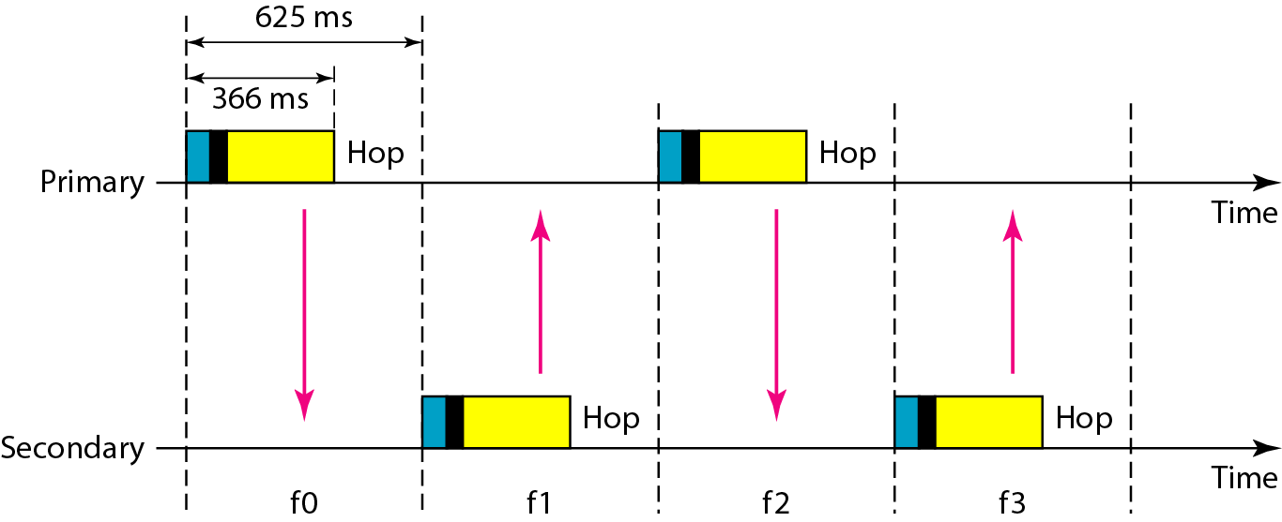
Figure 14.22 Single-secondary communication
14.<number>

Slide 49
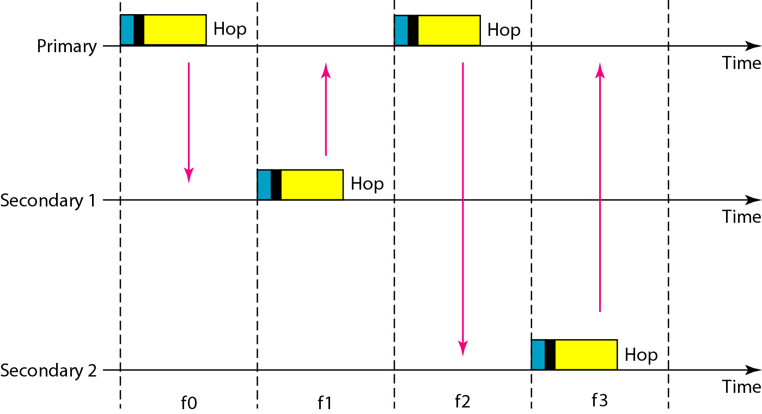
Figure 14.23 Multiple-secondary communication
14.<number>

Slide 50
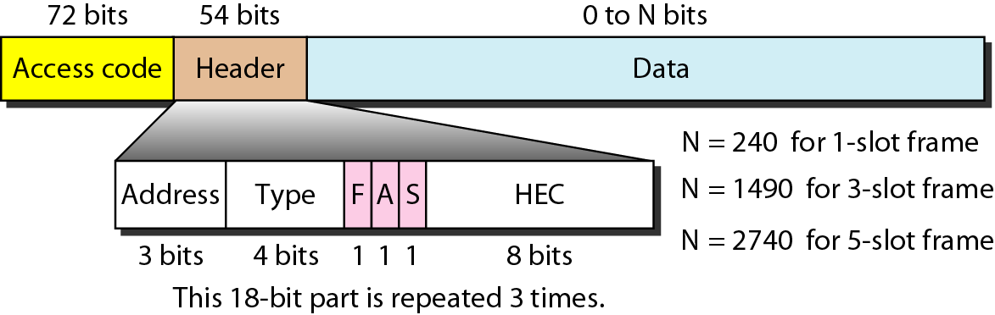
Figure 14.24 Frame format types
14.<number>

Slide 51
Access code. This 72-bit field normally contains synchronization bits and the
identifier of the primary to distinguish the frame of one piconet from that of
another.
Header. This 54-bit field is a repeated 18-bit pattern. Each pattern has the following subfields:
a. Address. The 3-bit address subfield can define up to seven secondaries (1 to 7).
If the address is zero, it is used for broadcast communication from the primary
to all secondaries.
b. Type. The 4-bit type subfield defines the type of data coming from the upper
layers. We discuss these types later.
c. F. This 1-bit subfield is for flow control. When set (1), it indicates that the
device is unable to receive more frames (buffer is full).
d. A. This 1-bit subfield is for acknowledgment. Bluetooth uses Stop-and-Wait
ARQ; 1 bit is sufficient for acknowledgment.
e. S. This 1-bit subfield holds a sequence number. Bluetooth uses Stop-and-Wait ARQ; 1 bit is sufficient for sequence numbering.
f. HEC. The 8-bit header error correction subfield is a checksum to detect errors
in each 18-bit header section.
Payload. This subfield can be 0 to 2740 bits long. It contains data or control information
14.<number>

Slide 52
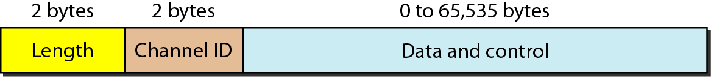
Figure 14.25 L2CAP data packet format
14.<number>

Slide 53
THANK YOU.
Chapter ends here.
14.<number>

