Slide 1

Data Science
Visualization

Slide 2


DS Magic
Problem Formulation
Data Acquisition
Feature Engineering
Visualization
Data Preprocessing
Exploratory Data Analysis
Predictive Modeling
Model Development
Model Evaluation
Model Deployment
Model Monitoring and Maintenance

Slide 3
Visualization
“to visualize” (Oxford, 2010)
form a mental image of; imagine
make (something) visible to the eye
Not only produce pretty images, but also aid the understanding of data
In general: Visualization’s objective is to represent data in a way that humans can easily gain insight and understand its structure

Slide 4
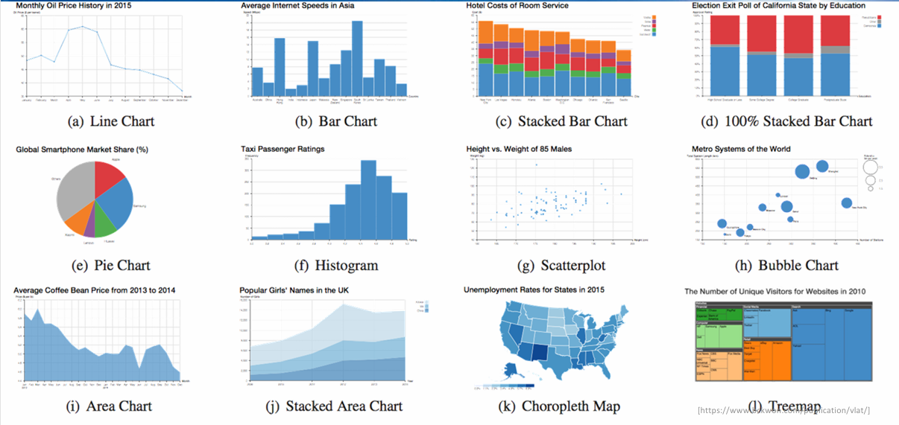
Visualization-Examples

Slide 5
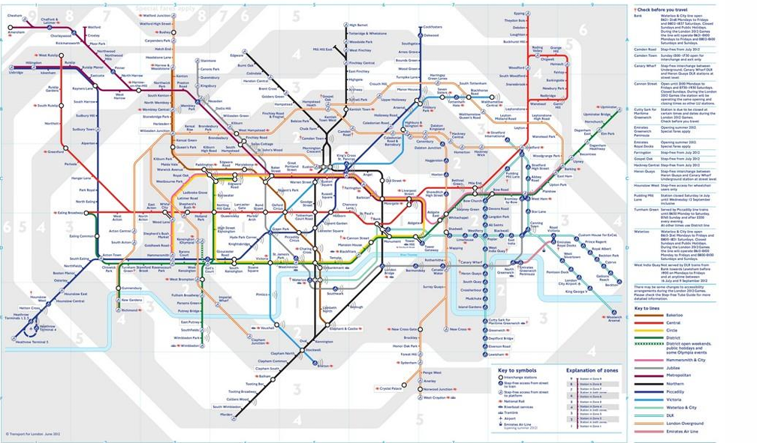
Visualization-Examples

Slide 6
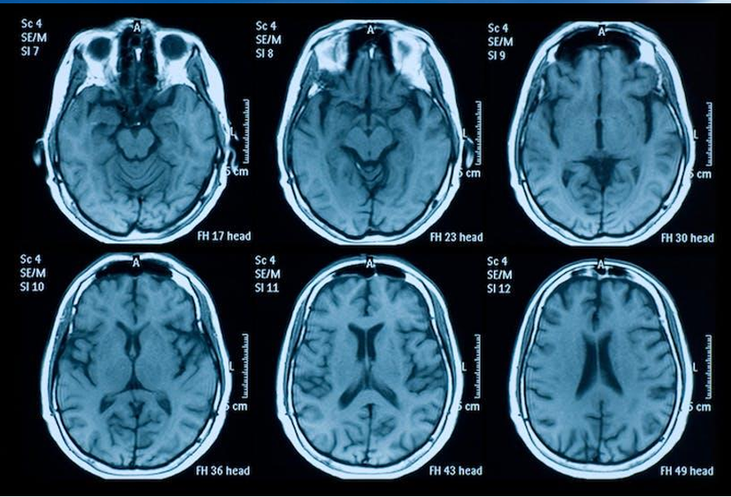
Visualization-Examples

Slide 7
Visualization
Definition: “Computer-based visualization provides visual representations of datasets designed to help people carry out tasks more effectively.”
Rationale behind many aspects of this definition
Why have a human in the loop?
Why have a computer in the loop?
Why use an external representation?
Why depend on vision?
Why represent all the data?
Why focus on tasks and effectiveness?

Slide 8
Human in the Loop
"Human in the loop" means that a person is involved in the process of analyzing and making decisions using visual data. The system is not fully automated; it needs a human’s judgment, intuition, or feedback.
Humans are better than computers at understanding real-world context, noticing meaningful patterns, and making wise decisions when the data is unclear or confusing.
In a hospital, a chart shows a patient's heart rate over time. A doctor (the human) sees a sudden spike and decides to take action, even if the system didn’t trigger an alert.

Slide 9
Computer in the Loop
The computer collects, processes, and displays large amounts of data, often in real-time. It’s fast, accurate, and never gets tired.
Computers help automate tasks, process huge datasets, and create visuals instantly, which humans cannot do alone.
A retail dashboard updates sales from hundreds of stores every second, a task too large for a person to do manually.

Slide 10
External representation
Instead of keeping all the information in your mind, you show it outside, like a chart, graph, or map, something visible and physical/digital.
External visuals reduce memory load. It’s easier to think, spot trends, or explain things when data is seen, not remembered.
Rather than remembering 20 values, a bar chart shows them all, and you can immediately see which one is the highest.

Slide 11
Depend on Vision
This means using our eyes to understand data, by seeing it in a visual format (charts, colors, shapes) instead of reading tables or code.
Our brain processes visuals faster than text or numbers. We naturally detect shapes, trends, and anomalies.

Slide 12
Represent all the Data
It means don’t hide or summarize too early, try to show as much of the original data as needed for proper analysis.
Showing all data helps you spot outliers, errors, or unexpected trends. It supports transparent decision-making.

Slide 13
Focus on Tasks and Effectiveness
Don’t just make visuals look “cool”, make sure they help people complete a task or answer a question effectively.
The purpose of visualization is to solve problems, make decisions, or understand situations, not just decoration.

Slide 14
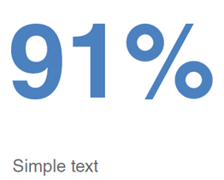
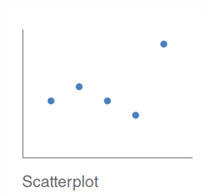
Choosing Effective Visuals (most commonly used)
Simple Text: Used for displaying key performance indicators (KPIs), such as total revenue, active users, or profit margin, in a clear and immediate way.
Scatterplot: Ideal for showing relationships and correlations between two numerical variables, such as customer age vs. purchase frequency in an e-commerce dashboard.

Slide 15
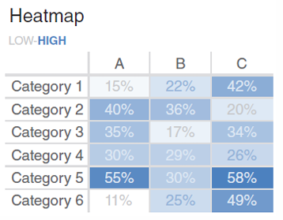
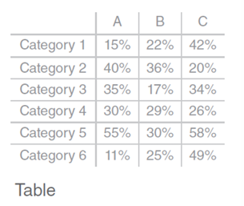
Choosing Effective Visuals (most commonly used)
Heatmap: Useful for identifying patterns in large datasets, such as showing peak website traffic hours across different days of the week.
Table: Best suited for displaying detailed, structured data, such as a list of transactions, employee performance metrics, or inventory stock levels.

Slide 16
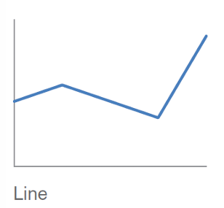
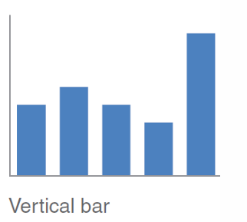
Choosing Effective Visuals (most commonly used)
Line Chart: Ideal for tracking trends over time, such as monthly sales growth, stock prices, or website traffic over the past year
Vertical Bar Chart: Best for comparing categories, such as revenue by product type or sales performance across different regions.

Slide 17

Tools and Methods

