Slide 1

Fall-2026
Database
Management
Systems
Turning Raw Data into Meaningful Information
Week 05

Slide 2
2
Reference
Books
Modern Database Management
By Jeffrey A. Hoffer, V. Ramesh, Heikki Topi
13th Edition
1
Fundamentals of Database Management Systems
By Mark L. Gillenson
2nd Edition
2

Slide 3
3
Week 05 Overview
ER Model
Constraints & Design
Entities and entity sets
Attributes and their types
Keys: primary, candidate, composite
Relationships and relationship sets
Degree of relationships
Mapping cardinalities
Participation constraints
Weak entities
ISA hierarchies
Aggregation
Conceptual design choices
ER diagram practice

Slide 4
4
Lectures
Entity Relationship Model
Source: Chapter 2, Database System Concepts — Silberschatz, Korth, Sudarshan
Courtesy: Aasma Zahid, Asst. Prof., Dept. of SE, FJWU
Student
Enrolls
Course

Slide 5
5
Data Models
Recap
A collection of tools for describing:
Data
Data relationships
Data semantics
Data constraints
Examples of data models
Entity-Relationship model
Relational model

Slide 6
6
ER Model and Relational Model
Recap
ER Model
Relational Model
A high-level data model based on the perception of a real world comprising a collection of entities and of relationships among these entities.
A lower-level data model that uses a collection of tables to represent both data and relationships among those data.

Slide 7
7
ER and Relational Models
Recap
Both are conceptual data models.
Designers formulate the database schema by first modeling the data at a high level using the ER model, and then translate it into the relational model.
Real world
ER model
(high level)
Relational model
(tables)

Slide 8
8
ER Model
A popular data model – useful to database designers
  Graphical representation of the miniworld
ER design is translated to the relational model
Elements of the ER Model
Entities
Entity Sets
Attributes
Relationships

Slide 9
9
Entity & Entity Sets
Entity
Entity Set
An entity is a thing or object in the real world that is distinguishable from other objects.
E.g. a person, a car, a bank account
Entities have attributes — e.g. people have names, addresses, etc.
An entity set is a set of entities of the same type that share the same properties.
E.g. the set of customers in a bank, the set of all students in a college.

Slide 10
10
Entity & Entity Sets
Examples of entities
Naming and defining entity types
Person
Employee, Student, Patient
An entity type name is a singular noun
An entity type should be descriptive and specific
An entity name should be concise
Place
Store, Warehouse
Object
Machine, Product, Car
Event
Sale, Registration, Renewal
Department
Student
Concept
Account, Course
Entity set — represented by a rectangle

Slide 11
11
Attributes
An entity is represented by a set of attributes, that is, descriptive properties possessed by all members of an entity set.
E.g. name, address, weight, height are properties of a Person entity.
Guidelines for naming attributes
An attribute name is a noun
An attribute name should be unique
1
2
Each attribute name should follow a standard format, to keep it unique and clear
Similar attributes of different entity types should use similar but distinguishing names
3
4

Slide 12
12
Attributes
Properties of entities in an entity set
Like fields in a struct
Like columns in a table/spreadsheet
Like data members in an object
ID
Name
Domain
The set of permitted values for each attribute — e.g. Name can be text strings of a certain length.
Student
Attributes are represented by ovals

Slide 13
13
Attributes: Types
Simple & Composite Attributes
Simple attributes contain a single value.
EmpNo
Employee
Name
ID

Slide 14
14
Attributes: Types
Simple & Composite Attributes
Composite attributes can be divided into sub-parts.
EmpNo
FirstName
Employee
Name
MidName
LastName
ID
Name is composite

Slide 15
15
Attributes: Types
Single-Valued & Multi-Valued Attributes
Multi-valued attributes contain more than one value.
Phone
Employee
double oval
Email

Slide 16
16
Attributes: Types
Derived Attributes
Derived attributes are computed from other attributes.
Can be derived from DoB
Age
Employee
Bonus
dashed oval = derived
Can be derived from salary

Slide 17
17
Attributes: Types
Key Attributes
Key attributes uniquely identify an entity.
ERD
Tabular
EmpNo | Name | ...
123456 | John Wong | ...
456789 | Mary Cheung | ...
146777 | John Wong | ...
EmpNo
Employee
Name

Slide 18
18
Attributes: Types
Composite Key
Name or Address alone cannot uniquely identify an employee, but together they can!
Address
Employee
together = key
Name

Slide 19
19
Attributes: Types
An entity can have more than one candidate key.
One of them is selected as the key — the primary key.
In many cases, a key is artificially introduced (e.g. EmpNo) to make applications more efficient.
Unique
EmpNo
Primary Key
Employee
Name
SS_Number
Unique

Slide 20
20
Relationship
A relationship is an association among several entities.
A relationship name is an active or a passive verb.
Relationship name
Author
writes
Book
An author writes a book.
A book can be written by an author.

Slide 21
21
Relationship
Given a customer and an account, the relationship deposits between them indicates that the customer deposits money into the account.
Hayes | deposits | A-102
customer entity | relationship | account entity
Students enroll in courses
Students
Enroll
Courses
Represented by a diamond

Slide 22
22
Relationships
Students enroll in courses
Courses are held in rooms
Students
Enroll
Courses
held
ID
Name
Rooms

Slide 23
23
Relationship Sets
A relationship set is a set of relationships of the same type.
Mathematically, a relationship set is a relation among n ≥ 2 entity sets. If E1, E2, …, En are entity sets, then a relationship set R is a subset of:
{ (e1, e2, …, en) | e1 ∈ E1, e2 ∈ E2, …, en ∈ En }
where (e1, e2, …, en) is a relationship.
Example: (Hayes, A-102) ∈ Deposits

Slide 24
24
Representation of a Relationship
Deposits
Customers
Accounts
CustomerNo | AccountNo
A123456 | A-101
B456789 | A-201
B456789 | A-302
A-101
A123456
A-201
B456789
A-302
Each line is one relationship in the Deposits set

Slide 25
25
Relationship Sets
Relationships can have descriptive attributes.
For instance, the deposits relationship set between entity sets customer and account may have the attribute access-date.
CustomerNo | AccountNo | AccessDate
A123456 | A-101 | 25 Aug 2010
B456789 | A-201 | 3 June 2009
B456789 | A-302 | 2 Mar 2010
Can we add multiple access dates?
Note: A relationship instance in a relationship set must be uniquely identifiable from its participating entities, without using the descriptive attributes.

Slide 26
26
Degree of Relationships
Degree: the number of entity types that participate in a relationship. Three cases:
Unary
Binary
Ternary
Between two instances of one entity type
Between the instances of two entity types
Among the instances of three entity types
E
R
E1
R
E2
E1
R
E2
E3

Slide 27
27
Unary / Recursive Relationships
A relationship relating entities of the same type.
Employees play different roles: manager or worker.
You can “unfold” a recursive relationship to understand it:
manager
Employee
work-for
worker
manager
worker
Employee
work-for
Employee

Slide 28
28
Unary / Recursive Relationships
Without role names
With role names
EmployeeNo | EmployeeNo
A1234 | A6543
A1234 | A8734
ManagerNo | WorkerNo
A1234 | A6543
A1234 | A8734
Here, ManagerNo and WorkerNo are valid EmployeeNo values.

Slide 29
29
Binary & Ternary Relationships
Binary: Employee works in a Department
Employee
Works_In
Department
Ternary: Employee works in a Department at a particular Location
Employee
Works_In
Department
Location

Slide 30
30
Mapping Cardinalities
Express the number of entities to which another entity can be associated via a relationship set.
Most useful in describing binary relationship sets.
For a binary relationship set, the mapping cardinality must be one of the following types:
1 : 1
1 : M
M : 1
M : N
One to one
One to many
Many to one
Many to many

Slide 31
31
Mapping Cardinalities
One to One (1:1)
An entity in A is associated with at most one entity in B, and an entity in B is associated with at most one entity in A.
A
B
a1
b1
Customer
Borrows
Loan
a2
b2
a3
b3
A customer can borrow 1 loan, and vice versa.
Some elements in A and B may not be mapped to any elements in the other set.
a4
b4

Slide 32
32
Mapping Cardinalities
One to Many (1:M)
An entity in A is associated with any number (zero or more) of entities in B. An entity in B, however, can be associated with at most one entity in A.
A
B
b1
Customer
Borrows
Loan
a1
b2
a2
b3
A customer can borrow more than 1 loan, whereas a loan has only one borrower.
Some elements in A and B may not be mapped to any elements in the other set.
a3
b4
b5

Slide 33
33
Mapping Cardinalities
Many to One (M:1)
An entity in A is associated with at most one entity in B. An entity in B, however, can be associated with any number (zero or more) of entities in A.
A
B
a1
An arrow (→) in the ER diagram points to the “one” side of a relationship.
a2
b1
a3
b2
a4
b3
a5

Slide 34
34
Mapping Cardinalities
Many to Many (M:N)
An entity in A is associated with any number (zero or more) of entities in B, and an entity in B is associated with any number (zero or more) of entities in A.
A
B
a1
b1
Customer
Borrows
Loan
a2
b2
a3
b3
A customer can borrow more than one loan.
A loan can have more than one borrower.
a4
b4

Slide 35
35
Lecture
ER Constraints & Conceptual Design
1
Participation constraints
2
Weak entities
3
ISA hierarchies & aggregation
4
Conceptual design choices
5
ER diagram practice

Slide 36
36
Participation Constraints
Total Participation
The participation of an entity set E in a relationship set R is said to be total if every entity in E participates in at least one relationship in R.
Partial Participation
If only some entities in E participate in relationships in R, the participation of entity set E in relationship R is said to be partial.

Slide 37
37
Participation Constraints
Example
Partial
Total
Customer
Borrows
Loan
Thin line = partial participation · Thick line = total participation
Every loan must have a customer.
Not every customer (of the bank) borrows a loan.

Slide 38
38
Participation Constraints
Does every department have a manager?
If so, this is a participation constraint: the participation of Departments in Manages is said to be total (vs. partial).
Every department MUST have at least one employee.
Every employee MUST work in at least one department.
There may exist employees managing no department.
name
since
dname
ssn
lot
did
budget
Employees
Manages
Departments
Works_In
since

Slide 39
39
Weak Entities
A weak entity can be identified uniquely only by considering the primary key of another (owner) entity.
Owner entity set and weak entity set must participate in a one-to-many relationship set (one owner, many weak entities).
Weak entity sets must have total participation in this identifying relationship set.
transac# is a discriminator within a group of transactions in an ATM.
address
amount
transac#
atmID
since
type
ATM
Transactions
double diamond = identifying relationship

Slide 40
40
ISA (‘is a’) Hierarchies
As in C++ or other programming languages, attributes are inherited.
If we declare A ISA B, every A entity is also considered to be a B entity.
Reasons for using ISA:
  To add descriptive attributes specific to a subclass
  To identify entities that participate in a relationship
ssn
name
lot
Employees
ISA
hourly_wages
hours_worked
contractid
Hourly_Emps
Contract_Emps
Overlap constraints: Can Joe be an Hourly_Emps as well as a Contract_Emps entity? If so, specify Hourly_Emps OVERLAPS Contract_Emps.
Covering constraints: Does every Employees entity also have to be an Hourly_Emps or a Contract_Emps entity? If so, write Hourly_Emps AND Contract_Emps COVER Employees.

Slide 41
41
Aggregation
Used when we have to model a relationship involving (entity sets and) a relationship set.
Aggregation allows us to treat a relationship set as an entity set for purposes of participation in (other) relationships.
Employees are assigned to monitor SPONSORSHIPS.
ssn
name
lot
Employees
Monitors
until
pid
started_on
pbudget
since
did
dname
budget
Projects
Sponsors
Departments
Aggregation vs. ternary relationship
Monitors and Sponsors are distinct relationships, with descriptive attributes of their own. Also, we can say that each sponsorship is monitored by at most one employee (which we cannot do with a ternary relationship).

Slide 42
42
Exercise: Car Entity
Model a Car entity with the following attributes:
Type
Doors
Name
Make
Car
Company
Color
Wheels
Chassis
Which attribute could be the key?

Slide 43
43
Conceptual Design Using the ER Model
Design choices
Constraints in the ER Model
Should a concept be modeled as an entity or an attribute?
Should a concept be modeled as an entity or a relationship?
Identifying relationships: binary or ternary? Aggregation?
A lot of data semantics can (and should) be captured.
But some constraints cannot be captured in ER diagrams.

Slide 44
44
Entity vs. Attribute
Should address be an attribute of Employees or an entity (connected to Employees by a relationship)?
It depends on how we want to use address information, and on the semantics of the data:
If…
Several addresses per employee
Address must be an entity, since attributes cannot be set-valued.
If…
Structure matters (city, street, etc.)
E.g. to retrieve employees in a given city, address must be modeled as an entity, since attribute values are atomic.

Slide 45
45
Entity vs. Attribute (Contd.)
Works_In4 does not allow an employee to work in a department for two or more periods (a relationship is identified by its participating entities).
Similar to the problem of wanting to record several addresses for an employee: we want to record several values of the descriptive attributes for each instance of this relationship.
Accomplished by introducing a new entity set, Duration.
name
dname
from
to
ssn
lot
did
budget
Employees
Works_In4
Departments
name
dname
ssn
lot
did
budget
Employees
Works_In4
Departments
from
Duration
to

Slide 46
46
Entity vs. Relationship
The first ER diagram is OK if a manager gets a separate discretionary budget for each department.
What if a manager gets a discretionary budget that covers all managed departments?
  Redundancy: dbudget is stored for each department managed by the manager.
  Misleading: suggests dbudget is associated with the department–manager combination.
name
dname
ssn
lot
since
dbudget
did
budget
Employees
Manages2
Departments
name
ssn
lot
dname
Employees
since
did
budget
Manages2
Departments
ISA
Managers
This fixes the problem!
dbudget

Slide 47
47
Binary vs. Ternary Relationships
name
Suppose:
  A policy cannot be owned by more than one employee.
  Every policy must be owned by some employee.
  Dependent is a weak entity set, identified by policyid.
ssn
lot
pname
age
Employees
Covers
Dependents
Policies
Bad design
policyid
cost
pname
age
name
Dependents
ssn
lot
Employees
Purchaser
Policies
Beneficiary
Better design
policyid
cost

Slide 48
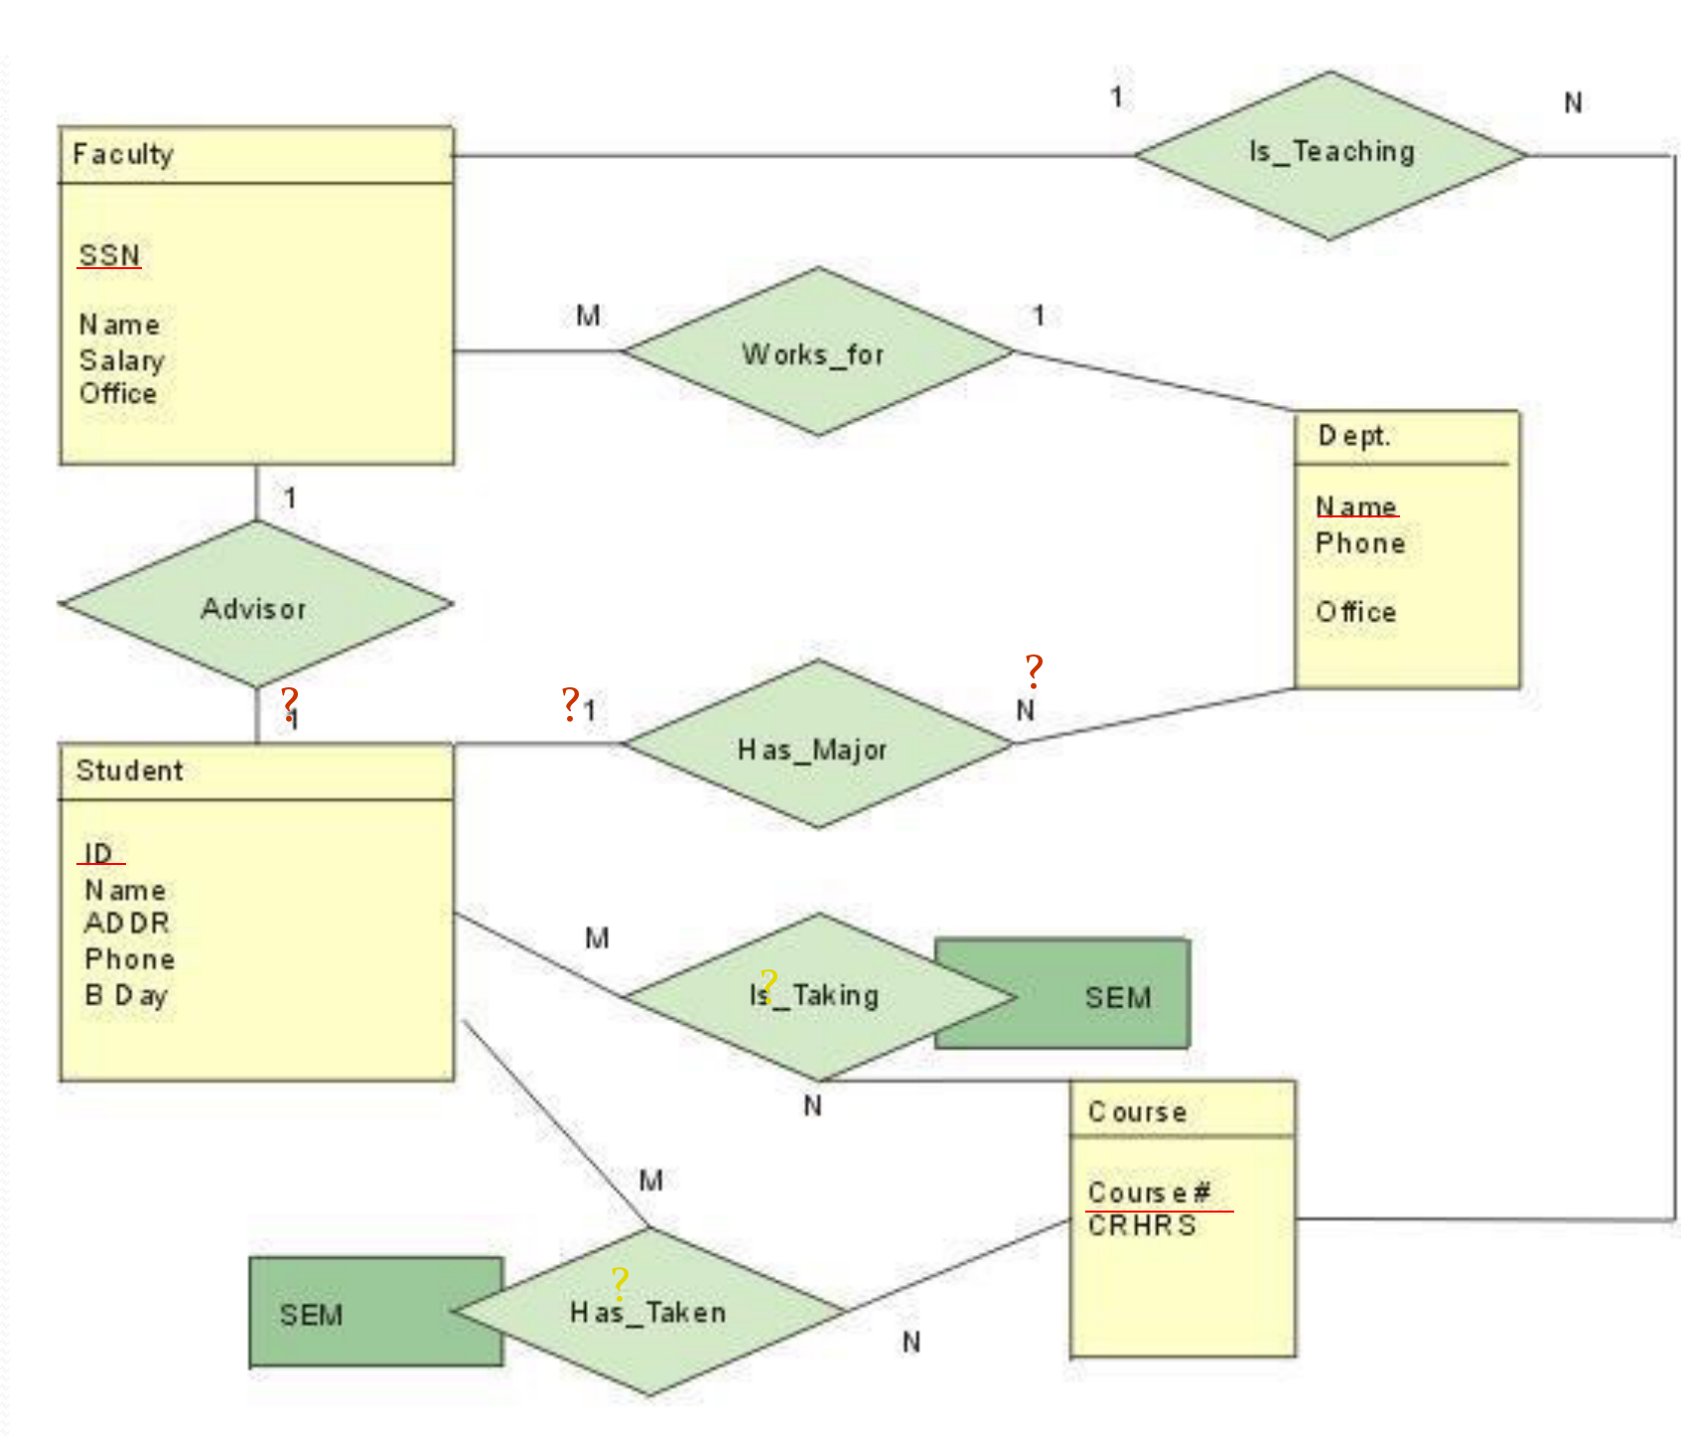
48
ER Diagram Practice 1
Practice
Identify the cardinalities marked with “?”
Diagram source: Yan Huang, CSCE4350

Slide 49
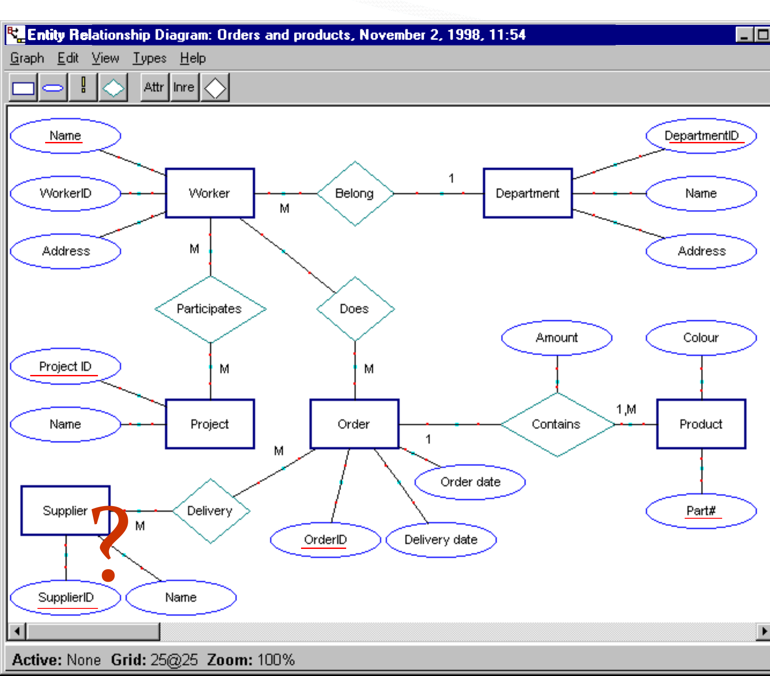
49
ER Diagram Practice 2
Practice
Orders and products: identify the missing elements marked with “?”
Diagram source: Yan Huang, CSCE4350

Slide 50
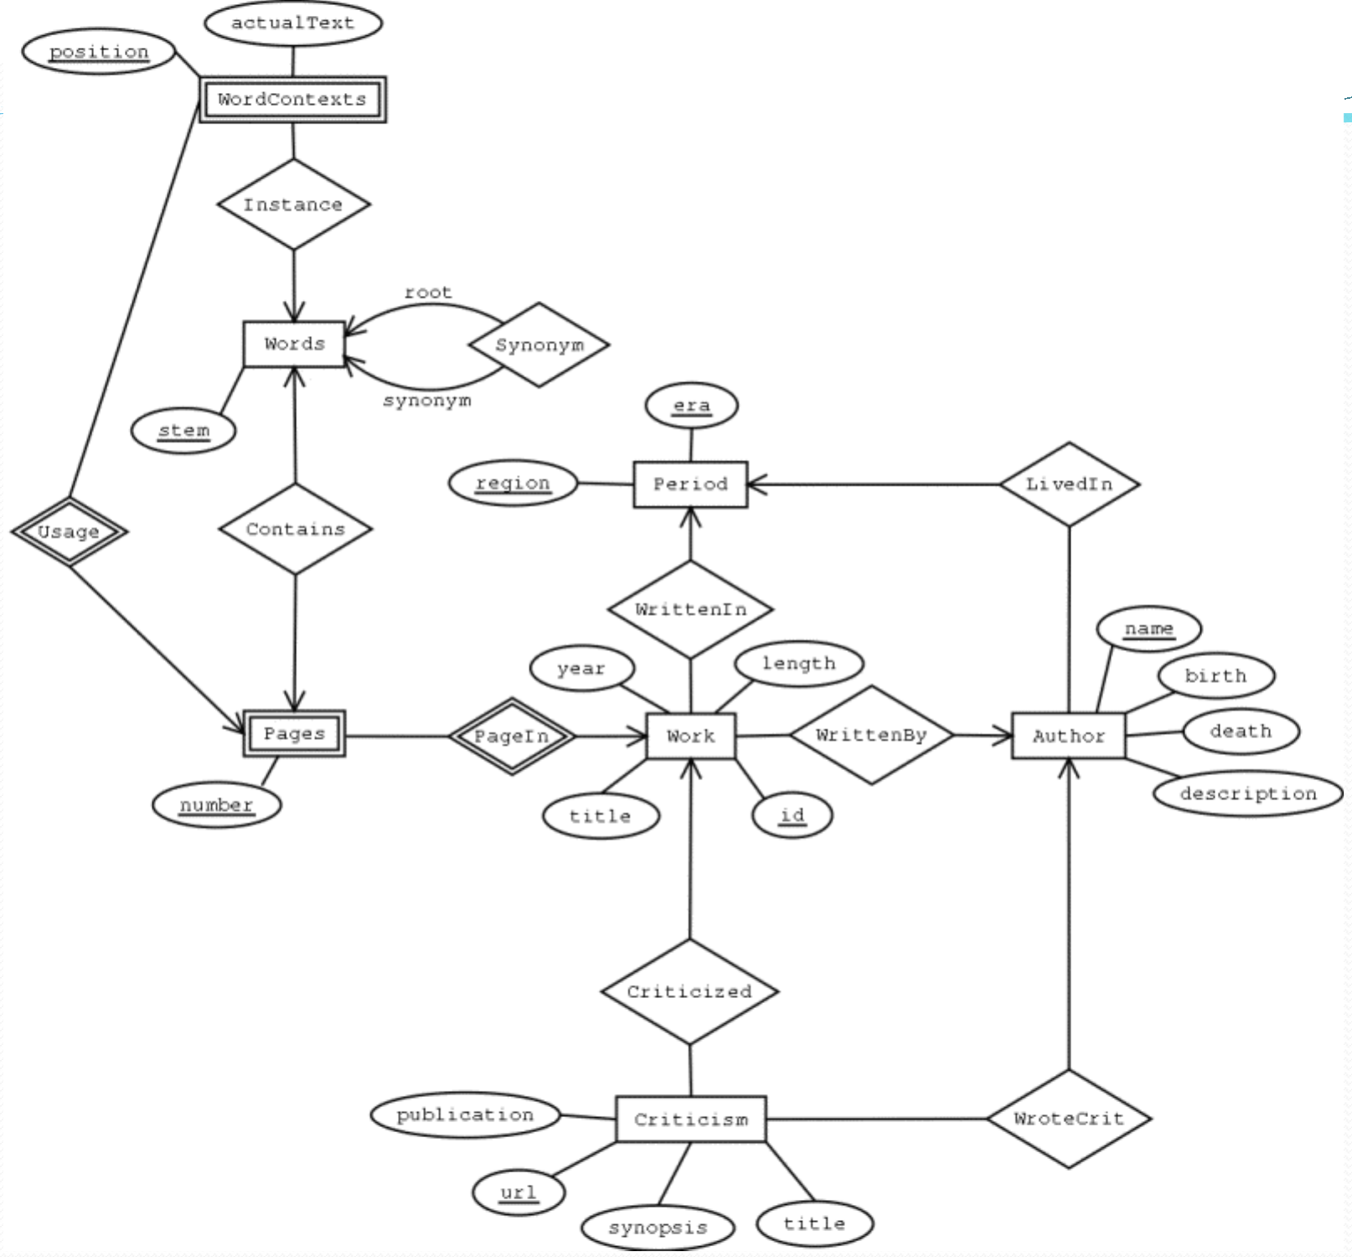
50
ER Diagram Practice 3
Practice
Read the diagram: name each entity, weak entity and relationship
Diagram source: Yan Huang, CSCE4350

Slide 51
51
Connectivity and Cardinality
Figure 4.7 Connectivity and cardinality in an ERD
Connectivities
PROFESSOR
CLASS
teaches
(1,1)
(1,4)
Cardinalities

Slide 52
52
References
Books
Database System Concepts
By Abraham Silberschatz, Henry F. Korth, S. Sudarshan
Chapter 2 (source of this week's slides)
1
Modern Database Management
By Jeffrey A. Hoffer, V. Ramesh, Heikki Topi
13th Edition
2
Fundamentals of Database Management Systems
By Mark L. Gillenson
2nd Edition
3

