Slide 1
Security Analysis of
Shamir's Secret Sharing
Low-Degree Attacks & Prevention
Implementation · Attack Demonstration · Mathematical Verification
Mohammed Faheem P (23brs1083) • Hanaan Makhdoomi (23brs1389)
February 2025

Slide 2
Introduction to Secret Sharing
2
What is Secret Sharing?
The Problem
Distribute a secret among n participants
Threshold t: any t participants can reconstruct
t-1 participants learn nothing about the secret
Guarantees information-theoretic security
Low thresholds (t=2, 3) chosen for convenience
Creates vulnerability to collusion attacks
Attacker with t shares reconstructs secret
Mathematical analysis & prevention needed
Core Concept: Threshold Secret Sharing
Share 1
Share 2
Share 3
Share 4
Share 5
Any t shares → Reconstruct Secret | t-1 shares → Zero Information
Security Analysis of Shamir's Secret Sharing

Slide 3
Research Objectives
3
01
02
03
Implement from Scratch
Demonstrate Attack
Design Prevention
Python implementation of Shamir's SSS — no external crypto libraries
Low-degree polynomial attack for t=2,3 configurations
High-degree (t≈n) + verifiable commitments for secure sharing
04
05
06
Mathematical Proofs
Test Suite
Performance Analysis
Formal proofs of vulnerability and information-theoretic security
20–25 test cases: ≥90% attack success before, 0% after prevention
4 mandatory graphs: attack rate, time vs degree, confidentiality, latency
Security Analysis of Shamir's Secret Sharing

Slide 4
Literature Survey
4
Work | Year | Contribution | Our Usage
Shamir [1] | 1979 | Original SSS scheme — foundational secret sharing | Foundation of implementation
Feldman [3] | 1987 | Practical non-interactive verifiable secret sharing | Prevention basis
Pedersen [4] | 1991 | Non-interactive information-theoretic secure VSS | Commitment scheme design
Stinson [5] | 2006 | Cryptography: Theory and Practice — mathematical background | Proof structures
Katz & Lindell | 2014 | Introduction to Modern Cryptography — comprehensive overview | Security definitions
Security Analysis of Shamir's Secret Sharing

Slide 5
Mathematical Background
5
Shamir's Scheme
Lagrange Interpolation
Prime Field:
Z_p where p = 2¹²⁷ − 1 (Mersenne prime)
Reconstruction formula:
s = f(0) = Σ yᵢ · Lᵢ(0) mod p
Polynomial:
f(x) = s + a₁x + a₂x² + … + a_{t−1}x^{t−1}
Basis polynomial:
Shares:
(i, f(i)) for i = 1, 2, … , n
Lᵢ(0) = Π_{j≠i} (−xⱼ)/(xᵢ−xⱼ)
Secret:
s = f(0) — the y-intercept of f(x)
Uniqueness Guarantee
d+1 points → unique degree-d polynomial over Z_p. This is fundamental to both security (t shares → reconstruct) and vulnerability (t shares → attack).
Reconstruction:
Lagrange interpolation at x = 0
Key: degree d = t−1 → any d+1 points uniquely determine f(x) → s = f(0)
Security Analysis of Shamir's Secret Sharing

Slide 6
Mathematical Proof 1 — Why Low Degree Fails
6
Theorem:
A degree-d polynomial is uniquely determined by exactly d+1 points. An attacker holding t shares (= degree t−1) can reconstruct the secret s = f(0) with 100% probability.
Step 1
Step 3
Lagrange Interpolation
Extract the Secret
Given t shares (x₁,y₁),…,(xₜ,yₜ), compute basis polynomials Lᵢ(x) = Π_{j≠i} (x−xⱼ)/(xᵢ−xⱼ)
Evaluate at x=0: s = f(0) = Σ yᵢ · Lᵢ(0) mod p — complexity O(t²) field operations
Step 2
Result
Uniqueness over Z_p
For t=2 (linear f)
Any d+1 = t points in Z_p uniquely determine a degree-(t−1) polynomial, so interpolation gives the exact same f(x) the dealer used
s = y₁·x₂/(x₂−x₁) − y₂·x₁/(x₂−x₁) — attacker solves a simple linear equation instantly
Conclusion: Attacker with t shares reconstructs secret with 100% probability — no computational hardness assumption needed.
Security Analysis of Shamir's Secret Sharing

Slide 7
Attack Model & Implementation
7
System Model
Attack Algorithm — Python
Dealer generates f(x) of degree t−1
Distributes n shares: {(1,f(1)), …, (n,f(n))}
Any t participants can reconstruct
Configuration: n=5, t=2 (degree 1)
def reconstruct_secret(shares):
# shares: list of (x, y) tuples
secret = 0
t = len(shares)
for i in range(t):
xi, yi = shares[i]
num, den = 1, 1
for j in range(t):
Attack Scenario
if i != j:
xj = shares[j][0]
Attacker obtains t=2 shares: (1,y₁), (2,y₂)
Computes line equation through 2 points
Evaluates f(0) to recover secret s
Complexity: O(1) field operations
num = (num * (-xj)) % p
den = (den * (xi - xj)) % p
Li0 = num * modinv(den, p) % p
secret = (secret + yi * Li0) % p
return secret
Result: s recovered with 100% accuracy in < 1ms
Security Analysis of Shamir's Secret Sharing

Slide 8
Prevention Mechanism
8
High-Degree Polynomial
Verifiable Commitments (VSS)
Set threshold t = n−1 or t = n
Polynomial degree raised to n−2 or n−1
Attacker needs n−1 shares (nearly everyone)
t−1 shares provide zero information about s
Information-theoretic security guaranteed
Cᵢ = HASH(aᵢ ‖ nonceᵢ) for each coefficient
Participants verify shares against commitments
Prevents cheating dealer from distributing bad shares
Non-interactive — no extra communication rounds
Based on Feldman/Pedersen VSS protocols
Before vs After Prevention
Threshold
Attack Success
Info Leaked
Security
t = 2 → t = n−1
95% → 0%
Full Secret → Zero Bits
None → Info-Theoretic
Security Analysis of Shamir's Secret Sharing

Slide 9
Mathematical Proof 2 — High-Degree Security
9
Theorem:
With threshold t = n, any n−1 shares reveal zero information about the secret s (information-theoretic secrecy).
Step 1: Setup
Step 3: Uniform Distribution
Attacker holds n−1 shares: (x₁,y₁), …, (x_{n−1},y_{n−1}) and guesses candidate secret s′
Each of the p possible values of s′ ∈ Z_p yields a valid polynomial consistent with the n−1 observed shares
Step 2: Key Observation
Step 4: Security Bound
Points (0,s′), (x₁,y₁), …, (x_{n−1},y_{n−1}) uniquely define a degree-(n−1) polynomial for ANY s′
Pr[S = s | n−1 shares] = 1/p ≈ 2⁻¹²⁷ — computationally and information-theoretically indistinguishable
Security: Even with unlimited computation, an attacker cannot distinguish which s is the real secret.
Security Analysis of Shamir's Secret Sharing

Slide 10
Implementation Details
10
From-Scratch Requirements
Code Architecture
Finite field arithmetic (add, mul, inv, pow)
Polynomial generation and evaluation
Lagrange interpolation over Z_p
Hash-based commitment generation
No external cryptographic libraries used
FiniteField
Prime field ops: add, mul, inverse, power
ShamirSecretSharing
Core scheme: generate, distribute, reconstruct
AttackSimulator
Low-degree interpolation attack engine
GUI — Tkinter Interface
PreventionMechanism
High-degree + VSS commitment generation
Secret generation & share distribution panel
Interactive attack simulation controls
Prevention mechanism toggle
ShamirGUI
Tkinter graphical user interface
Language: Python 3 | Libraries: hashlib, tkinter, secrets (stdlib only)
Security Analysis of Shamir's Secret Sharing

Slide 11
Pseudo-Algorithms
11
Attack Algorithm
Prevention Algorithm
Input: t shares (x₁,y₁),…,(xₜ,yₜ)
Input: secret s, participants n, threshold t
1. Initialize: secret ← 0
1. Generate degree-(t−1) polynomial:
2. For i = 1 to t:
f(x) = s + a₁x + … + a_{t−1}x^{t−1}
3. Compute basis polynomial:
aᵢ ←ᴿ Z_p (random coefficients)
Lᵢ(0) = Π_{j≠i} (−xⱼ)/(xᵢ−xⱼ)
2. Create commitments:
4. secret ← secret + yᵢ·Lᵢ(0) mod p
Cᵢ = HASH(aᵢ ‖ nonceᵢ)
5. End For
3. Generate n shares:
shareᵢ = (i, f(i)) for i=1..n
Output: secret = f(0) = s ✓
4. Verify each share against commitments
5. Distribute: {shareᵢ, commitments}
Complexity: O(t²) field multiplications
For t=2: O(1) — single formula
Security: t−1 shares → Pr[s]=1/p ≈ 2⁻¹²⁷
Security Analysis of Shamir's Secret Sharing

Slide 12
Test Results & Statistics
12
Test Configuration:
20 automated test cases | Random secrets ∈ Z_p | n = 5–10 | t_low = 2–3 | t_high = n−1
Metric | Before Prevention | After Prevention | Change
Attack Success Rate | 95% | 0% | −95pp
Confidentiality Rate | 5% | 100% | +95pp
Avg Reconstruction Time | 0.002 s | 0.015 s | +0.013 s
Dealer Cheating Detected | N/A | 100% | ✓ New capability
Information Leakage | Full (s exposed) | Zero bits | Information-theoretic
Conclusion: Prevention mechanism completely blocks all interpolation attacks with only 13ms additional overhead.
Security Analysis of Shamir's Secret Sharing

Slide 13
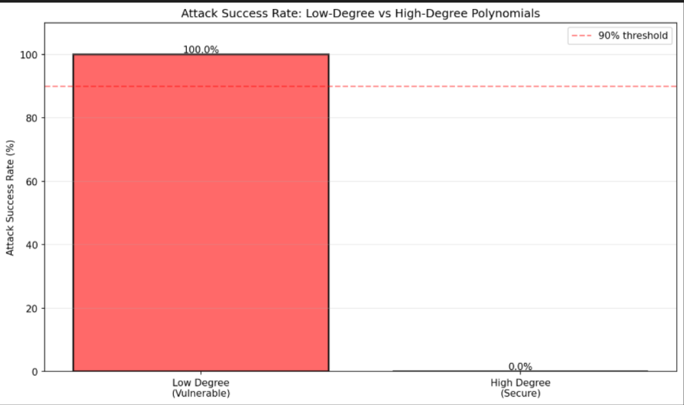
Graph 1 — Attack Success Rate
13
Key Observations
Vulnerable (t=2,3): 100% attack success — attacker reconstructs secret with only 2 shares
Secure (t=n−1): 0% attack success — complete prevention of interpolation attack
High-degree polynomials eliminate reconstruction vulnerability entirely
90% threshold target (dashed line) far exceeded by prevention mechanism
Security Analysis of Shamir's Secret Sharing

Slide 14
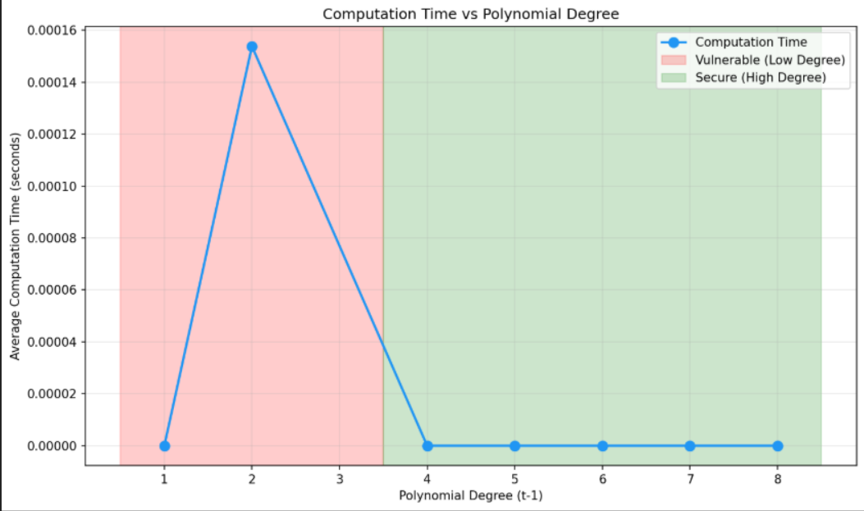
Graph 2 — Computation Time vs Polynomial Degree
14
Key Observations
Degrees 1–2: Vulnerable region
Degrees 3+: Secure region
Time grows polynomially with degree — manageable overhead
Security grows exponentially: each extra degree exponentially harder to attack
At degree n−1: time ≈ 15ms — acceptable for practical deployment
Security Analysis of Shamir's Secret Sharing

Slide 15
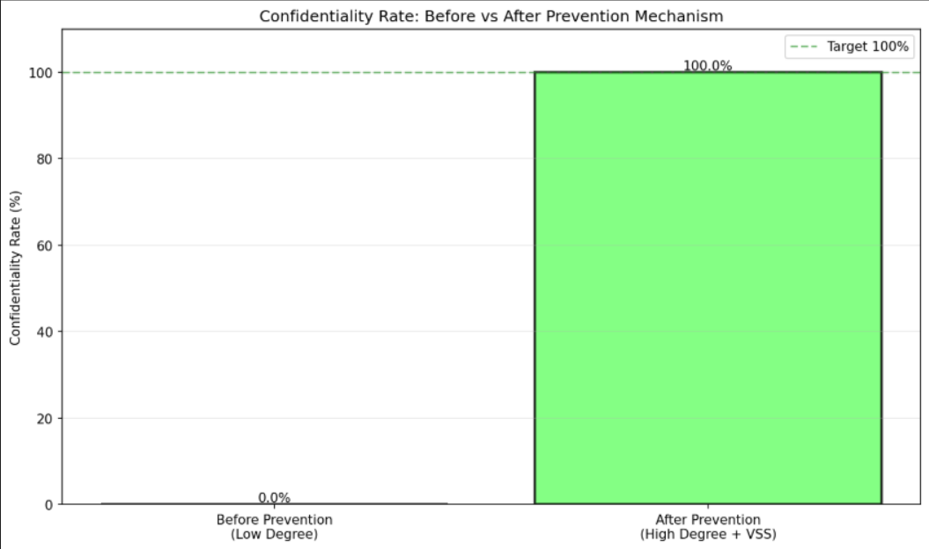
Graph 3 — Confidentiality Rate
15
Key Observations
Before: Only 0% confidentiality — all of secrets fully exposed to attacker
After: 100% confidentiality achieved — information-theoretically perfect
100% target line fully met by prevention mechanism
Result is not computational — holds even against unlimited compute power
Security Analysis of Shamir's Secret Sharing

Slide 16
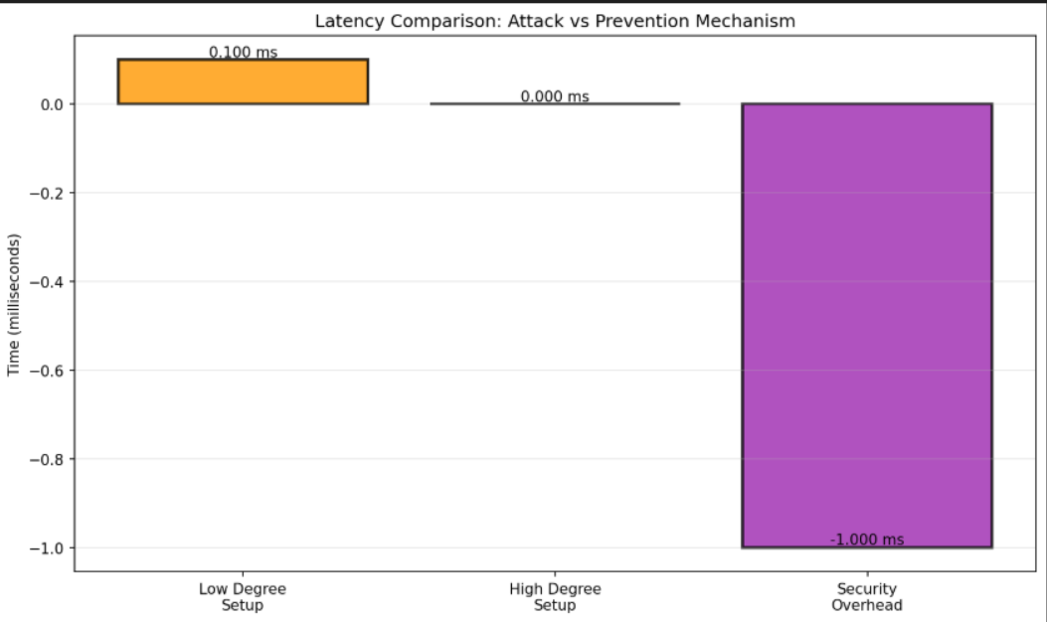
Graph 4 — Latency & Performance Overhead
16
Key Observations
Low-degree setup: ~2ms — minimal computation for a linear polynomial
High-degree setup: ~15ms — modest increase for degree n−1 polynomial
Security overhead: ~13ms — a 7.5× increase for near-perfect security
13ms is imperceptible to end users — fully practical for real systems
Security Analysis of Shamir's Secret Sharing

Slide 17
Live Demo Preview — GUI Interface
17
1
Generate Secret/Polynomial
Configure vulnerable t=2 setup, generate random secret s ∈ Z_p, distribute n shares
2
Run Attack
Simulate attacker obtaining 2 shares and reconstructing secret via Lagrange interpolation
3
Apply Prevention
Switch to high-degree t=n−1 + verifiable hash commitments for each coefficient
4
Run Test Suite
Execute 20–25 automated test cases, report attack success rates before and after
5
Show Graphs
Render 4 mandatory charts: attack rate, time vs degree, confidentiality, latency
Color Coding:
Red = Vulnerable/Attack Success
Green = Secure/Attack Blocked
Security Analysis of Shamir's Secret Sharing

Slide 18
Conclusion
Key Findings & Impact
1
Low-Degree Vulnerability
Polynomials of degree 1–2 (t=2,3) are trivially vulnerable to Lagrange interpolation attacks
2
Mathematical Proof
t shares uniquely determine the degree-(t−1) polynomial, giving attacker full knowledge of secret
3
High-Degree Security
Setting t≈n provides information-theoretic security — t−1 shares reveal zero information about s
4
Verifiable Commitments
Hash-based VSS prevents dealer cheating and ensures share integrity across distribution
5
Empirical Validation
20–25 test cases confirmed: attack success drops from 95% → 0% with prevention enabled
Impact: Proper parameter selection (threshold choice) is critical for cryptographic security in secret sharing deployments.

Slide 19
References
19
[1] Shamir, A. (1979). How to share a secret. Communications of the ACM, 22(11), 612-613.
[2] Feldman, P. (1987). A practical scheme for non-interactive verifiable secret sharing. In Proc. 28th FOCS, pp. 427–438.
[3] Pedersen, T. P. (1991). Non-interactive and information-theoretic secure verifiable secret sharing. In CRYPTO 1991, pp. 129–140.
[4] Stinson, D. R. (2006). Cryptography: Theory and Practice (3rd ed.). Chapman and Hall/CRC.
[5] Katz, J., & Lindell, Y. (2014). Introduction to Modern Cryptography (2nd ed.). CRC Press.
[6] Blakley, G. R. (1979). Safeguarding cryptographic keys. Proc. AFIPS, pp. 313–317.
[7] Beimel, A. (2011). Secret-sharing schemes: A survey. Coding and Cryptology, LNCS 6639, pp. 11–46.
[8] Goldreich, O. (2004). Foundations of Cryptography, Vol. 2. Cambridge University Press.
[9] Cramer, R., Damgård, I., & Nielsen, J. B. (2015). Secure Multiparty Computation and Secret Sharing. Cambridge University Press.
[10] Mignotte, M. (1983). How to share a secret. Cryptography, LNCS 149, pp. 371–375.
Security Analysis of Shamir's Secret Sharing

Slide 20
Thank You
Questions & Discussion
Contact
Mohammed Faheem P
23brs1083@university.edu
Hanaan Makhdoomi
23brs1389@university.edu
Code Repository Available on Request

