Slide 1
Hello Everyone
Welcome to our Presentation
Presentators
Fahim Faysal
0112230224
Sottojit Kumar
011222168
Tamjiduzzaman Shourob
0112230206

Slide 2
E-Cash
What is E-cash for?
Main Features
E-Case is an app where users can save their money and withdraw at their desired time. They can create accounts with their desired name and password .They can deposit and withdraw their money with out any charge.
Sign Up
Log In
Withdraw
Deposite

Slide 3
Home
?
login
?
signup
Thanks
Deposite
Withdraw
?
?
login
Thanks
Thanks

Slide 4
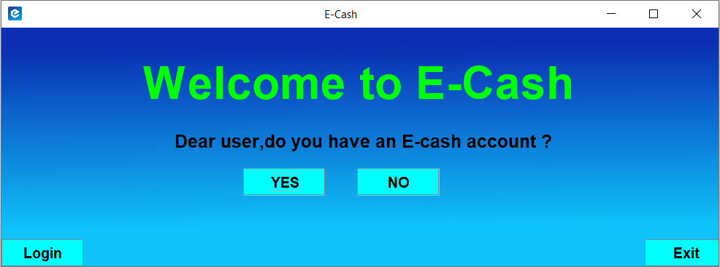
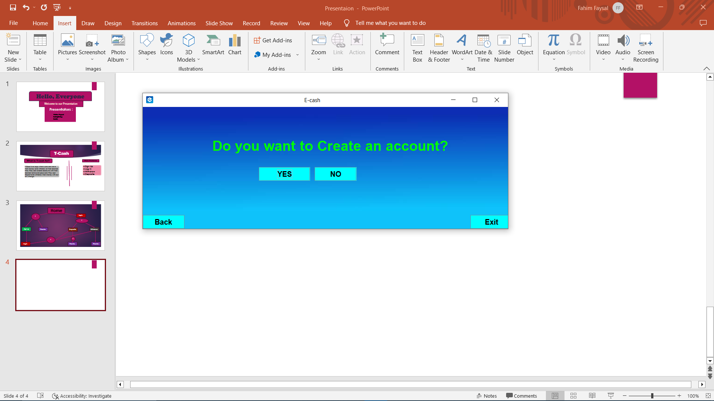
Here “Yes” and “Login” buttons do the same task. These buttons will make a move to the login page

Slide 5
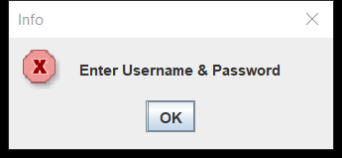
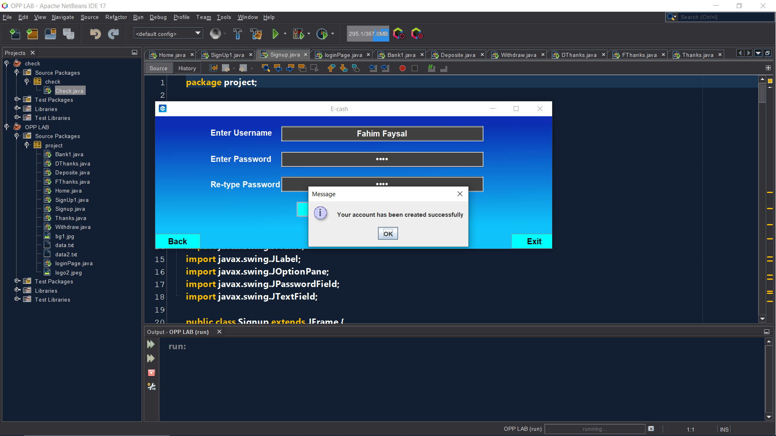
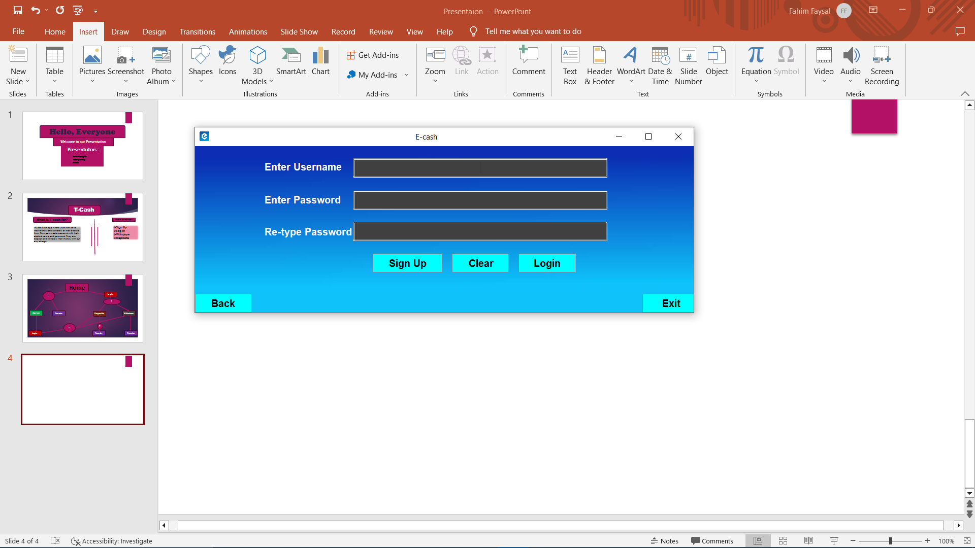
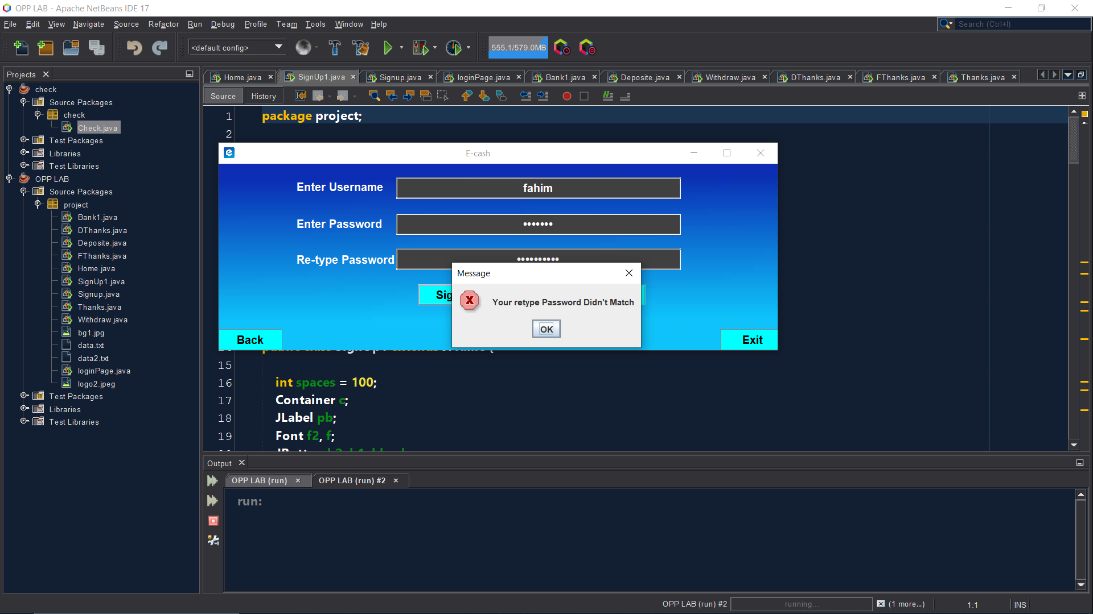
If press yes

Slide 6

If press No

Slide 7
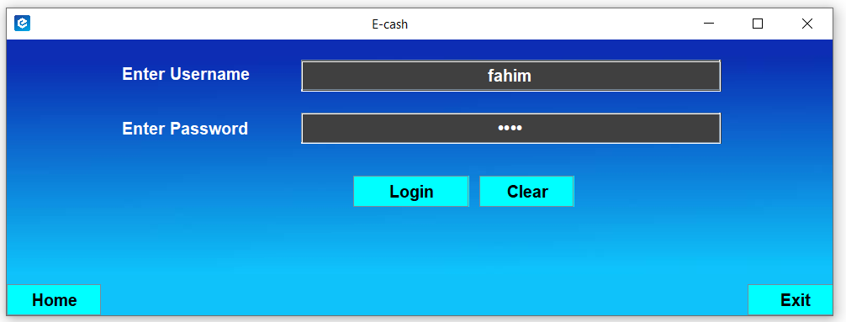
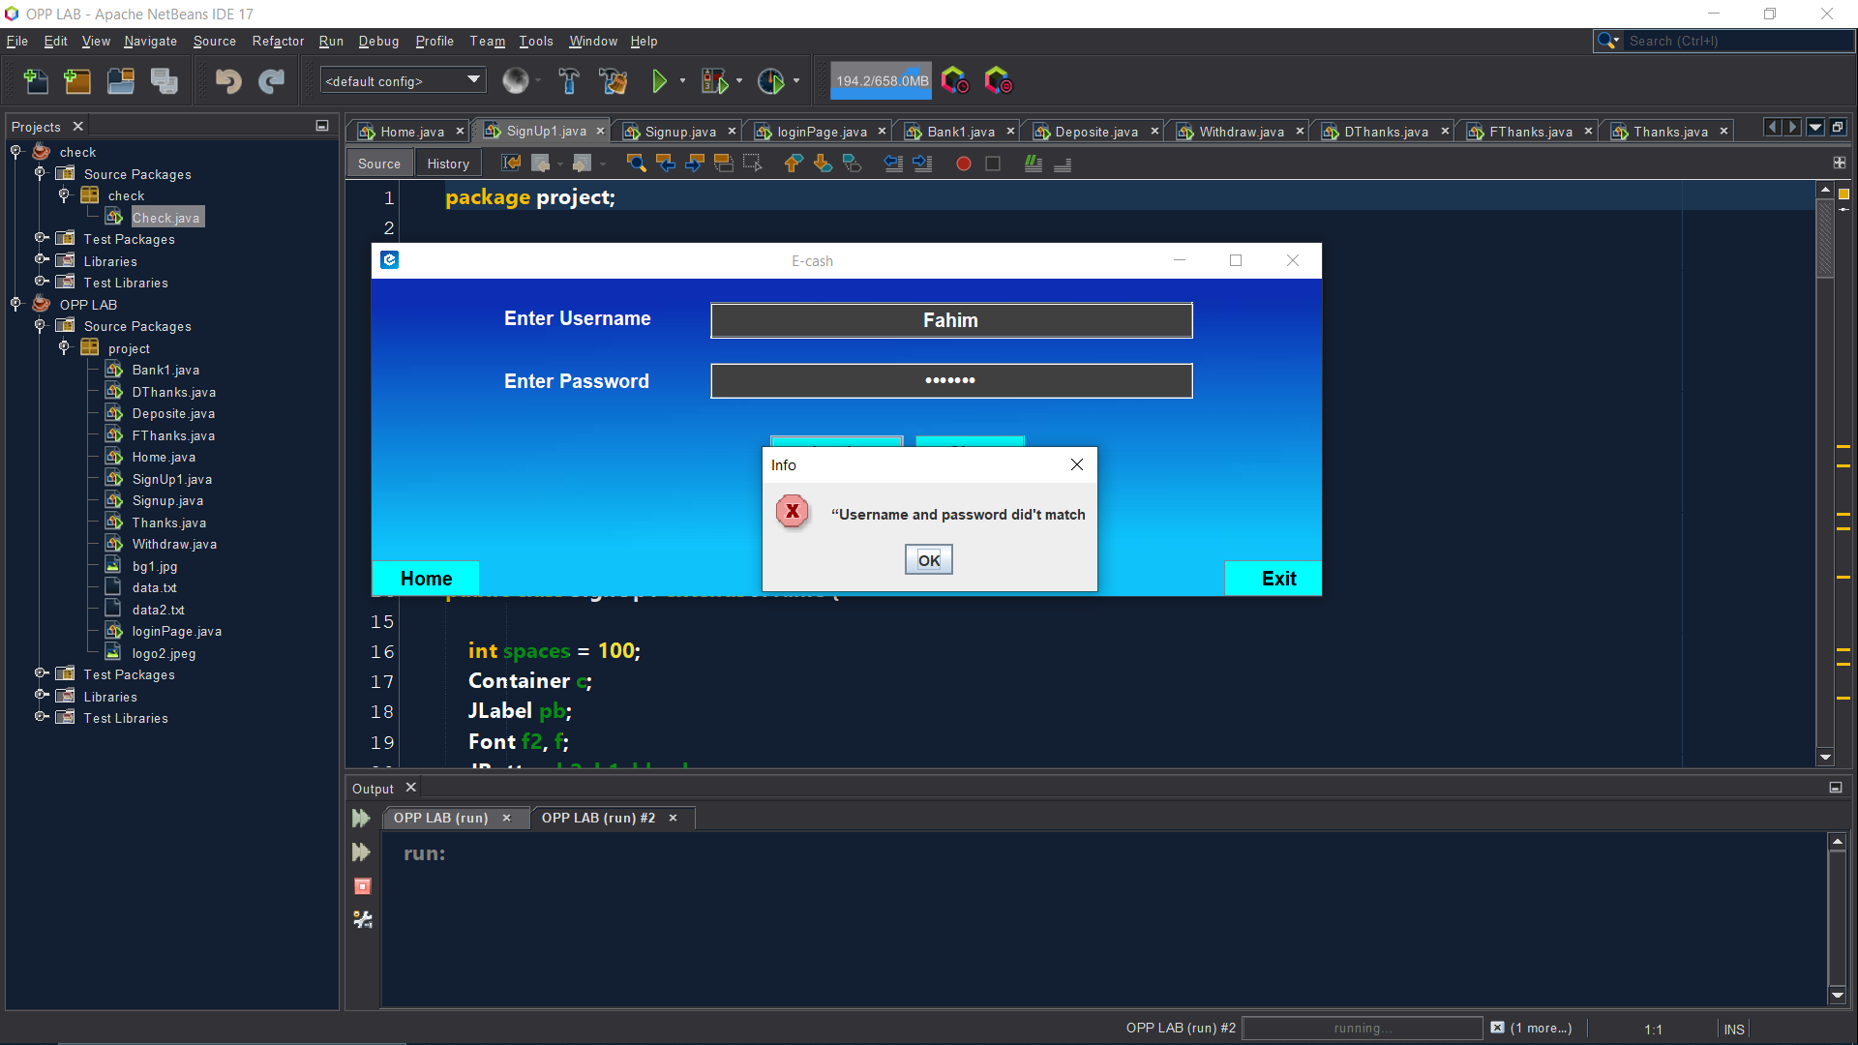

If Login successful

Slide 8
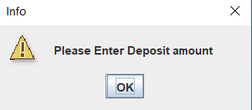
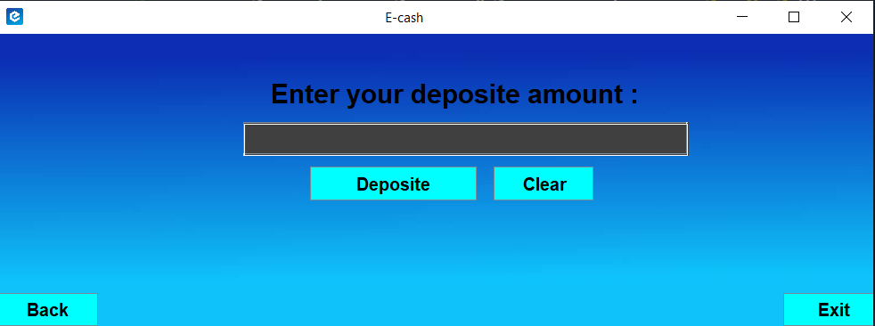
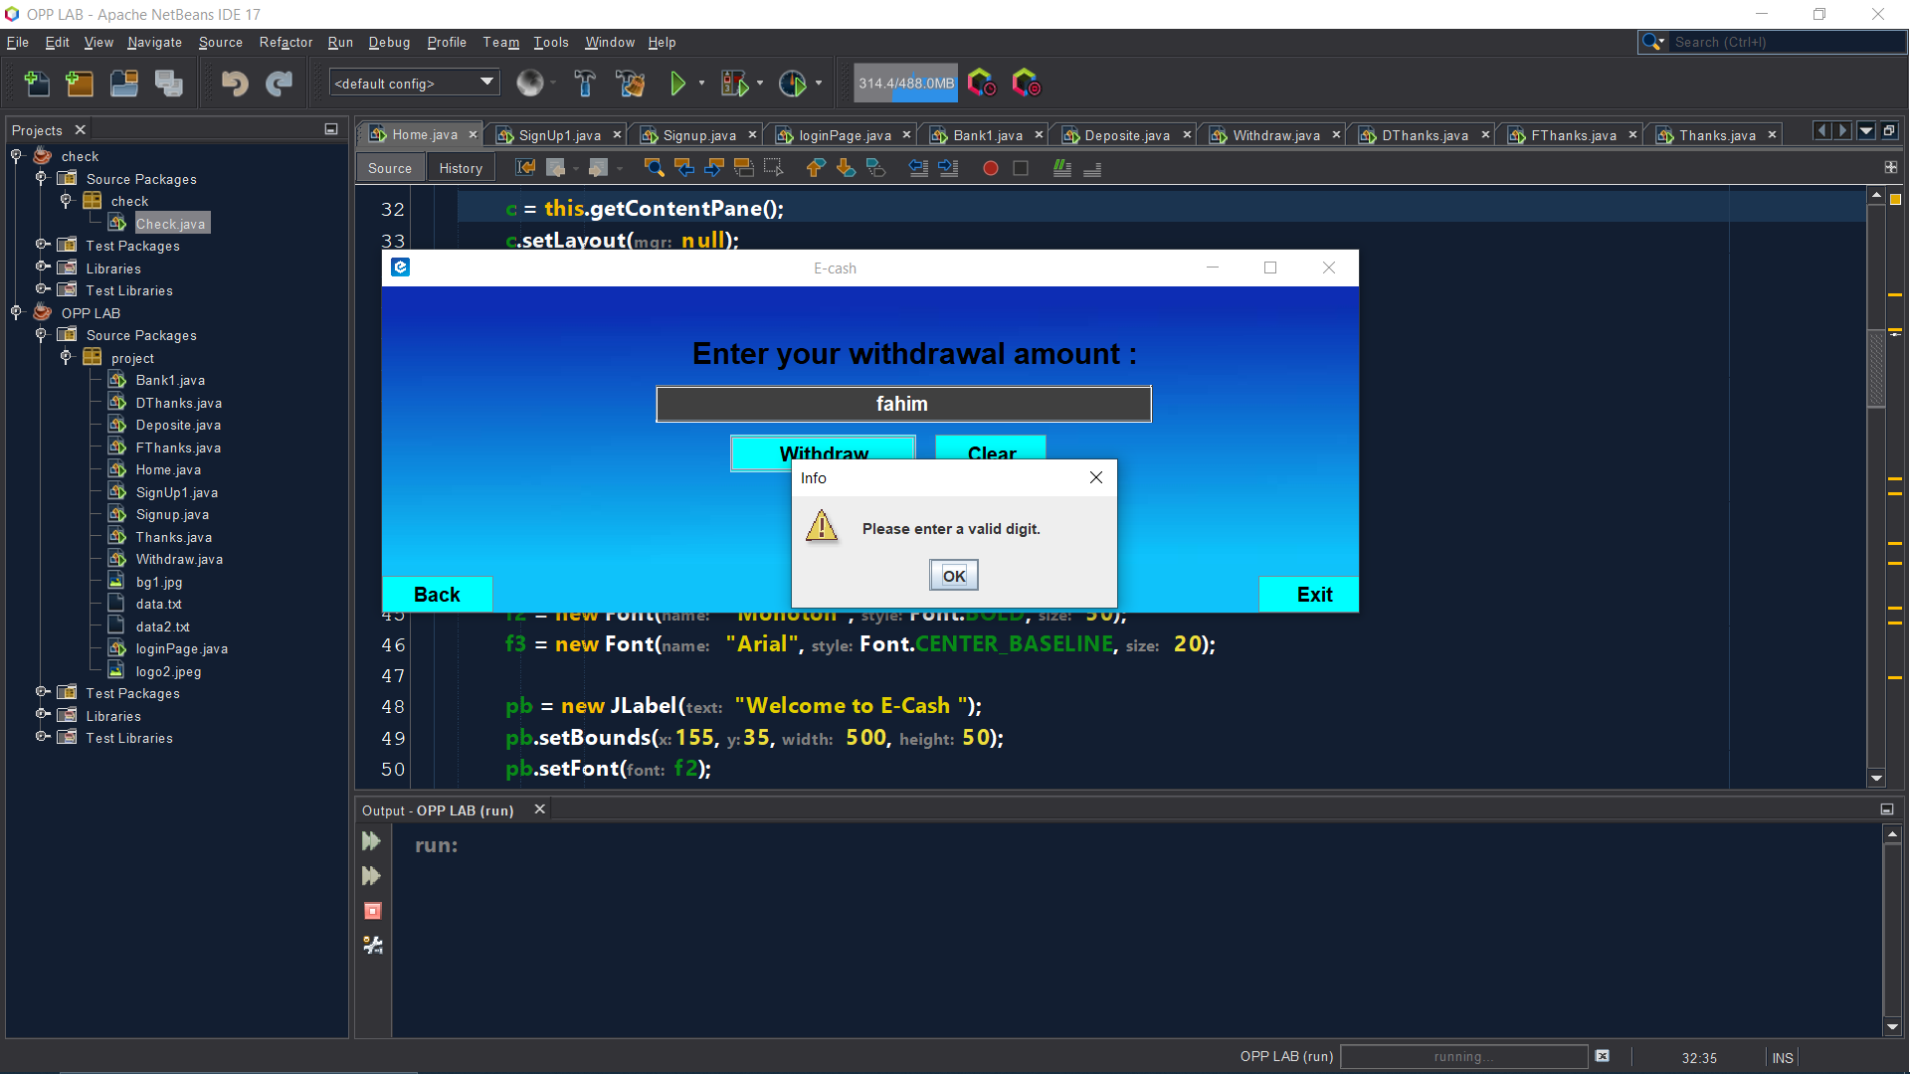

If Deposite successful

Slide 9
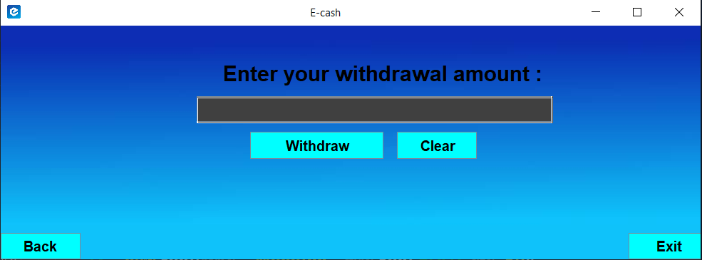

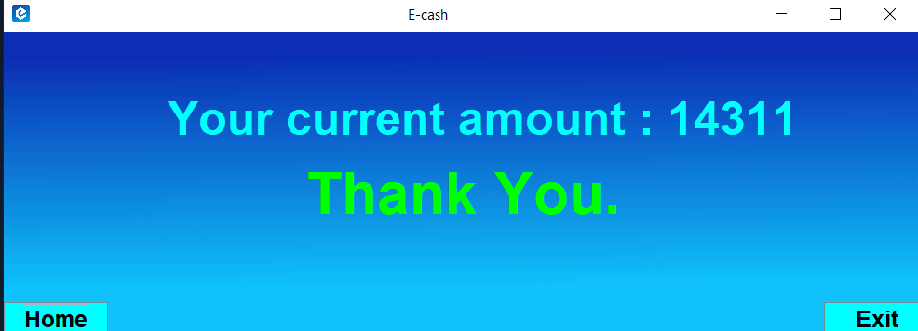
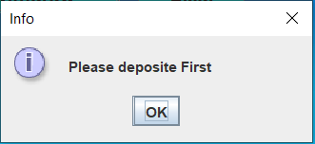
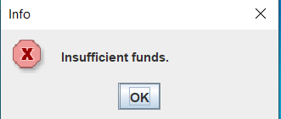
If withdraw successful

Slide 10
Home
Every time clicking this button will be able to move in the Home page/First page
Clear
By clicking this button all the text fields of the current page will be clear.
Exit
By clicking this button you will be able to exit from the app

Slide 11
Do you have any

Slide 12
Thank You

