Slide 1
Recursion

Slide 2
Week 11: Recursion
Objectives:
  Understand the nature of recursion
  Learn to write recursive functions
  Comparing recursive codes with iterative codes
Reference:
  Chapter 8, Lesson 8.6

Slide 3
Week 11: Outline (1/2)
Week 10 Exercise #3: Module Sorting
Introduction
Two Simple Classic Examples
  3.1 Demo #1: Factorial
  3.2 Demo #2: Fibonacci
Gist of Recursion
Exercises #1 – 3
Thinking Recursively
  6.1 Think: Sum of Squares
  6.2 Demo #3: Counting Occurrences

Slide 4
Week 11: Outline (2/2)
Exercise #4 (take-home): Sum Array
Auxiliary Function
Types of Recursion
Tracing Recursive Codes
Recursion versus Iteration
Towers of Hanoi (separately given)

Slide 5
1. Week 10 Exercise #3: Module Sorting (take-home) (1/2)
Week10_SortModules.c: Given two arrays: one containing the module codes, and the other containing the number of students enrolled in the modules. Sort the modules according to the number of student enrolment, using Selection Sort, Bubble Sort, or Insertion Sort (if you happen to know it).
You may assume that there are at most 10 modules and a module code is at most 7 characters long.
This is a take-home exercise.
This exercise is mounted on CodeCrunch.
Notes:
CS1010 Programming Methodology

Slide 6
1. Week 10 Exercise #3: Module Sorting (take-home) (2/2)
Sample run:
Input
Enter number of modules: 10
Enter module codes and student enrolment:
CS1010 292
CS1234 178
CS1010E 358
CS2102 260
IS1103 215
IS2104 93
IS1112 100
GEK1511 83
IT2002 51
MA1101S 123
Sorted by student enrolment:
IT2002 51
GEK1511 83
IS2104 93
IS1112 100
MA1101S 123
CS1234 178
IS1103 215
CS2102 260
CS1010 292
CS1010E 358
See input file modules.in
Output
Notes:
CS1010 Programming Methodology

Slide 7
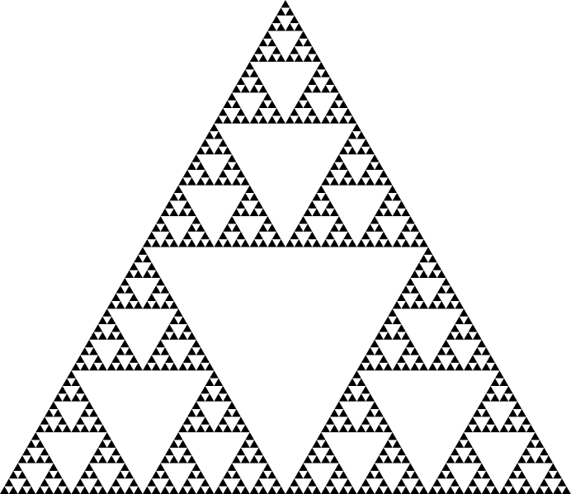
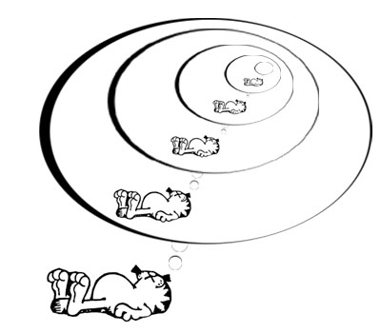
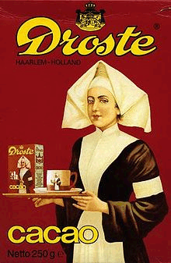
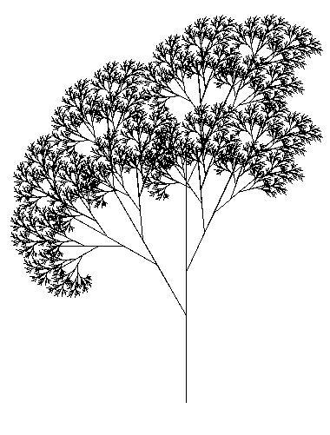
2. Introduction (1/3)
Recursion
A central idea in CS.
Some examples of recursion (inside and outside CS):
Garfield dreaming recursively.
Sierpinksi triangle
Droste effect
Recursive tree

Slide 8
2. Introduction (2/3)
Recursion
A central idea in CS.
Definitions based on recursion:
Dictionary entry:
Recursion: See recursion.
Recursive definitions:
A person is a descendant of another if
  the former is the latter’s child, or
  the former is one of the descendants of the latter’s child.
A list of numbers is
  a number, or
  a number followed by a list of numbers.
To understand recursion, you must first understand recursion.
Recursive acronyms:
GNU = GNU’s Not Unix
PHP = PHP: Hypertext Preprocessor

Slide 9
2. Introduction (3/3)
There is NO new syntax needed for recursion.
Recursion is a form of (algorithm) design; it is a problem-solving technique for divide-and-conquer paradigm
  Very important paradigm – many CS problems solved using it
Recursion is:
A method where
the solution to a problem
depends on
solutions to smaller instances
of the same problem.

Slide 10
3. Two Simple Classic Examples
From these two examples, you will see how a recursive algorithm works
Winding phase
Invoking/calling ‘itself’ to solve smaller or simpler instance(s) of a problem …
… and then building up the answer(s) of the simpler instance(s).
Unwinding phase

Slide 11
3.1 Demo #1: Factorial (1/3)
n! = n × (n – 1) × (n – 2) × … × 2 × 1
Iterative code (version 1):
// Pre-cond: n >= 0
int factorial_iter1(int n) {
int ans = 1, i;
for (i=2; i<=n; i++) {
ans *= i;
}
return ans;
}
Iterative code (version 2):
// Pre-cond: n >= 0
int factorial_iter2(int n) {
int ans = 1;
while (n > 1) {
ans *= n;
n--;
}
return ans;
}
Week11_factorial.c

Slide 12
3.1 Demo #1: Factorial (2/3)
Recurrence relation:
n! = n × (n – 1)!
0! = 1
n! = n × (n – 1) × (n – 2) × … × 2 × 1
Doing it the recursive way?
// Pre-cond: n >= 0
int factorial(int n) {
if (n == 0)
return 1;
else
return n * factorial(n-1);
}
No loop!
But calling itself (recursively) brings out repetition.
Note: All the three versions work only for n < 13, due to the range of values permissible for type int. This is the limitation of the data type, not a limitation of the problem-solving model.

Slide 13
3.1 Demo #1: Factorial (3/3)
int f(int n) {
if (n == 0)
return 1;
else
return n * f(n-1);
}
Trace factorial(3). For simplicity, we write f(3).
Winding:
Trace tree:
f(3): Since 3 ≠ 0, call 3 * f(2)
f(2): Since 2 ≠ 0, call 2 * f(1)
f(1): Since 1 ≠ 0, call 1 * f(0)
f(0): Since 0 == 0, …
f(3)
6
3 *
f(2)
2
Unwinding:
2 *
f(1)
1
f(0): Return 1
f(1): Return 1 * f(0) = 1 * 1 = 1
f(2): Return 2 * f(1) = 2 * 1 = 2
f(3): Return 3 * f(2) = 3 * 2 = 6
1 *
f(0)
1

Slide 14

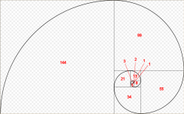
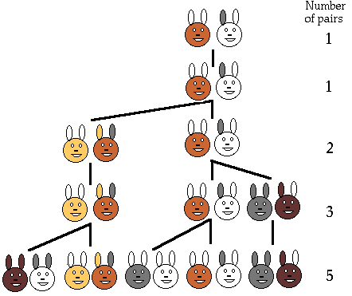
3.2 Demo #2: Fibonacci (1/3)
The Fibonacci series models the rabbit population each time they mate:
  1, 1, 2, 3, 5, 8, 13, 21, …
The modern version is:
  0, 1, 1, 2, 3, 5, 8, 13, 21, …
Fibonacci numbers are found in nature (sea-shells, sunflowers, etc)
http://www.maths.surrey.ac.uk/hosted-sites/R.Knott/Fibonacci/fibnat.html
Notes:
Population growth is related to the Fibonacci series. It was the question of how fast rabbits could breed under ideal circumstances that Leonardo Fibonacci originally investigated in the year 1202. Here was the question he posed:
Suppose a newborn pair of rabbits, one male and one female, is put in the wild. The rabbits mate at the age of one month and at the end of its second month a female can produce another pair of rabbits. Suppose that the rabbits never die and that each female always produces one new pair, with one male and one female, every month from the second month on. How many pairs will there be in one year?
The sequence is 1 1 2 3 5 8 13 21 ….

Slide 15
3.2 Demo #2: Fibonacci (2/3)
0, 1, 1, 2, 3, 5, 8, 13, 21, …
Week11_fibonacci.c
Iterative code:
Recursive code:
// Pre-cond: n >= 0
int fib_iter(int n) {
int prev1 = 1,
prev2 = 0, sum;
if (n < 2)
return n;
for (; n>1; n--) {
sum = prev1 + prev2;
prev2 = prev1;
prev1 = sum;
}
return sum;
}
// Pre-cond: n >= 0
int fib(int n) {
if (n < 2)
return n;
else
return fib(n-1) + fib(n-2);
}
Recurrence relation:
  f_{n} = f_{n-1} + f_{n-2} n ≥ 2
  f₀ = 0
  f₁ = 1

Slide 16
3.2 Fibonacci (3/3)
int fib(int n) {
if (n < 2)
return n;
else
return fib(n-1) + fib(n-2);
}
fib(n) makes 2 recursive calls: fib(n-1) and fib(n-2)
Trace tree (or call tree) for fib(5)
Winding
5
Unwinding
fib(5)
3
2
fib(4)
fib(3)
2
1
1
1
fib(3)
fib(2)
fib(2)
fib(1)
1
1
1
0
1
0
fib(2)
fib(1)
fib(1)
fib(0)
fib(1)
fib(0)
1
0
fib(1)
fib(0)

Slide 17


4. Gist of Recursion (1/6)
Iteration vs Recursion: How to compute factorial(3)?
You, do f(2) for me. I’ll return 3 * your answer to my boss.
Recursion man
You, do f(1) for me. I’ll return 2 * your answer to my boss.
Iteration man
I do f(3) all by myself…return 6 to my boss.
You, do f(0) for me. I’ll return 1 * your answer to my boss.
f(3)
f(2)
I will do f(0) all by myself, and return 1 to my boss.
f(3)
f(1)
f(0)

Slide 18
4. Gist of Recursion (2/6)
Problems that lend themselves to a recursive solution have the following characteristics:
  One or more simple cases (also called base cases or anchor cases) of the problem have a straightforward, non-recursive solution
  The other cases can be redefined in terms of problems that are smaller, i.e. closer to the simple cases
  By applying this redefinition process every time the recursive function is called, eventually the problem is reduced entirely to simple cases, which are relatively easy to solve
  The solutions of the smaller problems are combined to obtain the solution of the original problem

Slide 19
4. Gist of Recursion (3/6)
To write a recursive function:
  Identify the base case(s) of the relation
  Identify the recurrence relation
// Pre-cond: n >= 0
int factorial(int n) {
if (n == 0)
return 1;
else
return n * factorial(n-1);
}
// Pre-cond: n >= 0
int fib(int n) {
if (n < 2)
return n;
else
return fib(n-1) + fib(n-2);
}

Slide 20
4. Gist of Recursion (4/6)
Always check for base case(s) first
  What if you omit base case(s)?
Do not write redundant base cases
int factorial(int n) {
if (n == 0)
return 1;
else if (n == 1)
return 1;
else if (n == 2)
return 2;
else if (n == 3)
return 6;
else
return n * factorial(n-1);
}
redundant

Slide 21
4. Gist of Recursion (5/6)
When a function is called, an activation record (or frame) is created by the system.
Each activation record stores the local parameters and variables of the function and its return address.
Such records reside in the memory called stack.
  Stack is also known as LIFO (last-in-first-out) structure
A recursive function can potentially create many activation records
  Winding: each recursive call creates a separate record
  Unwinding: each return to the caller erases its associated record

Slide 22
4. Gist of Recursion (6/6)
int f(int n) {
if (n == 0) return 1;
else return n * f(n-1);
}
Example: factorial(3)
n
0
n
n
1
n
1
1
1
n
n
n
n
1
2
2
2
2
n
n
n
n
n
3
3
3
3
3
f(3)
f(2)
f(1)
f(0)
n
2
n
n
2
3
3
6

Slide 23
5. Exercises #1 – 3 (1/2)
Given the following 2 recursive functions, trace mystery1(3902) and mystery2(3902) using the trace tree method
void mystery1(int n) {
if (n>0) {
printf("%d", n%10);
mystery1(n/10);
}
}
void mystery2(int n) {
if (n>0) {
mystery2(n/10);
printf("%d", n%10);
}
}
The order of statements does matter!

Slide 24

5. Exercises #1 – 3 (2/2)
The recurrence relation for Greatest Common Divisor (GCD) of two non-negative integers a and b, not both zero, is given below:
Write a function int gcd(int a, int b) to compute the GCD of a and b. Skeleton program Week11_gcd.c is given.
The math function double pow(double x, double y) computes x^{y}. Write your own, simpler function double mypow(double x, int n) to compute x^{n}, where n is a non-negative integer. Skeleton program Week11_pow.c is given.
  The recurrence relation is not given, can you derive it before writing the function?

Slide 25

6. Thinking Recursively
It is apparent that to do recursion you need to think “recursively”:
  Breaking a problem into simpler problems that have identical form
Is there only one way of breaking a problem into simpler problems?

Slide 26
6.1 Think: Sum of Squares (1/5)
Given 2 positive integers x and y, where x ≤ y, compute
  sumSq(x,y) = x² + (x+1) ² + … + (y-1) ² + y²
For example
  sumSq(5,10) = 5² + 6² + 7² + 8² + 9² + 10² = 355
How do you break this problem into smaller problems?
How many ways can it be done?
We are going to show 3 versions

Slide 27
6.1 Think: Sum of Squares (2/5)
Version 1: ‘going up’
Version 2: ‘going down’


Slide 28
6.1 Think: Sum of Squares (3/5)
Version 3: ‘combining two half-solutions’


Slide 29
6.1 Think: Sum of Squares (4/5)
Trace trees


Slide 30
6.1 Think: Sum of Squares (5/5)
Trace tree


Slide 31
6.2 Demo #3: Counting Occurrences (1/4)
Given an array
  int list[] = { 9, -2, 1, 7, 3, 9, -5, 7, 2, 1, 7, -2, 0, 8, -3 }
We want
  countValue(7, list, 15)
  to return 3 (the number of times 7 appears in the 15 elements of list.

Slide 32
6.2 Demo #3: Counting Occurrences (2/4)
Iterative code:
Week11_countValue.c
int countValue_iter(int value, int arr[], int size) {
int count = 0, i;
for (i=0; i<size; i++)
if (value == arr[i])
count++;
return count;
}

Slide 33
6.2 Demo #3: Counting Occurrences (3/4)
To get countValue(7, list, 15) to return 3.
Recursive thinking goes…
9
-2
1
7
3
9
-5
7
2
1
7
-2
0
8
-3
… and get someone to count the 7 in this smaller problem, …
If I handle the last element myself, …
… then, depending on whether the last element is 7 or not, my answer is either his answer or his answer plus 1!

Slide 34
6.2 Demo #3: Counting Occurrences (4/4)
Recursive code:
Week11_countValue.c
int countValue(int value, int arr[], int size) {
if (size == 0)
return 0;
else
return (value == arr[size-1]) +
countValue(value, arr, size-1);
}
Note: The second return statement is equivalent to the following (why?):
if (value == arr[size-1])
return 1 + countValue(value, arr, size-1);
else
return countValue(value, arr, size-1);

Slide 35
7. Exercise #4 (take-home): Sum Array
Write a program Week11_sumArray.c to read data into an integer array with at most 10 elements, and sum up all values in the array, using a recursive function.
We will discuss it next week. This exercise will be mounted on CodeCrunch.
Sample runs:
Enter number of elements: 6
Enter 6 values: 4 3 -2 0 1 3
Array read: 4 3 -2 0 1 3
Sum = 9
Enter number of elements: 8
Enter 8 values: 11 25 56 8 12 7 31 16
Array read: 11 25 56 8 12 7 31 16
Sum = 166

Slide 36
8. Auxiliary Function (1/3)
Sometimes, auxiliary functions are needed to implement recursion. Eg: Refer to Demo #3 Counting Occurrences.
If the function handles the first element instead of the last, it could be re-written as follows:
int countValue(int value, int arr[],
int start, int size) {
if (start == size)
return 0;
else
return (value == arr[start]) +
countValue(val, arr, , start+1, size);
}

Slide 37
8. Auxiliary Function (2/3)
However, doing so means that the calling function has to change the call from:
countValue(value, list, ARRAY_SIZE)
to:
countValue(value, list, 0, ARRAY_SIZE)
The additional parameter 0 seems like a redundant data from caller’s point of view.

Slide 38
8. Auxiliary Function (3/3)
Solution: Keep the calling part as:
countValue(value, list, ARRAY_SIZE)
Rename the original countValue() function to countValue_recur(). The recursive call inside should also be similarly renamed.
Add a new function countValue() to act as a driver function, as follows:
int countValue(int value, int arr[], int size)
{
return countValue_recur(value, arr, 0, size);
}
See program Week11_countValue_auxiliary.c

Slide 39
9. Types of Recursion
Besides direct recursion (function A calls itself), there could be mutual or indirect recursion (we do not cover these in CS1010)
  Examples: Function A calls function B, which calls function A; or function X calls function Y, which calls function Z, which calls function X.
Note that it is not typical to write a recursive main() function.
One type of recursion is known as tail recursion.
  Not covered in CS1010

Slide 40
10. Tracing Recursive Codes
Beginners usually rely on tracing to understand the sequence of recursive calls and the passing back of results.
However, tracing a recursive code is tedious, especially for non-tail-recursive codes. The trace tree could be huge (example: fibonacci.)
If you find that tracing is needed to aid your understanding, start tracing with small problem sizes, then gradually see the relationship between the successive calls.
Students should grow out of tracing habit and understand recursion by examining the relationship between the problem and its immediate subproblem(s).

Slide 41
11. Recursion versus Iteration (1/2)
Iteration can be more efficient
  Replaces function calls with looping
  Less memory is used (no activation record for each call)
Some good compilers are able to transform a tail-recursion code into an iterative code.
If a problem can be done easily with iteration, then do it with iteration.
  For example, Fibonacci can be coded with iteration or recursion, but the recursive version is very inefficient (large call tree due to duplicate computations), so use iteration instead.

Slide 42
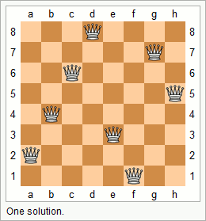
11. Recursion versus Iteration (2/2)
Many problems are more naturally solved with recursion, which can provide elegant solution.
  Towers of Hanoi
  Mergesort (to be covered in CS1020)
  The N Queens problem
Conclusion: choice depends on problem and the solution context. In general, use recursion if
  A recursive solution is natural and easy to understand.
  A recursive solution does not result in excessive duplicate computation.
  The equivalent iterative solution is too complex.

Slide 43
12. Tower Of Hanoi
In a separate Powerpoint file.

Slide 44
Summary for Today
In this lecture we looked at:
  Recursion as a design strategy
  The components of a recursive code
  Difference between Recursion and Iteration

Slide 45

Announcements/Things-to-do
Revise:
  Lesson 8.6 Functions with One Recursive Call
Exercise #4: Sum Array
Next week’s lecture:
  Structures: Lessons 8.1 – 8.5
  File Processing: Lessons 3.3 – 3.4

Slide 46
End of File

