Slide 1
Programming Methodology

Slide 2
Week 2: Overview of C Programming
Objectives:
  Able to create programs using the editor vim
  Able to execute your first program
  Understand basic C constructs, interactive input, output, and arithmetic operations
  Understand basic programming style
Week2 - 2

Slide 3

Outline
0. Algorithms (last week)
General
Our first sample program
Errors: syntax, run-time, logic, and undetected errors
Demo: Getting your program to execute
  * Demo on ssh, basic UNIX commands
  * Exercise #1: Using vim and gcc
Exercise #2: Temperature Convert
Program structure as:
  * Input: scanf()
  * Compute: variables, data type, constants, precedence rules
  * Output: printf()
Exercise #3: Temperature Estimate
Style: naming, presentation, simplicity and efficiency
This symbol indicates the focus of today’s lesson.
Week2 - 3

Slide 4

1. General
Program: A sequence of instructions that a computer can interpret and execute. The instructions follow the rules of the language chosen.
There are many “types” of programming languages: A to Z
http://en.wikipedia.org/wiki/List_of_programming_languages_by_category
C: A general-purpose computer programming language developed in 1972 by Dennis Ritchie at the Bell Telephone Lab for use with the UNIX operating system.
A+, APL, Ada | Basic | C, C#, C++ | D, Delphi | E, Eiffel
F, Fortran, F# | G, | Haskell | IDL, Io, ICI | Java, JASS
K, | Lisp, Logo | M, Maple | Nimrod | Oz
Pascal, Python | Q, | R, RPG, Ruby | Smalltalk, Scheme | Tcl, Today
uniPaaS | Vimscript, VBA | Winbatch | X++, XL | Y, Z++

Slide 5
Edit, Compile and Execute
Source code
Editor
produces
eg: vim welcome.c
welcome.c
Executable code
Compiler
produces
eg: gcc welcome.c
a.out
Cannot compile?
Output
Incorrect result?
Execute
produces
Hello, welcome to CS1010!
eg: a.out
Test, test, and test!
Week2 - 5
Notes:
CS1010 Programming Methodology

Slide 6
2. Our First Program (1/4)
Week2_MileToKm.c
/*
* Converts distance in miles to kilometres.
*/
#include <stdio.h> /* printf, scanf definitions */
#define KMS_PER_MILE 1.609 /* conversion constant */
int main(void) {
float miles, // input – distance in miles
kms; // output – distance in kilometres
/* Get the distance in miles */
printf("Enter distance in miles: ");
scanf("%f", &miles);
// Convert the distance to kilometres
kms = KMS_PER_MILE * miles;
// Display the distance in kilometres
printf("That equals %9.2f km.\n", kms);
return 0;
}
Sample Run
$ gcc Week2_MileToKm.c
$ a.out
Enter distance in miles: 10.5
That equals 16.89 km.
Week2 - 6

Slide 7
2. Our First Program (1/4)
Week2_MileToKm.c
#include <stdio.h>
#define KMS_PER_MILE 1.609
int main(void) {
float miles,kms;
printf("Enter distance in miles: ");
scanf("%f", &miles);
kms = KMS_PER_MILE * miles;
printf("That equals %9.2f km.\n", kms);
return 0;
}
Sample Run
$ gcc Week2_MileToKm.c
$ a.out
Enter distance in miles: 10.5
That equals 16.89 km.
Week2 - 7

Slide 8
2. Our First Program (2/4)
General form of a C program:
preprocessor directives
main function heading
{
declarations
executable statements
}
Week2 - 8

Slide 9
2. Our First Program cont.
The main() function starts as following, where execution begins
int main(void)
The rest of the function is called body
int main(void)
{
function body
}
Body is divided into two parts
  Declaration
  Executable statements

Slide 10
2. Our First Program (3/4)
/*
* Converts distance in miles to kilometres.
*/
#include <stdio.h> /* printf, scanf definitions */
#define KMS_PER_MILE 1.609 /* conversion constant */
int main(void) {
float miles, // input – distance in miles
kms; // output – distance in kilometres
/* Get the distance in miles */
printf("Enter distance in miles: ");
scanf("%f", &miles);
// Convert the distance to kilometres
kms = KMS_PER_MILE * miles;
// Display the distance in kilometres
printf("That equals %9.2f km.\n", kms);
return 0;
}
standard header file
preprocessor directives
constant
reserved words
variables
comments
functions
special symbols
punctuations
Week2 - 10

Slide 11
2. Our First Program (4/4)
What happens in the computer memory?
memory
memory
memory
Executable code of Week2_MileToKm.c
Executable code of Week2_MileToKm.c
Executable code of Week2_MileToKm.c
miles
miles
miles
?
10.5
10.5
kms
kms
kms
?
?
16.89
At the beginning
After user enters: 10.5 to
scanf("%f", &miles);
After this line is executed:
kms = KMS_PER_MILE * miles;
Do not assume that uninitialised variables contain zero! (Very common mistake.)
Week2 - 11

Slide 12

Notes (1/2)
Basic steps of a program
  Read inputs (scanf)
  Compute
  Print outputs (printf)
We will stick to interactive inputs
  Standard input stream (stdin) – default is keyboard
  Use scanf() function
Assume input data are according to specification
  No need to validate input data, unless otherwise stated
Outputs
  Standard output stream (stdout) – default is monitor
  Use printf() function
Week2 - 12

Slide 13
Notes (2/2)
Include <stdio.h> to use scanf() and printf() functions
  Include the header file (for portability sake) even though some systems do not require you to do so
  We can have similar preprocessor directives for other functions like <math.h> for mathematical operations sqrt()

Slide 14
3. Errors
Syntax Errors (and warnings)
  Program does not obey C construct /grammar such as invalid choice of identifier name, invalid expression, missing semi-colon, etc.
  Warning happens, for example, incomparable use of types for output
  We advise you to use gcc –Wall to compile your programs
Run-time Errors
  Program terminates unexpectedly due to illegal operation, such as dividing a number by zero
Logic Errors
  Program produces result as opposed to what is expected (wrong algorithm)
Undetected Errors
  Exist if we are not able to test all cases
The process of correcting errors in programs is called debugging.
This process can be very time-consuming.
Week2 - 14

Slide 15
5. Exercise #2 (Fahrenheit to Celsius) (1/2)
Write a program to convert a temperature in degrees Fahrenheit to degrees Celsius
    celsius = 5 / 9 * (fahrenheit – 32)
Correct/compile your program till free of (syntax) errors
Make sure your program is free of (run time, logic) errors
  Test on the following Fahrenheit degrees:
  32.5, 0, -54.3, 100 (and others of your choice)
Sample output:
Enter temperature in Fahrenheit: 32.5
That equals 0.277778 Celsius.
Week2 - 15

Slide 16
5. Exercise #2 (Fahrenheit to Celsius) (2/2)
Do you get the correct answers?
Enter temperature in Fahrenheit: 32.5
That equals 0.277778 Celsius.
Week2 - 16
◈

Slide 17
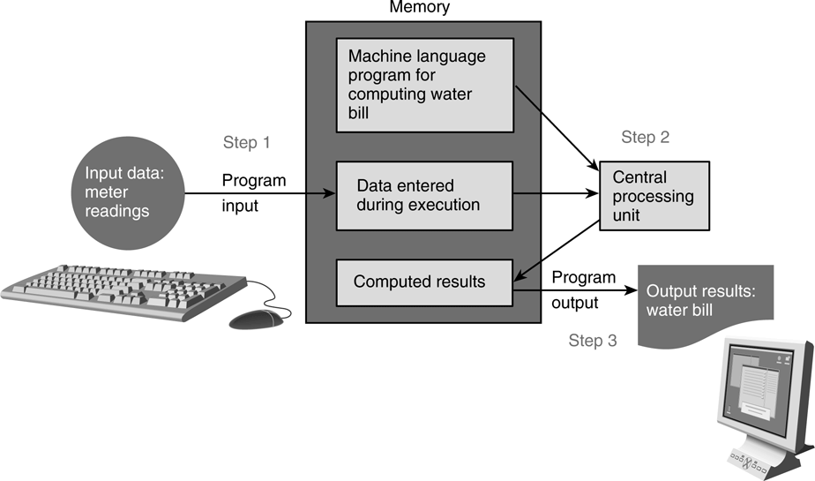
6. Program Structure
A program has 3 main parts:
  (plus Preprocessor Directives: #include <stdio.h>, #include <math.h>)
  Input : through stdin (using scanf), or file input
  Compute: through arithmetic operations
  Output: through stdout (using printf), or file output
We will learn file input/output later.
Week2 - 17

Slide 18
6. Program Structure: Input/Output (1/2)
Input/output statements:
  printf ( format string, print list );
  printf ( format string );
  scanf( format string, input list );
age
Address of variable ‘age’ varies each time a program is run.
20
    “age” refers to value in the variable age.
    “&age” refers to (address of) the memory cell where the value of age is stored.
One version:
int age;
double ht; // cumulative average point
printf("What is your age? ");
scanf("%d", &age);
printf("What is your HEIGHT? ");
scanf("%lf", &ht);
printf("You are %d years old, and your height is %f\n", age, ht);
Week2_InputOutput.c
Another version:
int age;
double ht; // cumulative average point
printf("What are your age and height? ");
scanf("%d %lf", &age, &ht);
printf("You are %d years old, and your height is %f\n", age, ht);
Week2_InputOutputV2.c
Week2 - 18
Notes:
CS1010 Programming Methodology

Slide 19
6. Program Structure: Input/Output (2/3)
%d and %lf are examples of format specifiers; they are placeholders for values to be displayed or read
Placeholder | Variable Type | Function Use
%c | char | printf / scanf
%d | int | printf / scanf
%f | float or double | printf
%f | float | scanf
%lf | double | scanf
%e | float or double | printf (for scientific notation)
Examples of format specifiers used in printf():
  %5d: to display an integer in a width of 5, right justified
  %8.3f: to display a real number (float or double) in a width of 8, with 3 decimal places, right justified
See Table 2.3 (page 65) for sample displays
Note: For scanf(), just use the format specifier without indicating width, decimal places, etc.
Week2 - 19

Slide 20
6. Program Structure: Input/Output (3/3)
\n is an example of escape sequence
Escape sequences are used in printf() function for certain special effects or to display certain characters properly
See Table 1.4 (pages 32 – 33)
These are the more commonly used escape sequences:
Escape sequence | Meaning | Result
\n | New line | Subsequent output will appear on the next line
\t | Horizontal tab | Move to the next tab position on the current line
\" | Double quote | Display a double quote "
%% | Percent | Display a percent character %
Note the error in Table 1.4. It should be %% and not \%
Week2 - 20

Slide 21
6. Program Structure: Compute (1/10)
Computation is through function
  So far, we have used one function: int main(void)
    main() function: where execution of program begins
A function body has two parts
  Declarations statements: tell compiler what type of memory cells needed
  Executable statements: describes the processing on the memory cells
int main(void) {
/* declaration statements */
/* executable statements */
return 0;
}
Week2 - 21
Notes:
CS1010 Programming Methodology

Slide 22
6. Program Structure: Compute (2/10)
Declaration Statements (2 parts: data type & identifier)
  Part 1: Standard Data Types
    (data type: tells computer how to store a particular value in memory and what operations can be performed on the value.)
    int
      Whole numbers, negative and positive
      32 bits, hence value between -2,147,483,648 (-2³¹) through +2,147,483,647 (2³¹ – 1)
      All numbers can not be represented as int for space limitation
    float (and double)
      an abstraction for real numbers (as it does not include all real numbers)
      It has exponent and mantissa
      3.14159
      15.0e-4 or 15.0E-4 (value is 0.0015)
      12e+5 or 12E+5 (value is 1200000.0)
Week2 - 22

Slide 23
6. Program Structure: Compute (2/10)
Declaration Statements (2 parts: data type & identifier)
  Part 1: Standard Data Types
  Why not using double in place of int?
    More space will be used
    There may be roundoff error, 13 in binary is not same as 13.0
Binary number
Sign
Exponent
Mantissa
int format
Double format

Slide 24
6. Program Structure: Compute (2/10)
Declaration Statements (2 parts: data type & identifier)
  Part 1: Standard Data Types
    (data type: tells computer how to store a particular value in memory and what operations can be performed on the value.)
    char
      individual character, which is a letter, a digit, or a special symbol
      enclosed in a pair of single quotes
      'A' 'z' '2' '9' '*' '?' ' ' '\n'
    ASCHII Format (American Standard Code for Information Interchange)
      A character is represented using integer
      0 to 9 has 48 through 57, so we have ‘0’ <‘1’ and so on
      A to Z has 65 through 90
      a to z has 97 through122

Slide 25
6. Program Structure: Compute (3/10)
Declaration Statements
  Part 2: Identifier: name of a variable or function
    Reserved words (or keywords)
      e.g. int, void, double, return
    Standard identifiers
      e.g. printf, scanf
    User-defined identifiers
      Avoid reserved words and standard identifiers
      Consist only of letters, digit characters and underscores, and must not begin with a digit character
      Case-sensitive
      e.g. invalid: 1Letter, double, int, TWO*FOUR, joe’s
      valid: maxEntries, _X1234, this_IS_a_long_name
Week2 - 25

Slide 26
6. Program Structure: Input/Output (2/3)
%d and %lf are examples of format specifiers; they are placeholders for values to be displayed or read
Placeholder | Variable Type | Function Use
%c | char | printf / scanf
%d | int | printf / scanf
%f | float or double | printf
%f | float | scanf
%lf | double | scanf
%e | float or double | printf (for scientific notation)
Examples of format specifiers used in printf():
  %5d: to display an integer in a width of 5, right justified
  %8.3f: to display a real number (float or double) in a width of 8, with 3 decimal places, right justified
See Table 2.3 (page 65) for sample displays
Note: For scanf(), just use the format specifier without indicating width, decimal places, etc.
Week2 - 26

Slide 27
CSE115
Cse115
115CSE
_115CSE
CSE_115

Slide 28
Operators

Slide 29
Arithmetic Operators I
In C, we have the following operators (note that all these example are using 9 as the value of its first operand)
Operation | Operator | Operand | Value After
Addition | + | 2 | 11
Subtraction | - | 2 | 7
Multiplication | * | 2 | 18
Division | / | 3 | 3
Increment | ++ | + | 10
Decrement | -- | - | 8
Modulus | % | 2 | 1

Slide 30
Arithmetic Operators II
There are 2 types of arithmetic operators in C:
  unary operators
    operators that require only one operand.
  binary operators.
    operators that require two operands.

Slide 31
Unary Operator
C Operation | Operator | Example
Positive | + | a=+3
Negative | - | b=-a
Increment | ++ | i++
Decrement | -- | i--
The first assigns positive 3 to a
The second assigns the negative value of a to b.
i++ is equivalent to i = i + 1
i-- is equivalent to i = i-1

Slide 32
PRE- / POST-Increment
It is also possible to use ++i and --i instead of i++ and i--
However, the two forms have a slightly yet important difference.
Consider this example:
  int a = 9;
  printf(“%d\n”, a++);
  printf(“%d”, a);
The output would be:
  9
  10

Slide 33
PRE- / POST-Increment cont…
But if we have:
int a = 9;
printf(“%d\n”, ++a);
printf(“%d”, a);
The output would be:
  10
  10
a++ would return the current value of a and then increment the value of a
++a on the other hand increment the value of a before returning the value

Slide 34
The following table illustrates the difference between the prefix and postfix modes of the increment and decrement operator.
int R = 10, count=10;
++ Or -- Statement | Equivalent Statements | R value | Count value
R = count++; | R = count; count = count + 1 | 10 | 11
R = ++count; | count = count + 1; R = count; | 11 | 11
R = count --; | R = count; count = count – 1; | 10 | 9
R = --count; | Count = count – 1; R = count; | 9 | 9

Slide 35
Binary Operators
C Operation | Operator | Example
Addition | + | a+3
Subtraction | - | a-6
Multiplication | * | a*b
Division | / | a/c
Modulus | % | a%x
The division of variables of type int will always produce a variable of type int as the result.
You could only use modulus (%) operation on int variables.

Slide 36
Assignment Operators
Assignment operators are used to combine the '=' operator with one of the binary arithmetic operators
In the following slide, All operations starting from c = 9
Operator | Example | Equivalent Statement | Results
+= | c += 7 | c = c + 7 | c = 16
-= | c -= 8 | c = c – 8 | c = 1
*= | c *= 10 | c = c * 10 | c = 90
/= | c /= 5 | c = c / 5 | c = 1
%= | c %= 5 | c = c % 5 | c = 4

Slide 37
Precedence Rules
Precedence rules come into play when there is a mixed of arithmetic operators in one statement. For example: x = 3 * a - ++b%3;
The rules specify which of the operators will be evaluated first.
Precedence | Operator | Associativity Level
1 (highest) | () | Left to right
2 | Unary | Right to left
3 | * / % | Left to right
4 | + - | Left to right
6 (lowest) | = += -= *= /= %= | Right to left

Slide 38
Precedence Rules cont…
For example: x = 3 * a - ++b % 3;
  how would this statement be evaluated?
If we intend to have the statement evaluated differently from the way specified by the precedence rules, we need to specify it using parentheses ( )
Using parenthesis, we will have
      x = 3 * ((a - ++b)%3);
The expression inside a parentheses will be evaluated first.
The inner parentheses will be evaluated earlier compared to the outer parentheses.

Slide 39
Equality and Relational Operators
Equality Operators:
Relational Operators:
Operator | Example | Meaning
== | x==y | x is equal to y
!= | x!=y | x is not equal to y
Operator | Example | Meaning
> | x>y | x is greater than y
< | x<y | x is less than y
>= | x>=y | x is greater than or equal to y
<= | x<=y | x is less than or equal to y

Slide 40
Logical Operators
Logical operators are useful when we want to test multiple conditions.
There are 3 types of logical operators and they work the same way as the boolean AND, OR and NOT operators.
&& - Logical AND
  All the conditions must be true for the whole expression to be true.
  Example: if (a == 10 && b == 9 && d == 1)
  means the if statement is only true when a == 10 and
  b == 9 and d == 1.

Slide 41
Logical Operators cont…
|| - Logical OR
  The truth of one condition is enough to make the whole expression true.
  Example: if (a == 10 || b == 9 || d == 1)
  means the if statement is true when either one of a, b or d has the right value.
! - Logical NOT (also called logical negation)
  Reverse the meaning of a condition
  Example: if (!(points > 90))
  means if points not bigger than 90.

Slide 42
Conditional Operator
The conditional operator (?:) is used to simplify an if/else statement.
Syntax:
Condition ? Expression1 : Expression2
The statement above is equivalent to:
if (Condition)
Expression1
else
Expression2

Slide 43
Conditional Operator cont…
Example 1:
if/else statement:
if (total > 60)
grade = ‘P’
else
grade = ‘F’;
conditional statement:
total > 60 ? grade = ‘P’: grade = ‘F’;
OR
grade = total > 60 ? ‘P’: ‘F’;

Slide 44
Conditional Operator cont…
Example 2:
if/else statement:
if (total > 60)
printf(“Passed!!\n”);
else
printf(“Failed!!\n”);
Conditional Statement:
printf(“%s!!\n”, total > 60? “Passed”: “Failed”);

Slide 45
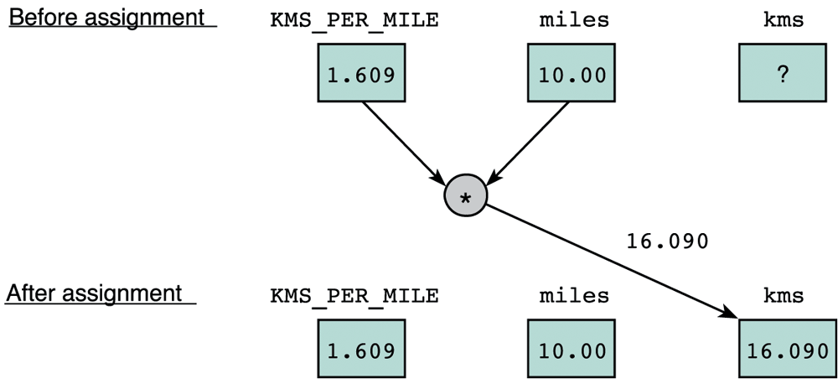
6. Program Structure: Compute (4/10)
Executable Statements
  I/O statements (e.g. printf, scanf)
  Assignment statements
    stores a value or a computational result in a variable
    (Note: ‘=’ is not equality, but assignment)
      e.g. kms = KMS_PER_MILE * miles;
Week2 - 45

Slide 46
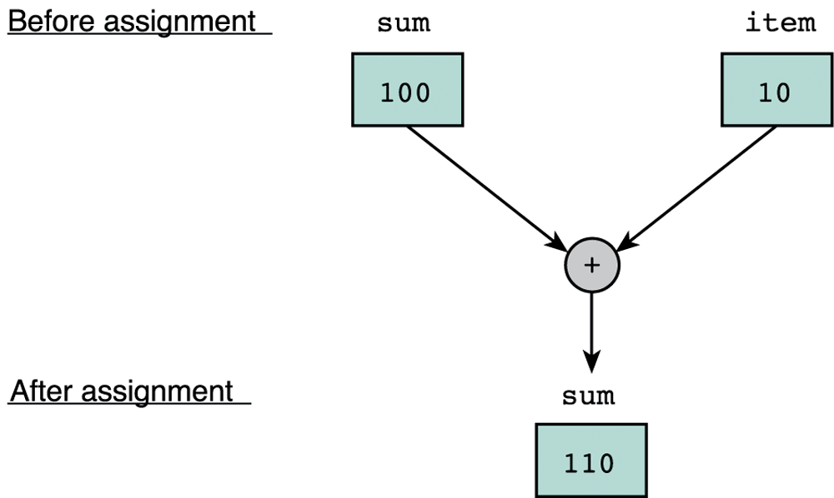
6. Program Structure: Compute (5/10)
      e.g. sum = sum + item;
  Note: Left side of an assignment statement is called lvalue – it must be assignable
  Examples of invalid assignment (result in compilation error “lvalue required as left operand of assignment”):
    32 = a;
    a + b = c;
  Assignment can be cascaded, with associativity from right to left:
    a = b = c = 3 + 6; // 9 assigned to variables c, b and a
    The above is equivalent to: a = (b = (c = 3 + 6));
    which is also equivalent to:
    c = 3 + 6;
    b = c;
    a = b;
Week2 - 46

Slide 47
6. Program Structure: Compute (6/10)
  Side Effect:
    An assignment statement does not just assigns, it also has the side effect of returning the value of its right-hand side expression
    Hence a = 12; has the side effect of returning the value of 12, besides assigning 12 to a
    Usually we don’t make use of its side effect, but sometimes we do, eg:
    z = a = 12; // or z = (a = 12);
    The above makes use of the side effect of the assignment statement a = 12; (which gives 12) and assigns it to z
    Side effects have their use, but avoid convoluted codes:
    a = 5 + (b = 10); // assign 10 to b, and 15 to a
    Side effects also apply to expressions involving other operators (eg: logical operators). We will see more of this later.
Week2 - 47

Slide 48
Input Output Operations
  Input
    Data transfer from outside world to memory
  Output
    Program computes results and stores in memory, result can be displayed by output operation
    f
printf(“That equals %f kilometers\n”, kms);
Function name
Arguments
Placeholder
printf(“I am %d years old, CGPA %\n”, age, CGPA);
Multiple Placeholders

Slide 49
Input Output Operations
scanf(“%f”, &miles);
Function name
Arguments
Address
printf(“I am %d years old, CGPA %\n”, age, CGPA);
Multiple Placeholders
  If we do not enter “&” sign, scanf does not know where to store the value

Slide 50
Input Output Operations
  The statement return(0) transfers control to Operating System

Slide 51
6. Program Structure: Compute (7/10)
Arithmetic operations
  Binary Operators: +, –, *, /, % (modulo or remainder)
    Left Associative (from left to right)
      46 / 15 / 2 → 3 / 2 → 1
      19 % 7 % 3 → 5 % 3 → 2
  Unary operators: +, –
    Right Associative
      x = – 23 p = +4 * 10
  Execution from left to right, respecting parentheses rule, and then precedence rule, and then associative rule (next page)
    addition, subtraction are lower in precedence than multiplication, division, and remainder
  Truncated result if result can’t be stored (the page after next)
    int n; n = 9 * 0.5; results in 4 being stored in n.

Slide 52
6. Program Structure: Compute (8/10)
Arithmetic operators: Associativity & Precedence (Table 2.6, Page 76)
Operator | Name | Number of operands | Position | Associativity | Precedence
( | Parentheses | Unary | Prefix | Left to right | 1
) | Parentheses | Unary | Postfix | Left to right | 1
+ | Positive sign | Unary | Prefix | Right to left | 2
- | Negative sign | Unary | Prefix | Right to left | 2
++ | Post-increment | Unary | Postfix | Left to right | 2
-- | Post-decrement | Unary | Postfix | Left to right | 2
++ | Pre-increment | Unary | Prefix | Right to left | 2
-- | Pre-decrement | Unary | Prefix | Right to left | 2
*, /, % | Multiplication, division, remainder | Binary | Infix | Left to right | 3
+, - | Addition, subtraction | Binary | Infix | Left to right | 4
=, +=, -=, *=, /=, %= | Assignment | Binary | Infix | Right to left | 5
Note error in reference book.
Week2 - 52

Slide 53
6. Program Structure: Compute (9/10)
Mixed-Type Arithmetic Operations
int m = 10/4; means
float p = 10/4; means
int n = 10/4.0; means
float q = 10/4.0; means
int r = -10/4.0; means
Type Casting
  Use a cast operator to change the type of an expression
    syntax: (type) expression
    int aa = 6; float ff = 15.8;
    float pp = (float) aa / 4; means
    int nn = (int) ff / aa; means
    float qq = (float) (aa / 4); means
Week2 - 53
◈

Slide 54
6. Program Structure: Compute (9/10)
Type conversion through type casting
  n=(int)(3.14*0.5);
ques_code=(int)’?’;
Week2 - 54
◈

Slide 55
6. Program Structure:
The number along with placeholder shows the column width
printf("Results: %3d meters = %4d ft. %2d in.\n",meters, feet, inches);
Results: 21 meters = 68 ft. 11 in.
The placeholder for feet ( %4d ) allows room for 4 digits,
The placeholder %2d to display any integer value between −9 and 99
Week2 - 55
◈
Notes:
CS1010 Programming Methodology

Slide 56
6. Program Structure:
The number along with placeholder shows the column width
printf("Results: %3d meters = %4d ft. %2d in.\n",meters, feet, inches);
Results: 21 meters = 68 ft. 11 in.
The placeholder for feet ( %4d ) allows room for 4 digits,
The placeholder %2d to display any integer value between −9 and 99
Week2 - 56
◈
Notes:
CS1010 Programming Methodology

Slide 57
6. Program Format:
The number along with placeholder shows the column width
printf("Results: %3d meters = %4d ft. %2d in.\n",meters, feet, inches);
Results: 21 meters = 68 ft. 11 in.
The placeholder for feet ( %4d ) allows room for 4 digits,
The placeholder %2d to display any integer value between −9 and 99
Week2 - 57
◈
Notes:
CS1010 Programming Methodology

Slide 58
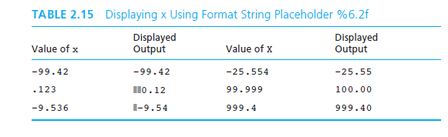
6. Program Format:
The double number can be formatted for places before and after decimal points
Week2 - 58
◈
Notes:
CS1010 Programming Methodology

Slide 59
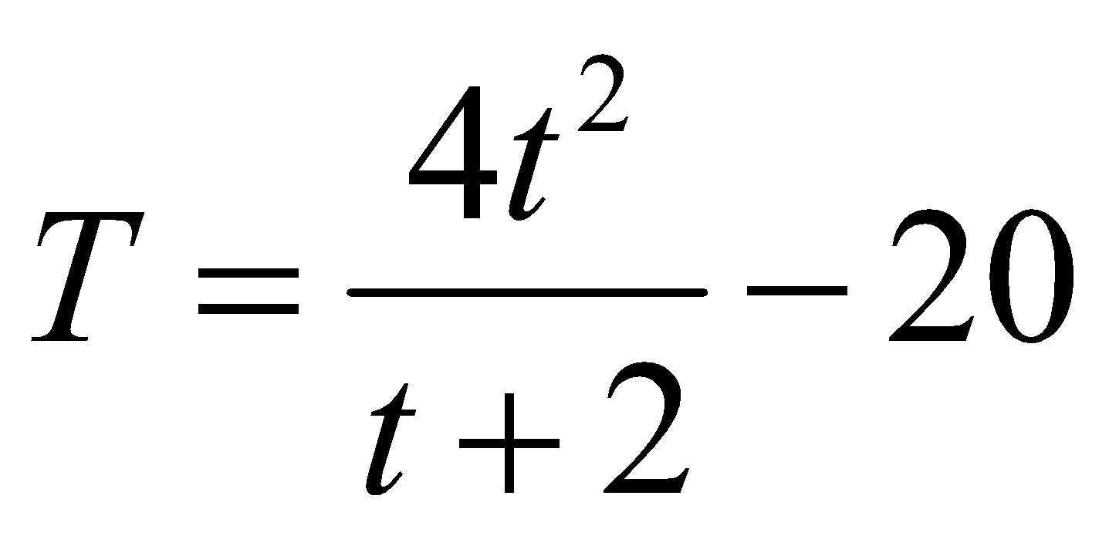
7. Exercise #3 (temperature estimate) (1/2)
Write a program Week2_Freezer.c that estimates the temperature in a freezer (in ºC) given the elapsed time (hours) since a power failure. Assume this temperature (T) is given by:
where t is the time since the power failure.
Your program should prompt the user to enter how long it has been since the start of the power failure in hours and minutes, both values in integers.
Note that you need to convert the elapsed time into hours in real number (use type float).
  For example, if the user entered 2 30 (2 hours 30 minutes), you need to convert this to 2.5 hours before applying the above formula.
Week2 - 59

Slide 60
Bit wise Operators
Operator | Description | Example
& | Binary AND Operator copies a bit to the result if it exists in both operands. | (A & B) will give 12 which is 0000 1100
| | Binary OR Operator copies a bit if it exists in either operand. | (A | B) will give 61 which is 0011 1101
^ | Binary XOR Operator copies the bit if it is set in one operand but not both. | (A ^ B) will give 49 which is 0011 0001
~ | Binary Ones Complement Operator is unary and has the effect of 'flipping' bits. | (~A ) will give -61 which is 1100 0011 in 2's complement form due to a signed binary number.
<< | Binary Left Shift Operator. The left operands value is moved left by the number of bits specified by the right operand. | A << 2 will give 240 which is 1111 0000
>> | Binary Right Shift Operator. The left operands value is moved right by the number of bits specified by the right operand. | A >> 2 will give 15 which is 0000 1111

Slide 61
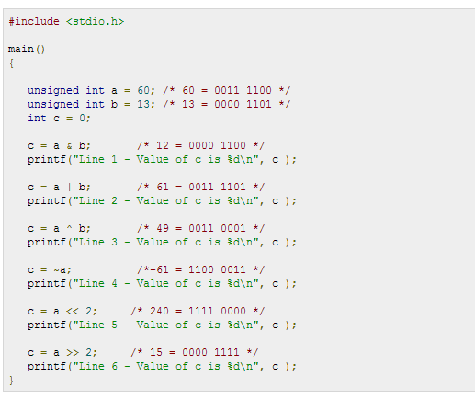

Slide 62
Bit-wise Operators

Slide 63
7. Exercise #3 (temperature estimate) (2/2)
Refer to the sample run below. Follow the output format.
Enter hours and minutes since power failure: 2 45
Temperature in freezer = -13.63
How long does it take the freezer to get to zero degree? Which of the following is the closest answer?
  3 hours
  4 hours 10 minutes
  6 hours 30 minutes
  8 hours
This is your take-home exercise. Bring your program to class next week.
This exercise is mounted on CodeCrunch as a practice exercise.
Week2 - 63

Slide 64
8. Style
Identifier naming for variables and functions
  User-defined identifiers: use lower-case with underscore or capitalise first character of every subsequent word (Eg: celsius, sum, second_max, secondMax)
  User-defined constants: use upper-case (Eg: KMS_PER_MILE, DAYS_IN_YEARS)
  Use names that are descriptive
Consistent indentation, and spacing to emphasize block structure
  int main(void) {
  // statements
  }
Comments major code segments adequately:
  Your name, Matric. number, discussion group, program’s purpose, etc.
  // line comment, or /* block comment */
Refer to some C Style Guides on the module website
  http://www.comp.nus.edu.sg/~cs1010/2_resources/online.html
Week2 - 64

