Slide 1
Chapter 3

Slide 2
Week 3: Top Down Design
Objectives:
  How to analyse, design, and implement a program
  How to break a problem into sub-problems with step-wise refinement
  How to use built-in library functions
  How to create your own user-defined functions
References:
  Chapter 3 The Basic of C – Math Functions
    We will do Character File Input/Output another time
  Chapter 5 Functions
Week3 - 2

Slide 3

Week 3: Outline (2/2)
Functions
  Syntax
  Precondition, postcondition
  Actual and Formal parameters
  Flow of control
  Function prototype
Exercise #3: Speed of Sound (take-home)
Exercise #4: Magic Number (take-home)
return statement in main()
CodeCrunch Issues
Week3 - 3

Slide 4
1. Check List: gcc
Compiling C programs
  Compile welcome.c with –Wall (all warnings) to produce a.out:
  gcc –Wall welcome.c
  To specify a name for the executable file, use the –o option (do this with care!):
  gcc –Wall welcome.c –o welcome
  Executable file will be named welcome instead of a.out.
  Learn to read compilation error messages from gcc
    It usually pinpoints the line (or its vicinity) where the error occurs
Common compilation errors/warnings at this point
  Missing & (address operator) in scanf() function
  Forgot to use –lm option when program uses math functions
    Eg: ld: fatal: symbol referencing errors.
Week2 - 4

Slide 5
2. Last Week’s Exercise #3
Write a program Week2_Freezer.c that estimates the temperature in a freezer (in Celsius) given the elapsed time (hours) since a power failure. Assume this temperature (T) is given by:
where t is the time since the power failure.
Thinking about the algorithm:
What are the variables (and their type) for input data?
What are the variables (and their type) for output?
Is there any formatting of output?
What are the variables (and their type) for intermediate results?
How to compute the result?
Week3 - 5


Slide 6
3. Math functions (1/2)
In C, there are many libraries offering functions for you to use.
Eg: scanf() and printf() – requires to include <stdio.h>
For t², you may use t*t, or the pow() function in the math library: pow(t, 2)
  pow(x, y) // computes x raised to the power of y
To use math functions, you need to
  Include <math.h> AND
  Compile your program with –lm option (i.e. gcc –lm …)
See Tables 3.3 and 3.4 (pages 88 – 89) for some math functions
Week3 - 6

Slide 7
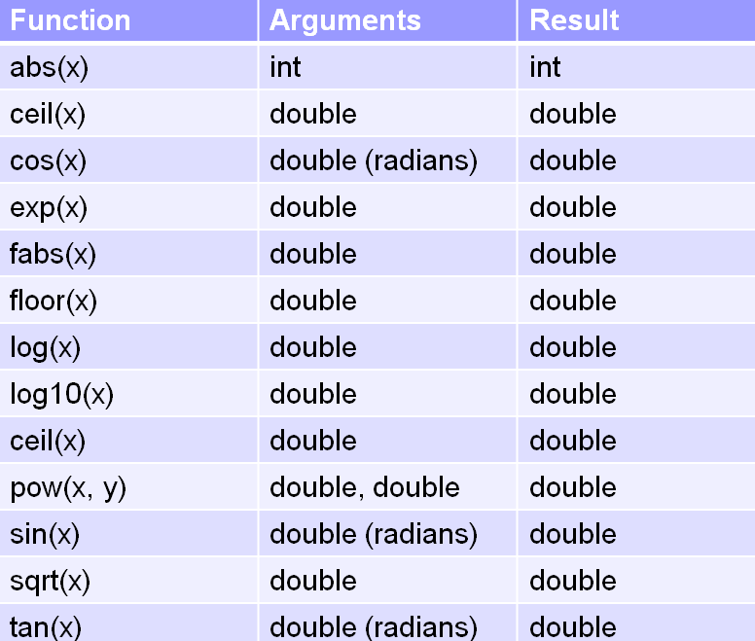
3. Math functions (2/2)
Some useful math functions
  Function abs(x) from <stdlib.h>; the rest from <math.h>
Week3 - 7


Slide 8
5. Problem Solving (1/2)
Given a problem, how to proceed to reach a working program?
Review week #1:
Determine problem features
Analysis
Rethink as appropriate
Write algorithm
Design
Produce code
Implementation
Check for correctness and efficiency
Testing
Week3 - 8

Slide 9
5. Problem Solving (2/2)
Analysis and Design
stepwise
refinement
NO
( hierarchy of )
sub-problems
problem
statement
sub-problems can
be implemented?
YES
structure chart
Implementation
& Testing
Knowledge in C
and its libraries
Knowledge in
data structure
(mostly CS1020)
Knowledge in
algorithms
Week3 - 9

Slide 10
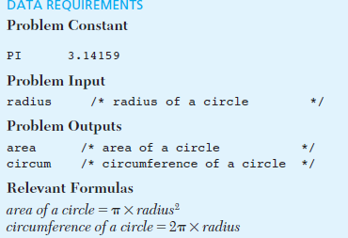
Case Study:
Area and Circumference of a circle
Problem:
  Get the radius
  Print area and circumference
Analysis:

Slide 11
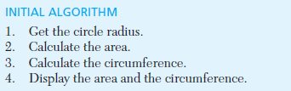

Case Study cont.
Design
Implementation: You have done it!
Testing:

Slide 12
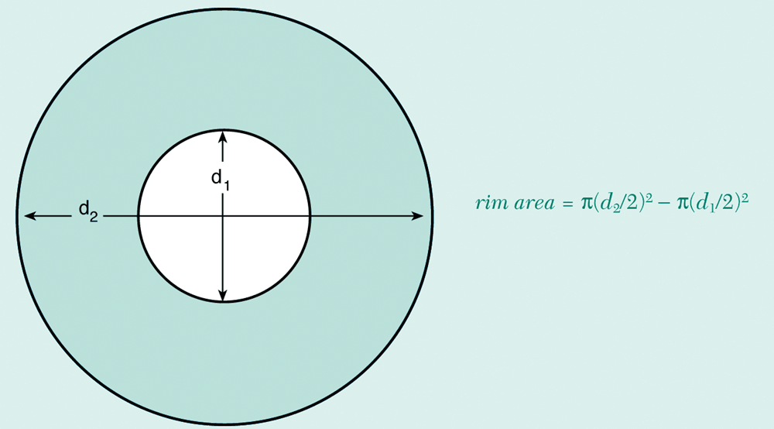
6. Case Study: Top-down Design (1/12)
You work for a hardware company that manufactures flat washers. To estimate shipping costs, your company needs a program that computes the weight of a specified quantity of flat washers.
rim area = π(d₂/2)² – π(d₁/2)²
Week3 - 12

Slide 13
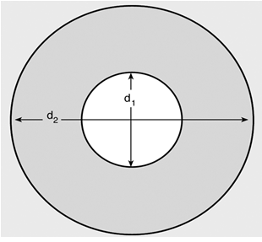
6. Case Study: Top-down Design (2/12)
Analysis:
To get the weight of a specified qty of washer, we need to know the weight of each washer
To get the weight of a washer, we need its volume × density
To get volume, we need its rim area × thickness
To get the rim area, we need d2 and d1
qty, density, thickness, d2, d1 should be given as inputs.
Answer
qty
weight
volume
density
rim area
thickness
rim area = π(d₂/2)² – π(d₁/2)²
d2
d1

Slide 14
6. Case Study: Top-down Design (3/12)
Analysis:
We define what the inputs and outputs are
Choose the identifier names and data types
Design:
Algorithm (view in words):
  Read in all the necessary inputs (qty, density, thickness, d2, d1)
  Compute weight of a single washer
    2.1 Compute the area of the (small) hole using d1
    2.2 Compute the area of the (big) circle using d2
    2.3 Subtract the big area from the small area to get the rim_area
    2.4 Compute volume = rim_area × thickness
    2.5 Compute weight = volume × density
  Compute the weight of the specified number of washer = weight × qty
  Output the calculated weight
Week3 - 14

Slide 15
6. Case Study: Top-down Design (4/12)
Design:
Algorithm (view in some hierarchical chart)
Compute Total Weight
Ask for all inputs
Compute Weight
Output total weight
qty?
density?
thickness?
d1?
d2?
Compute weight x qty
Compute hole area (use d1)
Compute big circle area (use d2)
Compute rim area
Compute volume (use thickness)
Compute weight (use density)
Week3 - 15

Slide 16
6. Case Study: Top-down Design (5/12)
Design:
Structure Chart
  a documentation tool that shows the relationship among the sub-problems
Compute Total Weight
Input : qty, density, thickness, d1, d2
Compute Weight of a single washer
Output total weight
Compute total Weight
Compute circle area
Week3 - 16

Slide 17
6. Case Study: Implementation (6/12)
#include <stdio.h>
#include <math.h>
#define PI 3.14159
int main(void) {
double d1, // input: hole circle diameter
d2, // input: big circle diameter
thickness, // input
density; // input
int qty; // input
double unit_weight, // single washer's weight
total_weight, // a batch of washers' total weight
outer_area, // area of big circle
inner_area, // area of small circle
rim_area; // single washer's rim area
// ask for all the inputs
printf("Inner diameter in cm: "); scanf("%lf", &d1);
printf("Outer diameter in cm: "); scanf("%lf", &d2);
printf("Thickness in cm: "); scanf("%lf", &thickness);
printf("Density in grams per cubic cm: "); scanf("%lf", &density);
printf("Quantity: "); scanf("%d", &qty);
Week3_Washers.c
Week3 - 17

Slide 18
6. Case Study: Implementation (7/12)
// compute weight of a single washer
outer_area = pow(d2/2, 2) * PI;
inner_area = pow(d1/2, 2) * PI;
rim_area = outer_area - inner_area;
unit_weight = rim_area * thickness * density;
// compute weight of a batch of washers
total_weight = unit_weight * qty;
// output
printf("Total weight of the batch of %d washers is %.2f grams.\n",
qty, total_weight);
return 0;
}
Week3_Washers.c
gcc Week3_Washers.c -lm
Week3 - 18

Slide 19
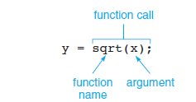
Library Functions
We can reuse predefined code
A function from math library looks like this:
Here if x is 16, square root becomes 4
Then the result is assigned to y

Slide 20
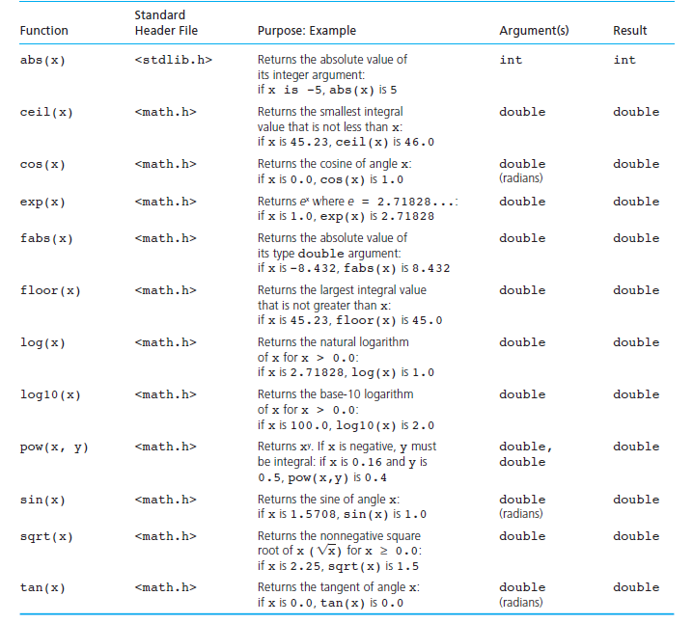

Slide 21

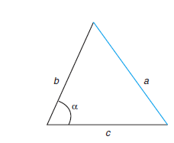
Using sqrt() function
We can use it to find roots of quadratic equation (we have done it already!)
Can use other math functions to find length of unknown side
Using the C code:

Slide 22
6. Case Study: Creating Function – back to old example
Note that area of circle is computed twice. For code reusability, it is better to define a function to compute area of a circle.
double circle_area(double diameter) {
return pow(diameter/2, 2) * PI;
}
We can then call/invoke this function whenever we need it.
circle_area(d2) → to compute area of circle with diameter d2
circle_area(d1) → to compute area of circle with diameter d1
Week3 - 22

Slide 23
6. Case Study: Creating Function (9/12)
#include <stdio.h>
#include <math.h>
#define PI 3.14159
double circle_area(double diameter) {
return pow(diameter/2, 2) * PI;
}
int main(void) {
// identical portion omitted for brevity
// compute weight of a single washer
rim_area = circle_area(d2) - circle_area(d1);
unit_weight = rim_area * thickness * density;
// identical portion omitted for brevity
}
Function definition
Calling circle_area() twice.
Week3 - 23

Slide 24
6. Case Study: Creating Function (10/12)
Components of a function definition
  Header (or signature): consists of return type, function name, and a list of parameters (with their types) separated by commas
  Function names follow identifier rules (just like variable names)
    May consist of letters, digit characters, or underscore, but cannot begin with a digit character
  Return type is void if function does not need to return any value
  Function body: code to perform the task; contains a return statement if return type is not void
Return type
Function name
Parameter
double circle_area(double diameter) {
return pow(diameter/2, 2) * PI;
}
Function body
Week3 - 24

Slide 25
6. Case Study: Calling a Function (11/12)
Values of arguments are copied into parameters
rim_area = circle_area(d2) - circle_area(d1);
Value of d2 copied to parameter diameter
Value of d1 copied to parameter diameter
Arguments need not be variable names; they can be constant values or expressions
circle_area(12.3) → To compute area of circle with diameter 12.3
circle_area((a+b)/2) → To compute area of circle with diameter (a+b)/2, where a and b are variables
Week3 - 25

Slide 26
6. Case Study: Function Prototype (12/12)
Preferred practice: add function prototype
  Before main() function
  Parameter names may be omitted, but not their type
#include <stdio.h>
#include <math.h>
#define PI 3.14159
double circle_area(double);
int main(void) {
// identical portion omitted for brevity
// compute weight of a single washer
rim_area = circle_area(d2) - circle_area(d1);
unit_weight = rim_area * thickness * density;
// identical portion omitted for brevity
}
double circle_area(double diameter) {
return pow(diameter/2, 2) * PI;
}
Week3_WashersV2.c
Function prototype
Function definition
Week3 - 26

Slide 27



7. Exercise #2: A simple “drawing” program (1/3)
Problem:
Write a program Week3_DrawFigures.c to draw a rocket ship (which is a triangle over a rectangle, over an inverted V), a male stick figure (a circle over a rectangle over an inverted V), and a female stick figure (a circle over a triangle over an inverted V)
rocket
male
female
Analysis:
No particular input needed, just draw the needed 3 figures
There are common shapes shared by the 3 figures
Design:
Algorithm (view in words):
  Draw Rocket ship
  Draw Male stick figure (below Rocket ship)
  Draw Female stick figure (below Male stick figure)
Week3 - 27

Slide 28
7. Exercise #2: A simple “drawing” program (2/3)
Design (Structure Chart):
rocket
male
female
Draw 3 Figures
Draw Rocket Ship
Draw Male Stick Figure
Draw Circle
Draw Female Stick Figure
Draw Circle
Draw Triangle
Draw Rectangle
Draw Inverted V
Draw Rectangle
Draw Inverted V
Draw Triangle
Draw Inverted V
Week3 - 28

Slide 29
7. Exercise #2: A simple “drawing” program (3/3)
Implementation (partial program)
Week3_DrawFiguresPartial.c
#include <stdio.h>
void draw_rocket_ship();
void draw_male_stick_figure();
void draw_circle();
void draw_rectangle();
int main(void) {
draw_rocket_ship();
printf("\n\n");
draw_male_stick_figure();
printf("\n\n");
return 0;
}
void draw_rocket_ship() {
}
void draw_male_stick_figure() {
}
void draw_circle() {
printf(" ** \n");
printf(" * * \n");
printf(" * * \n");
printf(" ** \n");
}
void draw_rectangle() {
printf(" ****** \n");
printf(" * * \n");
printf(" * * \n");
printf(" * * \n");
printf(" ****** \n");
}
Write a complete program Week3_DrawFigures.c
Week3 - 29

Slide 30
8. Functions (1/5)
A program is a collection of functions to transform input (if any) to output (if any)
In general, each box in a structure chart, which is a sub-problem, gives rise to a function
In mathematics, a function maps some input values to a single (possibly multiple dimensions) output
In C, a function maps some input values to zero or more output values
  Zero output through “void func ( … ) { … }”
  One output through, e.g., “double func ( … } { …; return value; }”
  More outputs through changing input values (we’ll cover this later)
    ‘&’ – ‘address of’ operator
    ‘*’ – ‘indirection’ operator; go to the address stored in the variable following the * to get the/put a value at that address
Return value (if any) from function call can (but need not) be assigned to a variable.
Week3 - 30

Slide 31
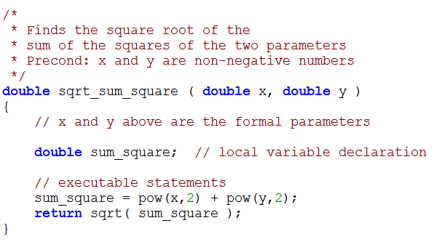
8. Functions (2/5)
Syntax: Example (Week3_Sample.c):
function interface comment
ftype fname (formal parameter declaration list)
{
local variable declarations
executable statements
// include return statements, if any
}
Notes:
Precondition: describes conditions that should be true before calling function.
Postcondition: describes conditions that should be true after executing function.
Week3 - 31

Slide 32
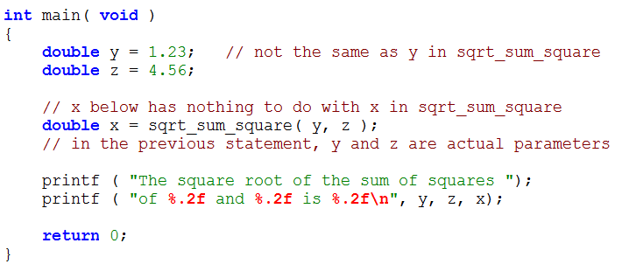
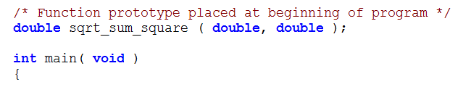
8. Functions (3/5)
Actual parameters (also arguments) are values passed to function for computation
Formal parameters (or simply parameters) are placeholder when function is defined.
Matching of actual and formal parameters from left to right
Scope of formal parameters, local variables are within the function only
Arrows indicate flow of control between main and a call to a function
Provide function prototype as function may be used before (compiler sees) its definition:
Week3 - 32

Slide 33
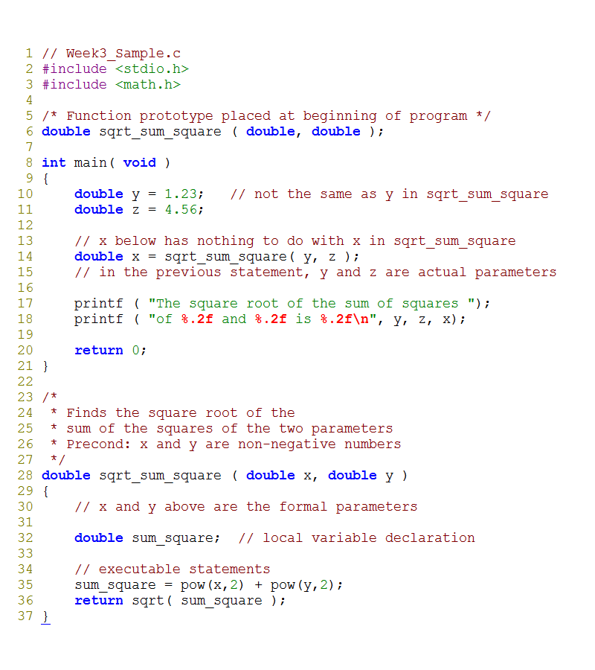
8. Functions (4/5)
Week3_Sample.c
The complete program
Week3 - 33

Slide 34
8. Functions (5/5)
Use of functions allow us to manage a complex (abstract) task with a number of simple (specified) ones.
  This allows us to switch between abstract and go to specific at ease to eventually solve the problem.
Function allows a team of programmers working together on a large program – each programmer will be responsible for a particular set of functions.
Function is good mechanism to allow re-use across different programs. Programmers use functions like building blocks.
Function allows incremental implementation and testing (with the use of driver function to call the function and then to check the output)
Acronym NOT summarizes the requirements for argument list correspondence. (N: number of arguments, O: order, T: type)
Week3 - 34

Slide 35
Program Style
Use comments before each function
Order of execution of function
  We start from main function, then we go to a function when it is called
Advantages of using function
  Organized code
  Hides the details
  When working in a team

Slide 36
9. Exercise #3: Speed of Sound (take-home)
Write a program Week3_SpeedOfSound.c that calculates the speed of sound (s) in air of a given temperature T (ºF). Formula to compute the speed s in feet/sec:
Values are of type float.
You should have a function speed_of_sound() to compute and return the speed. Decide on its parameter(s).
Sample run (values printed in 2 decimal places):
Temperature in degree Fahrenheit: 95.8
Speed of sound in air of 95.80 degree = 1924.92 ft/sec
Bring your program to class next week
This exercise is also mounted on CodeCrunch
Week3 - 36

Slide 37
10. Exercise #4: Magic Number (take-home)
Write a program Week3_MagicNumber.c that reads two positive integers (with at most 5 digits) and for each, adds up the digits (from right) in positions 1, 3, and 5. The right-most digit of the sum is the required answer.
For example, if input is 76524, then adding up the digits 4, 5 and 7, we get 16. The answer is hence 6.
You should have a function get_magic() to compute and return the answer. Decide on its parameter(s). What is the precondition of the function?
Sample run:
Enter 1st value: 76524
Magic number = 6
Enter 2nd value: 8946
Magic number = 5
Bring your program to class next week
This exercise is also mounted on CodeCrunch
Week3 - 37

Slide 38
11. return statement in main( )
(for reading only)
Our C programs have this header for main() function
  int main(void)
You usually see this return statement in main()
  return 0;
The value 0 is returned to the operating system (which is UNIX in our case) on which the program is run. This is called the status code of the program.
In UNIX, when a program terminates with a value of 0, it means a successful run.
You may optionally check the status code to determine the appropriate follow-up action.
You do not need to worry about this.
Week3 - 38

Slide 39
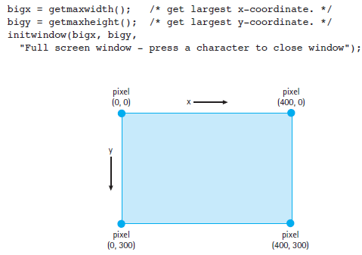
Introducing Graphics functions (Explore more yourself!!!)
In normal display mode, text mode we use printf()
In graphics mode we can draw pictures and patterns on the screen
You will
need to know graphics functions

Slide 40
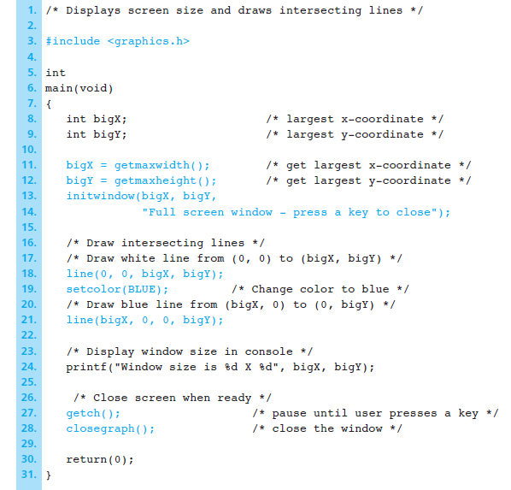
Example Program

Slide 41
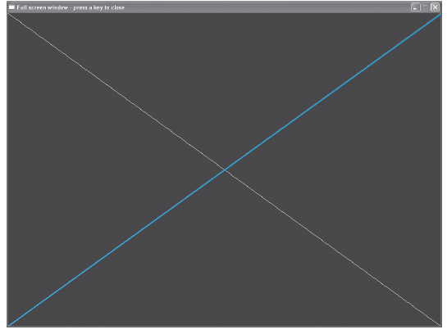
Output

Slide 42
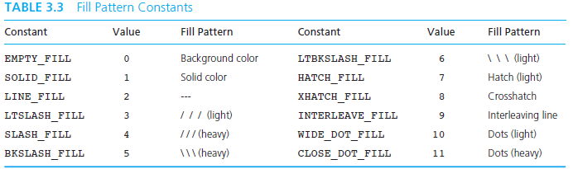

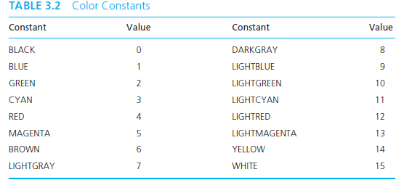
More ….
We can choose to use colors and filling styles according to our needs!

Slide 43
Summary for Today
Today’s most important lessons
  Stepwise refinement to get structure chart
  Knowing how to use built-in functions
  Writing your own user-defined functions
Week3 - 43

Slide 44
End of File

