Slide 1
Programming Methodology

Slide 2
Week 4: Selection Statements
Objectives:
  Using relational and logical operators
  Using selection statements in a program
  Formulating complex selection structures to solve decision problems.
Reference:
  Chapter 4 Lessons 4.1 – 4.6, Beginning Decision Making
Week4 - 2

Slide 3
Week 4: Outline (1/2)
Week 3 Exercises
Sequential vs non-sequential control flow
Selection Structures
  3.1 if and if-else Statements
  3.2 Conditions
  3.3 Truth Values
  3.4 Logical Operators
  3.5 Evaluation of Boolean Expressions
  3.6 Short-Circuit Evaluation
Indentation Style
Week4 - 3

Slide 5

3. Selection Structures
C provides two control structures that allow you to select a group of statements to be executed or skipped when certain conditions are met.
if … else…
switch
Week4 - 5

Slide 6

3.1 if and if-else Statements
true
cond?
How are conditions specified and how are they evaluated?
false
if statement
  if ( condition ) {
  /* Execute these statements if TRUE */
  }
Example
Week4 - 6

Slide 7

3.1 if and if-else Statements
Braces { } optional only if there is one statement in the block.
true
false
cond?
if-else statement
  if ( condition ) {
  /* Execute these statements if TRUE */
  }
  else {
  /* Execute these statements if FALSE */
  }
Example
Week4 - 7

Slide 8
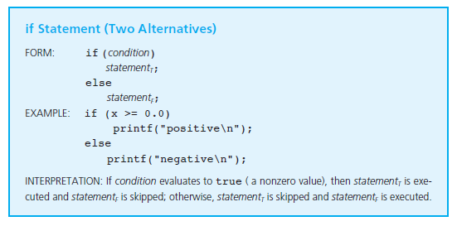
3.1 if and if-else Statements
Week4 - 8

Slide 9
The conditions can be fancy
if-else statement
  if ( condition ) {
  /* Execute these statements if TRUE */
  }
  else {
  /* Execute these statements if FALSE */
  }
Example
if((x<60) && (x>50))
printf(”study harder for a better grade);
else
printf(“No comments now!”);
Week4 - 9

Slide 10
What you can do
Grade >60, pass otherwise, fail
Time>6:00 PM, study. Otherwise, have fun

Slide 12
3.2 Condition
A condition is an expression evaluated to true or false.
It is composed of expressions combined with relational operators.
Relational operators
  Examples: ( a <= 10 ), ( count > max ), ( value != -9 )
Relational Operator | Interpretation
< | is less than
<= | is less than or equal to
> | is greater than
>= | is greater than or equal to
== | is equal to
!= | is not equal to
Week4 - 12

Slide 13
3.3 Truth Values (1/2)
Boolean values: true / false.
There is no boolean type in ANSI C. Instead, we use integers:
  0 to represent false
  Any other value to represent true (1 is used as the representative value for true in output)
Example:
Week4_TruthValues.c
int a = (2 > 3);
int b = (3 > 2);
printf("a = %d; b = %d\n", a, b);
Week4 - 13


Slide 14

3.3 Truth Values (1/2)
Be careful of the value returned/evaluated by a relational operation.
Since the values 0 and 1 are the returned values for false and true respectively, we can have codes like these:
  int a = 12 + (5 >= 2); // 13 assigned to a
  int b = (4 > 5) < (3 > 2) * 6; // 1 assigned to b
  int c = ( (4 > 5) < (3 > 2) ) * 6; // 6 assigned to c
You are certainly not encouraged to write such convoluted codes!
Week4 - 14

Slide 15
3.4 Logical Operators
Complex conditions: combine two or more boolean expressions.
Examples:
  If temperature is greater than 40C or blood pressure is greater than 200, go to A&E immediately.
  If all the three subject scores (English, Maths and Science) are greater than 85 and mother tongue score is at least 80, recommend taking Higher Mother Tongue.
Logical operators are needed: && (and), || (or), ! (not).
A | B | A && B | A || B | !A
False | False | False | False | True
False | True | False | True | True
True | False | False | True | False
True | True | True | True | False
Note: There are bitwise operators such as & , | and ^, but we are not covering these in CS1010.
Week4 - 15

Slide 16
3.5 Evaluation of Boolean Expressions (1/2)
The evaluation of a boolean expression proceeds according to the precedence and associativity of the operators.
Example #1: What is the value of x?
int x, a = 4, b = -2, c = 0;
x = (a > b && b > c || a == b);
gcc issues warning (why?)
Example #2: What is the value of x?
x = ((a > b) && !(b > c));
See Week4_EvalBoolean.c
Week4 - 16


Slide 17
3.5 Evaluation of Boolean Expressions (2/2)
Lesson 4.5 Precedence of Logical Operators (pg 142-143)
Operators | Name | Associativity | Precedence
() | Parentheses | L to R | 1 (highest)
++, -- | Post-increment | L to R | 2
++, -- | Pre-increment | R to L | 2
! | Logical NOT | L to R | 3
+, - | Positive, negative sign | L to R | 3
*, /, % | Multiplication, division, mod | L to R | 4
+, - | Addition, subtraction | L to R | 5
==, >=, <=, >, <, != | Relational operator | L to R | 6
&& | Logical AND | L to R | 7
|| | Logical OR | L to R | 8
=, +=, -=, *=, /=, %= | Assignment | R to L | 9 (lowest)
Note error in reference book.
Week4 - 17

Slide 18
3.6 Short-circuit Evaluation
Does the following code give an error if a is zero?
if ((a != 0) && (b/a > 3))
printf(. . .);
Short-circuit evaluation uses the following facts:
  expr1 || expr2 : If expr1 is true, skip evaluating expr2, as the result will always be true.
  expr1 && expr2: If expr1 is false, skip evaluating expr2, as the result will always be false.
CS1010 (AY2011/2 Semester 1)
Week4 - 18

Slide 19
4. Indentation Style
Acceptable
Not acceptable
if (cond) {
statements;
}
else {
statements;
}
if (cond)
{
statements;
}
else
{
statements;
}
if (cond)
{
statements;
}
else
{
statements;
}
No indentation!
if (cond) {
statements;
} else {
statements;
}
if (cond) {
statements; }
else {
statements; }
Closing braces not aligned with if/else keyword.
Week4 - 19

Slide 20
5. Quiz (1/2)
Match each condition in (A) to its equivalent condition in (B). Assume that a is an int variable.
A
B
if (a == 0) {
…
}
if (a) {
…
}
if (a != 0) {
…
}
if (!a) {
…
}
Codes in (B) are very frequently encountered in C programming. They are not considered convoluted.
Week4 - 20


Slide 21
5. Quiz (2/2)
What is the output of the following code?
if (x <= y)
printf("Line 1\n");
printf("Line 2\n");
printf("Line 3\n");
Assuming that a, b and c are int variables, is the following condition correct? Why?
if (a > b > c)
If it is wrong, how can you correct it?
Week4 - 21


Slide 22
6. Demo #1: Hi-Lo Game
User to guess a secret jackpot number (between 1 and 10).
Program responses according to whether user’s guess is smaller than, larger than, or equal to the jackpot.
Analysis
  Inputs: jackpot number, your guess
  Outputs: appropriate messages (“too high”, “too low”, etc.)
Week4 - 22
Notes:
Intro to OOP with Java, C. Thomas Wu
©The McGraw-Hill Companies, Inc.
22

Slide 23
6. Demo #1: Hi-Lo Game (version 1)
Week4_HiLo_v1.c
// Hi-Lo Game version 1
#include <stdio.h>
int main(void) {
int guess, jackpot = 8;
printf("Guess the jackpot number between 1 and 10!\n");
printf("Please type your guess: ");
scanf("%d", &guess);
if (guess < jackpot)
printf("Sorry, your guess is too low.\n");
if (guess > jackpot)
printf("Sorry, your guess is too high.\n");
if (guess == jackpot)
printf("You hit the JACKPOT!\n");
return 0;
}
Jackpot is fixed to 8! No fun. We need random number (you’ll learn that in discussion session.)
Can we change the 3 ‘if’ statements into a single nested ‘if-else’ statement?
Week4 - 23
Notes:
CS1010 Programming Methodology

Slide 24
6. Demo #1: Hi-Lo Game (version 2)
Week4_HiLo_v2.c
// Hi-Lo Game version 2
#include <stdio.h>
int main(void) {
int guess, jackpot = 8;
printf("Guess the jackpot number between 1 and 10!\n");
printf("Please type your guess: ");
scanf("%d", &guess);
if (guess < jackpot)
printf("Sorry, your guess is too low.\n");
else if (guess > jackpot)
printf("Sorry, your guess is too high.\n");
else
printf("You hit the JACKPOT!\n");
return 0;
}
Is this single nested ‘if-else’ statement better than 3 ‘if’ statements? Why?
Week4 - 24
Notes:
CS1010 Programming Methodology

Slide 25
7. Indentation Style Again (1/2)
Week4_HiLo_v2.c shows a simple case of a frequently encountered selection structure: if-else-if.
Week4 - 25
Notes:
CS1010 Programming Methodology

Slide 26
7. Indentation Style Again (1/2)
// marks is an int variable
if (marks >= 90)
printf("Grade A\n");
else
if (marks >= 75)
printf("Grade B\n");
else
if (marks >= 60)
printf("Grade C\n");
else
if (marks >= 50)
printf("Grade D\n");
else
printf("Grade F\n");
  This follows the indentation guideline, but for such cases the code tends to be long and skew to the right.
Week4 - 26
Notes:
CS1010 Programming Methodology

Slide 27
7. Indentation Style Again (2/2)
Alternative (and preferred) indentation style for the if-else-if structure is shown on the right
// marks is an int variable
if (marks >= 90)
printf("Grade A\n");
else
if (marks >= 75)
printf("Grade B\n");
else
if (marks >= 60)
printf("Grade C\n");
else
if (marks >= 50)
printf("Grade D\n");
else
printf("Grade F\n");
// marks is an int variable
if (marks >= 90)
printf("Grade A\n");
else if (marks >= 75)
printf("Grade B\n");
else if (marks >= 60)
printf("Grade C\n");
else if (marks >= 50)
printf("Grade D\n");
else
printf("Grade F\n");
Week4 - 27
Notes:
CS1010 Programming Methodology

Slide 28
8. Exercise #1: Leap Year (1/2)
Problem: Write a modular program Week4_LeapYear.c to determine whether a year is a leap year.
  It should have a function int isLeapYear(int) with the year as the parameter and returns 1 (true) if it is a leap year, or 0 (false) otherwise
Analysis:
  Input: a 4-digit positive integer
  Output: “xxxx is a leap year” or “xxxx is not a leap year” where xxxx is the year
Design:
  Year is a leap year if it is divisible by 4 but not by 100; or …
  It is divisible by 400
Week4 - 28
Notes:
CS1101 Programming Methodology

Slide 29
8. Exercise #1: Leap Year (2/2)
Are these leap years?
  1997
  2002
  1996
  2000
  1900
  2100
  2400
  2300
Week4 - 29

Notes:
CS1101 Programming Methodology

Slide 30
9. Demo #2: Maximum of 3 Numbers (1/2)
Problem: Find the maximum among 3 integer values.
Version #1
Week4_FindMax_v1.c
int getMax(int num1, int num2, int num3) {
int max = 0;
if ((num1 > num2) && (num1 > num3))
max = num1;
if ((num2 > num1) && (num2 > num3))
max = num2;
if ((num3 > num1) && (num3 > num2))
max = num3;
return max;
}
Spot the error.
After correcting the error, can we change the 3 independent ‘if’ statement to a nested ‘if-else’ statement?
Week4 - 30

Slide 31
9. Demo #2: Maximum of 3 Numbers (2/2)
Another version:
Week4_FindMax_v2.c
int getMax(int num1, int num2, int num3) {
int max = 0;
if (num1 > max)
max = num1;
else if (num2 > max)
max = num2;
else if (num3 > max)
max = num3;
return max;
}
Spot the error.
Week4 - 31

Slide 32
10. Very Common Errors
The code fragments below contain some very common errors. One is caught by the compiler but the other is not (which make it very hard to detect). Spot the errors.
int a = 3;
if (a > 10);
printf("a is larger than 10\n");
printf("Next line\n”);
int a = 3;
if (a > 10);
printf("a is larger than 10\n");
else
printf("a is not larger than 10\n");
printf("Next line\n”);
Week4 - 32
Notes:
32

Slide 33
11. Nested if and if-else Statements
Nested if (if-else) structures refer to the containment of an if (if-else) structure within another if (if-else) structure.
For example
  If it is a weekday, you will be in school from 8 am to 6 pm, do revision from 6 pm to 12 midnight, and sleep from 12 midnight to 8 am.
  If it is a weekend, then you will sleep from 12 midnight to 10 am and have fun from 10 am to 12 midnight.
Week4 - 33

Slide 34
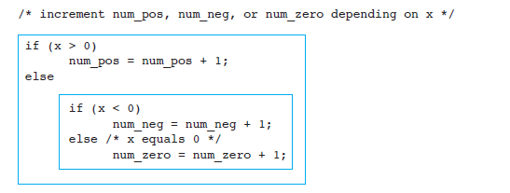
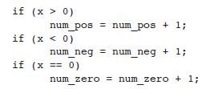
Nested if-else example
Nested if statements
Sequence of if statements

Slide 35
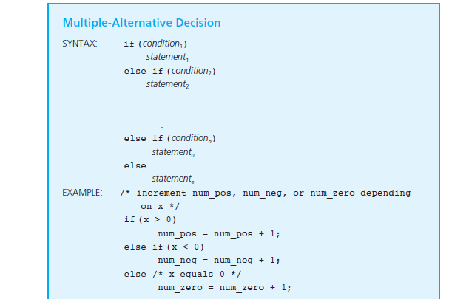
Multiple alternatives

Slide 36
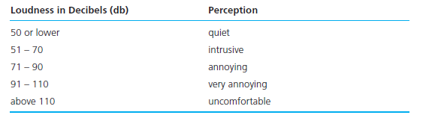
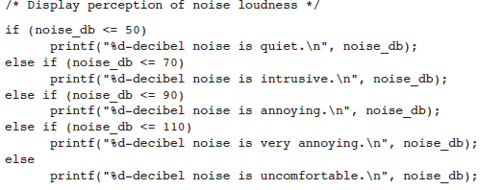
Nested if else

Slide 38
13. switch Statement
An alternative to if-else-if (section 7) is to use the switch statement.
Syntax:
switch ( <variable> ) {
case value1:
Code to execute if <variable> == value1
break;
case value2:
Code to execute if <variable> == value2
break;
...
default:
Code to execute if <variable> does not equal the
value following any of the cases
break;
}
Restriction: variable must be of discrete type
(eg: int, char).
Week4 - 38

Slide 39
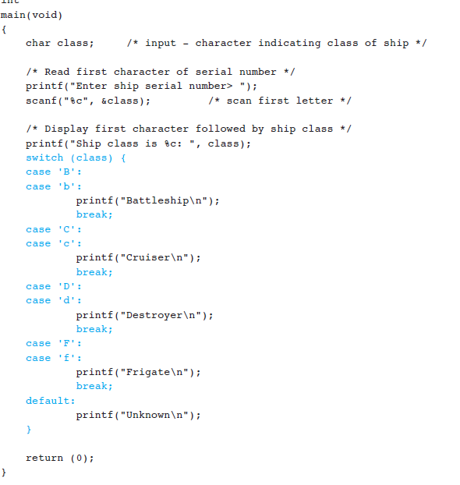
Ex

Slide 40
What you can do
A, E, I, O, U it’s a vowel, otherwise consonant

Slide 41
13. switch Statement
int grade int value;; //scanf from user
value=grade/10; // 6 is D, 7 is C, 8 is B and 9, 10 is A
switch (value) {
case 6:
printf(“Grade is D”);
break;
case 7:
printf(“Grade is C”);
break;
case 8:
printf(“Grade is B”);
break;
case 9:
case 10:
printf(“Grade is A”);
break;
default:
printf(“Try a better faculty next semester!”);
break;
}
Week4 - 41

Slide 42
Summary for Today
Today’s most important lessons
  if and if-else statements
  switch statement
Week4 - 42

Slide 43

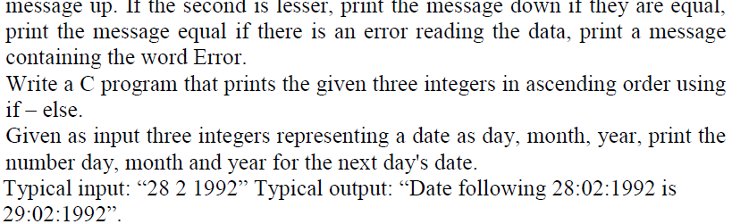
Problems

Slide 44
End of File

