Slide 1

NSU Library Orientation Presentation
Undergraduate Program, Fall 2026
North South University Library

Slide 2
Supports the research, teaching and learning needs of the North South University community by providing wide-ranging scholarly resources, facilities and services, and working with faculty and students in the discovery, use, creation and management of information.
Mission of NSU Library

Slide 3
About NSU Library
The NSU Central Library is the first RFID based automated university library in Bangladesh.
One of the best university libraries in Bangladesh due to its rich collection, research support, welcoming space and quality services.
NSU Central Library has more than 56,000 printed books, 107,000 online journals and 237,000 Online E-books.
It has six floors, over 83,850 sq.ft. area, accommodates over 950 students at a time.

Slide 4

Library Timing
The NSU Library remains 7 days open during the normal semester period.
NSU Library Hours (Regular)
Saturday - Thursday | 08.00 A.M. – 10.30 P.M.
Friday | 09.00 A.M. – 09.00 P.M.
During Semester Break
Saturday - Friday | 09.00 AM – 09.00 PM

Slide 5
General Rules for Library Users
Library is mainly a place of self-paced study area, therefore silence is required throughout the library wherever indicated.
The Cellphone must be kept on silent/vibration mode in the library and should not be used in anywhere within the main library premises.
Foods, beverages/cold-drinks, dating/gossiping, group discussions are not allowed in the main library.
Personal belongings are (e.g. bags, personal books, ) not allowed in the main library. There is pigeon hole to keep your personal belongings.
Writing or marking in books is strictly prohibited.
Any offenses/indecent behavior will be pursued immediately under the university’s codes of discipline.

Slide 6









Not Allowed
In Main Floor

Slide 7




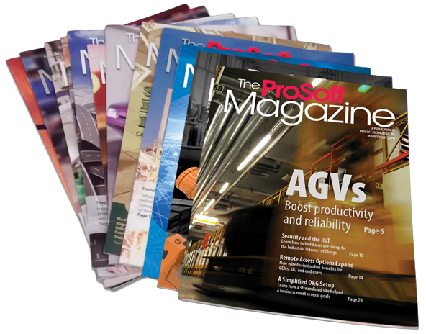


Printed Books: 56,000+
E-Books: 237,000+
E-Journals: 107,000+
DVD & CD ROM: 2,328
Foreign and Local Magazines
Thesis Paper: 2,600+
24 Foreign and National Dailies

Slide 8
Library sections
NSU Library
Archives Section
Study Hall
Bangladesh : History and Heritage Corner
Circulation Section
Periodical Section
Reference Section
Cyber & Audio Visual Section
Thesis Paper
Newspaper & Magazine
IELTS Corner
Computing Zone
General Reading Zone
Silent Reading Zone

Slide 9
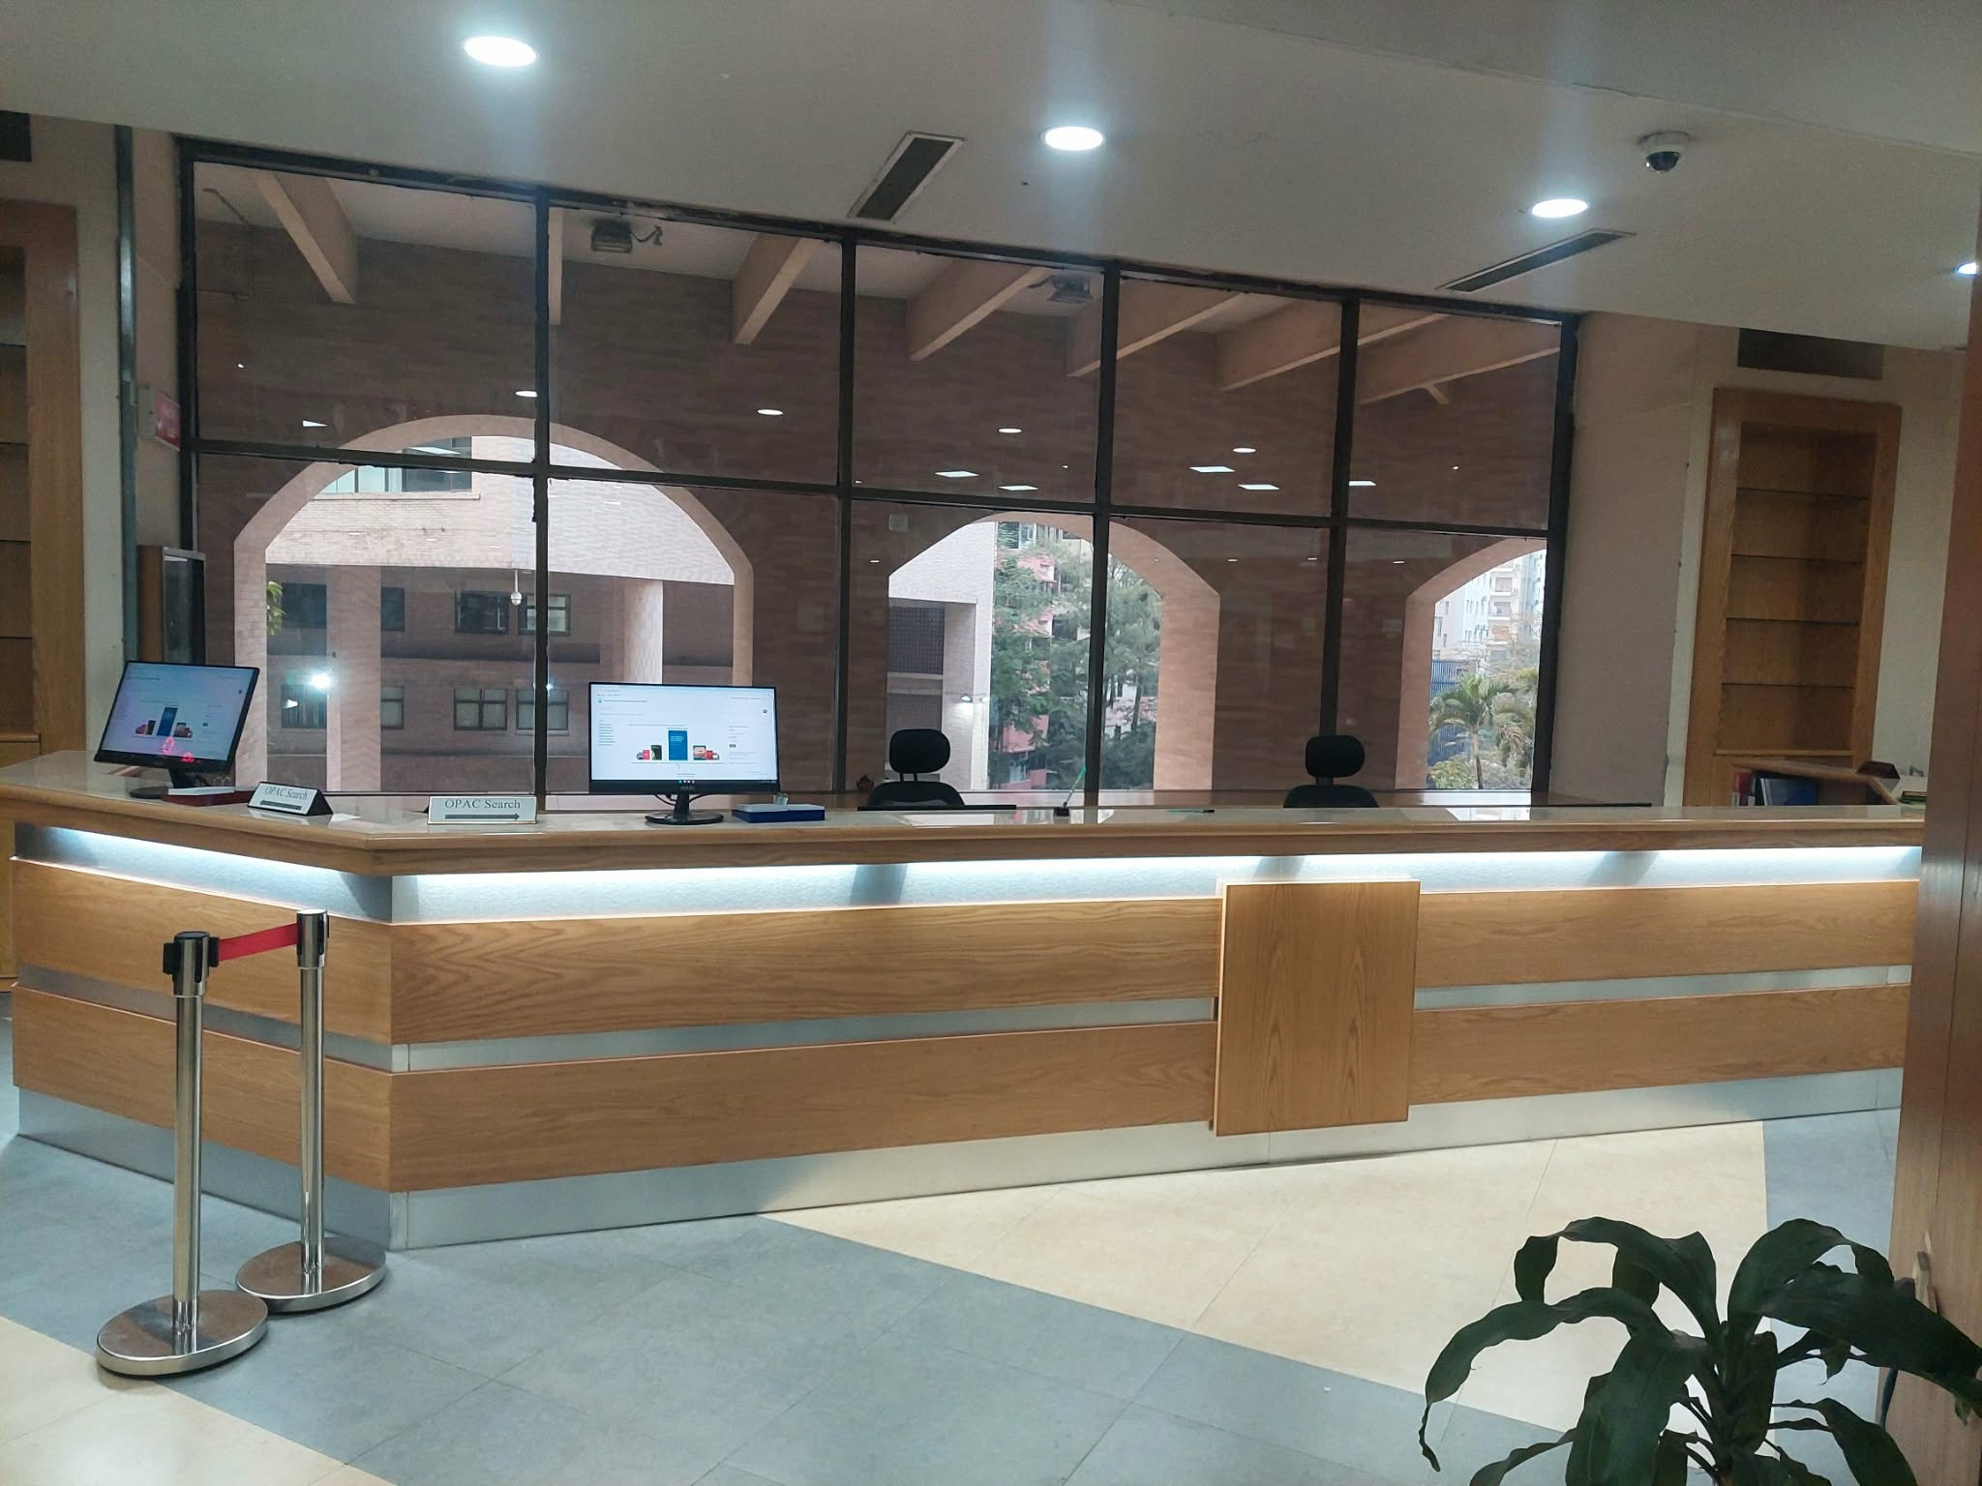
Quick view
Circulation Section

Slide 10
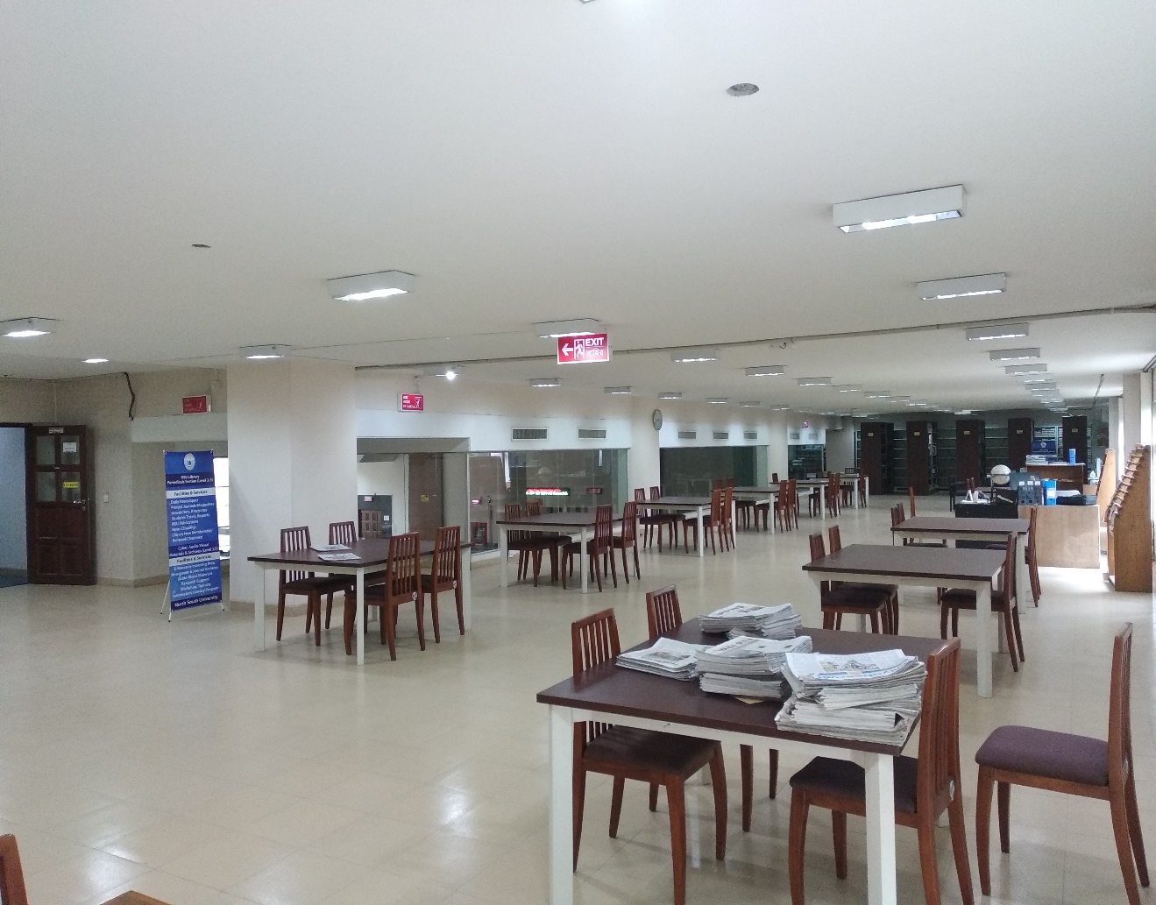
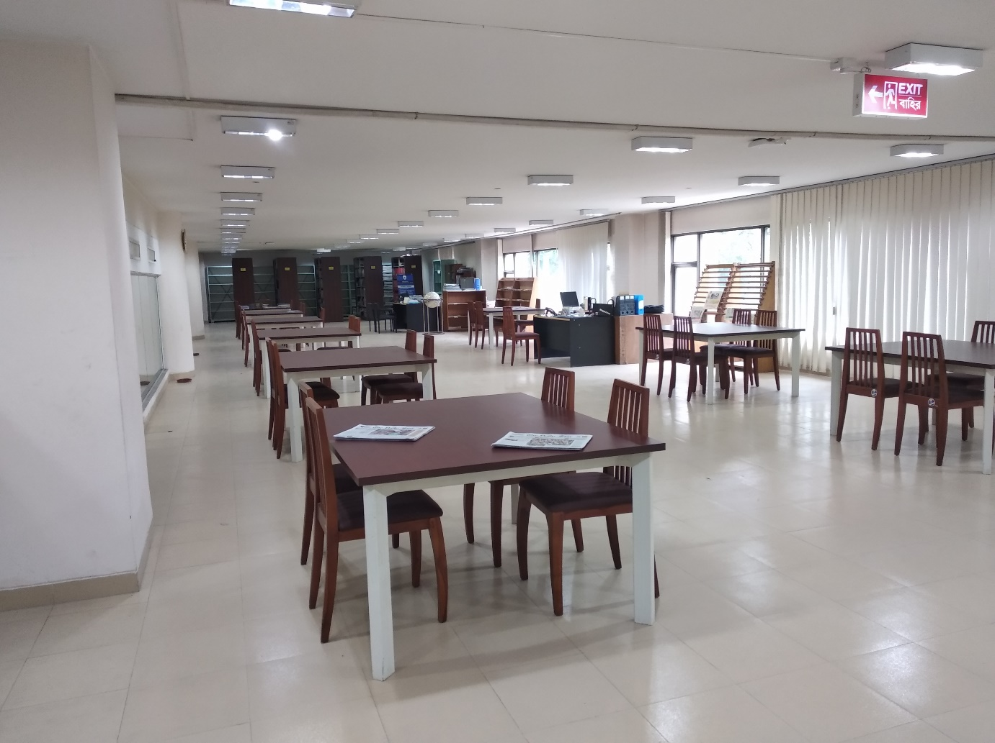
Quick view
Periodical Section

Slide 11
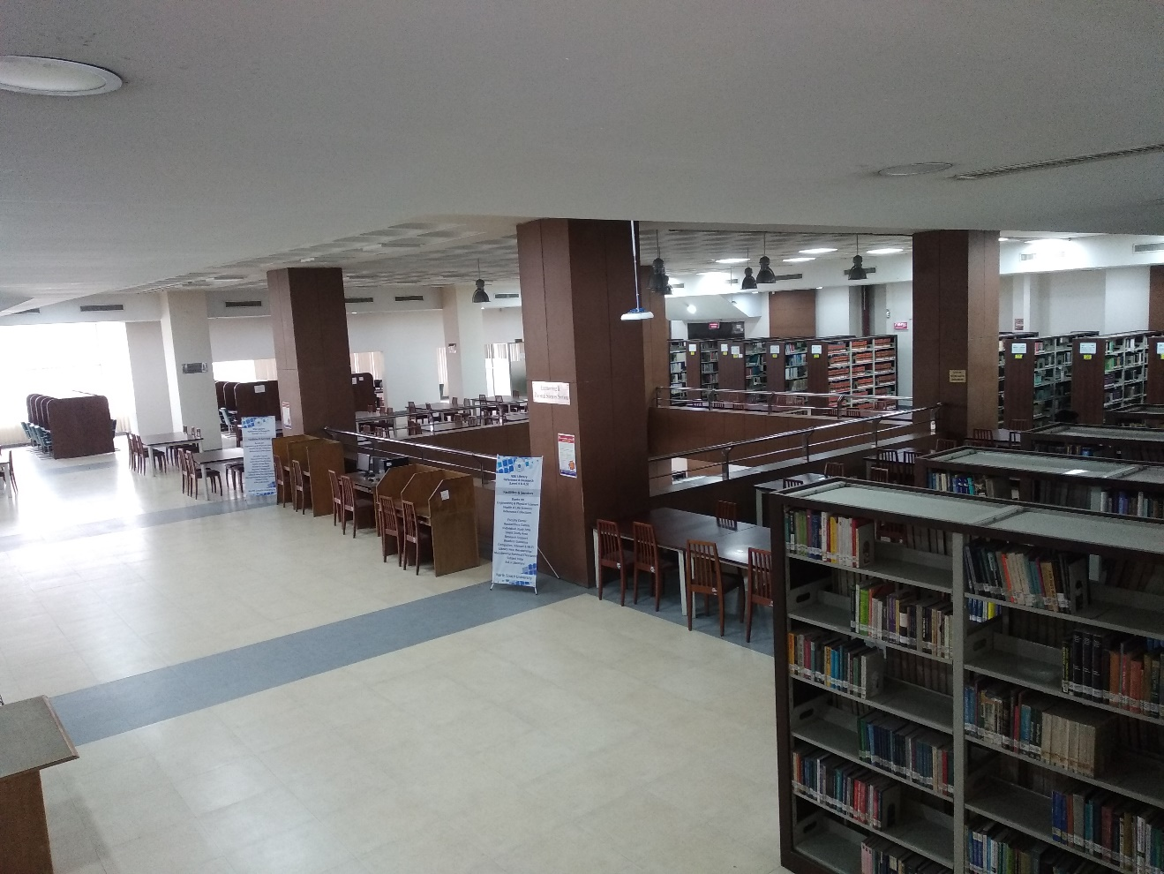
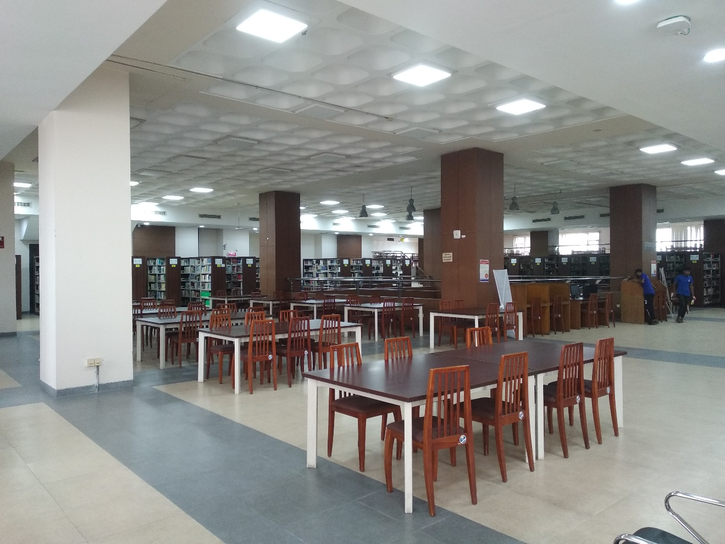
Quick view
REFERENCE Section

Slide 12
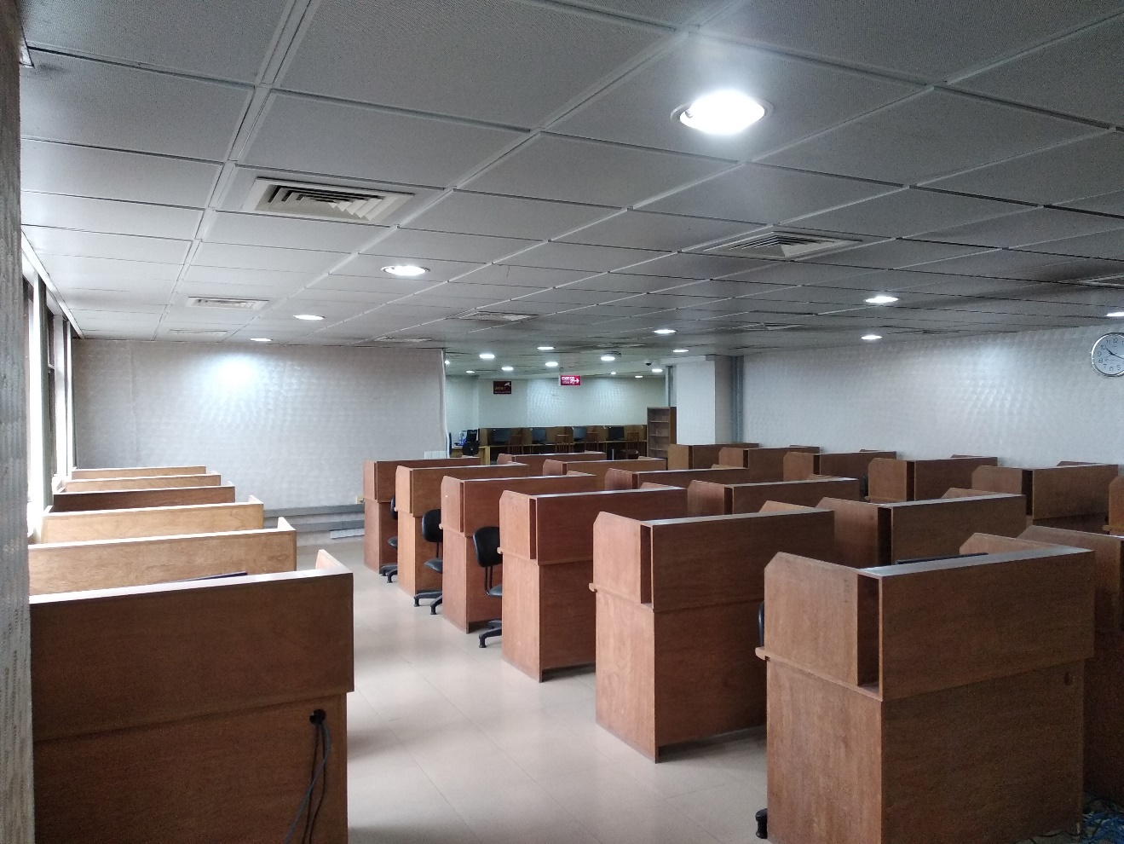
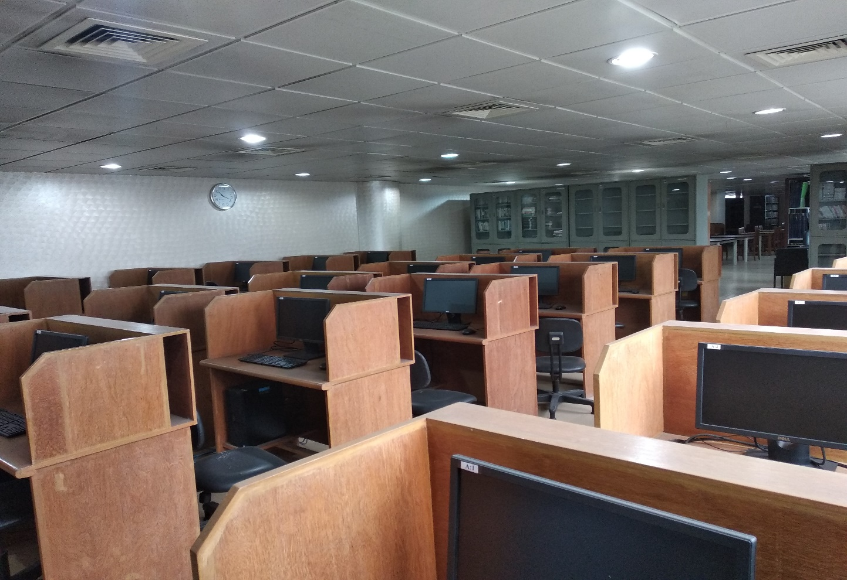
Quick view :
Cyber & Audio-Visual Section

Slide 13
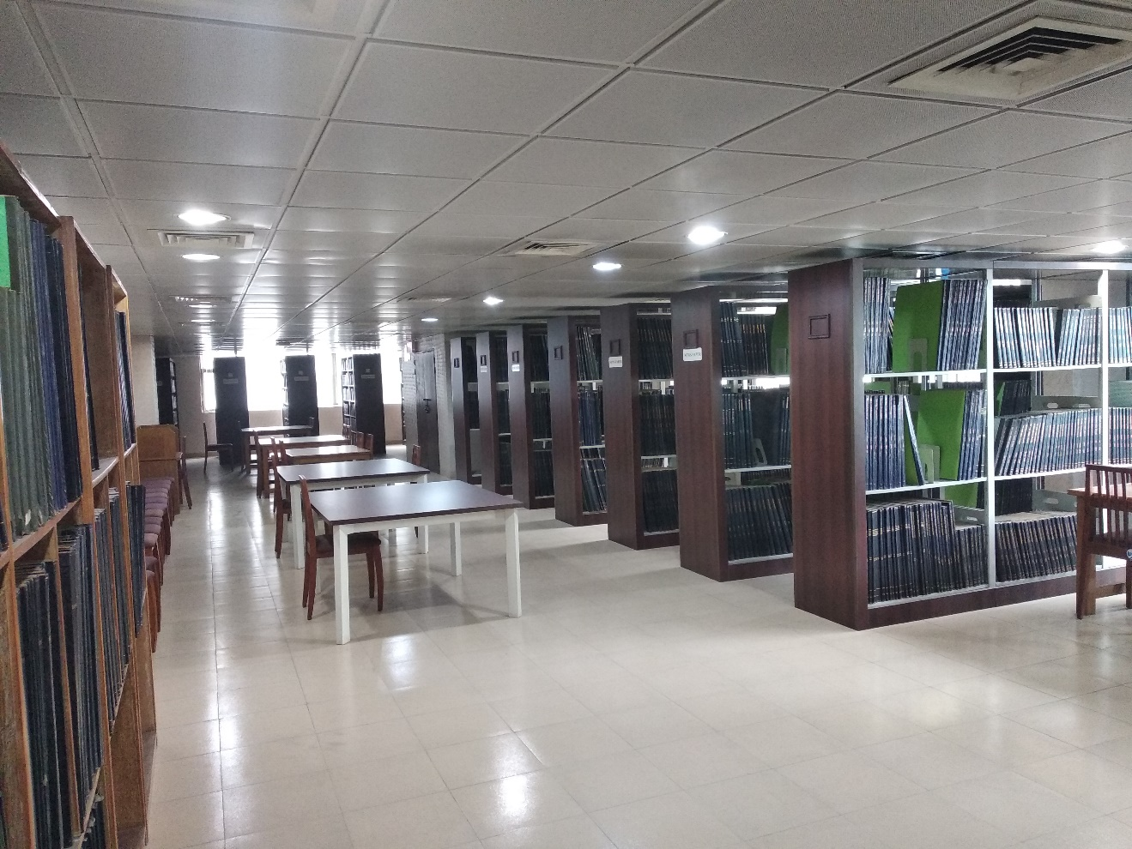
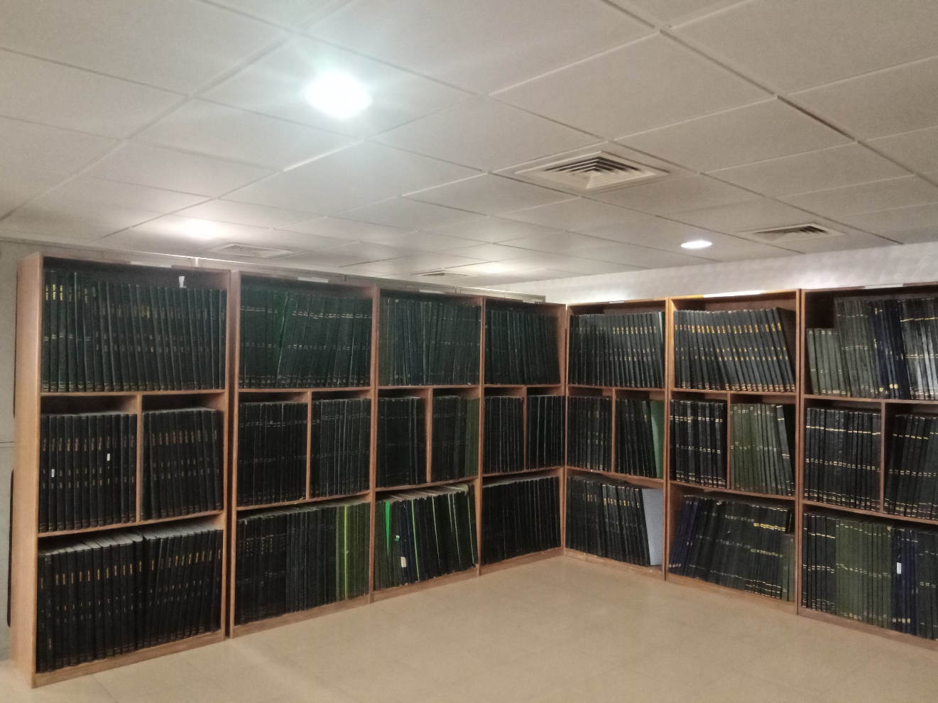
Quick view
Archives Section

Slide 14
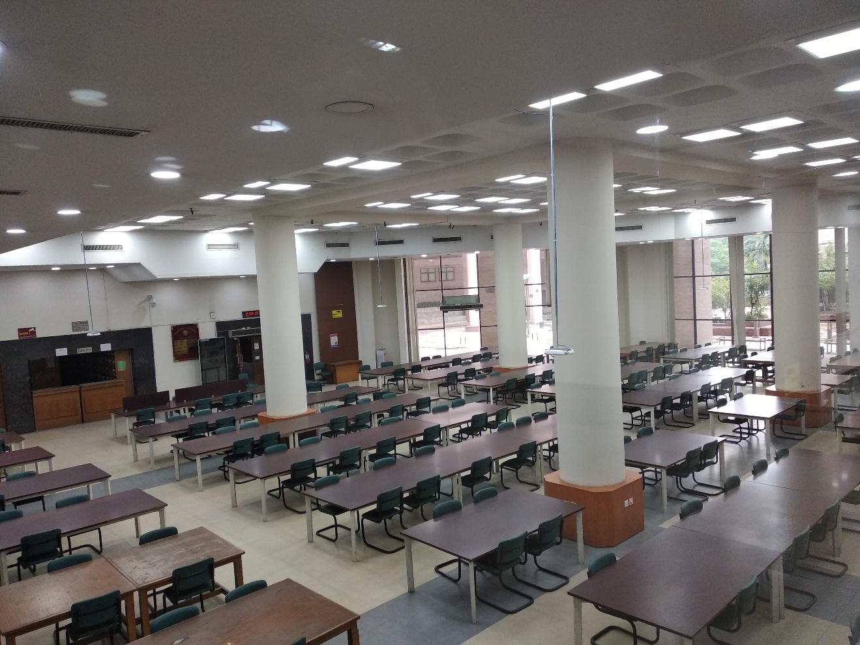
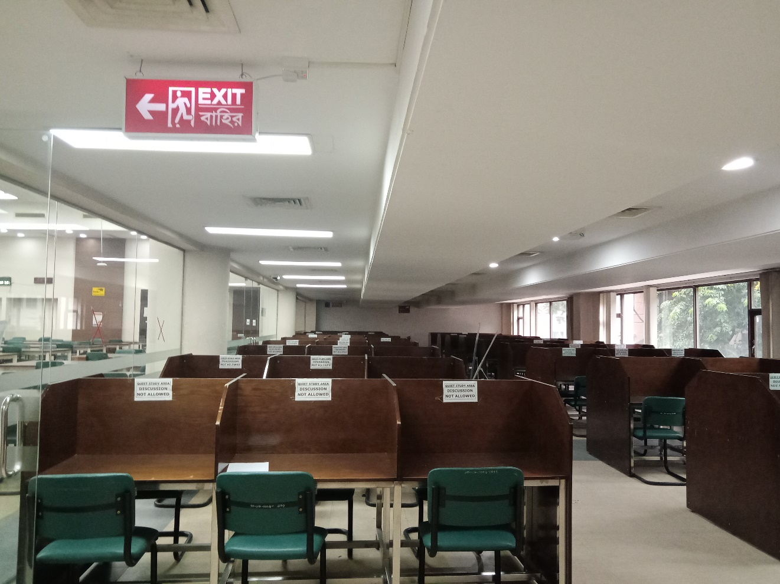
Quick view
Study Hall

Slide 15
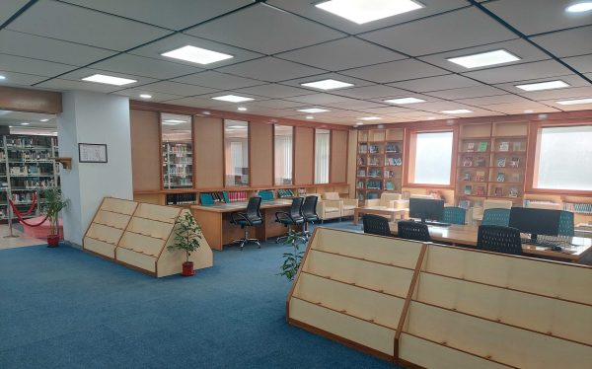
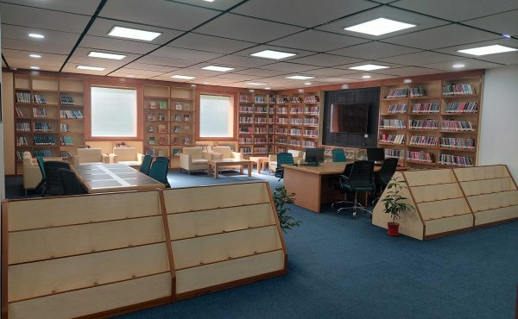
Quick view
Bangladesh: History & Heritage Corner

Slide 16
Library Research Support
To enhance the scholarly output of the NSU community the NSU Library has designed a range of research support programs and services.
Research Support Program
Services
Tools
Training & Workshop
1. Research Databases (online journals)
2. Remote Access
3. Plagiarism Checking services
1. Scopus
2. EndNote
3. Mendeley
4. Eikon (Business)
5. Grammarly
6. Turnitin
1. Faculty Orientation
2. Student Orientation
3. Scholarly Writing Instructions
4. Information Literacy Program

Slide 17
Library Membership
All valid students (Graduate/Undergraduate, Summer-2026) are member of NSU Library.
No need to register through online for Library Membership.
Library members are eligible to get the full benefit of library.

Slide 18
FAQs related to Library Membership
FAQs:
  Do I need to apply for membership?
        You do not need to apply for library membership. Since you are students of North South University (Admitted on Summer 2026), you are by-default library member.
  How to get Library Membership Number?
        You will receive an email from NSU Library to confirm your library membership number along with password.

Slide 19
Steps to Follow to Borrow Book(s)
  Search a book by the title in the ‘Search Box’ option of library website.
  In the next page where detail information of the book is available, you should note the ‘Call Number’ of the book.
  Following the call number you have to go to the specific shelf to collect the book.
  By the Self-Check Machine you may borrow the book by yourself.
  Go to the Circulation Desk to confirm your book borrowing.

Slide 20
Rules for Borrowing Books
  Library members can borrow books for 14 days.
  Members can renew borrowed books through online for another 14 days.
  Undergraduate student can borrow 3 (three) books at a time.
  Graduate students can borrow 4 (four) books at a time.
  Late fine is 20 taka / day, and the fine to pay at designated Bank (UCB).

Slide 21
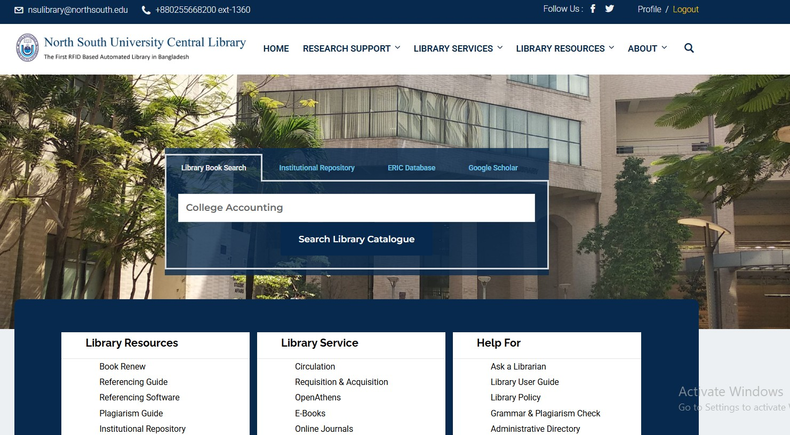
Book Search

Slide 22
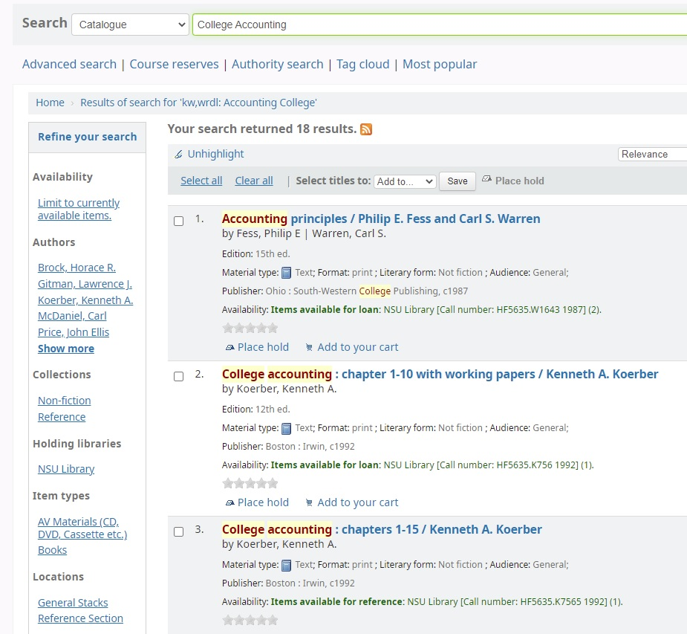
Search Result in Library Opac

Slide 23
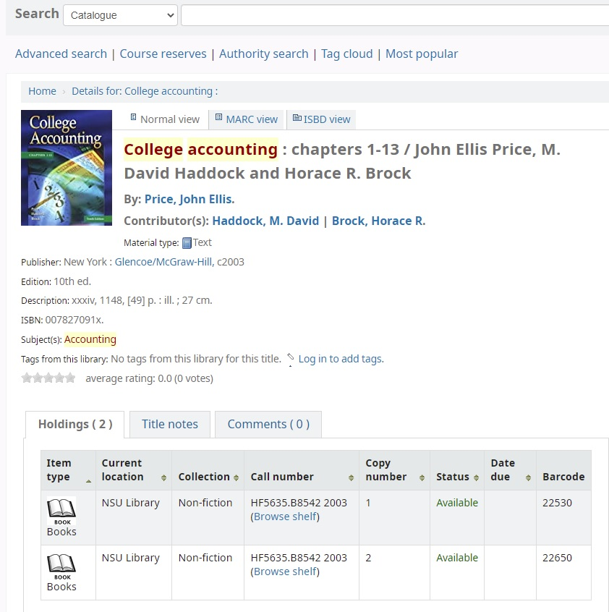
Note the Call Number of the Book

Slide 24
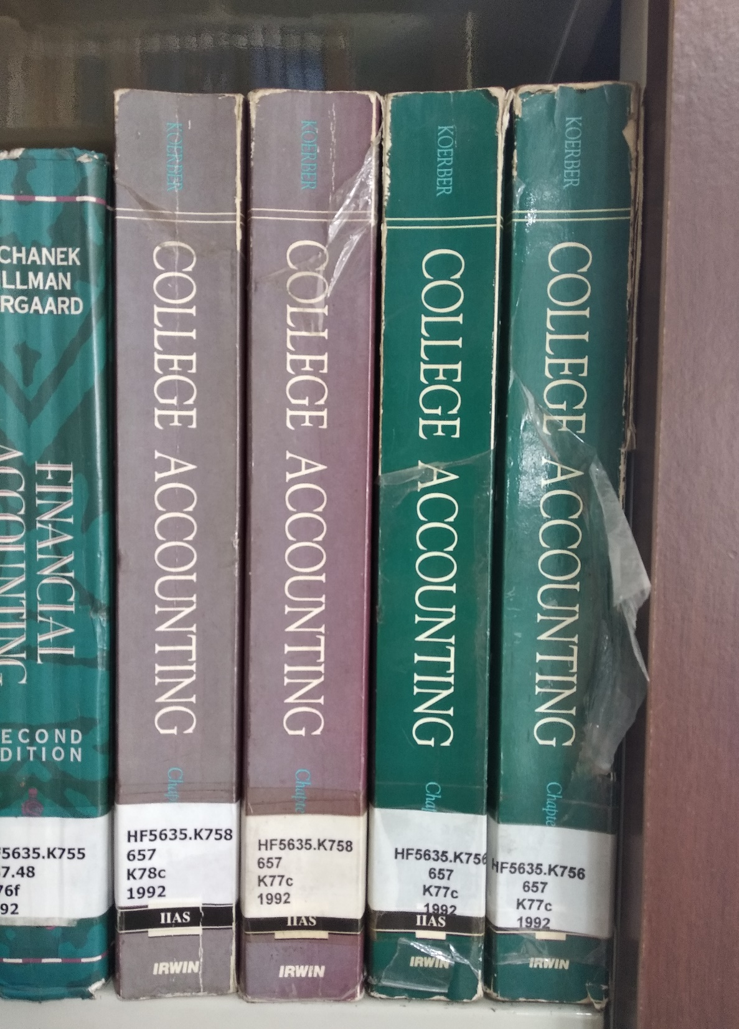
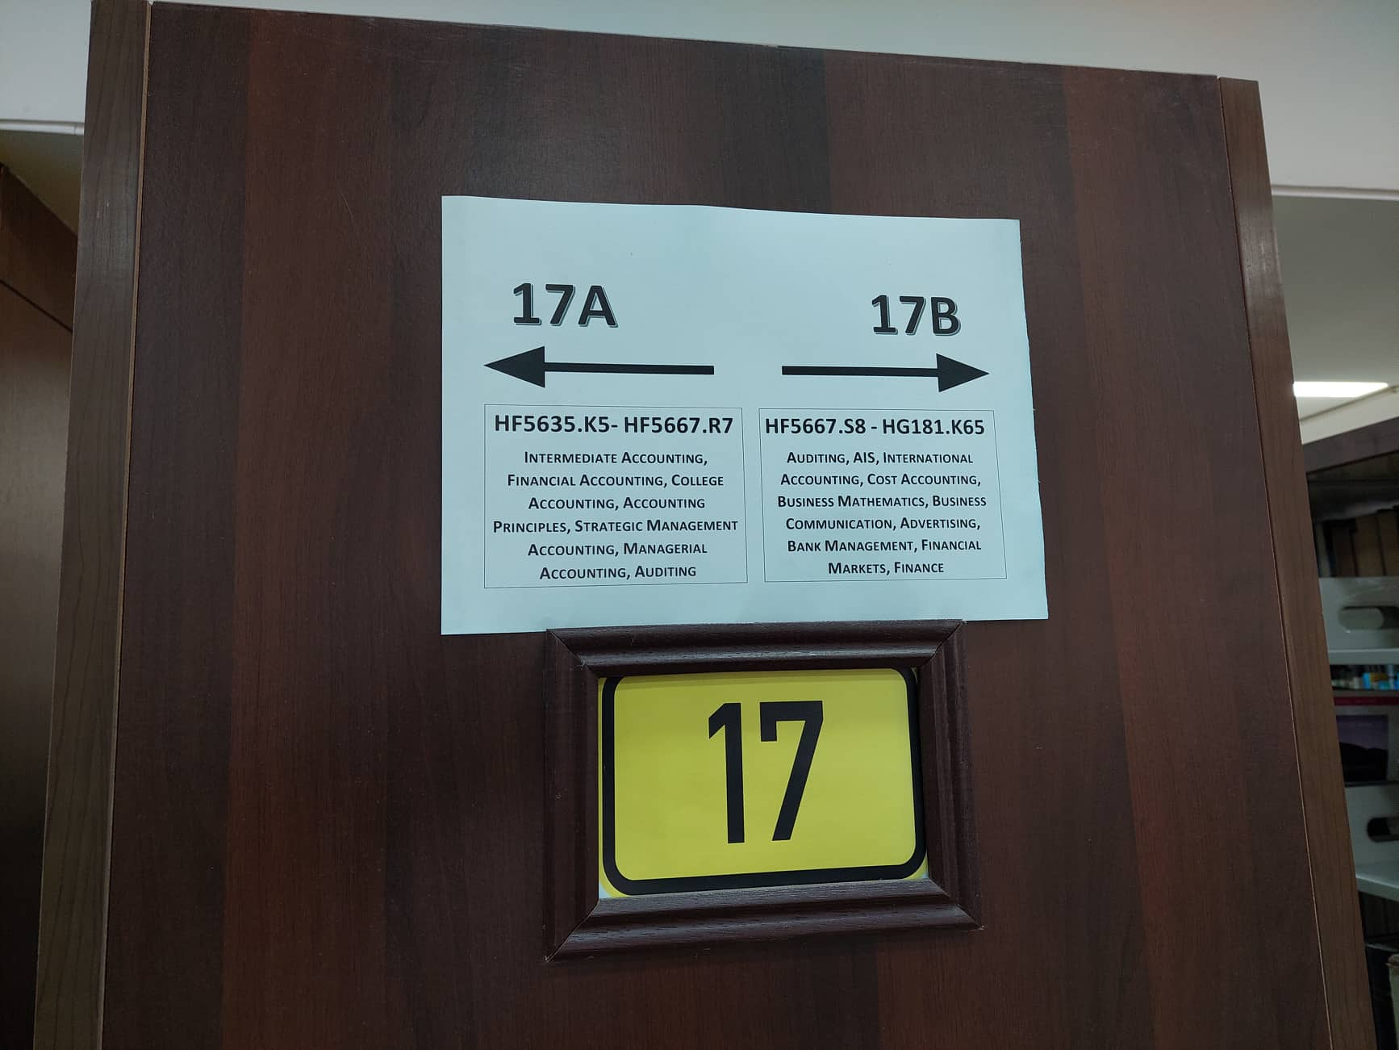
To go to the Shelf to Pick the Book

Slide 25
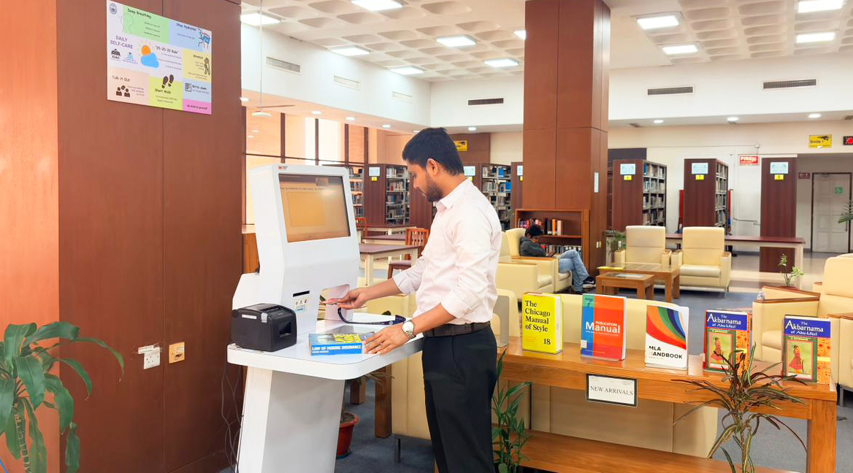
Borrow the Book by Self-Check Machine

Slide 26
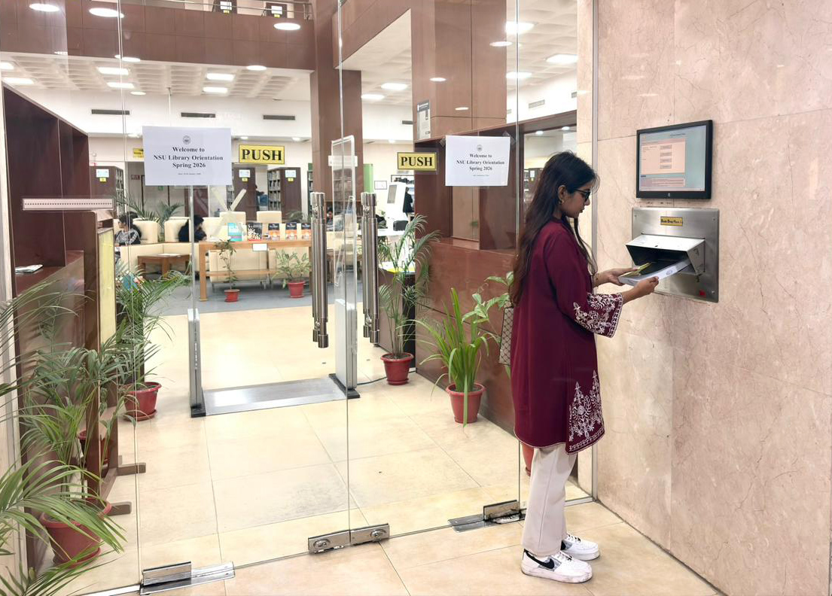
Book Drop Box
NSU Library Book Drop Box enable you to return borrowed books conveniently outside regular service desk hours. Located at the main entrance gate on the 3rd floor of NSU Library, this self-service facility allows for quick and hassle-free returns. All returned items are securely collected by library staff and processed through the circulation system, ensuring timely updates to users’ library accounts while saving time and reducing congestion at the service desk.

Slide 27

Book Reservation

Slide 28
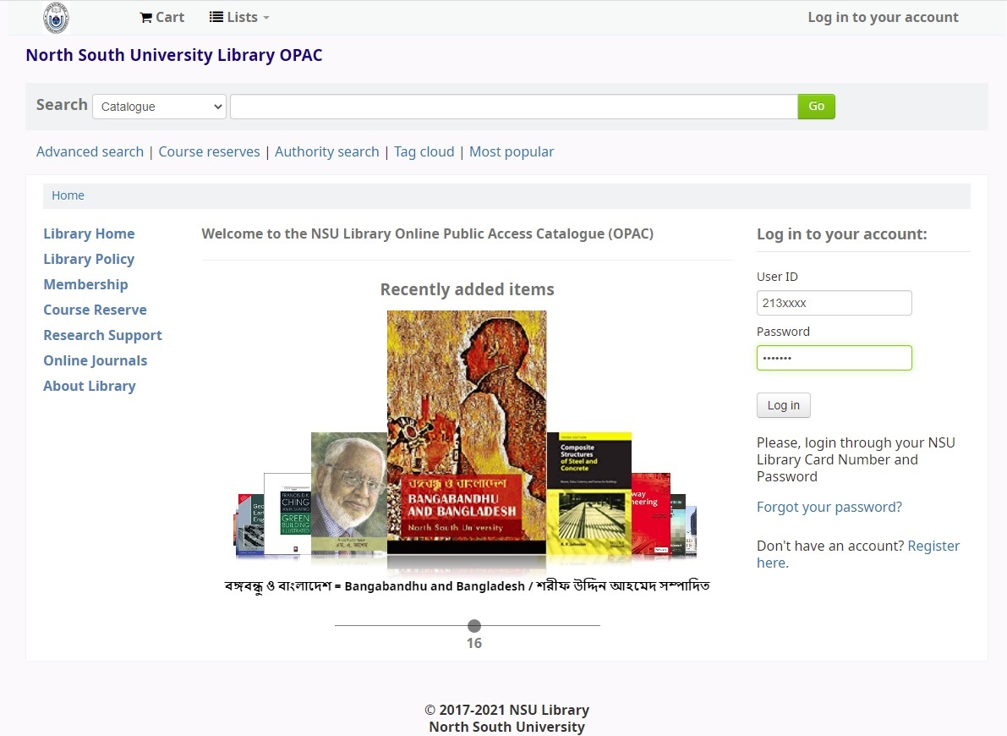
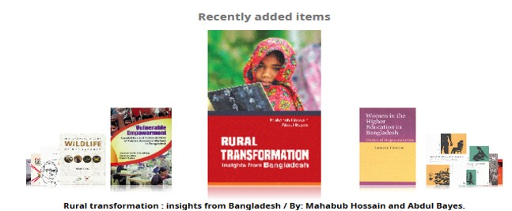

Slide 29
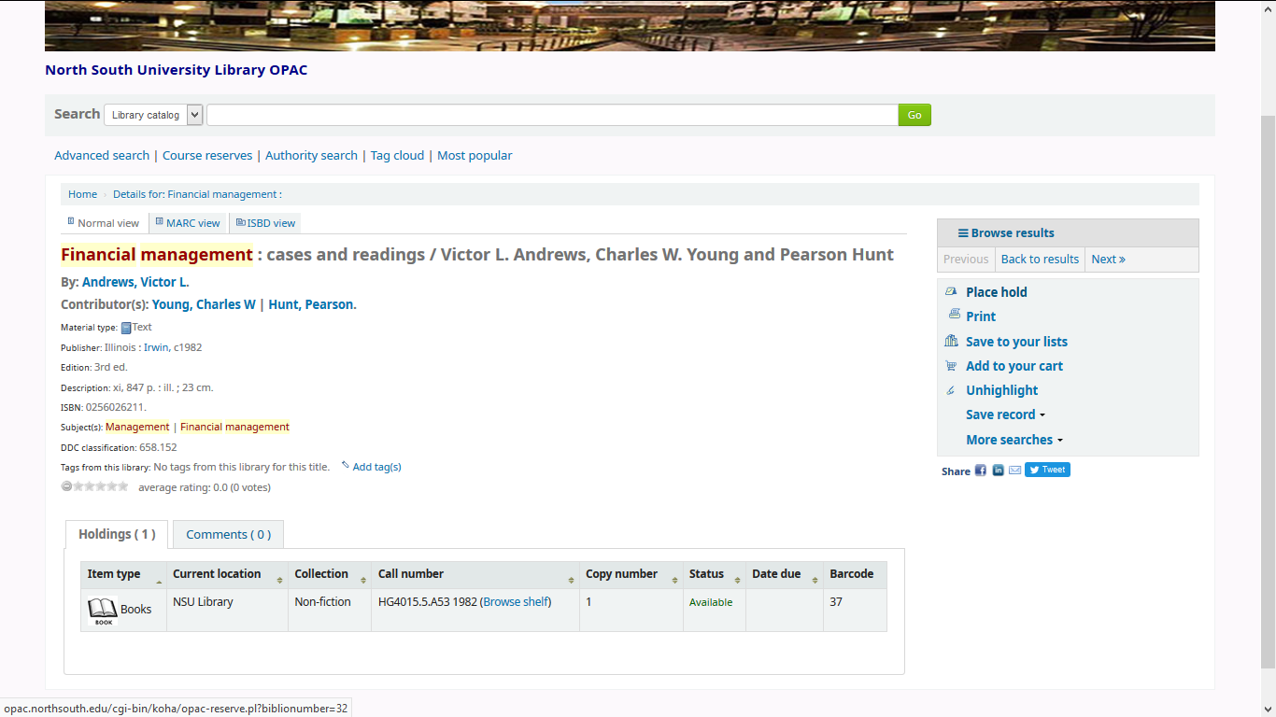

Slide 30
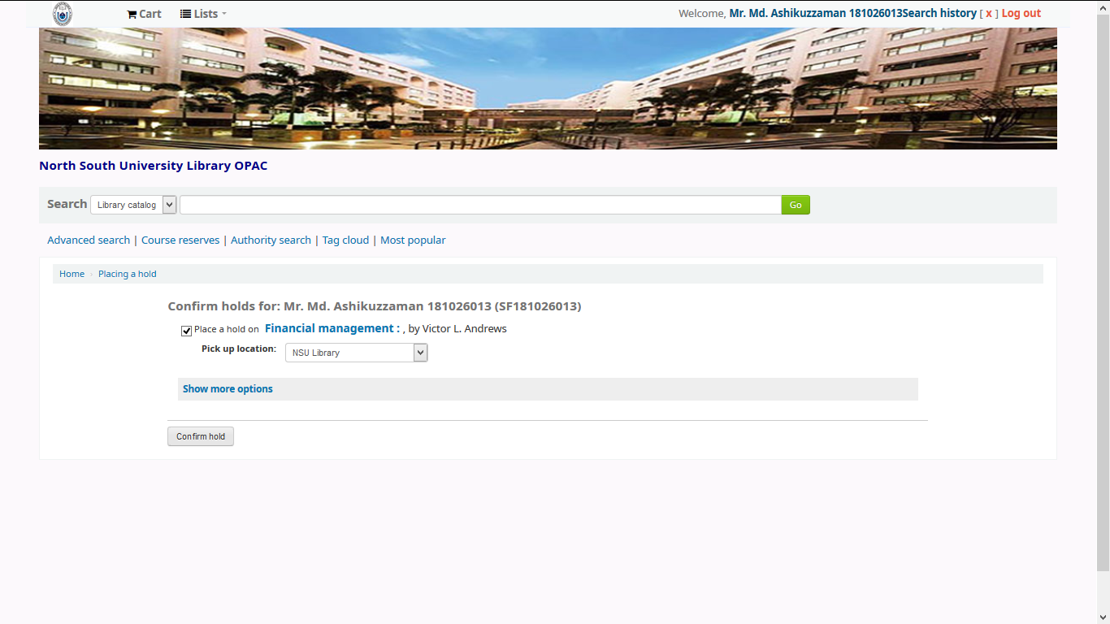

Slide 31
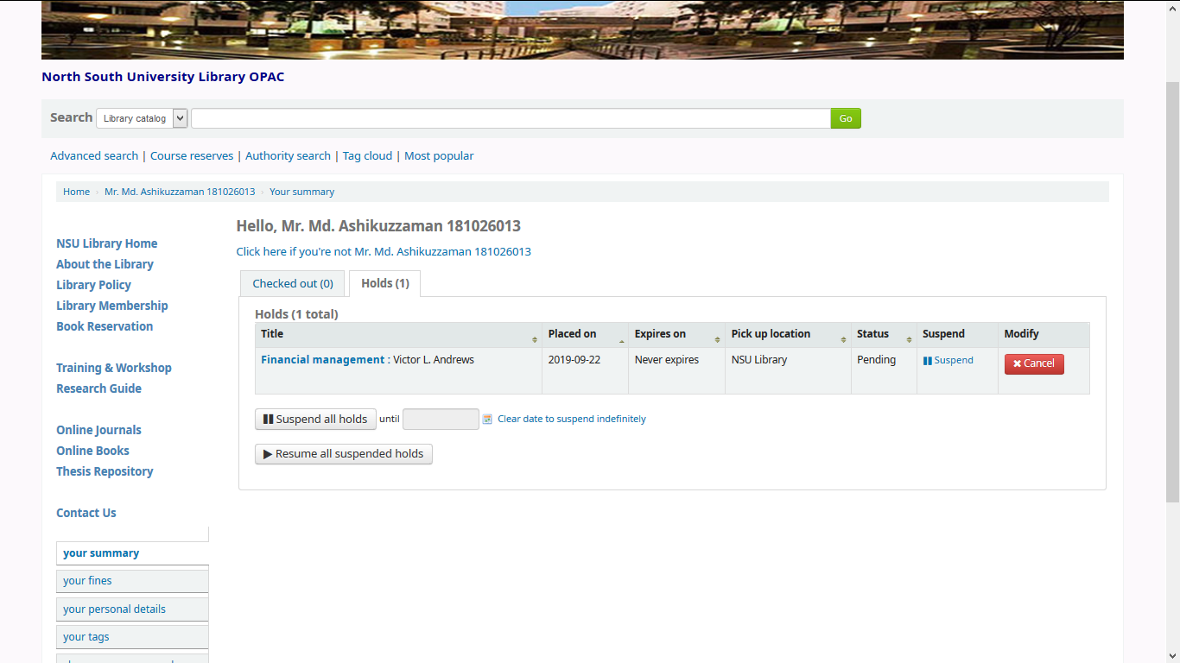

Slide 32


Book Renew

Slide 33
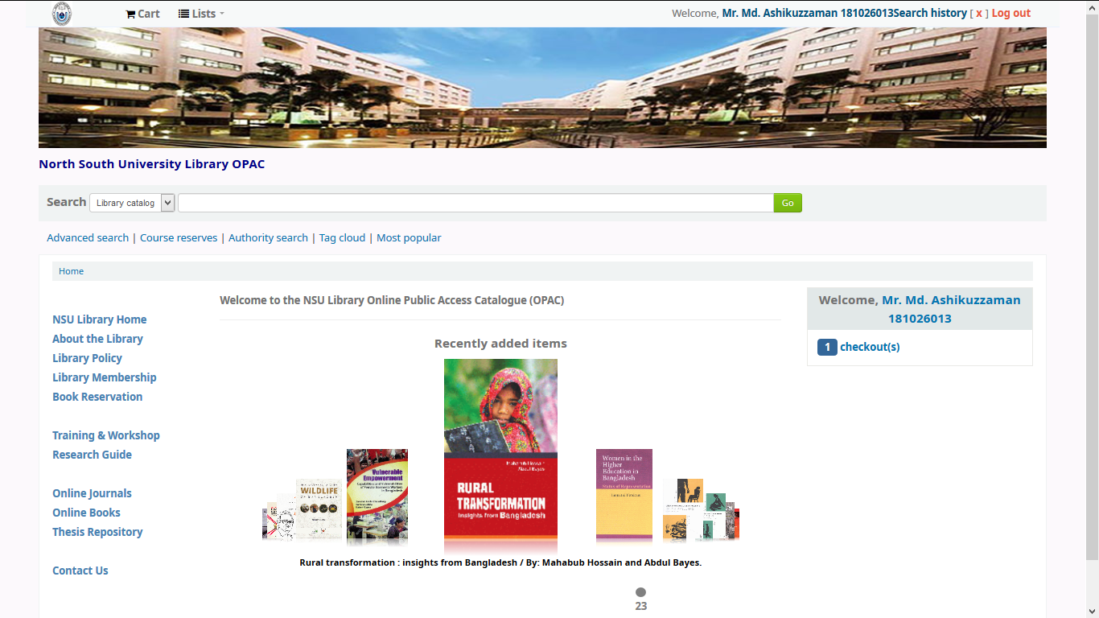
Book Renew

Slide 34
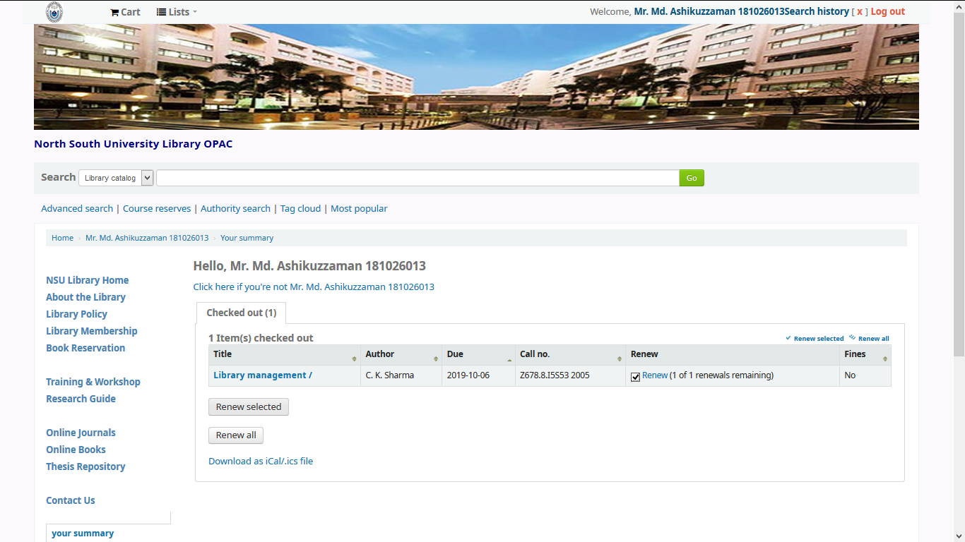

Slide 35
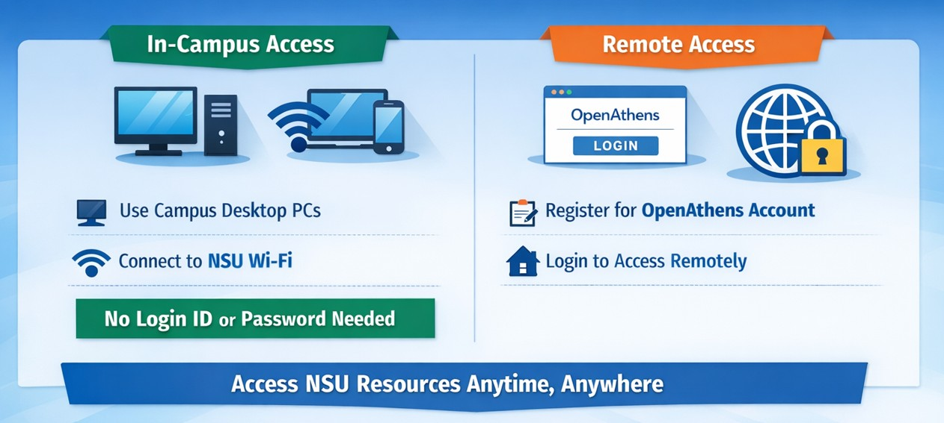
NSU Journal Access Methods
NSU Library’s subscribed online databases and e-journals are accessible both on campus and remotely.
In-Campus Access:
Use desktop PCs available on the NSU campus, or
Connect your laptop or smartphone to NSU Wi-Fi
No login ID or password is required for on-campus access
Remote Access:
Register for an OpenAthens account
Use your OpenAthens login to access NSU Library’s subscribed databases from anywhere

Slide 36
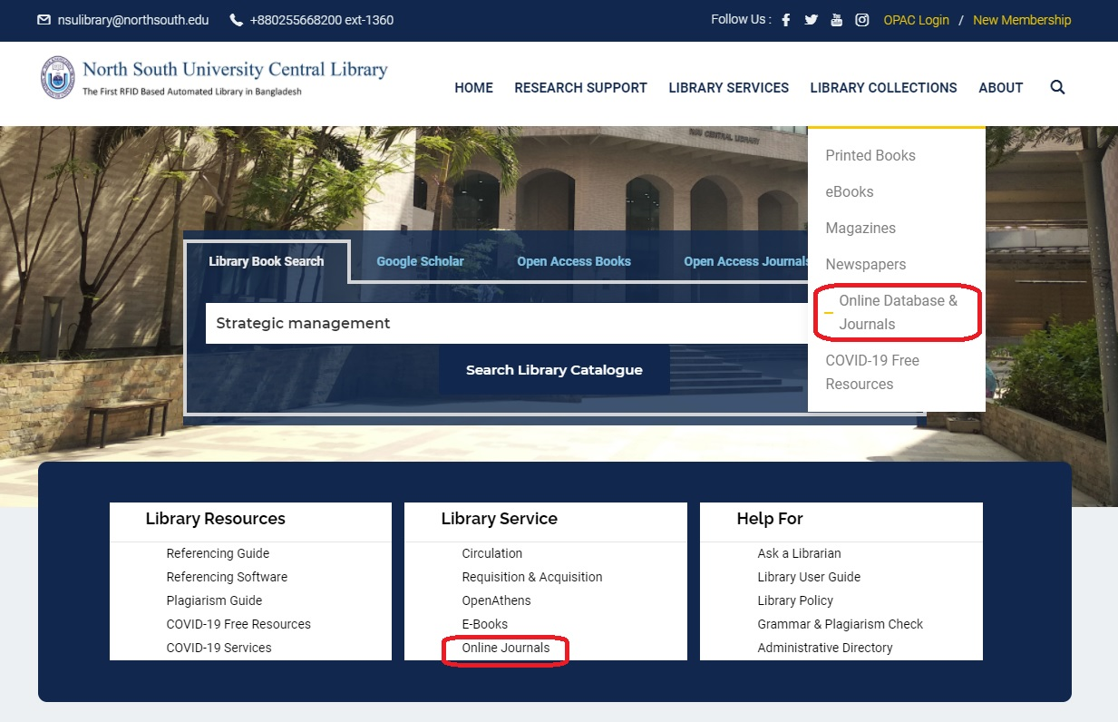
Search Online Journals & Online Books

Slide 37
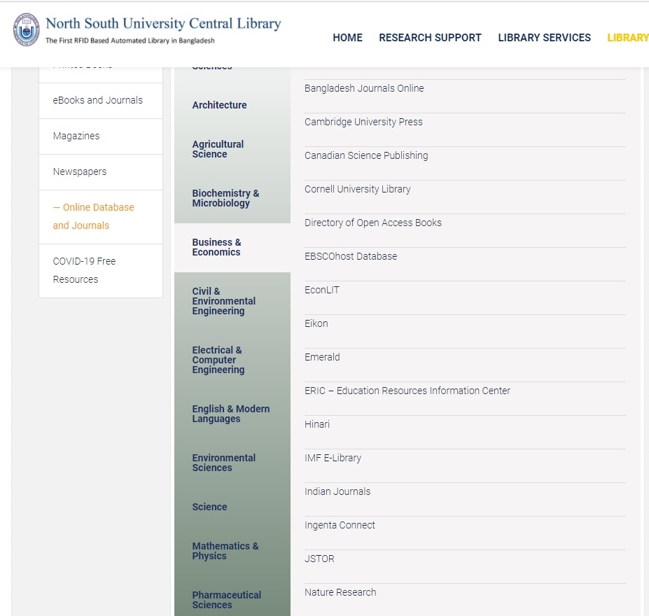

Slide 38
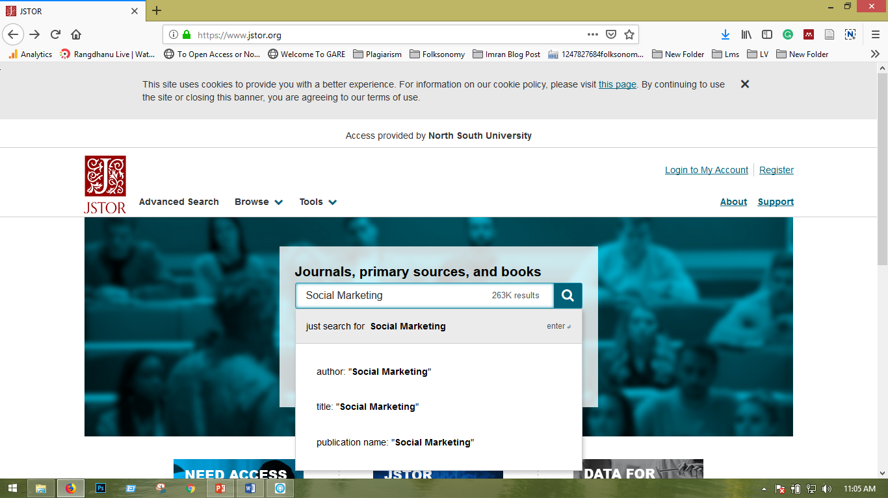

Slide 39
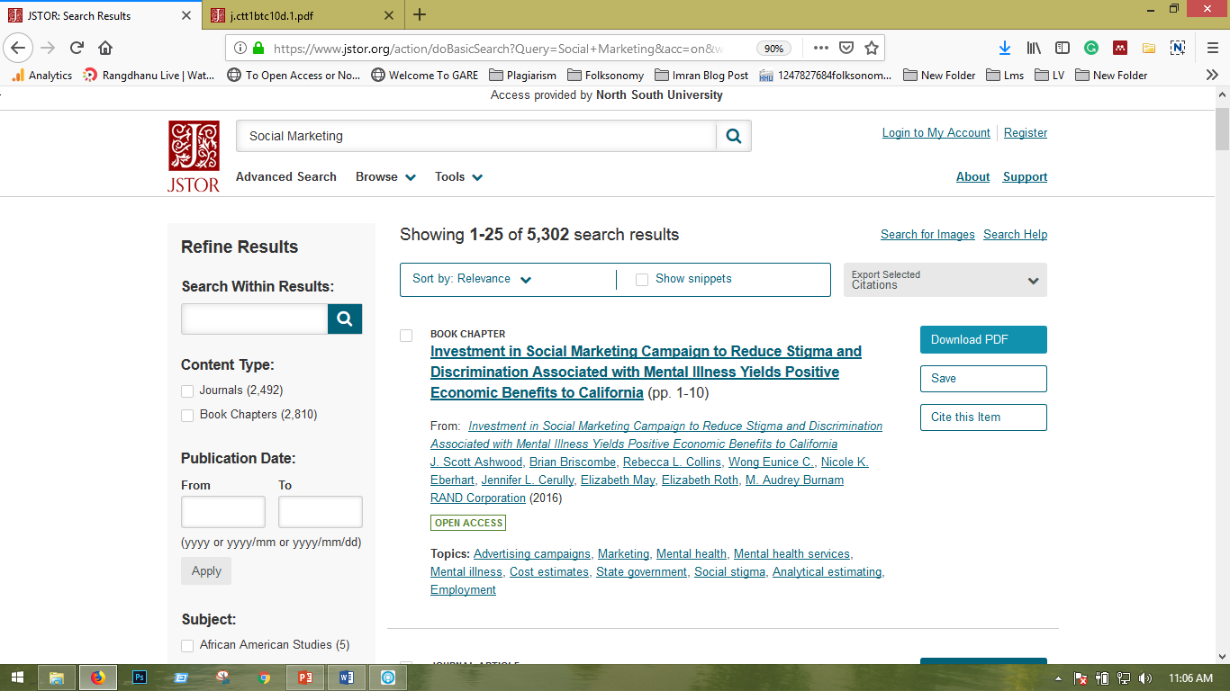

Slide 40







Get Library Research Tools through website

Slide 41
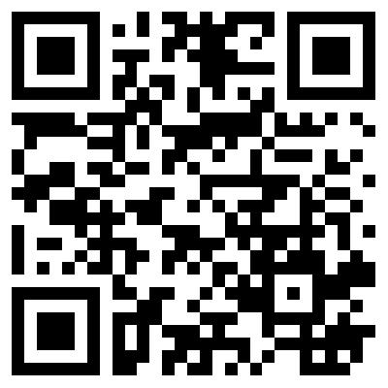
Follow NSU Library Facebook Page- Please Scan

Slide 42
Web Links of NSU LIBRARY Resources
Online Catalog (OPAC)
https://opac.northsouth.edu
eBooks
Research Support & Training
NSU Library Facebook
NSU Library Twitter
Repository
Online Journals & Databases
https://repository.northsouth.edu/
https://library.northsouth.edu/library-collections/online-database-journals/
https://twitter.com/libraryNSU
https://library.northsouth.edu/library-collections/ebooks/
https://library.northsouth.edu/research-support/training-and-workshop/
https://www.facebook.com/Library.NSU

