Slide 1
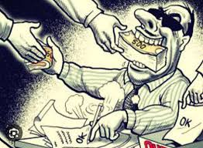
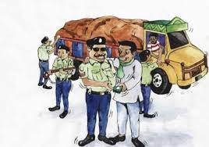
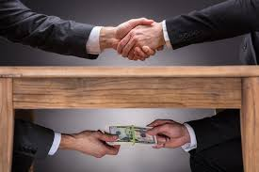

Slide 2

CORRUPTION: A Development Problem

Slide 3
CORRUPTION
What is Corruption?
Types of Corruption
Impects of Corruption
How to remove Corruption

Slide 4
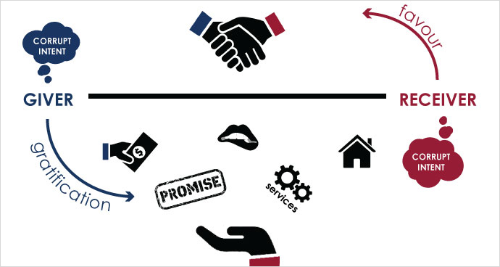
What is corruption?
Corruption is a dishonest or illegal behavior especially by powerful people.

Slide 5
TYPES OF CORRUPTION
Petty Corruption
Political Corruption

Slide 6
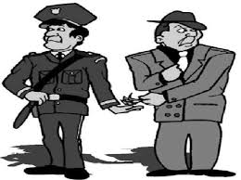
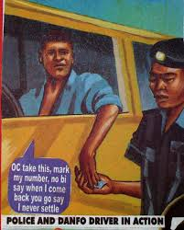
PETTY CORRUPTION
Petty corruption is everyday abuse of entrusted power by public officials in their interactions with ordinary citizens, who often are trying to access basic goods or services in places like hospitals, schools, police departments and other agencies.

Slide 7
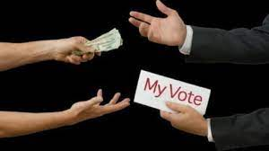
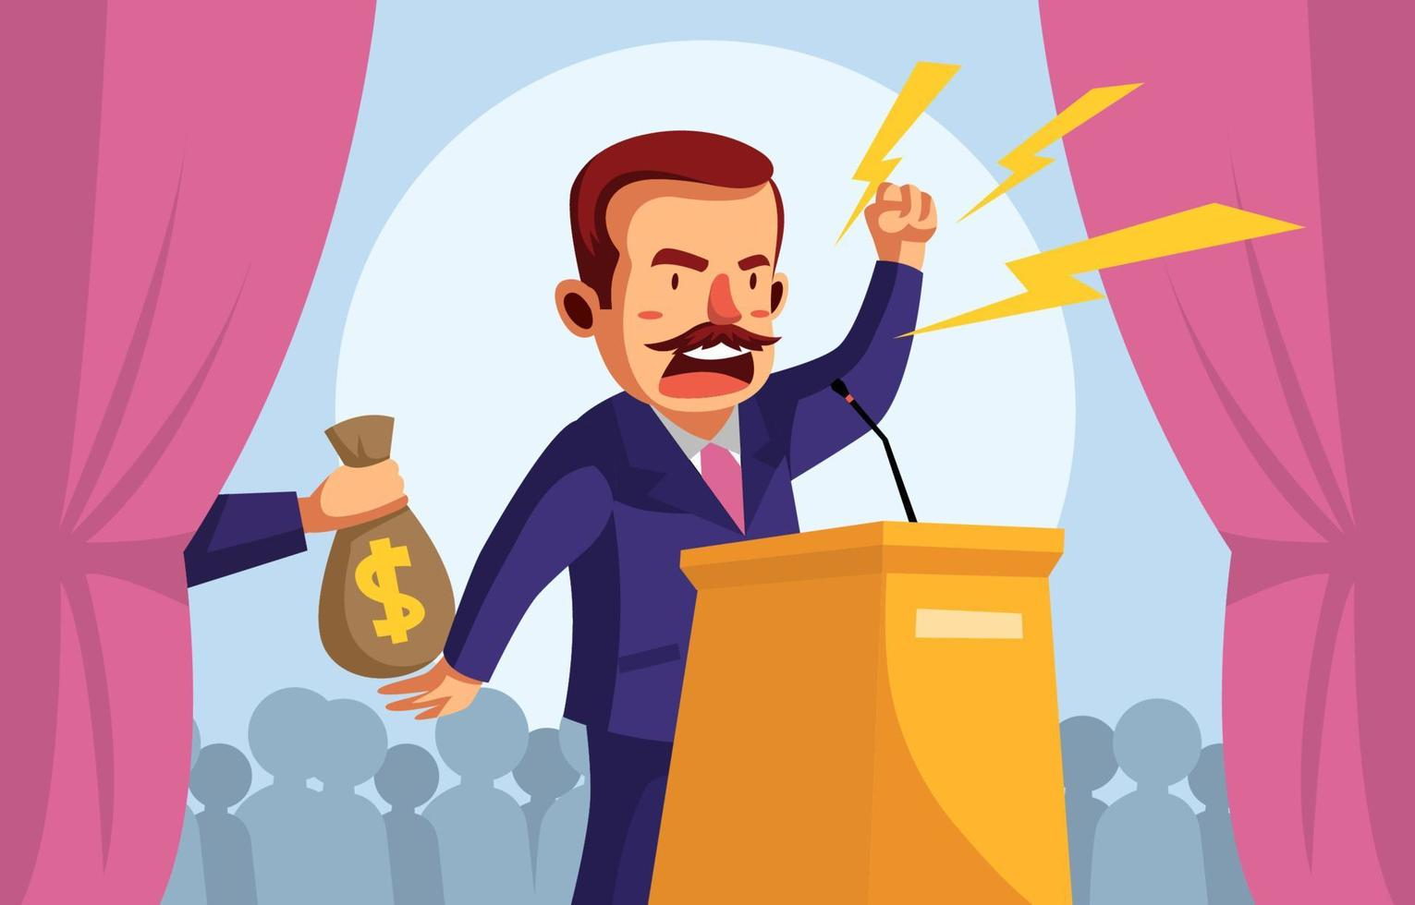
Political corruption
Political corruption is the use of powers by government officials or their network contacts for illegitimate private gain.

Slide 8
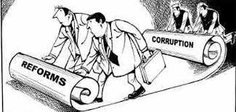
IMPECTS OF CORRUPTION
dermining the Sustainable Development Goals, Economic loss and inefficiency
Poverty and inequality
Personal loss, intimidation and inconvenience
Public and private sector dysfunctionality
Failures in infrastructure
Rigged economic and political systems
Impunity and partial justice

Slide 9
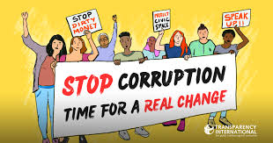

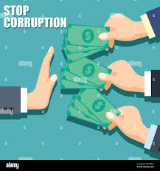
How to remove corruption
ANTI CORRUPTION ORGANIZATIONS
Self determination of not to give bribe
Awareness & campaings through medias, socials networking site
Vigorous punishment
ANTI CORRUPTION laws

Slide 10




THANK YOU

Slide 11


