Slide 1
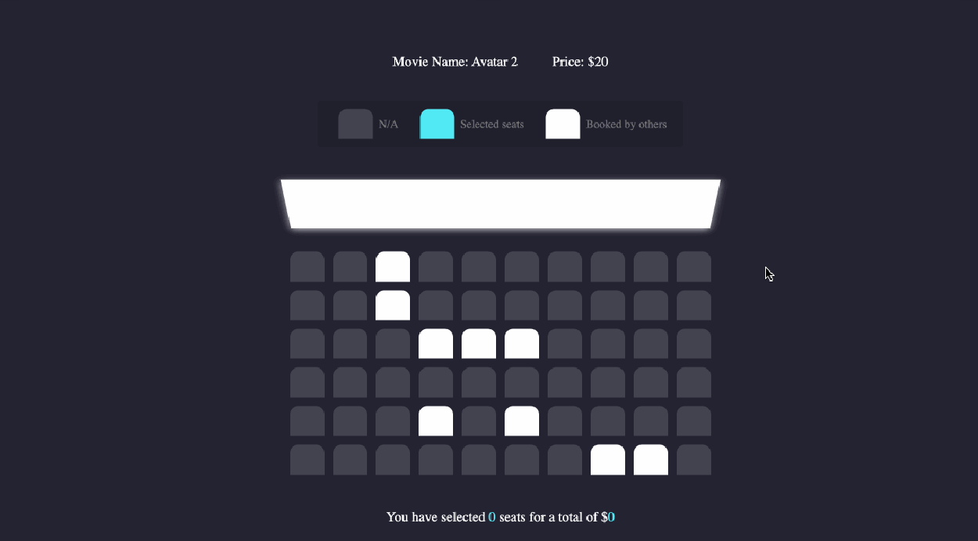
TEAM-10
PROBLEM STATEMENT - TicketSys (concerts/movies/sporting events) platform
Team details
Team Leader- MD FAHIM UDDIN CHOUDHARY (22CS8093)
Team Members :-
AVISHEK PAUL (22CS8091)
MAYANK MANI SINGH (22CS8092)
AURIC MANDAL (22CS8094)
DAKSH MANOHAR (22CS8095)
SHREYA GUPTA (22CS8096)
SRI NIKET KUMAR (22CS8097)
SAYAN BANERJEE (22CS8098)
ALETI RISHIK (22CS8099)
MOHAMMED HASEEB (22CS8100)

Slide 2
Problem Description
Develop a TicketMaster as a leading ticketing platform where event-executors can sell tickets for
concerts, theaters, and sporting events and audience/users can purchase tickets.
Probable Features
Visual map of available spots, marking it as "reserved" until payment completion
Define allocation policy
Display various deals and packages
Dynamic pricing (price reduction/escalation for last minute bookings; seat position, etc.) system
Text-based user interface & availability matrix visualization & ticket generation
The system satisfy the following requirements:
Enables event managers & users to login from different terminals from different physical machines.
Enables Manager/User registration and authentication (using some hash based password)
Multithreaded platform
User-friendly text interface
Provide a well documented header file with set of well defined APIs/function interface so that any other reservation scenario may be implemented with minor modification

Slide 3
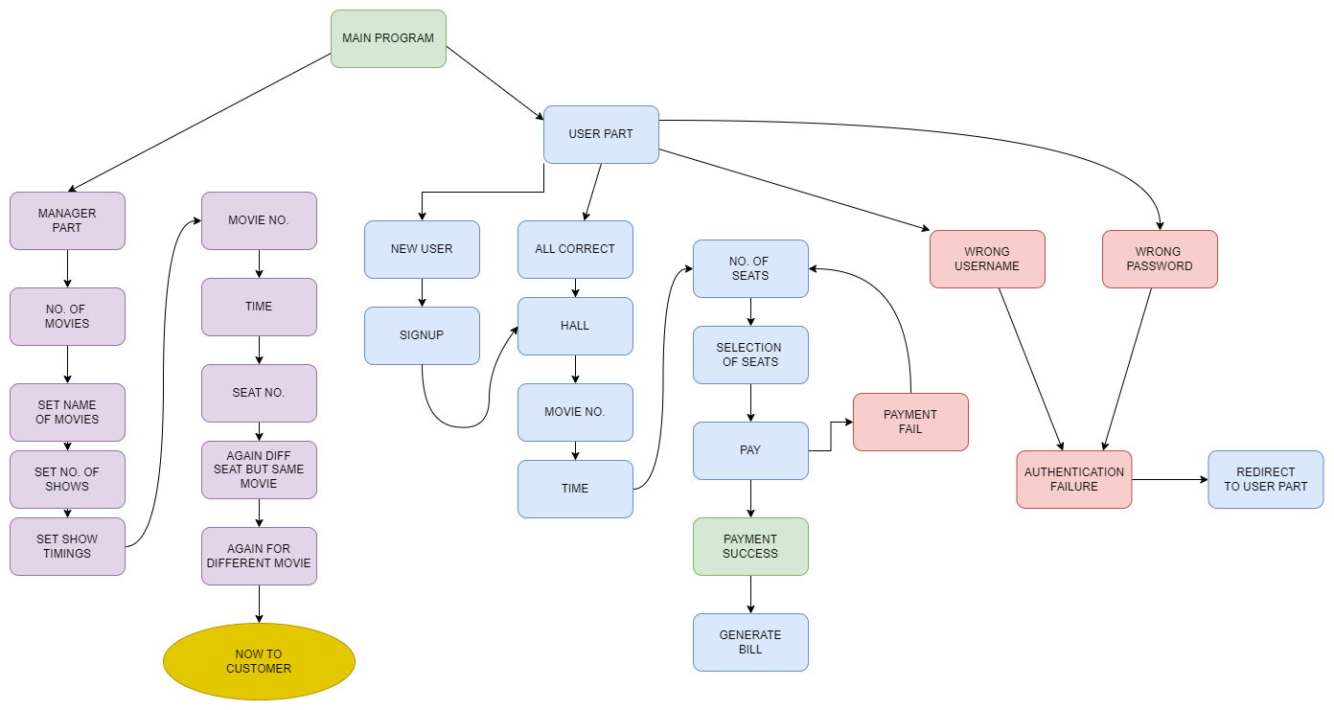
Features

Slide 4
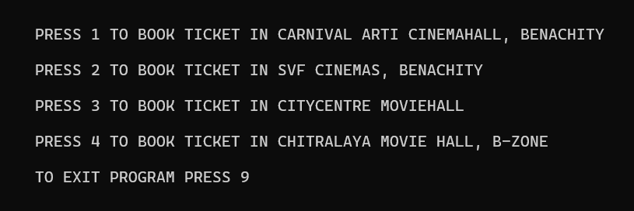
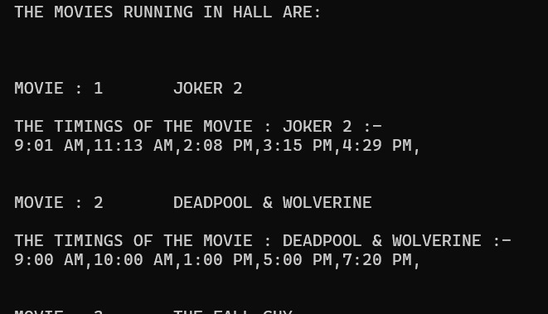
User Interface
A user-friendly interface featuring four cinema halls allows easy access for both managers and customers. Managers can press the 'O' key to manage movie schedules, while customers can simply press any other key to explore and select movies and showtimes effortlessly.

Slide 5
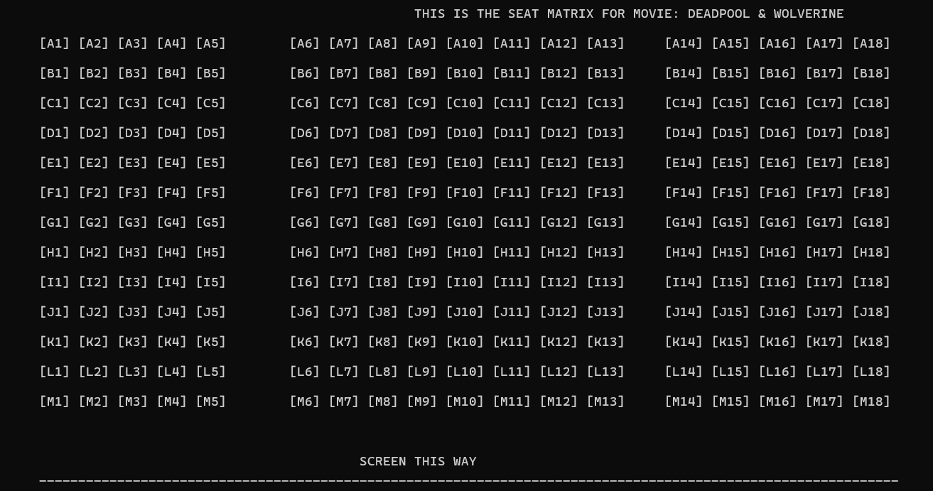
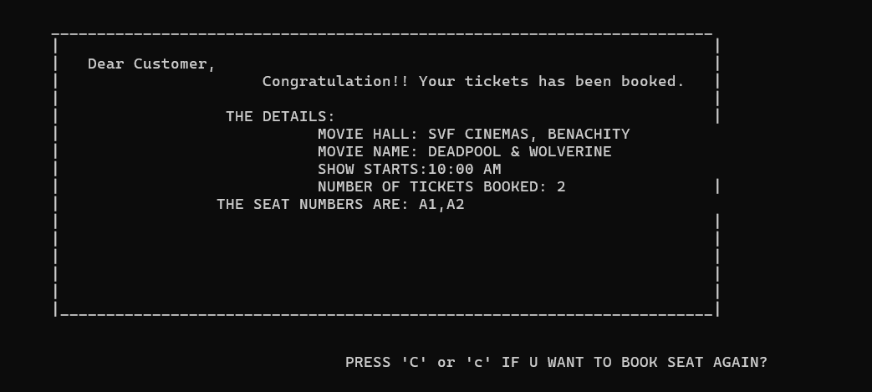
User Interface
Users can conveniently view and choose seats through the terminal's interactive seating matrix, simplifying the booking process. After completing the payment, they receive a generated bill, all within the terminal's easy-to-use interface, providing a seamless cinema booking experience.

Slide 6
Contributors
Manager Side: Avishek, Fahim, Daksh, Rishi
Authorization of Manager, adding movies, movie timing , pricing and marking seats as selected.
Customer Side: Haseeb, Sayan, Auric
Registration of new customers, authorization of existing customers, and seat booking by customers by choosing movie names and timings of the show.
User Interface: Shreya, Mayank, Sri Niket
Design and updation of the seat matrix for each movie and their corresponding timing, generation of billing slips.

Slide 7
OS Level Features
Multi-threading/Concurrency
If the system is handling multiple booking requests at the same time, you can use multi threading to handle concurrent requests efficiently. This ensures that the system remains responsive while processing multiple transactions simultaneously.
File Handling and Persistence
File I/O operations allow you to store and retrieve booking data or logs directly on the file system. This can be helpful in scenarios where you're storing logs or booking histories.
System Scheduling
Operating systems provide scheduling mechanisms that could be used to send notifications like reminders about bookings, perform automated backups, or trigger events at specific intervals.

Slide 8
Dynamic Pricing
Factors Considered
Seat Availability: Fewer remaining seats , should lead to higher prices.
Time Remaining: Less time until the show , should increase the price.
Actor Preference: Higher-preference actors ,should command higher prices.
Early Bird Discount: If booking is early and there's ample time, a discount should be applied
SeatFactor = ( TotalSeats / RemainingSeats )
EarlyBirdFactor = ( Remaining Seats / Remaining Time for the show )
Time Factor = 1/ Remaining time ActorFactor => MorePreferred Actor
Dynamic Price Formula
Price = BasePrice * (1 + Weight1 * SeatFactor + Weight2 * TimeFactor + Weight3 * ActorFactor - Weight4 * EarlyBirdFactor)

Slide 9
THANK YOU!

