Slide 1
Data Analysis Project Report
Asking questions from the data set
Which product categories generate the highest sales and profit?
Which shipping modes are most profitable?
1
2
Which states are the most profitable?
How does discount affect profit?
3
4

Slide 2
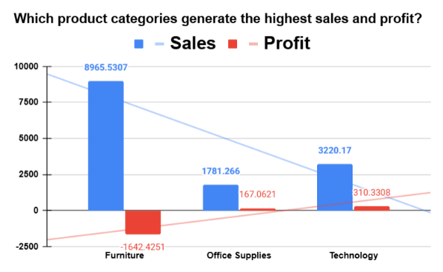
Sales vs profit by category
Highest sales
Furniture
$8,965.53 in sales, yet a $1,642.43 loss
Highest profit
Technology
$310.33 profit on $3,220.17 sales

Slide 3
Profit by category
1. Furniture
2. Office Supplies
3. Technology
Sales
$8,965.53
Sales
$1,781.27
Sales
$3,220.17
Profit
-$1,642.43
Profit
$167.06
Profit
$310.33
Highest sales, but some products are sold with high discounts, resulting in negative profit.
Profitable, but both sales and profit are lower than the other categories.
Sales are much lower than Furniture, but it converts sales into profit more effectively.
Conclusion: Strong sales but poor profitability.
Conclusion: Provides a stable positive profit.
Conclusion: The most profitable category.

Slide 4
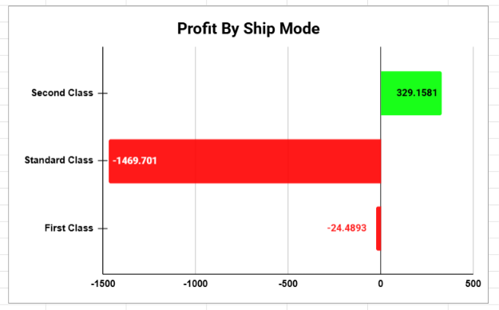
Profit by ship mode
Only profitable mode
Second Class
$329.16 profit
Biggest loss
Standard Class
−$1,469.70 loss; First Class loses $24.49

Slide 5
Ship mode chart: the numbers
Ship mode | Profit | Result
Second Class | $329.16 | Profitable
Standard Class | −$1,469.70 | Loss
First Class | −$24.49 | Loss
Total | −$1,165.04 | Net loss
−$1,165.04
4.5×
$24.49
Net profit across all ship modes, the same total as the category chart.
Standard Class loses about 4.5 times what Second Class earns.
First Class is close to break-even, with only a small loss.

Slide 6
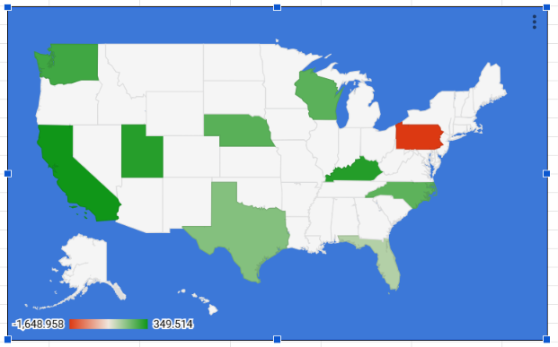
Which states are most profitable?
Highest profit
California
Pennsylvania: is red on the map, the largest loss (down to −$1,648.96).
Why states differ: sales, discounts, product mix and order volume.
Conclusion: Darker green means higher profit. A few states contribute a large share, while others have low or negative profit.

Slide 7
Reading the state map
$349.51
−$1,648.96
10 states
Top of the color scale: the highest state profit shown.
Bottom of the scale: Pennsylvania is shaded red.
are shaded: 9 in green (profit) and 1 in red (loss).
How to read the colors
Dark green: California, Utah, Kentucky
Medium green: Washington, Wisconsin, Nebraska, North Carolina
Light green: Texas, Florida (small profit)
Red: Pennsylvania (loss)
−$1,648.96 (loss)
$349.51 (profit)
Darker green means higher profit. White is close to break-even.

Slide 8
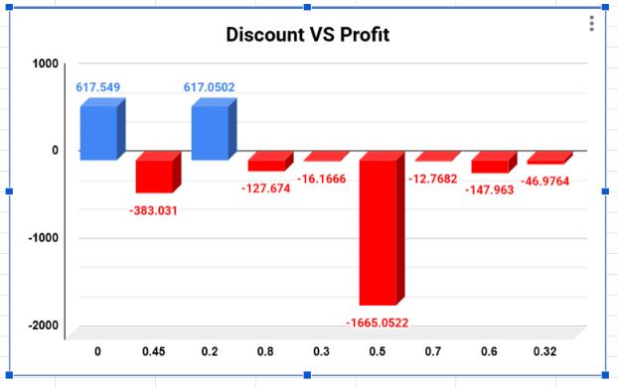
How does discount affect profit?
0% and 20% discount: profit stays near $617.
30% and above: every discount level loses money.
50% discount: the largest loss, $1,665.05.
Conclusion: Higher discounts cut revenue and profit. Keep discounts near 20% or lower.

Slide 9
Discount chart: the numbers
Discount | Profit | Result
0% | $617.55 | Profit
20% | $617.05 | Profit
30% | −$16.17 | Loss
32% | −$46.98 | Loss
45% | −$383.03 | Loss
50% | −$1,665.05 | Loss
60% | −$147.96 | Loss
70% | −$12.77 | Loss
80% | −$127.67 | Loss
$1,234.60
earned at 0% and 20% discounts combined.
−$2,399.63
lost across all seven discount levels of 30% and above.
69%
of those losses come from the 50% discount alone ($1,665.05).

Slide 10
Key takeaways
Technology
Second Class
is the most profitable category; Furniture sells most but loses money.
is the only profitable ship mode.
California
Discounts
has the highest profit among the states shown.
of 30% and above lose money; keep them near 20% or lower.

