Slide 1







Automated Object Transportation System
Submitted by – Group B2.02
MD. Woahidur Rahman
ID:2006102
Syed Mohammad Wasif Itban
ID:2006112
Arif Zakaria
ID:2006126
MD. Mahmud Akon
ID:2006127
MD. Fahim Rahman
ID:2006128
Kamrul Hasan Shanto
ID:2006130

Slide 2
Outline
Objective
Steps
Literature Review
Robot Design
Workspace Setup
Implementation
Reflection on Individual and Team Work
Future Works
References

Slide 3
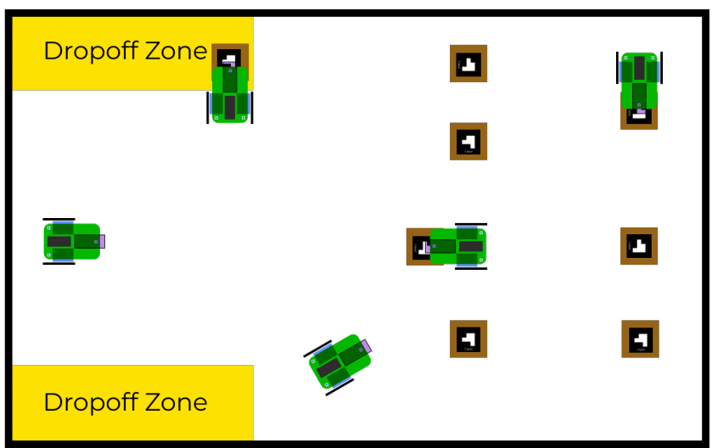
1. Objective
Locate objects and drop off zones inside a workspace
Pick up the objects and drop them in drop-off zones
Track any real time change in the position of the objects and drop off zone and adjust movement accordingly
Avoid both static and dynamic obstacles along the path

Slide 4
2. Steps
Designing a robot that will be able to pick and drop objects
Taking live feed from an overhead camera and processing it in a central PC
Using OpenCV to localize the robot, objects and drop off zones
Using pathfinding algorithm to find the most optimal path around obstacles
Commanding the robot from central PC using WIFI

Slide 5
3. Literature Review
Aruco Tag Guided Drawing Robot :
https://courses.ece.cornell.edu/ece5990/ECE5725_Fall2020_Projects/Dec_21_Demo/Drawing%20Robot/eam348_mm2994_W/index.html
https://docs.opencv.org/3.4/modules.html

Slide 6
3. Literature Review
Aruco Marker Official Documentation:
https://docs.opencv.org/3.4/modules.html

Slide 7
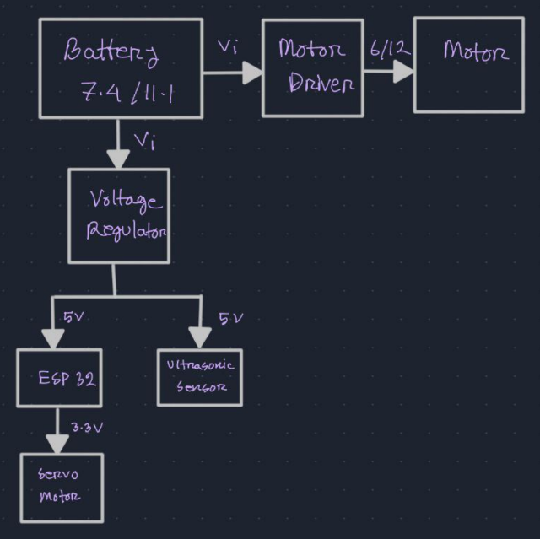
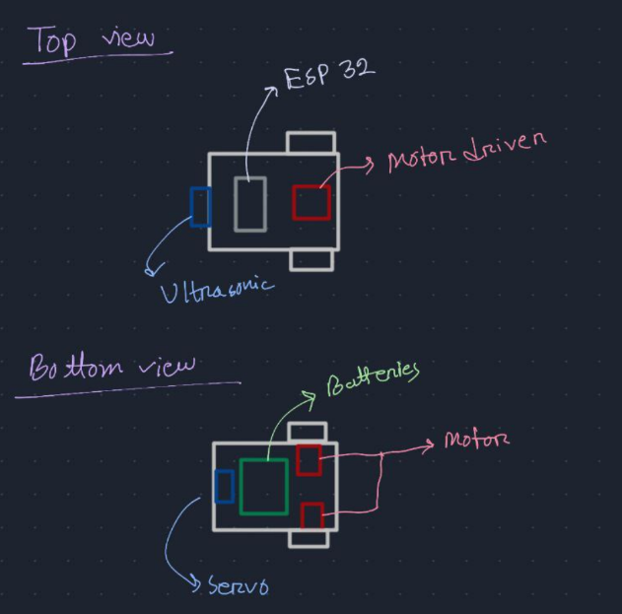
4. Robot Design
Initial Design

Slide 8
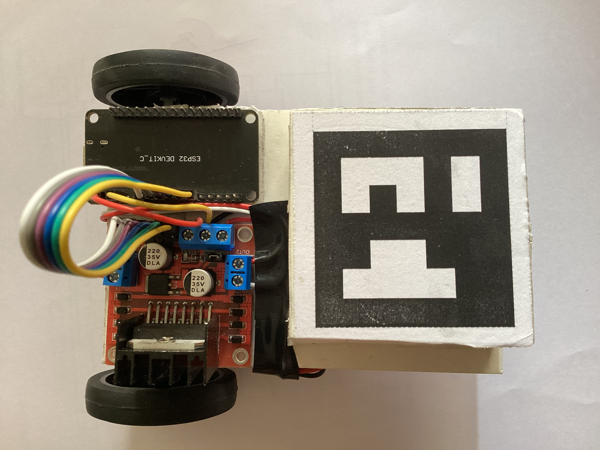
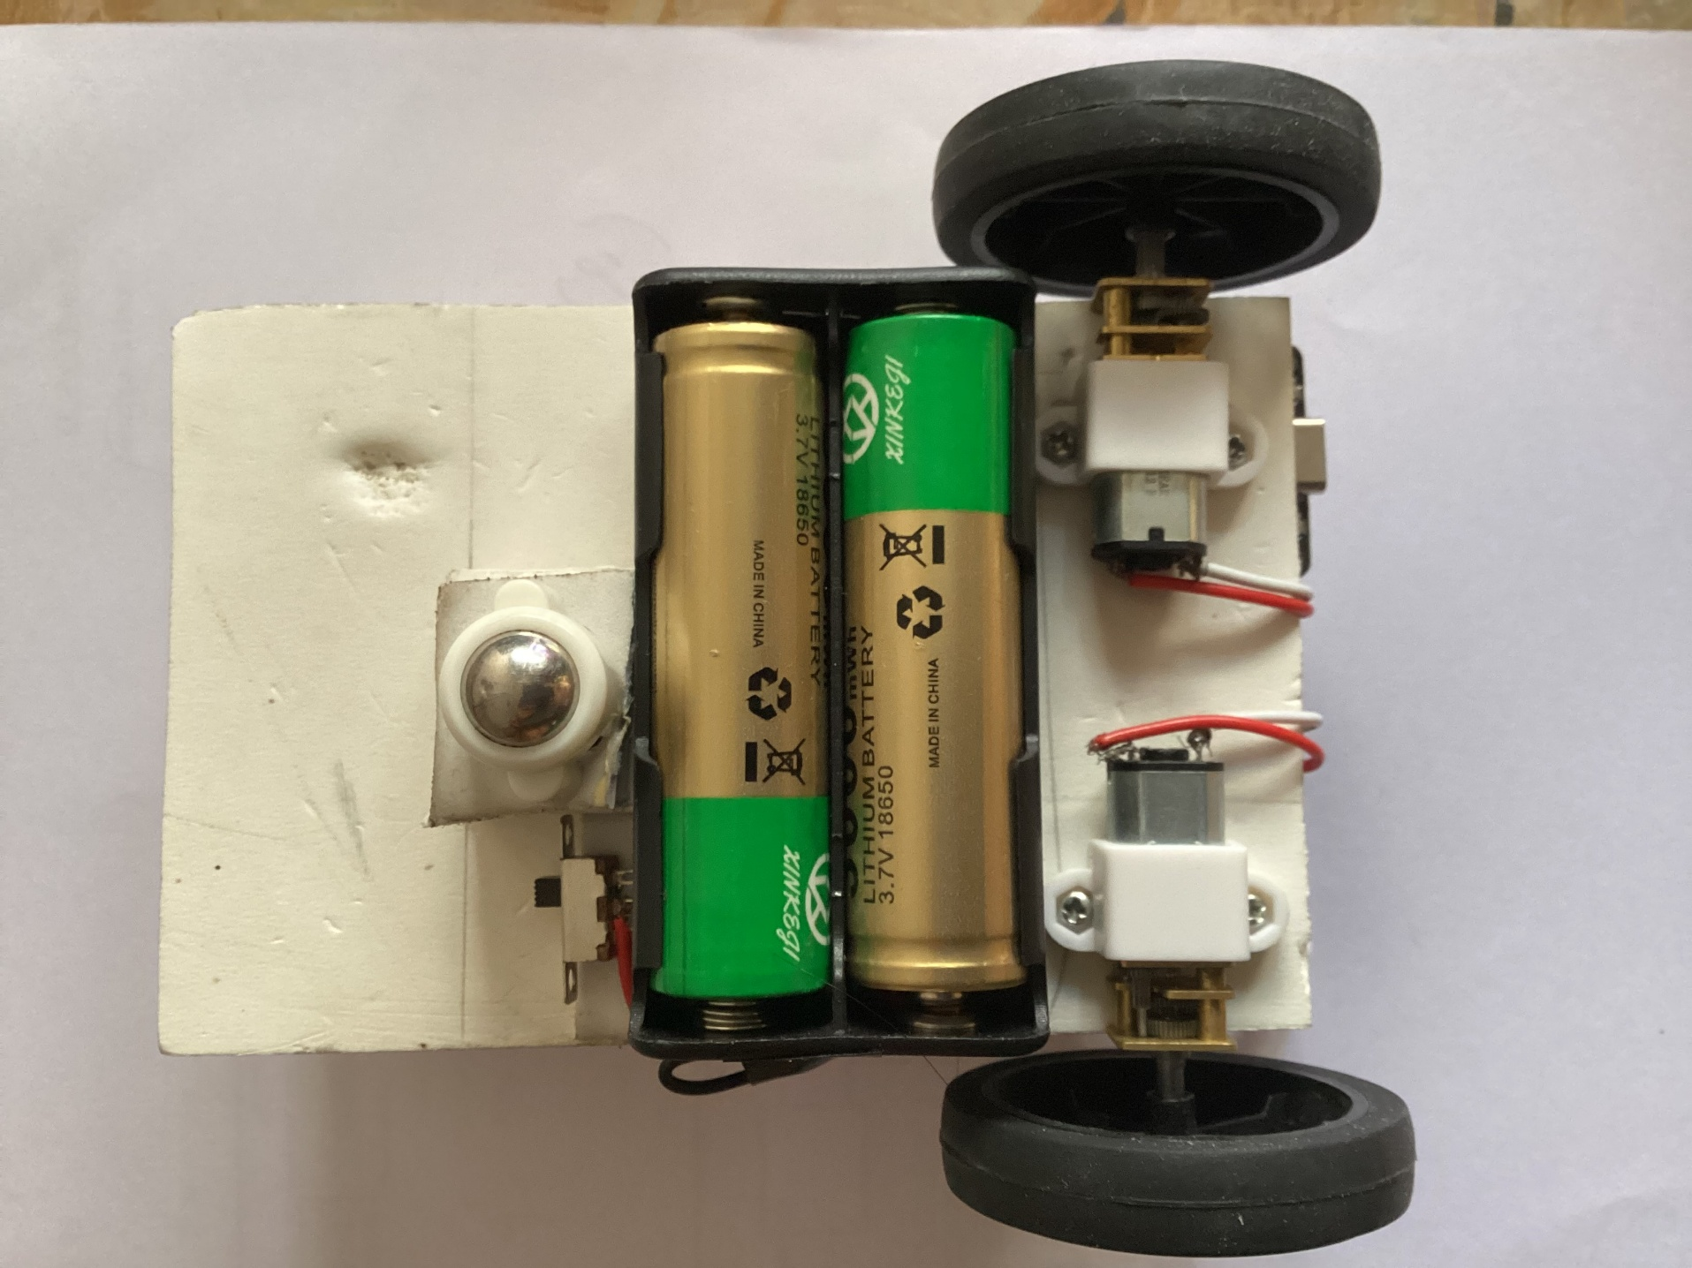
4. Robot Design
Initial Build

Slide 9
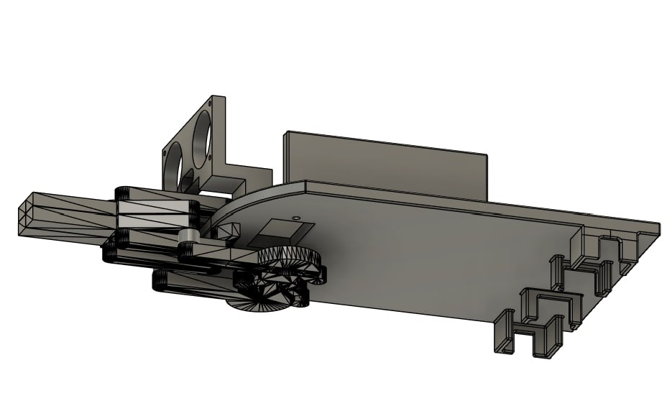
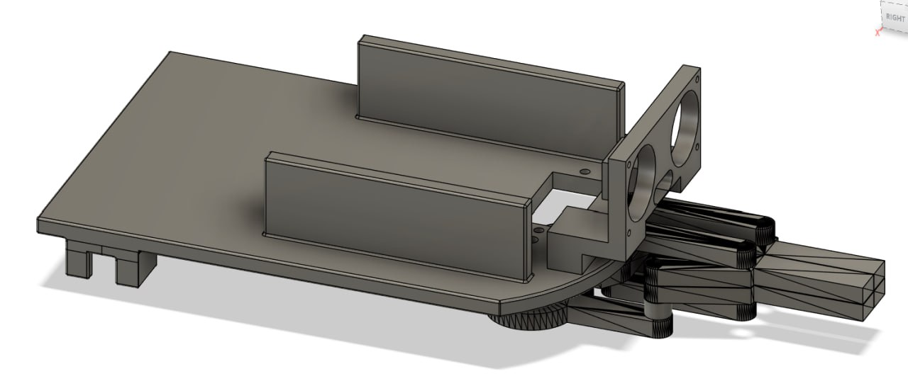
4. Robot Design
CAD Model

Slide 10
4. Robot Design
Final design
signal
Motor
Motor driver
Power
Motor
signal
Power
Power
signal
Esp32
signal
Servo

Slide 11
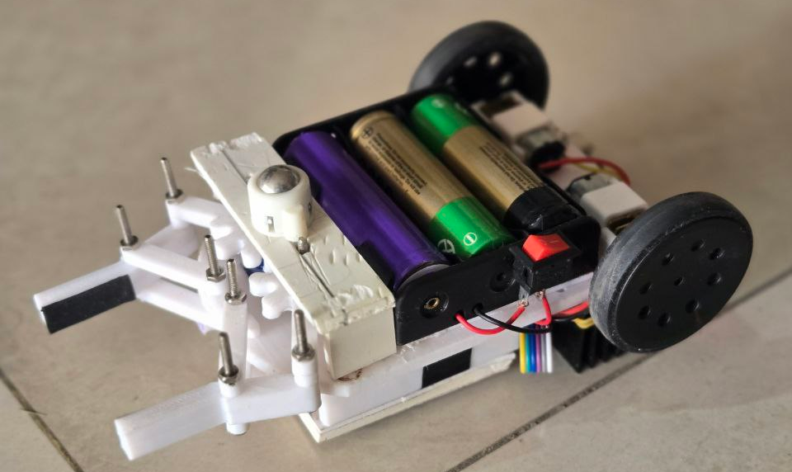
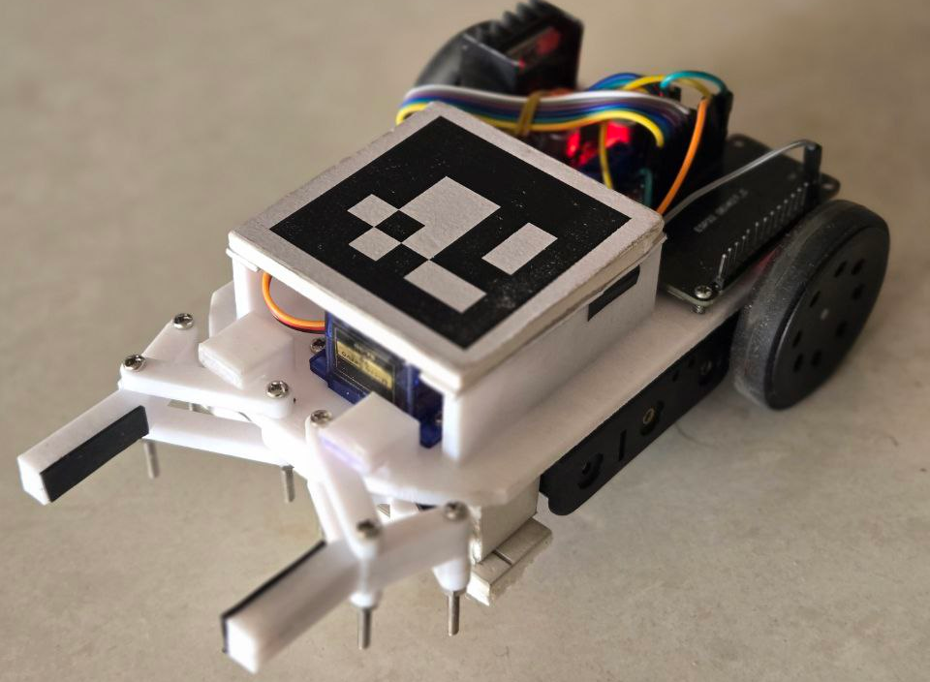
4. Robot Design
Final Design

Slide 12
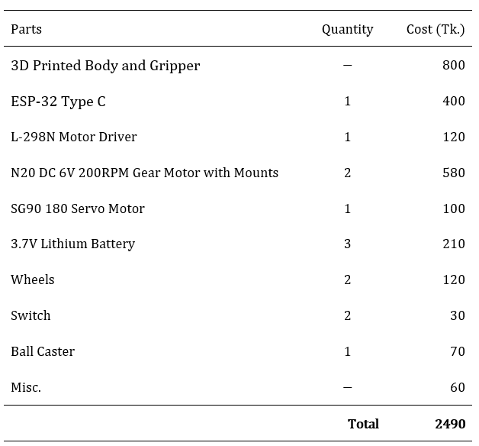
4. Robot Design
Bill of Materials

Slide 13
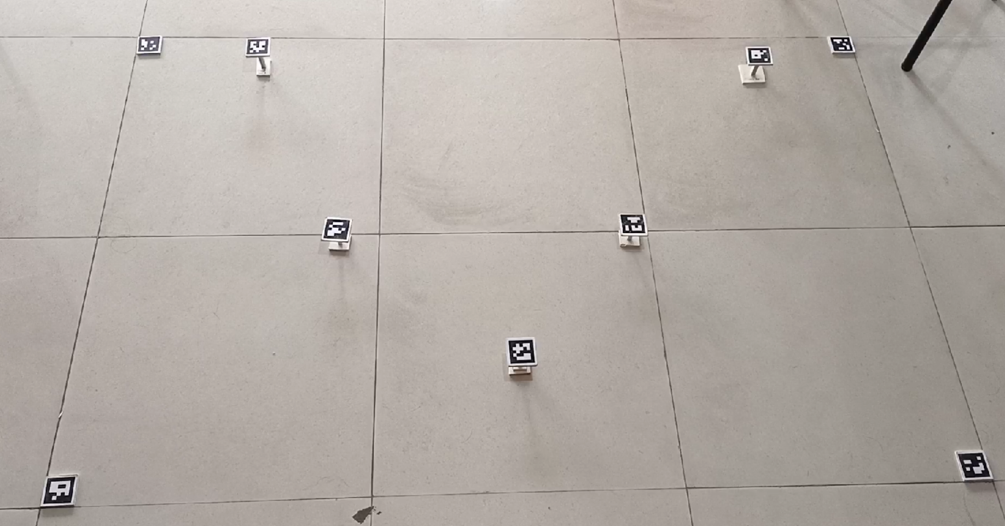
5. Workspace Setup

Slide 14
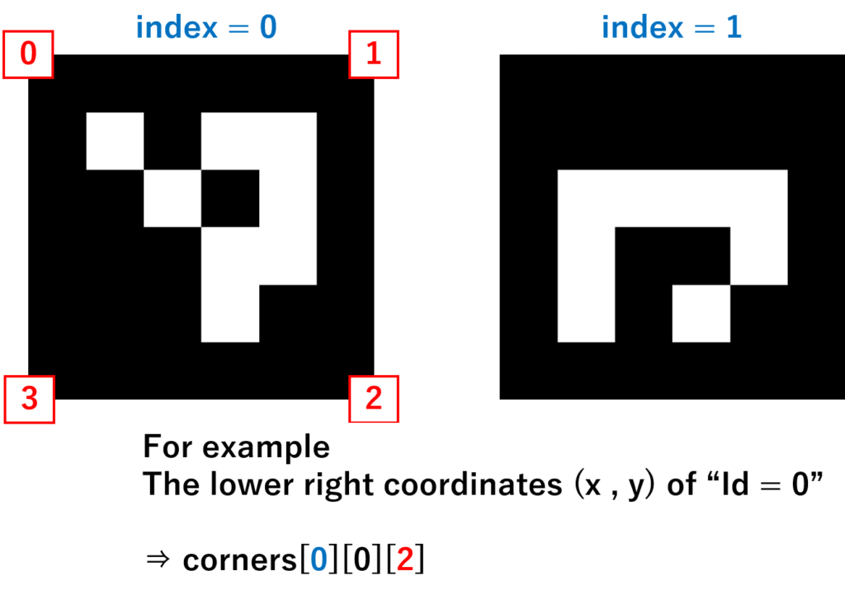
5. Workspace Setup

Slide 15
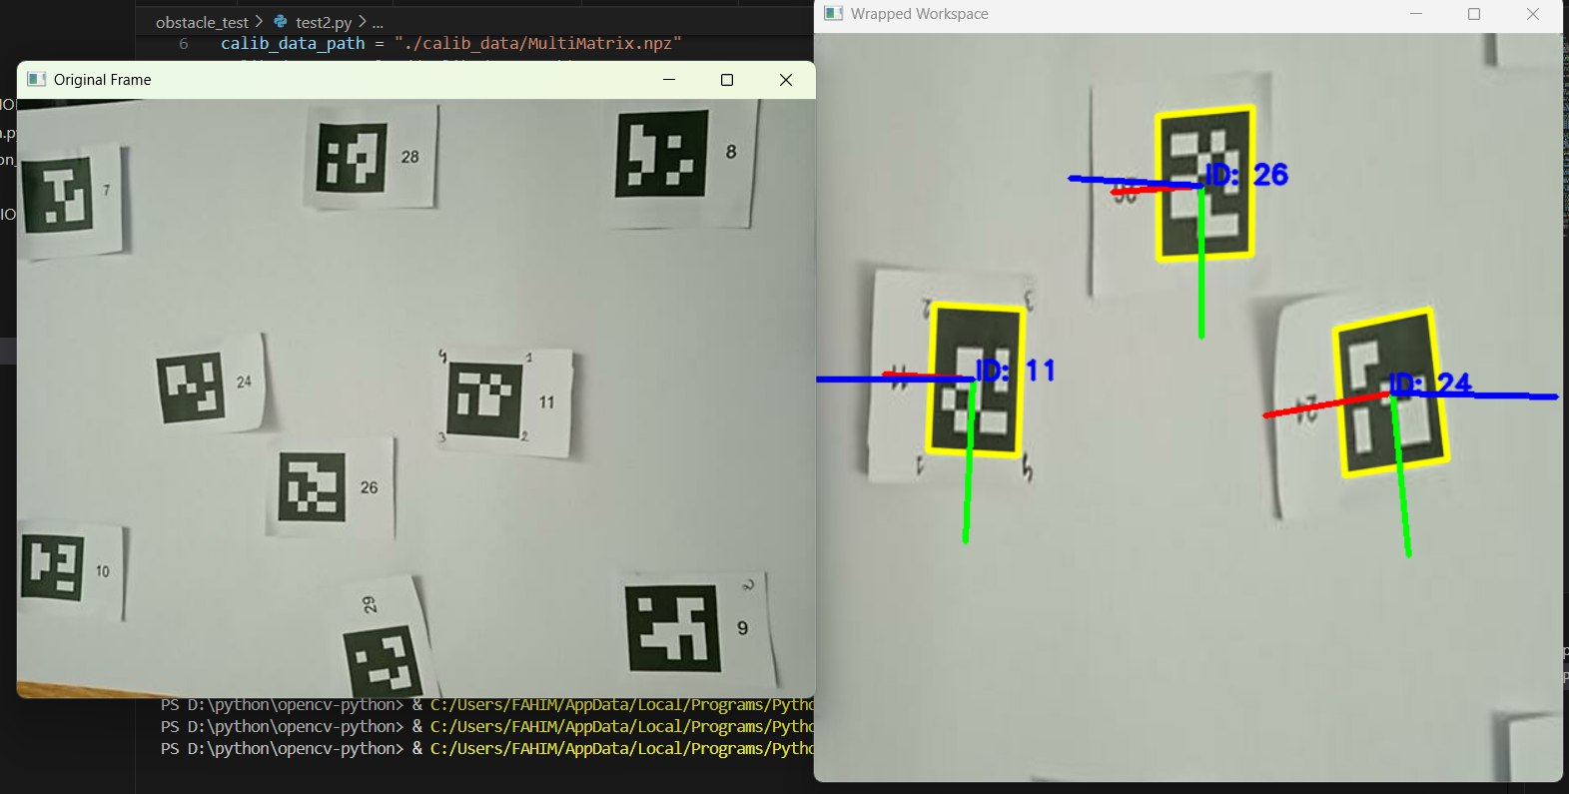
6. Implementation
Localization

Slide 16
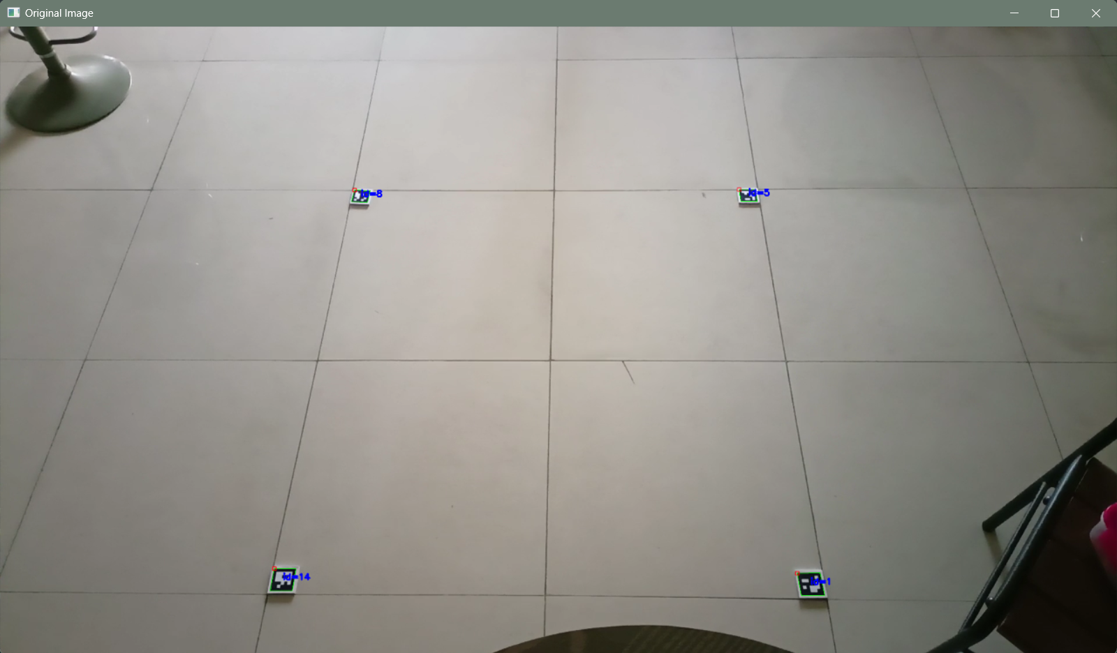
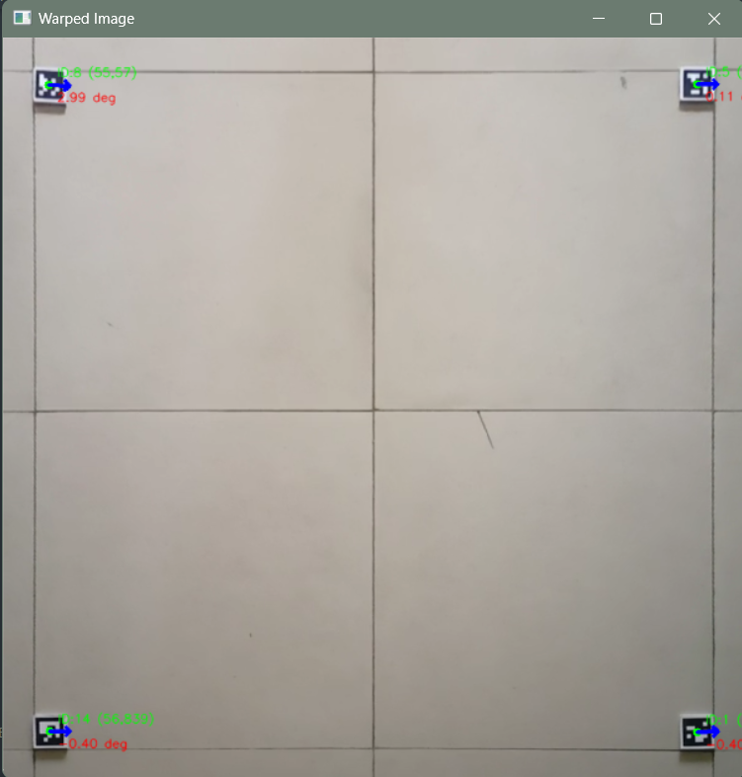
6. Implementation
Mapping

Slide 17
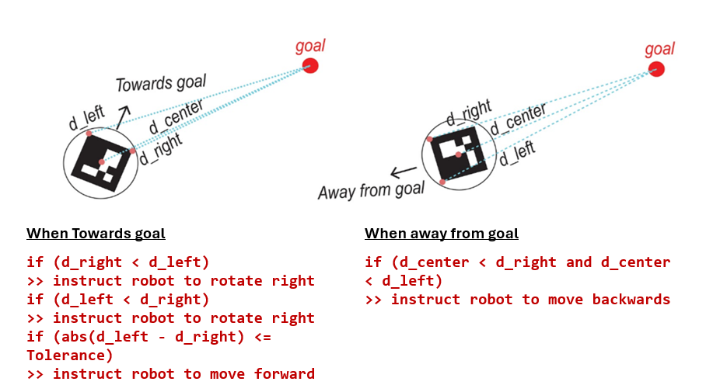
6. Implementation
Movement Towards Objects

Slide 18
6. Implementation
Controller Logic
left_delay = max(10, min(30, int(difference * 0.5)))
right_delay = max(10, min(30, int(difference * 0.5)))
forward_delay = max(30, min(100, int(distance_c * 0.05)))
backward_delay = max(30, min(100, int(distance_c * 0.05)))

Slide 19
6. Implementation
Pick Logic
// Create a list of target markers except 4 corners, robot and drop off zones and already visited markers
FOR an id in target markers:
// Run the Aruco follower
IF distance (Robot to target marker) < Tolerance
CLOSE the gripper
IF marker id is even:
move to id 2
ELSE
move to id 3
// Delete the marker from target markers and move it to already visited markers

Slide 20
6. Implementation
Drop Logic
IF Marker is close to drop off zone:
OPEN gripper
MOVE backwards
// Goes to the next iteration

Slide 21
6. Implementation
Demonstration

Slide 22
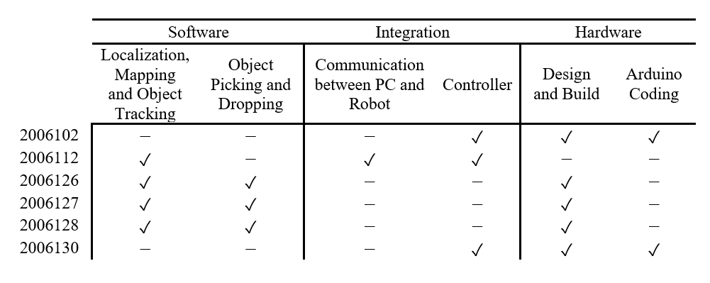
7. Reflection on Individual and Team work
Task Management

Slide 23
7. Reflection on Individual and Team work
Workflow
Hardware | Software
Primary Design Materials Purchase Primary Assembly Chassis Design Gripper Design 3D Printing Final Assembly Testing | Aruco Marker Detection Homography (Mapping pixel coordinates to real life distances) Aruco Tracker and Follower Real Time Obstacle Detection Real Time Path Planning Controller Design Object Picking Object Placing Implementation of Path Planning and Obstacle Avoidance Integration and Testing

Slide 24
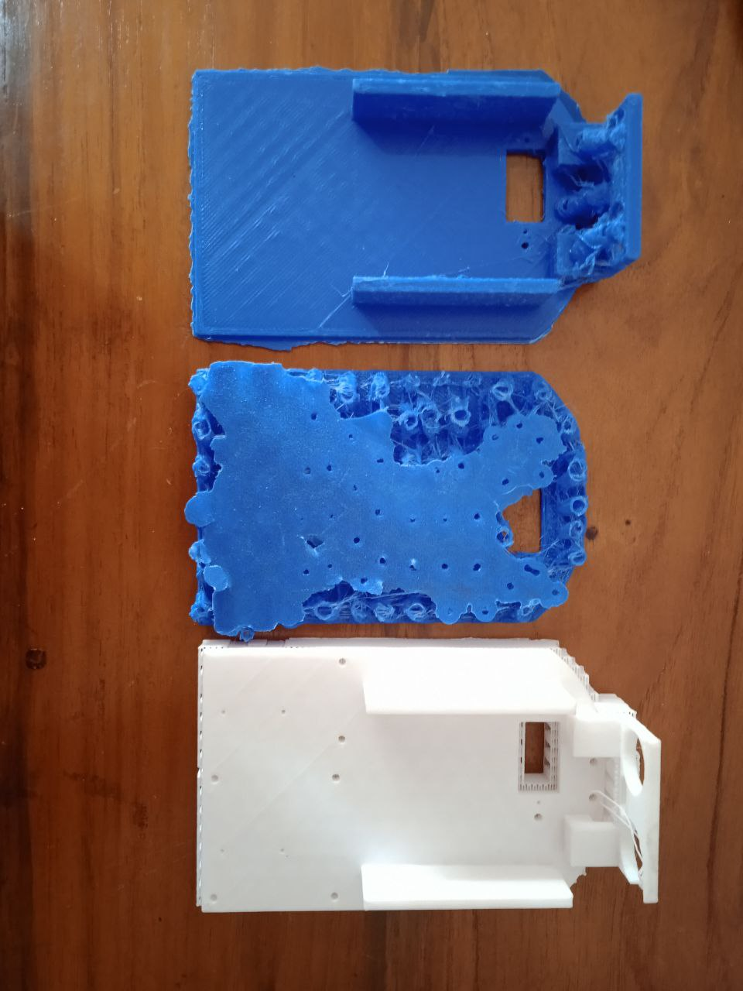
8. Mishaps
3D printing Failure

Slide 25
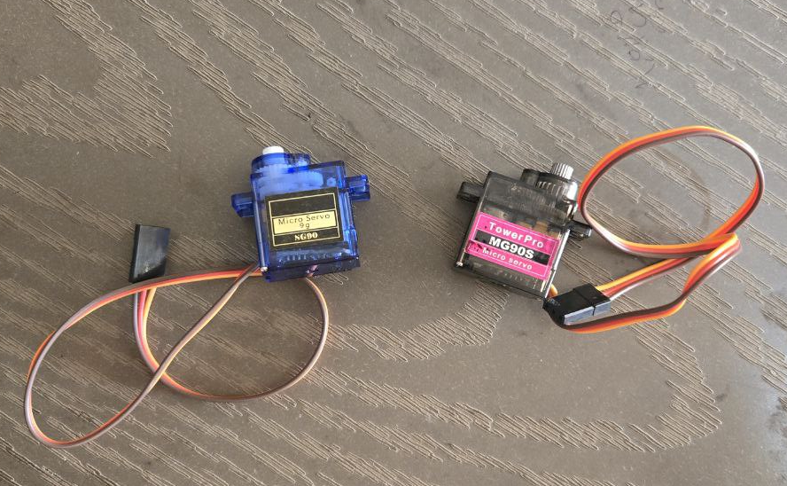
8. Mishaps
Issues with Servo

Slide 26
8. Mishaps
Fixing the issues
Stopping the servo after the claw opens or closes
IF command is "open" THEN
Attach servo to SERVO_PIN (enable power)
Move servo to the open position (120 degrees)
Wait for 500 milliseconds
Detach servo (disable power)
ELSE IF command is "close" THEN
Attach servo to SERVO_PIN (enable power)
Move servo to the closed position (180 degrees)
Wait for 500 milliseconds
Detach servo (disable power)
END IF

Slide 27
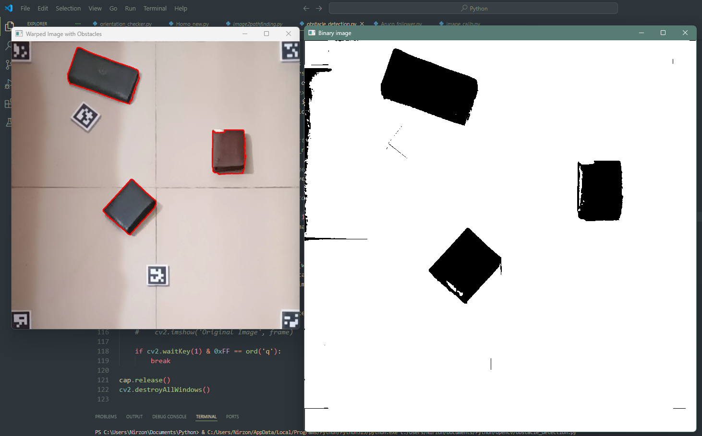
8. Future Works
Implementation of Obstacle Detection

Slide 28
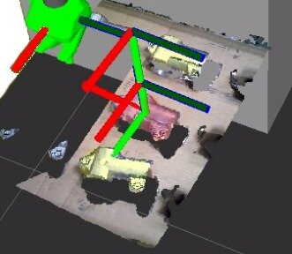
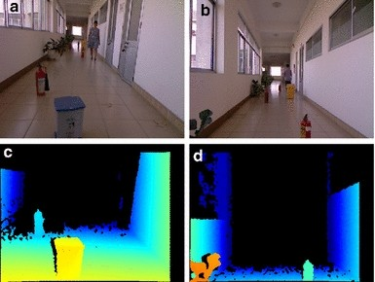
8. Future Works
Implementation of Obstacle Detection Using image classification

Slide 29
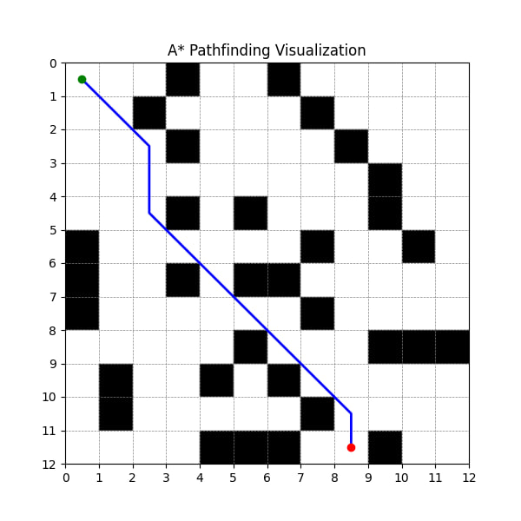
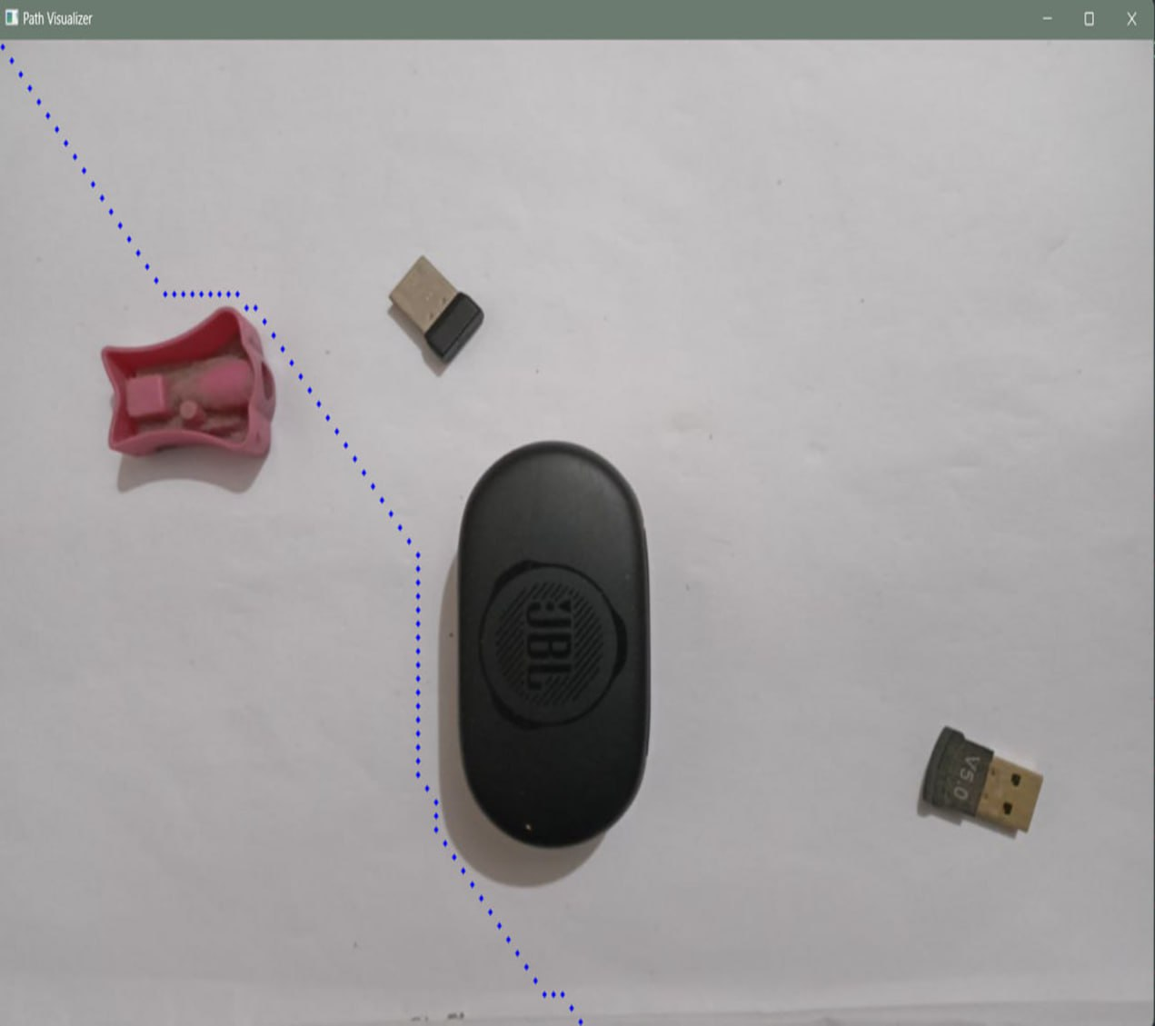
8. Future Works
Implementation of Optimized Path Planning

Slide 30
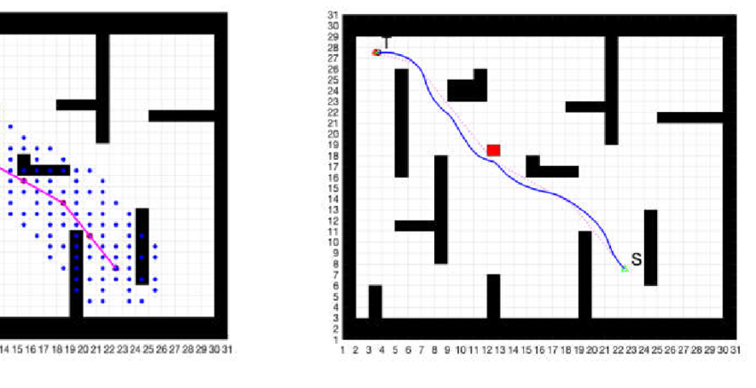
8. Future Works
Dynamic Window method for path planning

Slide 31
Thank You!

