Slide 1
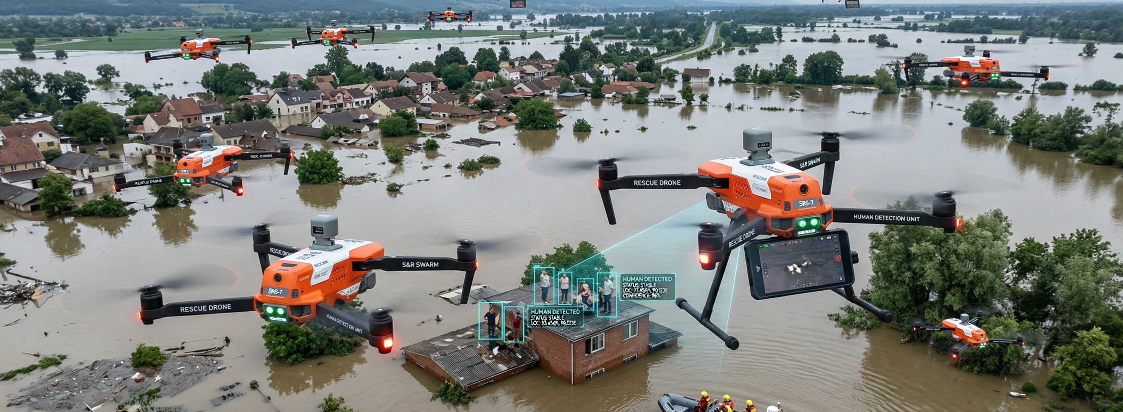
HIVE-R: Bio-Inspired Swarm Drone System for Human Detection in GPS-Denied Rescue Environments
Submitted by – Group 4
Adnan Hamim
2006124
Md.Fahim
2006128
Raisa Nusrat
2006132
Md Jaied Hasan
2006146
Asif Hasan
2006189

Slide 2
Outline
Overview
Workflow
Algorithm
Results
Industrial Applications
Design
Future Work

Slide 3
Overview
This project presents an autonomous swarm drone system designed for search and rescue (SAR) operations in flood-affected and GPS-denied environments (indoor and outdoor).
Each drone in the swarm operates independently using Visual Odometry (SLAM) to perform real-time localization and mapping, effectively creating a fake GPS framework for navigation.
The system enables coordinated area coverage through multiple drones, improving search efficiency and reducing rescue time in critical situations.
The drone is equipped with AI-based human detection, capable of identifying victims even in low-visibility or fuzzy environments.
A target-based help protocol ensures detected victim locations are shared across the swarm or control center for rapid response and rescue planning.
The system is designed to be scalable, robust, and reliable for real-world disaster scenarios where traditional GPS-based navigation fails.

Slide 4
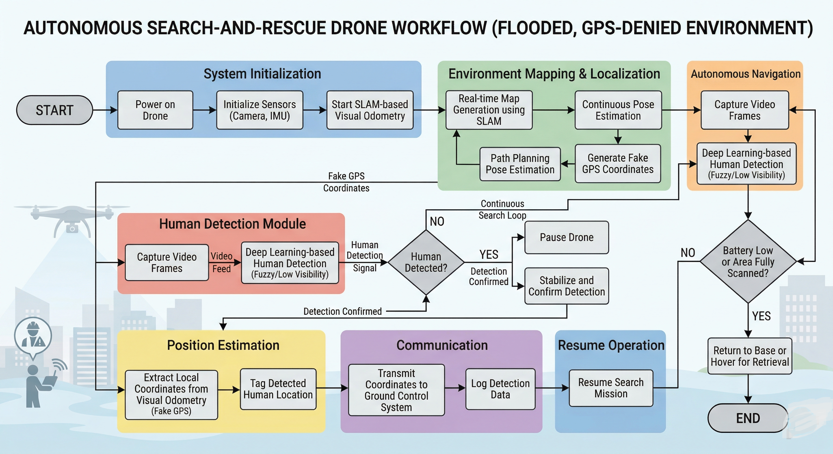
Workflow

Slide 5
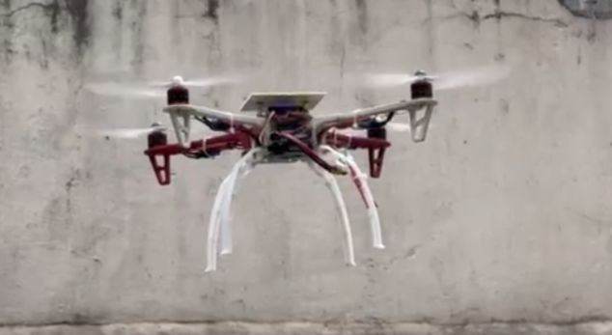
Design
Hardware Components
Raspberry Pi 4
  Main onboard processor
  Handles SLAM, navigation, and decision-making
Camera (Webcam )
  Captures real-time video feed
  Used for visual odometry and human detection
Inertial Measurement Unit (IMU)
  Provides acceleration and angular velocity data
  Assists in pose estimation and stabilization
Flight Controller (Pixhawk)
  Controls motors and ensures flight stability
  Interfaces with Raspberry Pi for high-level commands
Motors & Propellers
  Enable lift and movement of the drone
Battery (Li-Po)
  Provides power to all onboard components
Communication Module ( Telemetry)
  Sends detected target coordinates to ground station
Software Components
Robot Operating System (ROS)
  Framework for communication between modules
SLAM Algorithm
  Real-time mapping and localization (fake GPS generation)
Human Detection Model
  Detects victims in low-visibility environments
Navigation & Mission Planner
  Autonomous exploration

Slide 6
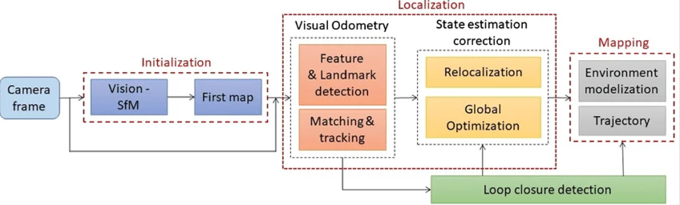
SLAM Algorithm
Core SLAM Loop: This is the heart of the algorithm, which repeats continuously to keep the localization and map synchronized.
1. Feature Extraction: The algorithm analyzes the sensor data to find distinct, recognizable points, such as a corner of a building or a unique shape on the floor. These are the "landmarks" the robot uses for reference.
2. Data Association: The robot compares the features it just saw with the landmarks it already has in its existing map. This is a crucial step to answer the question: "Is this a feature I've seen before, or is it new?"
3. Pose Estimation (Localization): Using the matched landmarks, the robot calculates its current position and orientation in the world. It uses the known locations of the landmarks to triangulate its own position.
4. Map Update: Based on its calculated pose, the robot updates the map. It refines the positions of existing landmarks and adds any new features it has discovered for future reference.

Slide 7
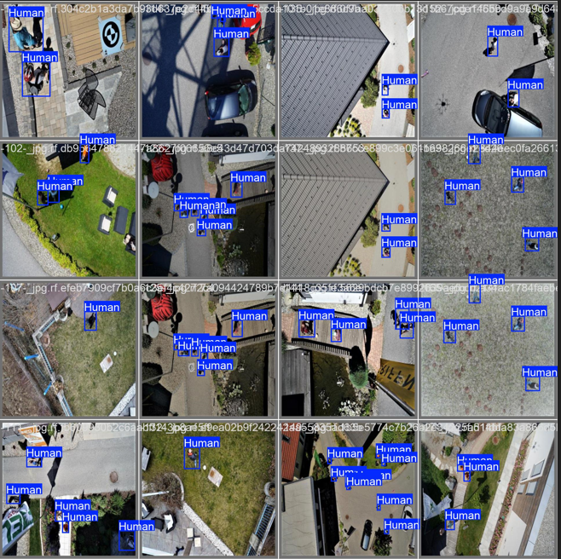
Human Detection Model:
Model:
YOLOv8 Nano
(Optimized for real-time inference on Raspberry Pi 4 )
Key Features:
Lightweight deep learning model for edge deployment
Performs real-time human detection onboard the drone
Low latency and efficient computation
Fuzzy Augmentation:
Training data enhanced with blur, noise, and low-visibility effects
Improves detection performance in flood, foggy, and harsh environments
Dataset:
Human detection dataset from Carnegie Mellon University

Slide 8
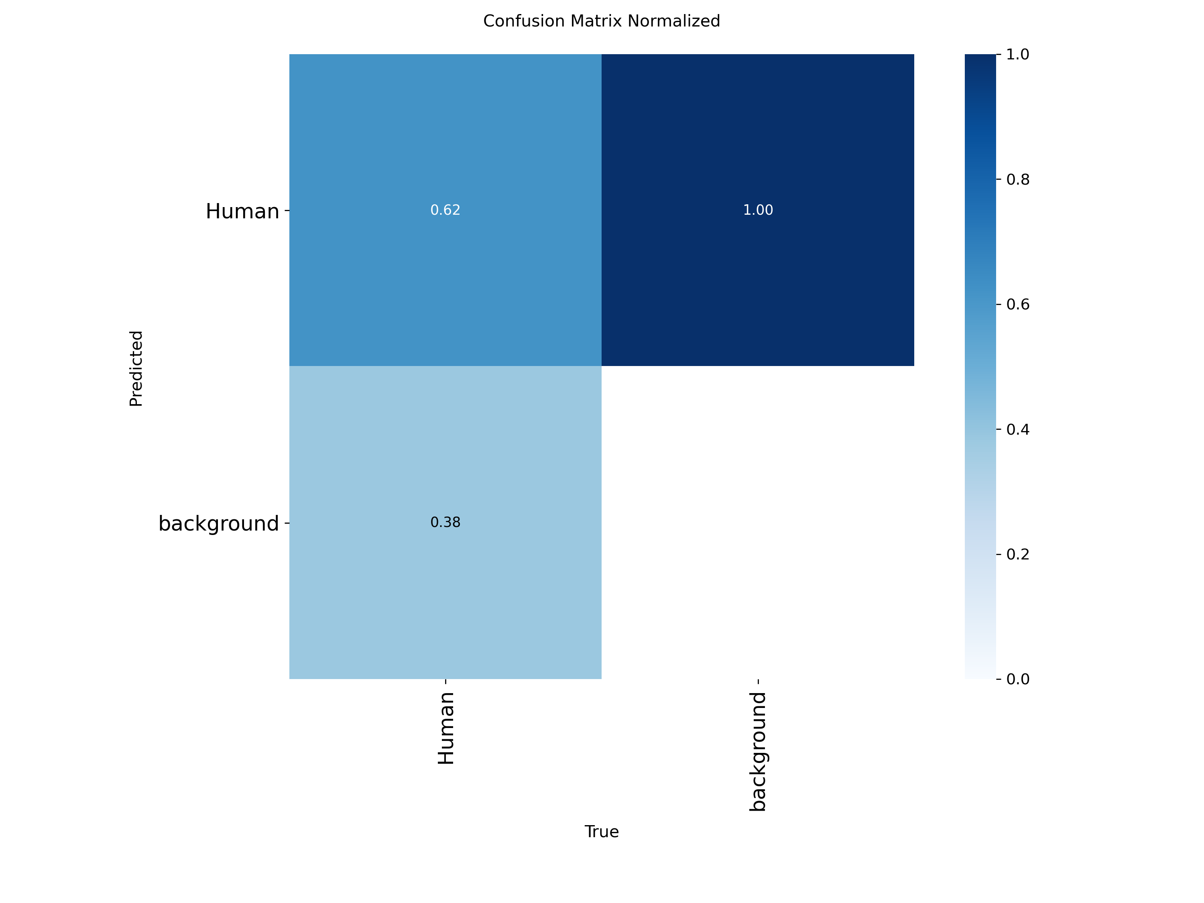
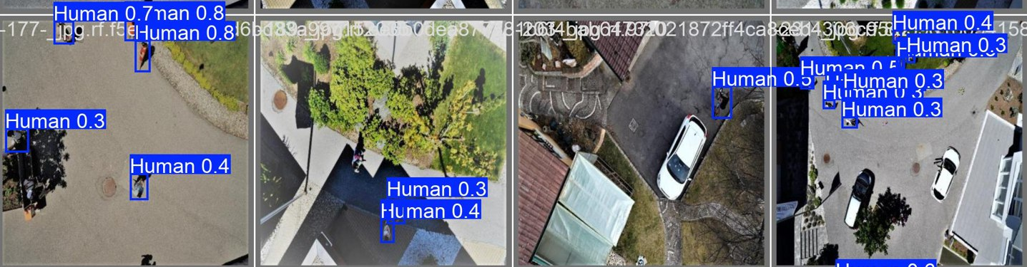
Results:
Human detection model result:
human detection accuracy
Classsification Matrix

Slide 9
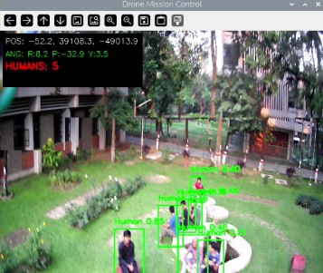
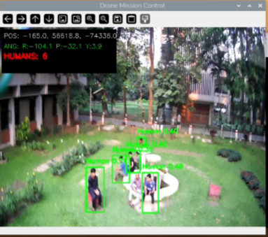
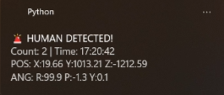
Results:
Message came to Ground station:

Slide 10

Demo:

Slide 11
Industrial Applications
Disaster Management & Search and Rescue (SAR)
  Rapid victim detection in floods, earthquakes, and collapsed structures
Smart Surveillance Systems
  Autonomous monitoring in hazardous or inaccessible environments
Defense & Security
  Border surveillance and reconnaissance in GPS-denied zones
Industrial Inspection
  Monitoring of factories, warehouses, and offshore facilities
Agriculture & Environmental Monitoring
  Flood assessment, damage analysis, and resource mapping
Swarm Robotics Applications
  Scalable multi-drone systems for large-area coverage using Swarm Robotics

Slide 12
Future Works
Swarm Coordination Enhancement
  Advanced inter-drone communication and collaborative mapping
Improved Localization
  Integration of Sensor Fusion (LiDAR, GPS when available)
Advanced AI Models
  More accurate detection using improved deep learning architectures
Real-Time Path Optimization
  Smarter exploration and faster area coverage
Autonomous Rescue Assistance
  Payload delivery (food, medicine, communication devices)
Cloud & Edge Integration
  Real-time data sharing and centralized mission control
Energy Optimization
  Longer flight time through efficient power management

