Slide 1

Two Player Pong Game Using Verilog on CPLD
FINAL PROJECT PRESENTATION
Presented To:
Nafis Sadik
Lecturer •EEE
BUET
Raficcha Yasmin
Adjunct Lecturer •EEE
BUET

Slide 2
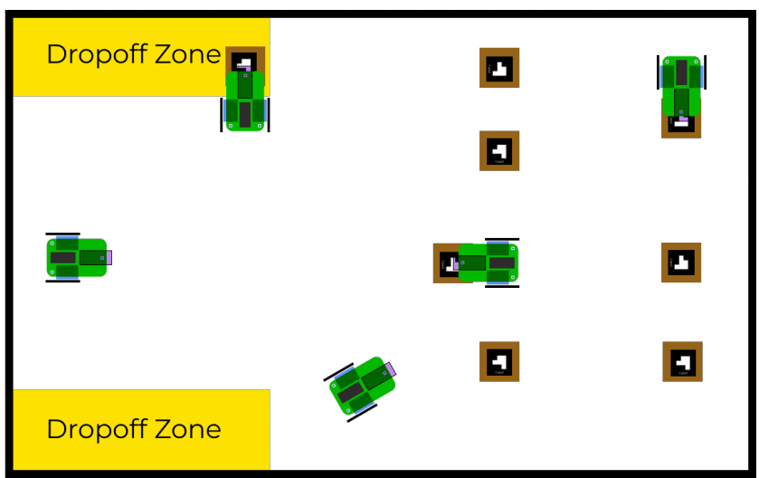
OBJECTIVE
  Pick up objects (pallets) and drop them on movable drop-off zones
  Avoid both static and dynamic obstacles along its path

Slide 3
STEPS
  Designing a robot that will be able to pick and drop objects
  Taking live feed from an overhead camera and processing it in a central PC
  Using OpenCV to localize the robot, objects and drop off zones
  Using pathfinding algorithm to find the most optimal path around obstacles
  Commanding the robot from central PC using a communication protocol
  Commanding the robot from central PC using a communication protocol

Slide 4
Game Display

Slide 5
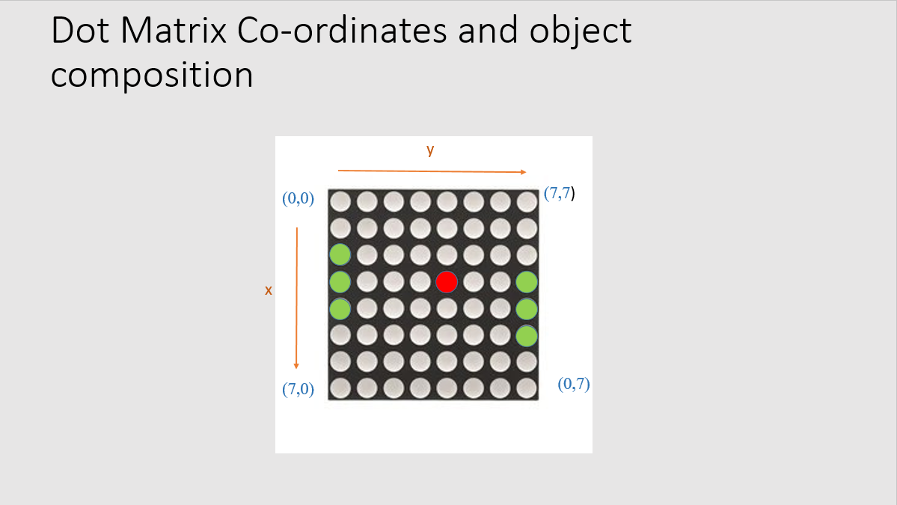

Slide 6
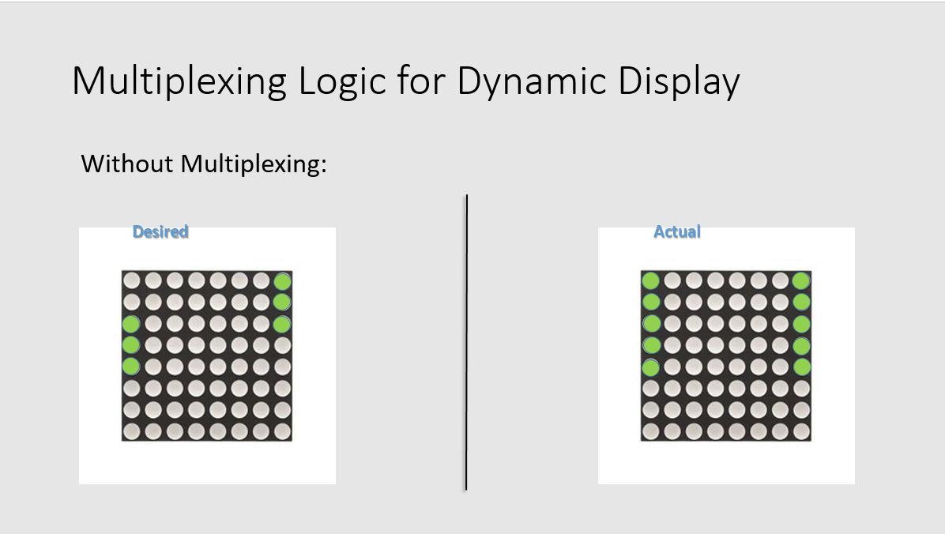

Slide 7
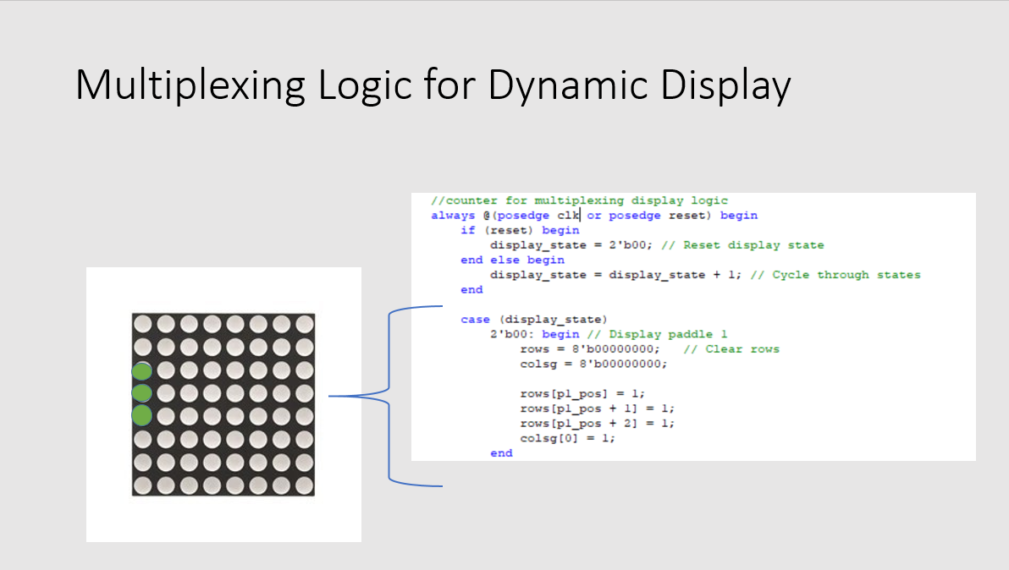

Slide 8
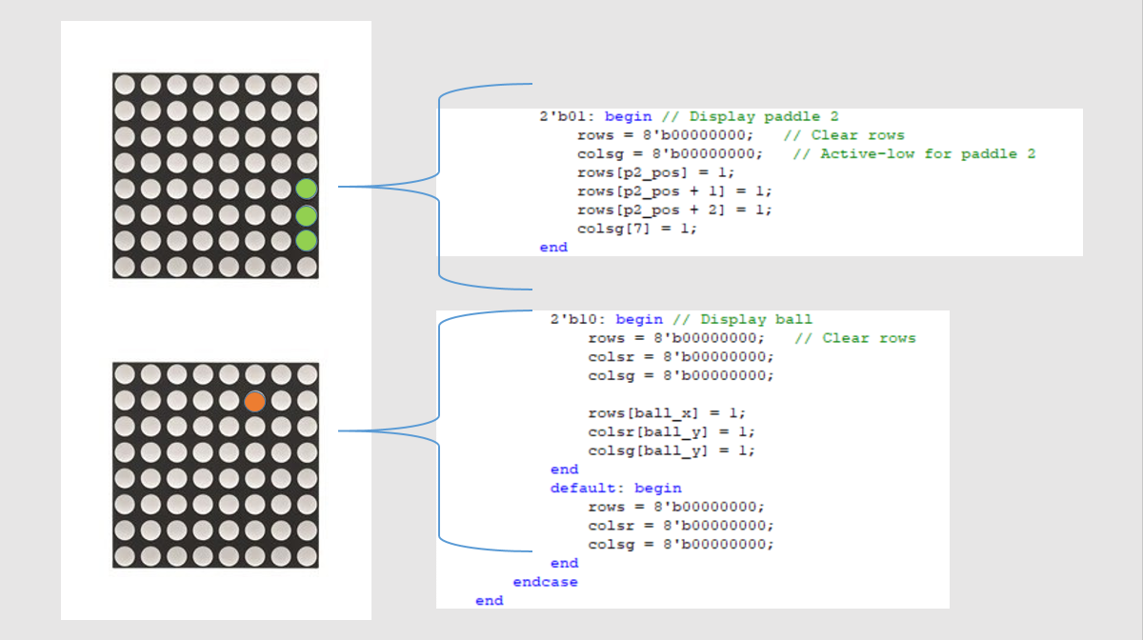

Slide 9


Slide 10
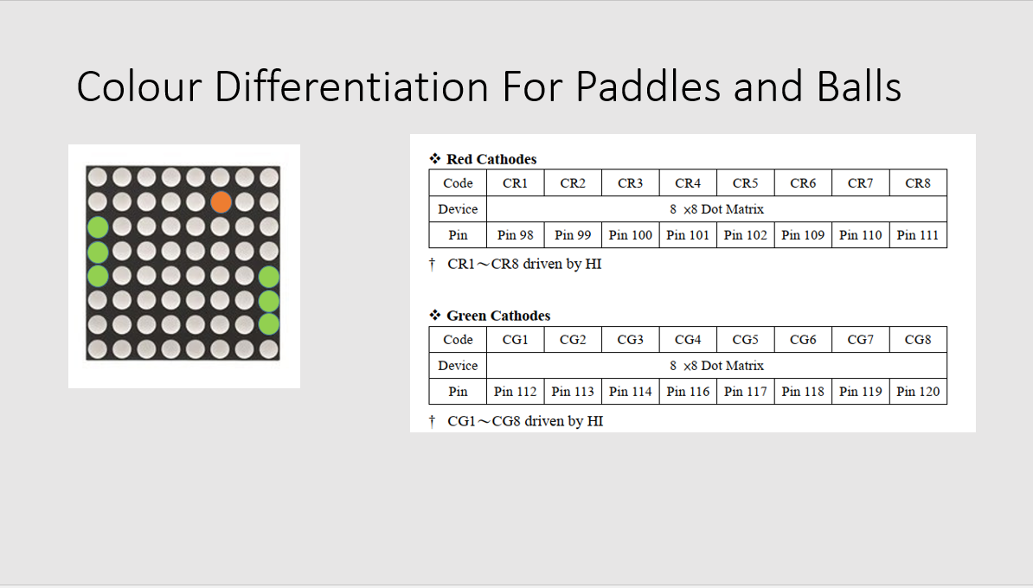

Slide 11
Game Mechanics

Slide 12
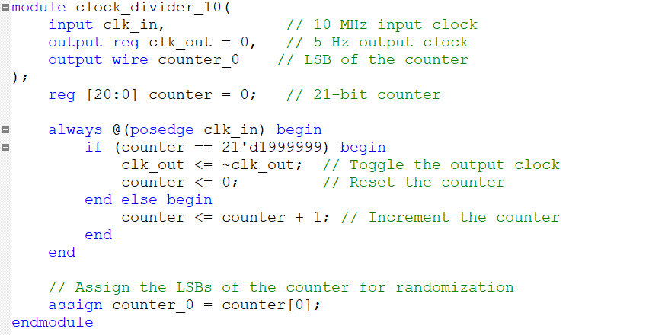
GAME CLOCK
  Clock for paddle and ball movement brought down to $≈5 Hz$
  counter_0 updates at $5MHz$

Slide 13
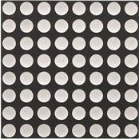
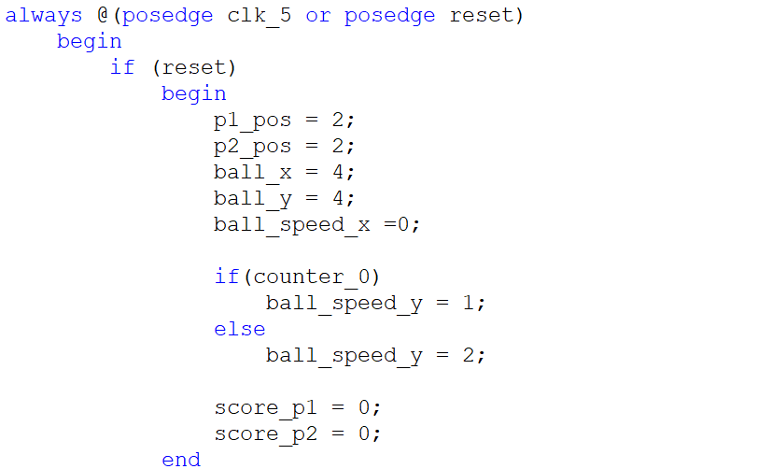


START AND RESET
  $$y$$
  $$x$$

Slide 14
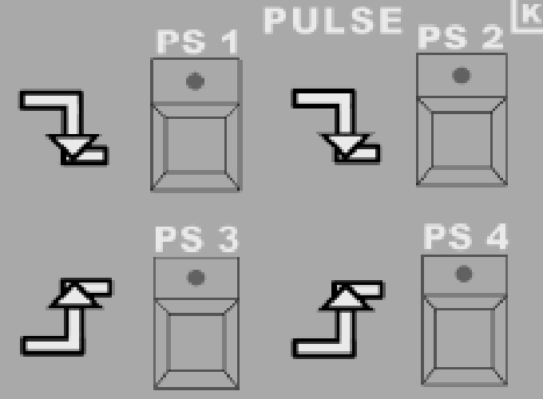
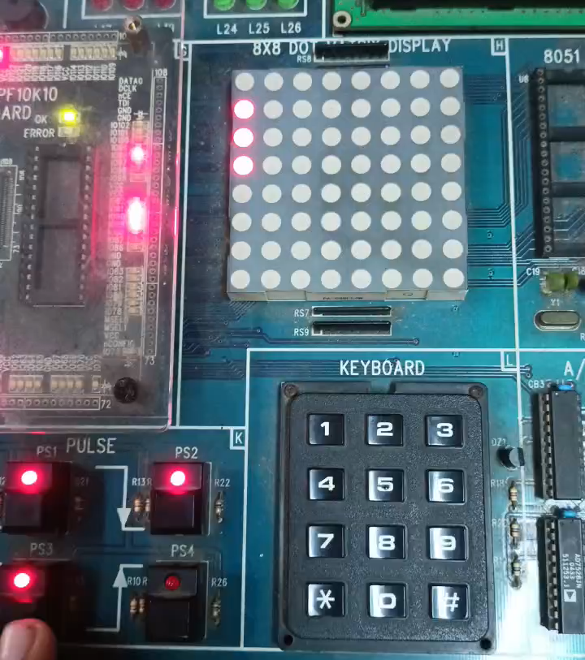
PADDLE CONTROL
  Up_p1
  Up_p1
  Down_p1
  Down_p2

Slide 15
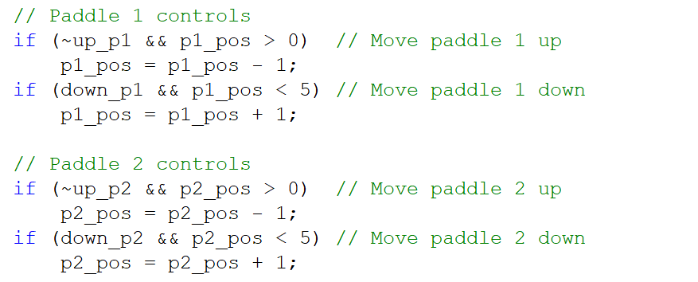
PADDLE CONTROL
  Negedge Pulse

Slide 16
BALL MOVEMENT
  $$y$$
  ball_speed_x = 0 : stands still
  ball_speed_x = 1 : moves down
  ball_speed_x = 2 : moves up
  $$x$$
  ball_speed_y = 0 : stands still
  ball_speed_y = 1 : moves right
  ball_speed_x = 2 : moves left

Slide 17
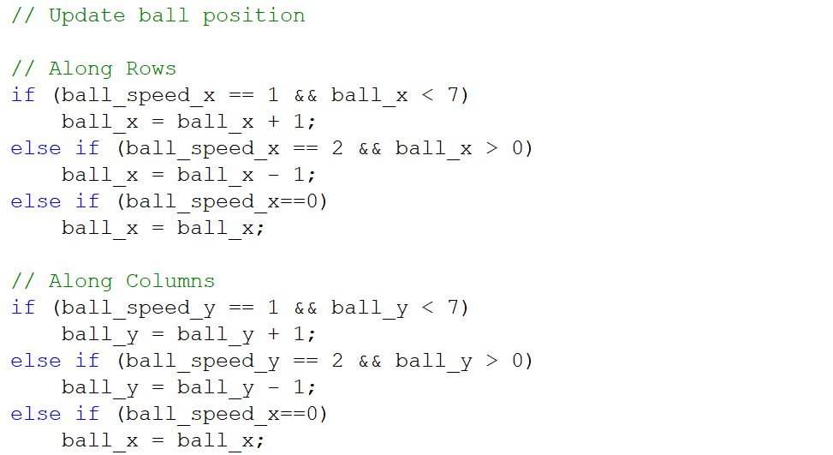
BALL MOVEMENT

Slide 18
BOUNDARY COLLISION
  $$y$$
  if(ball_x==0): ball_speed_x = 1
  $$x$$
  if(ball_x==7): ball_speed_x = 2

Slide 19
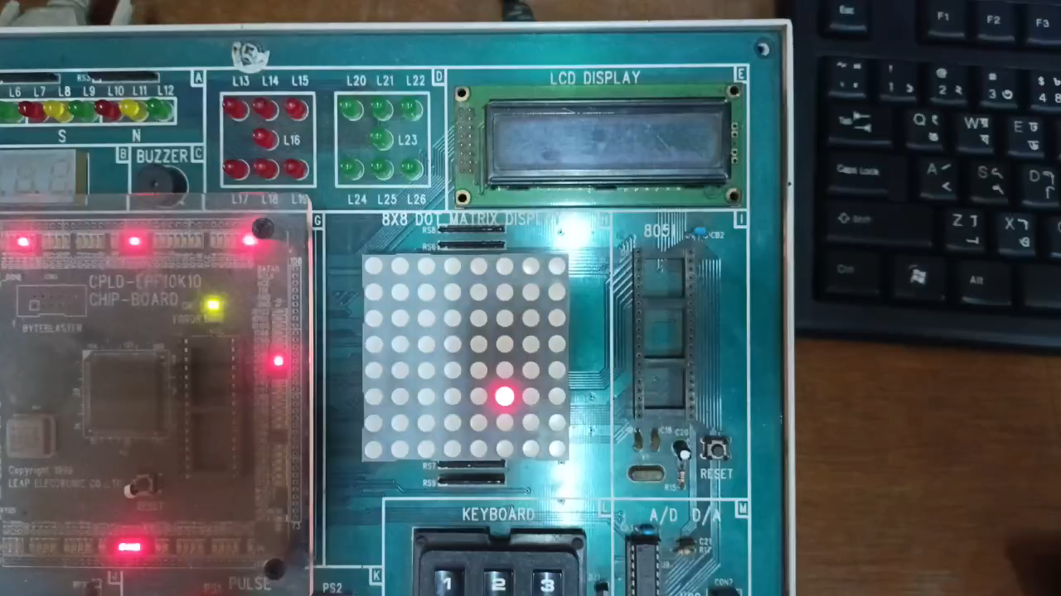
BOUNDARY COLLISION

Slide 20
PADDLE COLLISION
  $$y$$
  if(ball_x==p1_pos): ball_speed_x = 2
  if(ball_x==p1_pos+1): ball_speed_x = 0
  if(ball_x==p1_pos+2): ball_speed_x = 1
  $$x$$
  if(ball_y==0): ball_speed_y = 1

Slide 21
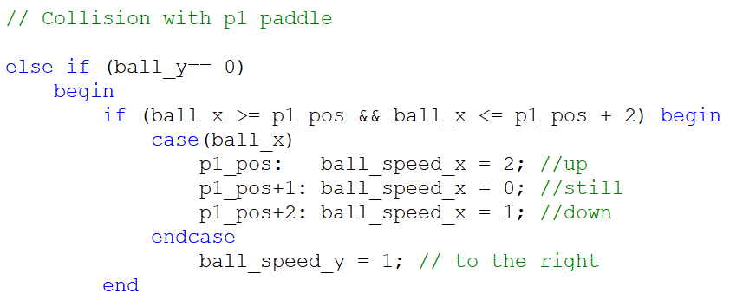
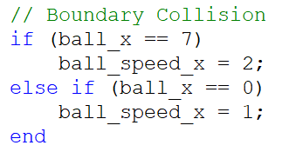
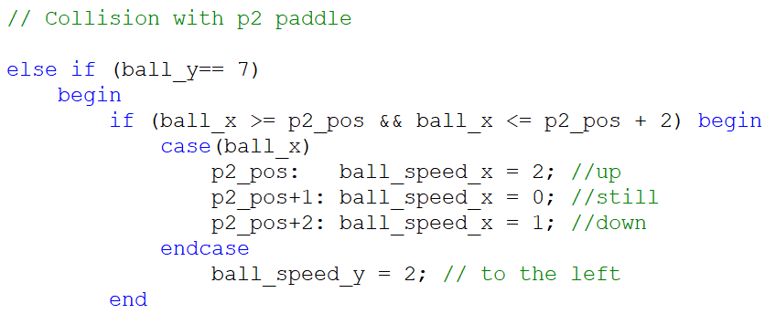
COLLISION LOGIC

Slide 22
SCORING LOGIC
  $$y$$
  If (ball_y == 0 and
  ball_x p1_pos or
  ball_x > p1_pos+2): >score_p2 = score_p2 +1
  >ball_x = 4, ball_y = 4
  >ball_speed_y =1
  >p1_pos and p2_pos = 2
  $$x$$

Slide 23
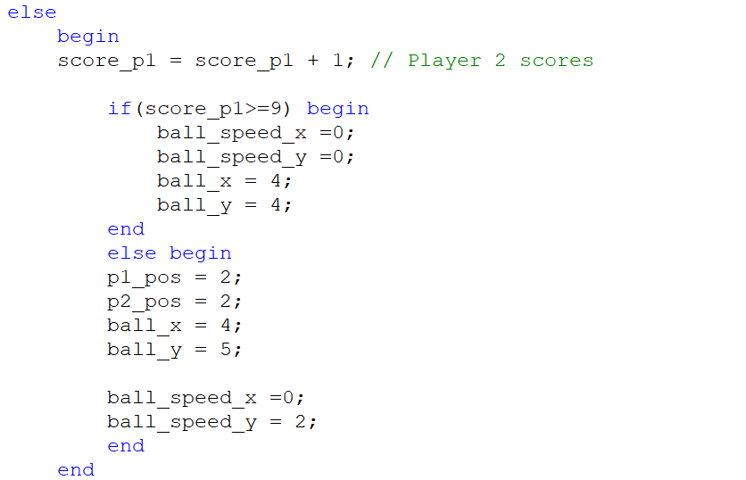
SCORING LOGIC

Slide 24
Score Display

Slide 25
Thank you!

