Slide 1
Generating captions from images in Bengali through an encoder-decoder network using a CNN-RNN/LSTM model
Fahim Faisal Rafi 19201081
Reak Roy 22301776
Md. Fahim Haque 20101014
1

Slide 2
Introduction
The convergence of natural language processing and com-
puter vision has opened up new avenues for image recognition
and language production in this age of fast technological
advancement. Among them, image captioning is a particularly
interesting field that tries to close the semantic gap between
textual descriptions and visual data.
2

Slide 3
Literature Review
[1] "Chittron'', an automated image annotation in Bangla which uses a pre-trained VGG16 image embedding model alongside stacking LSTM layers.
[2] Used Transformer-based architecture for automatic Bengali image captioning, achieving excellent results on the BanglaLekhaImageCaptions dataset.
[3] discusses the qualitative analysis involving evaluating the generated captions based on their quality and similarity to human descriptions.
31

Slide 4
Methodology
Feature
Extraction (Encoding)
Dataset Collection
Sequence Processing
Caption Generation
(Decoding)
4

Slide 5
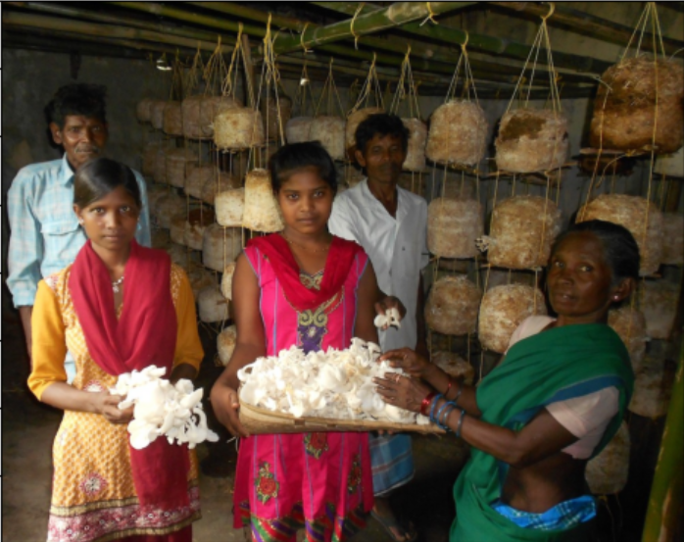
Dataset
We used 9,154 images from the BanglaLekhaImageCaptions dataset. It consists of images and annotations in Bengali. The images are human annotated in Bengali by two adult native Bengali speakers. The captions are stored in a single json file and each image is about 1000x800 pixels in size.
5

Slide 6
Model
We utilized a CNN (Convolutional Neural Network) for image feature extraction in the encoder block and an RNN (Recurrent Neural Network) network in the decoder block for sequence processing to generate the textual captions.
6

Slide 7
Data Training
Utilized a 80:20 split ratio among training and testing
Of the 9,154 images, 7323 images have been used for training and 1831 images have been used for validation
2 captions have been used with each image bringing the total number of captions to 18,308
7

Slide 8
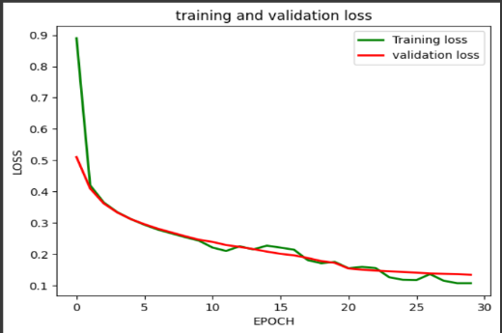
Results
A training loss of 0.1070 during test set assessment has been reported, the low validation loss suggests effective performance in generating relevant captions.
8

Slide 9
Limitations
Dataset size
Lack of diversity of captions
Coherent captions
Caption relevance
9

Slide 10
Future Improvement
Focus on speed and accuracy for a better model
Explore new models or fine-tune existing ones for precision and efficiency
Increasing training set size for improved recognition strength
10

Slide 11
Conclusion
Our model displays a remarkable ability to interpret visual material and generate contextually appropriate captions in Bengali. The effective collaboration of these models enables the development of coherent and contextually suitable captions, showcasing an admirable fusion of picture recognition and natural language processing.
11

Slide 12
References
Rahman, M., Mohammed, N., Mansoor, N., \& Momen, S. (2018). Chittron: An Automatic Bangla Image Captioning System (Version 1). arXiv. https://doi.org/10.48550/ARXIV.1809.00339
Palash, M. A. H., Nasim, M. A. A., Saha, S., Afrin, F., Mallik, R., \& Samiappan, S. (2021). Bangla Image Caption Generation through CNN-Transformer based Encoder-Decoder Network (Version 1). arXiv. https://doi.org/10.48550/ARXIV.2110.12442
Khan, M. F., Shifath, S. M. S.-U.-R., \& Islam, Md. S. (2021). Improved Bengali Image Captioning via deep convolutional neural network based encoder-decoder model (Version 1). arXiv. https://doi.org/10.48550/ARXIV.2102.07192
12

