Slide 1
Title: "Deep learning-based video quality enhancement for the new versatile
video coding"
by
Soulef Bouaafia,Randa Khemiri,Seifeddine Messaoud, Olfa Ben Ahmed, Fatma Ezahra Sayadi
Presented by
Name: Md. Fahim Haque
ID: 20101014
Course: CSE 438
Section: 1
Institution: BRAC University

Slide 2

Abstract
Challenges in Multimedia-IoT (M-IoT) applications
Improving Quality of Experience (QoE) through WSE-DCNN
Mitigating compression artifacts in Versatile Video Coding (VVC)
Higher video quality in smart city scenarios

Slide 3
Introduction
Evolution of multimedia technologies and M-IoT
Role of M-IoT in connecting humans, health centers, industries, and objects
Challenges: interoperability, security, and data processing
Paramount importance of Quality of Experience (QoE) in M-IoT

Slide 4
Literature Review
Challenges in multimedia data processing in M-IoT
Emphasis on efficient feature extraction, encoding/decoding, and improved QoE
Adoption of Versatile Video Coding (VVC) and its challenges
In-loop filtering techniques (DBF, SAO, ALF) limitations

Slide 5
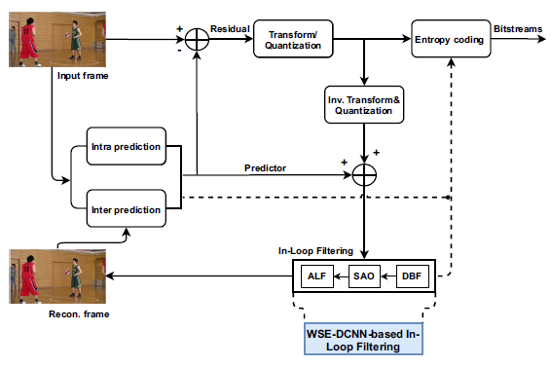
Methodology
Introduction to Wide-Activated Squeeze-and-Excitation Deep Convolutional Neural Network (WSE-DCNN)
Overcoming limitations of traditional in-loop filtering methods
Focus on removing compression artifacts for high-quality compressed videos in M-IoT applications
Design for robust quality improvement, especially in smart city scenarios

Slide 6
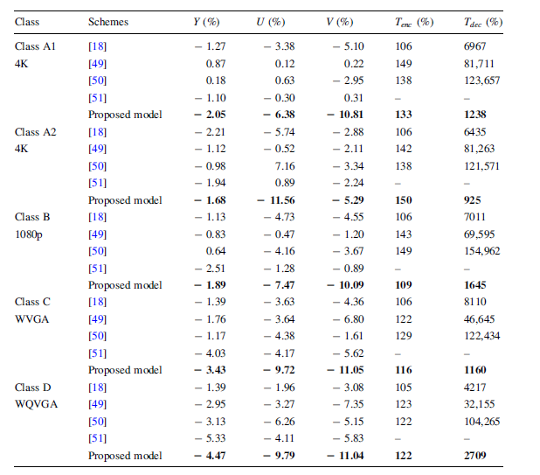
Results

Slide 7
Key Contributions
Introduction of the WSE-DCNN framework for M-IoT, emphasizing video quality in smart city contexts.
Implementation of the WSE-DCNN approach into the VVC standard, showcasing coding gains for random access configurations.
Adaptation of the M-IoT scenario-based smart city context to improve QoE in video quality.

Slide 8
Conclusion
Addressing challenges in multimedia data in M-IoT
Emphasis on Quality of Experience (QoE)
WSE-DCNN as a promising solution to enhance video quality in smart city scenarios
Demonstrated potential coding gains
Future work: optimization, broader M-IoT domains, scalability, keeping pace with multimedia technologies advancements.

