Slide 1
Pong Version 6.8
Submitted by : Md. Shorifuzzaman Roll : 06
Md. Fahim Arefin Roll :08
Submitted to : Md. Asif Hossain Khan
Anna Fariha

Slide 2
Outline of presentation
Introduction
Project Goal
Project Summary
Project Features
Game Play
Navigation Chart
Limitations

Slide 3
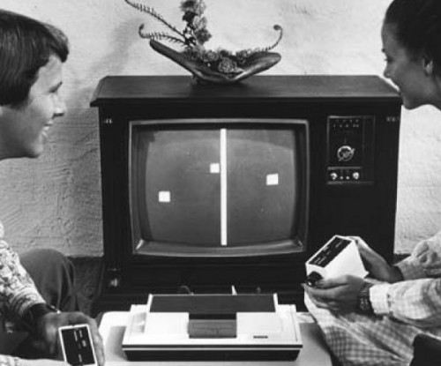
Introduction
“Pong” is one of the earliest arcade video games
It is a "tennis like" game having two paddles and a ball

Slide 4
Project goal
To Create a multiplayer game
To write a game program in c language using Turbo C compiler
To overcome some limitations of the original game
To create a customizable and user-friendly graphical user interface using the basic bgi functions.

Slide 5
Project summary
Controlling two paddles using keyboard and mouse input
Moving the ball in a specified direction , so that it doesn’t get stuck in certain cases
Taking the winner’s name to and adding it to the leaderboard if he’s in the top 10.
Implementing “Pause” menu so that the user can pause and resume the game.

Slide 6
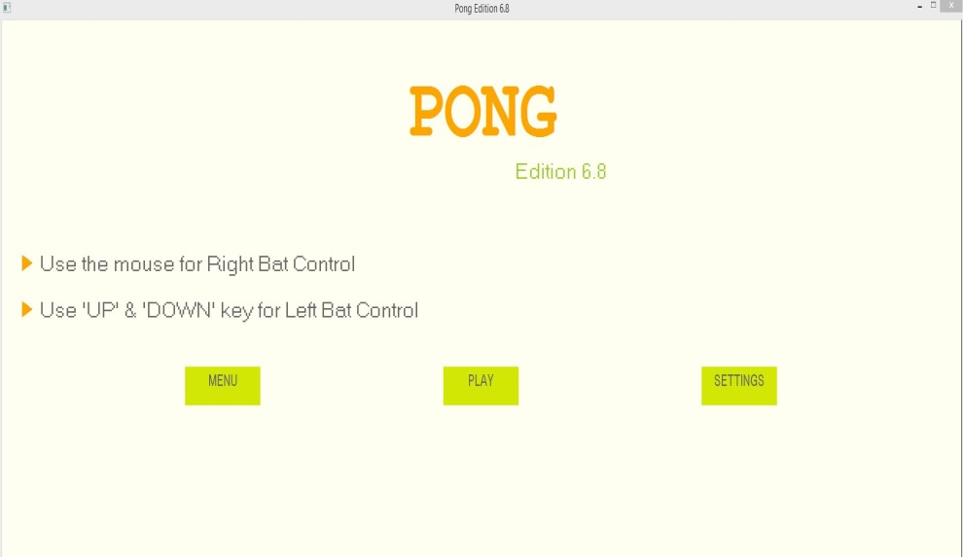
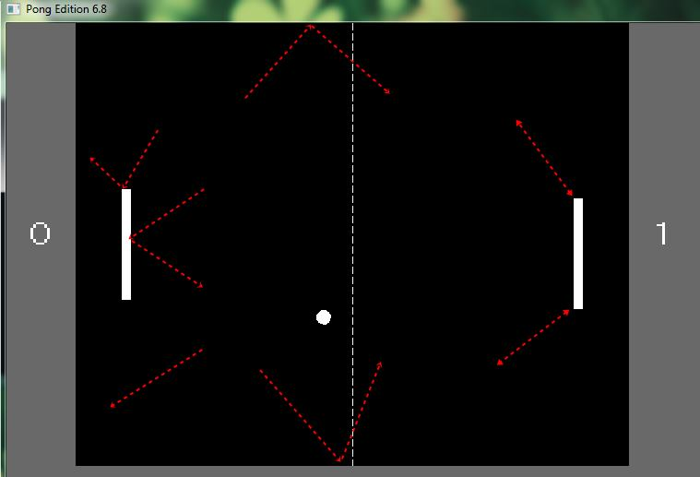
Project Features
Creating a customizable background and bat style for the game
Implementing a menu and a settings page for selecting certain options
Providing the user freedom to change the settings of “Sound”, “Bat Speed”, “Score Position” and “Scorecard view”.

Slide 7
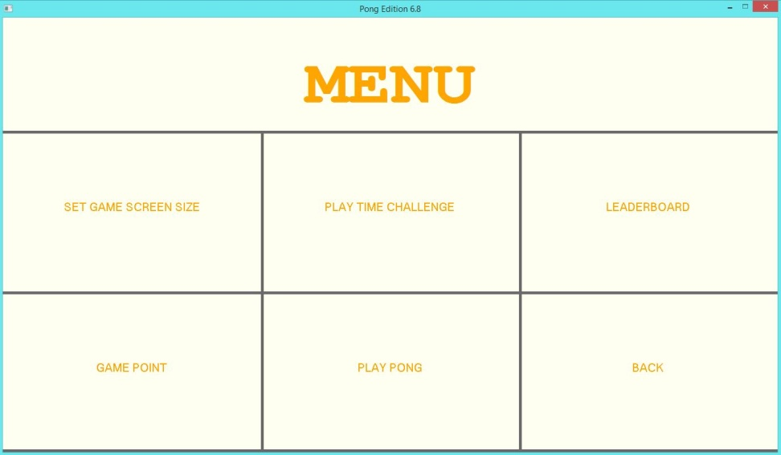
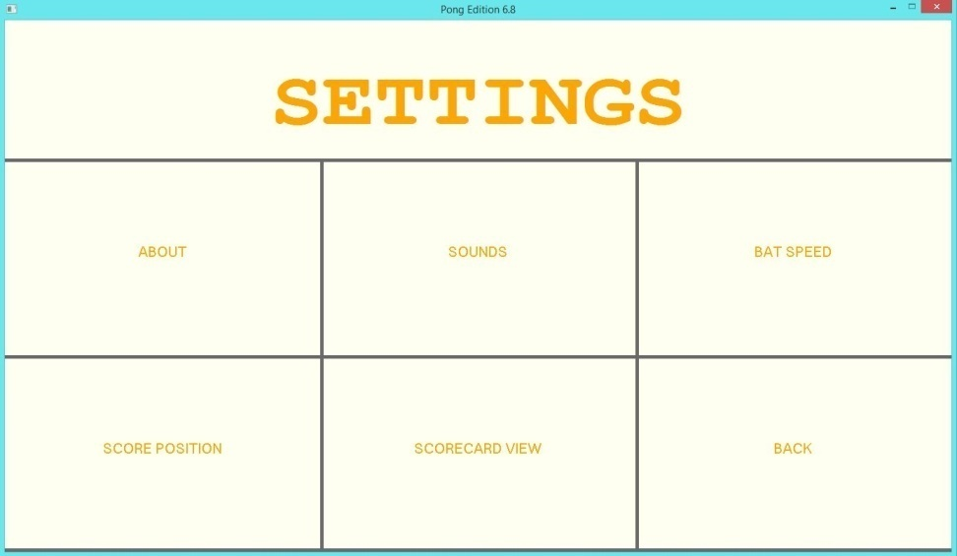
Project Features
Users have an array of options to change game settings

Slide 8
Game Play
Two players control the paddle by moving them vertically across both left & right sides of the screen
One can earn a point when the other fails to return the ball
Time challenge: The higher scorer in the time limit wins the game.
Game point: The player who reaches the total game limiting points first, wins the game.

Slide 9
Navigation Flow(Start Screen)
START SCREEN
MENU
PLAY
SETTINGS

Slide 10
Navigational Flow (Menu)
Menu
GAME POINT
SET GAME SCREEN SIZE
PLAY TIME CHALLENGE
BACK
30
60
150
450
LEADERBOARD
Player 1
Player 2
600 * 480
800 * 640
750 * 500
900 * 600
5
5
Play Pong
PLAY
START SCREEN
15
10
20
10
5
10

Slide 11
Navigational Flow(Settings)
Settings
SCORE POSITION
ABOUT
SOUNDS
BAT_SPEED
TOP
1.2x
1.4x
1.75x
1x
MUTE
SOUND 1
SOUND 2
SOUND3
MIDDLE
BOTTOM
SCORECARD VIEW
SET SCOREBOARD COLOR
SET BAT STYLE
SET BAT STYLE
BACK
START SCREEN

Slide 12
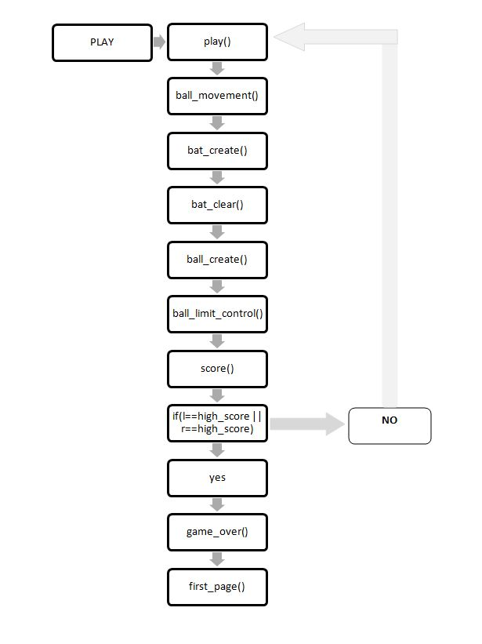
Play Function Flow

Slide 13
Limitations
We wanted to vary the speed of the game according to the screen size, but as bgi is "CPU-friendly" , it doesn't maintain a constant speed across all devices and it is not even consistent on a particular device.

Slide 14
Conclusion
Despite limitations and backdated resources, this game works perfectly as a double-player game which brings in more excitement than a computer simulated game.

