Slide 1
Fetch in JavaScript
Request/Response in web application

Slide 2
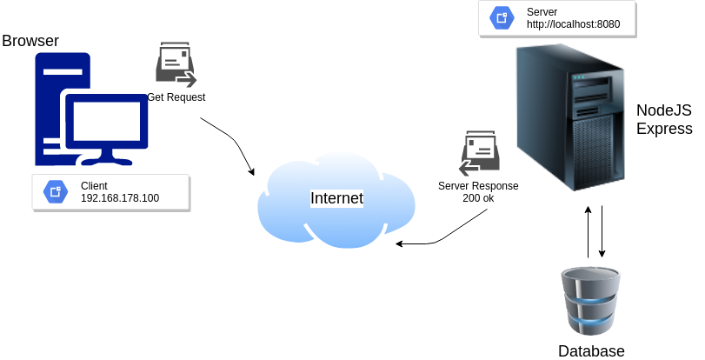
Request/Response Cycle

Slide 3
Blocking Code
Blocking is when the execution of additional JavaScript in the Node.js process must wait until a non-JavaScript operation completes.
  const fs = require('fs');
  const data = fs.readFileSync('/file.md'); // blocks here until file is read
Equivalent to above but asynchronous
  const fs = require('fs');
  fs.readFile('/file.md', (err, data) => {
    if (err) throw err;
  });

Slide 4
Non-blocking Code
Lets expand our last example little bit
  var fs = require('fs');
  var data = fs.readFileSync('/file.md'); // blocks here until file is read
  console.log(data);
  moreWork(); // will run after console.log
  const fs = require('fs');
  fs.readFile('/file.md', (err, data) => {
    if (err) throw err;
    console.log(data);
  });
  moreWork(); // will run before console.log

Slide 5
Concurrency and Throughput
As an example, let's consider a case where each request to a web server takes 50ms to complete and 45ms of that 50ms is database I/O that can be done asynchronously.
Choosing non-blocking asynchronous operations frees up that 45ms per request to handle other requests.
This is a significant difference in capacity just by choosing to use non-blocking methods instead of blocking methods.

Slide 6
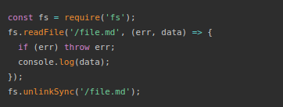
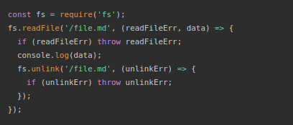
Danger of mixing blocking & non-blocking

Slide 7
Promises
Imagine you are a kid. Your mom promises you that she'll get you a new phone next week.
You don't know if you will get that phone until next week. Your mom can either really buy you a brand new phone, or stand you up and withhold the phone if she is not happy.
This is a promise.
A promise has 3 states. They are:
  Pending: You don't know if you will get that phone
  Fulfilled: Mom is happy, she buys you a brand new phone
  Rejected: Your mom is happy, she withholds the phone

Slide 8
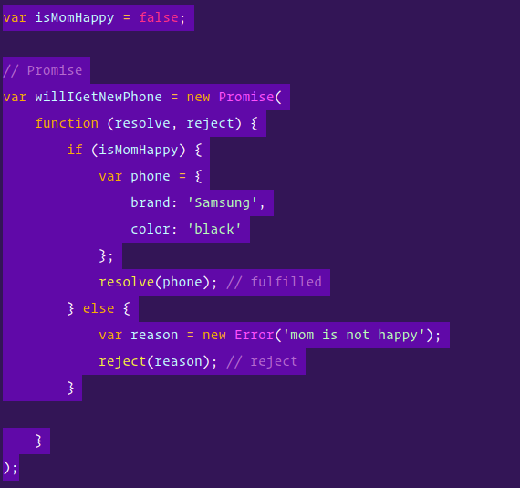
Creating a promise

Slide 9
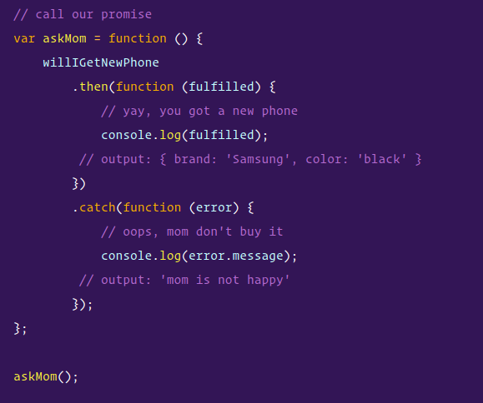
Consume promises

Slide 10
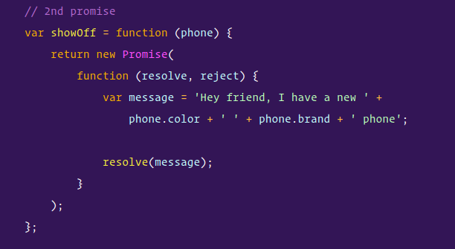
Chaining promises
Let's say, the kid, promises your friend that you will show them the new phone when your mom buy you one.

Slide 11
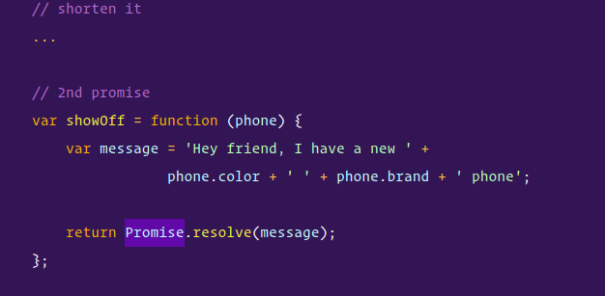
Chaining promises

Slide 12
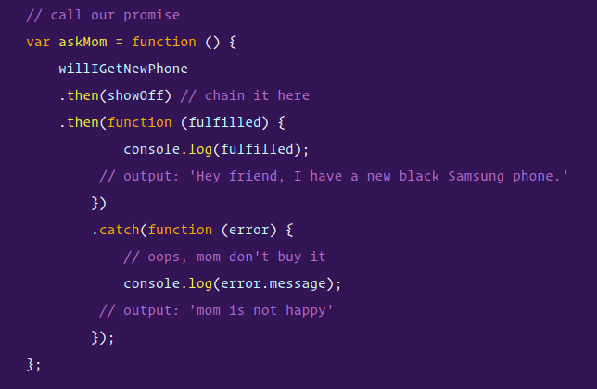
Chaining promises
The kid can only start the showOff promise after the willIGetNewPhone promise.

Slide 13
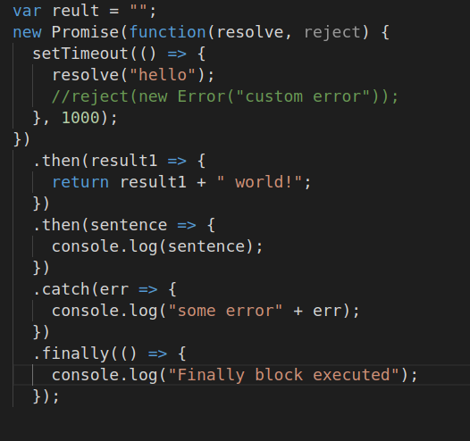
Finally block in Promises
A Promise object serves as a link between the executor and the consuming functions, which will receive the result or error. Consuming functions can be registered (subscribed) using methods .finally()

Slide 14
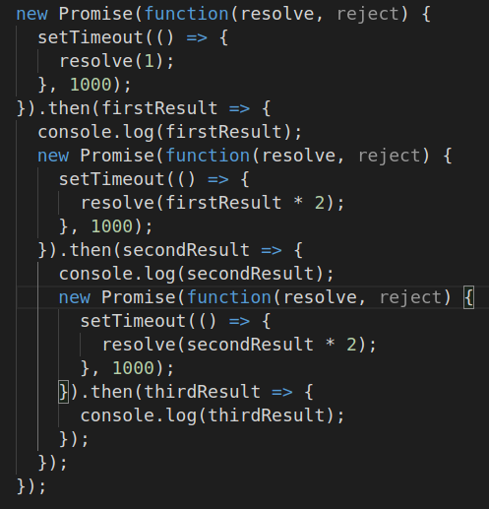
Multiple promises
After each second
A new resolve function
Will be invoked.

Slide 15
Promise.all()
Promise.all() takes an array of promises (technically can be any iterable, but usually an array) and returns a new promise.
The new promise resolves when all listed promises are settled and the array of their results becomes its result.
For instance, download several URLs in parallel and process the content when all are done.
That’s what Promise.all() is for.

Slide 16
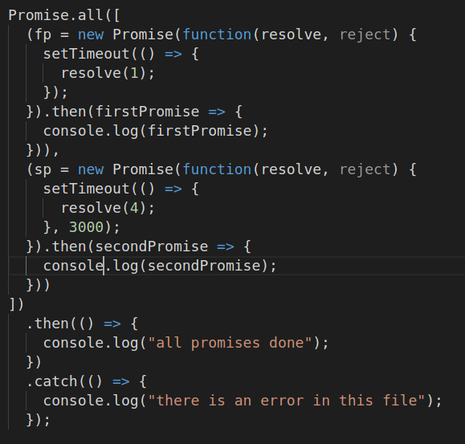
Promise.all

Slide 17
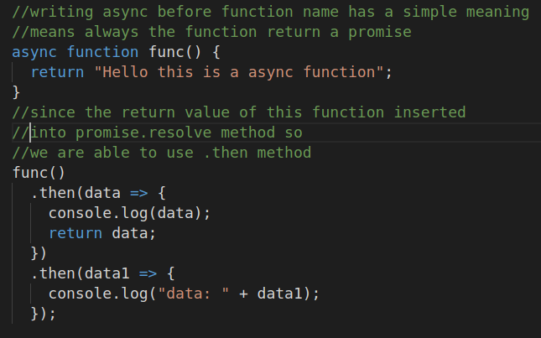
Async in promises
The word “async” before a function means one simple thing: a function always returns a promise. Other values are wrapped in a resolved promise automatically.

Slide 18
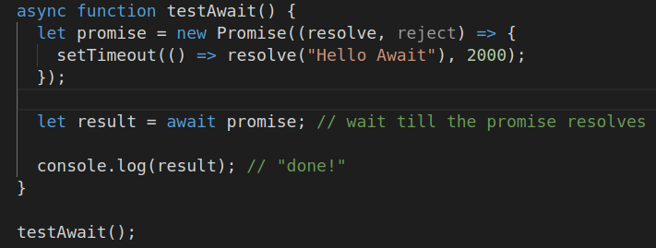
await in Promises
The keyword await makes JavaScript wait until that promise settles and returns its result.

