Slide 1
Fetch in JavaScript
Request/Response in web application

Slide 2
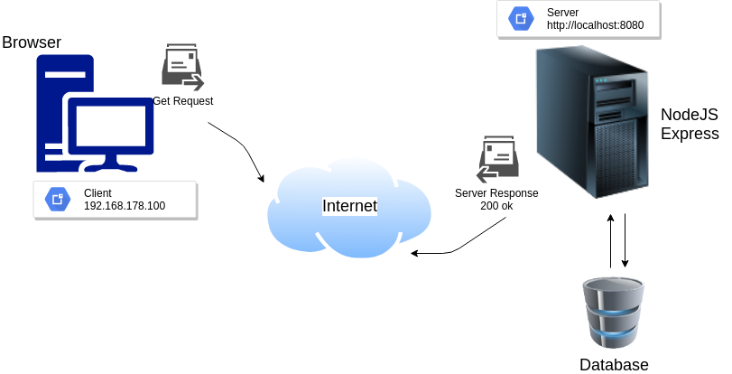
Request/Response Cycle

Slide 3
Blocking Code
Blocking is when the execution of additional JavaScript in the Node.js process must wait until a non-JavaScript operation completes.
  const fs = require('fs');
  const data = fs.readFileSync('/file.md'); // blocks here until file is read
Equivalent to above but asynchronous
  const fs = require('fs');
  fs.readFile('/file.md', (err, data) => {
    if (err) throw err;
  });

Slide 4
Non-blocking Code
Lets expand our last example little bit
  var fs = require('fs');
  var data = fs.readFileSync('/file.md'); // blocks here until file is read
  console.log(data);
  moreWork(); // will run after console.log
  const fs = require('fs');
  fs.readFile('/file.md', (err, data) => {
    if (err) throw err;
    console.log(data);
  });
  moreWork(); // will run before console.log

Slide 5
Concurrency and Throughput
As an example, let's consider a case where each request to a web server takes 50ms to complete and 45ms of that 50ms is database I/O that can be done asynchronously.
Choosing non-blocking asynchronous operations frees up that 45ms per request to handle other requests.
This is a significant difference in capacity just by choosing to use non-blocking methods instead of blocking methods.

Slide 6
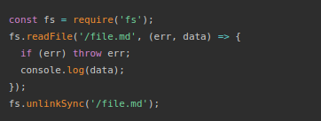
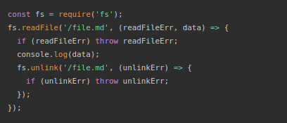
Danger of mixing blocking & non-blocking

Slide 7
Promises
Imagine you are a kid. Your mom promises you that she'll get you a new phone next week.
You don't know if you will get that phone until next week. Your mom can either really buy you a brand new phone, or stand you up and withhold the phone if she is not happy.
This is a promise.
A promise has 3 states. They are:
  Pending: You don't know if you will get that phone
  Fulfilled: Mom is happy, she buys you a brand new phone
  Rejected: Your mom is happy, she withholds the phone

Slide 8
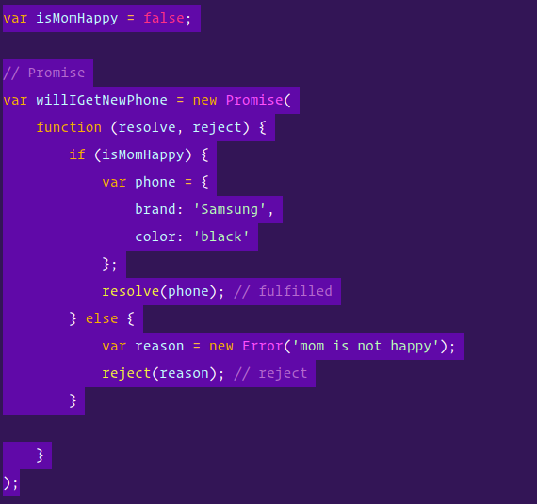
Creating a promise

Slide 9
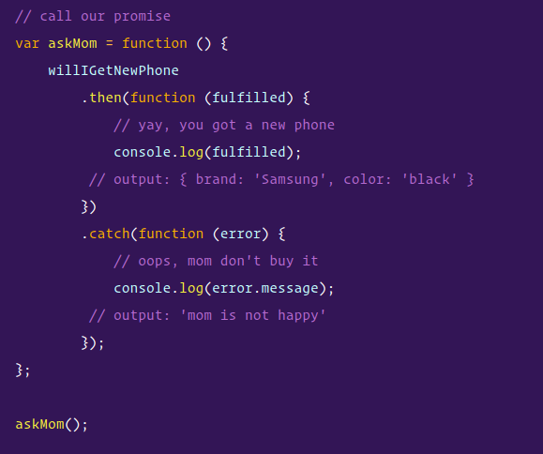
Consume promises

Slide 10
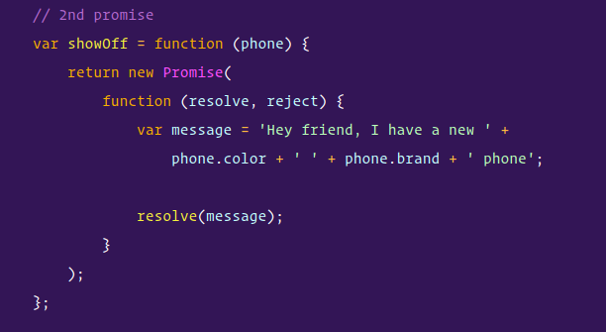
Chaining promises
Let's say, the kid, promises your friend that you will show them the new phone when your mom buy you one.

Slide 11
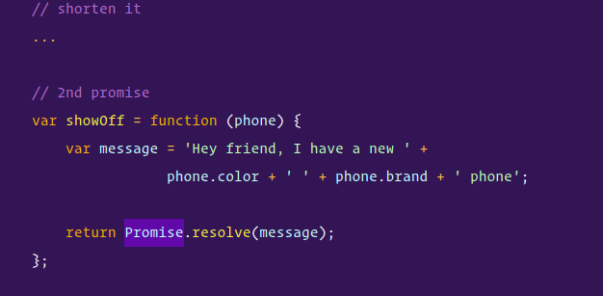
Chaining promises

Slide 12
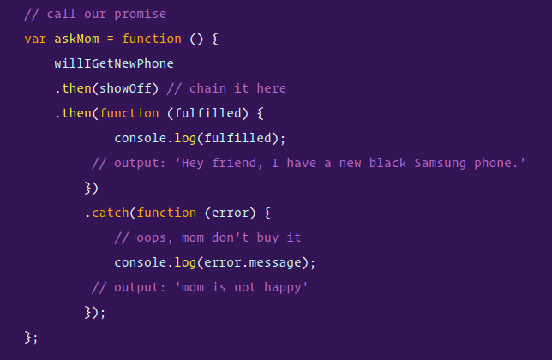
Chaining promises
The kid can only start the showOff promise after the willIGetNewPhone promise.

Slide 13
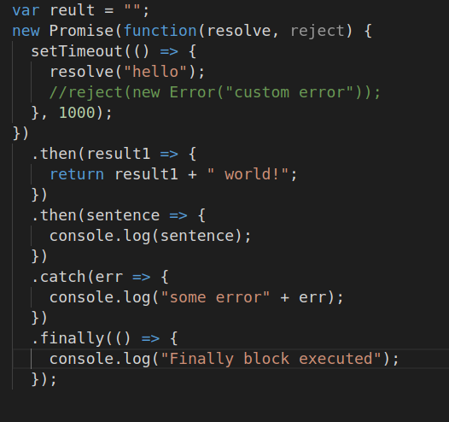
Finally block in Promises
A Promise object serves as a link between the executor and the consuming functions, which will receive the result or error. Consuming functions can be registered (subscribed) using methods .finally()

Slide 14
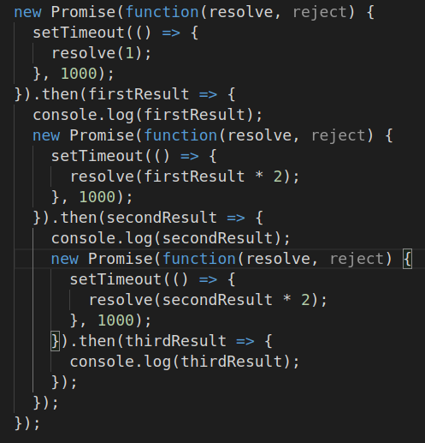
Multiple promises
After each second
A new resolve function
Will be invoked.

Slide 15
Promise.all()
Promise.all() takes an array of promises (technically can be any iterable, but usually an array) and returns a new promise.
The new promise resolves when all listed promises are settled and the array of their results becomes its result.
For instance, download several URLs in parallel and process the content when all are done.
That’s what Promise.all() is for.

Slide 16
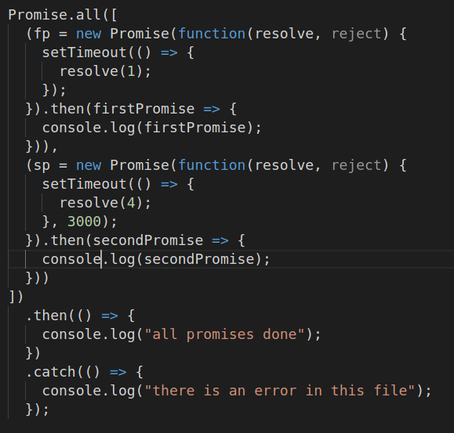
Promise.all

Slide 17
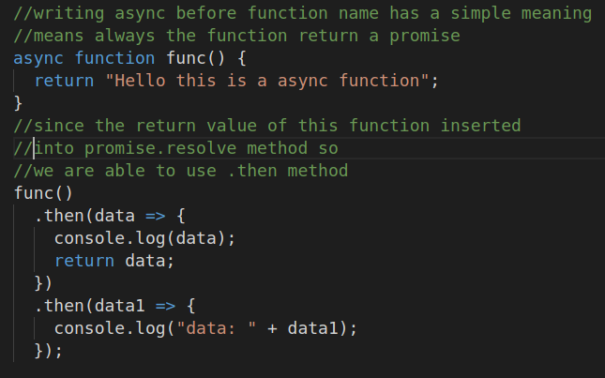
Async in promises
The word “async” before a function means one simple thing: a function always returns a promise. Other values are wrapped in a resolved promise automatically.

Slide 18
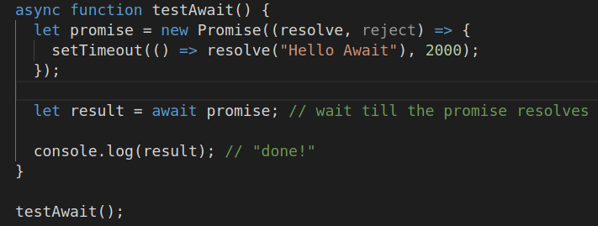
await in Promises
The keyword await makes JavaScript wait until that promise settles and returns its result.

Slide 19
Fetch(url)
The Fetch API provides an interface for fetching resources (including across the network). It will seem familiar to anyone who has used XMLHttpRequest, but the new API provides a more powerful and flexible feature set.

Slide 20
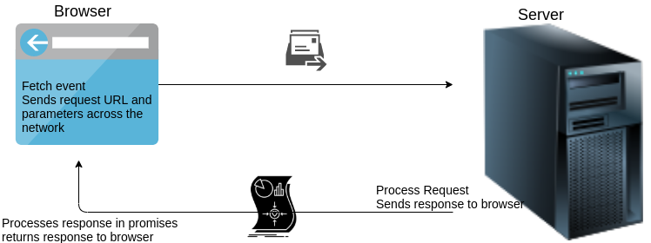
Fetch Function Workflow

Slide 21
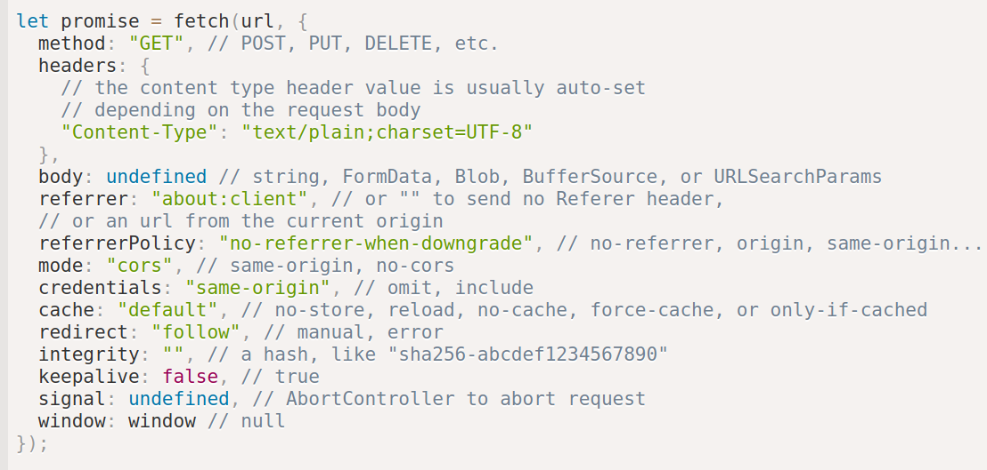
Fetch(URL, Options)
URL : URL parameter in fetch function is the address of the resource on the server.
Options: options are defined inside an object and can define different header property of the request such as method.

Slide 22
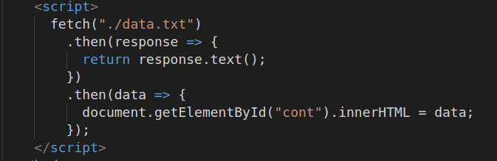
Fetch Example
Send a request to read the content of a .txt file and display it inside web-page.
Return value of a fetch function is a promise, therefore we can use .then and .catch methods.

Slide 23
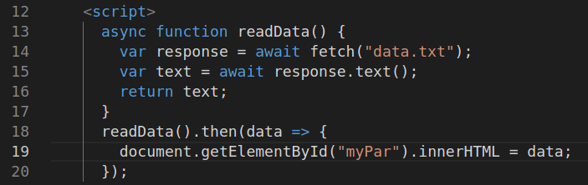
Fetch Request with Async functions
If you want to control the execution order of statements then you can use Async functions together with await keyword.
In the above example line 15 never execute before 14 although readData() is an asynchronous function.

Slide 24

JavaScript Object Notation

Slide 25
What is JSON?
JSON stands for JavaScript Object Notation and
It is a lightweight data-interchange format.
It is easy for humans to read and write.
It is easy for machines to parse, generate and transfer it over the net.

Slide 26
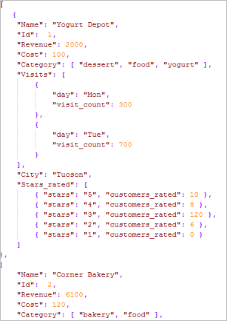
JSON Format
Json file extension is .json and as illustrated in the picture it contains objects but all property and values of this object should be within “ ”
This object has no name
It can contain nested objects as a value for the main object’s properties.

Slide 27
JSON Functions
Json has 2 functions to transform data from JavaScript to JSON or vice versa .
JSON.stringify()
This function used to convert JavaScript object into json object.
JSON.parse()
This function can convert json to JavaScript objects.

Slide 28
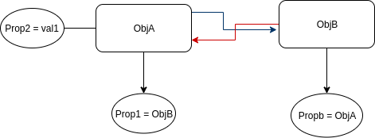
JSON.stringify(value[, replacer, space] )
Value: A value to encode
Replacer: Array of properties to encode or a mapping function function(key, value)
  This array helps you to exclude some of the properties from conversion to json. Therefore it’s really useful when a circular reference between objects exist.
Space: Amount of space to use for formatting

Slide 29
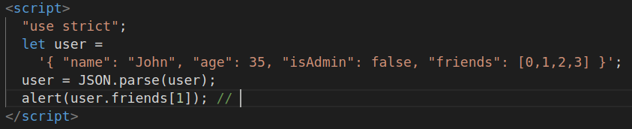
JSON.parse(str, [reviver])
Str: is the json object that needs to convert into JavaScript object.
Reviver: Optional function(key,value) that will be called for each (key, value) pair and can transform the value.

Slide 30
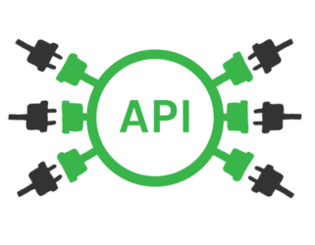
Application Programming Interface

Slide 31
What is API?
Definition: Abbreviation for Application Programming Interface: a way of communicating with a particular computer program or internet service
(Cambridge dictionary)

Slide 32
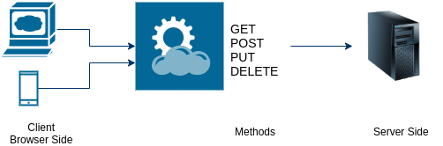
RestFul APIs
A RESTful API (Representational State Transfer) is an application program interface (API) that uses HTTP requests to GET, PUT, POST and DELETE data.

Slide 33
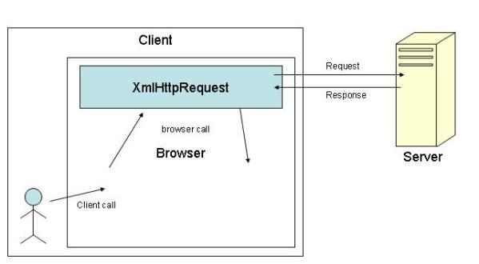
XMLHttpRquest()
Built-in browser object
Allow to send HTTP request
Operate any kind of data such as xml, json, text, binary files

Slide 34
How to implement XMLHttpRequest
Create an instance
Setup a request
Open connection and send the request

Slide 35
Process the Response
Listen to xhr response events
  On load event: Trigger when the response completely loaded
  On progress event: Trigger periodically when one part of the response loaded into client computer. Let the user to track the progress of response.
  On error event: Trigger when there is an error for processing the request.

Slide 36
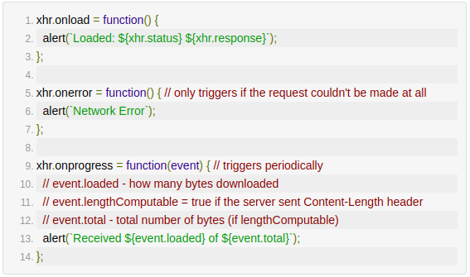

Slide 37
Response Type
“” default – get string
“text” -get string
“json” -get json
“arraybuffer” -get as arraybuffer (binary data)
“blob” -get Blob (binary data)
“document” -get as XML document
Using following statement to set the type:

Slide 38
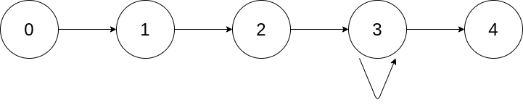
Ready States
XMLHttpRequest changes between states as it progresses.
  UNSENT = 0 - Initial state
  OPENED = 1 - Open called
  HEADING_RECEIVED = 2 - response headers received
  LOADING = 3 - response is loading
  DONE = 4 - response complete
  To get the state of request using

Slide 39
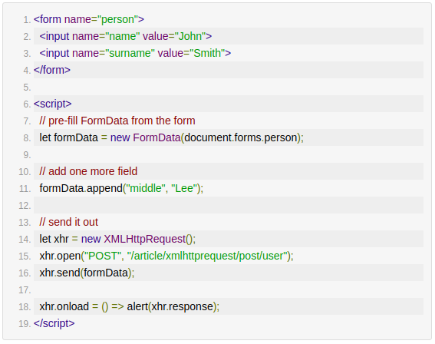
POST Method
Form sent with
multipart/form-data
Encoding
If you want JSON
Then use :
xhr.setRequestHeader
with argument
Content-type and
application/json

Slide 40
Cross Origin Resource Sharing
CORS

Slide 41
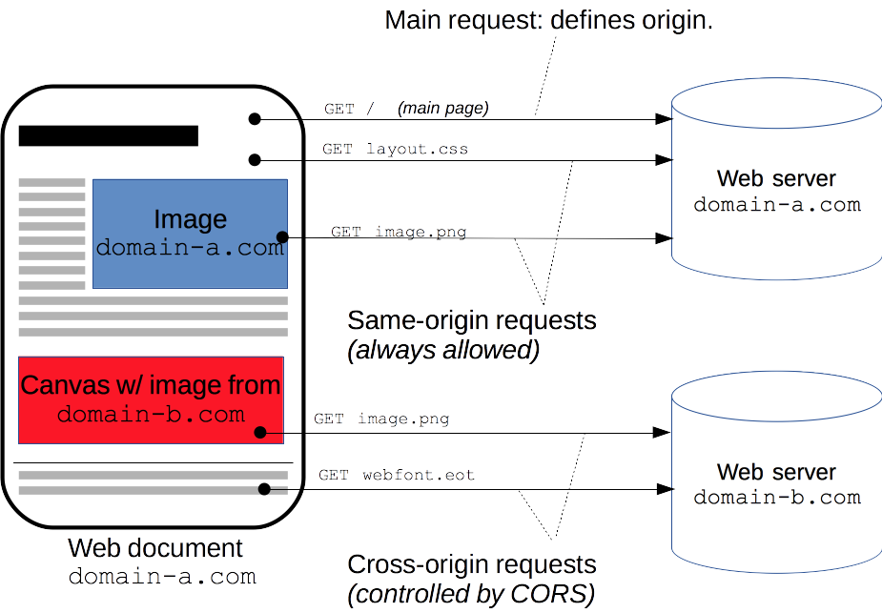
What is CORS?
Cross Origin HTTP request executes when it requests a resource that has a different origin.

Slide 42
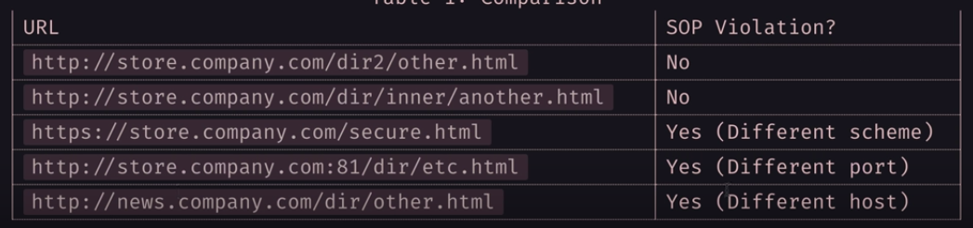
What is Origin?
Where the request originate from.
If you are on google.com home page then for outgoing requests, google.com is the “origin”
Origin: <schema> “://” <hostname> [“:” <port>]
Example: Origin: http://store.company.com:80

Slide 43
HTTP Request & Response Headers
Request Headers :
When a domain is requesting to interact with a resource on another domain, request headers are added from the first domain in order to use the cross-origin resource sharing feature.
  Origin
  Access-Control-Request-Method
  Access-Control-Request-Headers
Response Headers:
The domain who’s resources are being requested can respond to the first domain
  Access-Control-Allow-Origin
  Access-Control-Allow-Methods
  Access-Control-Allow-Headers
  Access-Control-Allow-Credentials
  ...
Notes:
Access-Control-Allow-Credentials → used to let the cookies shared or not with other origins

Slide 44
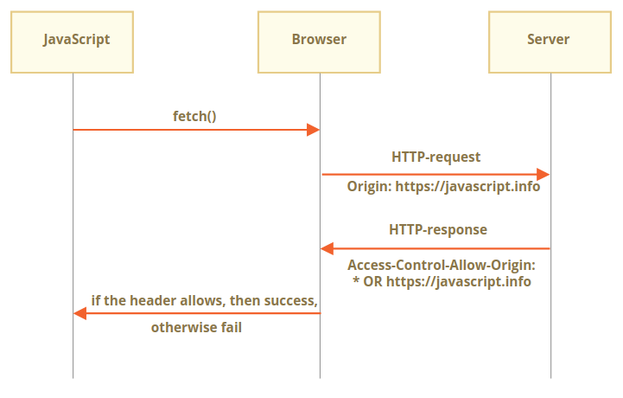
Simple Request (simple method+simple headers)

Slide 45
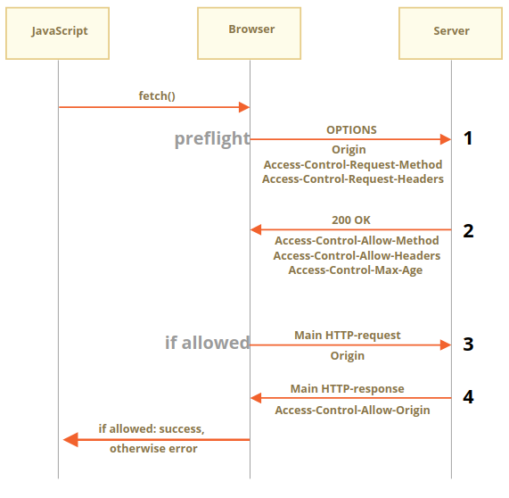
Non-Simple Requests

