Slide 1
Modules in JavaScript
Browser side
Prepared by: A.Fahim Ahmadi | Sep 2019 | DCI Dusseldorf

Slide 2
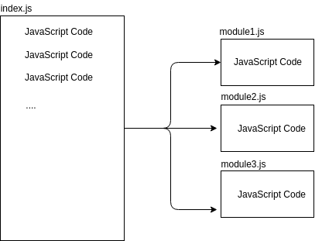
Introduction
Good authors divide their books into chapters and sections; good programmers divide their programs into modules.

Slide 3
Why Modules?
Maintainability: Modules are self-contained (independent) and well designed module aims to lessen the dependencies on parts of code-base as much as possible. So it can be update, grow and improve independently.
Name-spacing: In JavaScript, variables outside the scope of a top-level function are global. Therefore, it’s common to have “name-space pollution”, where completely unrelated code shares global variables.
Re-usability: we’ve all copied code we previously wrote into new projects at one point or another.

Slide 4
Overview of IIFE
Immediately Invoking Function Expression
(function ( ){
JavaScript code
})( );
( ( )=>{
JavaScript code
})( );
OR
Example:
(function(){
console.log(‘Hello World!…);
})()

Slide 5
Scope Isolation and Encapsulation
Name-Spacing is one of JavaScript Module’s advantages and based on this concept we should prevent from name-space pollution.
var countFunc = (function() {
var counter = 0;
return {
countUp: function() {
return ++counter;
},
countDown: function() {
return --counter;
}
};
})();
console.log(countFunc.countUp());
console.log(countFunc.countUp());
console.log(countFunc.countDown());
console.log(countFunc.countDown());
Output:
1
2
1
0

Slide 6
Export and Import in JavaScript
Using export or import to javascript keyword to re-use functions, variables, objects or classes…
Module.js
export class Person {
OR
export default class Person{
constructor(fname, lname) {
this.firstName = fname;
this.lastName = lname;
}
eating() {
console.log("I am eating.");
}
}
import * as <namespace> from <path>
OR
import {Person} from ‘module.js’
Var preson = new Person(‘fahim’, ‘ahmadi);
Console.log(person.firstName);

Slide 7
Transpiling
Transpilers, or source-to-source compilers such as ‘babel’ are tools that read source code written in one programming language, and produce the equivalent code in another language.
Why Transpilers used? To be sure about compatibility of vanilla JavaScript (ES 6) with all browser.
Actually we write our code in ES6 (ES2015) and let a transpiler translate it to vanilla ES5 that works in every browser.

Slide 8
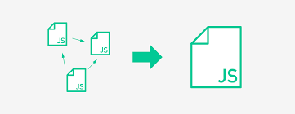
Bundling
JavaScript bundling is a technique that groups separate files in order to reduce the number of HTTP requests that are required to load a page.
Bundling is commonly used in today's “module-based” development where some functionalities are basically split into Modules

Slide 9
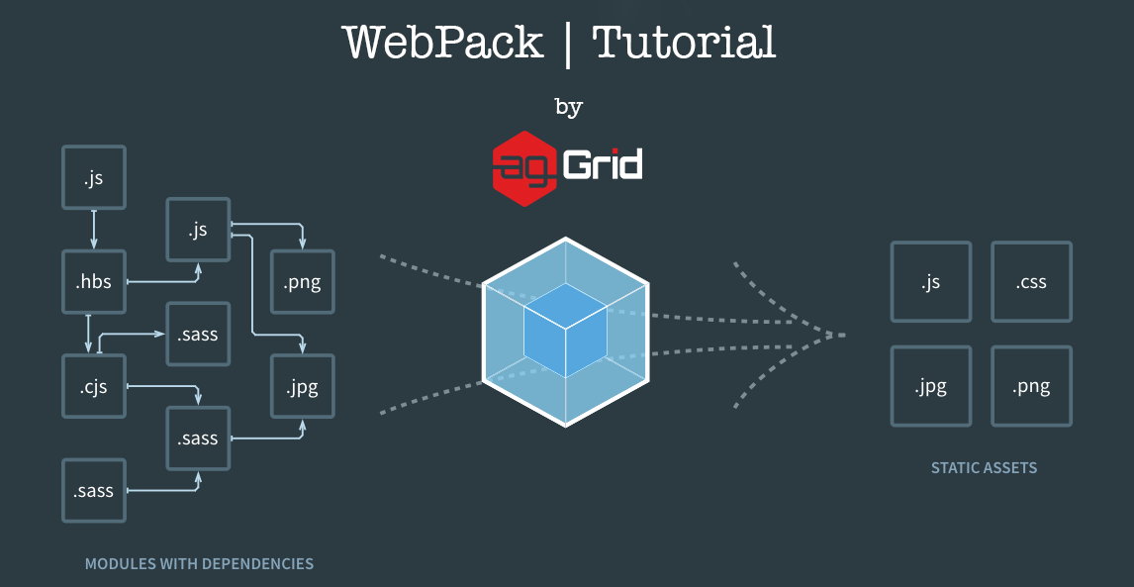
Bundling Tools [Web Pack]
Webpack is an open-source JavaScript module bundler. It is a module bundler primarily for JavaScript, but it can transform front-end assets like HTML, CSS, and images if the corresponding plugins are included.
Webpack takes modules with dependencies and generates static assets representing those modules.

Slide 10
How to use Webpack
Create a project directory and initiate it.
  mkdir project && cd project && npm init -y
Create source and distribution directory inside project
  mkdir src dist
Create a webpack configuration file.
  touch webpack.config.js
Install webpack and webpack development server.
  npm install -D webpack@VERSION webpack-dev-server@VERSION
Add following configuration into package.json
  “script” : {"build": "webpack", "build:prod": "webpack -p",
        "start": "node server.js", "dev": "webpack-dev-server"}

Slide 11
Cont...
Install transpilers:
  npm install -D babel-loader babel-core
  npm install -D css-loader style-loader
  npm install -D file-loader
Edit webpack.config.js file
Build a simple app with css, html and javascript files
Include the html and css file into javascript file
  require('file-loader?name=[name].[ext]!./index.html');
  import './css/style.css';

Slide 12
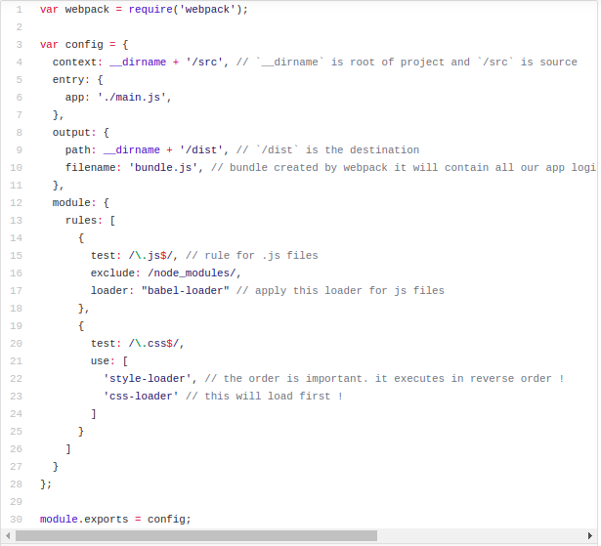

Slide 13
Cont...
Include bundle.js file into html file
  <script defer src="/bundle.js"></script>
Compile the project
  npm run build
Run the project on the server
  npm run dev
Open browser and use http://localhost:8080/ to access the home page of the project.

Slide 14
DCI Boilerplate
Use following link to download the project
  Git clone https://github.com/DigitalCareerInstitute/dci-boilerplate-II.git
Use npm run build to compile the project
Use npm start to run the project
Use npm deploy to deploy the project into github.

Slide 15
Any Question ?

