Slide 1
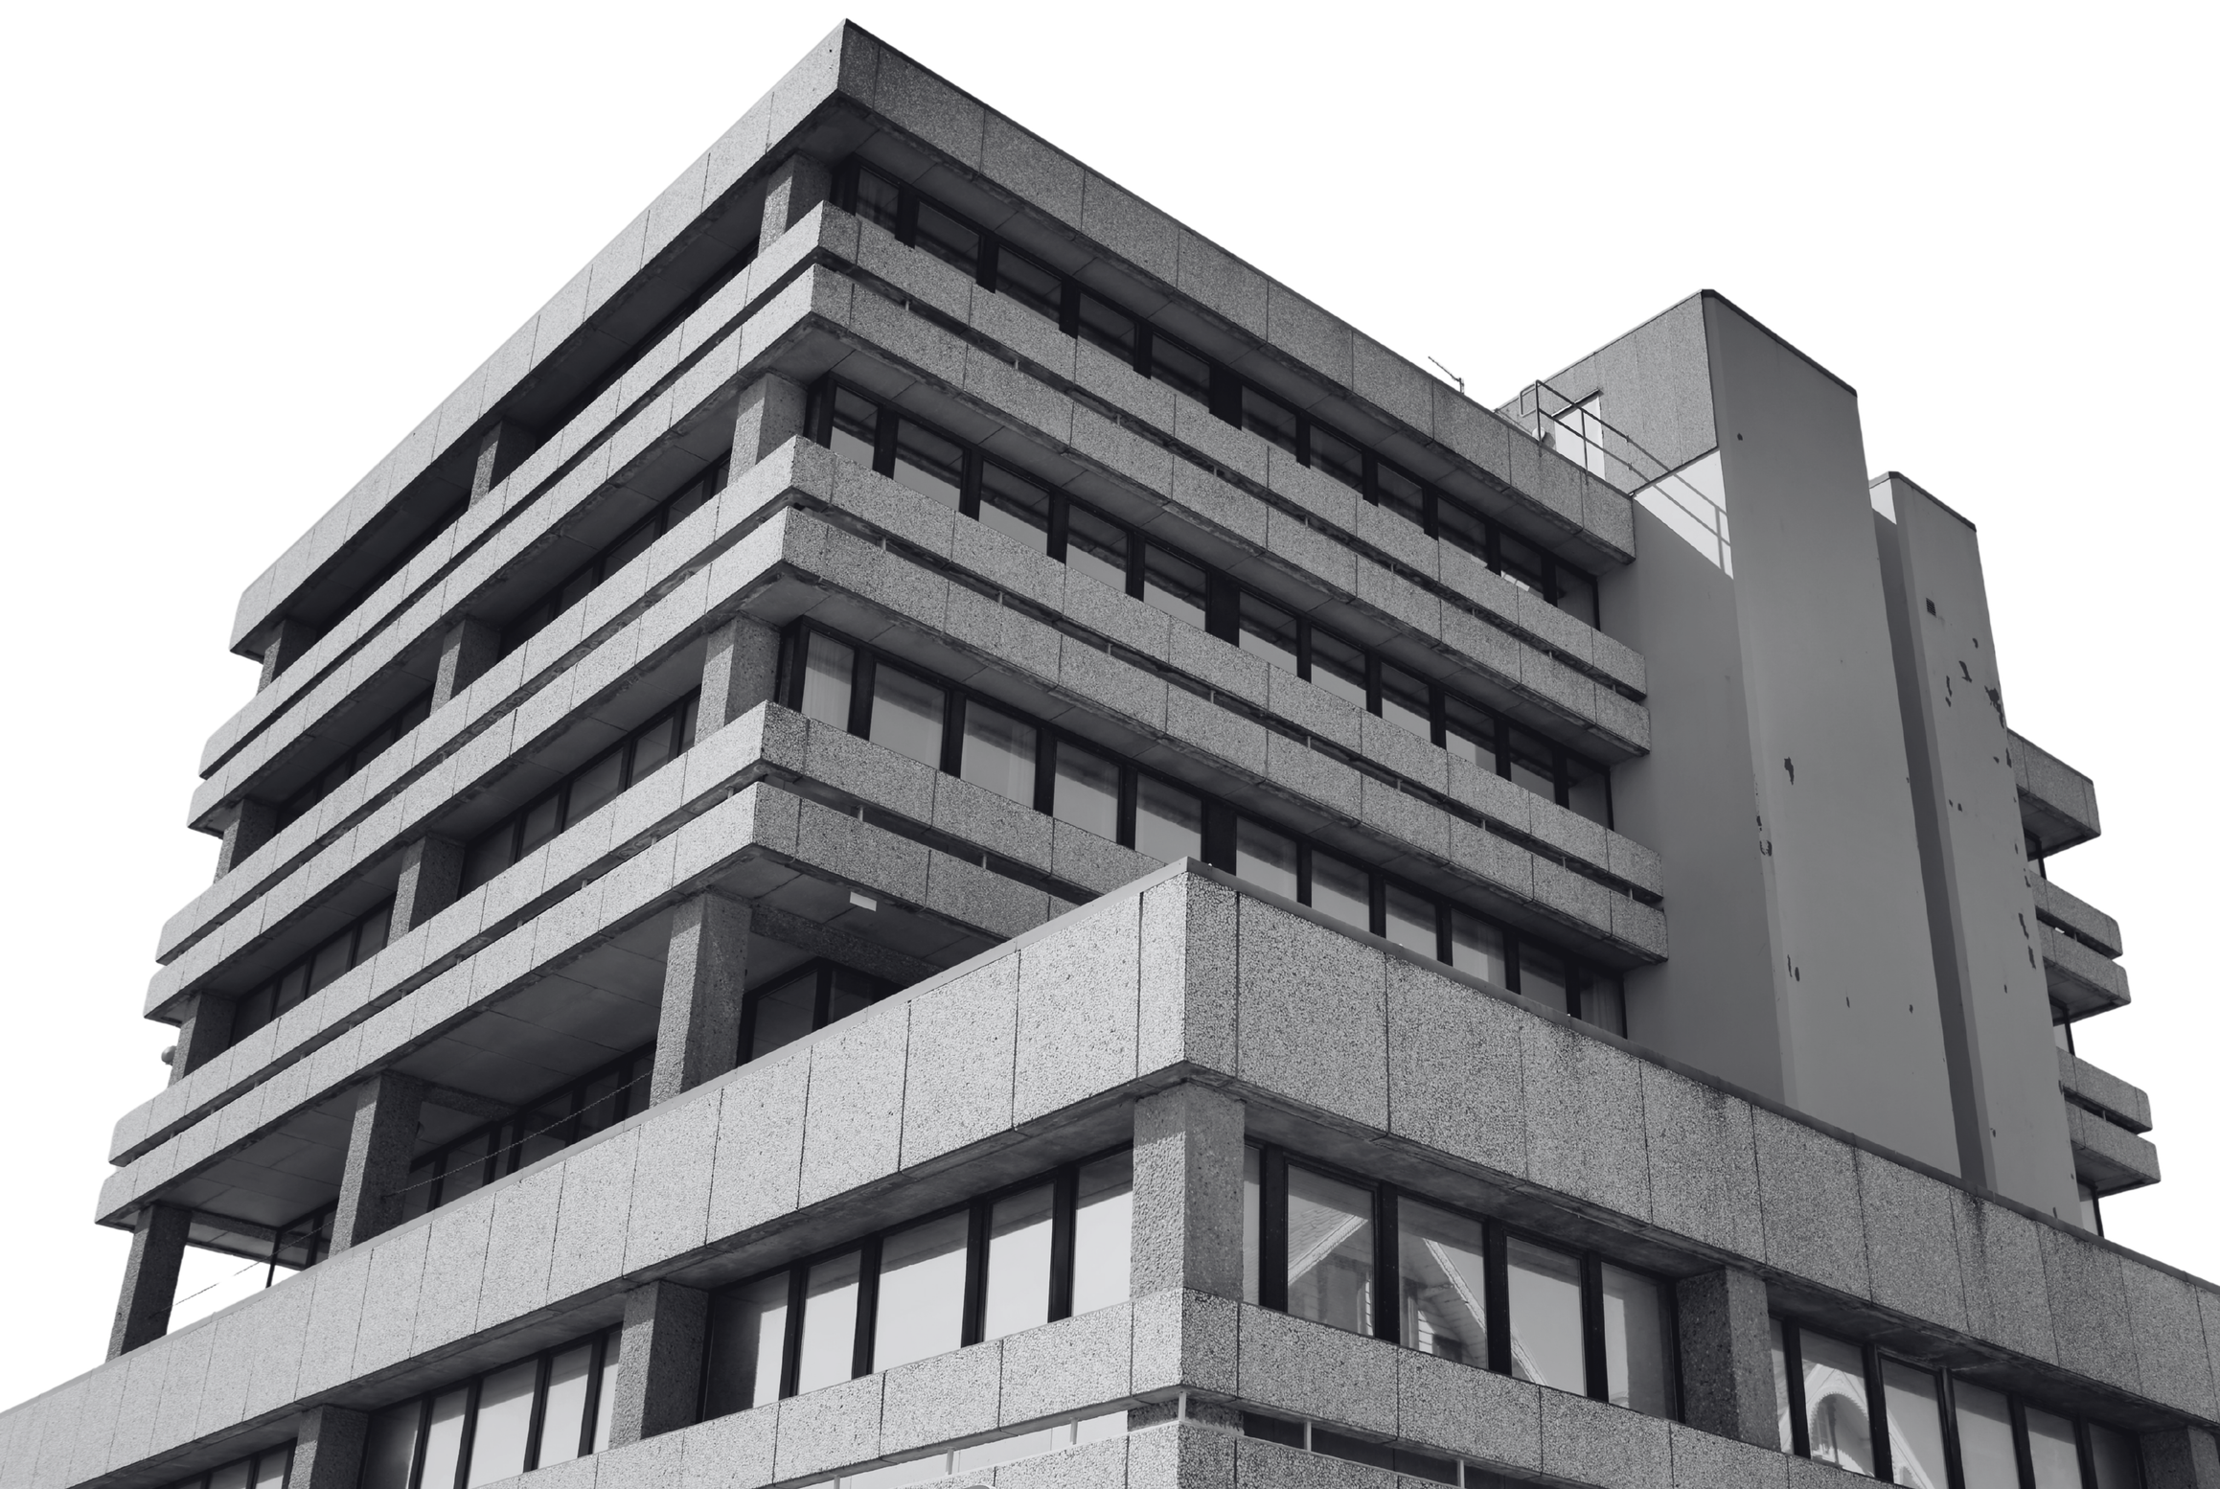


www.proxsisgroup.com
2026
21 Years of mission:
"Growing Others, Growing Together"

Slide 2

www.proxsisgroup.com
WHAT IS PROXSIS?
The Largest Consulting Firm
in Indonesia
A knowledge-based solutions ecosystem: 7 holdings and 40+ business cells, growing together since 2005 and trusted by Fortune 100 customers.
2005
Founded
7
Holdings
40+
Business Cells
Fortune 100
Customers
Fueled by Knowledge. Powered by Ideas.

Slide 3



Vision 2030
Creating Hundreds of Millionaires
Integrating individual health and agility, reinforced by the strength of a solid,
large-scale ecosystem.
www.proxsisgroup.com

Slide 4
LIST OF COMPANIES:
Proxsis Global Solusi
• ITC - PT PGS
• Proxsis Cyber Security
• Proxsis Digital (MIKTA)
• Proxsis Infra (PBG)
• Biztech Academy
Proxsis Internasional Inkorpora
• PT Proxsis Strategi Bisnis
• Proxsis Mark
Proxsis Accel Global
• PAMS-ISO Center
• PT Icicert Manajemen Indonesia
• Proxsis Akunta Solusi
Sinergi Solusi Group
• IEC
• PT Sinergi Solusi Pratama
• SAS-CPM
• PT Novartha Venture Kapital
• PT Sinergi Solusi Akademi
• PT Sinergi Solusi Indonesia
Proxsis Talent Force
• PTF Consulting
• PTF Asesmen
• PTF Promitra
• PTF Training
PMI Holding
• PT PSCM
• Proxsis CIA
• Proxsis East Training
Proxsis Academy Group
• PT Difin Kreatif Inkorpora
• Proxsis Event
• Proxsis Academy Global

Slide 5


PROXSIS & COMPANIES:
7 HOLDINGS, +40 BUSINESS CELLS
Proxsis Internasional Inkorpora
Subsidiary:
PT Proxsis Strategi Bisnis
Proxsis Mark
Proxsis Global Solusi
Subsidiary:
ITC - PT PGS
Proxsis Cyber Security
Proxsis Digital (MIKTA)
Proxsis Infra (PBG)
Biztech Academy
PT Proxsis Solusi Bisnis
Super Holding - Investment Arm
Proxsis AI-Indonesia
Sinergi Solusi Group
Subsidiary:
IEC
PT Sinergi Solusi Pratama
SAS-CPM
PT Novartha Venture Kapital
PT Sinergi Solusi Akademi
PT Sinergi Solusi Indonesia
Proxsis Accel Global
Subsidiary:
PAMS-ISO Center
PT Icicert Manajemen Indonesia
Proxsis Akunta Solusi
Proxsis Talent Force
Subsidiary:
PTF Consulting
PTF Asesmen
PTF Promitra
PTF Training
Proxsis Academy Group
Subsidiary:
PT Difin Kreatif Inkorpora
Proxsis Event
Proxsis Academy Global
PMI Holding
Subsidiary:
PT PSCM
Proxsis CIA
Proxsis East Training
A Cosmic Ecosystem of Interconnected Growth

Slide 6

INSIDE THE PROXSIS UNIVERSE
Proxsis AI
Private & Secure Enterprise AI Platform - powered by Proxsis LLM
Transforming enterprise knowledge, documents, and workflows into intelligent decision systems.
Knowledge Management Assistant
Automated Document Analysis
Risk & Compliance Monitoring
Strategic Decision Support
Workflow Automation
Executive Insight Generation
Private AI deployment - Controlled access - Enterprise governance - Compliance-ready
60+ AI use cases mapped across 10 divisions of the ecosystem.
AI for Everyone at Proxsis
www.proxsisgroup.com

Slide 7
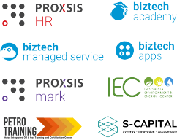
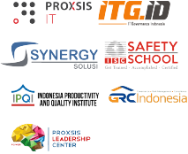

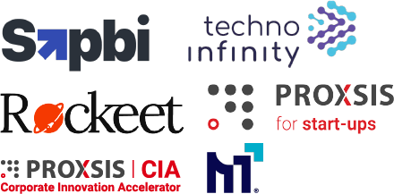
Proxsis & Co. has been providing the best knowledge based solutions since our birth in 2005
Today, Proxsis stands proud with 7 sub holding companies and more than 40 business cell that collaborate within and beyond our ecosystem to provide the best solutions for the nation’s and world’s toughest challenges.
Through an entrepreneurial based development, proxsis continues to innovate and grow by establishing a multitude of knowledge-based solutions as well as external investment and business incubation for leverage
Proxsis established several business cells namely out IT GRC consultant and several professional development solutions
Growth through Intensive investment & incubation for new entrepreneurs from within the company
Proxsis expands to east Indonesia by establishing Proxsis East based in Surabaya
Business model innovation: hub & cell based on entrepreneurship and strong core values.
Proxsis establishes its first business in 2005 with strong knowledge business service
2020-Now
2018-2020
Investment in Technology and Innovation for superior products to supplement exponential growth strategy
2010-2018
2005-2007
2007-2010

Slide 8
















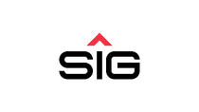




































Our Fortune 100 Customers
www.proxsisgroup.com

Slide 9

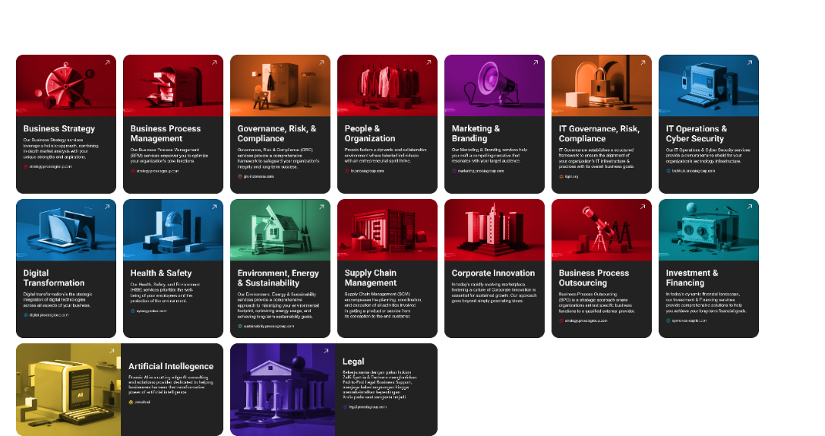
Our Wide Range of Solutions

Slide 10


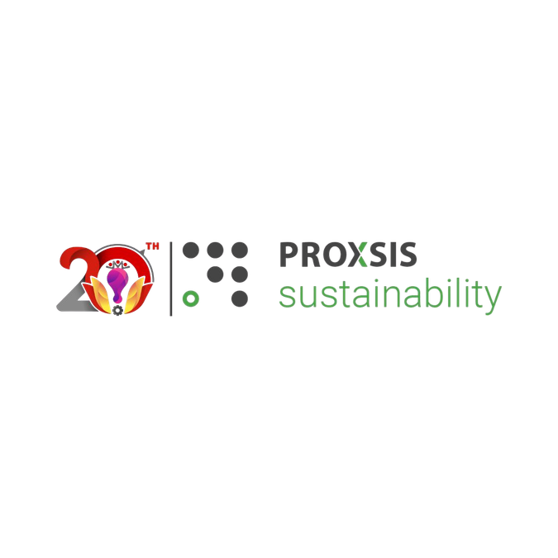

The Six Core Services
of the Proxsis Ecosystem
Consulting
Group
01
02
Corporate Support & Services
06
03
Talent
Force
05
04
Management System Audit & Certification

Slide 11

OFFICE ADDRESS
Head Office
Gedung Permata Kuningan
Lt. 17, Jl. Kuningan Mulia, Menteng Atas, Setiabudi, Jakarta Selatan,
Jakarta 12920
Jakarta Office 2
Tamansari Hive Office,
Jl. DI. Panjaitan No.Kav. 2, Cipinang Cempedak, Jatinegara, Jakarta Timur, Jakarta 13340
Jakarta Office 3
Synergy Solusi Training Center, Jl. Kebagusan Raya No. 47, Ragunan Pasar Minggu, Jakarta Selatan, Jakarta 12550
Surabaya Office
AMG Tower Lantai 17, Jl. Raya Dukuh Menanggal No. 1A, Gayungan, Surabaya, Jawa Timur 60234
UK Office
153 Otley Rd,
Headingley,
Leeds LS6 3QG,
United Kingdom
Bandung Office
Jl. Kiara Sari Raya No.18, Margasari, Kec. Buahbatu, Kota Bandung, Jawa Barat 40287
Padang Office
Jl.Marapak , Kalumbuk, Kuranji Kota Padang, Sumatera Barat
www.proxsisgroup.com

Slide 12
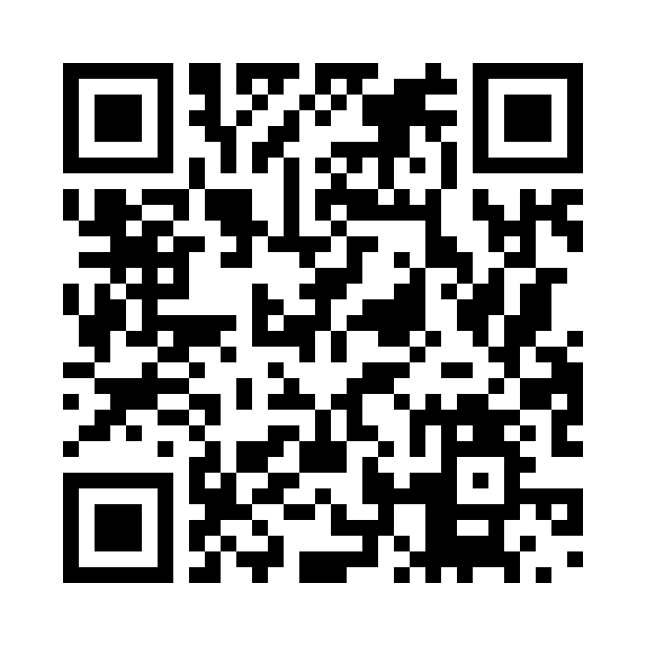
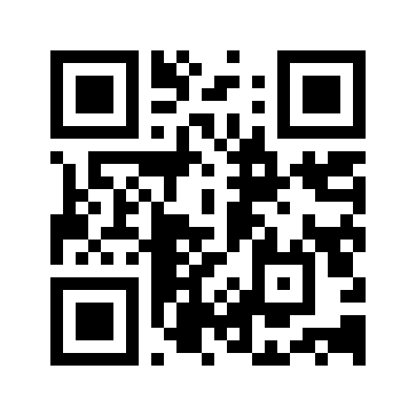
PROXSIS
Thank you.
Growing Others, Growing Together
SCAN TO CONNECT & EXPLORE
Follow our journey
Explore our solutions
@proxsis_ecosystem
www.proxsisgroup.com
Notes:
Website: https://proxsisgroup.com/. Instagram handle @proxsis_ecosystem supplied by Fahi on 9 November 2026. Two QR codes requested for Instagram and website, side by side. Thank You replaces the former slide12 following Fahi instruction.

